Slide 1
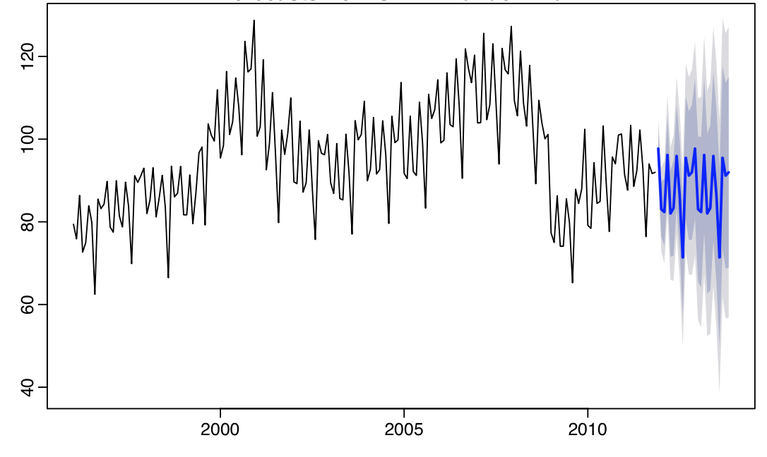
Introduction to Forecasting: Using the ‘forecast’ Package
Indy UseR group
July 21, 2015
Ben Staiger
Notes:
Make some introductions to who I am, and what I do. My background with modeling and this package.

Slide 2
What is Forecasting?
“Making predictions of the future based on past and present data and analysis trends”
- Wikipedia
Notes:
While many of these methods are never something that you would implement in practice. They serve as a baseline for many more complex models aand are a foundation of the essence of what forecasting is. Taking information from your time-series and translating it into a prediction about the future.

Slide 3

Rob J Hyndman
Professor of Statistics at Monash University in Australia
Editor-in-Chief of the International Journal of Forecasting
Director of the International
Institute of Forecasters

Slide 4
What Will We be discussing
Simple Forecasting
Data Transformations
Evaluating Forecast Accuracy
Exponential Smoothing Models
Time Series Decomposition
ARIMA Modeling
Notes:
Some of the methods used in this presentation will be from the stats package, but are generally important to the topic at hand. All of the data sets used are included in the fpp (forecasting principles and practice) package which includes forecast stats, tseries and other relevant packages to forecasting used by Rob Hyndman

Slide 5
Simple Forecasting
(really simple)
Notes:
While many of these methods are never something that you would implement in practice. They serve as a baseline for many more complex models aand are a foundation of the essence of what forecasting is. Taking information from your time-series and translating it into a prediction about the future.

Slide 6
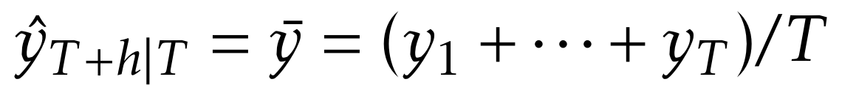
Mean Forecasting
Forecasted value is the average of the series
Most rudimentary forecasting method
Baseline for approaching models

Slide 7
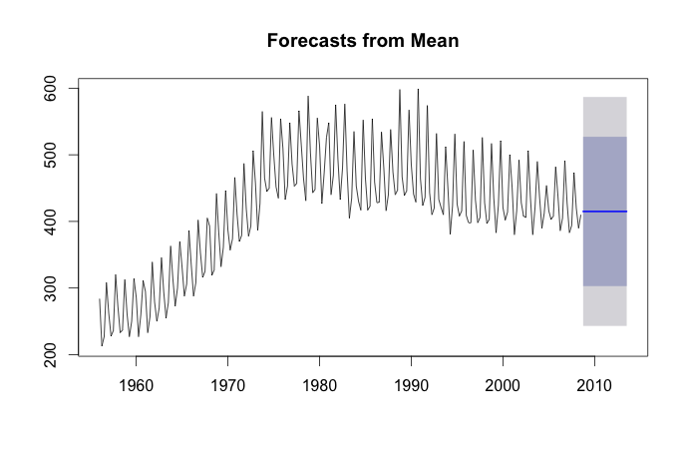
> forecast = meanf(x, h=20)
> plot(forecast)
Notes:
Prediction intervals based on the standard deviation of the forecast, the forecasted value will always lie at the mean of the interval, but the interval may provide some feedback into the accuracy or reliability of the forecast

Slide 8
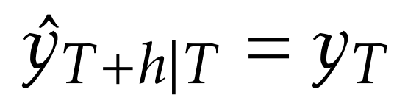
Naïve Forecasting
Forecasted value is the same as the last value
Introduces the idea of recency
Data that is closer in time frame may be more relevant
Notes:
This model brings into focus the idea that more recent data may be more relevant than older data. Again while this may be an extreme scenario, some of these methods are the same ideas that we apply in our own life unconsciously.

Slide 9
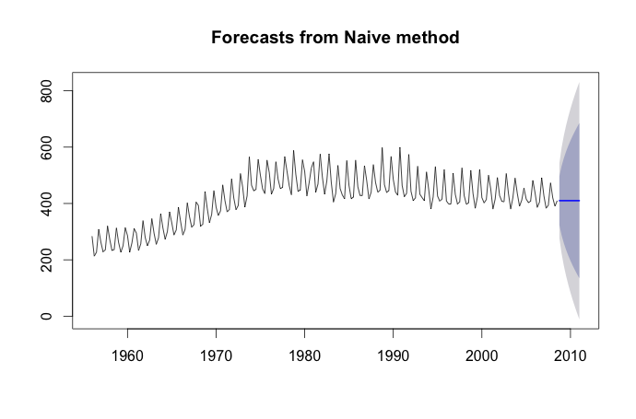
> forecast = naive(x, h=20)
> plot(forecast)

Slide 10
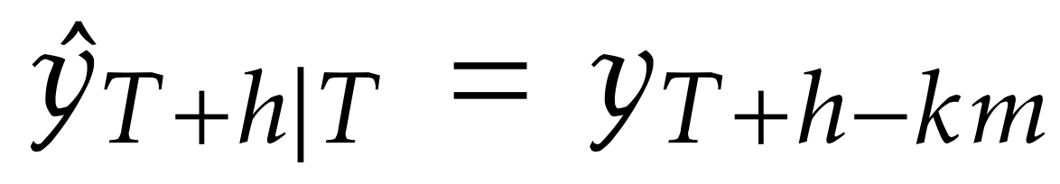
Seasonal Naïve Forecasting
Forecasted value is equal to the value “last season”
Seasons are predetermined timeframes upon which the data may cycle
Many things repeat on annual, monthly, weekly basis
Notes:
This takes the previous idea and extends it to the idea of seasonality

Slide 11
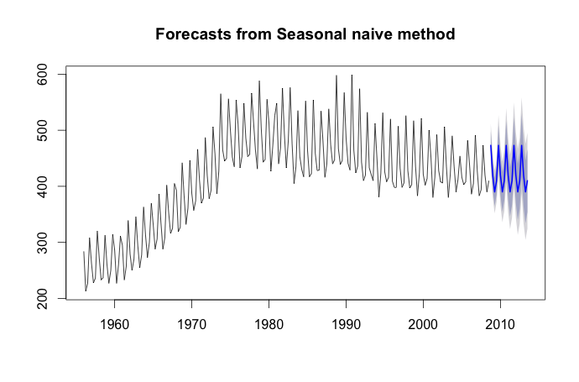
> forecast = snaive(x, h=20)
> plot(forecast)

Slide 12
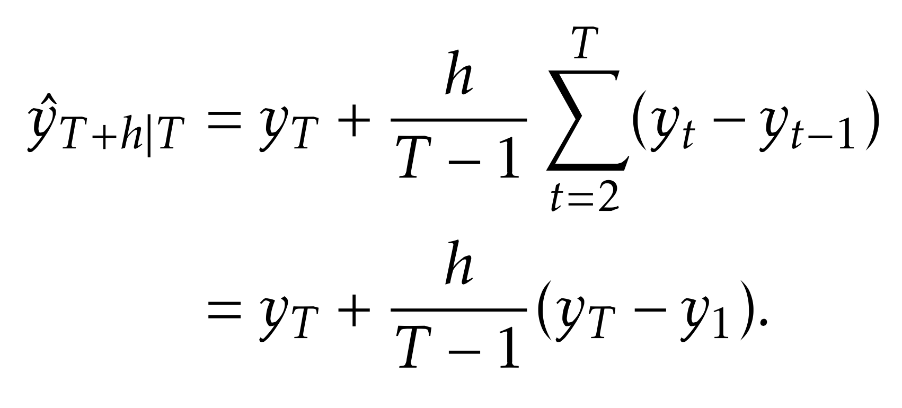
Drift Forecasting
Forecasted Value is based on the linear trend of the whole time-series
Begin to incorporate the idea of directionality

Slide 13
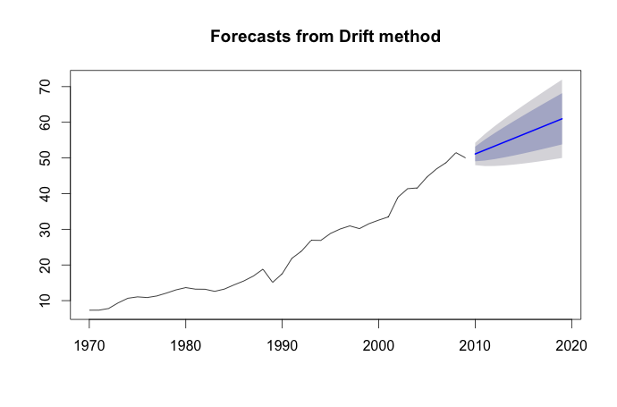
> forecast = rwf(y, drift=TRUE)
> plot(forecast)

Slide 14
Data Transformations

Slide 15
Log Transformations
“Logarithms, in particular, are useful because they are more interpretable: changes in a log value are relative (percent) changes on the original scale.” –Hyndman
Commonly used to impact the distribution of the data, reducing skewness, stabilize variance

Slide 16
Power Transformations
Also a common method of stabilizing the variance within data
Again, transform the data to have a distribution that is more normal

Slide 17
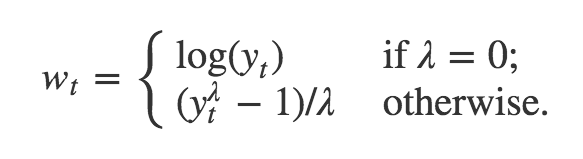
Box-Cox Transformations
This is a family of transformations
Includes both logarithmic and power transformations
Notes:
Both of these transformations belong the the Box-Cox family of transformations. Hence, these transformation are implemented in the forecast package through the general method BoxCox..

Slide 18
Using Box-Cox in ‘forecast’
In R:
BoxCox(x,lambda=h)
- Transform Data based on the Box-Cox function
BoxCox.lambda(x)
- Attempts to estimate lambda-parameter to eliminate changes in variance

Slide 19
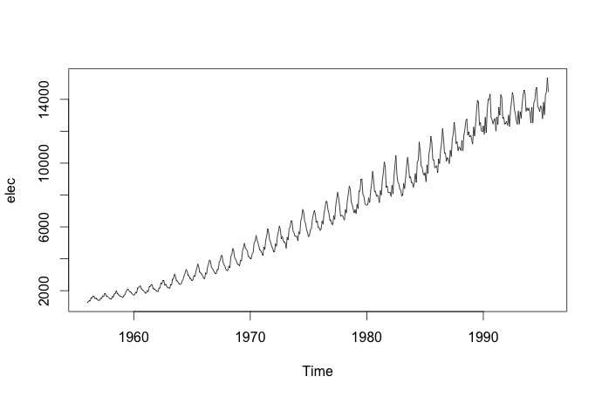
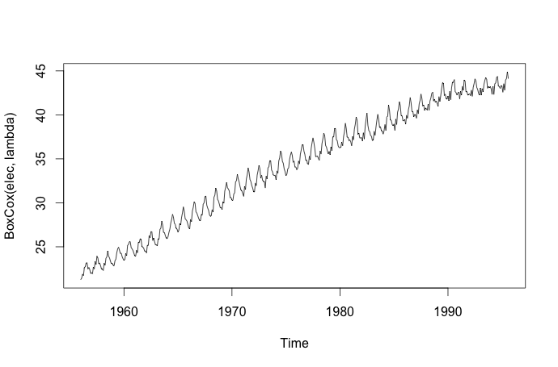
plot(elec)
lambda= BoxCox.lambda(elec)
plot(BoxCox(elec,lambda))

Slide 20
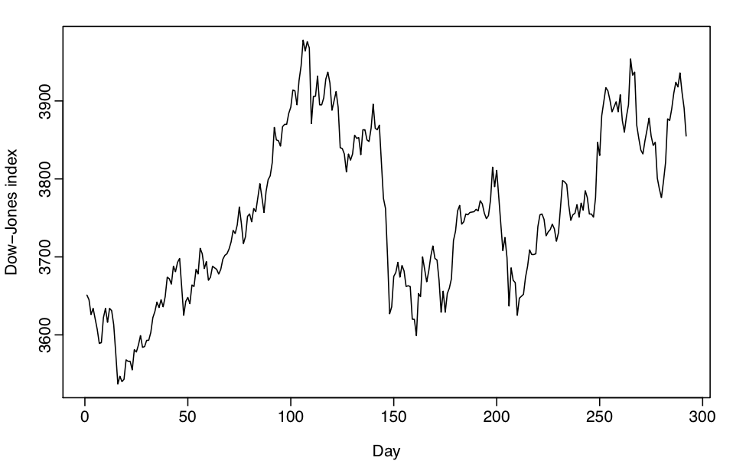
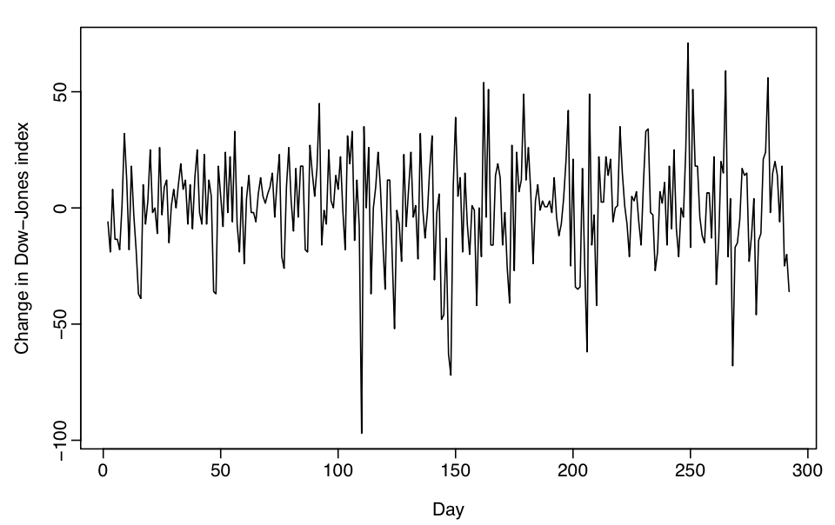
Stationary Data
At any point the in the data set mean and variance are the same
(e.g.) Lacks trend and has constant variance

Slide 21
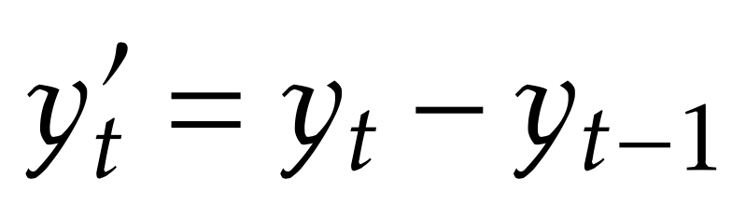
Differencing
Commonly used as an approach to help stabilize the mean
Can be applied multiple times if necessary
Result (of a single difference) will have T-1 data points

Slide 22
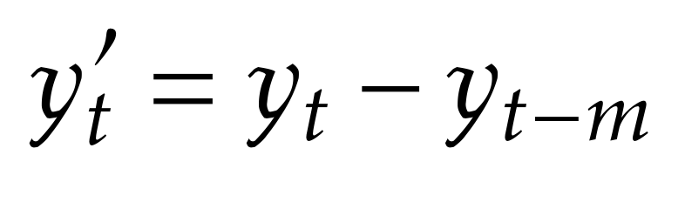
Seasonal Differencing
Essentially the same concept
Instead adjacent time points, compare with the previous season

Slide 23
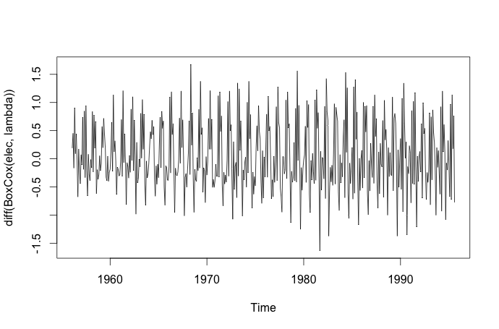
elecadj = BoxCox(elec,lambda)
stationary = diff(elecadj)

Slide 24
Test For Stationarity
Dickey-Fuller Test can be used to determine whether or not data is stationary
> lambda= BoxCox.lambda(elec)
> elecadj = BoxCox(elec,lambda)
> adjusteddata = diff(elecadj)
> adf.test(adjusteddata)
Augmented Dickey-Fuller Test
data: adjusteddata
Dickey-Fuller = -16.4006, Lag order = 7, p-value = 0.01
alternative hypothesis: stationary

Slide 25
Evaluating Forecast Accuracy

Slide 26
Scale-Dependent Metrics
Only make sense in context of the data
Common Metrics:
Mean Absolute Error (MAE): mean(|e_{i}|)
Root Mean Squared Error (RMSE): √(mean(e_{i}²))

Slide 27
Scale-Independent Metrics
Mean Absolute Percentage Error (MAPE)
Mean(|p_{i}|); p_{i}=100e_{i}/y_{i}
Mean Absolute Scaled Error (MASE)
A little bit more complicated…
Essentially error scaled by the MAE from the training set

Slide 28
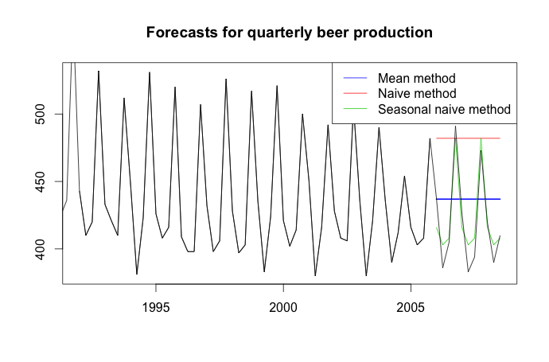
beer2 <- window(ausbeer,start=1992,end=2006-.1)
beerfit1 <- meanf(beer2,h=11)
beerfit2 <- rwf(beer2,h=11)
beerfit3 <- snaive(beer2,h=11)

Slide 29
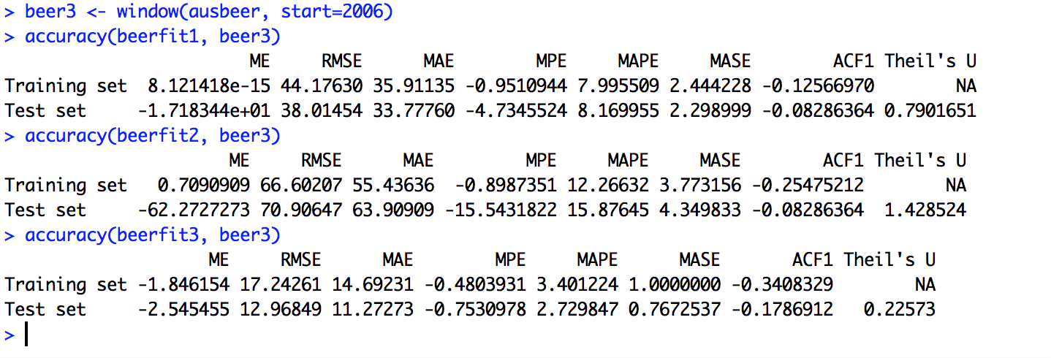
One Easy Method
To Evaluate these metrics in ‘forecast’ only one call is necessary: “accuracy(x, data)”

Slide 30
Model Comparison
There are many other methods for testing models against one another
Akaike Information Criterion (AIC)
Bayesian Information Criterion (BIC)
Many more… (Included in the package)

Slide 31
Evaluating Models
Using autocorrelation, one can make decisions as to how well fit the model is
If you see autocorrelation in the residuals, this is likely an indicator that your residuals are not just white-noise (there is missed/unsused information)
The “Acf” function will provide autocorrelation
The “residuals” function will provide residuals from a model

Slide 32
Exponential Smoothing

Slide 33
What is Exponential Smoothing?
In between average model and naïve
Assign weights to recent values to predict future values
The weights are exponentially decreasing for less recent values

Slide 34
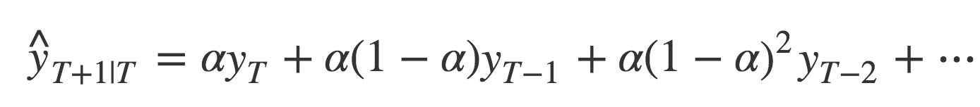
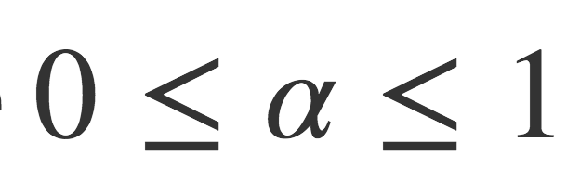
Simple Exponential Smoothing (SES)
Find coefficient value through minimizing SSE or other optimization method
Does not account for Trend
Does not account for Seasonality

Slide 35
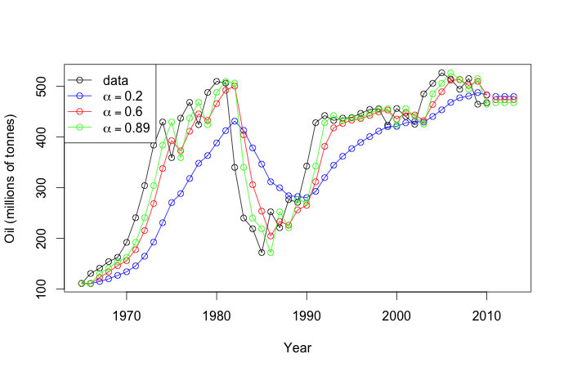
fit1 <- ses(oil, alpha=0.2, initial="simple", h=3)
fit2 <- ses(oil, alpha=0.6, initial="simple", h=3)
fit3 <- ses(oil, h=3)

Slide 36
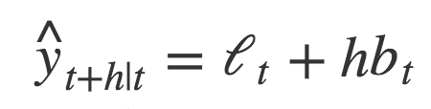
Holt’s Method
Extend SES to incorporate trend within the data
Uses two equations
One to forecast the level (similar to SES equation)
One to forecast the slope (similar to SES, but applies to slopes)
Combine these forecasts to forecast the time-series

Slide 37
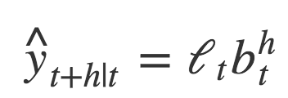
Exponential Trend
Similar to Holt’s method
Rather than being an additive accumulate, it is multiplicative
b_{t} here represents a growth rate as a ratio of previous terms, rather than a slope

Slide 38
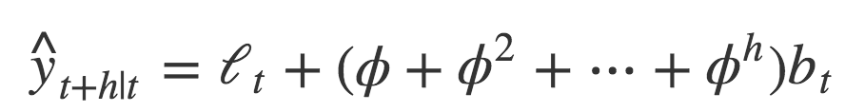
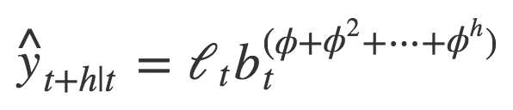
Damped Trend Methods
Both of the previous methods display indefinite increasing/decreasing behavior
Due to this, they tend to over-forecast longer time horizons
Adding a dampening parameter so that the tend to a flat-line in the long term can be beneficial
Both additive and multiplicative methods can be damped

Slide 39
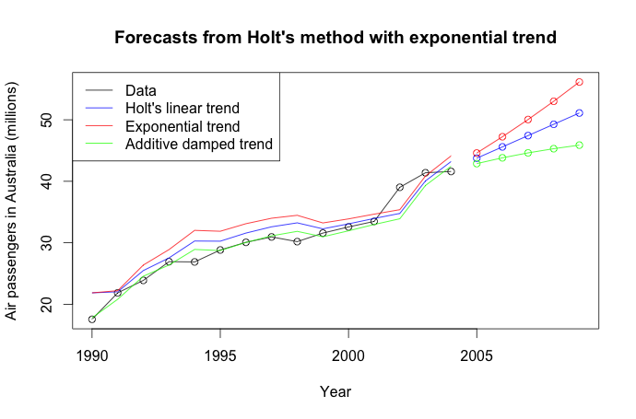
fit1 <- holt(air, alpha=0.8, beta=0.2, initial="simple", h=5)
fit2 <- holt(air, alpha=0.8, beta=0.2, initial="simple", exponential=TRUE, h=5)
fit3 <- holt(air, alpha=0.8, beta=0.2, damped=TRUE, initial="simple", h=5)

Slide 40
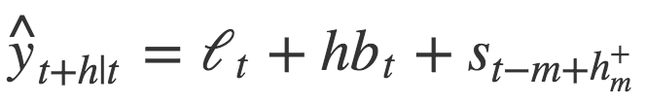
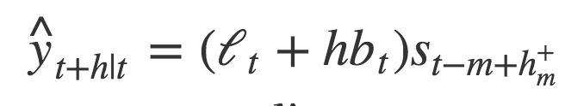
Holt-Winters Seasonal Method
Include a third equation for seasonality
Applicable to both additive and multiplicative methods
(also possible dampening)

Slide 41
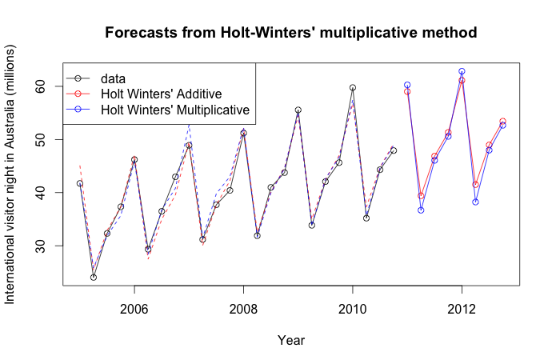
fit1 <- hw(aust, seasonal="additive")
fit2 <- hw(aust, seasonal="multiplicative")

Slide 42
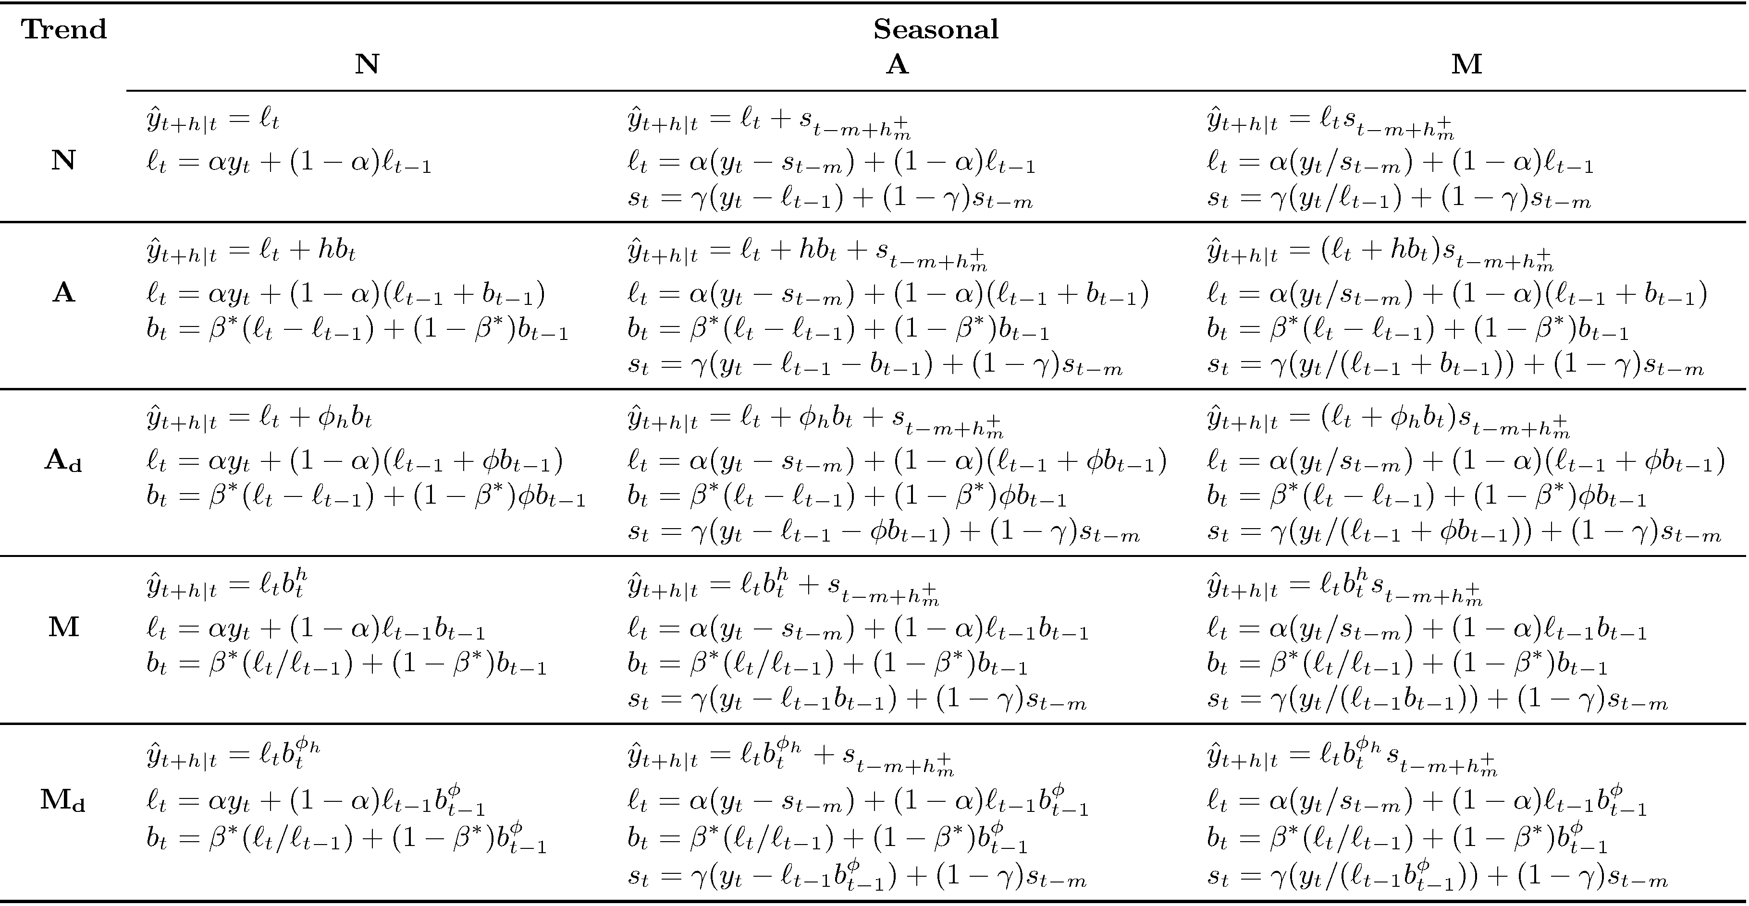

Slide 43
Time Series Decomposition

Slide 44
Time Series Components
Trend
Long-term increasing/decreasing patterns in data
Seasonal
Pattern of fluctuation on a fixed time period
Cyclic
Rising/falling pattern, not on a fixed time frame

Slide 45
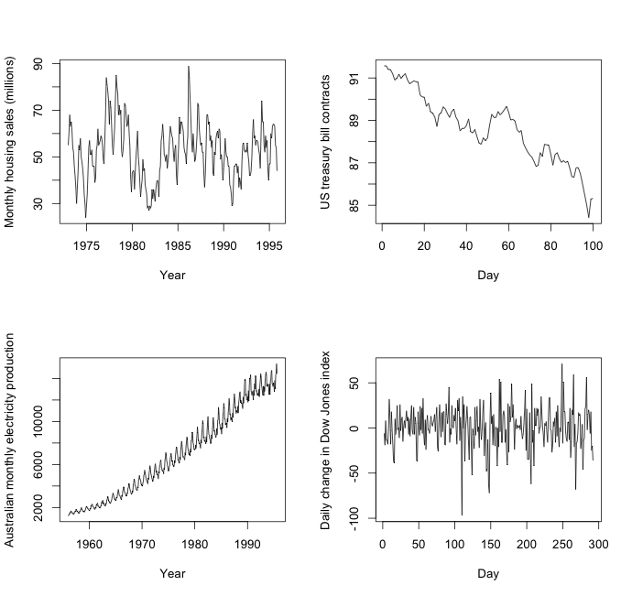

Slide 46
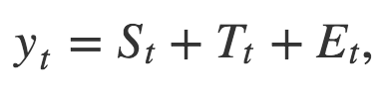
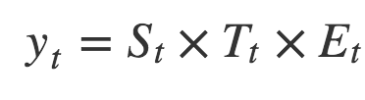
STE model
Think of our data as a composition of three components
Seasonality
Trend-Cycle
Remainder (Error)
Alternatively, one could fit a transformed model instead of the multiplicative model
Notes:
Additive model is more appropriate if the seasonal fluctuations or variation around the trend/cycle does not vary with the level of the time series If they do, the multiplicative method is more appropriate. With economic time series, multiplicative models are common

Slide 47
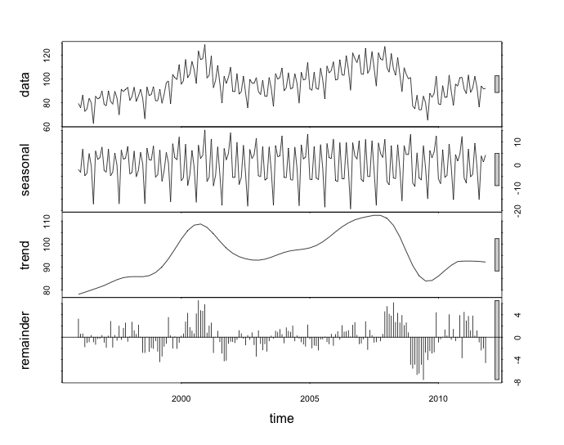
fit <- stl(elecequip, s.window=5)
plot(fit)
Notes:
Seasonal and Trend decomposition using Loess

Slide 48
What can we do with this?
Provides good visual insight into the data
Use isolated parts of the data for analytics
Forecast isolated portions of data

Slide 49
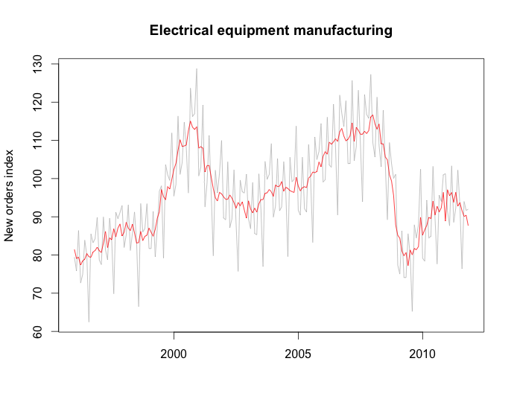
fit <- stl(elecequip, s.window=5)
seasadj(fit)
Notes:
, there are a few other methods included here using moving averages and standard seasonal windows(quarterly, yearly, etc). This is a rather robust application of decomposition and so I will not be covering all of the other methods in the interest of time. Through the parameters of this method you can variable sized seasonal windows within plot and change the window for trend and other components of this method

Slide 50
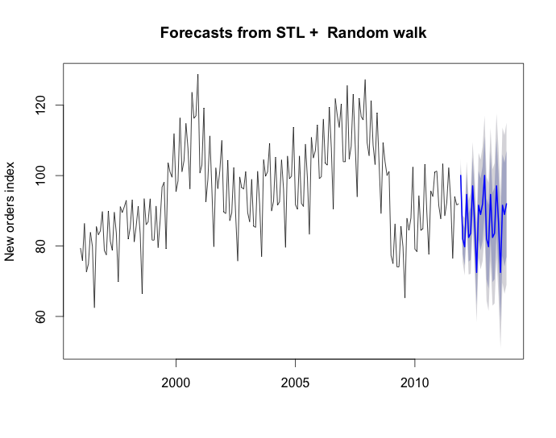
fit <- stl(elecequip, s.window=5)
fcast <- forecast(fit, method="naive")
plot(fcast, ylab="New orders index")

Slide 51
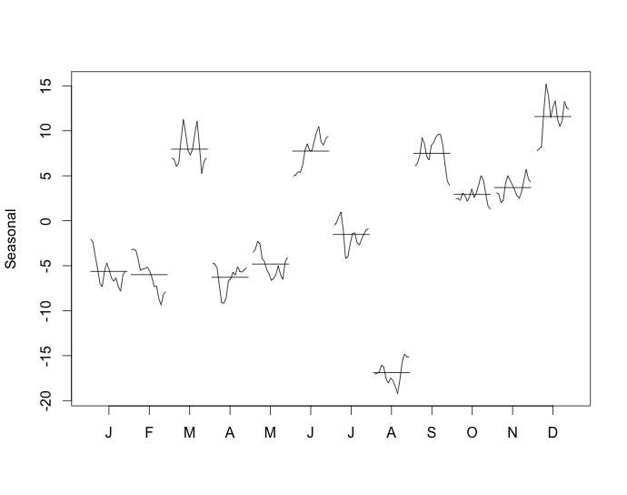
monthplot(fit$time.series[,"seasonal"], main="", ylab="Seasonal")

Slide 52
ARIMA Modeling

Slide 53
Autoregressive Models
Based on a linear combination of past values
As the name states, regression against itself

Slide 54
Moving Average Models
Rather than past values, forecast based on past errors (white noise)
Still using a regression-like model

Slide 55
ARIMA models
Combine AR and MA models with a Integration step
The integration is some level of differencing
Model parameters are fit though analyzing auto-correlations and using information criterion (AIC, BIC)
Notes:
I will not talk in depth about how specifically to understand parameters for these models since that is fairly beyond the scope of this introduction.

Slide 56
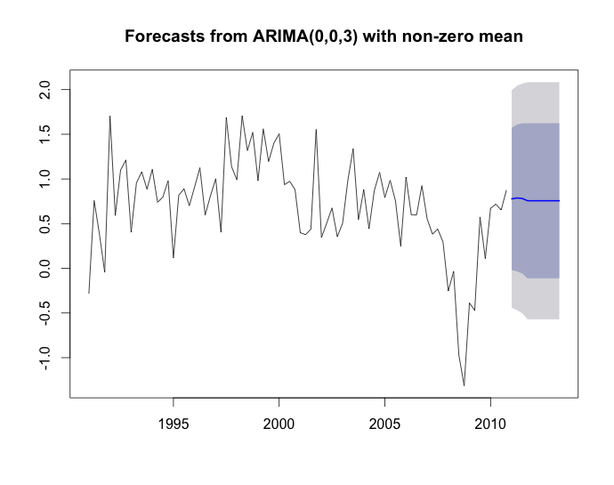
fit <- auto.arima(usconsumption[,1],seasonal=FALSE)
plot(forecast(fit,h=10),include=80)
Notes:
The auto.arima function will use some of what I mentioned to try to fit a reasonable ARIMA function to the data. It will investigate the autocorrelation within the data and look at “wiggling” the parameters to compare different information criterion to select a final model. I would still would not suggest applying any of these models in a blind manner, but discussing how to properly select parameters for all these models is a long discussing that many university courses spend whole semesters discussing. In this case we can see the the model actually selected 0 for both differencing and the AR model, so this is essentially just a Moving Average model.

Slide 57
Seasonal ARIMA Models
Clearly we still see seasonal components within data
We address these with another set of parameters to fit AR, I, and MA to seasonal components.
our parameters are now (p,d,q)(P,D,Q)_{m}

Slide 58
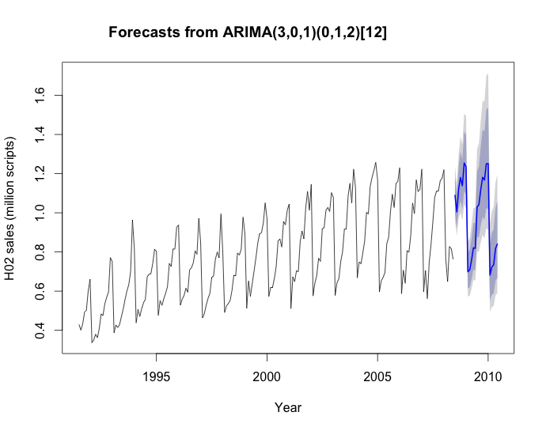
fit <- Arima(h02, order=c(3,0,1), seasonal=c(0,1,2), lambda=0)
plot(forecast(fit), ylab="H02 sales (million scripts)", xlab="Year")

Slide 59
More Advanced Tools

Slide 60
More Advanced Tools
Hierarchical Forecasting
Neural Network Models
Dynamic Regression Models
Vector Autoregression

Slide 61
Resources
A whole book is available online!
https://www.otexts.org/fpp
(Many examples were pulled directly from this book)
Of course the CRAN documentation
http://cran.r-project.org/web/packages/forecast/forecast.pdf

