Slide 1
Realtime debugging of a softcore OpenRISC CPU
Jules Peyrat
January 5th, 2026

Slide 2
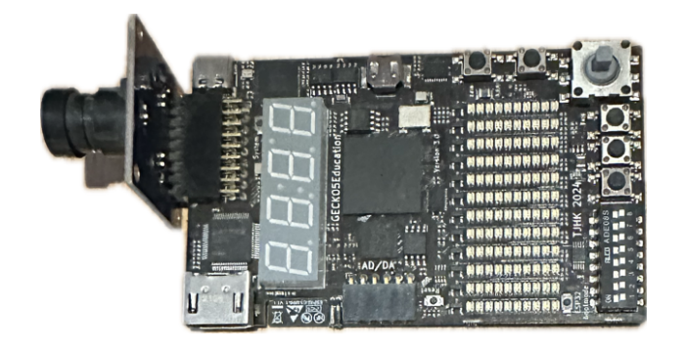
Context
CS473 Course Material
  Lattice ECP5 FPGA (« Gecko5Education »)
  Running a softcore OpenRISC CPU (OR1300)
  Toolchain to compile C programs for the or1k CPU
At the moment, GDB is not compatible with the softcore CPU
We would like students to be able to debug and upload their programs using GDB
Step-by-step execution, check RF/memory content

Slide 3
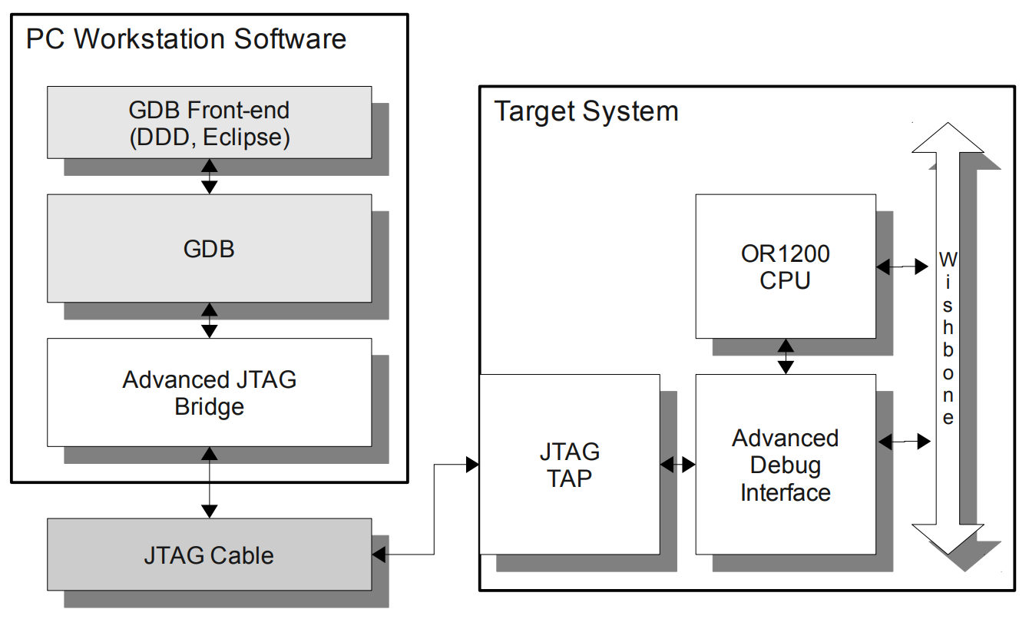

Objective
System Bus
GDB & User
Front End
Target CPU
OR1300
TAP Controller
SW/HW Bridge
Lattice ECP5 FPGA
« Gecko5Education »
Debug
Controller

Slide 4
Overview
The JTAG Standard
OpenOCD Driver
Top-Level Debug Controller
Interfacing the system bus
Interfacing the RF

Slide 5
1/ The JTAG Standard
OR1300

Slide 6
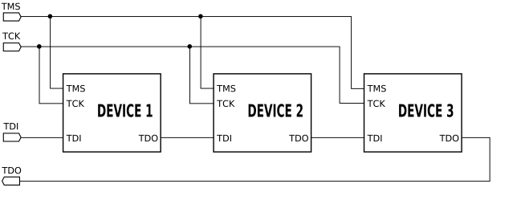
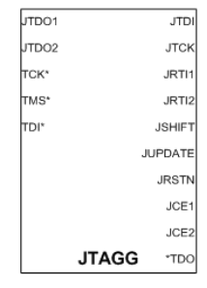
1/ The JTAG Standard
Join Action Test Group
HW communication protocol for debugging SoC’s
Five signals
  TCK (JTAG clock)
  TDI, TDO (input and output bit lines)
  TMS (next slide)
  Async reset
In this project we use the native JTAGG primitive of our FPGA (also used to reconfigure gates)

Slide 7
2/ OpenOCD
OR1300
SW/HW Bridge

Slide 8
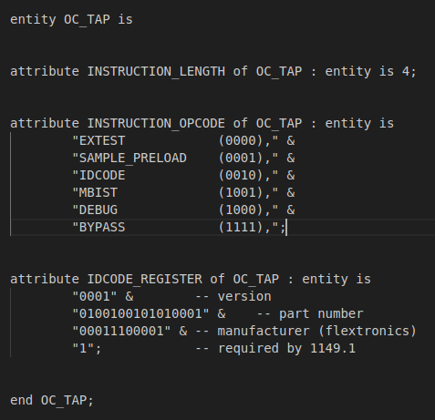
2/ OpenOCD
HW/SW bridge through JTAG
To work, OpenOCD needs
  IR and DR shift register lengths…
  IR instruction code…
  Debug controller command formats (see later)
Problem
Using a non-native TAP controller (the one from the FPGA)
Need for an adapted OpenOCD driver
Very close to an existing driver! (mohor)
Recompile OpenOCD with that additional driver
BSD file of a supported TAP controller

Slide 9
3/ Debug Controller
OR1300
Debug
Controller

Slide 10
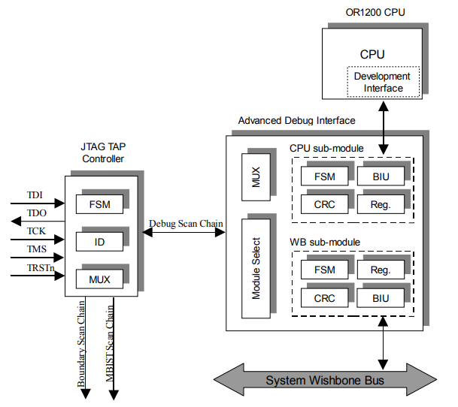
3/ Top-Level Debug Controller
Advanced Debug Interface
Composed of 4 submodules
Submodule selection
Forwards commands to other submodules
Most recent implementation of a debug interface for or1k

Slide 11
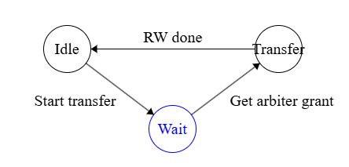
4/ Interfacing the system Bus (WB module)
Our OR1300 CPU uses a different bus architecture (=/= Wishbone)
Some differences
  Different buses for address and data (WB), only one for our system bus
  No support for bus arbiter
Modify the FSM of the Bus Interface Unit (BIU)
Three states
  One to wait grant from bus arbiter
  One to wait ack from slave (transaction success)
In case of bus error, goes back to Idle and assert signal

Slide 12
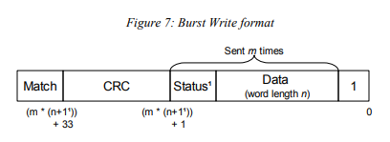
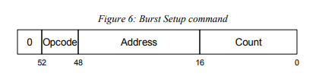
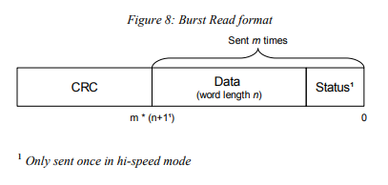
4/ BIU Command Formats
One burst read = 2 distinct commands
Setup Command → Burst Command
Status bit used to check if the bus was available
Tries again 3 times if needed

Slide 13
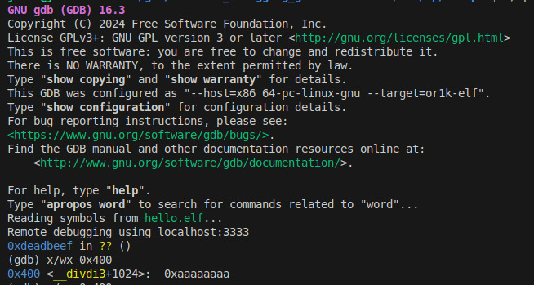
4/ Memory Reads
Open the OpenOCD server and connect to it using GDB
"x/wx 0x400" (read full 32-bit word in hex)
→ JTAGG, module selection, BIU work
Unaligned 32-bit reads
GDB output
4-bytes unaligned 32-bit read
8118 reading buffer of 4 byte at 0x00000401
8119 Read memory at 0x00000401, size: 1, count: 0x1
[…]
8123 Read memory at 0x00000402, size: 2, count: 0x1
[…]
8127 Read memory at 0x00000404, size: 1, count: 0x1
[…]
8130 CRC OK!
4-bytes aligned 32-bit read (OpenOCD logs)
406 reading buffer of 4 byte at 0x00000400
407 Read memory at 0x00000400, size: 4, count: 0x1
408 Reading WB32 at 0x00000400
409 Doing burst read, size 4, count 1, start 0x400
410 CRC OK!

Slide 14
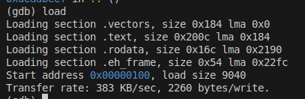
4/ Memory Writes
Writes suffer from CRC errors
"set {int}0x400 = 0x12345678"
Likely cause → CRC submodule uses the TDI input line (1 cycle late)
Unable to upload programs at the moment
20576 writing buffer of 4 byte at 0x400
20577 Write memory at 0x400, size: 4, count: 0x1
20578 Writing WB32 at 0x400
20579 Doing burst write, word size 4, word count 1,start address 0x00000400
20580 CRC ERROR! match bit after write is 0 (computed CRC 0x00000000)
20581 CRC ERROR! match bit after write is 0 (computed CRC 0x00000000)
20582 CRC ERROR! match bit after write is 0 (computed CRC 0x00000000)
20583 Reporting -4 to GDB as generic error

Slide 15

5/ Accessing the register file
The OR1300 register file is a simple dual port memory. Both ports are already used by the CPU
  Duplicate the RF to get two additional read ports.
Structure of CPU submodule very similar to WB submodule
  Refactor BIU (simple FSM with 2 states)
Dummy register read
  Assert one signal to trick BIU into thinking bus is always available

Slide 16
Future work
Implement the OpenOCD driver
Fix top-level debug controller
Dummy memory and register reads
Implement system bus BIU
Fix CRC errors due to TDI
Implement RF BIU & give access to RF
Stalling and step-by-step execution
Experiment with GDB frontends (DDD)

Slide 17
Thank you

Slide 18
Appendix

Slide 19
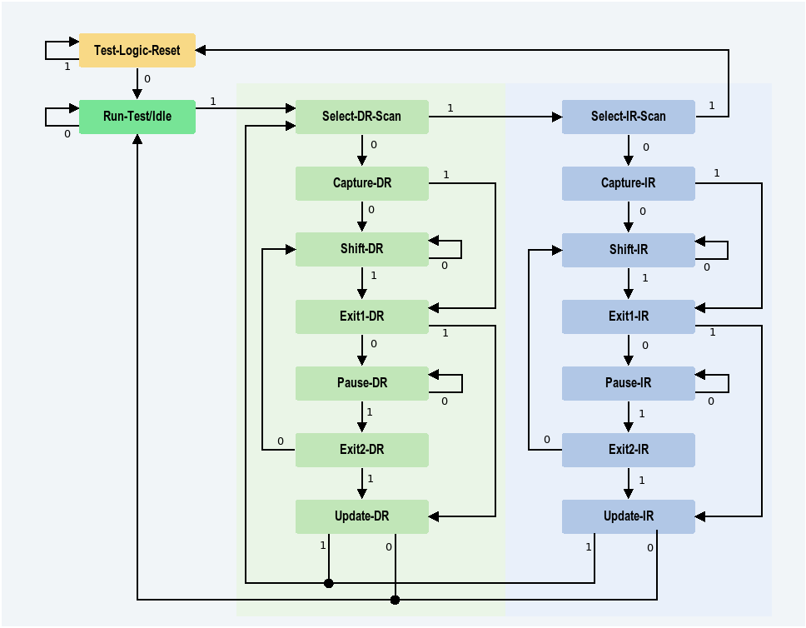
1/ The JTAG TAP Controller
TAP (Test Access Port) Controller = implements a FSM
Example: 32-bit stall command
  Select DEBUG instruction (IR)
    TMS = 1 → Select-DR-Scan
    TMS = 1 → Select-IR-Scan
    TMS = 0 → Capture-IR
    TMS = → Shift-IR
    Send data through TDI…. (TMS=0)
    TMS = 1 → Exit-IR
    TMS = 1 → Update-IR
    TMS = 0 → Run-Test/Idle
  Send data through DR
    Same but skip cycle 2
Use of shift registers
TDI
Instruction/Data Register
TDO

Slide 20
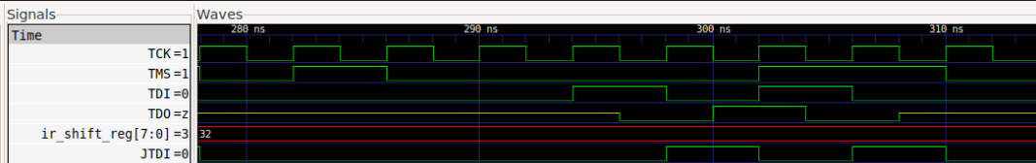
1/ The JTAGG Primitive
What or1k wants us to do
  Use a provided softcore TAP controller
  Artificially create a JTAG interface
What we want to do
  Use the hardware JTAGG primitive of our FPGA
  Same component used for reconfigurating the FPGA
Problem
  No direct access to the TDI signal
  TDI is 1-cycle late
  Solution = delay by 1 the Shift-DR state signal

