Slide 1
Realtime debugging of a softcore OpenRISC CPU
Jules Peyrat
14 november 2025

Slide 2
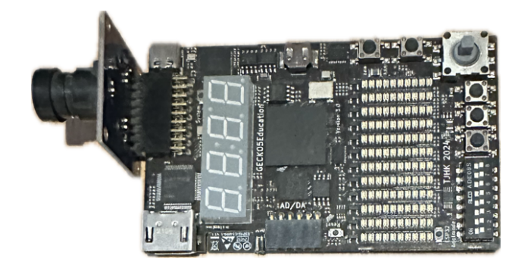
Context
CS473 Course Material
  Lattice ECP5 FPGA (« Gecko5Education »)
  Running a softcore OpenRISC CPU (OR1300)
  Toolchain to compile C programs for the or1k (OpenRISC 1k) CPU
At the moment, GDB is not compatible with the softcore CPU
We would like students to be able to debug their programs using GDB
Step-by-step execution, check register and memory content

Slide 3
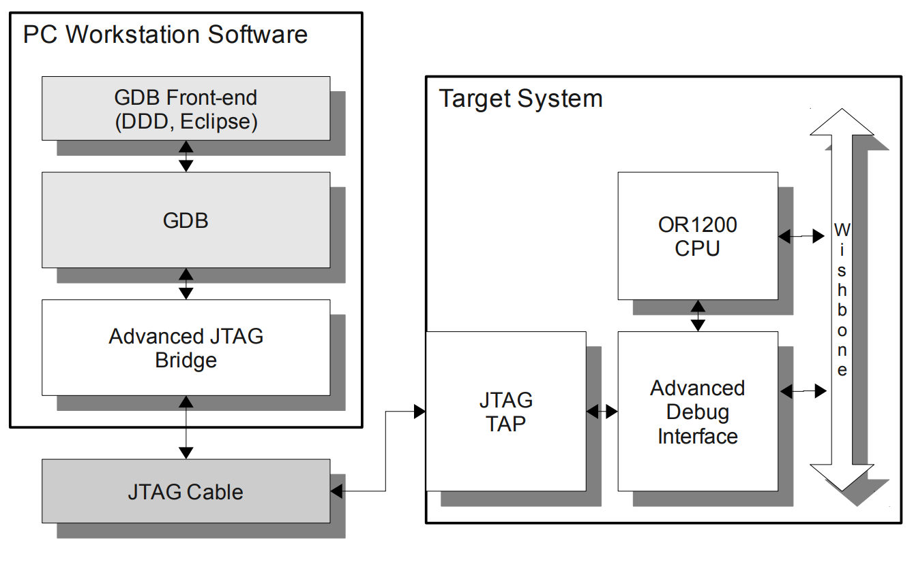

Objective
System Bus
GDB & User
Front End
Target CPU
OR1300
TAP Controller
SW/HW Bridge
Lattice ECP5 FPGA
« Gecko5Education »
Debug
Controller

Slide 4
Overview
The JTAG Standard & Interfacing JTAG
Using OpenOCD (Open On-Chip Debugger)
Debug Controller
Interfacing the System Bus

Slide 5
1/ The JTAG Standard
OR1300

Slide 6
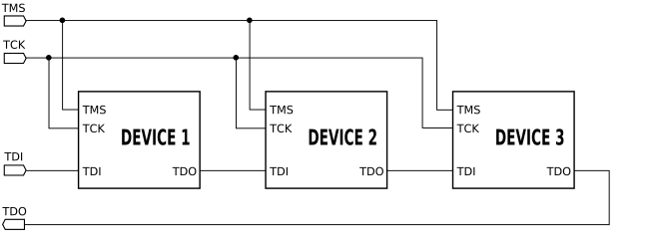
1/ The JTAG Standard
Join Action Test Group
HW communication protocol for debugging SoC’s
Five signals
  TCK (JTAG clock)
  TDI, TDO (input and output bit lines)
  TMS (next slide)
  Async reset
Instructions
  BYPASS (TDI = TDO)
  IDCODE (32bit SoC info: manufacturer, revision….)
  DEBUG

Slide 7
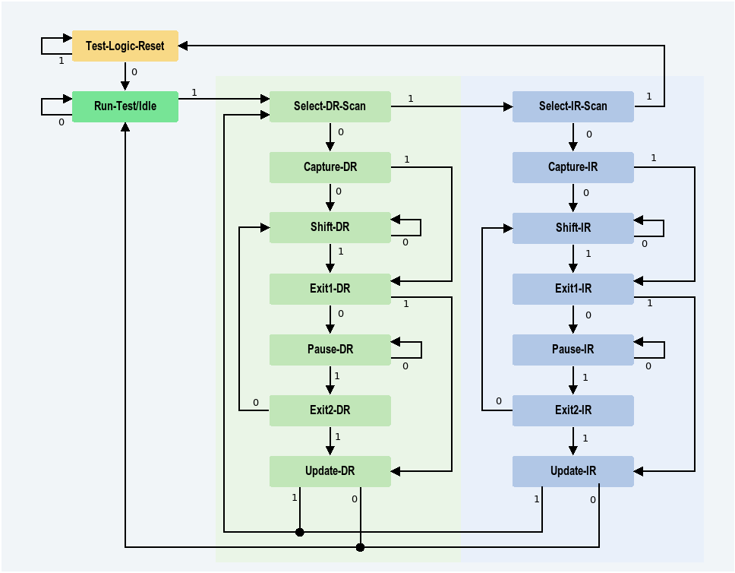
1/ The JTAG TAP Controller
TAP (Test Access Port) Controller = implements a FSM
Example: 32-bit stall command
  Select DEBUG instruction (IR)
    TMS = 1 → Select-DR-Scan
    TMS = 1 → Select-IR-Scan
    TMS = 0 → Capture-IR
    TMS = → Shift-IR
    Send data through TDI…. (TMS=0)
    TMS = 1 → Exit-IR
    TMS = 1 → Update-IR
    TMS = 0 → Run-Test/Idle
  Send data through DR
    Same but skip cycle 2
Use of shift registers
TDI
Instruction/Data Register
TDO

Slide 8
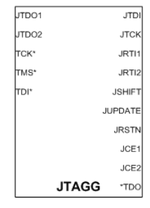
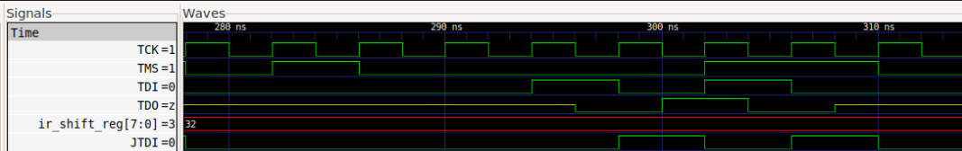
1/ The JTAGG Primitive
What or1k wants us to do
  Use a provided softcore TAP controller
  Artificially create a JTAG interface
What we want to do
  Use the hardware JTAGG primitive of our FPGA
  Same component used for reconfigurating the FPGA
Problem
  No direct access to the TDI signal
  TDI is 1-cycle late
  Solution = delay by 1 the Shift-DR state signal

Slide 9
2/ OpenOCD
OR1300
SW/HW Bridge

Slide 10
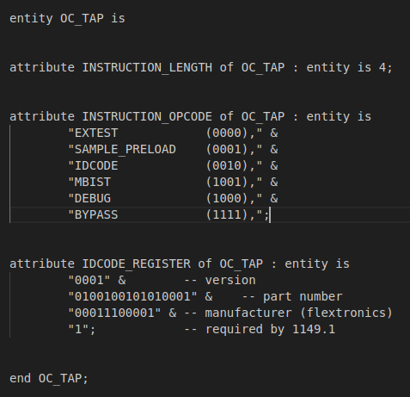
2/ OpenOCD
HW/SW bridge through JTAG
To work, OpenOCD needs
  IR and DR shift register lengths…
  IR instruction code…
  Debug controller command formats…
Problem
Using an « unsupported » TAP controller (the one from the FPGA)
Need for an adapted OpenOCD driver
Very close to an existing driver! (mohor)
BSD file of the OpenOCD-supported TAP controller

Slide 11
3/ Debug Controller
OR1300
Debug
Controller

Slide 12
3/ Debug Controller
OR1200-supported version provided by or1k project
Composed of 4 submodules
Needs refactoring:
  Using JTAGG requires to adapt the input shift register logic (1 cycle delay problem)
  Not the same bus architecture (next slide)
At the moment, the input shift register logic somewhat works (under a certain input shift register size threshold. Above => bit flips)
Debug Controller
SoC
JTAG
reg_module_id
CPU0 Submodule
CPU0
CPU1 Submodule
CPU1
Wishbone Submodule
Wishbone Bus
JSP Submodule

Slide 13
4/ System Bus
The OR1200 CPU uses a Wishbone bus architecture
Our OR1300 CPU uses a different bus architecture
Example of difference:
  OR1300 has one 32-bit for both address and data. Address is provided at the beginning of a transaction.
  OR1200 has two 32-bit buses for both address and data.
Wishbone Submodule
JTAG Command Logic
Bus Interface Unit

Slide 14
Future work
Implement the OpenOCD driver
Fix the JTAGG interfacing problem
Write a dummy debug controller for dummy memory reads and CPU states
Test the whole setup with GDB
Re-implement the BIU to support the OR1300 bus
  Perform memory reads from GDB
  Upload programs using GDB
Link the CPU debug submodule to the OR1300 CPU
  Stall the CPU
  Step-by-step execution

Slide 15
Thank you

