Slide 1
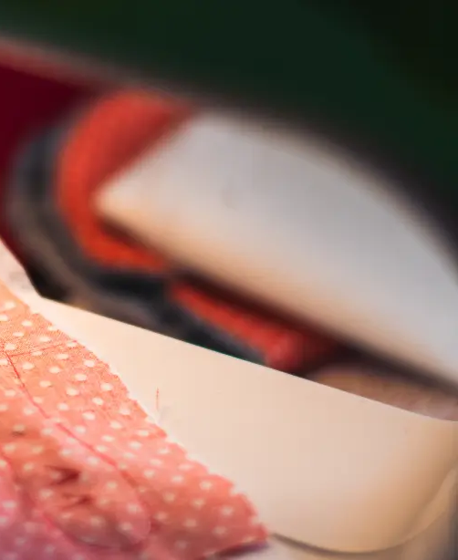
Alpha Splice
Restoring a sewing mental model
for RGBA compositing
Human-Computer Interaction
A direct-manipulation tool that treats a mask as a source selector — not just a visibility mask.
Notes:
Hi everyone. Today I’m presenting Alpha Splice, a direct-manipulation RGBA compositing tool.
The problem I’m trying to solve sounds simple: given two images with alpha, the user draws a region, and the result should use one image inside that region and the other image outside it.
But the important part is that we are not only compositing visible color. We are also preserving alpha as real data.
So the main HCI question is: why does a task that feels simple in the real world become so awkward in tools like Photoshop?

Slide 2
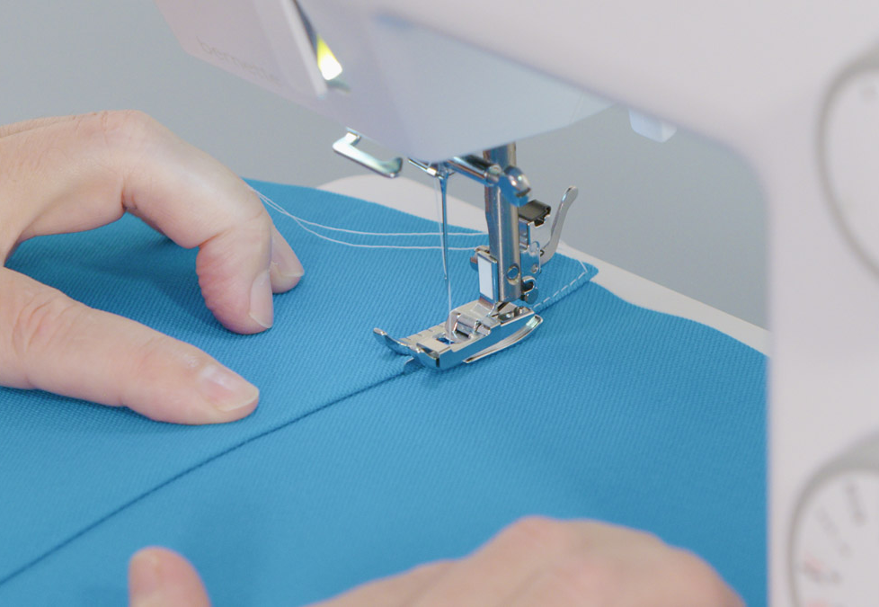
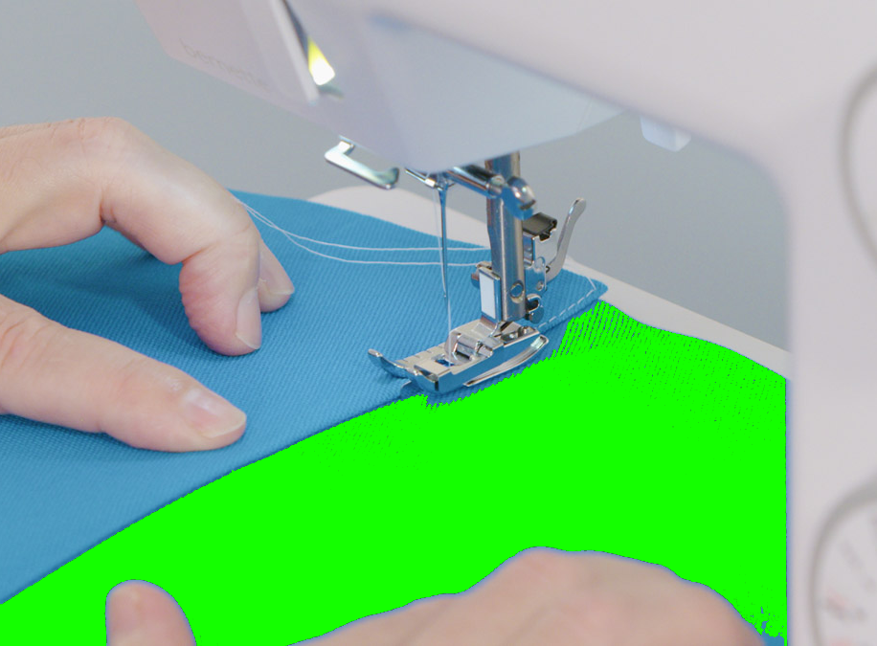
Real-world intuition: stitch along a seam
In fabric work, a boundary naturally divides the surface into two regions.
Original sewing photo
Same photo with a region highlighted
One side of the seam uses one fabric.
The other side uses another fabric.
The green overlay is not a real object. It just makes the implicit region explicit — the digital equivalent of a mask.
Start from a physical task people already understand
Notes:
I want to start from a physical analogy: sewing.
In fabric work, a seam naturally divides the surface into two regions. One side belongs to one piece of fabric, and the other side belongs to another piece.
On the left is the original sewing photo. On the right, I added the green overlay. The green is not a real object in the photo. It is just making the implicit region explicit.
Humans understand this immediately. We do not think about layers, channels, or file formats. We just understand that this side of the seam uses one material, and that side uses another material.
That is the mental model I want to preserve in the digital tool.

Slide 3
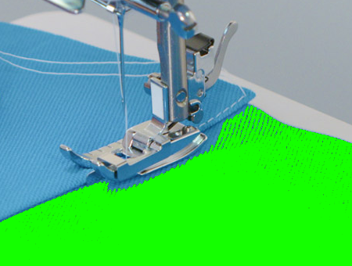
Zoom into one pixel on the green side
The seam is not just hiding and showing. It decides which image owns each pixel.
If a pixel is inside the selected region:
Final pixel = Background RGBA
If a pixel is outside the selected region:
Final pixel = Foreground RGBA
Highlighted seam region
So the mask is a source selector, not just a visibility mask.
One-pixel view: the whole RGBA tuple must come from one source
Notes:
So we have this sewing intuition: one side of the seam belongs to one fabric, the other side belongs to another.
Now the question is: what does this actually mean when we move from fabric to pixels? What happens at the boundary?
Let's zoom all the way down to one pixel on the green side.
If this pixel is inside the selected green region, then the whole pixel should come from the background image.
That means not only the visible RGB color, but also the alpha value. The final R, G, B, and A should all come from the same source.
If the pixel is outside the selected region, then the whole pixel should come from the foreground image.
So the mask is not just hiding or showing a layer. It is a source selector.
For every pixel, the mask answers one question: which image owns this pixel’s RGBA data?

Slide 4
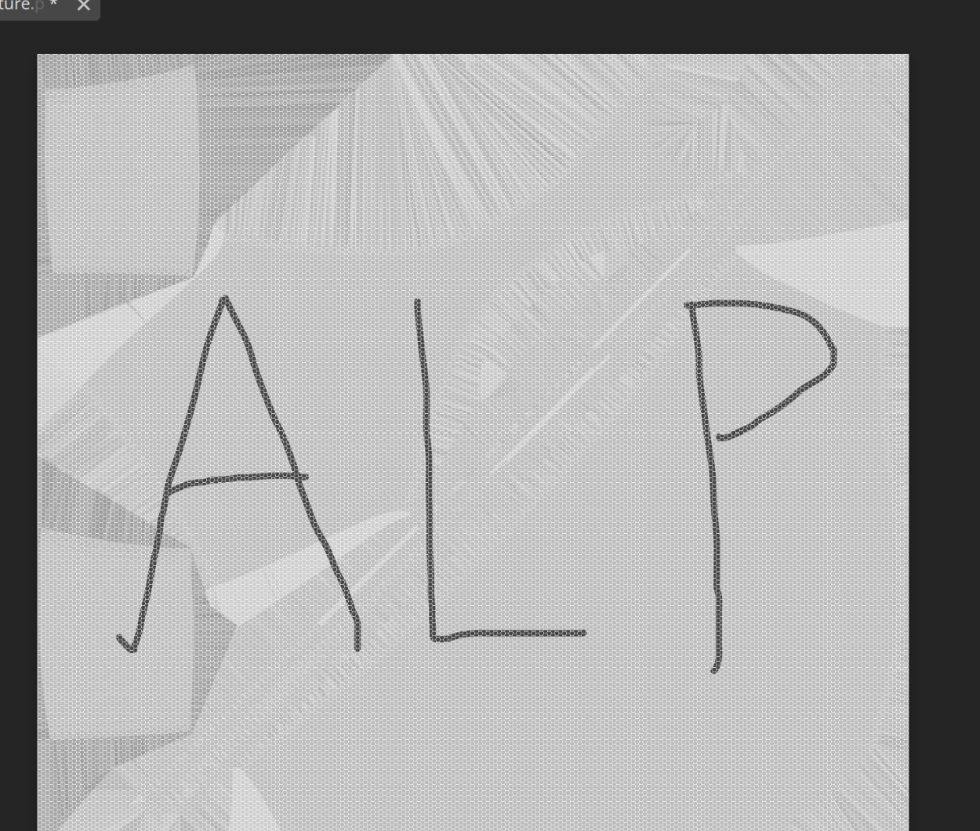
The trap: visual correctness is not data correctness
A normal top-layer cutout can look right on screen while exporting the wrong RGBA data.
Looks right
Inside the hole, you see the background.
That solves the visual problem.
Can still be wrong on export
Outside the hole, semi-transparent foreground can become foreground over background,
instead of the foreground RGBA you wanted to preserve.
Naive idea: erase a hole from the top layer and reveal the layer below.
Screen result ≠ exported pixel data
This is why the problem is about RGBA routing, not just masking
Notes:
Here is the trap.
The naive solution is very tempting: put the foreground image on top, put the background below it, and erase a hole from the top layer.
On screen, this can look correct. Inside the hole, we see the background. So visually, the task seems solved.
But for texture authoring, VFX, or game art, visual correctness is not enough. The exported RGBA data also has to be correct.
For example, outside the hole, I may want to preserve the foreground’s original alpha. But if Photoshop treats this as normal layer compositing, the result may become “foreground over background”.
That means the background has already participated in the pixel data. The image may look fine, but the exported alpha is not the alpha we intended.
So the real problem is not just masking. The real problem is RGBA routing.

Slide 5
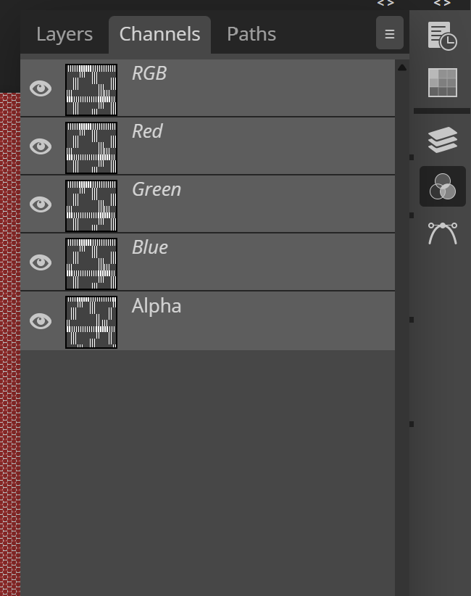
Why Photoshop breaks the abstraction
In the physical task, pattern and fabric stay together. In Photoshop, RGB and alpha split apart.
User intention
“Use image A on this side, image B on that side.”
Photoshop asks for two separate mental models:
Layers and layer masks for visible RGB
Channels for final alpha data
Manual reconstruction to make exported RGBA correct
That is the gulf of execution: a simple spatial intention gets translated into implementation details.
Channels panel
HCI point: one semantic operation becomes two disconnected workflows
Notes:
This is where Photoshop breaks the sewing abstraction.
In the physical sewing task, the pattern and the fabric stay together. When we cut and stitch a piece of fabric, we do not separate its visible pattern from its material backing.
But in Photoshop, these concepts are split.
Layer masks control what we see in the layer stack. That mostly solves the visible RGB problem.
But alpha data lives in a different conceptual space: the Channels panel.
So the user’s intention is simple: use image A on this side, image B on that side.
But Photoshop asks the user to translate that intention into implementation details: layers, masks, selections, channels, extracted alpha, recombined alpha.
That is the gulf of execution. The user has a simple spatial intention, but the tool forces them to think in complex internal representation.

Slide 6
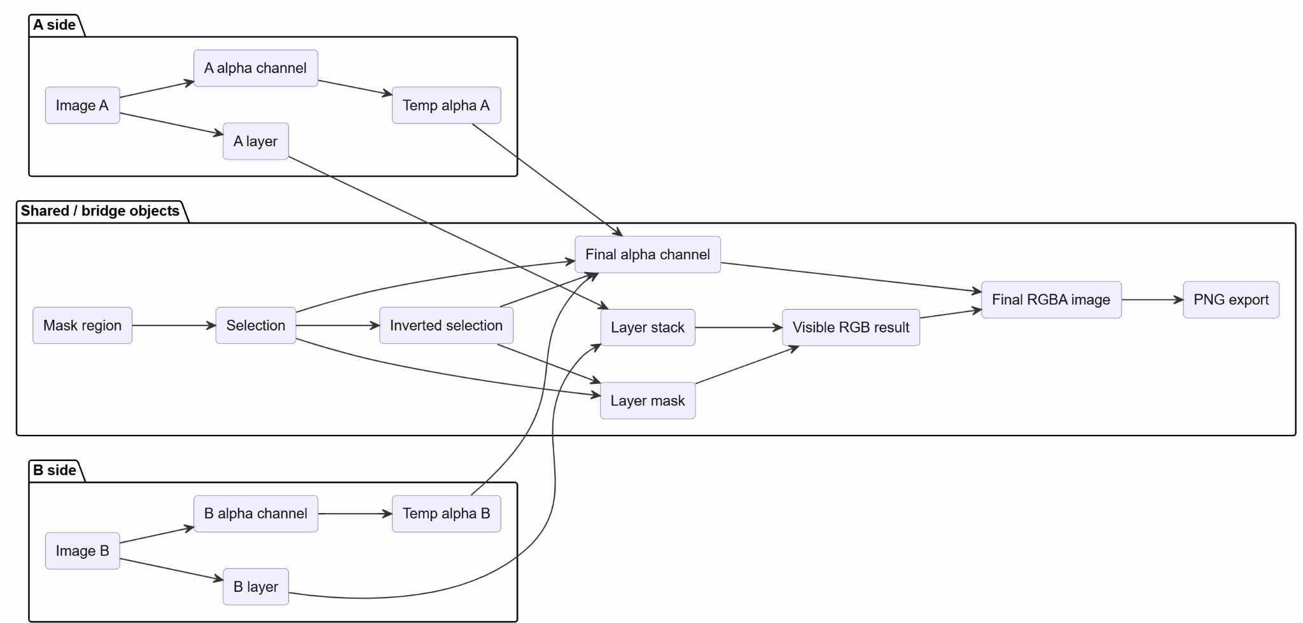
Feeling confused? You’re not alone.
One RGBA splice becomes layers, selections, masks, and channels.
The hard part is not drawing the region — it is keeping all these Photoshop objects synchronized.
Notes:
If this diagram feels confusing, that is exactly the point.
The original user intention is still just one sentence: use image A inside the selected region and image B outside it, while preserving the full RGBA data.
But at the object level, Photoshop spreads that intention across many separate things: A and B layers, A and B alpha channels, selections, inverted selections, a layer mask, temporary alpha copies, a final alpha channel, and the export state.
The up and down lanes show how both source images split into layer objects and alpha objects. The middle objects are the bridge: they keep the RGB path and the alpha path synchronized.
So the burden is not just the number of clicks. The burden is that the user has to coordinate these objects manually before the visible RGB result and the final alpha channel can merge into the exported RGBA image.
That is the abstraction gap Alpha Splice targets.

Slide 7

This Is Only the Simplest Case
The 20-step workflow is not a one-time cost. It is the cost of every creative decision.
Photoshop: every revision
Alpha Splice: every revision
1
Revise mask
Revise the mask
2
Redo layer mask
3
Re-extract alpha A
↓
4
Re-extract alpha B
Correct RGBA — done
repeat
every time
5
Re-select region
RGBA routing is automatic.
No resynchronization needed.
6
Re-composite alpha
7
Re-merge & export
The real question:
"Can I try another boundary?"
Design is iterative. A tool with high marginal cost per revision stops exploration before it starts.
Notes:
And remember, what I just showed is only the simplest version of the task.
So far, I have assumed two images, one clean mask, and a clear decision about which side uses which source.
But real texture work is messier. The user may need to align the images, extract a boundary from line art, repair small gaps, flood fill a region, expand or shrink the mask, and verify the alpha channel directly.
But even that is not the worst part.
The worst part is that design is iterative. The user does not draw the mask once and walk away. They want to try a different boundary, shift the region a few pixels, see what looks better.
In Alpha Splice, that is just another brush stroke.
In Photoshop, every revision means re-running the entire channel reconstruction. The RGB path and the alpha path are decoupled, so changing one does not automatically update the other. The user has to manually resynchronize them every single time.
So the 20-step workflow is not a one-time cost. It is the cost of every creative decision. And a workflow with high marginal cost per iteration does not just slow the user down — it stops them from exploring at all.
That is why this matters as an HCI problem. The tool is not just inefficient. It is actively hostile to the way design actually works.

Slide 8
Alpha Splice collapses the gulf of execution
The user expresses where. The system handles RGBA channel routing internally.
Step 1 — Align
Step 2 — Mask edit
Load two RGBA images
Choose base and overlay
Drag and scale until the seam lines up
Confirm and enter mask editing
Paint with brush / eraser
Use Border Fill from existing boundaries
See the RGBA result live
Export directly to PNG
User paints the region. The system routes RGBA correctly.
From two disconnected workflows to one direct-manipulation interaction
Notes:
Alpha Splice is my attempt to collapse that gulf of execution.
Instead of asking the user to manage layers and channels separately, the tool keeps the interaction spatial.
There are two main steps.
First, the user loads two RGBA images and aligns them. This is like placing two pieces of fabric before sewing.
Second, the user edits the mask. They can paint with a brush, erase, or use Border Fill to create a region from existing boundaries.
The key design decision is this: the user only expresses **where**.
The system handles the RGBA routing internally.
So instead of asking the user to reconstruct alpha manually, Alpha Splice treats the mask as a source selector and computes the correct RGBA result directly.
And because the system handles RGBA routing on every mask change, iteration is free. The user can revise the region as many times as they want, and the result is always correct. There is no resynchronization step.

Slide 9
Live demo · 3 minutes
I will show the same idea on an arbitrary mask — not just a seam-shaped region.
Demo flow
Load two images with alpha
Align overlay to base
Paint or fill the mask region
Toggle RGBA / alpha verification
Export the final PNG
Goal to watch for:
The interaction stays spatial, while channel routing stays invisible.
Arbitrary mask example
Demo emphasis: one gesture, correct RGBA output
Notes:
Here is the texture for a character's garment
And here is a new fabric scan(hex) we want to splice into part of it.

Slide 10
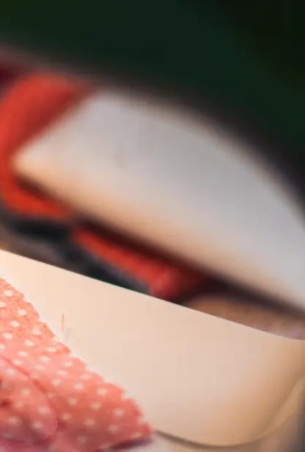
Takeaway
This task feels simple in the real world because a seam already tells us which material belongs on each side. Photoshop breaks that intuition by separating visible RGB from exported alpha. Alpha Splice restores the right abstraction: draw and revises the region freely, and let the system route RGBA for every pixel, every time.
Thank you
Questions?
Alpha Splice · HCI framing: restore the correct abstraction
Notes:
To summarize, this task feels simple in the real world because a seam already carries the right mental model.
One side belongs to one material. The other side belongs to another material. The visible pattern and the material data stay together.
Photoshop breaks that intuition by separating visible RGB from exported alpha.
Alpha Splice restores the right abstraction.
The user draws and revises the region freely, and the system routes RGBA for every pixel, every time.
So the contribution is not only reducing the number of steps. It is turning an implementation-heavy workflow back into a direct manipulation task — one that supports exploration, not just execution.

