Slide 1
LABVIEW project
The inverted pendulum stabilized by a flywheel,
under-actuated non-linear system

Slide 2
prepared by
Chihi Ines
Abbes Sonia
Abid Slim
Nagazi Eya
IIA4

Slide 3
Motivation goals: GymnasRobots

Slide 4
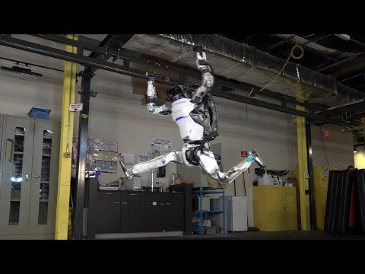

Slide 5
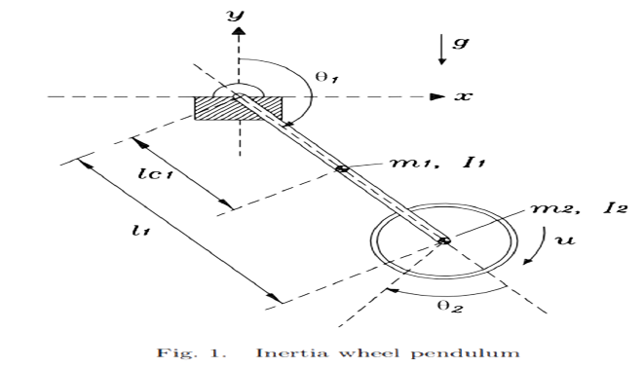
The Benchmark

Slide 6
Dynamic parameters
Notation | Description | Unit
L1 | Pendulum length | cm
Lc1 | the distance between the gravity center and the rotation axis | cm
m1 | Pendulum mass | Kg
m2 | Wheel mass | Kg
I1 | Pendulum Inertia | Kg.m²
I2 | Wheel Inertia | Kg.m²
g | gravity acceleration | m/s²

Slide 7
Dynamic Variables
Notation | Description | Unit
θ1 | Pendulum angular position | rad
θ2 | Wheel angular position | rad
(θ1) ̇ | Pendulum angular velocity | rad/s
(θ2) ̇ | Wheel angular velocity | rad/s
(θ1) ̈ | Pendulum angular acceleration | rad/s²
(θ2) ̈ | Wheel angular acceleration | rad/s²
u | Motor torque | Nm

Slide 8
Modelling hypotheses
Hypothesis 1: The masses of the pendulum and the inertia wheel are considered to be point masses located at their center gravity
Hypothesis 2: the friction mechanical phenomenal will be neglected
Hypothesis 3: The dynamics of the actuator motor associated with the wheel is not taken into account in the modelling of the system

Slide 9
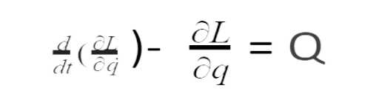

Theories
Lagrangian field theory:
Q =0 1 .u,
q= (θ1 θ2) ^{T}
L=K-V
M=(m11,m12,m21,m22)
m11=m1.lc12+m2l12+I1+I2 m12=m21=m22

Slide 10



Slide 11
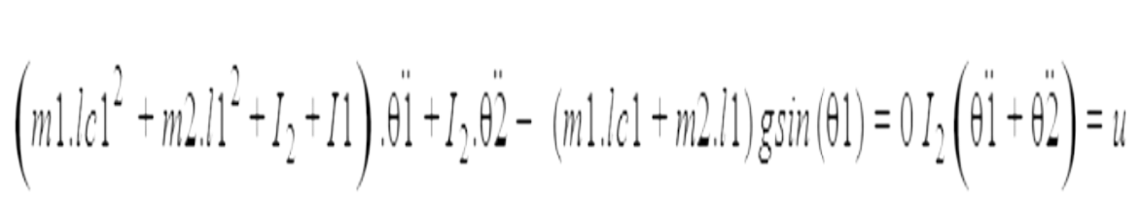
The dynamic model

Slide 12
Stabilisation
PID:
P:The proportional component depends only on the difference between the set point and the process variable.
I:The integral response will continually increase over time unless the error is zero
D:The derivative component causes the output to decrease if the process variable is increasing rapidly
LQR: Linear quadratic regulator is based on Riccati equations .Minimizing quadratic cost function with properly matched weights is the aim of the controller
target_voltage = a*p_angle + b*p_vel + c*m_vel
a,b and c are weights
pendulum angle - p_angle
pendulum velocity - p_vel
motor velocity - m_vel

Slide 13
Model Conception

Slide 14
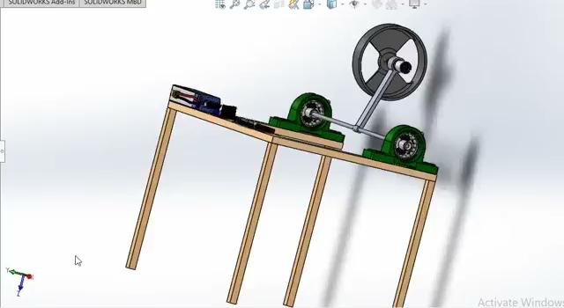

Slide 15
Flowchart

Slide 16
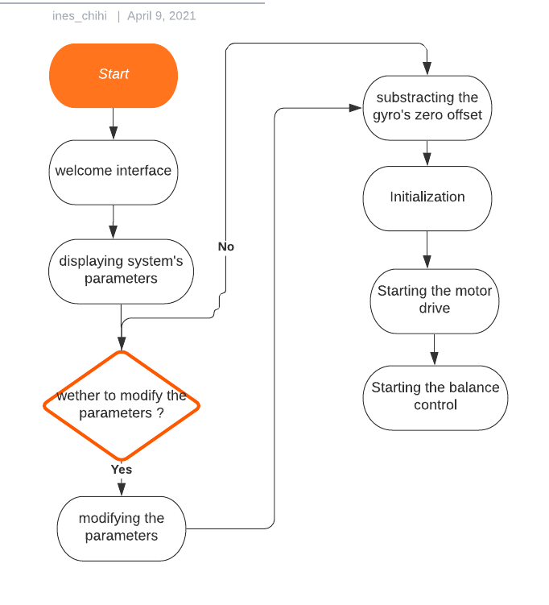

Slide 17
Front Panel

Slide 18
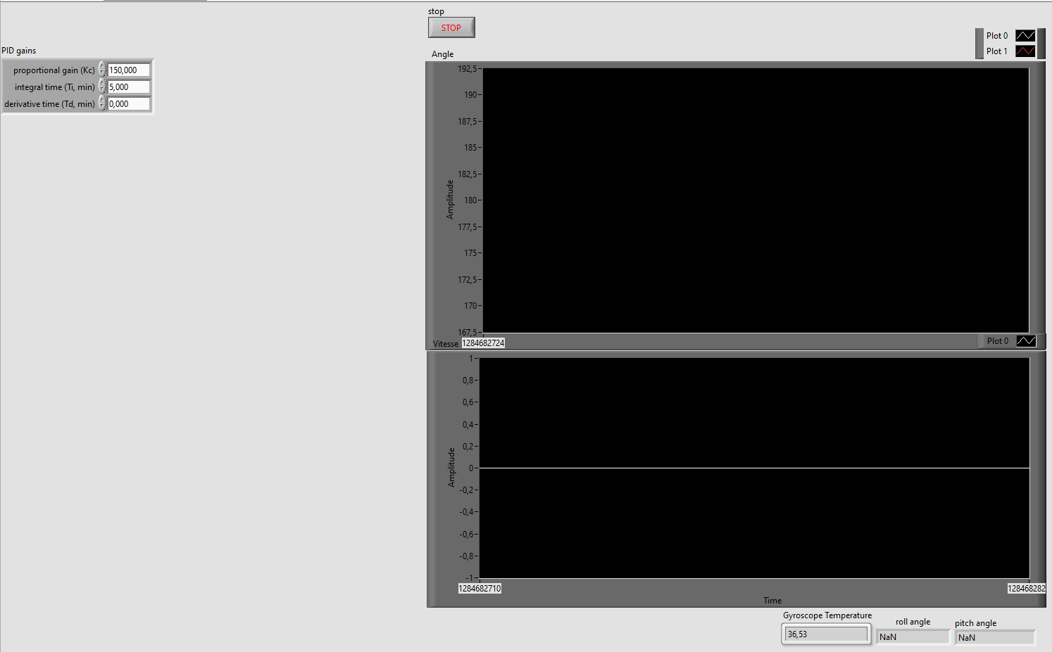

Slide 19
Block diagram

Slide 20
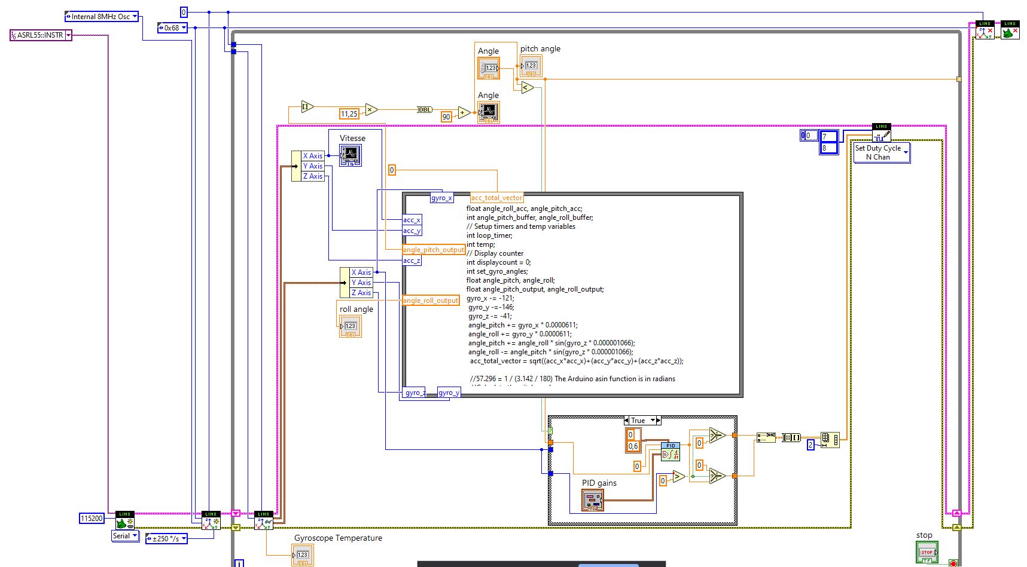

Slide 21
Communication technology
Bluetooth: It is an unwired method that use bluetooth module to ensure the communication between the labview and the model
=> No real time results, Problem of latency
Serial: It is a wired method that uses a cable to communicate the software with the model

Slide 22
Real time test

