Slide 1


Password Strength Checker
IT360
Amira Azouz Iheb Zitouni Ines Afli

Slide 2
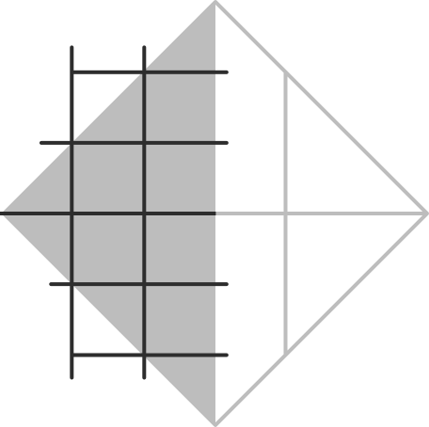

Outline
password strength checker techniques
Main existing solutions
Advantages
Disadvantages
1

Slide 3
Password strength checker techniques
Password Length: The number of characters in a password is often used as an indicator of its strength. Longer passwords are generally considered stronger.
Dictionary Attacks: Dictionary attacks involve trying a list of common words and phrases as potential passwords. Password strength testers may check if a password contains any common words or phrases.
Password Complexity: Password complexity is a measure of the diversity of characters used in a password. Passwords that contain a combination of letters, numbers, and special characters are generally considered more complex.
2

Slide 4
Password strength checker techniques
Passphrases: Some password strength testers encourage the use of passphrases, which are longer phrases that can be easier to remember than complex passwords. Passphrases can have higher entropy than shorter passwords.
Two-Factor Authentication: Password strength testers may also encourage the use of two-factor authentication, which requires an additional code or factor (such as a fingerprint or security key) to access an account.
Brute Force Resistance: Brute force resistance is a measure of how difficult it is to guess a password using a brute force attack. Passwords that resist brute force attacks are considered stronger.
3

Slide 5
Password strength checker techniques
Dictionary Usage: Attackers may use dictionaries of common passwords to guess passwords. Passwords that are not in these dictionaries are considered stronger.
Easy Memorization: Passwords that are easily memorizable by the user but difficult to guess by attackers are considered stronger.
Entropy: Password strength is often measured in terms of entropy, which refers to the randomness and unpredictability of the password. The higher the entropy, the stronger the password.
4

Slide 6
The main existing solutions:
Security.org:
This is a free online tool that allows you to test the strength of your password. You simply enter your password into the input field and the tool will give you an estimate of how long it would take for a computer to crack it using various types of attacks. The tool also provides feedback on the strength of your password and suggestions for how to improve it.
5

Slide 7

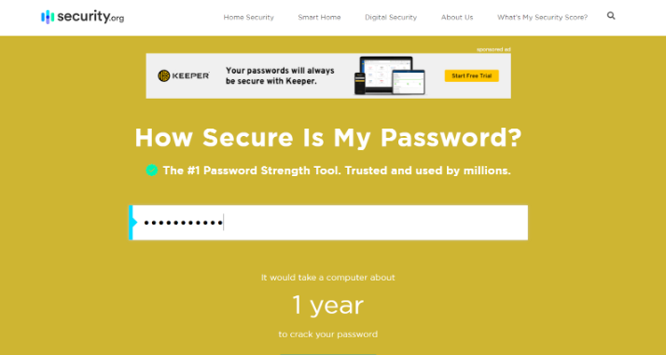

Security.org
6

Slide 8
The main existing solutions:
LastPass:
this is a popular paid password manager that includes a password strength tester. This tool runs locally. No data is sent over the internet. This tool is for personal testing purposes only. On the Password Security page, all at-risk passwords are displayed.If desired, you can use the "Filter by" option in the upper right to display only weak, reused, or missing passwords.
7

Slide 9
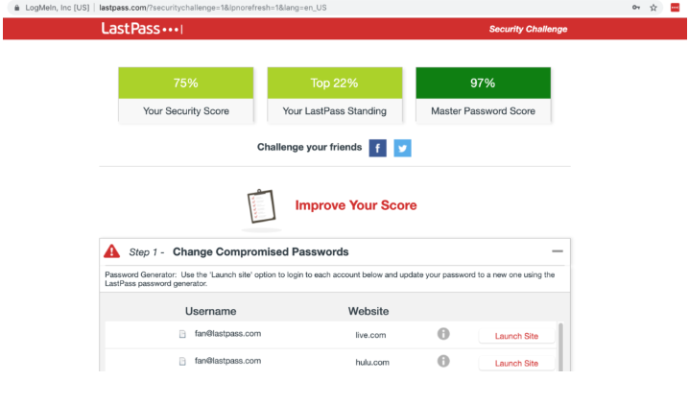
LastPass
8

Slide 10
The main existing solutions:
Google Password Manager:
includes a password strength tester that evaluates password length, complexity, and uniqueness. The strength tester also provides feedback on password reuse and encourages the use of two-factor authentication. However, Google Password Manager may not be accessible to users who prefer not to use Google products.
9

Slide 11
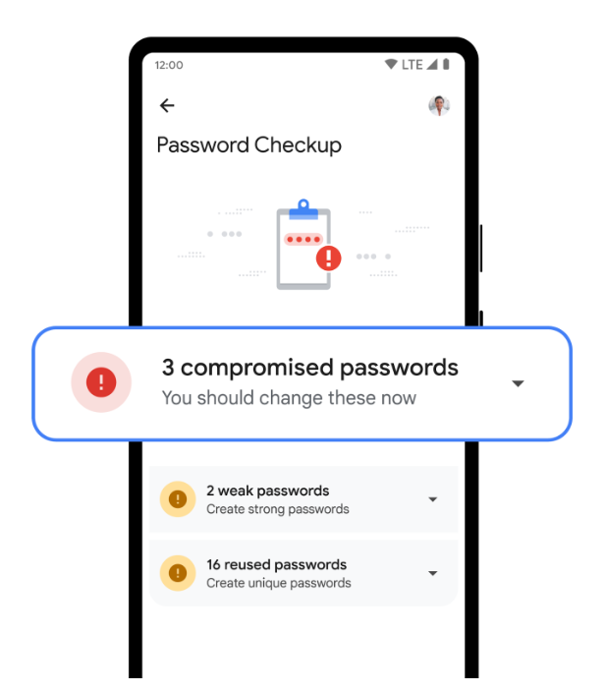
Google password manager
10

Slide 12
The main existing solutions:
The Password Meter:
The Password Meter is a web-based tool that uses an algorithm to evaluate the strength of a password based on various criteria, including length, character types, and dictionary words. It provides a score between 0 and 100, along with feedback on how to improve the password.
Kaspersky Password Checker:
It's very secure, easy to use, and provides excellent value. It keeps user data secure with standard security features like 256-bit AES encryption, a zero-knowledge policy, and multiple 2FA options.
11

Slide 13
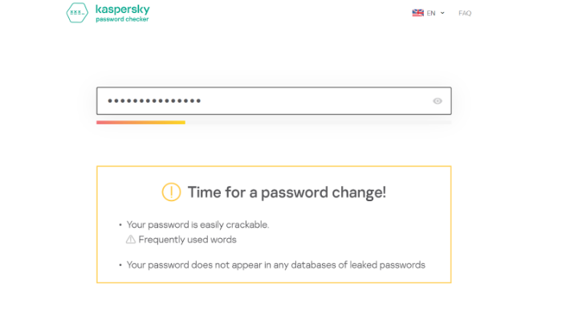
Kaspersky
12

Slide 14
The main existing solutions:
Norton Password Manager:
This is a password manager that includes a password strength tester. It evaluates password length, complexity, and uniqueness, and provides a password generator that can create strong, randomized passwords. It securely stores passwords, auto-fills them for users when they need to log in, and syncs across multiple devices.
13

Slide 15
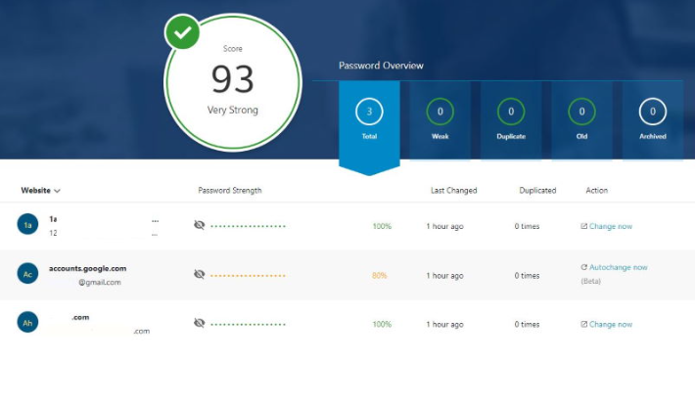
Norton
14

Slide 16
Advantages:
Provide a quick, free, and easy way to evaluate the strength of a password and is accessible from any device with internet access.
Give suggestions for improving the password's strength.
Provide an estimate of how long it would take for a computer to crack the password.
Provide a quick and easy way to evaluate the strength of a password.
Give suggestions for improving the password's strength.
Provides an estimate of how long it would take for a computer to crack the password.
User-friendly, easy to set up, and offer strong security features.
15

Slide 17
Limitations:
Don't provide a detailed breakdown of the password's strength.
May not account for all types of attacks or vulnerabilities.
May not consider whether the password has already been exposed in a data breach.
The algorithm may not be as robust as it should be, and the recommendations may not always be accurate or relevant to the specific user's needs.
May not be accessible to all users. Additionally, some users may not be comfortable with relying on a third-party service to test and store their passwords.
16

