Slide 1


_ F E A 2

Slide 2
Updates
Base Structure and API

Slide 3
Updates
Base Structure and API
Compas_fea2
backends
interfaces
postprocess
WIP
preprocess
utilities

Slide 4
Updates
Base Structure and API
Compas_fea2
backends
abaqus
interfaces
ansys
postprocess
opensees
WIP
preprocess
...
utilities

Slide 5
Updates
Base Structure and API
Compas_fea2
backends
abaqus
model
interfaces
ansys
problem
postprocess
opensees
job
preprocess
...
utilities

Slide 6
Updates
Base Structure and API
Compas_fea2
backends
abaqus
model
constraints
interfaces
ansys
problem
elements
postprocess
opensees
job
interactions
preprocess
...
materials
utilities
model
nodes
parts
sections
sets

Slide 7
Updates
Base Structure and API
Compas_fea2
backends
abaqus
model
bcs
interfaces
ansys
problem
loads
postprocess
opensees
job
outputs
preprocess
...
problem
utilities
step

Slide 8
Updates
Base Structure and API
Compas_fea2
backends
abaqus
model
Input_file
interfaces
ansys
problem
send_job
postprocess
opensees
job
read_results
WIP
preprocess
...
utilities

Slide 9
Compas_fea2
backends
abaqus
model
bcs
interfaces
ansys
problem
loads
postprocess
opensees
job
outputs
preprocess
...
problem
utilities
step

Slide 10
Installation

Slide 11
conda config --add channels conda-forge conda create -n fea2 python=3.7 compas --yes conda activate fea2
python

Slide 12
Python 3.7.6 | packaged by conda-forge | (default, Jul 2 2019, 02:07:37)
[GCC 4.2.1 Compatible Clang 4.0.1 (tags/RELEASE_401/final)] on darwin
Type "help", "copyright", "credits" or "license" for more information.
>>>

Slide 13
>>> import compas
>>> compas.__version__
‘0.16.1'
>>>

Slide 14
>>> import compas
>>> compas.__version__
‘0.16.2'
>>> exit()

Slide 15
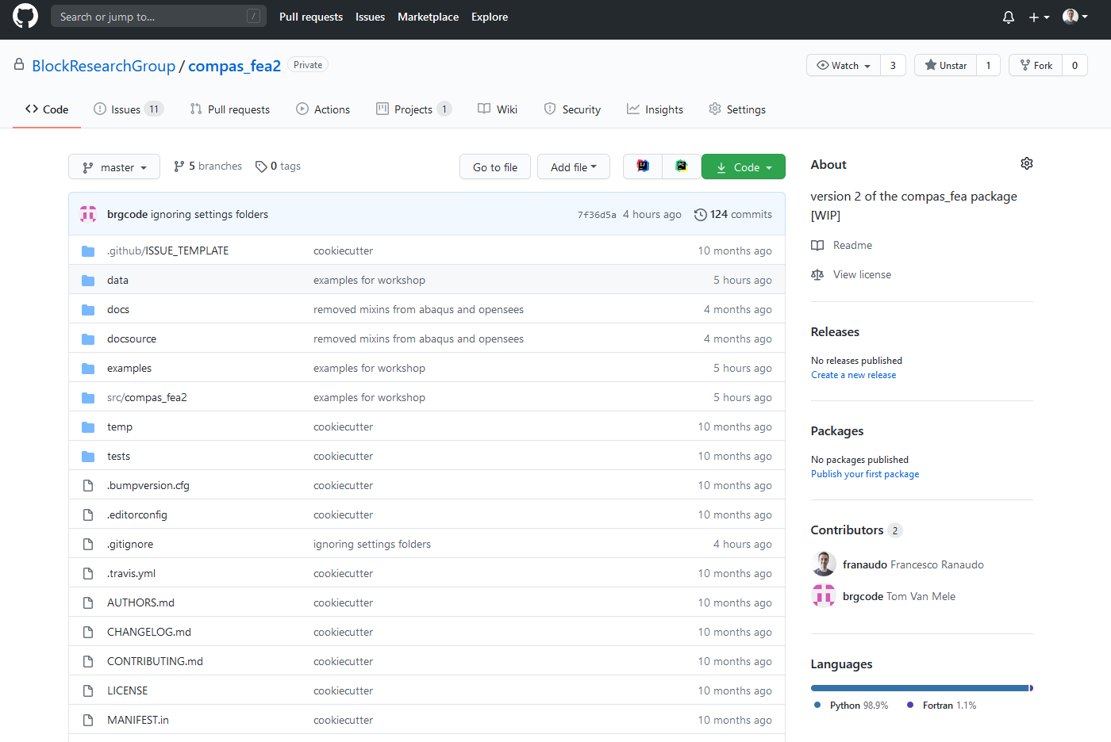
Installation
compas_fea2
https://github.com/BlockResearchGroup/compas_fea2

Slide 16
git clone https://github.com/BlockResearchGroup/compas_fea2.git cd compass_fea2 pip install –e .

Slide 17
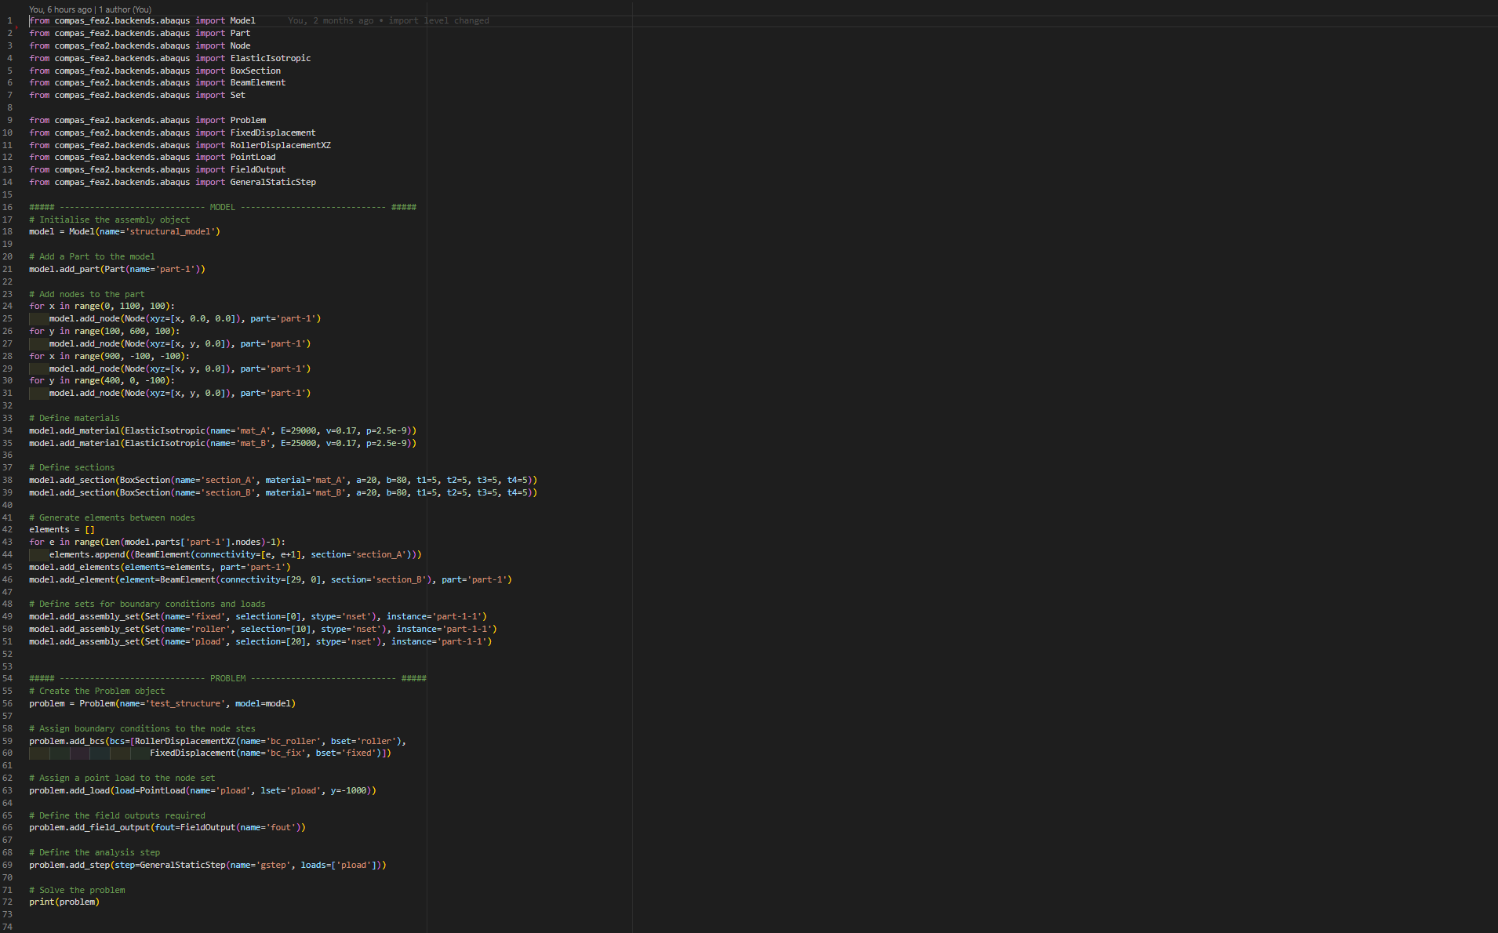
model imports

Slide 18
problem imports

Slide 19
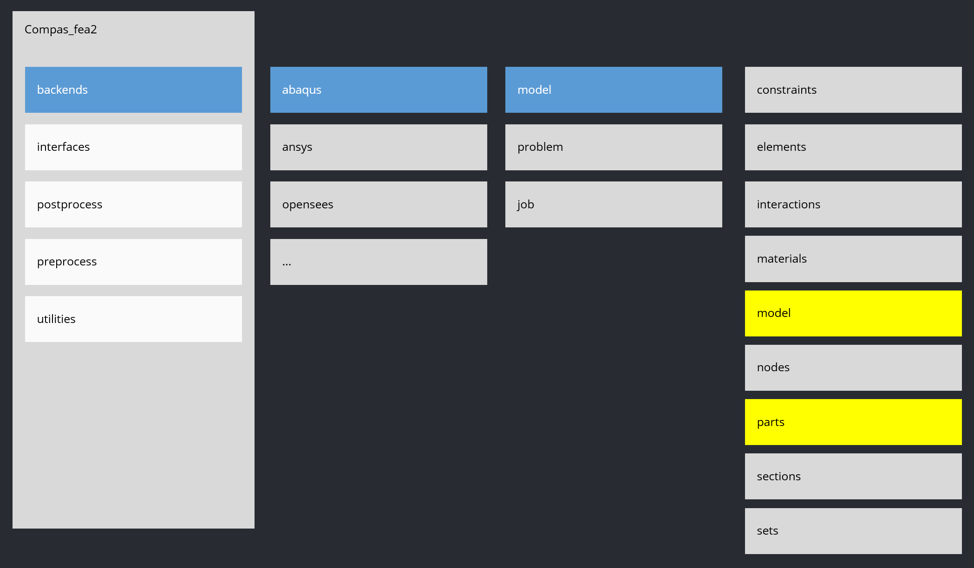
Initialize a model

Slide 20
create the geometry

Slide 21
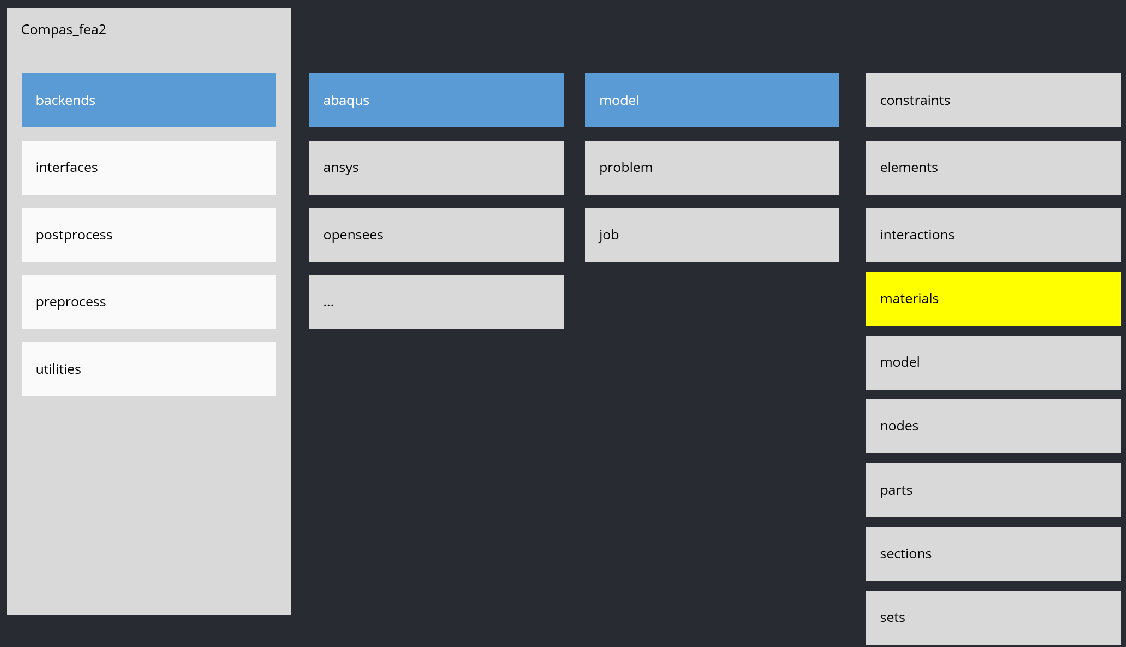
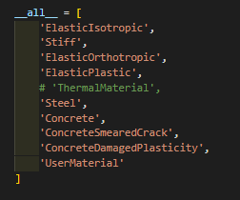
define materials

Slide 22
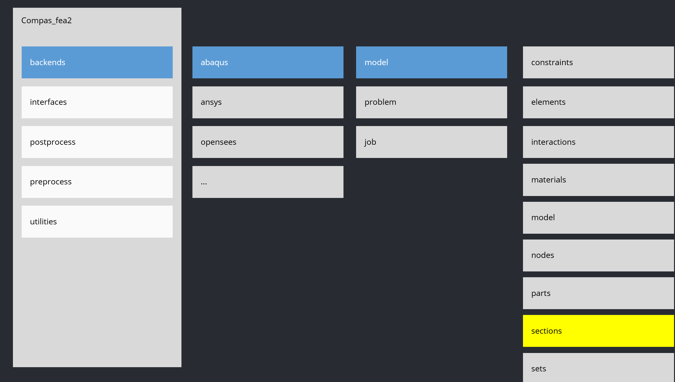
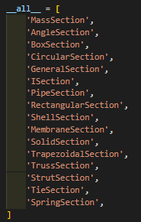
define sections

Slide 23
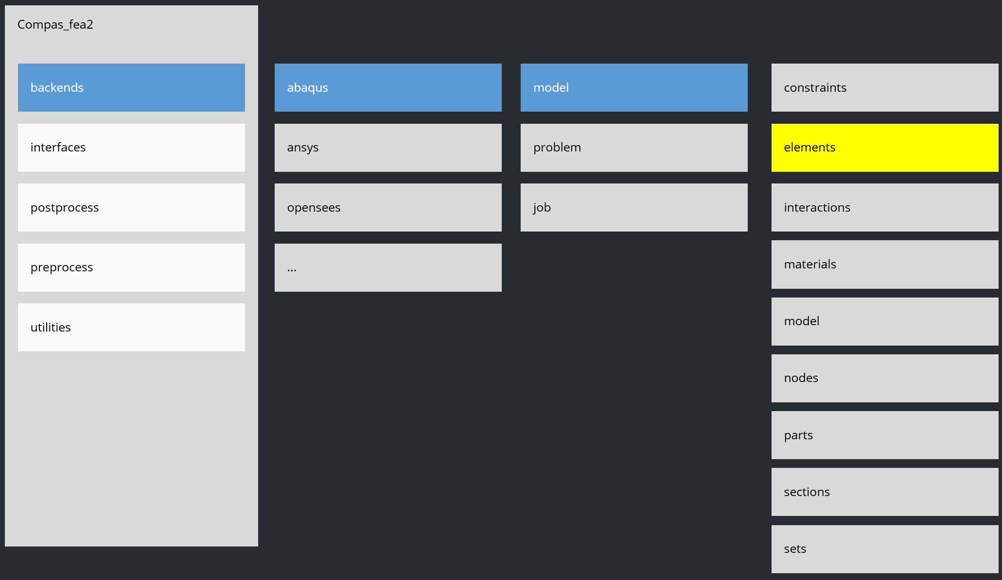
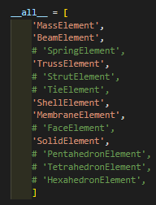
define elements

Slide 24
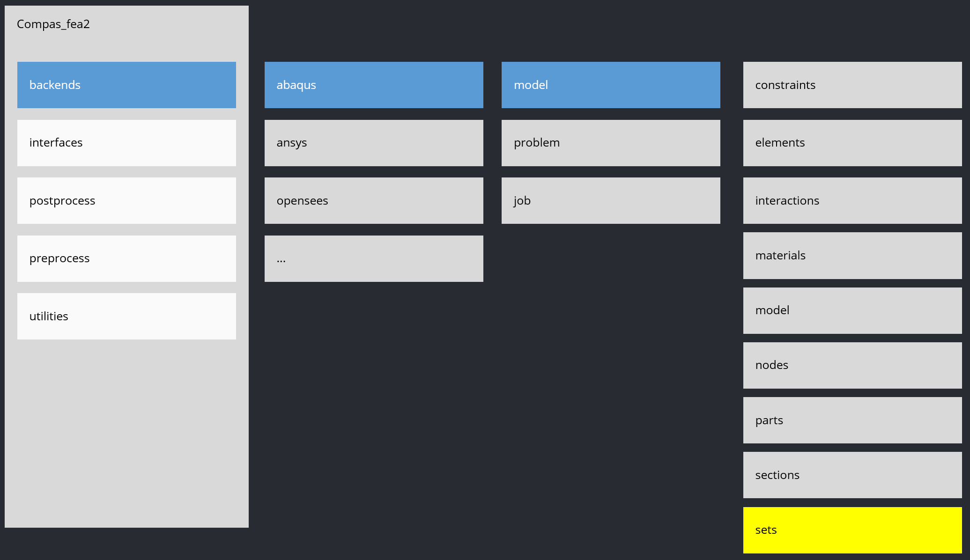
define sets

Slide 25
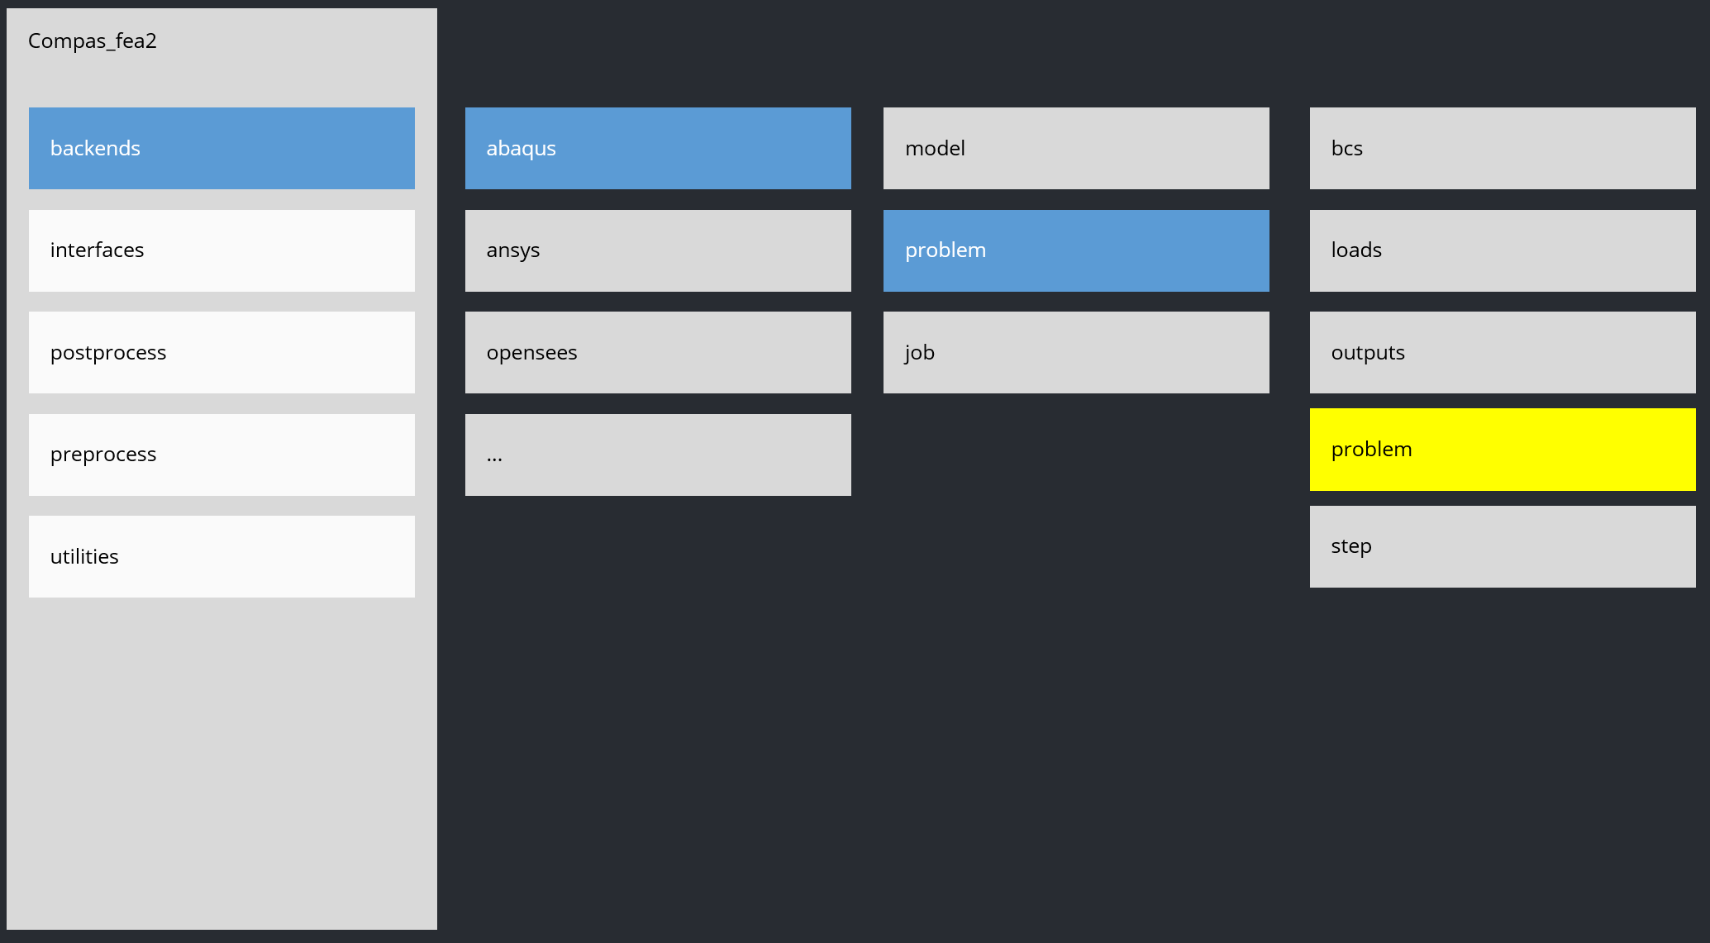
initialize Problem

Slide 26
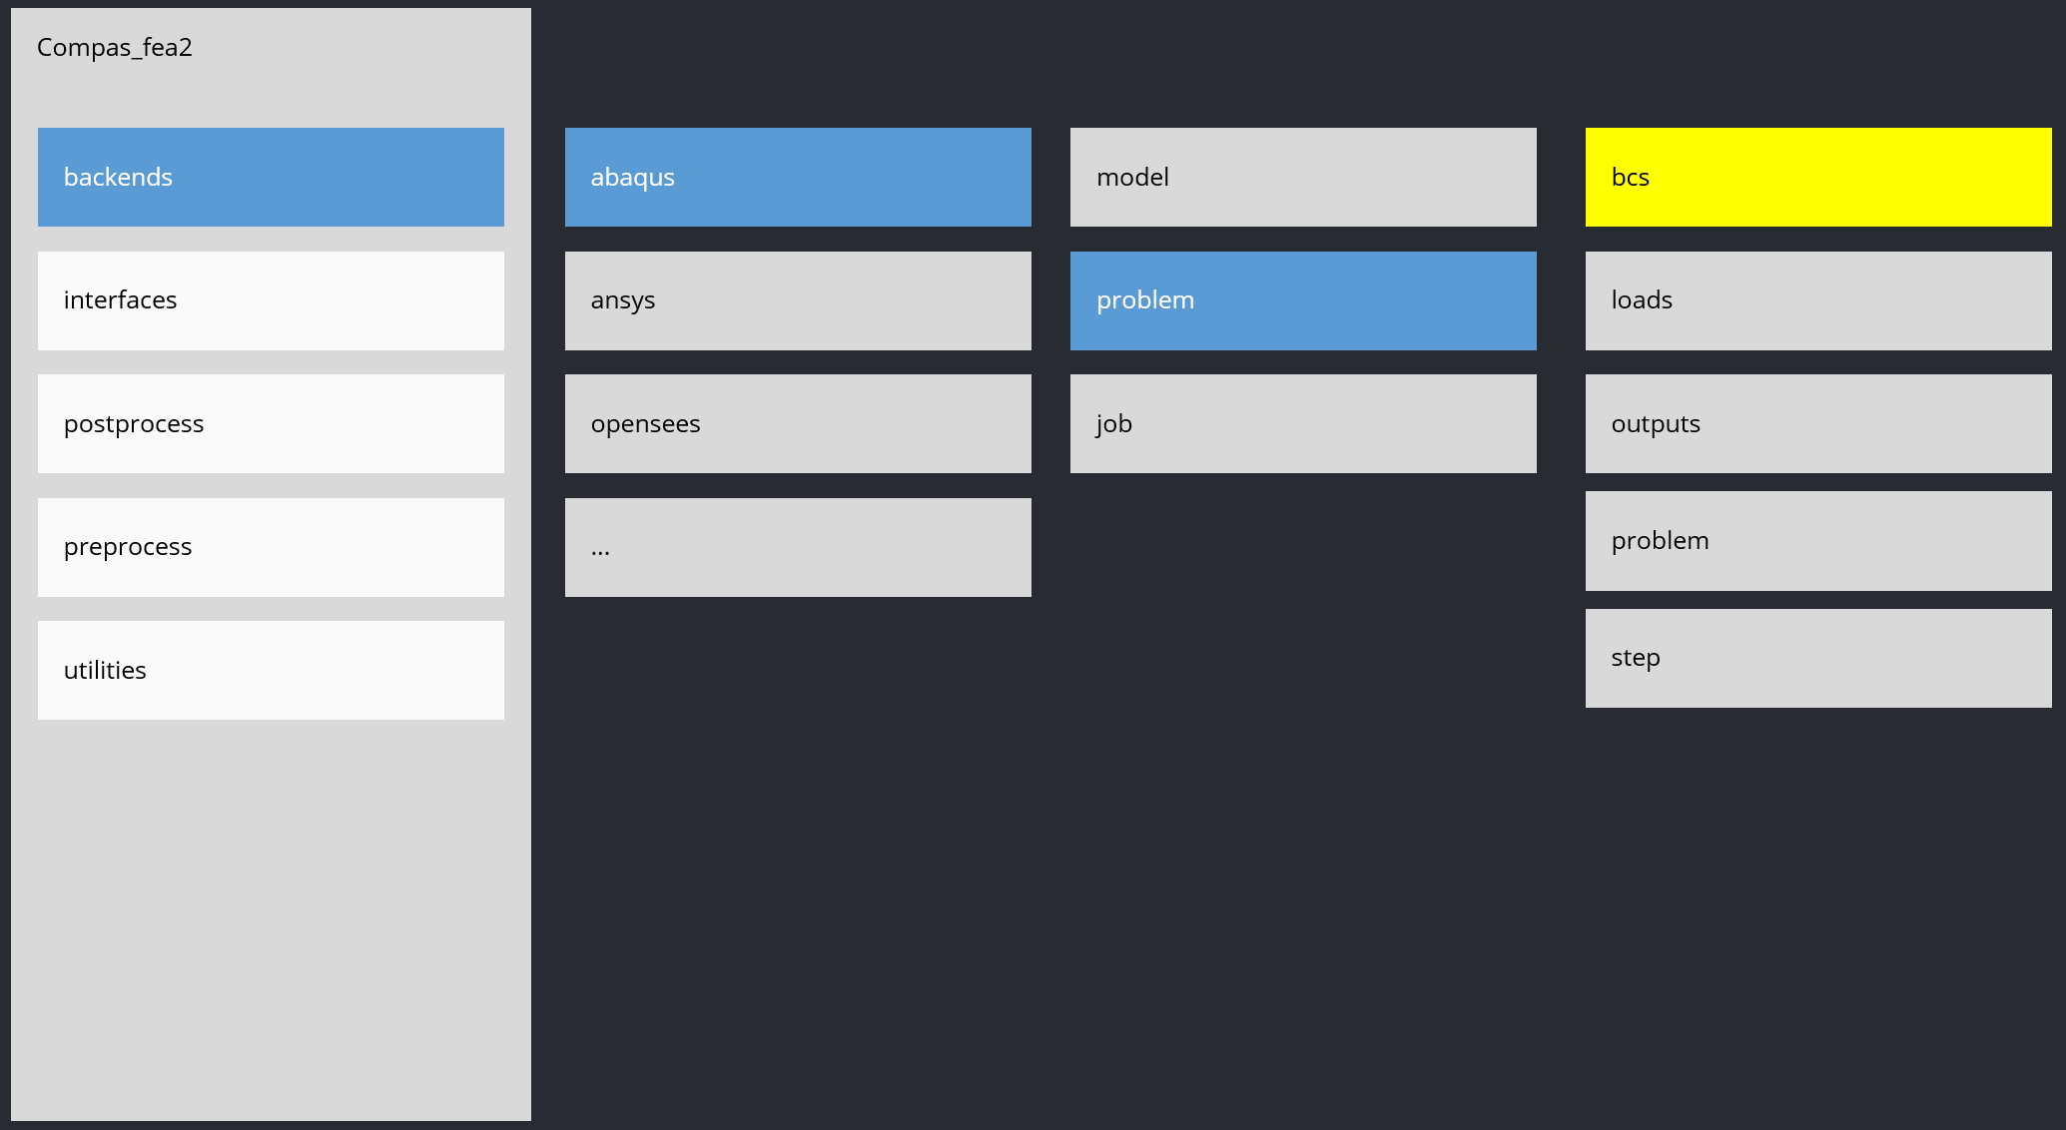
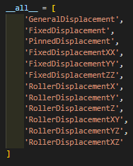
define bcs

Slide 27
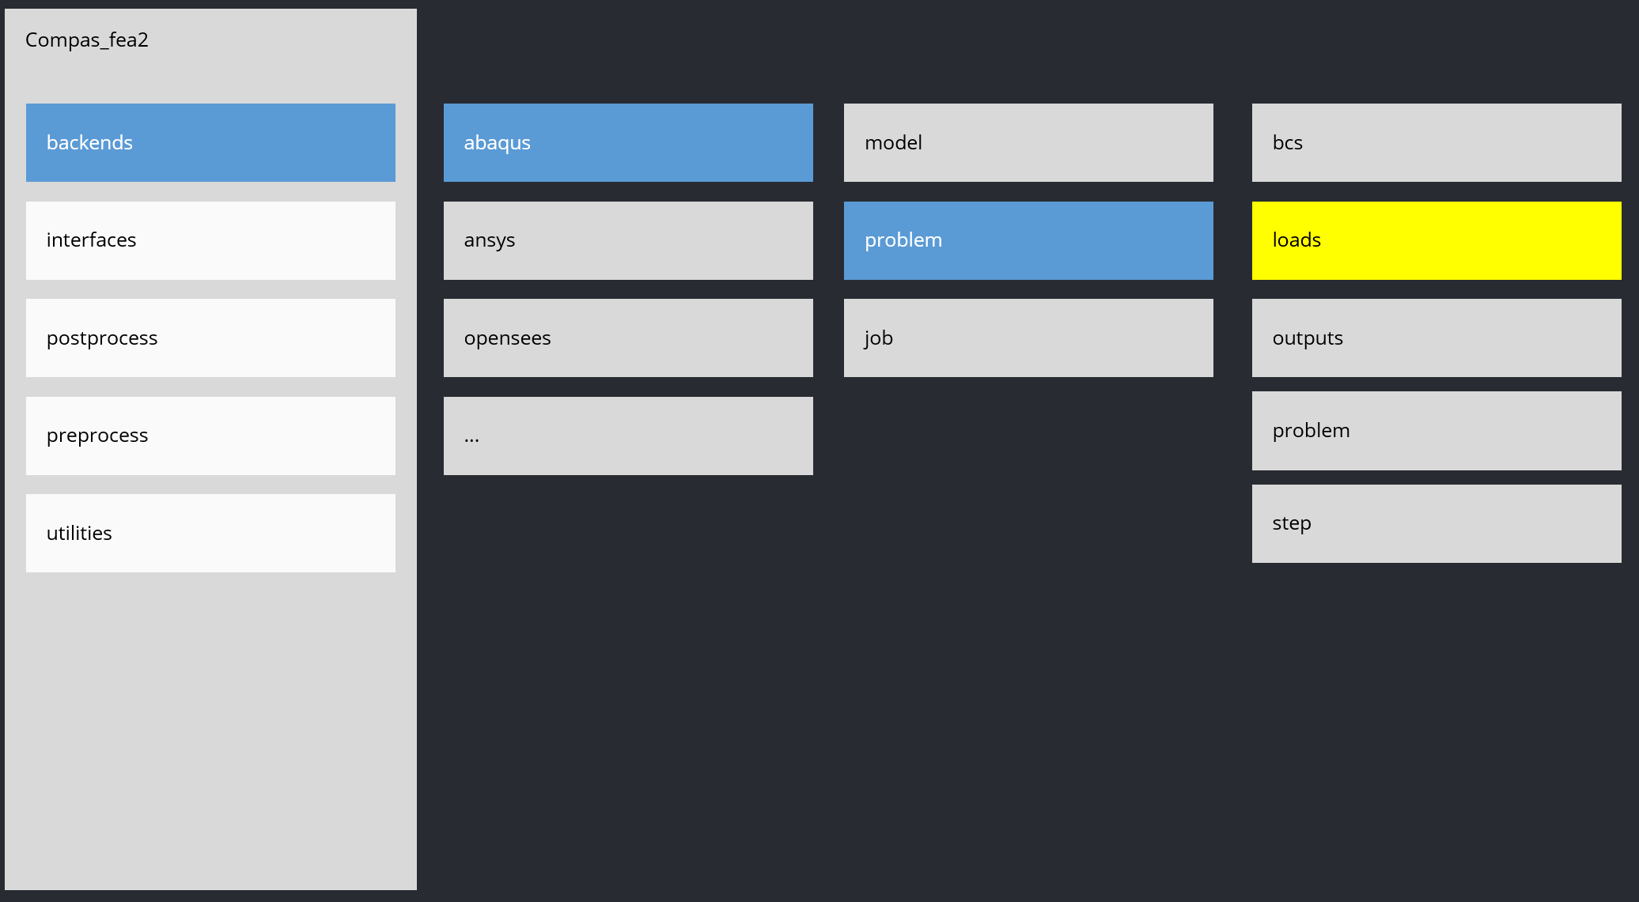
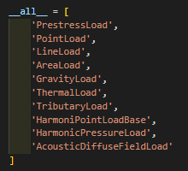
define loads

Slide 28
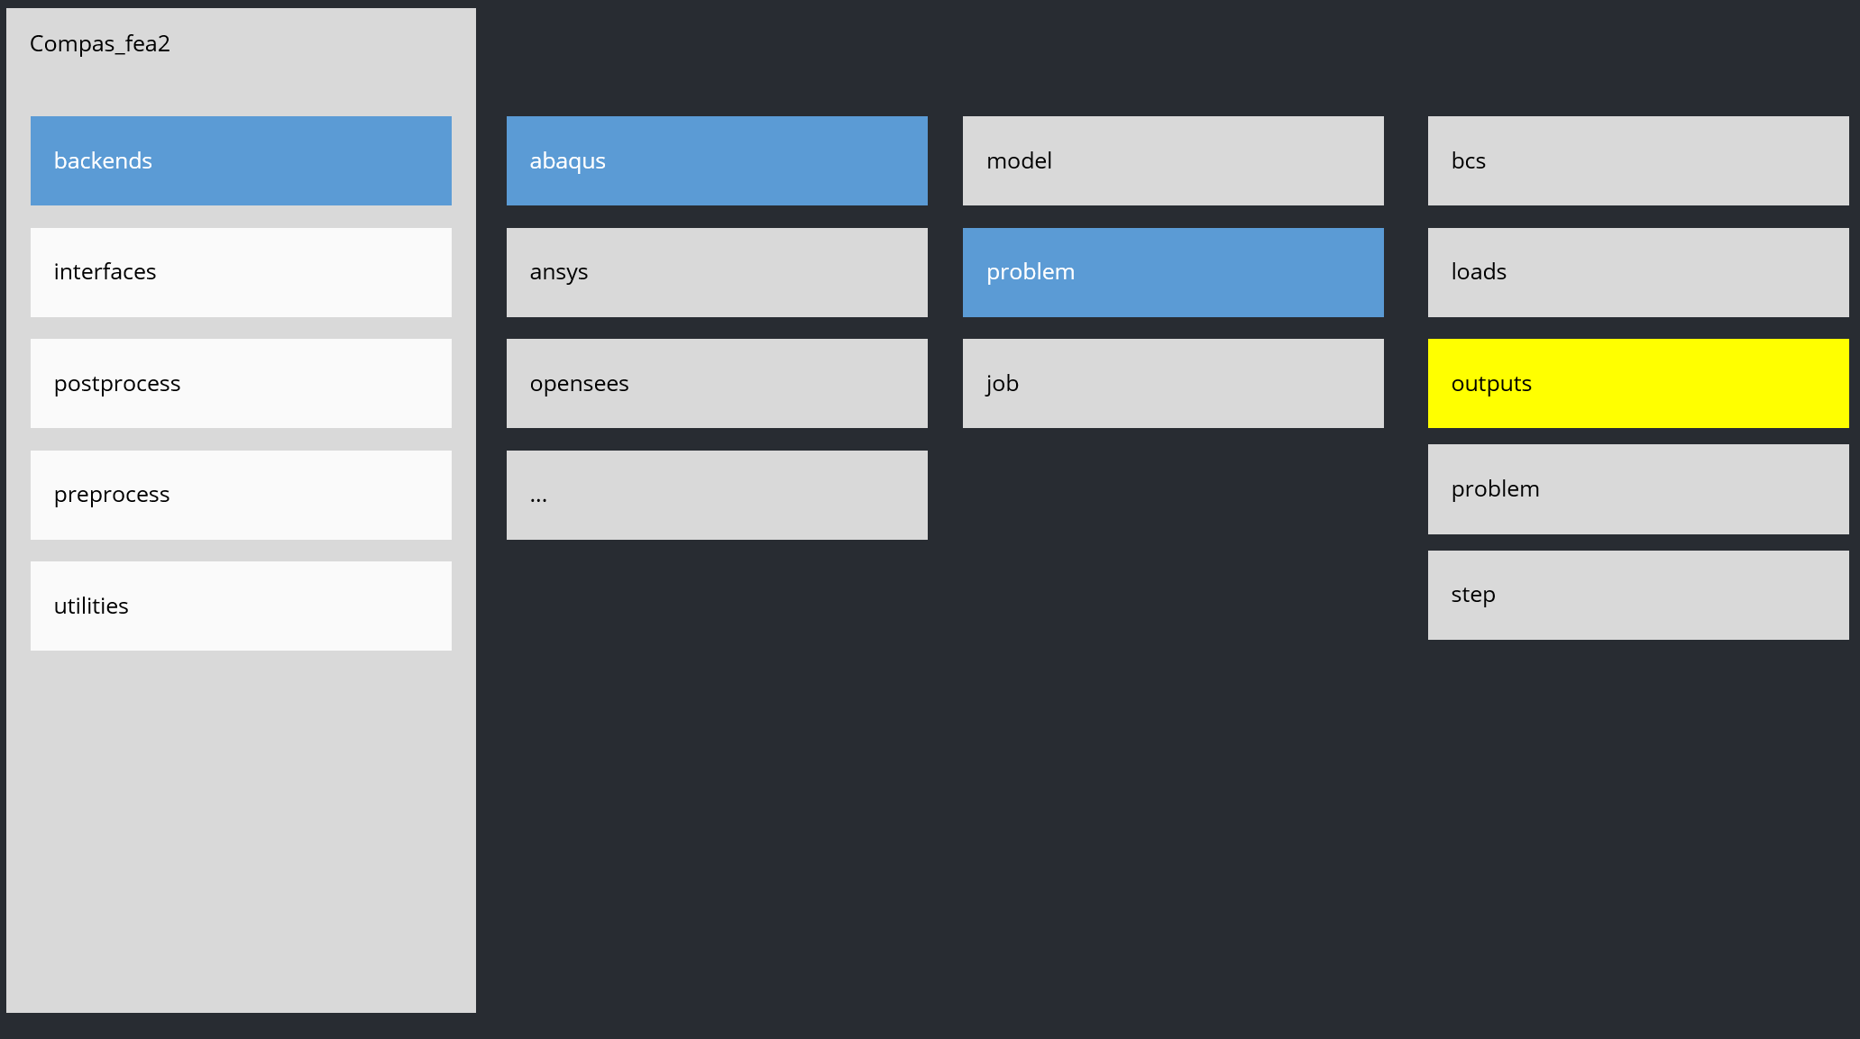
define 0utputs

Slide 29
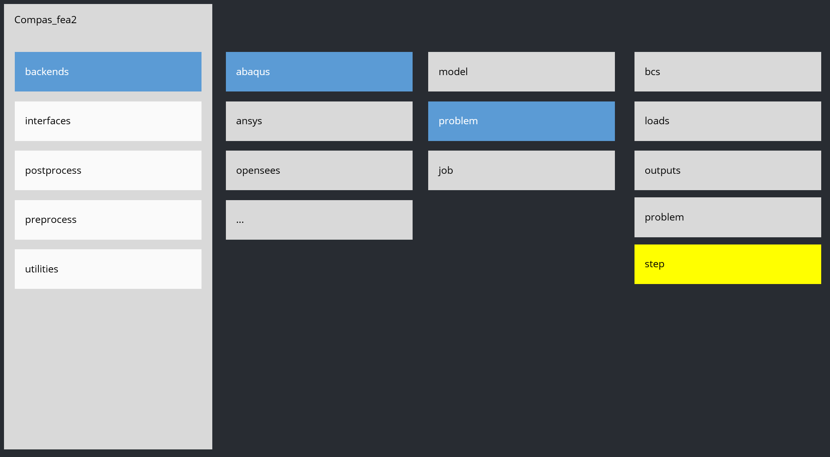
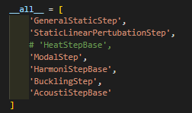
define steps

Slide 30
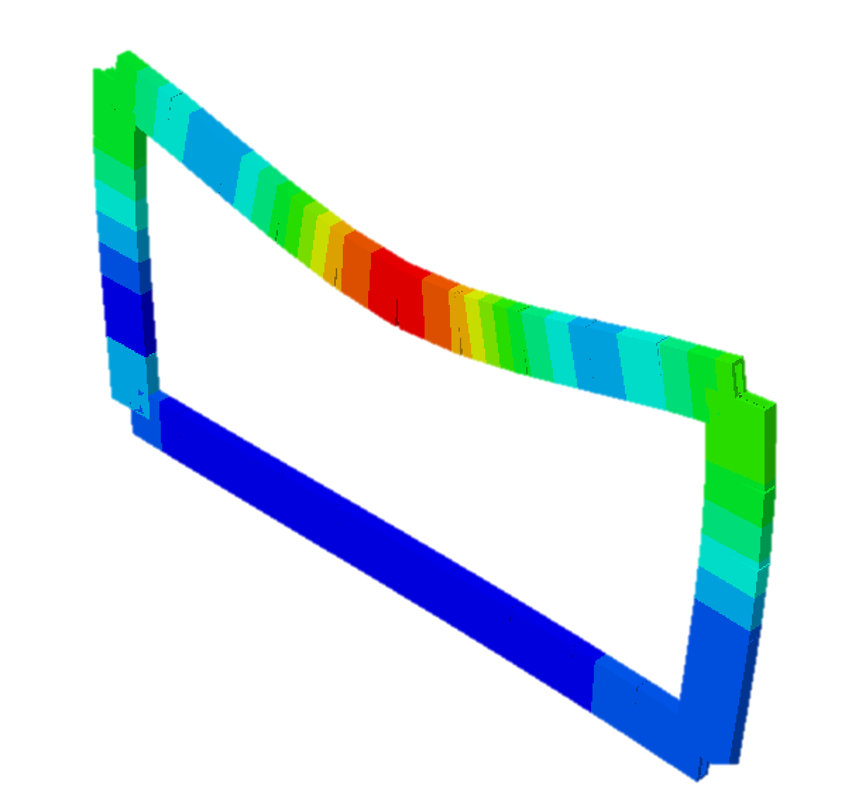
RUN!

Slide 31
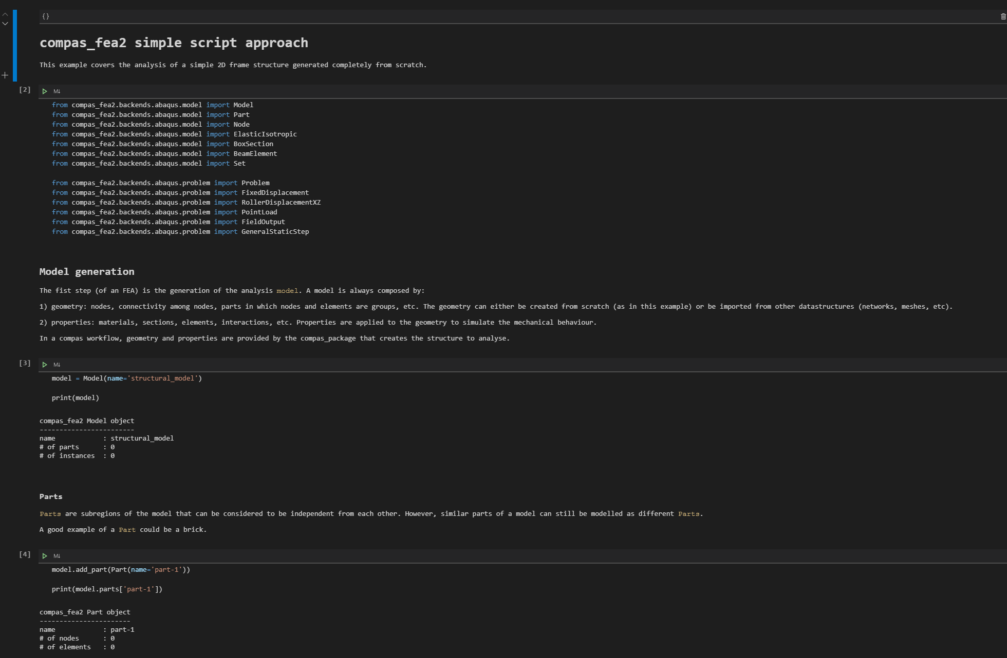
Examples
Interactive example

Slide 32
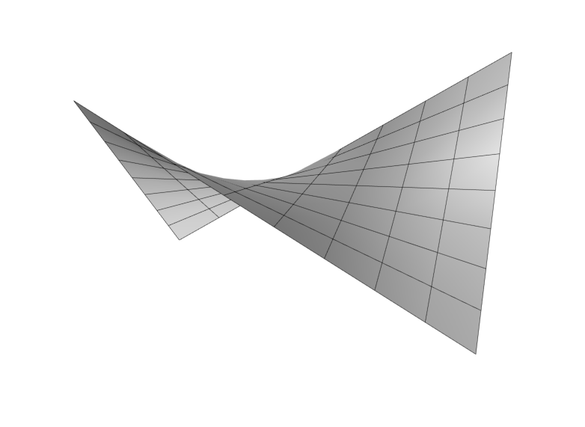
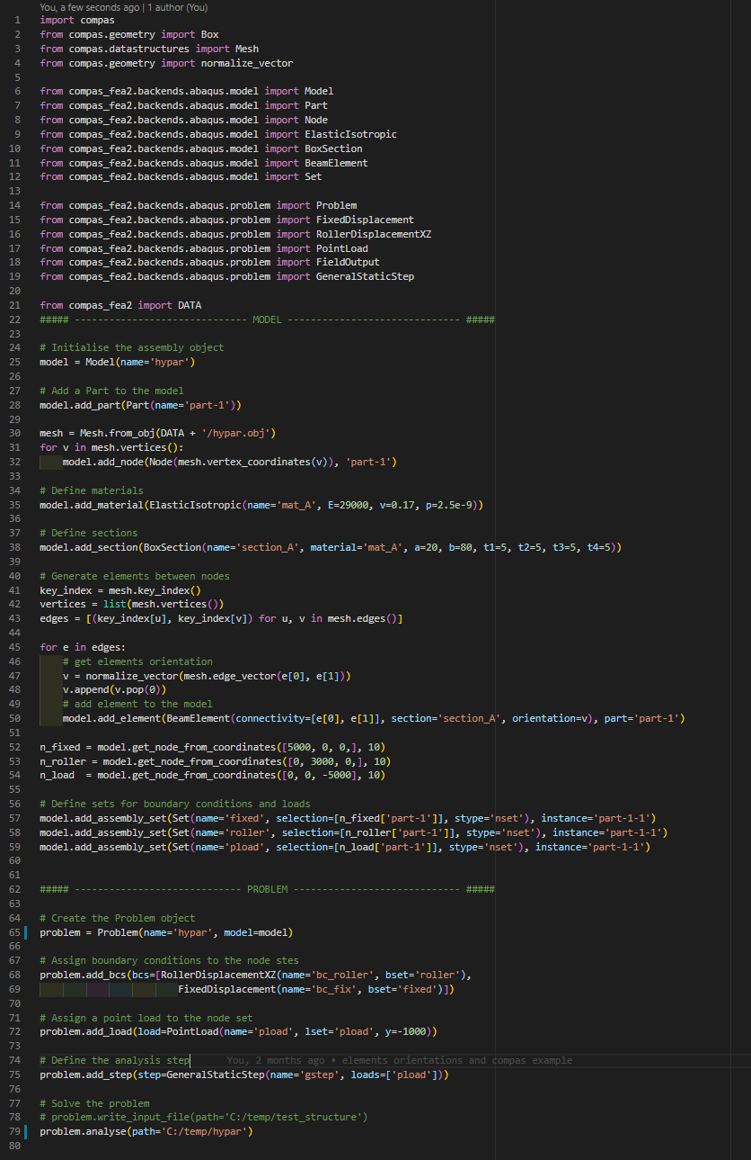
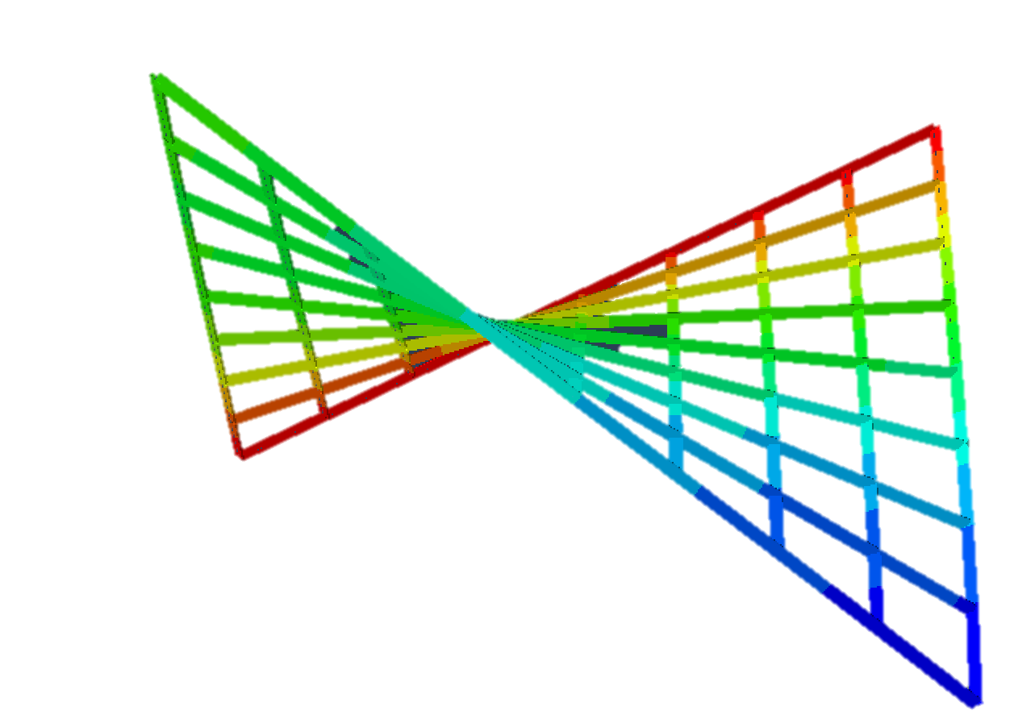
Examples
Complex geometry

Slide 33
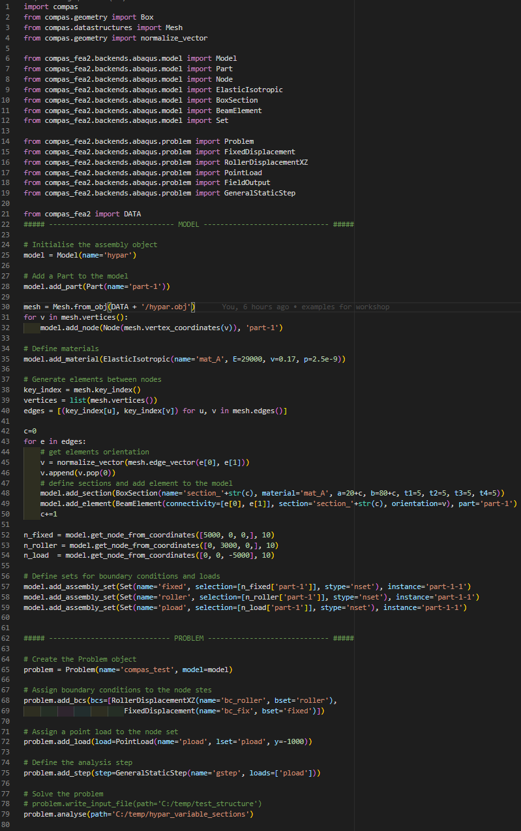
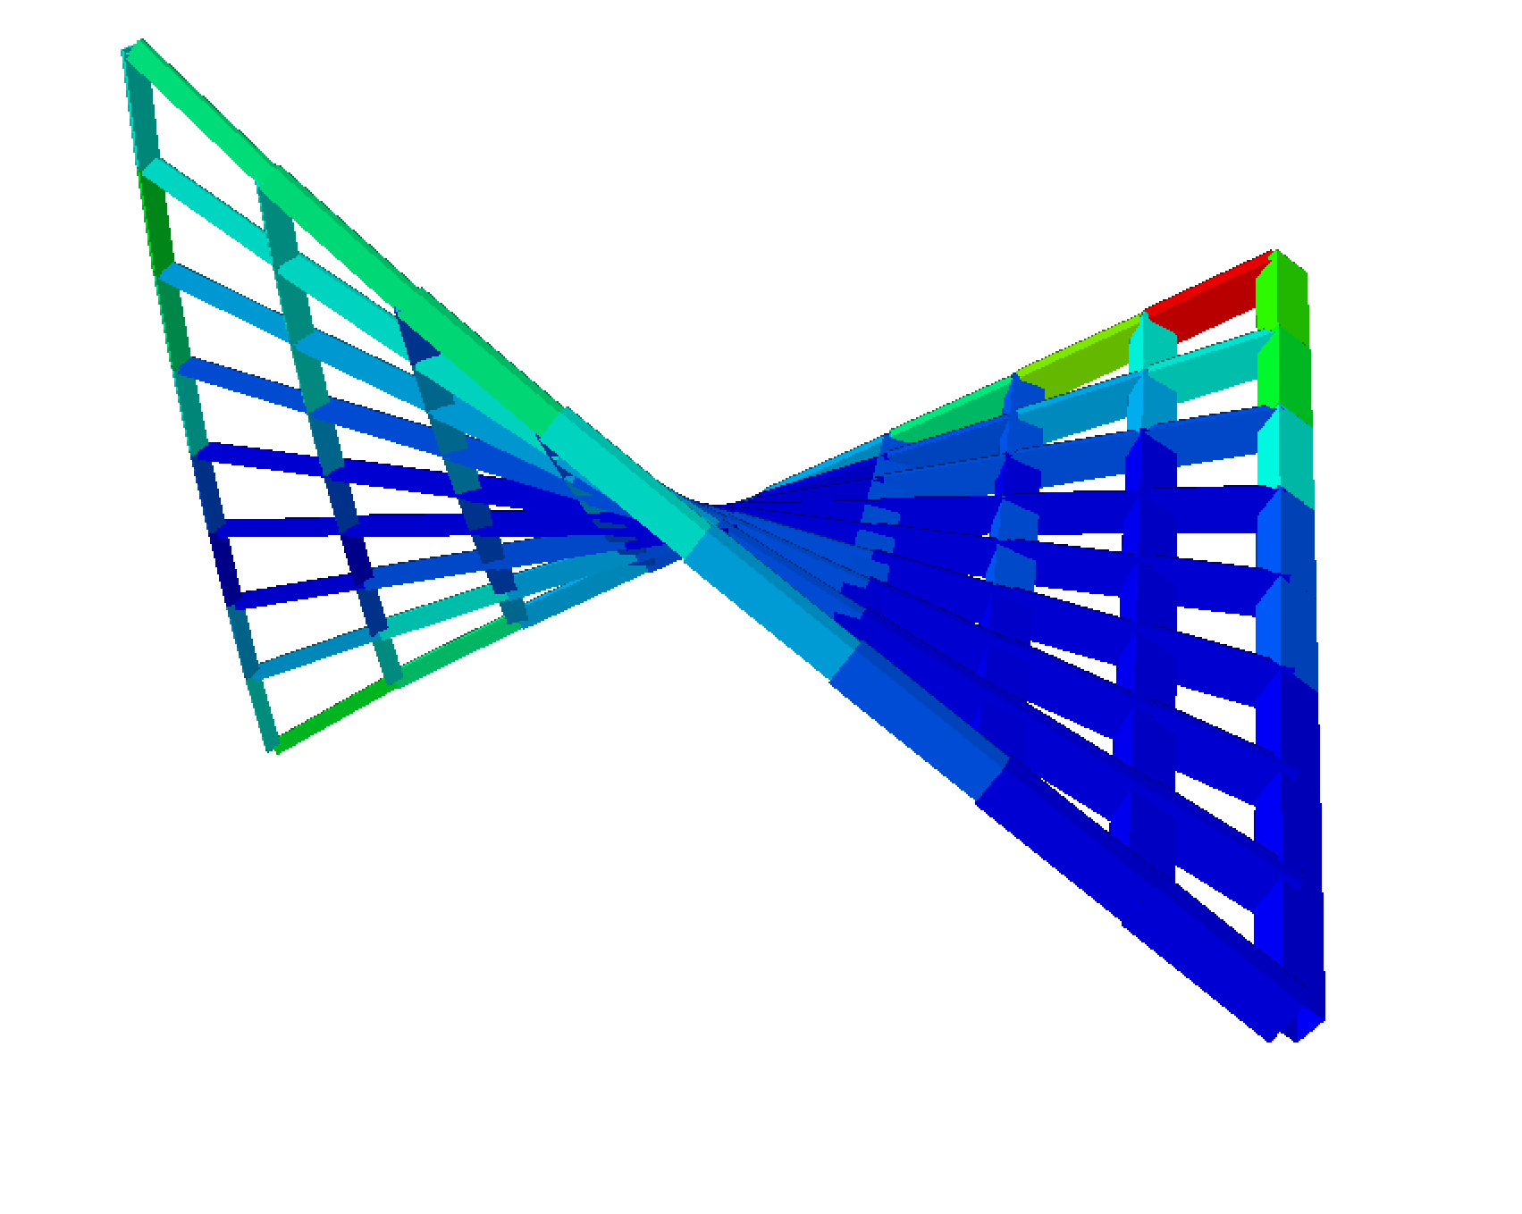
Examples
Complex geometry - parametric

Slide 34
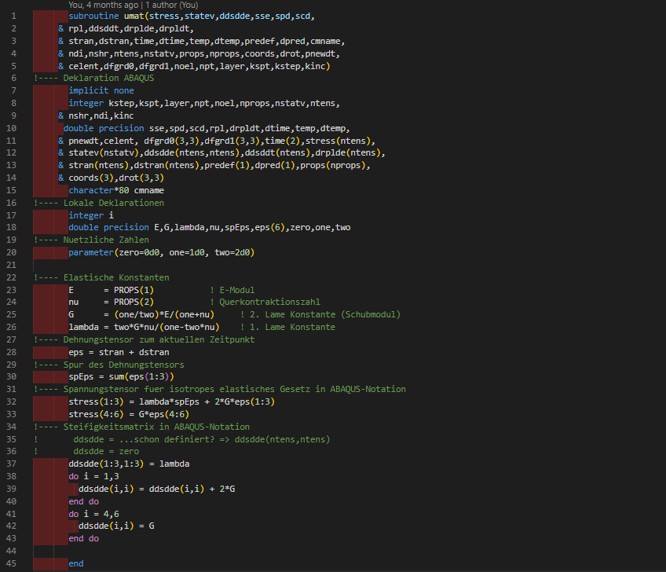
Examples
Complex geometry + user material

Slide 35
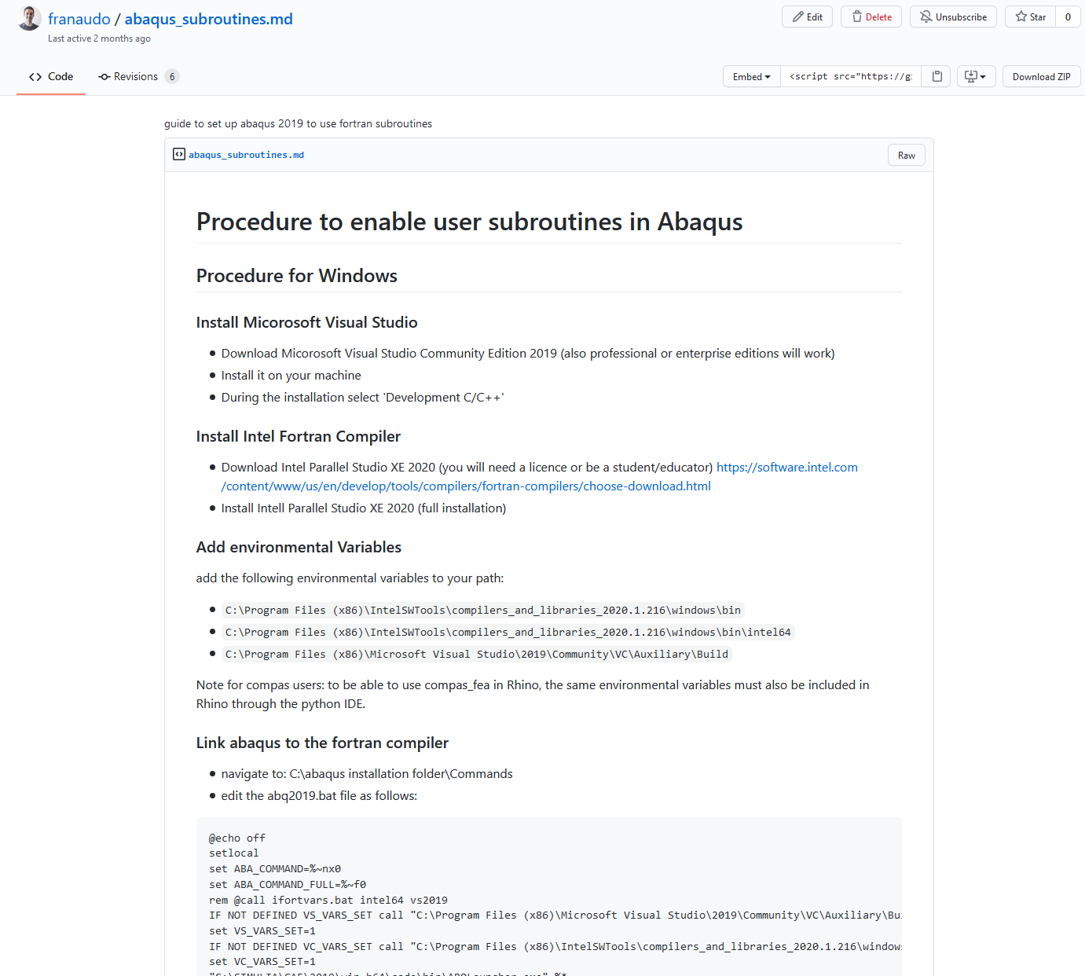

Examples
User Material in Abaqus
https://gist.github.com/franaudo/72362784ded685e4cb381e57020c9ec7

Slide 36
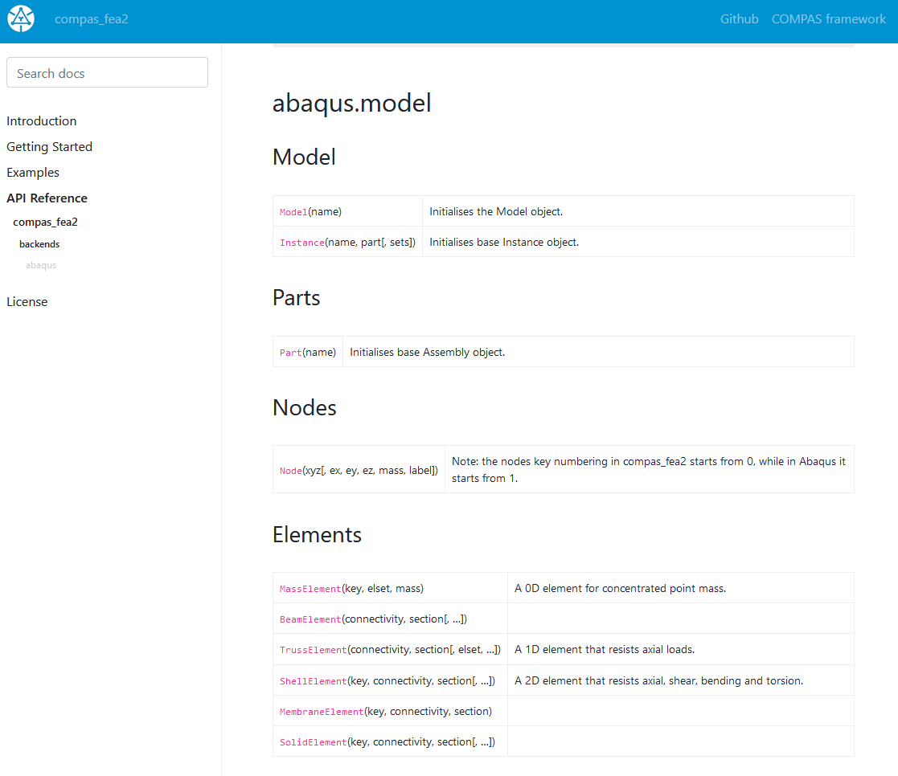
Next Steps
API Documentation

Slide 37




Thanks

Slide 38
That’s all folks!

