Slide 1


_ F E A 2

Slide 2
Updates
Timeline
Alpha Release
Beta Release
v1 Release
Base Structure and API
Base Structure + Abaqus
API
Ansys
Opensees
other
Interfaces
Rhino
Blender
Browser-based
Preprocess
Integration with COMPAS
User Materials integration
Post-process
‘Recipes’
Summer 2020
Autumn 2020
Winter 2020/21
Spring 2021

Slide 3

Updates
Timeline
Alpha Release
Beta Release
v1 Release
Base Structure and API
Base Structure + Abaqus
API
Ansys
Robin
Opensees
Aryan
other
Interfaces
Rhino
Juney
Blender
Browser-based
Li
Preprocess
Integration with COMPAS
Tom
User Materials integration
Post-process
‘Recipes’
Summer 2020
Autumn 2020
Winter 2020/21
Spring 2021

Slide 4

Updates
Timeline
Alpha Release
Beta Release
v1 Release
Base Structure and API
Base Structure + Abaqus
API
Ansys
Robin
Opensees
Aryan
other
Interfaces
Rhino
Juney
Blender
Browser-based
Li
Preprocess
Integration with COMPAS
Tom
User Materials integration
Post-process
‘Recipes’
Summer 2020
Autumn 2020
Winter 2020/21
Spring 2021

Slide 5
Updates
Base Structure and API
Compas_fea2
backends
interfaces
postprocess
WIP
preprocess
utilities

Slide 6
Updates
Base Structure and API
Compas_fea2
backends
abaqus
interfaces
ansys
postprocess
opensees
WIP
preprocess
...
utilities

Slide 7
Updates
Base Structure and API
Compas_fea2
backends
abaqus
model
interfaces
ansys
problem
postprocess
opensees
job
preprocess
...
utilities

Slide 8
Updates
Base Structure and API
Compas_fea2
backends
abaqus
model
constraints
interfaces
ansys
problem
elements
postprocess
opensees
job
interactions
preprocess
...
materials
utilities
model
nodes
parts
sections
sets

Slide 9
Updates
Base Structure and API
Compas_fea2
backends
abaqus
model
bcs
interfaces
ansys
problem
loads
postprocess
opensees
job
outputs
preprocess
...
problem
utilities
step

Slide 10
Updates
Base Structure and API
Compas_fea2
backends
abaqus
model
Input_file
interfaces
ansys
problem
send_job
postprocess
opensees
job
read_results
WIP
preprocess
...
utilities

Slide 11
Compas_fea2
backends
abaqus
model
bcs
interfaces
ansys
problem
loads
postprocess
opensees
job
outputs
preprocess
...
problem
utilities
step

Slide 12
Installation

Slide 13
conda config --add channels conda-forge conda create -n fea2 python=3.7 compas --yes conda activate fea2
python

Slide 14
Python 3.7.6 | packaged by conda-forge | (default, Jul 2 2019, 02:07:37)
[GCC 4.2.1 Compatible Clang 4.0.1 (tags/RELEASE_401/final)] on darwin
Type "help", "copyright", "credits" or "license" for more information.
>>>

Slide 15
>>> import compas
>>> compas.__version__
‘0.16.1'
>>>

Slide 16
>>> import compas
>>> compas.__version__
‘0.16.2'
>>> exit()

Slide 17
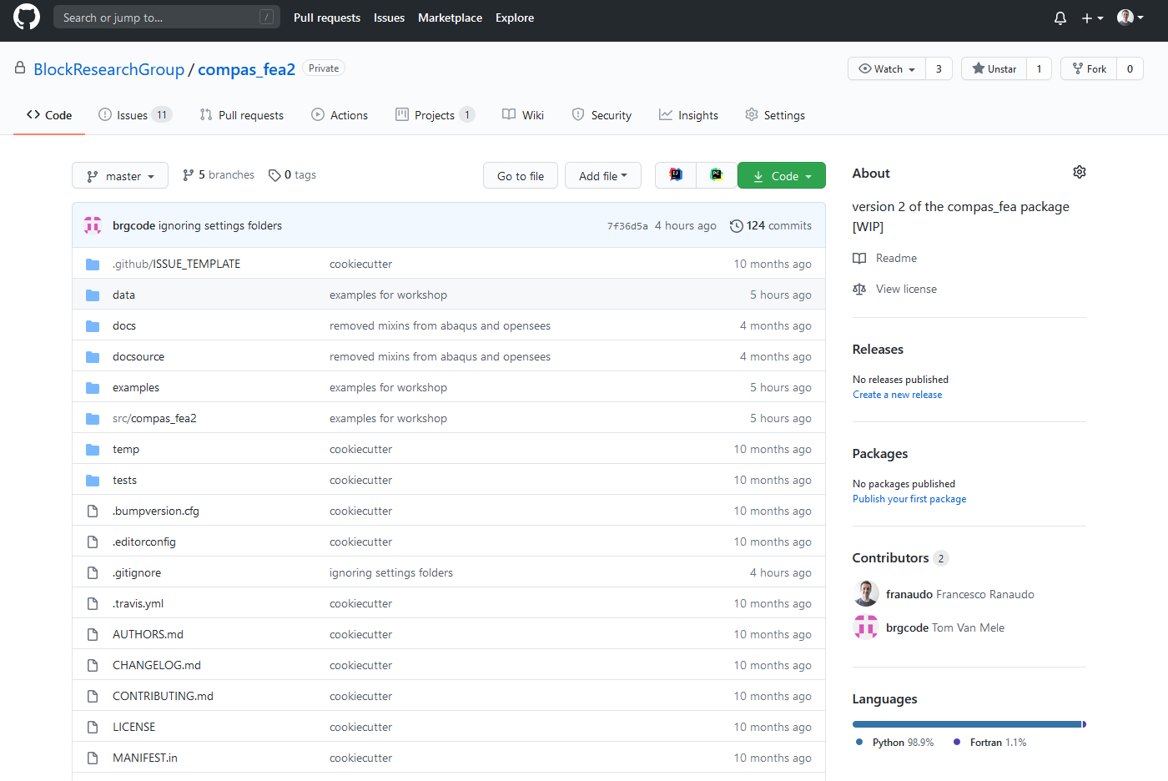
Installation
compas_fea2
https://github.com/BlockResearchGroup/compas_fea2

Slide 18
git clone https://github.com/BlockResearchGroup/compas_fea2.git cd compass_fea2 pip install –e .

Slide 19
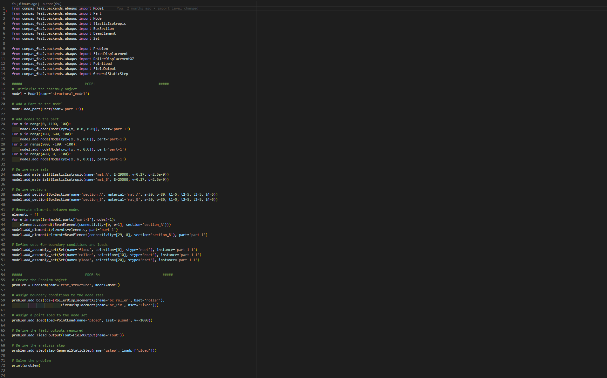

Slide 20
model imports

Slide 21
problem imports

Slide 22
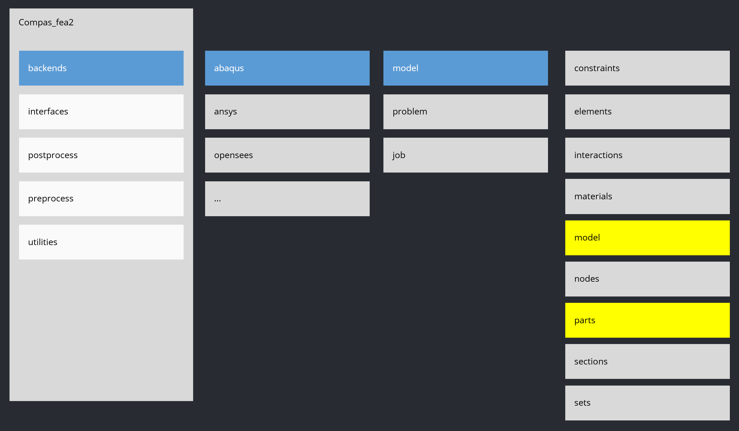
Initialize a model

Slide 23
create the geometry

Slide 24
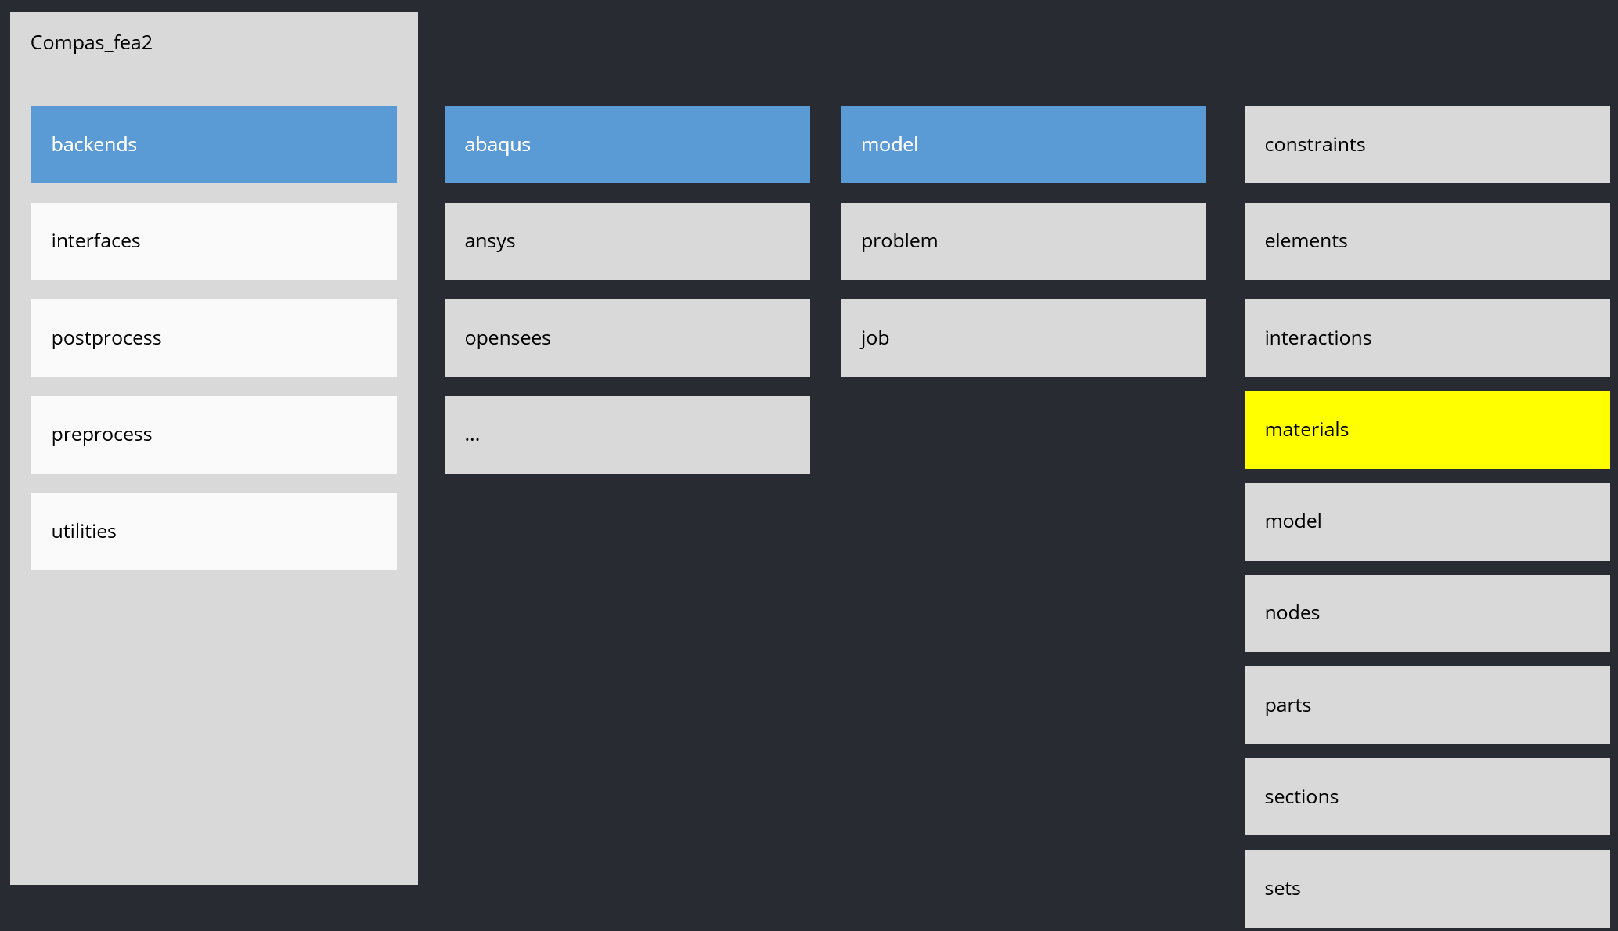
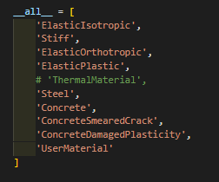
define materials

Slide 25
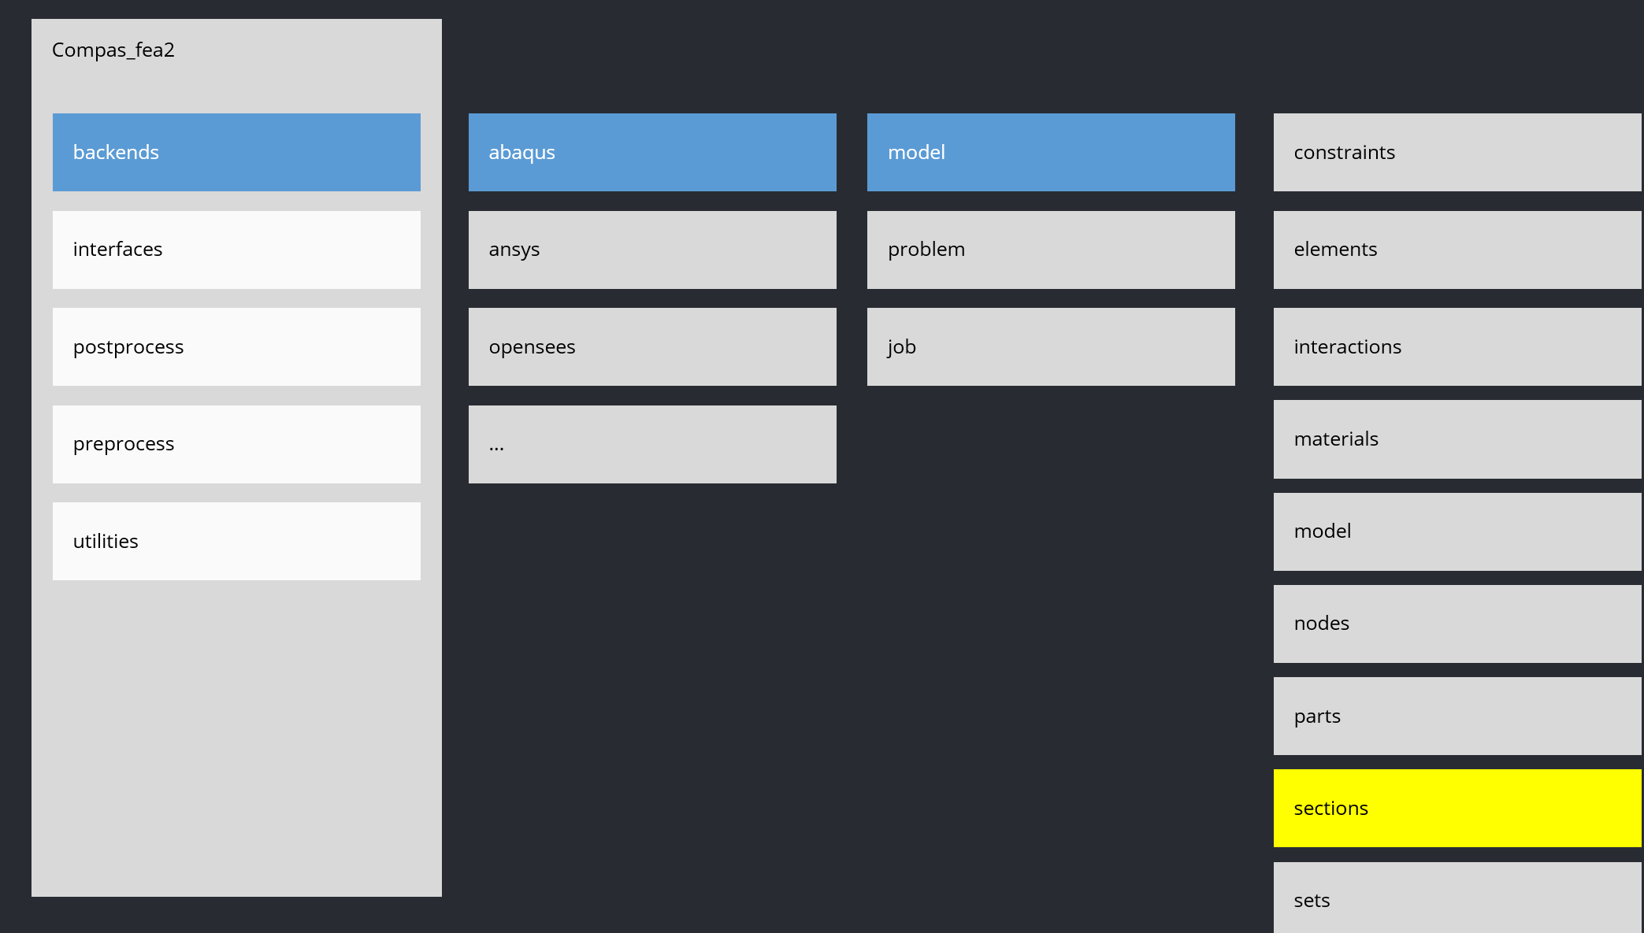
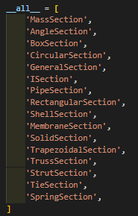
define sections

Slide 26
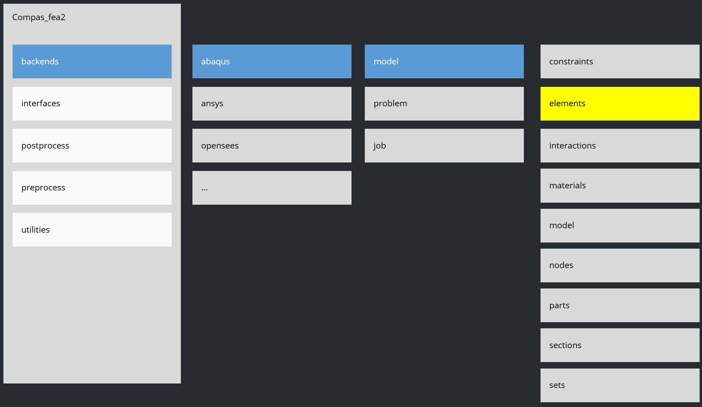
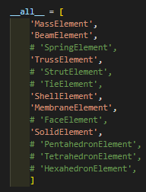
define elements

Slide 27
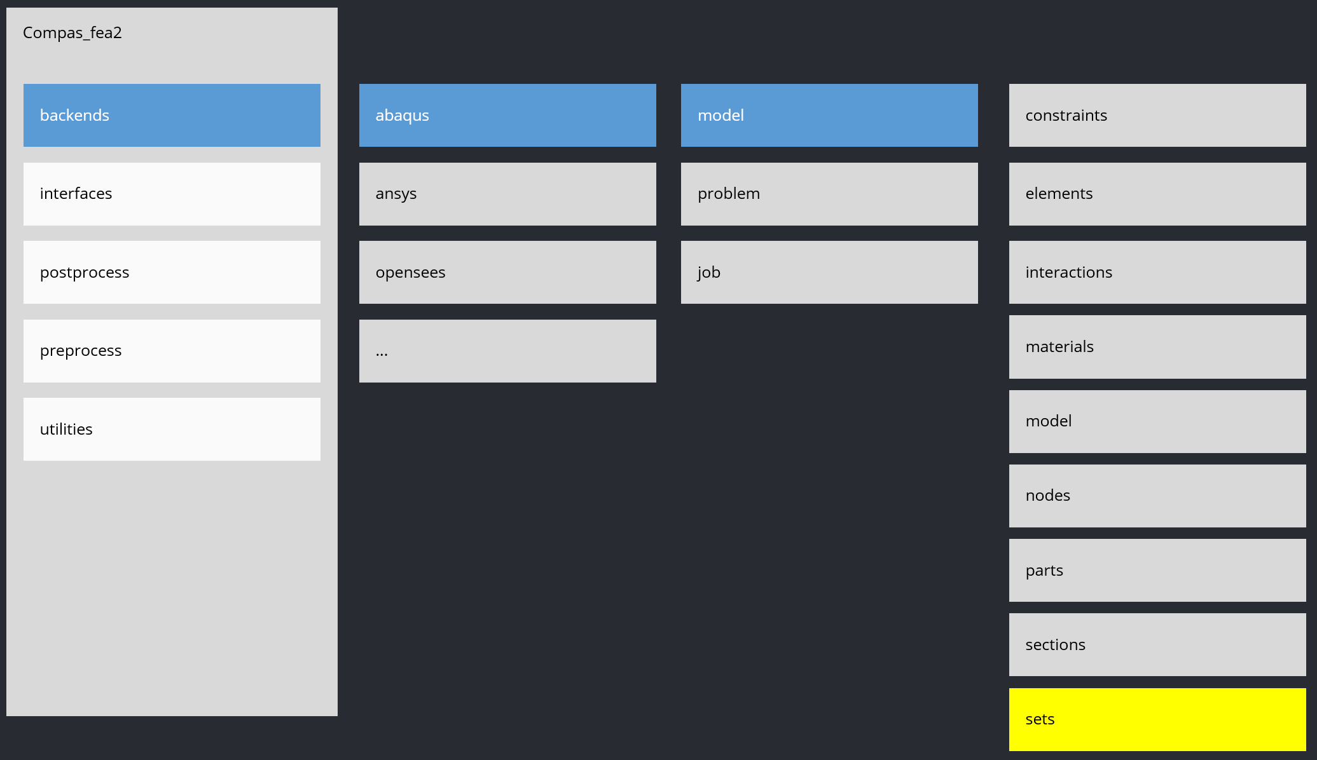
define sets

Slide 28
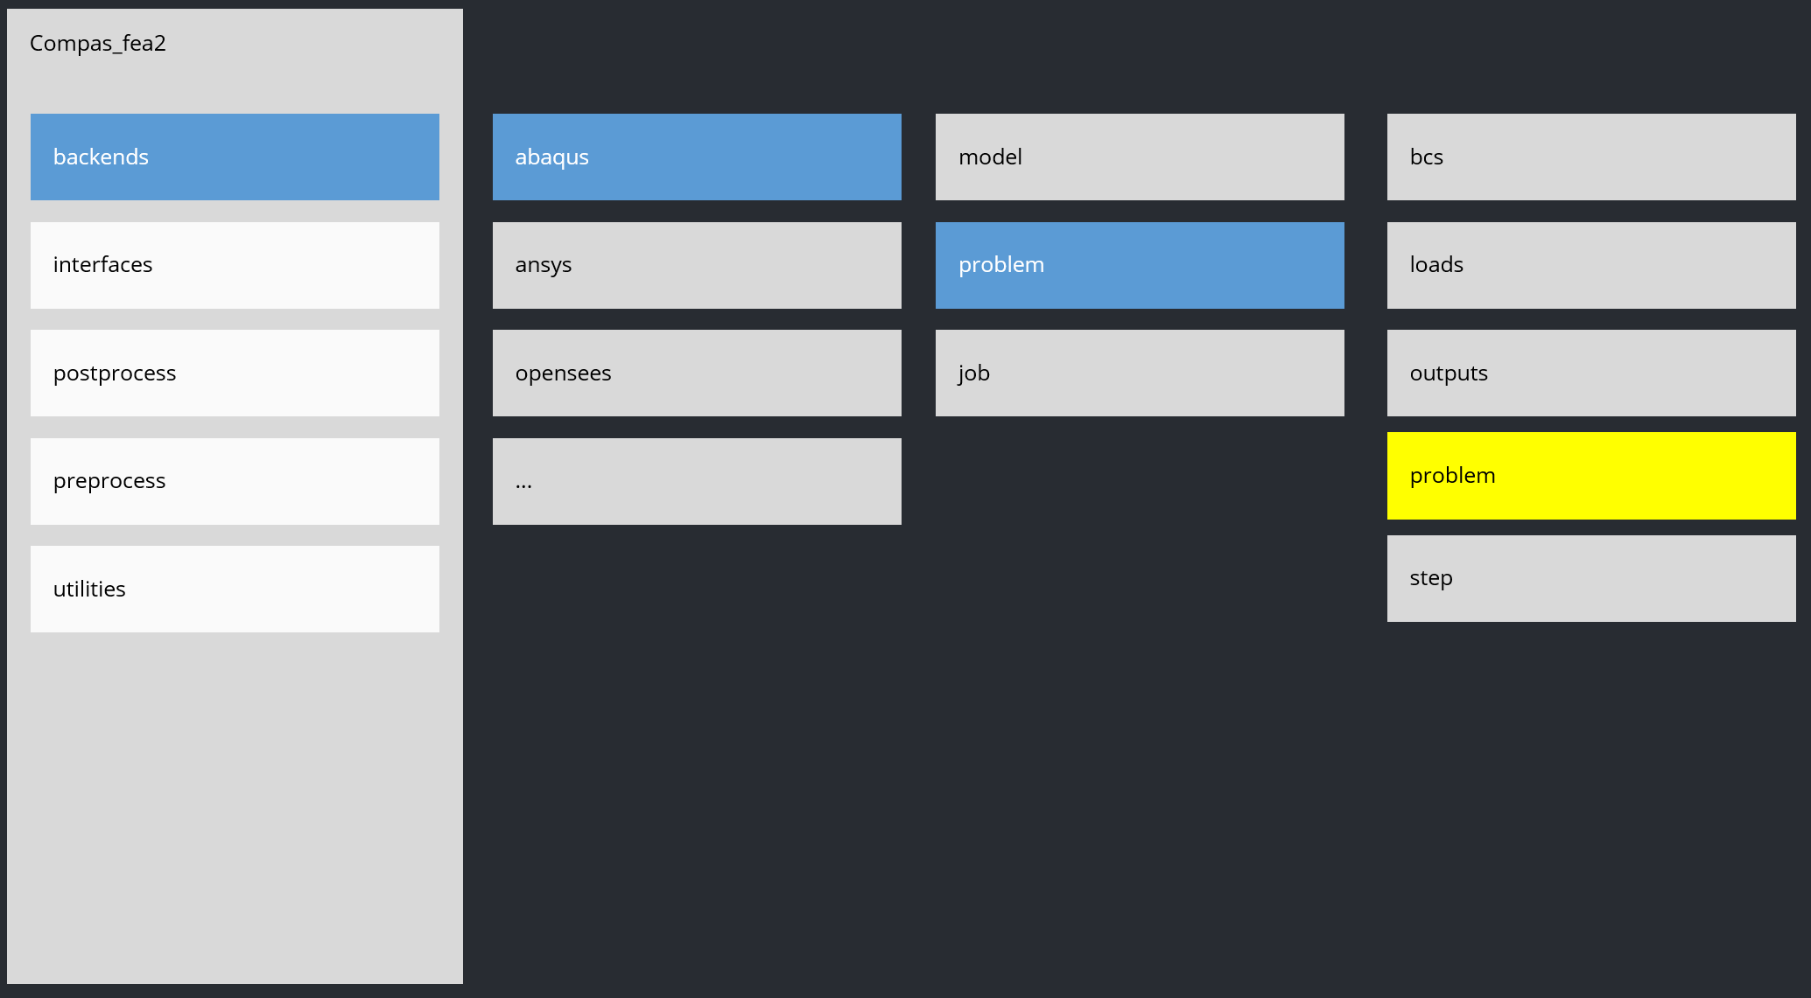
initialize Problem

Slide 29
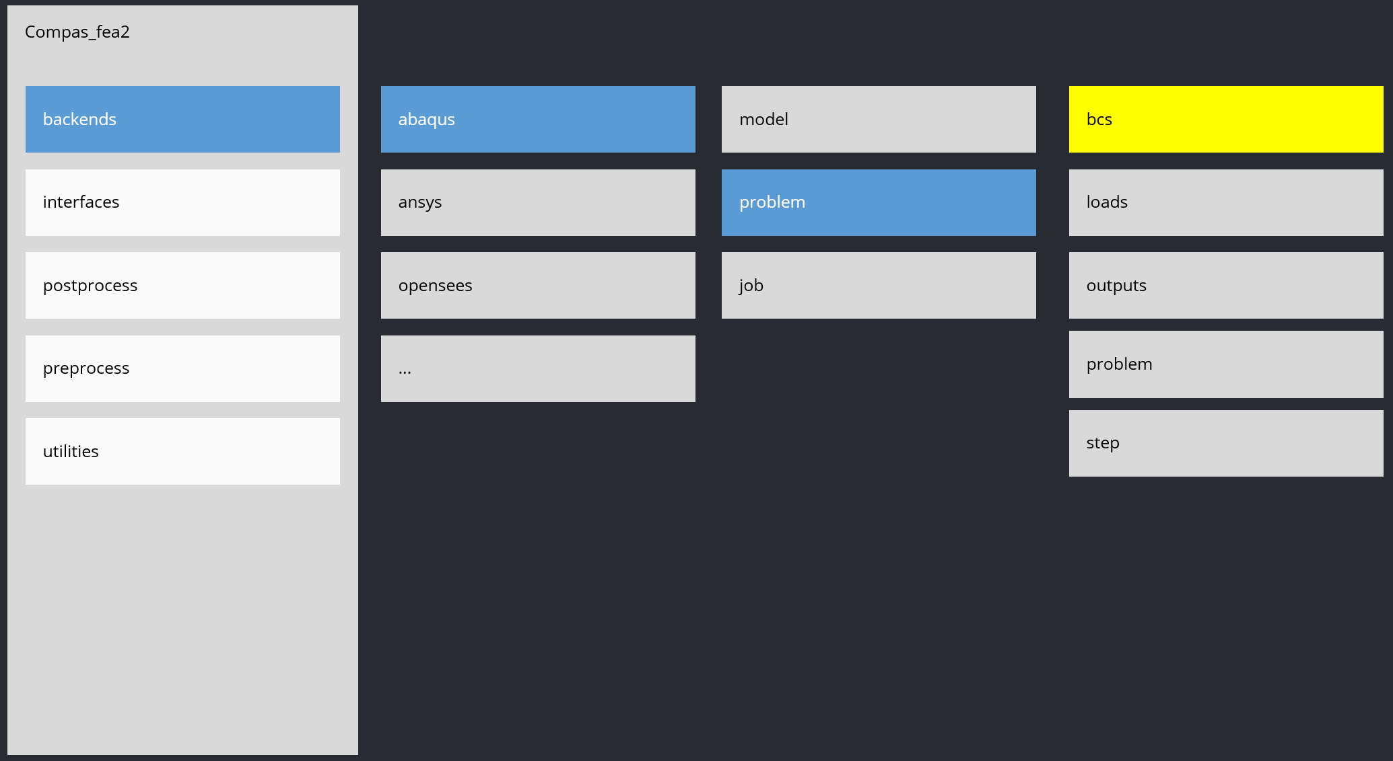
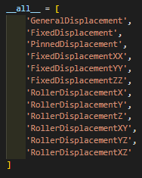
define bcs

Slide 30
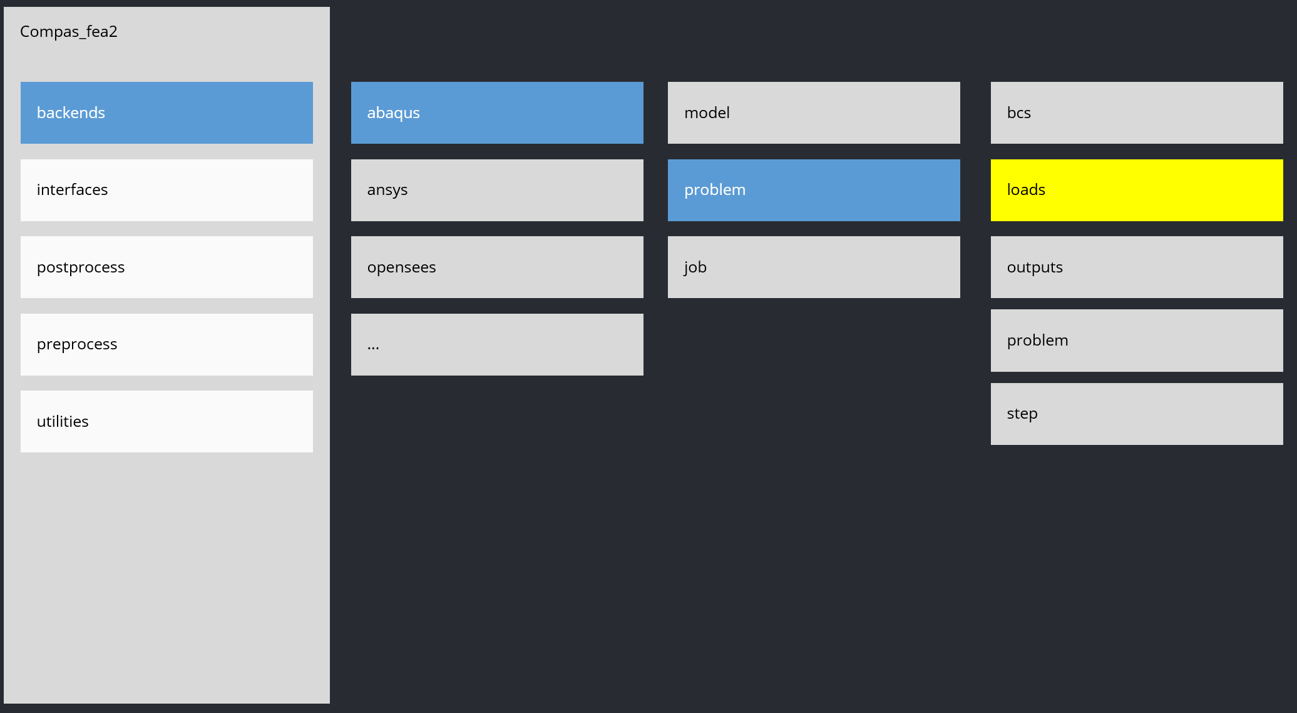
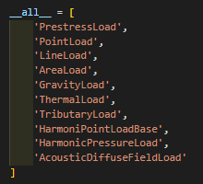
define loads

Slide 31
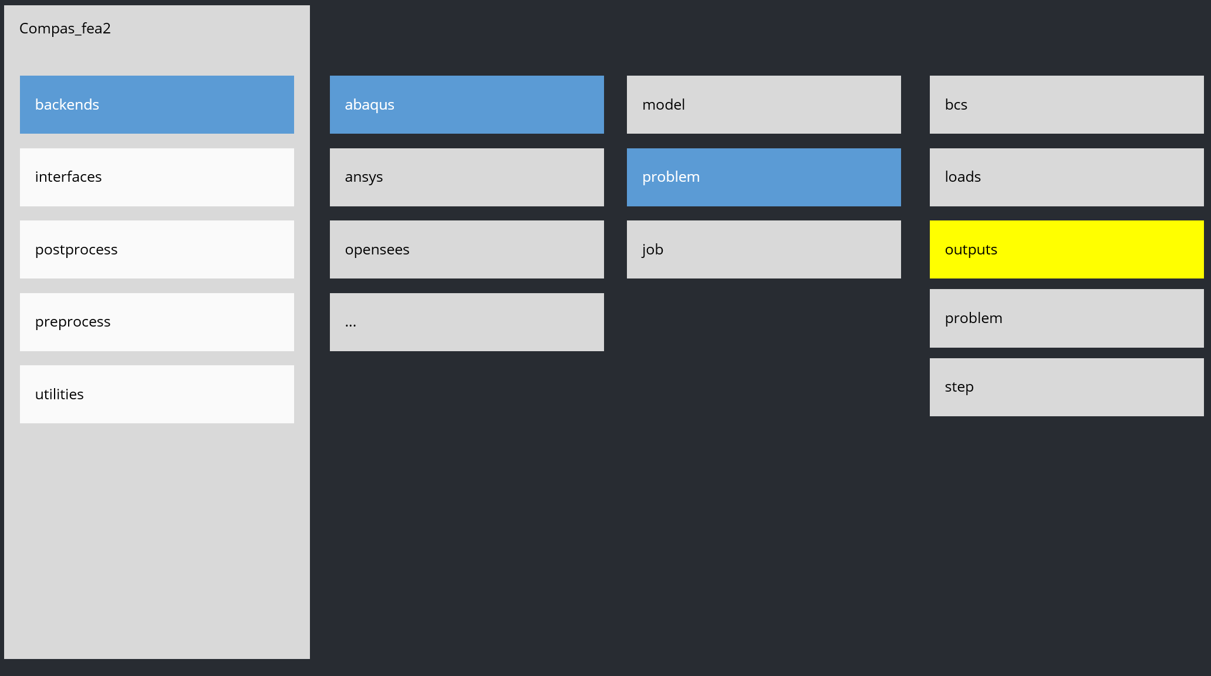
define outputs

Slide 32
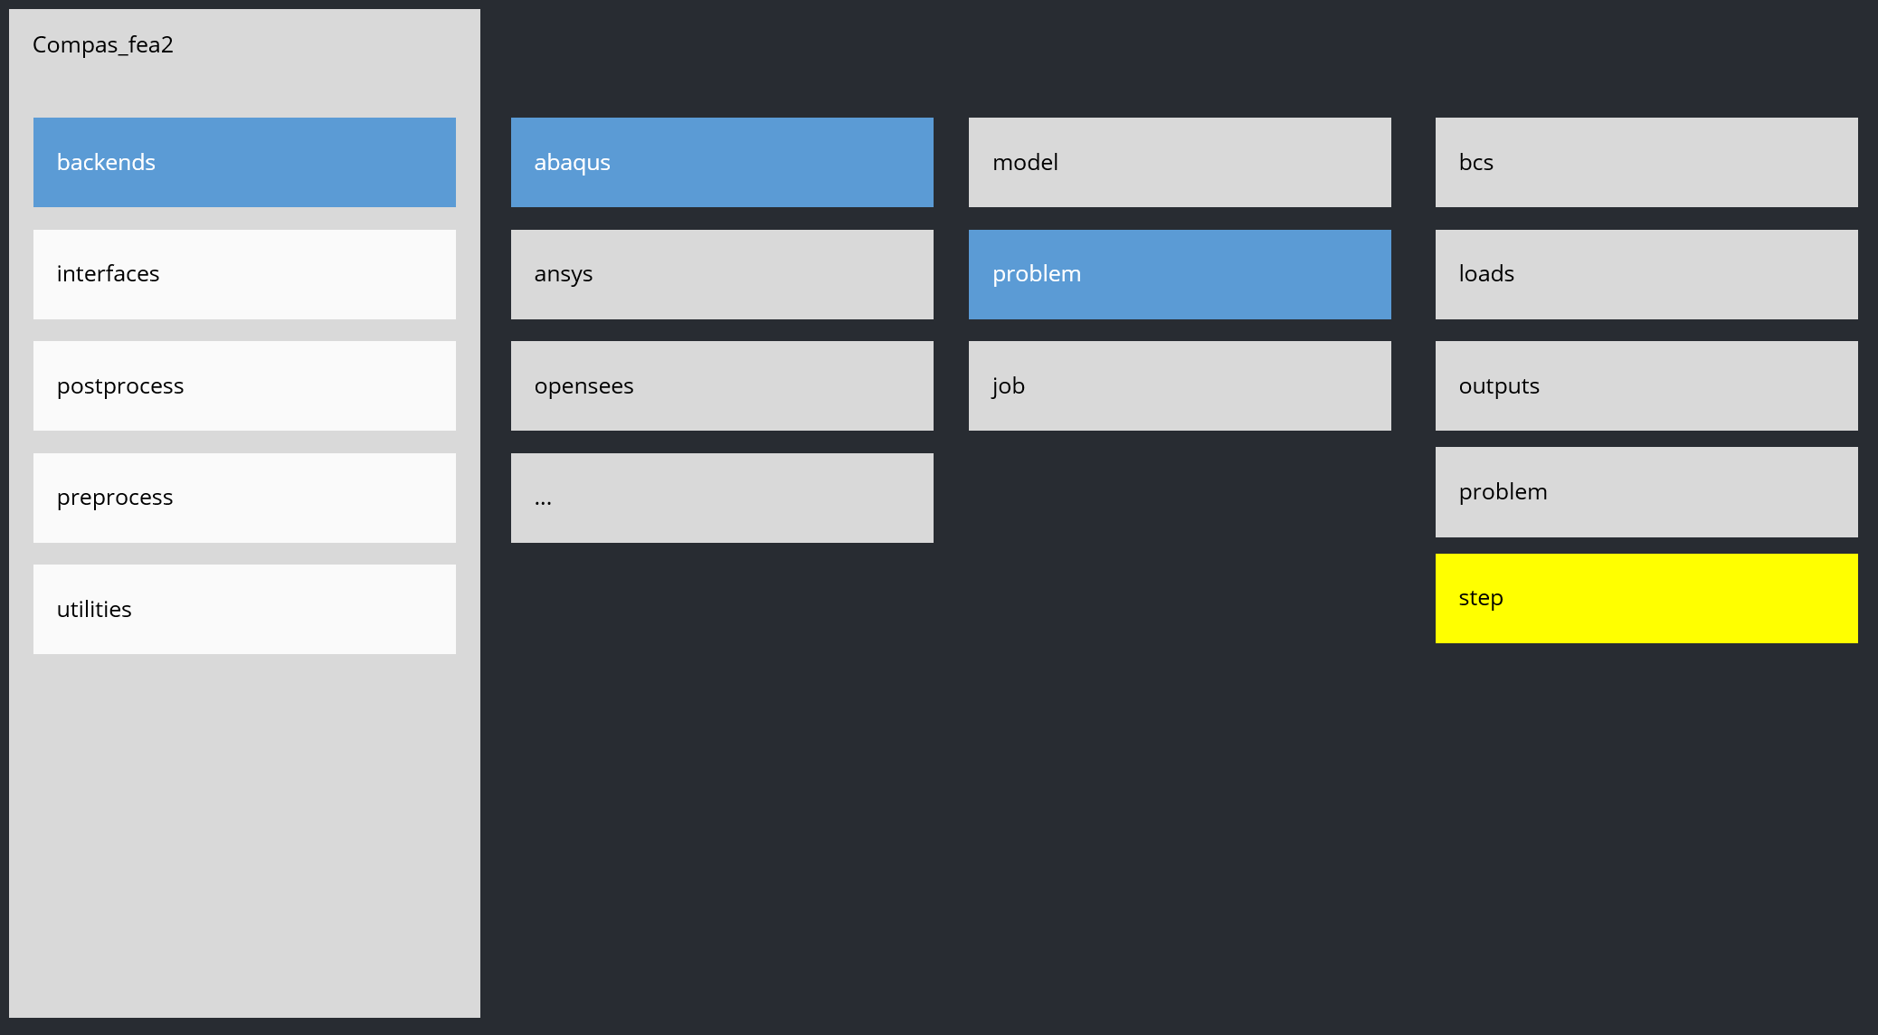
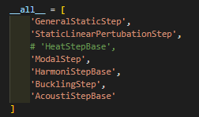
define steps

Slide 33
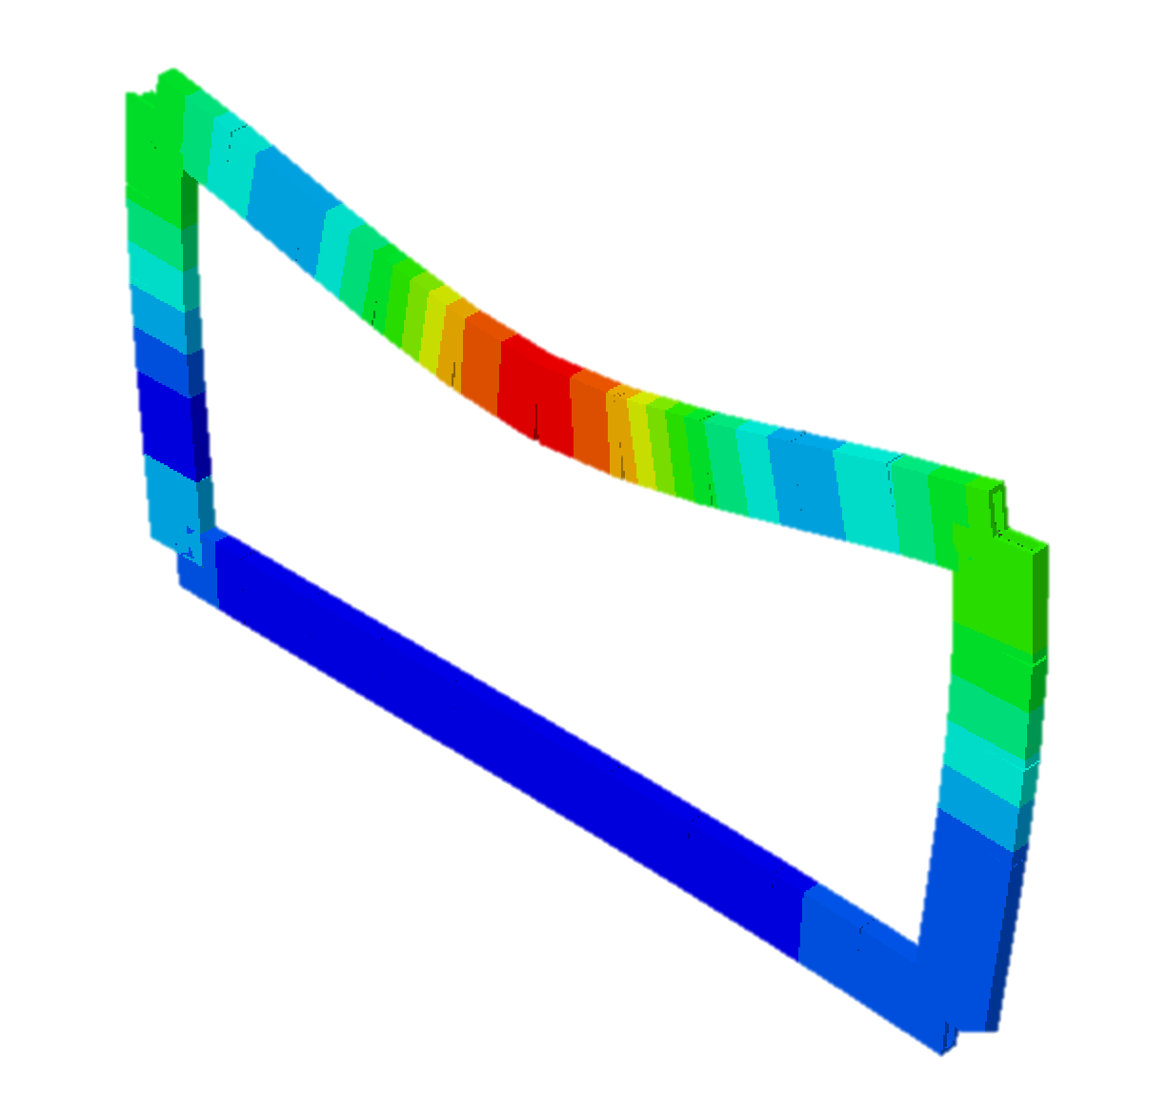
RUN!

Slide 34
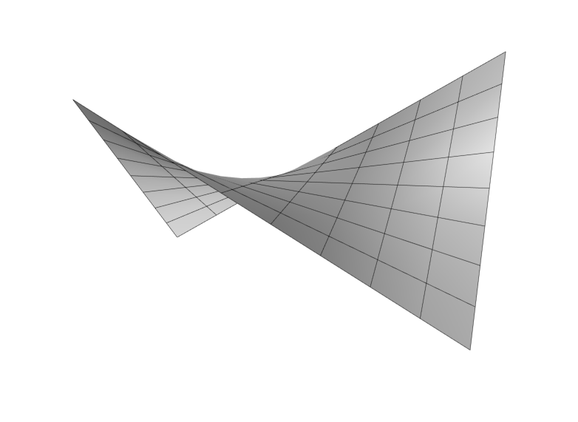
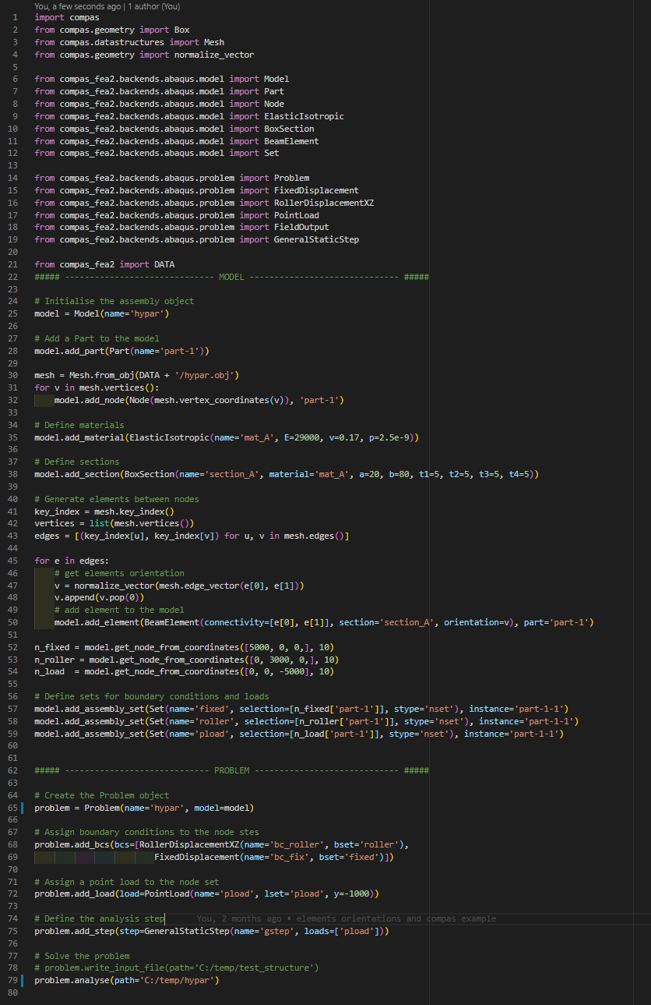
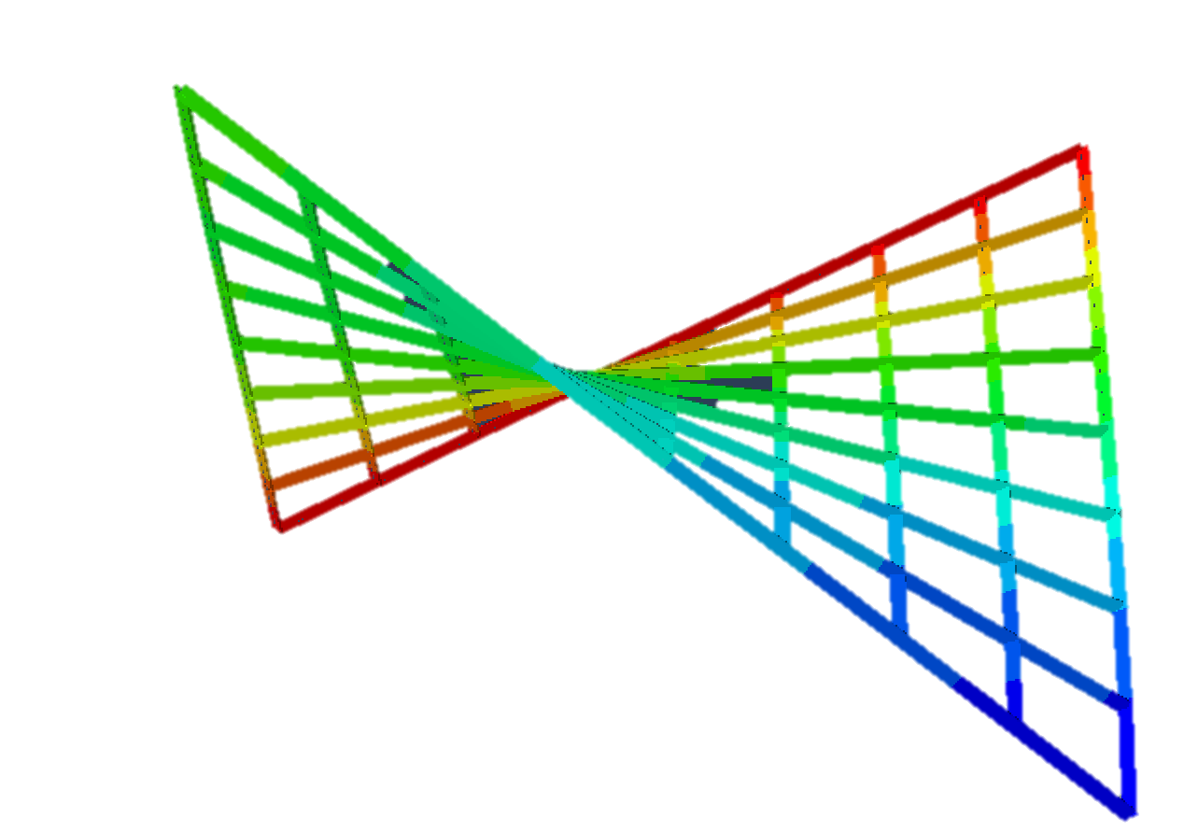
Examples
Complex geometry

Slide 35
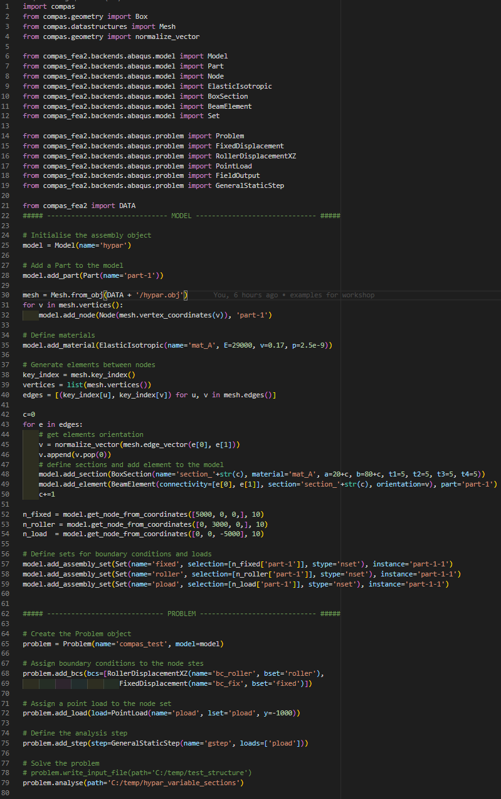
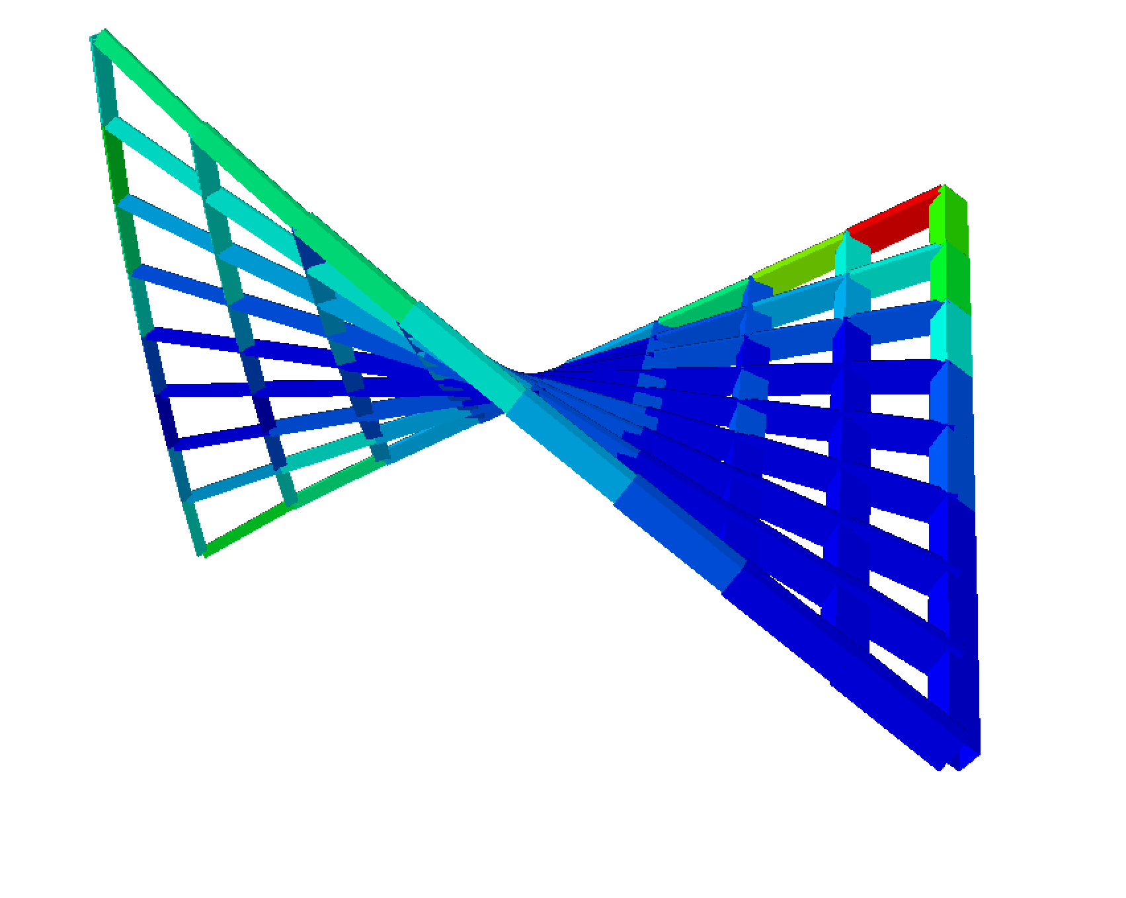
Examples
Complex geometry - parametric

Slide 36
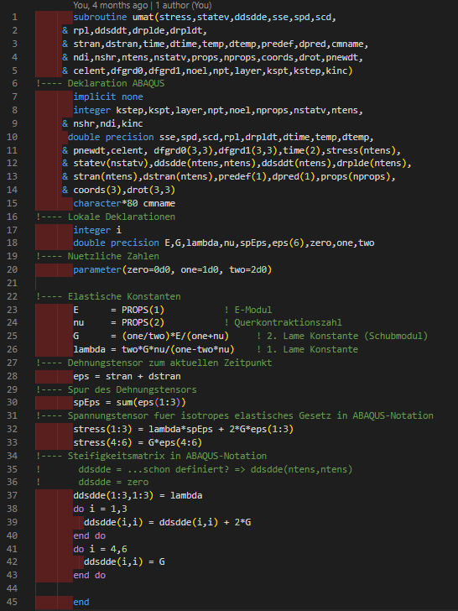
Examples
Complex geometry + user material

Slide 37
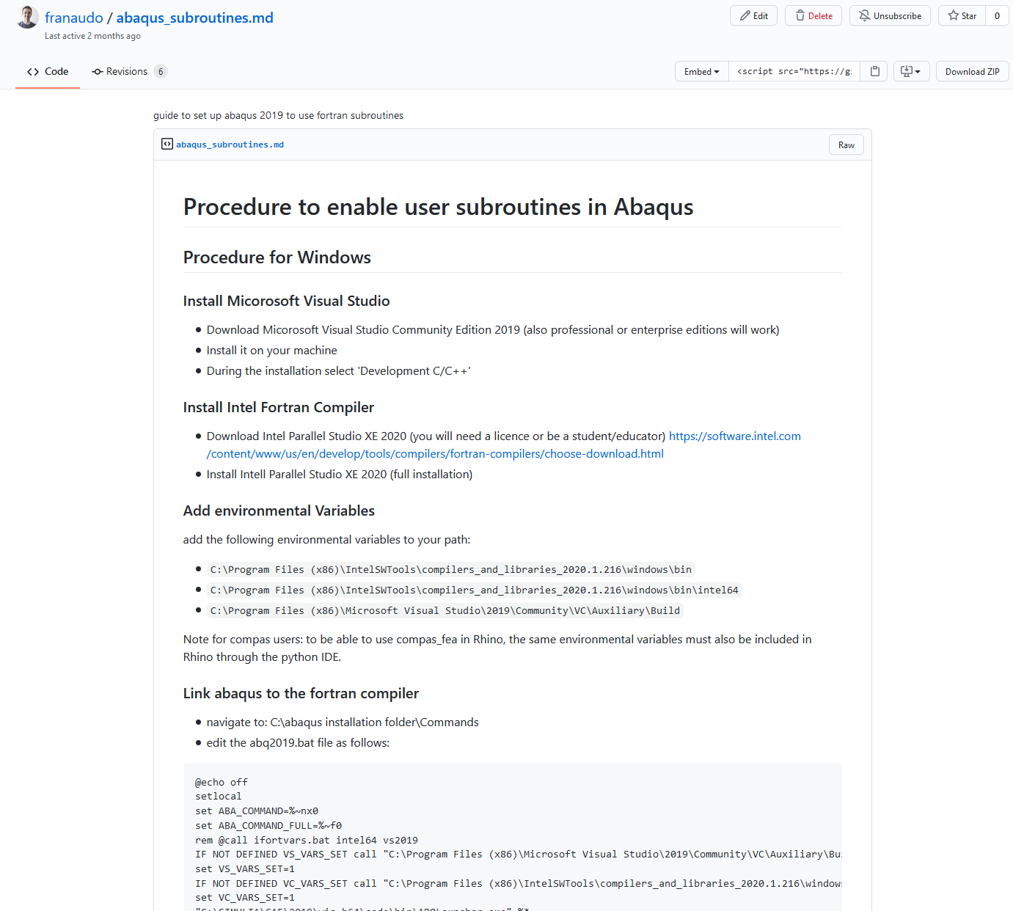

Examples
User Material in Abaqus
https://gist.github.com/franaudo/72362784ded685e4cb381e57020c9ec7

Slide 38
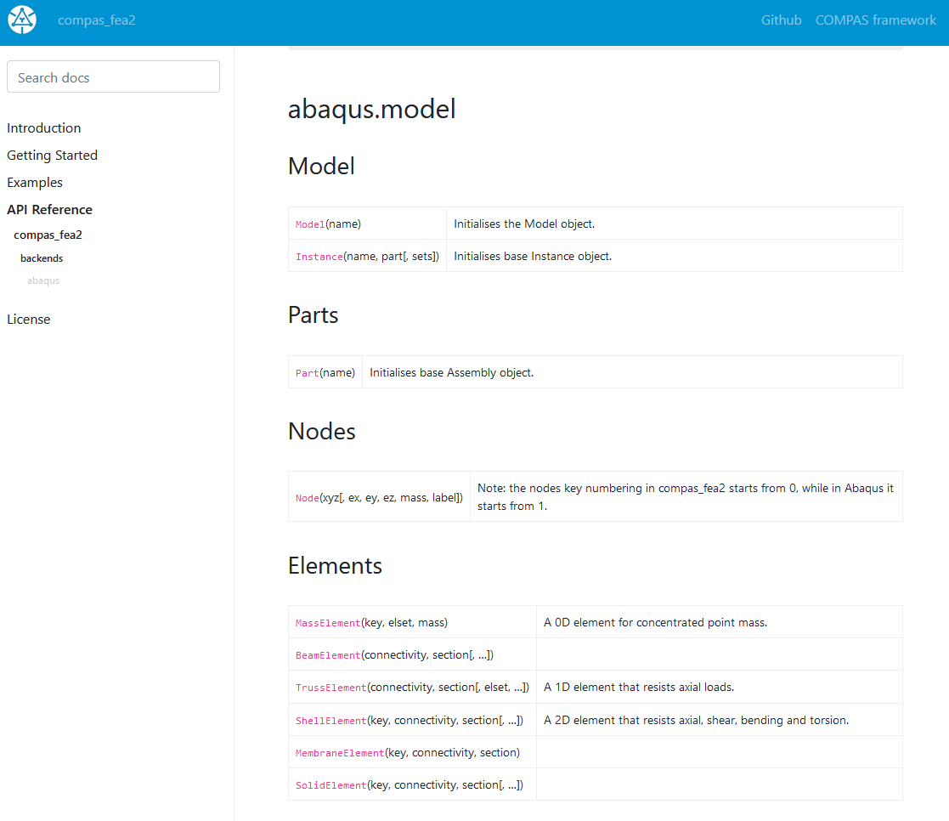
Next Steps
API Documentation

Slide 39
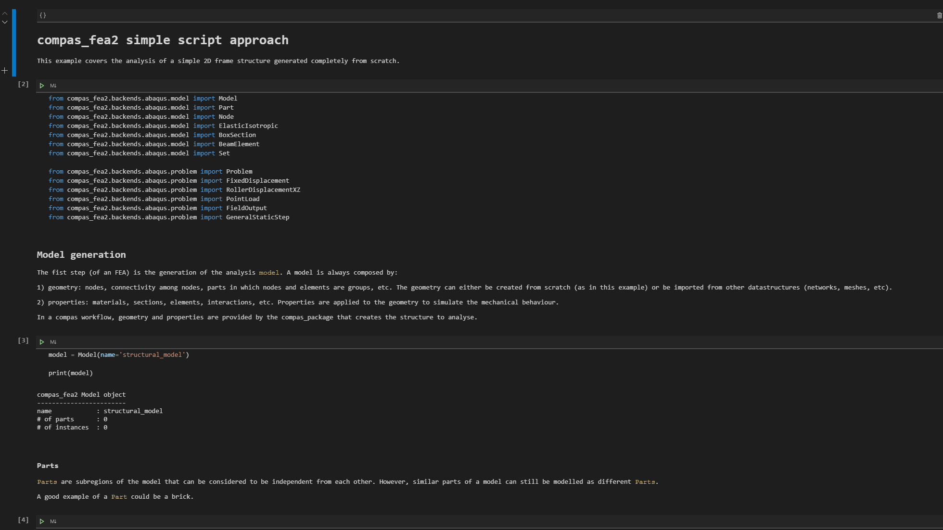

Slide 40
That’s all folks!

