Slide 1
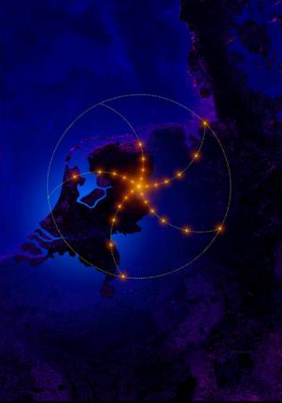
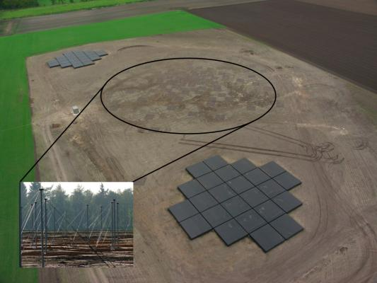

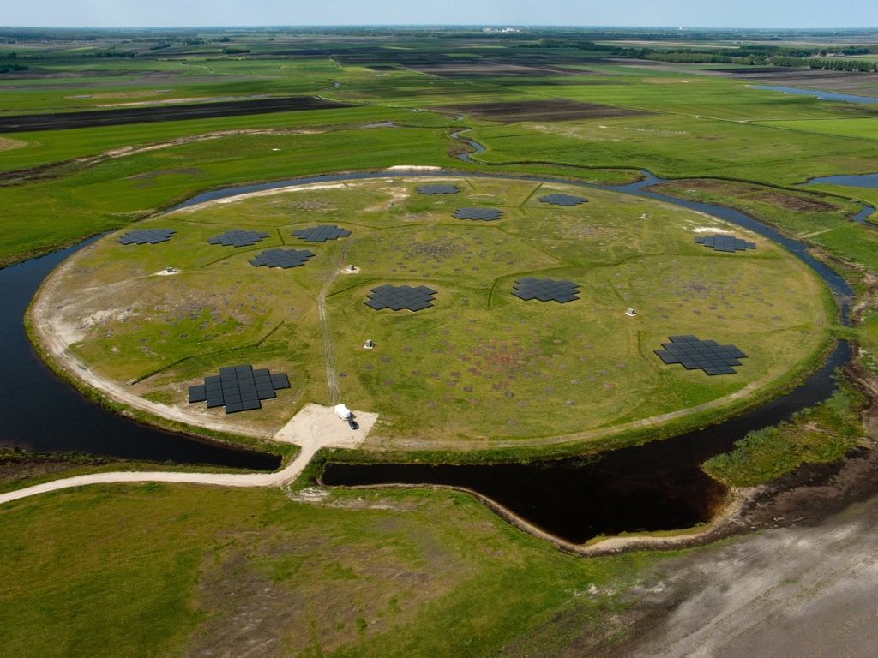
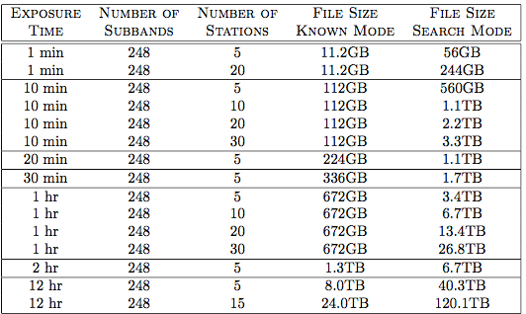
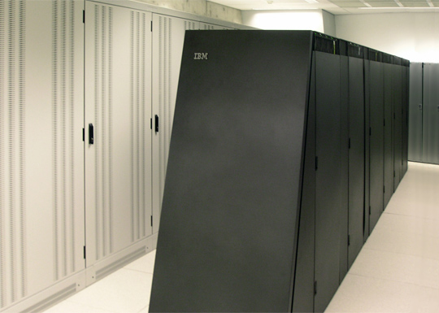
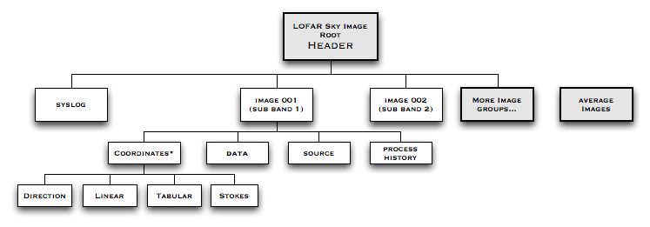
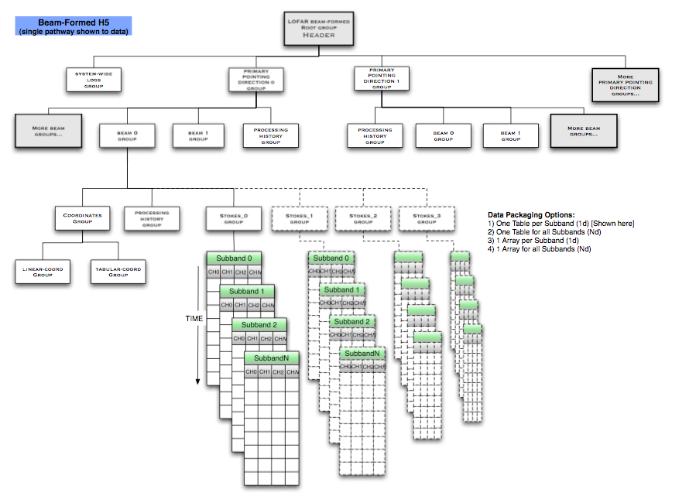
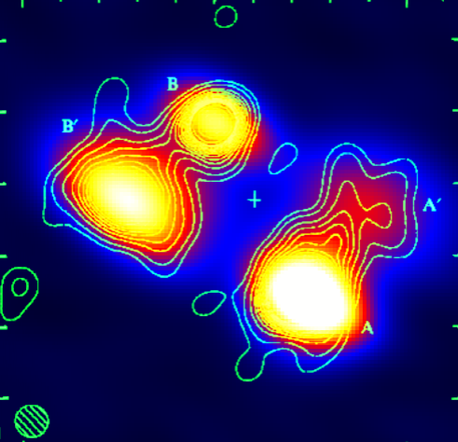
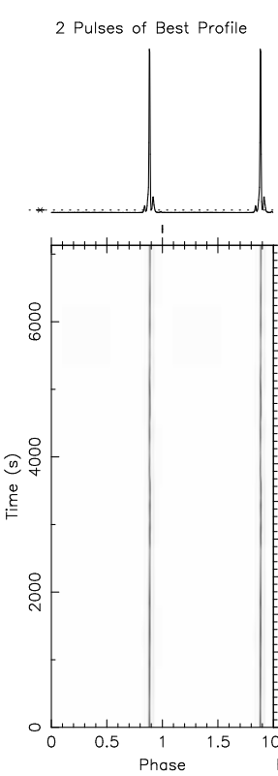
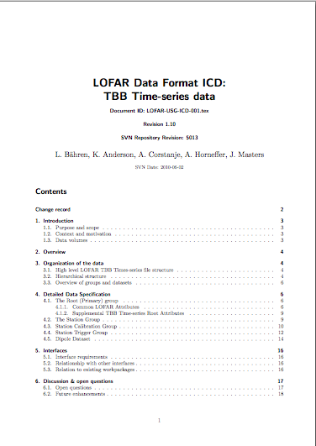
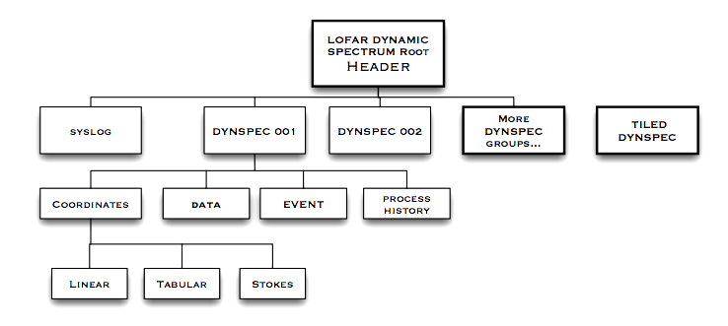
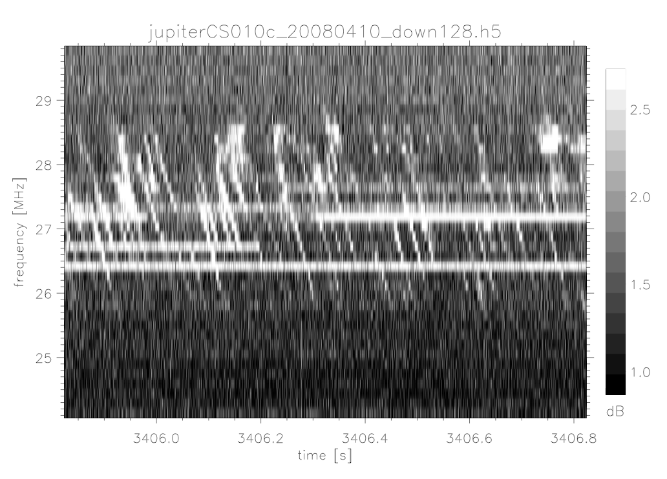
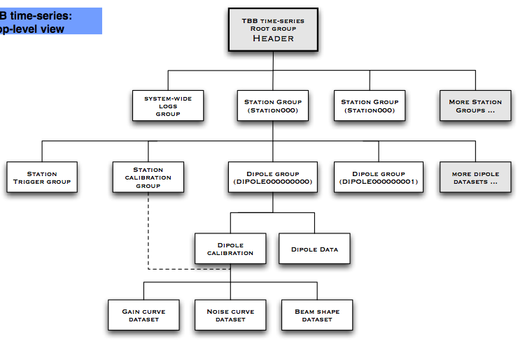

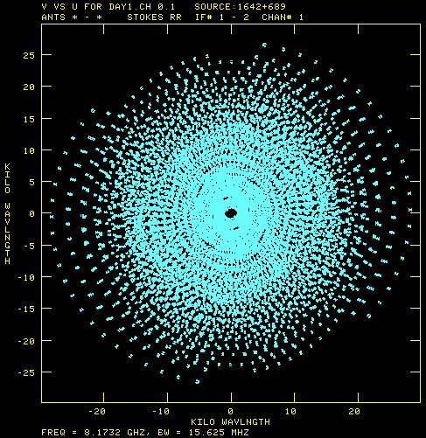

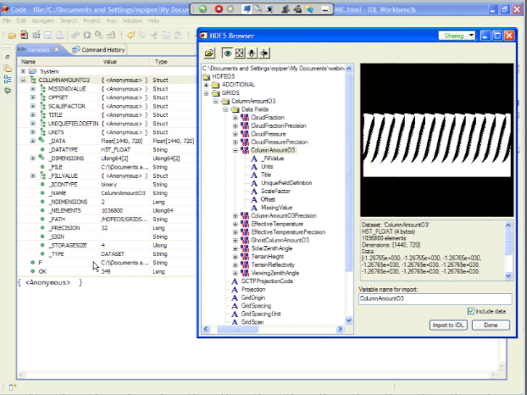

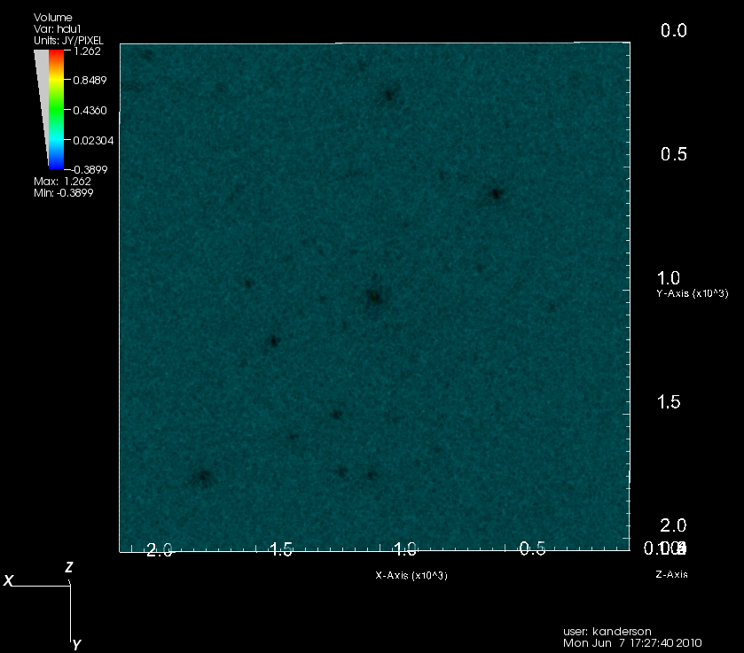
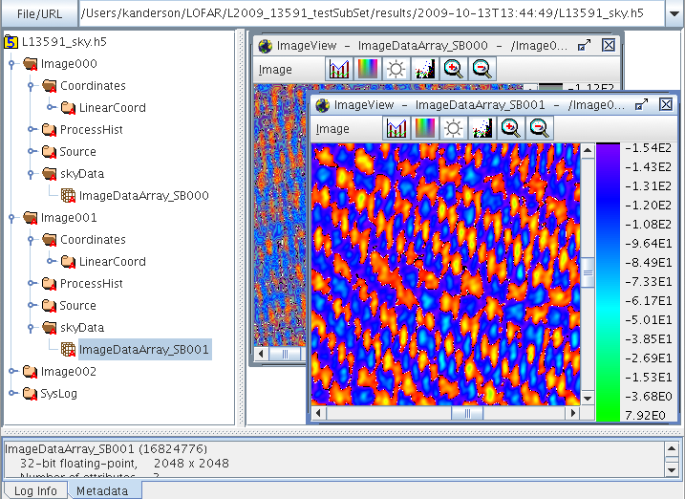




LOFAR & HDF5: Toward a New Radio Data Standard.
K. R. Anderson¹, A. Alexov¹, L. Bähren¹, J-M. Grießmeier², M. Wise³,G.A. Renting³
1: University of Amsterdam (UvA), 2: Laboratoire de Physique et Chimie de l'Environnement et de l’Espace (LPC2E),
3: Netherlands Institute for Radio Astronomy (ASTRON)
Abstract
For decades now, scientific data volumes have experienced relentless, exponential growth. As a result, legacy astronomical data formats are straining under a burden not conceived when these formats were first introduced. With future astronomical projects ensuring this trend, ASTRON and the LOFAR project is exploring the use of the Hierarchical Data Format, version 5 (HDF5), for LOFAR radio data encapsulation. Most of LOFAR's standard data products will be stored natively using the HDF5 format. In addition, HDF5 analogues for traditional radio data structures such as visibility data and spectral image cubes are also being developed. The HDF5 libraries allow for the construction of potentially distributed, entirely unbounded files. The nature of the HDF5 format further provides the ability to custom design a data encapsulation framework. The LOFAR project has designed several data formats that will accommodate and house all LOFAR data products, the primary styles and kinds of which are presented in this paper. With proper development and support, it is hoped that these data formats will be adopted by other astronomical projects as they, too, attempt to grapple with a future filled with mountains of data.
WWW.LOFAR.ORG
The LOFAR Radio Telescope
Sample Beam-Formed data sizes
LOFAR Data: Variety, Complexity, Volume
The “LOw Frequency ARray”
Officially opened by Queen Beatrix, June 12, 2010.
Currently, the “largest radio telescope in the world.”
25,000 networked, passive phased array antennae, 36 fields in The Netherlands
International stations, constructed or planned: Germany(5), Sweden(2), France(2), and the United Kingdom(1)
International Baselines to 1500 km; unlimited potential expansion.
Low Band Antenna (LBA) bandpass:10-90 MHz
High Band Antenna (HBA) bandpas:110-250 MHz.
Data Correlation: IBM Blue Gene/P supercomputer, Groningen, NL.
LOFAR – Multiple Observational Modes
Datasets produced by LOFAR observations will vary tremendously in size. Images, Beam-formed data, Transient Buffer board (TBB) time-series data are expected to produce large files, with the beam-formed and TBB potentially forming files of several tens of terabytes.
LOFAR’s observational modes are capable of producing highly complex, large volume datasets (see table, left)
Data rates up to 10Tb/sec
File sizes, 10’s to 100’s terabytes
Hierarchical, multidimensional data
Not a job for FITS!
The LOFAR “Superterp”, Exloo, NL
The Blue Gene/P supercomputer at Groningen, aka “STELLA”
BoF No. 5!
HDF5!
Wed, Nov 10
18:30 h
_______
LOFAR Data Format Specifications -- HDF5
ATTEND!
“Towards HDF5”
Birds of a Feather Session No.5
Wed, Nov 10
18:30 h
Schemata: LOFAR hierarchical data formats⁵
A viable solution was needed for potentially massive LOFAR data products. HDF5 provides a framework allowing users to essentially design their own files to appropriately accommodate a variety of data, something LOFAR will produce. For over a year now, the LOFAR project has been engaged in developing and designing a complete set of specifications for all LOFAR observational data. This has necessarily required differing file designs for differing data, with a certain structural parallelism maintained across all file designs.
These Interface Control Documents⁴ (ICD) provide detailed descriptions of all expected LOFAR Data Products.
Radio Sky Images
Transient Time Series
Beam-Formed data
Dynamic Spectra
UV Visibility
Rotation Measure Synthesis
Near-field Imaging
Radio Sky Images
Beam-Formed Data⁶
Dynamic Spectra
HDF5 Home Page:
www.hdfgroup.org
UV Visibility
Transient Buffer Board
Time series
4 Documents available from the LOFAR Wiki (“Data Products” link), http://usg.lofar.org/wiki
RM Synthesis and Near Field imaging under development
See Alexov, A., The LOFAR Pulsar Data Pipeline, ISKAF, 2010
Toolsets, Libraries, and Packages
Summary And Future Considerations
Since inception, the body of libraries and tools available to work with HDF5 files has grown substantially. In addition to the HDF5 library itself, these packages and interfaces are also available:
IDL
Visit
HDFView
DAL (LOFAR)
Pydal (LOFAR)
h5.py
Pytables
The LOFAR project is developing the C++ Data Access Library (DAL), which will provide full scope constructors for creating and accessing LOFAR data products.
In order that adoption of HDF5 in astronomy prove useful in the real world, the LOFAR project is committing resources to help develop the next generation of astronomical tools for LOFAR data.
The large effort is the development of the Data Access Library (DAL), which ultimately will provide interfaces through FITS, the Casa/AIPS++ Measurement Sets and HDF5. A python interface to the DAL, pydal, will also be forth coming. All LOFAR products will be accessible through DAL tools.
Future work involves developing an interface for DS9 and HDF5 LOFAR data files – yes, you will be able to open and examine LOFAR data with the de facto standard astronomical image viewer.
The large effort by LOFAR to design an HDF5 radio data standard is driven in large part by two considerations. One, there is no effective standard in radio astronomy data. Two, as indicated above, the expected data volumes produced by LOFAR will, in many cases, swamp current file technology. It is this reality that has led LOFAR on this work, and it is hoped that these efforts toward building a radio data standard will be recognized as essential to the future of radio astronomy.

