Slide 1
The Framework pulsar pipeline
pulp.py

Slide 2
FRAMEWORK PULSAR PIPELINE
“PULP” is the framework pulsar pipeline
Current release under SVN
@ $LOFARSOFT/src/Pulsar/pipeline:
drwxr-xr-x 9 <username> staff 306 Nov 1 11:17 .svn
-rw-r--r-- 1 <username> staff 1726 Nov 1 11:15 pipeline.cfg
-rwxr-xr-x 1 <username> staff 2341 Nov 1 11:15 pulp.py*
drwxr-xr-x 5 <username> staff 170 Nov 1 11:15 recipes
drwxr-xr-x 14 <username> staff 476 Nov 1 11:15 support
-rw-r--r-- 1 <username> staff 658 Nov 1 11:15 tasks.cfg

Slide 3
Framework Pulsar Pipeline
Current Pulp package: 9 recipes, 8 support modules, 3400+ loc
Head Node Recipes | Compute Node Recipes | Support Modules
buildPulsArch | ____________ | buildRSPS, RSPlist
bf2presto | bf2presto | bf2Pars
buildRSPAll | ____________ | fullRSP
prepareInf | ____________ | prepareInfFiles
prepfold | prepfold | prepfoldPars
rfiplot | rfiplot | rfiDirectories
In dev: |  | pulpEnv
flyseye, coherentstokes, tarBall, rfiAssemble | … | ?

Slide 4
Framework Pulsar Pipeline
Configuration
Environment:
Define $LOFARSOFT, $LOFARROOT (=/opt/LofIm/daily/lofar)
Make “pipeline_runtime/” directory (arbitrary location)
source ${LOFARSOFT}/devel_common/scripts/init.sh
Use LofIm
Define $TEMPO, $PRESTO
PYTHONPATH include
PYTHONPATH=/opt/pipeline/dependencies/lib/python2.5/site-packages:\
/opt/pipeline/framework/lib/python2.5/site-packages:\
/opt/LofIm/daily/pyrap/lib:\
${LOFARROOT}/lib/python2.5/site-packages:\
/opt/pythonlibs/lib/python/site-packages:\
${LOFARSOFT}/src/Pulsar/pipeline/recipes/master:\
${LOFARSOFT}/src/Pulsar/pipeline/recipes/nodes:\
${LOFARSOFT}/src/Pulsar/pipeline/support
PATH include
${LOFARSOFT}/release/bin:\
${LOFARSOFT}/release/share/pulsar/bin:\
${LOFARSOFT}/src/Pulsar/pipeline:\
/opt/LofIm/daily/casarest/bin:\
/opt/pipeline/dependencies/bin:\
/opt/LofIm/daily/askapsoft/bin:\
/opt/scripts:${PATH}

Slide 5
Framework Pulsar Pipeline
Configuration …
Framework configuration files (delivered with svn download)
Pipeline.cfg
Framework paths definition file
Tasks.cfg
Task definitions file
Sub[n].clusterdesc
Sub-cluster defintion files
Templates in $LOFARROOT/share
task.furl
multiengine.furl
N.B. * No shell interpolation *

Slide 6
FRAMEWORK PULSAR PIPELINE
Configuration cont’d …
Pipeline.cfg, example
[DEFAULT]
runtime_directory = /home/kanderson/LOFAR/pipeline_runtime
recipe_directories= [., /home/kanderson/LOFAR/lofarsoft/src/Pulsar/pipeline/recipes, /opt/pipeline/recipes]
lofarroot = /opt/LofIm/daily/Thu/lofar
task_files = [/home/kanderson/LOFAR/lofarsoft/src/Pulsar/pipeline/tasks.cfg] ⬅ tasks.cfg
default_working_directory = /data/scratch/kanderson
[layout]
job_directory = %(runtime_directory)s/jobs/%(job_name)s
log_directory = %(job_directory)s/logs/%(start_time)s
vds_directory = %(job_directory)s/vds
parset_directory = %(job_directory)s/parsets
results_directory = %(job_directory)s/results/%(start_time)s
[cluster]
clustername = pulsar
clusterdesc = /home/kanderson/LOFAR/pipeline_runtime/sub5.clusterdesc ⬅ cluster definition
#clusterdesc = /home/kanderson/LOFAR/pipeline_runtime/sub6.clusterdesc
task_furl = %(runtime_directory)s/task.furl ⬅ task.furl file
multiengine_furl = %(runtime_directory)s/multiengine.furl ⬅ multiengine.furl file
[deploy]
script_path = /opt/pipeline/framework/bin
controller_ppath = /home/kanderson/LOFAR/lofarsoft/src/Pulsar/pipeline/support:/opt/pipeline/dependencies/lib/ python2.5/site-packages:/opt/pipeline/framework/lib/python2.5/site-packages
engine_ppath = /home/kanderson/LOFAR/lofarsoft/src/Pulsar/pipeline/recipes/master:/home/kanderson/LOFAR/lofarsoft/src/Pulsar/pipeline/recipes/nodes:/home/kanderson/LOFAR/lofarsoft/src/Pulsar/pipeline/support:/opt/pipeline/dependencies/lib/python2.5/site-packages/:/opt/pipeline/framework/lib/python2.5/site-packages:/opt/LofIm/daily/pyrap/lib:/opt/LofIm/daily/lofar/lib/python2.5/site-packages:/opt/pythonlibs/lib/python/site-packages:
engine_lpath = /opt/pipeline/dependencies/lib:/opt/LofIm/daily/pyrap/lib:/opt/LofIm/daily/casacore/lib:/opt/LofIm/daily/lofar/lib:/opt/wcslib/lib/:/opt/hdf5/lib

Slide 7
FRAMEWORK PULSAR PIPELINE
Tasks.cfg:
[buildPulsArch]
recipe = buildPulsArch
filefactor = 8
[bf2presto]
recipe = bf2presto
executable = /home/kanderson/LOFAR/lofarsoft/release/share/pulsar/bin/bf2presto8
filefactor = 8
collapse = False
nsigmas = 7
[buildRSPAll]
recipe = buildRSPAll
filefactor = 8
[prepareInf]
recipe = prepareInf
filefactor = 8
[prepfold]
recipe = prepfold
executable = /home/kanderson/LOFAR/lofarsoft/release/share/pulsar/bin/prepfold
filefactor = 8
nopdsearch = True
nperstokes = 256
noxwin = True
fine = True
[rfiplot]
recipe = rfiplot
executable = /home/kanderson/LOFAR/lofarsoft/release/share/pulsar/bin/subdyn.py
filefactor = 8

Slide 8
FRAMEWORK PULSAR PIPELINE
Clusterdesc
Clusterdesc template files in $LOFARROOT/share
__________________
ClusterName = sub5
# Storage nodes.
Storage.Nodes = [ lse013..15 ]
Storage.LocalDisks = [ /data1..4 ]
# Compute nodes.
Compute.Nodes = [ lce037..45 ]
Compute.RemoteDisks = [ /net/sub1/lse013..15/data1..4 ]
Compute.RemoteFileSys = [ /lse013..15:/data1..4 ]
Compute.LocalDisks = [ /data ]
# Head nodes.
Head.Nodes = [ lfe001..2 ]
Head.LocalDisks = [ /data ]

Slide 9
FRAMEWORK PULSAR PIPELINE
Pulsar group has a legacy alias clusterdesc file,
pulsar.clusterdesc:
ClusterName = Pulsar
# Directory is the same as the parent.
SubClusters = [sub5.clusterdesc]

Slide 10
Framework Pulsar pipeline
The parallel pipeline framework
A series, possibly complex, of “recipes” are executed, much like a job queue.
Executed recipes create push-pull connections between the controlling “head node” and designated “compute nodes” of the cluster
The recipes create jobs based upon the number of input subbands, definition, and argument parameters
Assigns recipe jobs to available compute nodes
Compute node recipe receives control, computes
Completion of compute node recipe returns control to head node
Next recipe
Nominal processing:
248 subband incoherentstokes
4 or 8 “RSP” splits
4 jobs, 62 subbands / job or
8 jobs, 31 subbands/job

Slide 11
FRAMEWORK PULSAR PIPELINE
The pulsar pipeline definition:
def pipeline_logic(self):
obsid = self.inputs['obsid']
pulsar = self.inputs['pulsar']
filefactor = self.inputs['filefactor']
arch = self.inputs['arch']
with log_time(self.logger):
with ipython_cluster(self.config, self.logger):
if filefactor = 1:
self.run_task("buildPulsArch",obsid=obsid,pulsar=pulsar,filefactor=filefactor,arch=arch)
self.run_task("bf2presto”,obsid=obsid,pulsar=pulsar,filefactor=filefactor,arch=arch)
self.run_task("prepareInf”,obsid=obsid,pulsar=pulsar,filefactor=filefactor,arch=arch)
self.run_task("prepfold", obsid=obsid,pulsar=pulsar,filefactor=filefactor,arch=arch)
self.run_task("rfiplot", obsid=obsid,pulsar=pulsar,filefactor=filefactor,arch=arch)
else:
self.run_task("buildPulsArch",obsid=obsid,pulsar=pulsar,filefactor=filefactor,arch=arch)
self.run_task("bf2presto", obsid=obsid,pulsar=pulsar,filefactor=filefactor,arch=arch)
self.run_task("buildRSPAll”,obsid=obsid,pulsar=pulsar,filefactor=filefactor,arch=arch)
self.run_task("prepareInf”,obsid=obsid,pulsar=pulsar,filefactor=filefactor,arch=arch)
self.run_task("prepfold", obsid=obsid,pulsar=pulsar,filefactor=filefactor,arch=arch)
self.run_task("rfiplot", obsid=obsid,pulsar=pulsar,filefactor=filefactor,arch=arch)
…

Slide 12
FRAMEWORK PULSAR PIPELINE
Built-in processing:
Parallel processing of all subband splits, (i.e. +RSPA)
Capacity for parallel processing n splits for m obsids
“all” subbands processed automatically
“all” subband group handled as just another job
Except: <filefactor> == 1
Implements script switch “-rfi”
Current full cycle “incoherentstokes” processing
Build output path, [make or] read subband data locator list, subband split directories
bf2presto
Converts “incoherentstokes” [others] to data fold (prepfold) PRESTO format
Performance IO limited on single output path
Data folding preparation
Prepfold .inf files
Prepfold processing
Now, a simple, straight pipe
Recipe 1➔ recipe2 → recipe3 →…

Slide 13
Framework Pulsar Pipeline
(pulp.py, beta, delivered 13.10.2010)
Current usage:
$ pulp.py -d --obsid=L<yyyy>_<nnnnn[n…]> --job-name=<job_name> --arch=<archSelection> \
--pulsar=<pulsar> [--filefactor=<m>]
where,
--obsid = observation identifier <str>
eg., --obsid=L2010_06160
--arch = selected pulsar archive <str>
eg., --arch=arch134 (PULP_ARCHIVE @ lse013/data4)
--pulsar = name of pulsar (soon: or csv list of pulsar names).
--pulsar=B0919+06
--filefactor = subband splitting factor, <int>
eg., --filefaactor=4
optional user specification (range, 1-248)
default = 8
-d = debug level, pipeline verbosity switch, full logging -- framework argument
-j,--job-name= arbitrary user-defined name for the processing job -- framework argument

Slide 14
Framework Pulsar Pipeline
Nominal:
“lce044”
HEAD NODE
(“lfe001”)
recipe1
Storage
node
partitions
filefactor=4
“lce037”
Def
I
n
I
t
I
on
Recipe1
Job
cont
ro
l
recipe1
Recipe2
Compute nodes
“lce042”
recipe1
Recipe3
“lce039”
recipe1
This is the bad part

Slide 15
Framework Pulsar Pipeline
Single node operation:
- All paths are common and shared.
- all jobs see the same ‘scratch disk’
data1/
Read only
…/lse015/data1/
data2/
Read only
Local mount
/data/scratch
…/lse015/data2/
Four jobs / single node
data3/
Read only
Either path, okay
…/lse015/data3/
Lce[nnn]
Writable! drwxrwxr--
data4/
…/lse015/data4/
All jobs can see paths to storage nodes and local scratch
COMPUTE NODE
STORAGE NODE PARTITIONS

Slide 16
Framework Pulsar Pipeline
node to local: possibly common, but not shared
node to node: common, shared paths
LOCAL MOUNT DISKS
EG., “SCRATCH”
Four jobs, multi-node
Multi-node operation:
Output paths are not created equal.
Compute node paths to locally mounted node disks, eg., “scratch”, are not the same across compute nodes.
Local scratch disks are not visible to any other compute nodes.
All jobs “see” only paths to storage nodes
COMPUTE NODES
STORAGE NODE PARTITIONS

Slide 17
FRAMEWORK PULSAR PIPELINE
Example,
RECIPE 1 (single node recipe) builds output path on “scratch”
Local mount partitions
Storage node partition
“/data/scratch”
Node x
------
“OBSID/…/RSP[n]”
Recipe 1,
Job1:
buildOut()
on scratch
Jobs pushed to compute nodes
User selects “scratch”
as output partition.
Head node launches
jobs to compute nodes.
“/data/scratch”
Node y
------
Recipe(m)
Job(n)
IOError:
File not
Found!
RECIPE 2 (multi-node bf2presto recipe) is launched to all available nodes
Jobs not running on “Node x” will fail on an IOError when they cannot find the working directory on the locally mounted “/data/scratch” disk.

Slide 18
Framework Pulsar pipeline
What does this mean?
Storage node paths to all compute nodes are common and shared.
Local mount paths to all compute nodes are NOT common and shared.
Duh
Only writable shared paths (storage nodes) can be specified as “path to output”
Unless (!) the framework pipeline operation is restricted to one node
Therefore:
Locally mounted disks are not usable for the pipeline framework.
A user selected output path of ‘scratch” or any other locally mounted disk will break the pipeline.

Slide 19
FRAMEWORK PULSAR PIPELINE
What does that leave for selectable output paths?
Currently, the pulsar group (possibly others) have write permission only on data4 partitions of storage nodes attached to subnet 5 and subnet 6.
Pre-defined, user-selectable Pulsar Archives (--arch=) on subnet5 and subnet6:
‘arch134’ = /net/sub5/lse013/data4/PULP_ARCHIVE
‘arch144’ = /net/sub5/lse014/data4/PULP_ARCHIVE
‘arch154’ = /net/sub5/lse015/data4/PULP_ARCHIVE
‘arch164’ = /net/sub6/lse016/data4/PULP_ARCHIVE
‘arch174’ = /net/sub6/lse017/data4/PULP_ARCHIVE
‘arch184’ = /net/sub6/lse018/data4/PULP_ARCHIVE
Once a node is selected, a “user” can set an output path beyond this
But do they really need to do this?
No known examples of execution with extended output paths
Nominal operation here:
Output written on node’s “/data4” partition + user selected “archive” directory.
i.e.
Output → /net/sub5/lse015/data4/PULP_ARCHIVE/OBSID

Slide 20
FRAMEWORK PULSAR PIPELINE
Bottom line:
Presently, output paths available to the framework pipeline are limited to the writable ‘data4’ partitions of subnet 5 and subnet 6, which total six.
Scratch disks, or any local disk, will not function under current “mimic script” requirements.

Slide 21
Framework Pulsar Pipeline
LOCAL MOUNT DISKS
EG., “SCRATCH”
PATHS TO SCRATCH ARE NOT THE SAME
ON COMPUTE NODES.
A user selected output path of /data/scratch, or any locally mounted disk, will break the pipeline.
COMUTE NODES
STORAGE NODE PARTITIONS

Slide 22
Framework Pulsar pipeline
Dream:
Storage
nodes
“lce044”
HEAD NODE
(“lfe001”)
recipe1
filefactor=4
“lce007”
Def
I
n
I
t
I
on
Recipe1
Job
cont
ro
l
recipe1
Recipe2
Compute nodes
“lcennn”
recipe1
Recipe3
“lce039”
recipe1

Slide 23
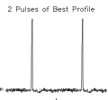
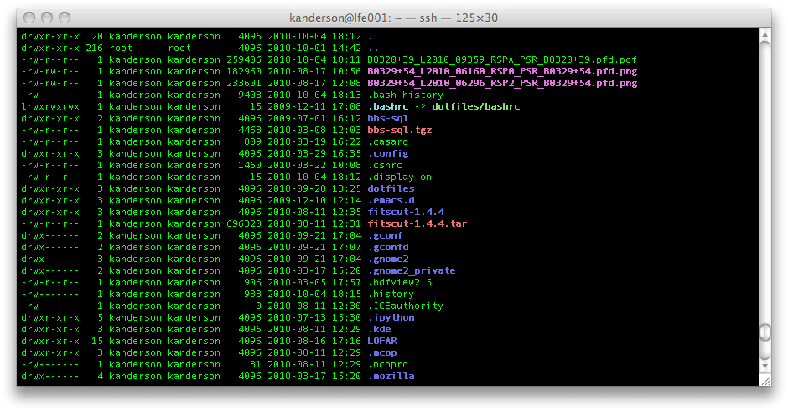
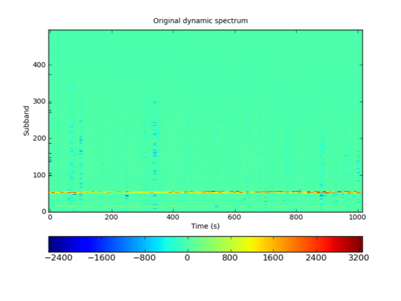
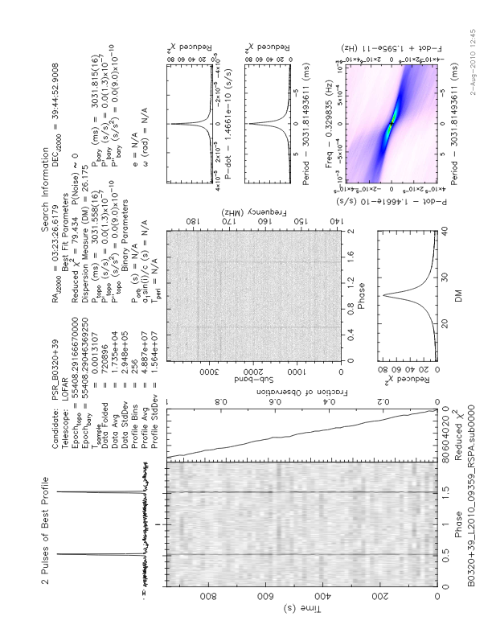
Framework Pulsar Pipeline
pulp prepfold and supplemental
plots

Slide 24
Framework Pulsar Pipeline
Near term implementation
Fly’s eye mode processing
Multi-beam observations
Coherentstokes processing
Pending beam-formed data in HDF5 format
FOV position pulsar name(s) determination
Implement “pulsars_at_location.sh” vis-a-vis pulp shell script

Slide 25
Framework Pulsar Pipeline
Future work, enhancements
Documentation (!)
User’s guide
Developer guide to recipe writing
Robust Parameter set handler
Robust data lists
Pipeline dependent on data lists
RTCP Storage log files have served
Whereabouts currently unknown
Complex pipeline definition
implement other observational modes,
new modes, requirements,
fly’s eye,
coherentstokes,
more plotting, charts, … .
Parameter and/or argument based recipe selection
Distributed writing on bf2presto process
Currently IO bound

Slide 26
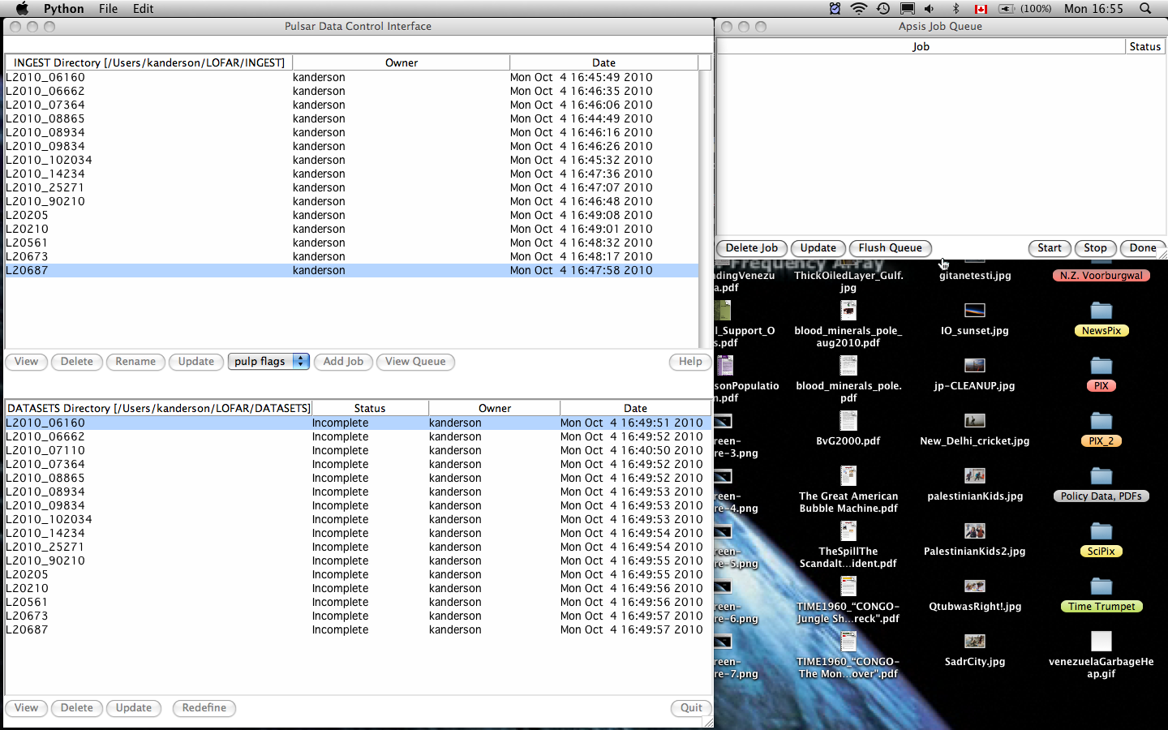
Framework Pulsar Pipeline
A existing gui control panel, usefulness under investigation

