Slide 1
Liora MLOps Bootcamp — July 2026
Australia Rain Prediction
From RAW-Data to Production - MLOps
Binary Rain Classifier · Australian Weather Stations · Full MLOps Lifecycle
Final Presentation · 13 Slides · Ines GASMI , Andrey GERBER , Gunter NEMBACH
Notes:
Introduce team members. Framing: 'We didn't just train a model — we built the infrastructure to track, serve, and monitor it like a real production system.'

Slide 2
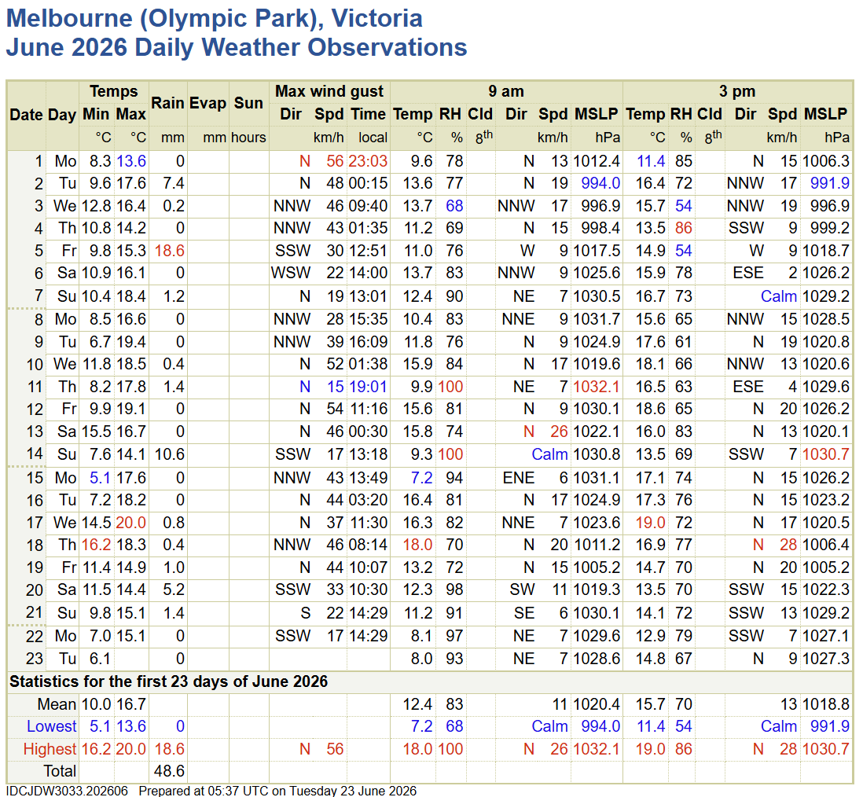
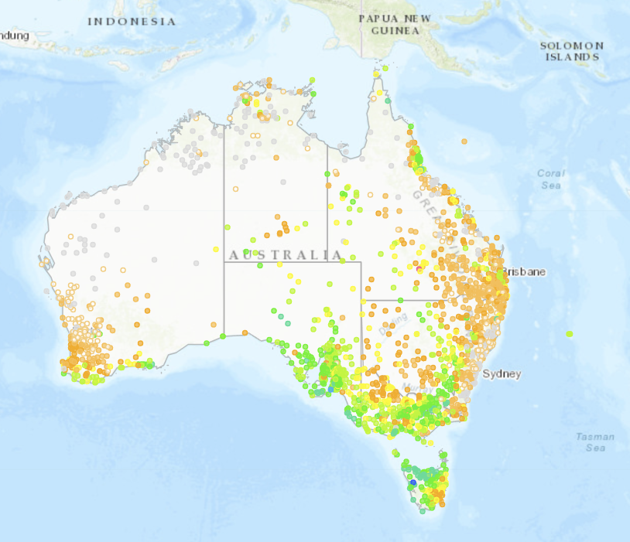
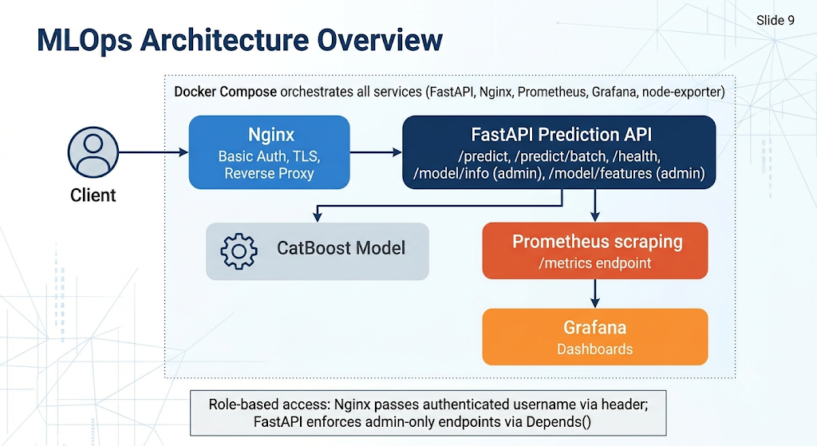
Question & Goal
Slide 2 / 13 · 2 min
Business Question
Why It Matters
Project Goal
Will it rain tomorrow at a given Australian weather station? Useful for agriculture, logistics, and event planning.
Binary forecast enabling timely operational decisions. ~22% of Melbourne days exceed 1 mm rainfall threshold.
Not only maximize predictive performance — demonstrate a reproducible, versioned, monitored MLOps lifecycle end-to-end.
⚡ ML + Ops — not just a model that works once, but a pipeline that can be retrained, tracked, deployed, and monitored repeatedly.
Notes:
Keep this short — 1 minute. Frame the project as ML + Ops. The goal was the lifecycle, not just the accuracy number.

Slide 3
Dataset Overview
Slide 3 / 13 · 3 min
145,461
23
49
~22%
Raw Rows
Features
Stations
Rain Days
2008 – 2017
weather metrics
across Australia
class imbalance
Key Features
Feature Group | Examples | Count
Numeric | Humidity, Pressure, Temperature, Wind, Rainfall… | 16
Categorical | Location, WindGustDir, WindDir9am/3pm, Season | 6
Engineered | Season (from Date → Summer/Autumn/Winter/Spring) | 1
Target | RainToday (Yes/No) — renamed from RainTomorrow | 1
Notes:
Mention that Sunshine, Cloud9am, Cloud3pm, Evaporation have significant missings (>40%) — leads to the dropna decision on next slide.

Slide 4
Data Versioning — DVC + DagsHub
Slide 4 / 13 · 3 min
weatherAUS.csv
(raw data)
.dvc pointer
(in Git repo)
DagsHub
Remote Storage
Reproducible
Data Lineage
Why DVC?
Raw data & model artifacts NOT stored in Git — only lightweight .dvc pointer files
Content-addressed blobs on DagsHub: every data version is fully reproducible
Prevents repository bloat while maintaining complete data lineage
Real lesson learned: DVC remote had gaps (blobs never pushed) → recovered from original source, re-ran dvc push to restore consistency
⚠ Lesson: DVC isn't just 'git for data' — remote storage gaps are a real failure mode. Always verify dvc push in CI.
Notes:
This is a strong 'we hit a real ops problem and fixed it' anecdote — show the DagsHub repo page if possible.

Slide 5
Feature Engineering & Preprocessing
Slide 5 / 13 · 3 min
Data Pipeline Steps
Sklearn Preprocessing Pipeline
1
Load
145,460 rows × 23 cols from BOM/Kaggle CSV
Numeric (16 features)
StandardScaler → zero mean, unit variance
2
dropna()
→ 56,420 rows (removes all rows with ANY missing value)
3
Location Filter
Melbourne, MelbourneAirport, Watsonia → 7,557 rows
Categorical (6 features)
OneHotEncoder (handle_unknown='ignore')
4
Rename Target
RainToday → RainYesterday | RainTomorrow → RainToday
ColumnTransformer → unified feature matrix
5
Season Feature
Date.month mapped to Summer/Autumn/Winter/Spring
6
Drop Date
Season captures temporal signal; raw date dropped
🔒 No Leakage: imputation/scaling statistics computed on X_train only — applied to X_test. Stratify=y preserves 76/24 class ratio in splits.
Notes:
Emphasize train/test separation discipline — the imputation and scaling statistics are computed on train only and then applied to test, preventing leakage. Explicitly verified during code review.

Slide 6
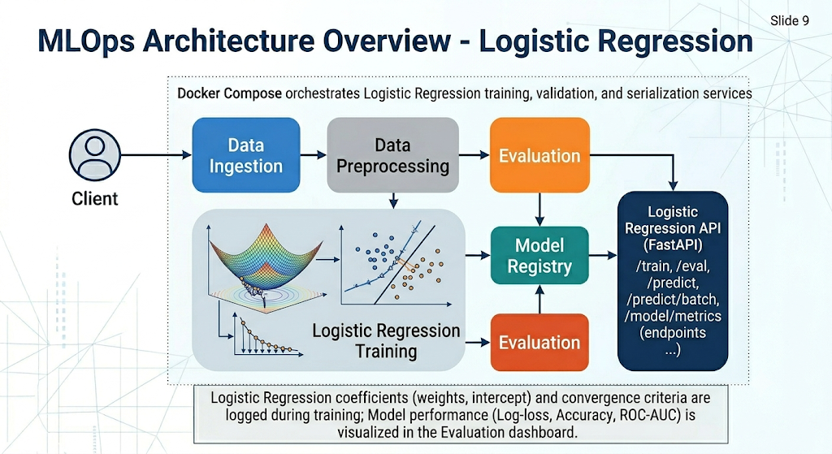
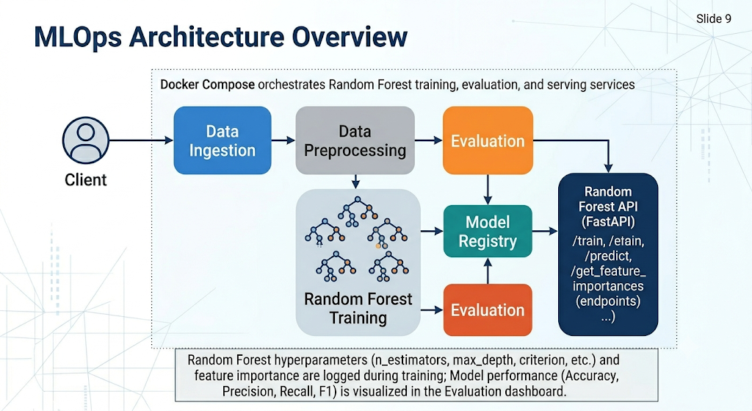
Modeling Pipeline
Slide 6 / 13 · 3 min
Random Forest (Primary)
Logistic Regression (Baseline)
n_estimators: [50, 100]
max_depth: [None, 10, 20]
min_samples_split: [2, 5]
→ 12 combos × 5 folds = 60 fits
StratifiedKFold(n_splits=5, shuffle=True)
Scoring: accuracy
solver: ['liblinear']
penalty: ['l1', 'l2']
class_weight: [None, 'balanced']
→ 4 combos × 5 folds = 20 fits
Same StratifiedKFold strategy
Note: penalty deprecated in sklearn ≥ 1.8
Chronological discipline: split respects time-series nature of weather data → no future pattern leakage. Full pipeline: Preprocessor → Classifier → GridSearchCV.
Notes:
Explain why chronological split matters for weather data — avoids leaking future weather patterns into training.

Slide 7
Model Results
Slide 7 / 13 · 4 min
~85%
83%
76%
51%
RF Accuracy
LR Accuracy
Baseline
LR Recall
Random Forest
Logistic Regression
Always predict No Rain
Rain class (Yes)
Detailed Comparison
Metric | Random Forest | Logistic Regression | Advantage
Accuracy | ~85% | 83% | RF
Precision (Rain) | Higher | 0.68 | RF
Recall (Rain) | Higher | 0.51 | RF
F1 (Rain) | Higher | 0.58 | RF
Interpretability | Medium (feat. importance) | High (coefficients) | LR
Training Time | ~0.4–0.9s/fold | ~0.1–0.2s/fold | LR
Notes:
Most important feature: Humidity3pm. Dataset imbalanced 76/24 — naive baseline would be 76%. Our RF at ~85% meaningfully beats that. Recall for Rain class is the real indicator of model quality for this problem.

Slide 8
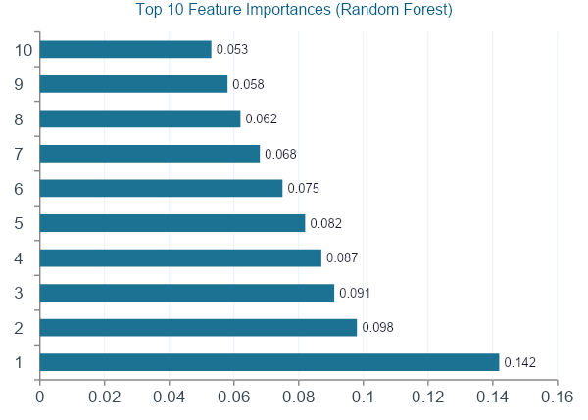
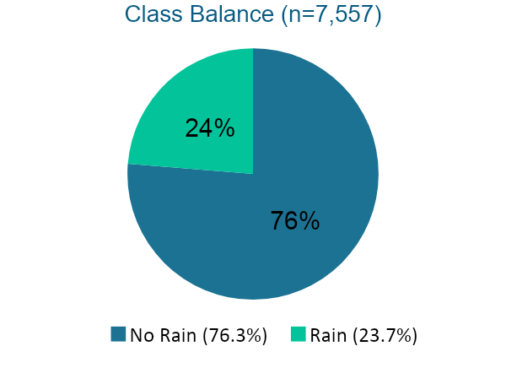
Model Results — Visual Analysis
Slide 8 / 13 · 4 min
Key Insight
Humidity3pm is the #1 predictor
Followed by pressure measurements
Imbalanced classes → always use stratify=y
Notes:
Pull a screenshot directly from the DagsHub MLflow run page to show real artifacts if possible. The feature importance numbers here are illustrative — replace with actual values from your run.

Slide 9
MLOps Architecture Overview
Client
Browser/API
Nginx
Reverse Proxy
FastAPI
Prediction API
CatBoost
Model
MLflow
Tracking
Prometheus
Scraping
Grafana
Dashboards
/metrics
Endpoint
API Endpoints
Security & Access Control
POST /predict → RainToday: Yes/No + confidence
Nginx: Basic Auth + TLS / SSL termination
Role-based access: admin vs. user via Depends()
Auth username passed via header to FastAPI
Docker Compose orchestrates all services
⚠ Credentials externalized to env vars (roadmap)
GET /health → service status
GET /metrics → Prometheus metrics
GET /model/info → active model version (admin)
GET /model/features → feature schema (admin)
Notes:
Walk through the request path left to right on the top row. This slide is the visual anchor for the whole 'Ops' half of MLOps.

Slide 10
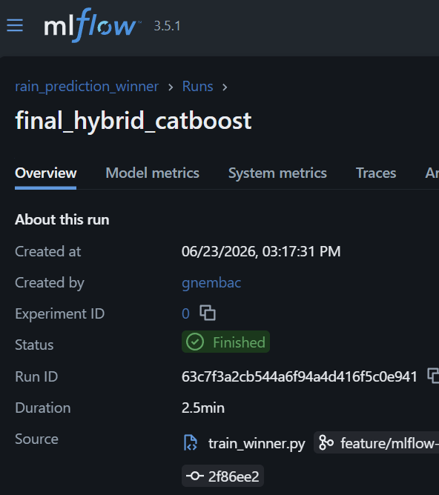
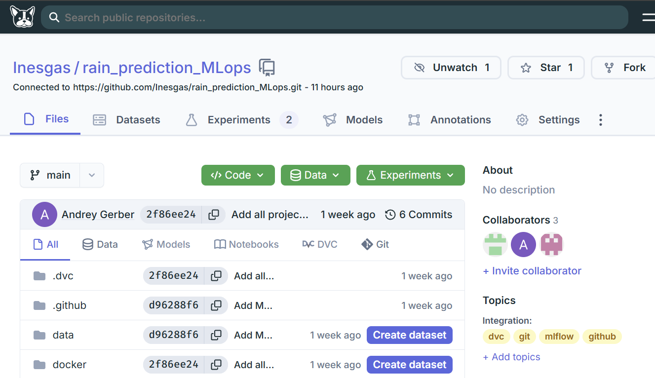
Experiment Tracking — MLflow + DagsHub
Slide 10 / 13 · 5 min
What Gets Logged Per Run
MLflow Integration Snippet
📌
Hyperparameters
import mlflow
n_estimators, max_depth, min_samples_split (RF) / solver, penalty, class_weight (LR)
with mlflow.start_run():
mlflow.log_params(grid_search.best_params_)
📊
Evaluation Metrics
mlflow.log_metric('accuracy', best_score)
accuracy, precision, recall, F1 (per class + weighted avg)
mlflow.sklearn.log_model(
grid_search.best_estimator_,
📅
Test Period Dates
'rain_classifier'
Train/test date ranges for reproducibility
)
🗂️
Model Artifact
Trained sklearn pipeline (CatBoost / RF / LR) logged as MLflow artifact
🔗
DVC Pointer
Link to versioned data snapshot used in training run
Notes:
Show a live screenshot of the DagsHub MLflow run page (parameters + metrics + artifacts tabs) — concrete proof, not just a claim.

Slide 11
Monitoring — Prometheus + Grafana
Slide 11 / 13 · 5 min
Infrastructure Metrics (Auto-instrumented)
Custom ML / Business Metrics
✅ Request latency (histogram)
rain_predictions_total
predictions by location + outcome
✅ Request counts by endpoint
rain_prediction_confidence
confidence score histogram
✅ HTTP status code distribution
rain_input_humidity/rainfall/pressure
✅ Error rate
data drift signal per location
rain_prediction_errors_total
✅ CPU / Memory (node-exporter)
error counter by failure type
🎯 Drift Monitoring: Humidity3pm & Pressure9am gauges serve as early-warning system when incoming feature distributions shift from training data.
Notes:
Emphasize the data-drift angle — these gauges aren't vanity metrics, they're an early-warning system if incoming feature distributions shift away from training data.

Slide 12
Limitations & Lessons Learned
Slide 12 / 13 · 3 min
🗄️ DVC Remote Gaps
🔒 Hardcoded Credentials
Missing blobs discovered during project — never pushed initially. Recovered from original source, re-ran dvc push to restore team consistency.
User/role credentials originally in API code. Identified as security risk — proposed fix: externalize to environment variables / secrets manager.
📁 Unrecoverable Artifacts
👤 Coarse-grained Auth
3 baseline feature tables (~300 MB total) remain unreproducible — no script regenerates them from raw data. Documentation gap.
Role-based access is admin vs. user only. No per-user rate limiting or audit logging yet. Acceptable for MVP, not for production.
Being upfront about real gaps is a strength in an MLOps presentation — it shows production-mindedness, not just 'it works on my machine'.
Notes:
These are real gaps found in the project. Being honest about them demonstrates maturity and production-awareness.

Slide 13
Roadmap & Closing
Next Steps
1
Externalize all credentials fully (env vars / secrets manager)
2
Automate dvc push + data integrity checks in CI pipeline
3
Add MLflow model registry stage transitions: staging → production
4
Automated retraining trigger on data drift signal from Grafana alerts
5
Extend per-user rate limiting and audit logging in FastAPI
"This project shows the full lifecycle — not just a model that works once, but a pipeline that can be retrained, tracked, deployed, and monitored repeatedly."
Notes:
End on the lifecycle framing — ties back to Slide 2's goal statement. Full circle. Thank the audience and open for questions.

