Slide 1

SAMSUNG PRISM
Generative AI
Hackathon
3rd Edition 2026 – 27
Theme ID - 02 – Smart Guided Troubleshooting Engine
Team Name – SRMIST_Puchkaz
College Name – SRMIST, KTR
Member Name & Email 1- PRISHA AGARWAL – pa6535@srmist.edu.in
Member Name & Email 2- DAKSH GUPTA - dg5502@srmist.edu.in
Member Name & Email 3- INESH AGARWAL - ia6861@srmist.edu.in
Member Name & Email 4- V DHRUV - vv2394@srmist.edu.in
Submission Github link - https://github.com/IneshAg/SRMIST_Puchkaz_Prism_GenAI

Slide 2
Theme - Smart Guided Troubleshooting Engine
Problem
Example
Customers describe device problems in highly variable language:
Formal descriptions
Short keyword queries
Casual/frustrated language
Typos and misspellings
Different device models
Different ways of describing the same symptom
“The mobile phone screen is cracked and flashes intermittently.”
The system needs to understand that this refers to a screen/display issue, identify the relevant troubleshooting procedure, and return structured actions.
Core challenge
Raw complaint → Understand intent → Find relevant solution → Return actionable steps

Slide 3
Existing Solutions & Gaps
EXISTING APPROACH | Gap
Human agent reading SIIS/KB | About 15 min per case, inconsistent, doesn't scale to millions of interactions
Static FAQ / keyword search | Breaks on colloquial or typo-heavy phrasing; returns articles, not plans
Plain LLM chatbot | Hallucinates steps, injects generic help URLs, alters deeplinks, slow and costly on every call
Exact-string caching | Paraphrases miss the cache, so latency and cost stay high
Prompt-only constraints | Word limits and format rules aren't reliably followed
Takeaway: A fast, grounded, verifiable system needs programmatic guardrails around the LLM, not just a better prompt.

Slide 4
Our Solutions & Architecture Diagram
Pipeline (POST /v1/troubleshoot):
Stage 1, Structure Extraction: the LLM parses SIIS text into Goal → Actions → StepGroups. Validators check goal, title and description syntax and word counts. Each step must be supported by the source text, and a fixable issue is repaired rather than rejected.
Stage 2, Deeplink Mapping: char n-gram TF-IDF retrieval over the catalog's descriptions, never the URI strings. A rule guard assigns critical or manual categories, sorts critical actions last, and falls back to bixby://dummy_positive when similarity is low.
Scrubber: strips URLs and verifies deeplinks against the catalog, then the plan is cached and returned as pure JSON
Stage 0, Query Enrichment: extracts the device with regex, then matches a 35-category symptom taxonomy. This normalizes the text into a canonical query and produces 8–10 paraphrases (formal, casual, keyword, frustrated, typo). It also produces a confidence score. An optional guarded LLM fallback runs only when nothing matches.
Semantic Cache check (Stage 3): a hit returns the validated plan with no LLM call. A low-confidence query skips the cache entirely.
Relevance gate: if the SIIS text is off-topic, return contexts: [] with fallback: "no_match". If there is no SIIS text, return no_siis_context.

Slide 5
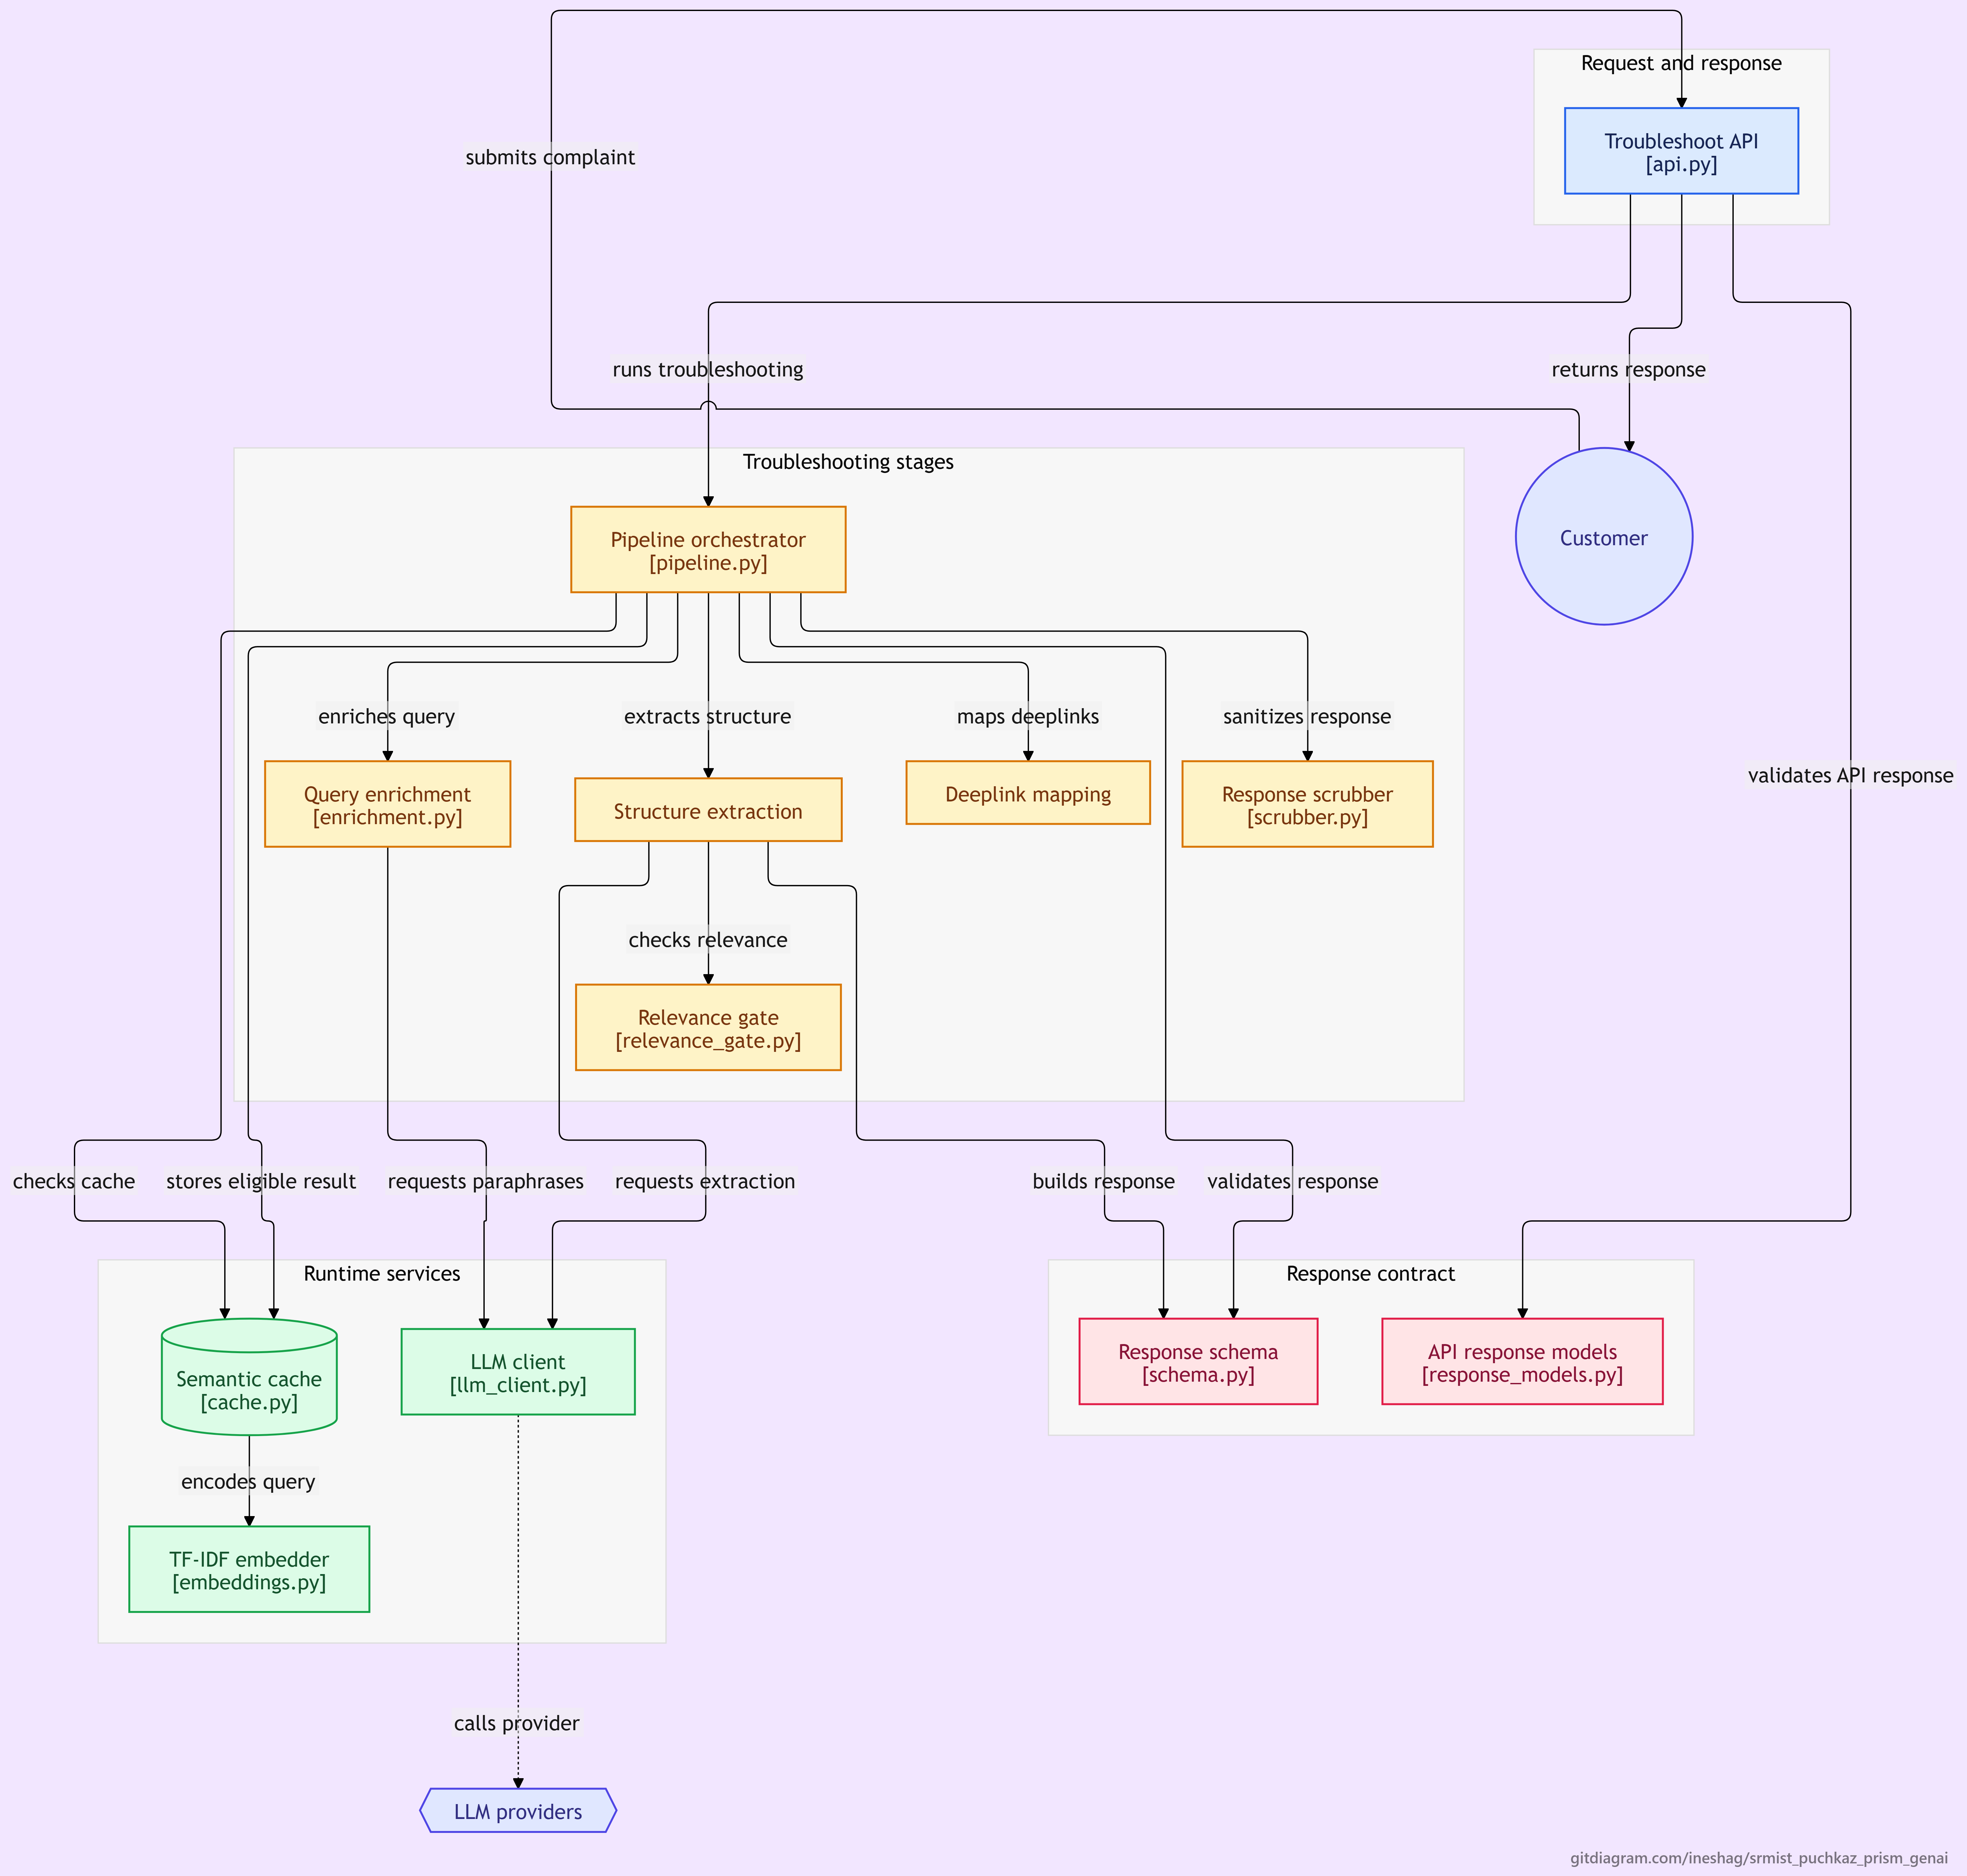

Slide 6
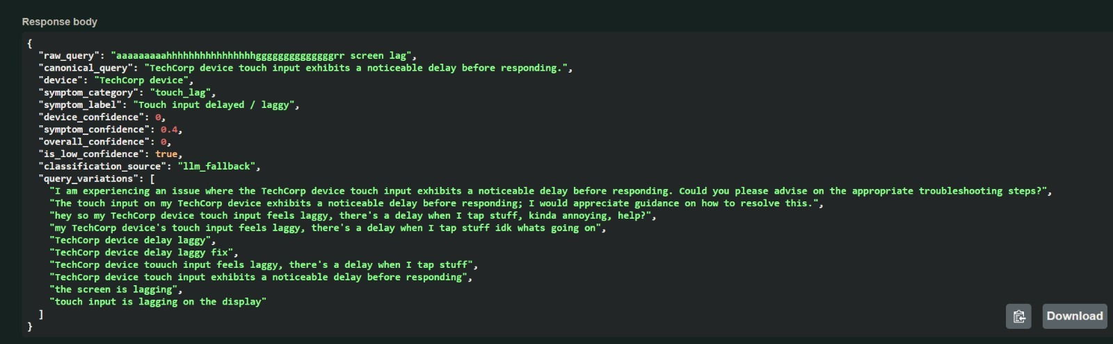
Demo & Product Walkthrough
https://drive.google.com/file/d/1_ooCOpjRS2G8lOtwKyPkBSGQNYcRL5gH/view?usp=sharing
Suggested 5-minute demo flow:
GET /health returns {"status":"ok"}.
Cold request: "phone swipe gestures wrong direction after app install" with a SIIS text. Show the goal, the ordered actions, and the deeplink on the auto action. Show meta: cache_hit:false, latency, model, cost.
Cache hit: send a paraphrase with no SIIS text, such as "my S22 display is completely black". Show cache_hit:true at about 2 ms.
Guardrails: send an off-topic SIIS article to show no_match, and a bare complaint to show no_siis_context.
Show validate_results.py passing on results.jsonl.

Slide 7
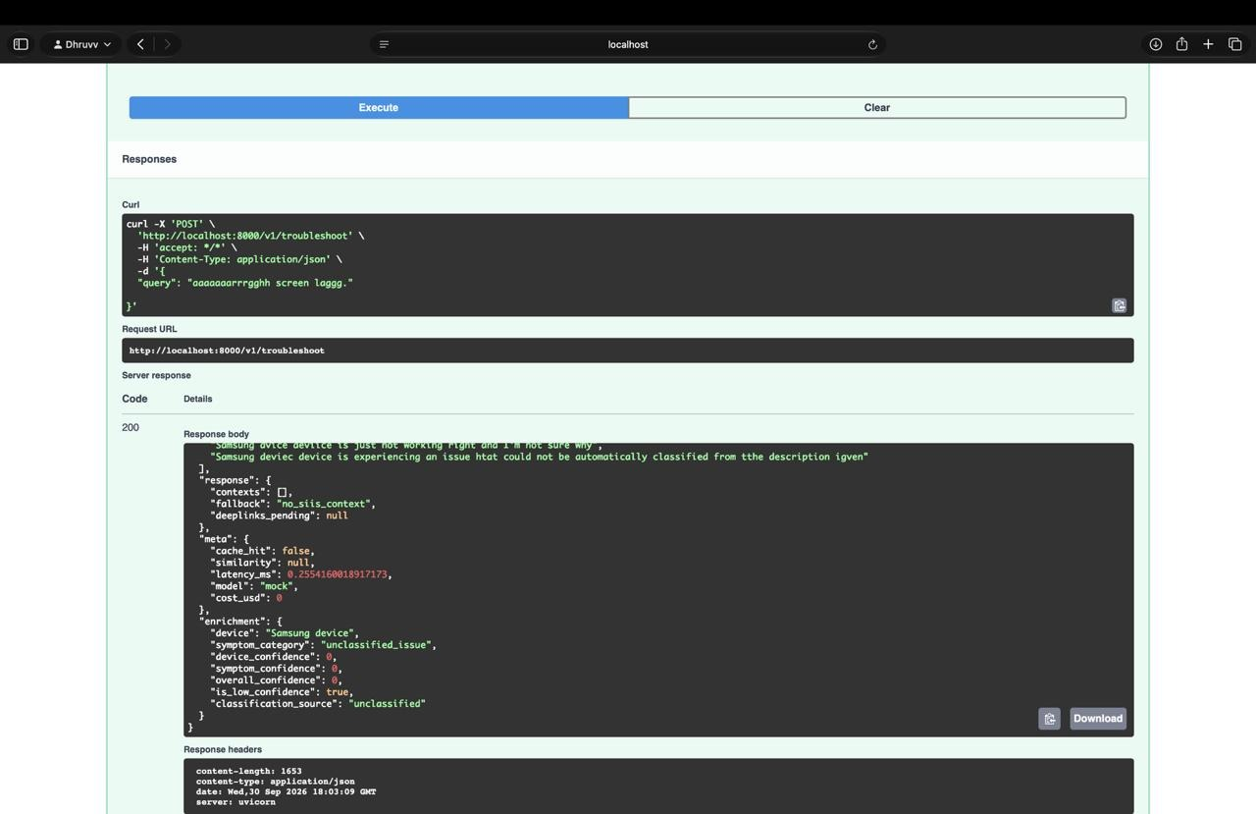

Slide 9
Tools and tech stack used
Language and API: Python 3.11, FastAPI, Uvicorn, Pydantic (the official schema.py contract)
LLM: Gemini (gemini-3.5-flash-lite) via a pluggable client. OpenAI, Anthropic and an offline mock are also supported. temperature=0, response memoization, 30 s timeout guard, per-request token cost tracking.
Retrieval and embeddings: scikit-learn char n-gram TF-IDF (3–5, char_wb) with cosine similarity over sparse matrices (SciPy and NumPy). This was chosen because HuggingFace was blocked on our network. Fully offline, typo-tolerant, and the Embedder protocol lets a dense model drop in later.
Cache: in-memory semantic cache, device-gated, thread-safe, pre-warmed from results.jsonl
Quality: pytest (119 test functions), validation scripts, benchmark scripts
Deploy: Docker (python:3.11-slim, healthcheck, vectorizer built at image build time)

Slide 10
Impact & Use case
Support time: about 15 min of manual triage becomes seconds, and about 2 ms on repeated issues.
Cost: a cache hit makes no LLM call and costs $0.00. Cold queries have tracked per-request cost.
Customer experience: a tappable deeplink replaces "go to Settings > Display > Navigation bar".
Safety and trust: no fabricated steps or links, and destructive actions always come last.
Use case walkthrough
Use case walkthrough: a user reports "swipe gestures go the wrong way after installing an app". The engine returns "Follow these steps to perform this Swipe Navigation Troubleshooting", with an auto action linked to the navigation bar settings.
Where it plugs in: Bixby, the Samsung Members app and agent-assist tools.

Slide 11
Innovation highlights, results and limitations
What Makes Our Solution Different?
1. Multi-register understanding
Formal + casual + keyword + frustrated + typo.
2. 32-category symptom intelligence
The taxonomy extends beyond only screen problems.
3. Deterministic + Generative AI
Rules handle known patterns while LLMs provide controlled fallback and enrichment.
4. Semantic deeplink mapping
Connects natural-language actions to device operations.
5. Device-aware semantic cache
Similar queries are matched while maintaining device isolation.
6. Grounded response generation
Troubleshooting actions are derived from the supplied troubleshooting knowledge.
7. Zero-URL-leak protection
Prevents unwanted URLs from leaking into the final response.

Slide 12
What’s next
1
2
Replace the keyword taxonomy with a learned intent classifier.
Handle multi-intent complaints, and clarify when a complaint is ambiguous.
3
4
Build a graded ground-truth set to score step accuracy (0–3) and deeplink relevance (0–2).
Scale the cache with bucketed or ANN lookup, since brute force reaches about 105 ms at 5,000 entries.
5
6
Persist the cache in Redis or a vector store, and add a feedback loop from "did this fix it?" signals.
Multilingual support.

Slide 13
Brownie points slide( differentiation)
Built for the brief's pitfalls: semantic cache keys, one Action = one Screen, regex URL scrubbing, matching on descriptions, and programmatic word-count enforcement.
Concurrency-safe cache, and a global error handler that never leaks a stack trace.
Extras beyond the contract: /v1/enrich, /v1/cache/stats, and an enrichment debug block with confidence scores.
Runs fully offline in mock mode, with no API key needed for the cache and the deterministic stages.
One command to reproduce: generate_results.py, validate_results.py, eval_paraphrase_hits.py.
Honest engineering: bugs found and fixed are documented in the README, for example the false classification on non-screen complaints and the cache serving empty or wrong-article answers.

Slide 14
Checklist- Updated on Public GitHub
Working prototype code — public or shared GitHub repo (Y/N) - Y
README with reproducible setup instructions (Y/N) - Y
Demo video, max 5 minutes (YouTube or Drive link) - Y
Presentation file (PPT or PDF) (Y/N) - Y

Slide 15
Thank you
pa6535@srmist.edu.in
https://docs.google.com/forms/d/e/1FAIpQLSd_WWF7mnEVUWV3eC-Ptc2PKeJ5Mt_422EknsfShKo_l1y3Og/viewform?edit2=2_ABaOnuenWDHxGAclXChZSHLoFlyEr9ohm8_h64DtXlPx3xwWv59VGoTGP7rUkO6eeZiLAV4
Organised by the Language AI Team and the PRISM Team, Samsung R&D Institute India
Notes:
Closing slide. Add the Google Form URL and a contact email before sharing. Edition 2 organising team for reference: Language AI - Sourabh Tiwari, Gaurav, Sanjeeth Pothireddy, Gorang Maniar; PRISM - Binny Lakra, Prakhar Chandrakar, Vishu Kumar; Kick-off and mentors - Giridhar Jakki, Deepraj Prabhakar Patkar (Language AI), Srimanu Prasad Nagaraju, Ashish Kumar (Tech Strategy).

