Slide 1
Environment
3 User classes with different functions of
Number of daily clicks
Cumulative daily cost
Purchase conversion rate
Bernoulli distribution independently drawn
N_arms= 5, different possible prices for every class
T=365
100 bids

Slide 2
Fashion website
E-commerce parameters
User Classes: 3 (Class C1, Class C2, Class C3)
Feature 1: Probability of clicking on a product(Bernoulli distribution)
Feature 2 : Probability of making a purchase after clicking(Bernoulli distribution)
Number of Prices: 5
Number of bids: 100
Time horizon: 365 days
Number of daily clicks, Cumulative daily cost e Purchase conversion rate: different for each class.

Slide 3
Pricing problem
Is the problem of finding the optimal price.
Tipically by maximizing the profit Π(p)=(p−c)⋅D(p), where:
p is the price,
c is the cost,
D(p) is the demand function.

Slide 4
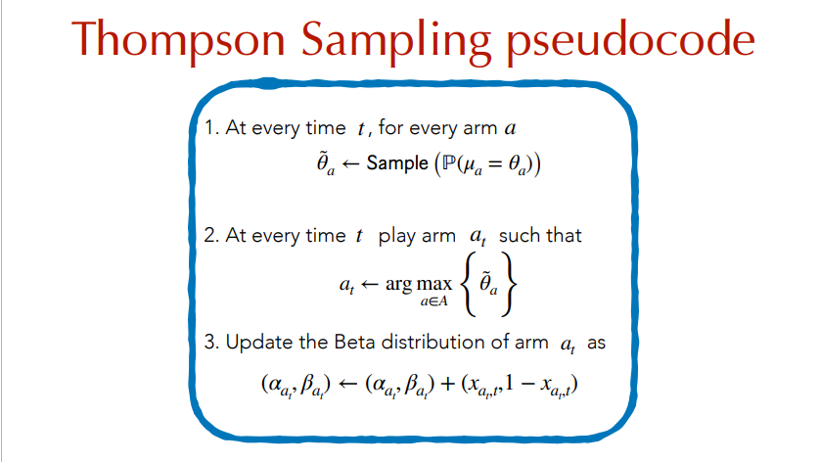

Slide 5
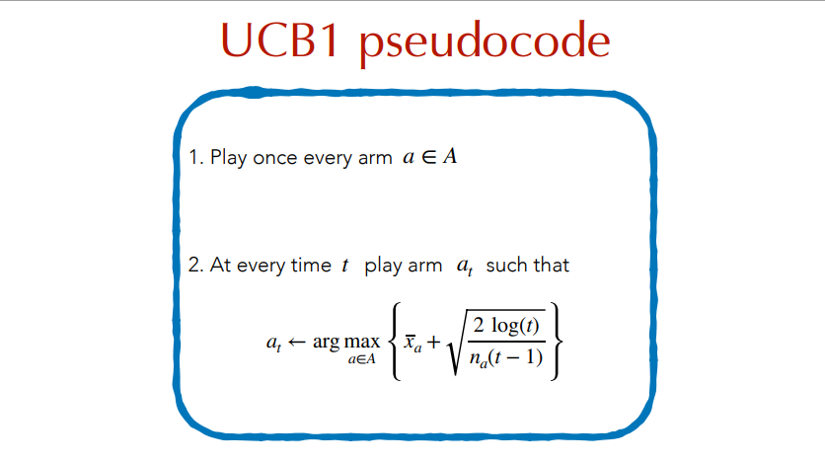

Slide 6
Requests
The average and standard deviation of
Cumulative regret
Cumulative reward
Instantaneous regret
Instantaneous reward

Slide 7
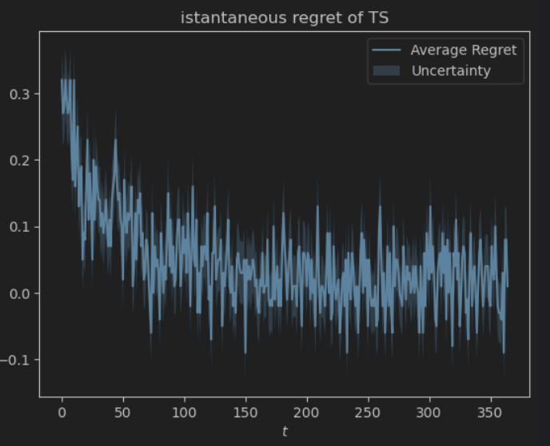
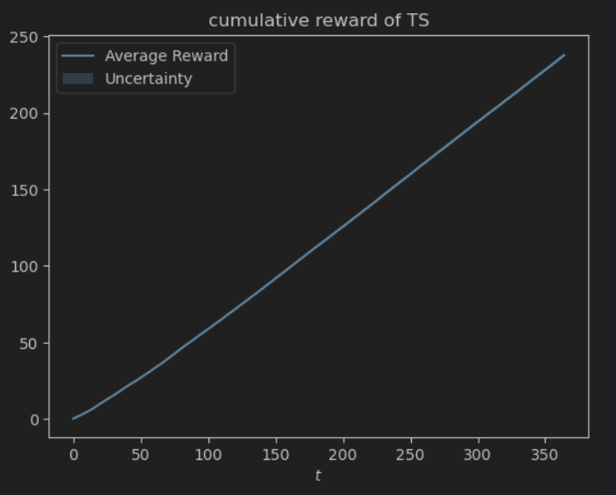
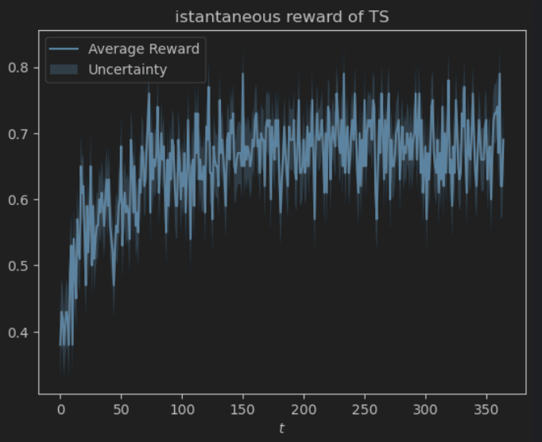
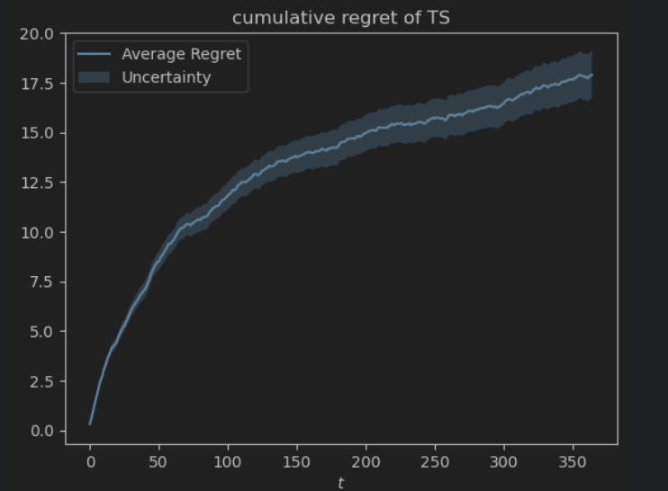
TS algo results

Slide 8
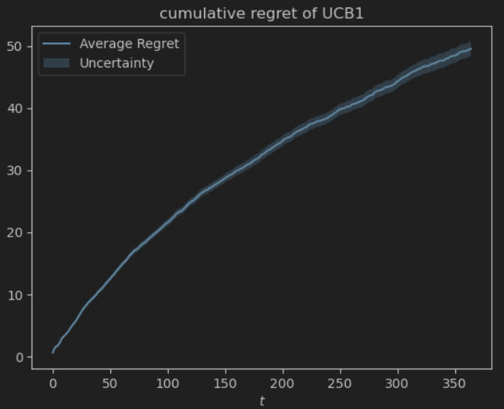
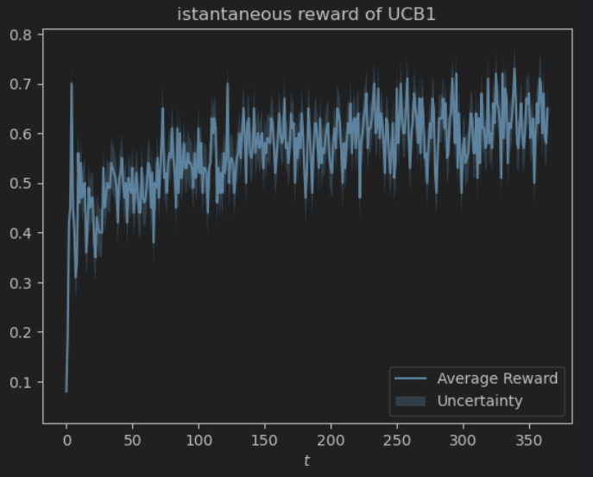
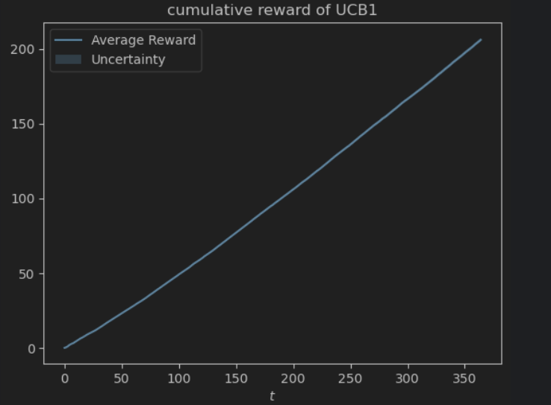
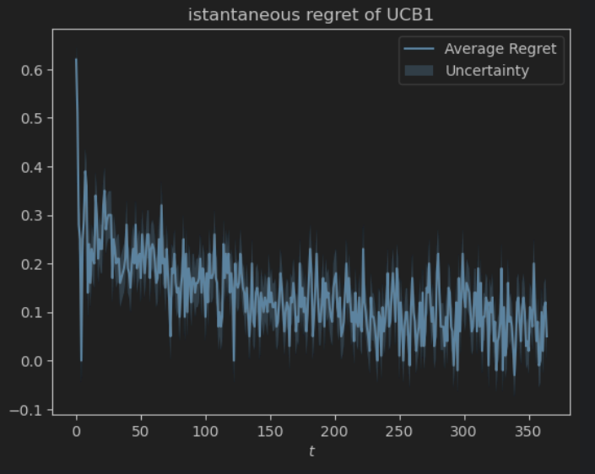
UCB1 algo results

Slide 9
TS vs UCB1
TS plots are more uncertain because UCB1 is a deterministic algorithm and TS is a randomized algorithm
The upper bound of the expected cumulative regret is much less than the lower bound of the expected cumulative regret of UCB1, they are disjoint therefore TS performs better than UCB1, but this is true also in general
But in general is difficul to extend TS algo to more difficult settings

Slide 10
Advertising problem
The problem: given a daily budget for a campaign, what is the best constant bid and daily budget for every sub-campaign
The advertiser’s goal is to find the optimal bids and daily budgets for every sub-campaign subject to the cumulative daily budget constraint.
It is an optimization problem

Slide 11
Gaussian processes
In the setting of countinuous pricing
Model observations as multivariate normals
They use the Kernel Function which describes the information gain of pulling an arm, how it affects the rewards of the other arms, we are using the Radial Basis Functon Kernel (RBF)

Slide 12
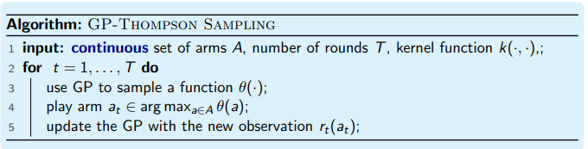
GP-TS

Slide 13
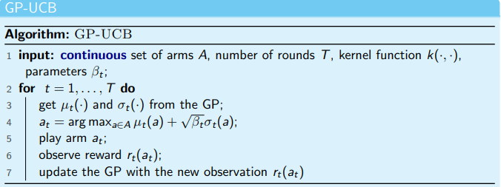
GP-UCB1
Extends UCB1, uses the variance of the random variable as the range (even though the support of the distribution is infinite)

Slide 14
Non-stationary environments
Rewards change during time
Therefore, generate a sequence of means and sample the rewards from that sequence of means depending on the time you are choosing your action

Slide 15
Non-stationary environments with abrupt changes
The reward function changes abruptly a few times
Algorithms for stochastic environments fail in non-stochastic environments.

Slide 16
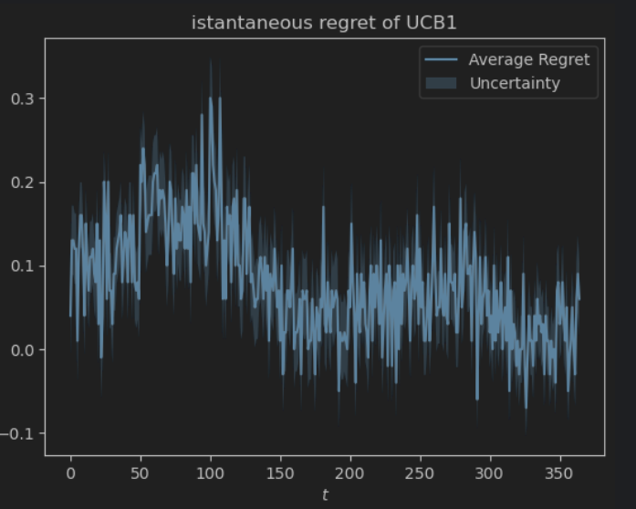
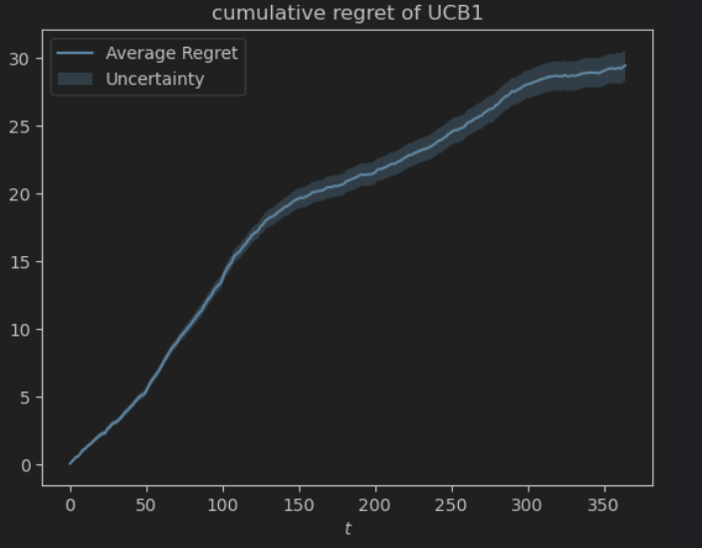
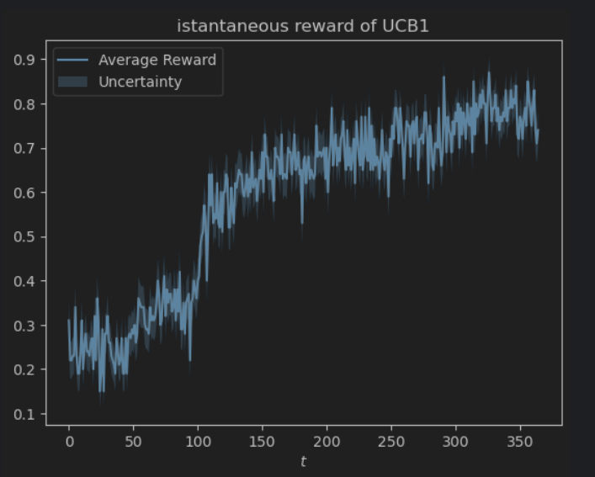
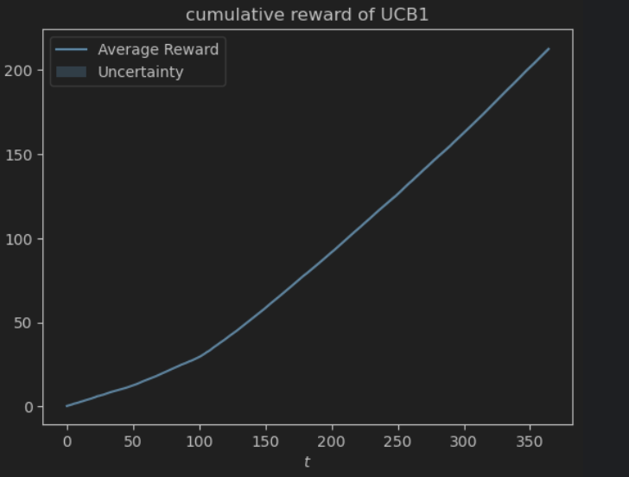
UCB1 in Non-stationary environment

Slide 17
SW-UCB1
Idea: consider only recent samples, we use a sliding window of size W to forget old samples, we compute the estimate of the algorithm using the last W < T samples
Advantages: this guarantees that the bounds do not monotonically reduce over time
Disadvantages:
SW-UCB has a cache, so it is more memory consuming
we do not exploit all the samples → the regret is larger in (almost) stochastic environments

Slide 18
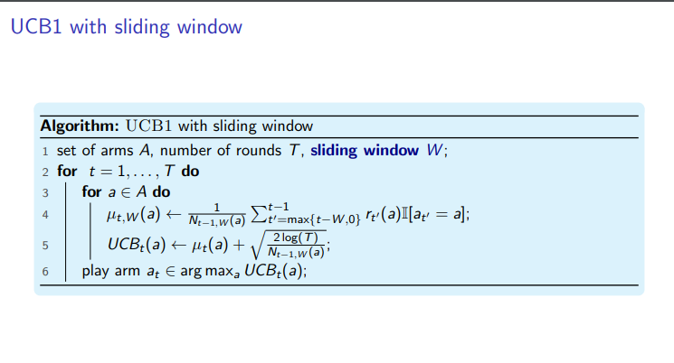

Slide 19
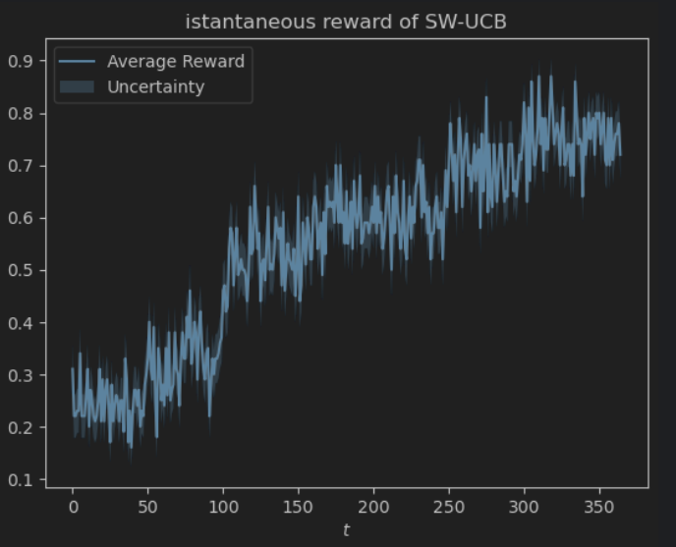
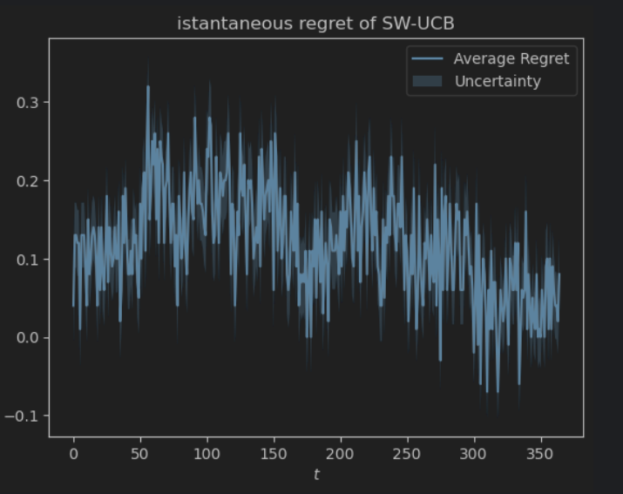
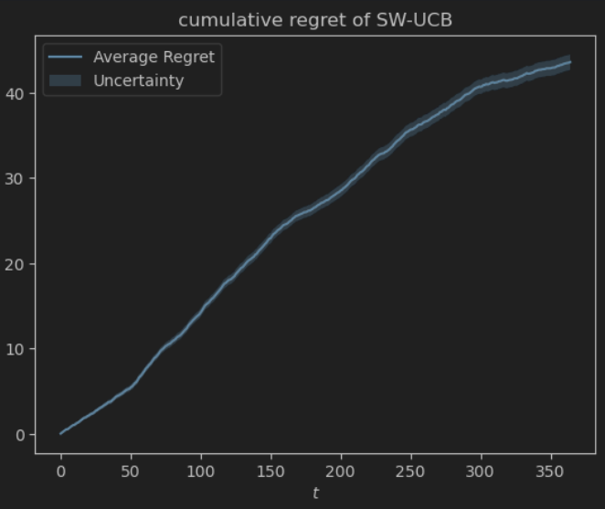
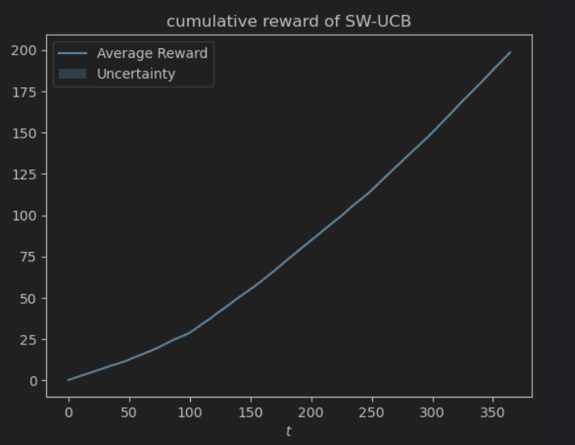
SW-UCB1

Slide 20
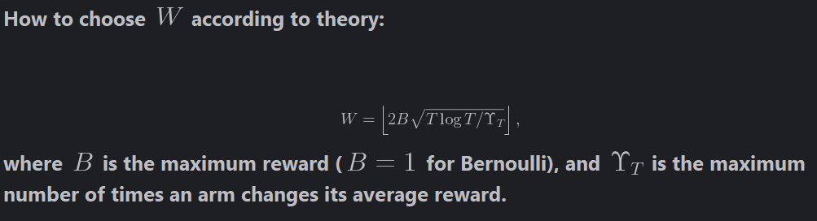
Analisys of Sliding Window lenght

Slide 21
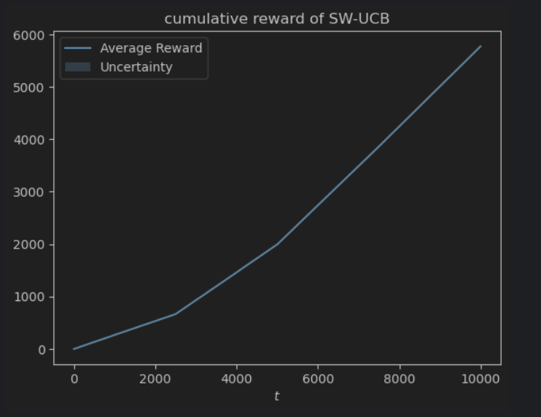

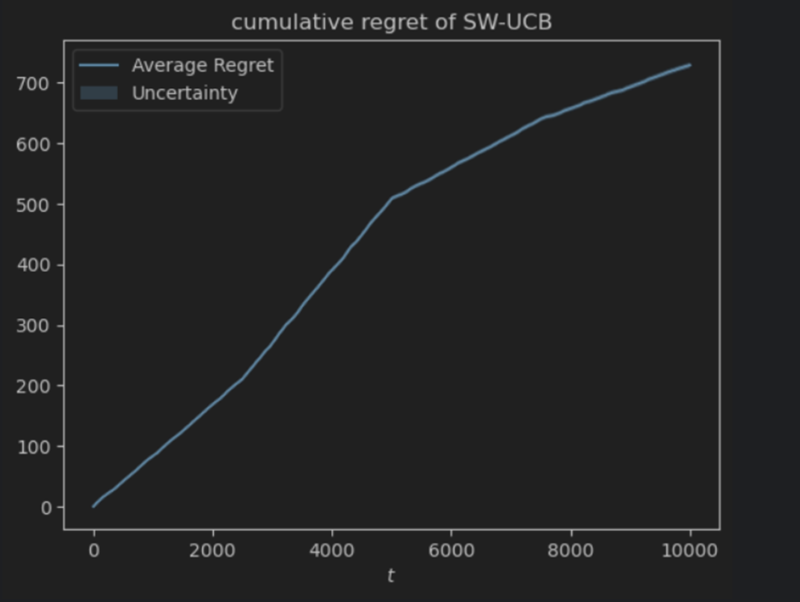
Analisys of Sliding Window lenght
By increasing T from 365 to 10000
Increase in average in cumulative regret and cumulative reward
With shorter w, cumulative regrets shows different slopes in the curve over time, it’s easier to detect suboptimal behaviors

Slide 22
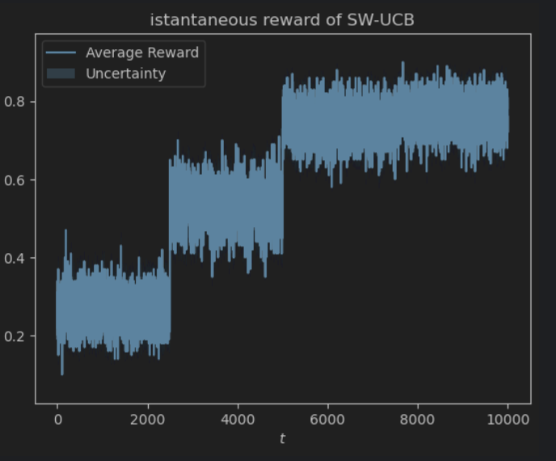
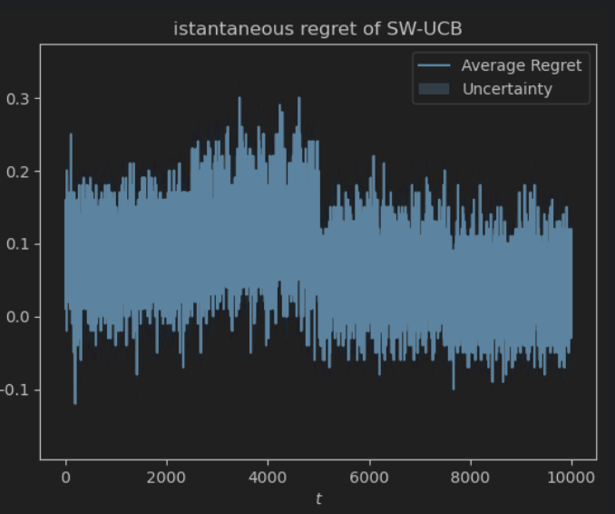
Analisys of Sliding Window lenght
Istantaneous reward is more fine-grained with shorter w so it allows better monitoring of recent actions as fluctuations in performance will be more apparent
Istantaneous regret is more fine-grained too with shorter w so it also helps detecting suboptimal behaviors

Slide 23
CUSUM-UCB: a simple change detector
Actively detects changes in the environment
Reset the learning algorithm when a change is detected
Basically works as UCB1, but uses the mean and the number of pulled arm after the last change detection to pull an arm, then looks for changes in the mean above a threshold, in case resets the parameters
Algorithm parameters :
Use the first M samples of the reward of arm a to compute the empirical mean µ(a) of the arm
ϵ The expected value or reference for detecting deviations.
H threshold, the limite above which the change is detected
Tracks the cumulative deviation over time. If this value exceeds the threshold, it signals a potential change in the process.

Slide 24
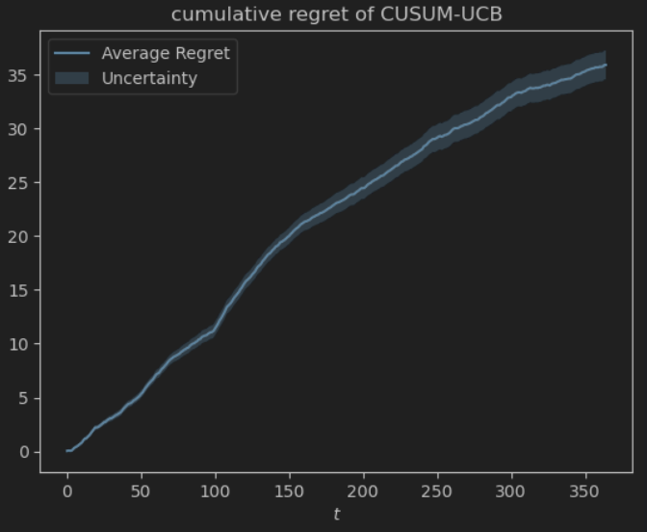
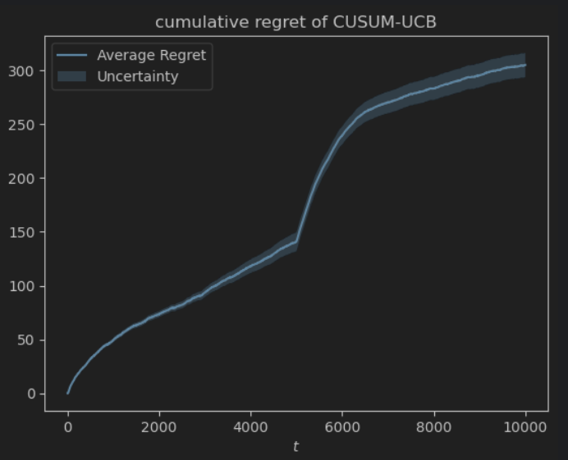
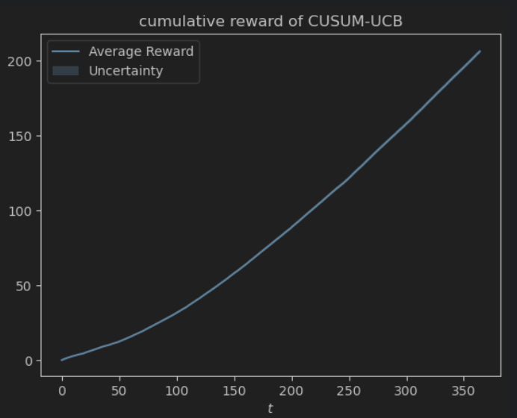
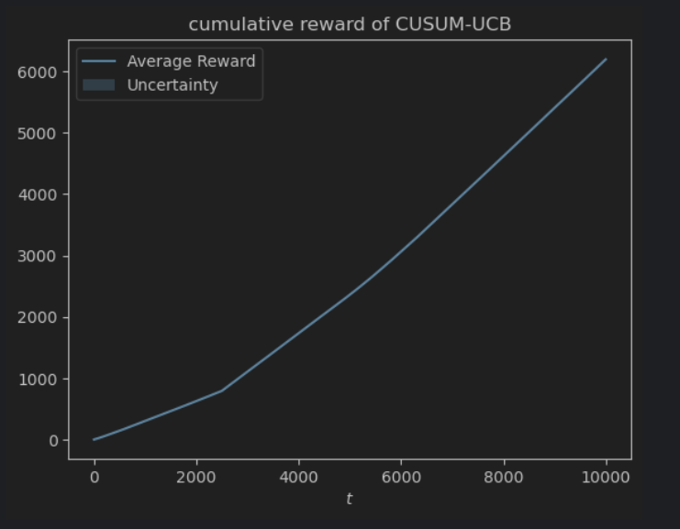
CUMSUM with changing parameters
With a higher threshold H change detection is slower, meaning the agent may continue to act suboptimally for a longer period before detecting the shift in rewards. This leads to higher cumulative regret
With higher expected value ϵ , if the target mean is too high, the algorithm may trigger alarms frequently, as even small deviations from this high target will be seen as significant. This can increase cumulative rewards
With lower ϵ , if the target mean is set too low, the algorithm might trigger fewer alarms, as observed values may not exceed the threshold often. The agent may miss opportunities to capture higher rewards, resulting in lower cumulative rewards.

Slide 25
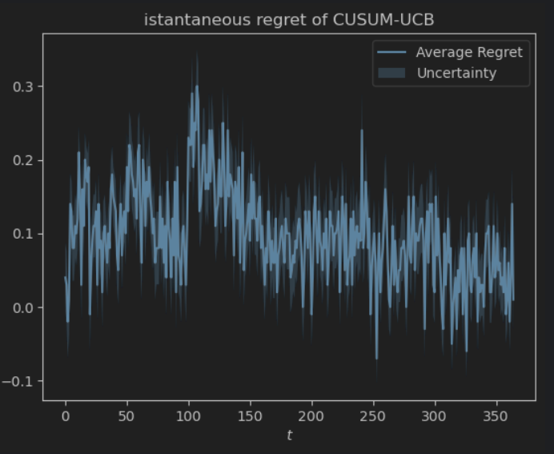
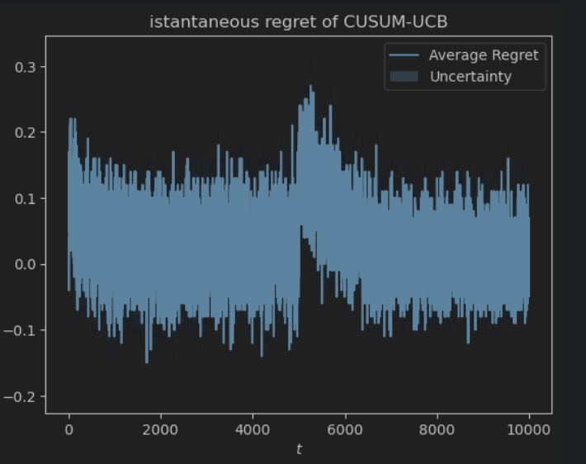
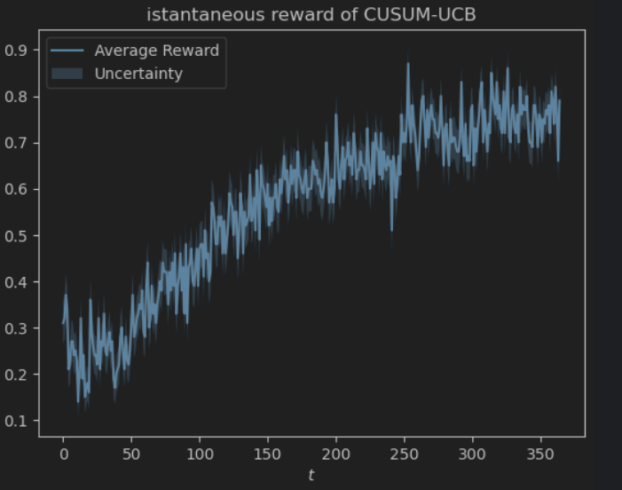
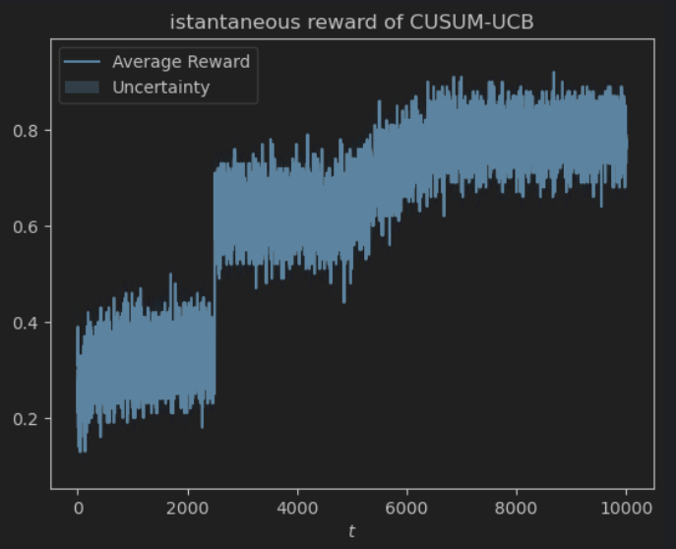
CUMSUM with changing parameters
With lower threshold, the algorithm is more sensitive, so the agent adapts faster to changes in the environment, potentially maximizing instantaneous reward sooner when the environment improves.
A lower threshold leads to faster change detection, which helps the agent reduce instantaneous regret when there is a sudden improvement in the optimal strategy.

Slide 26
SW vs CUMSUM
In SW cumulative regret is smoother while in CUMSUM there are jumps and it is smaller in average
In CUMSUM regret is piecewise sublineare, due to the reset strategy, that tries to exploit the initial(before changes) behavior of ucb1 in non stationary environment

