Slide 1

Basic PowerShell
An object oriented shell- and scripting language

Slide 2
Basic PowerShell
What
History
Basic usage
Functions and Modules
Useful Tools
PowerShell Core
Q & A
Notes:
Background
What is powershell
Shell
Cmd and Unix commands
Brief History
Versions
Evolution
vNext
Basic usage
Basic commands
Variables, Pipelines and functions
Data output (out-grid, to general file)
$profile
Aliases
Creating functions and Modules
Basic functions
Modules setup
Install scripts
Useful Tools
ISESteroids
PoshGit
VS Code
PowerShell Core
What is it
Mac and brief look
Q and A

Slide 3
What
What is PowerShell?
An object oriented scripting and shell language.
Designed for task automation and configuration management.
Based on the .NET framework where cmdlets represent small classes as system commands.
Notes:
What:
You can create objects with a set of functions and a constructor
Cmdlets (command-let)
Performs a single function and is the most common element for PowerShell automation. A cmdlet is generally written in a language such as C# and compiled. Like all other PowerShell commands, a cmdlet performs an action and returns a .NET object.

Slide 4

History
PowerShell 1.0
PowerShell 3.0
PowerShell 5.0
2006
2009
2012
2013
2014
2016
PowerShell 2.0
(ISE introduced)
PowerShell 4.0
PowerShell 6.0 Alpha
https://4sysops.com/archives/powershell-versions-and-their-windows-version/
Notes:
V1
Default: Server 2008
Installable
XP
Vista
Server 2003
V2
ISE Added
Default:
Win 7
Server 2008 R2
Installable:
XP
Vista
Server 2003 + 2008
V3
Default:
Win 8
Server 2012
Installable:
Win 7
Server 2008 R2
V4
Default:
Win 8.1
Server 2012 R2
Installable:
Win 7
Server 2008 R2
Server 2012
V5
Default:
Win 10
Installable:
Win 8.1
Server 2012 R2
V6
Installable on multiple platforms
Still in beta
PowerShell is forward compatible
Forward => as long the script has the required modules and functions accessable Functions that disappeared or aren’t available in newer versions will fail.

Slide 5
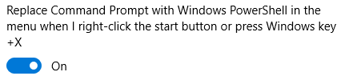
Basic usage
PowerShell Terminal
Ctrl + Space: starts autocomplete (interactive)
Tab to scroll through available options
“-” used to set a specific parameter, also has autocomplete.
Copy selected text with Ctrl + C or by pressing enter.
Past text with Ctrl + V or by right clicking.
Windows 10 is replacing cmd prompt in the WIN + X menu by PowerShell.
You can change this setting by searching for PowerShell in the settings:

Slide 6
Basic commands
Command | Descriptions | Useful options
Update-Help | Update your local help information to enable display of full help details
Get-Help <command> | Get help about a command | -ShowWindow
Get-Command | Shows the available commands in your session | -Verb
Get-Item | Return a specific file or directory
Get-ChildItem | Return the content of a directory | -Recurse -Filter
Get-Content | Read the content of a file
Copy-Item | Copy file or directory | -Recurse
Notes:
Win + X , A
Update-Help
Required to run as admin
Start powershell from explorer
Get-help Get-Item
Get-help Get-Item -ShowWindow
Get-Item .\
Get-ChildItem .\
Get-ChildItem .\ -Recurse
Get-Content .\demo-basic-commands\folder2\hello.txt

Slide 7
Pipelines
Piping works virtually everywhere in PowerShell.
Windows PowerShell does not pipe text between commands. it pipes objects.
Get-ChildItem -Path C:\WINDOWS\System32
Get-ChildItem -Path C:\WINDOWS\System32 | Out-Host -Paging
Notes:
Get-ChildItem .\ -Recurse | Out-GridView

Slide 8
Functions and Variable
https://stacktoheap.com/blog/2013/06/15/things-that-trip-newbies-in-powershell-pipeline-output/

Slide 9
Modules

Slide 10
Useful Tools

Slide 11
PowerShell Core

Slide 12
Table
Financial | Column 1 | Highlight column | Right aligned
Sub heading level
Row 2 |  |  | 7,078.89
Row 3
Row 4

Slide 13
Table
Features | Detail
Sub heading level
Row 2 | Top and left aligned bullets
Row 3
Row 4

Slide 14
Table
Features | Detail
Sub heading level
Row 2 | Top and left aligned bullets
Row 3
Row 4

Slide 15
Alternative grey layout option
Introduction level
First level bullet
Second level bullet
Third level bullet

Slide 16
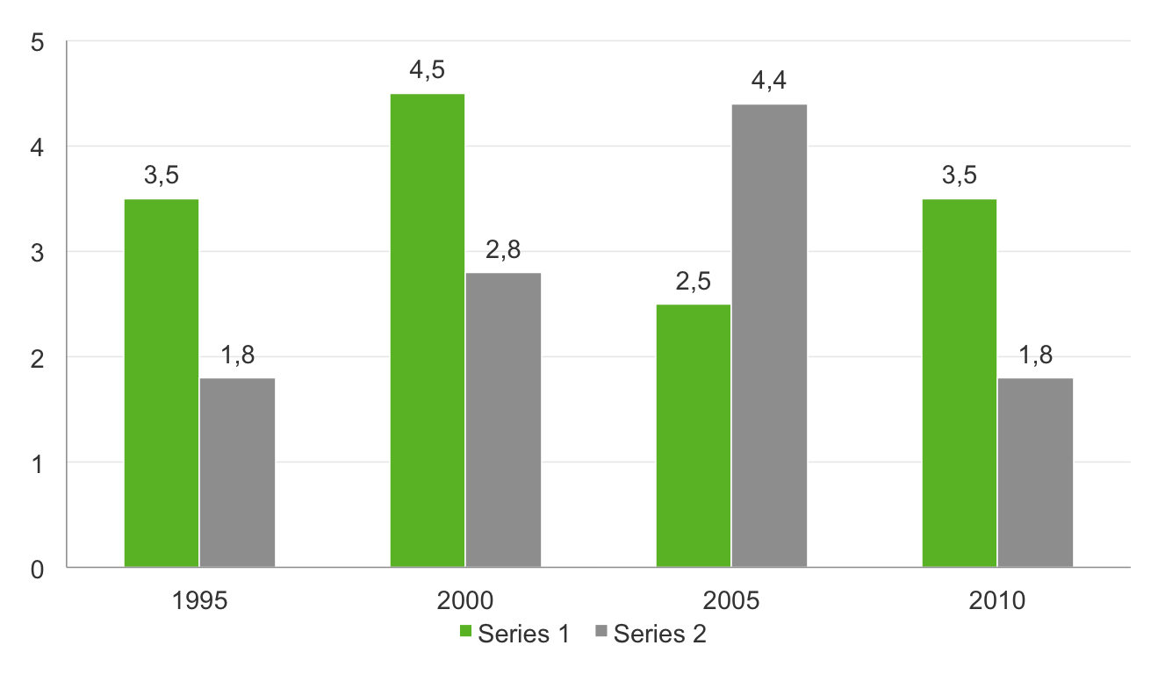
Example of column graph: 2 colours
Chart title

Slide 17
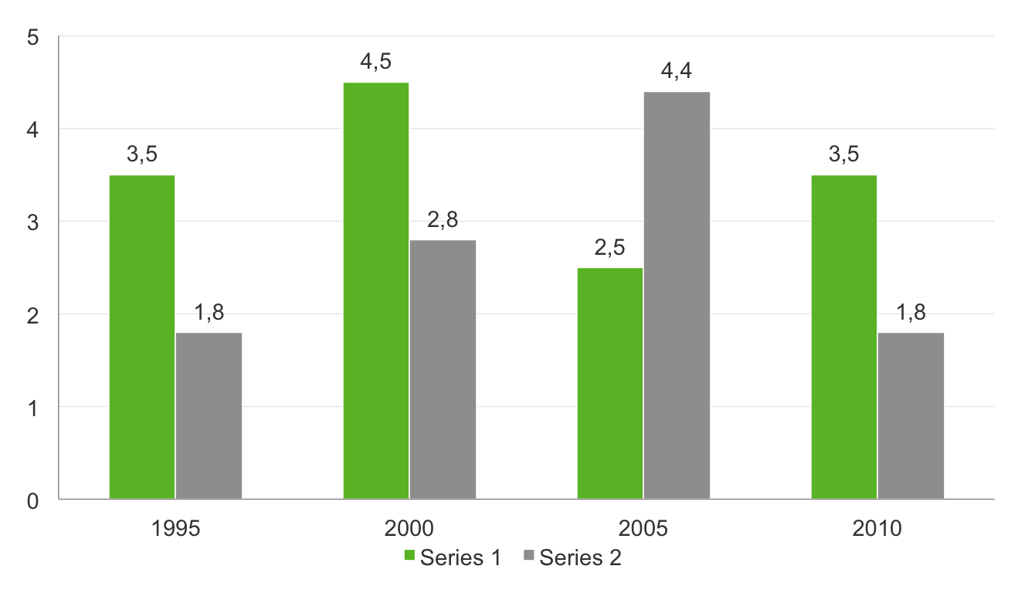
Example of column graph: 2 colours on grey background
Chart title

Slide 18
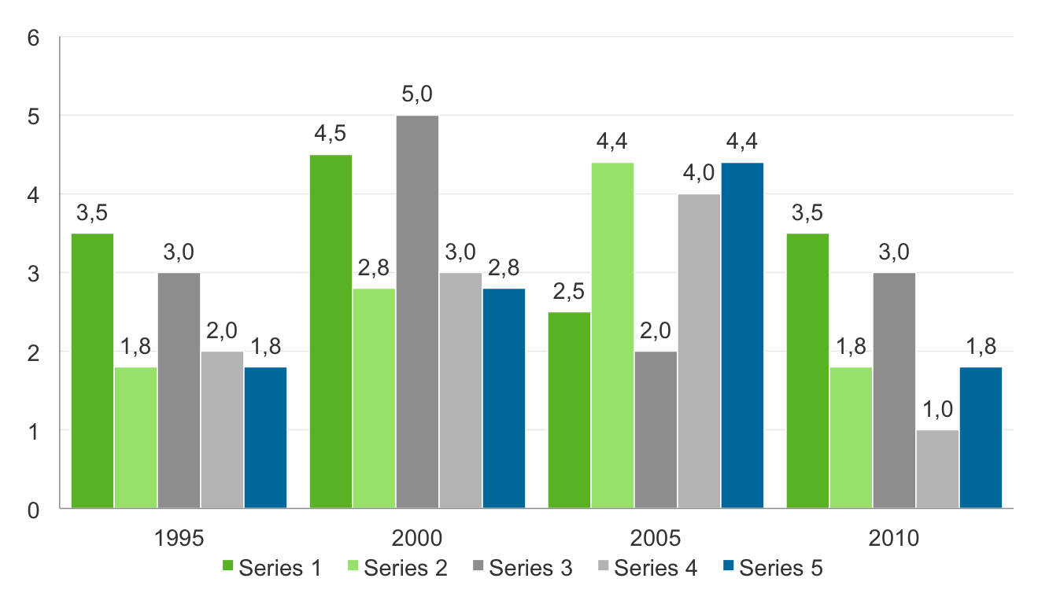
Example of column graph: 3 or more colours
Chart title

Slide 19
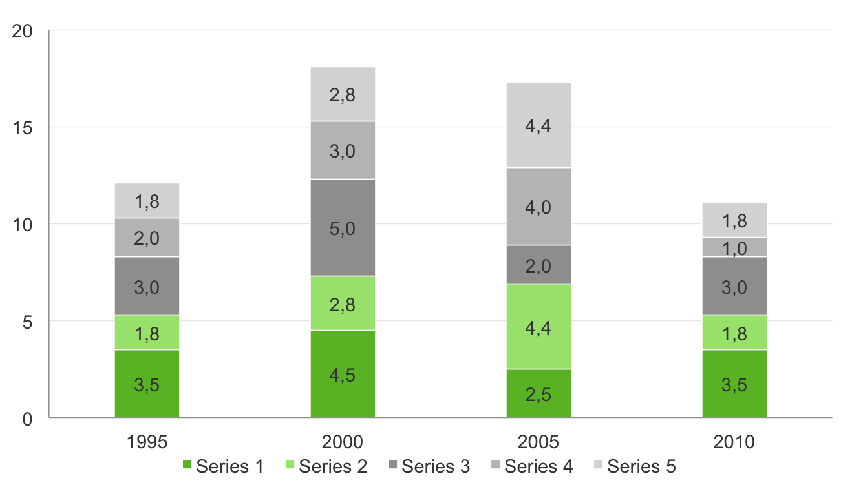
Example of column graph: 3 or more colours
Chart title

Slide 20
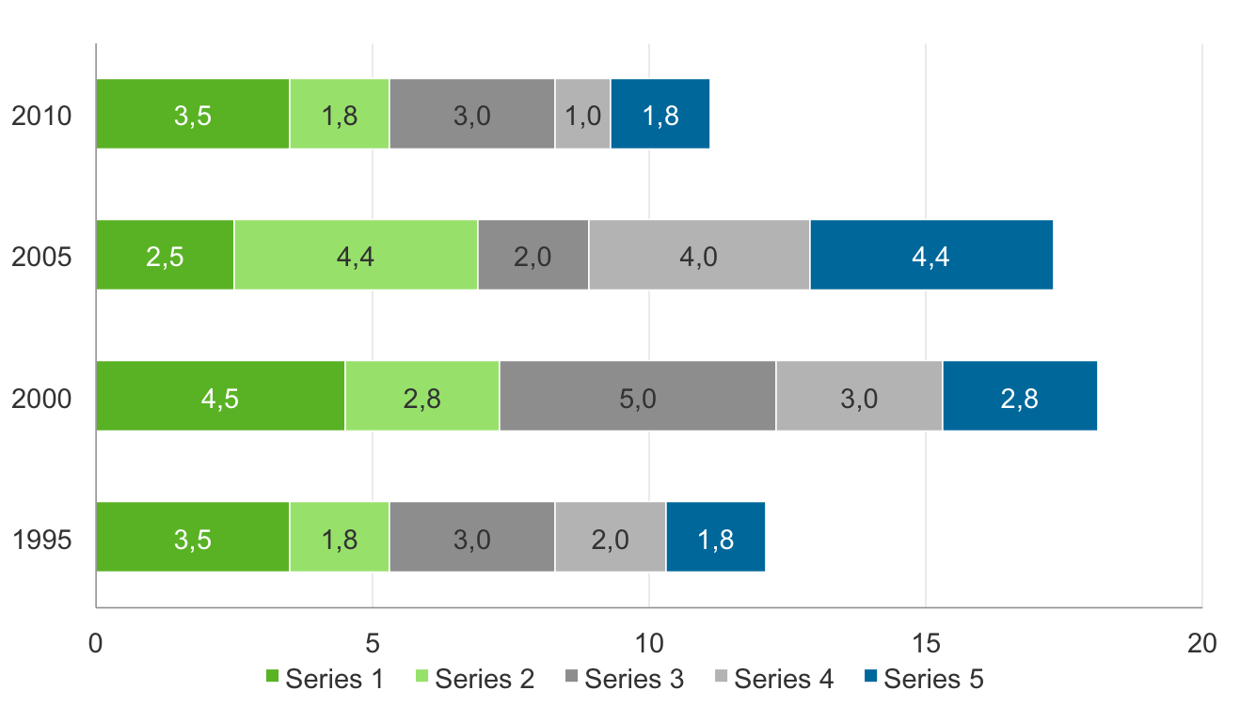
Example of column graph: 3 or more colours
Chart title

Slide 21
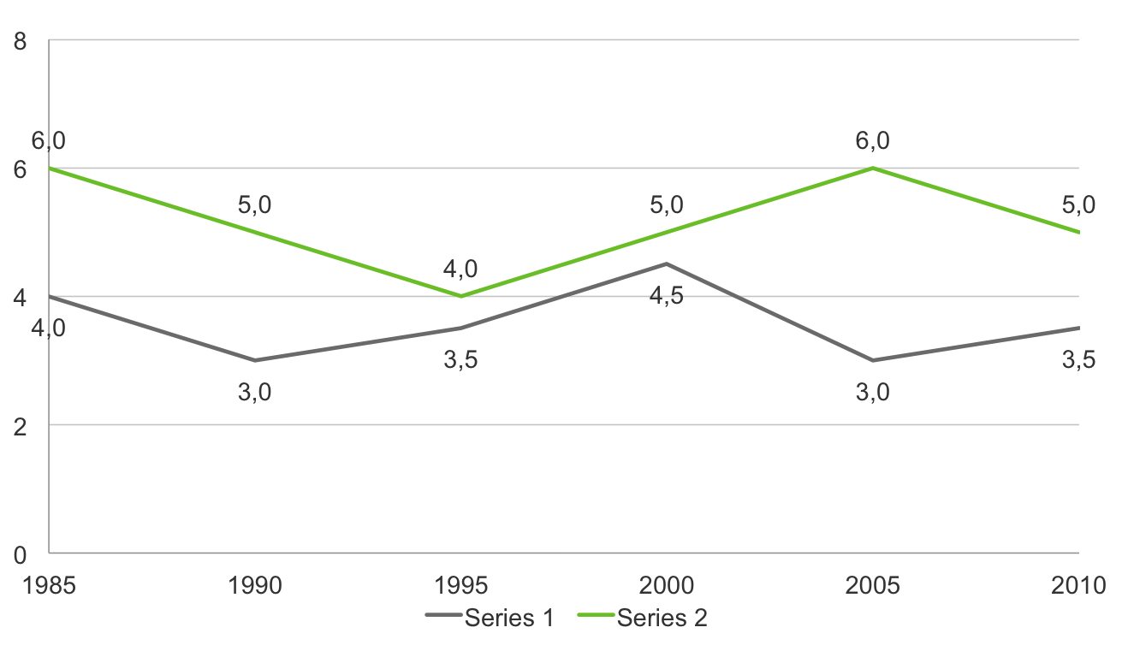
Example of column graph: 3 or more colours
Chart title

Slide 22
To set graph as default for new graphs:
Select example graph on following page
Click on chart tools>design tab and select “save as template” Choose a name for your default
On next page, click on the graph icon
Add your data
Select the graph and click on chart tools>design tab, then select “change chart type”
Select “templates” and click on your saved template

Slide 23
Click on graph icon and add data Please see instruction on previous page

Slide 24
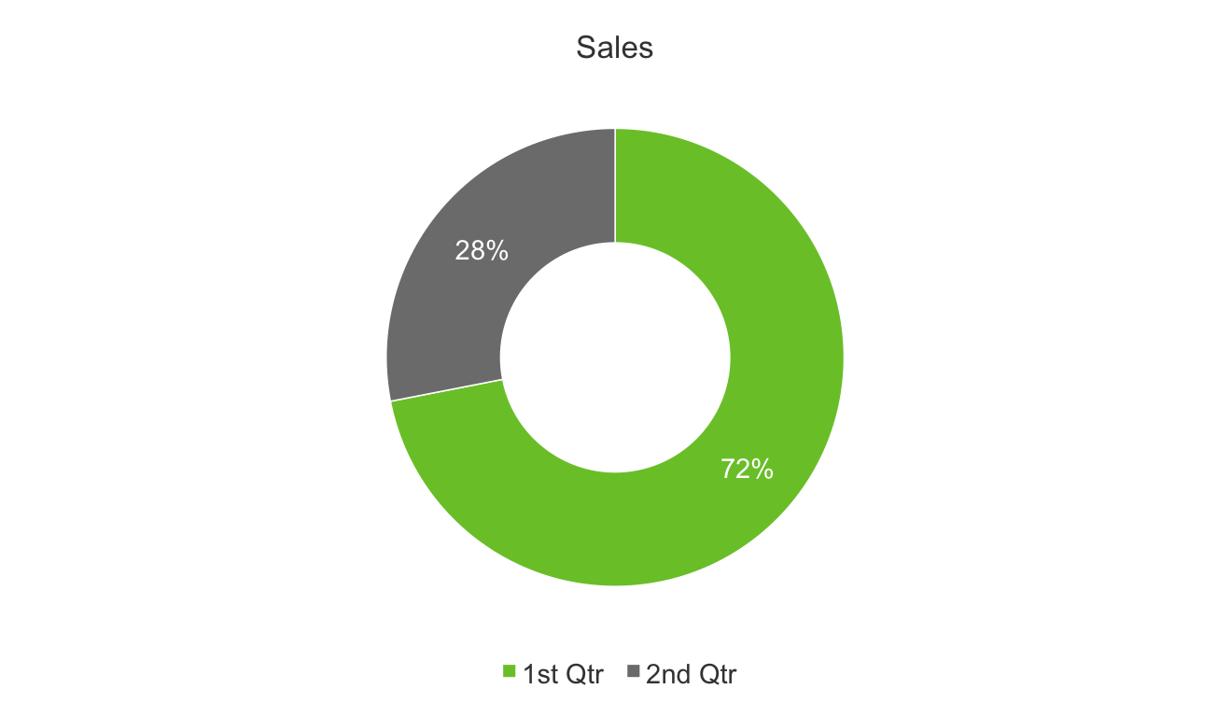
Example of pie chart: 2 colours only

Slide 25
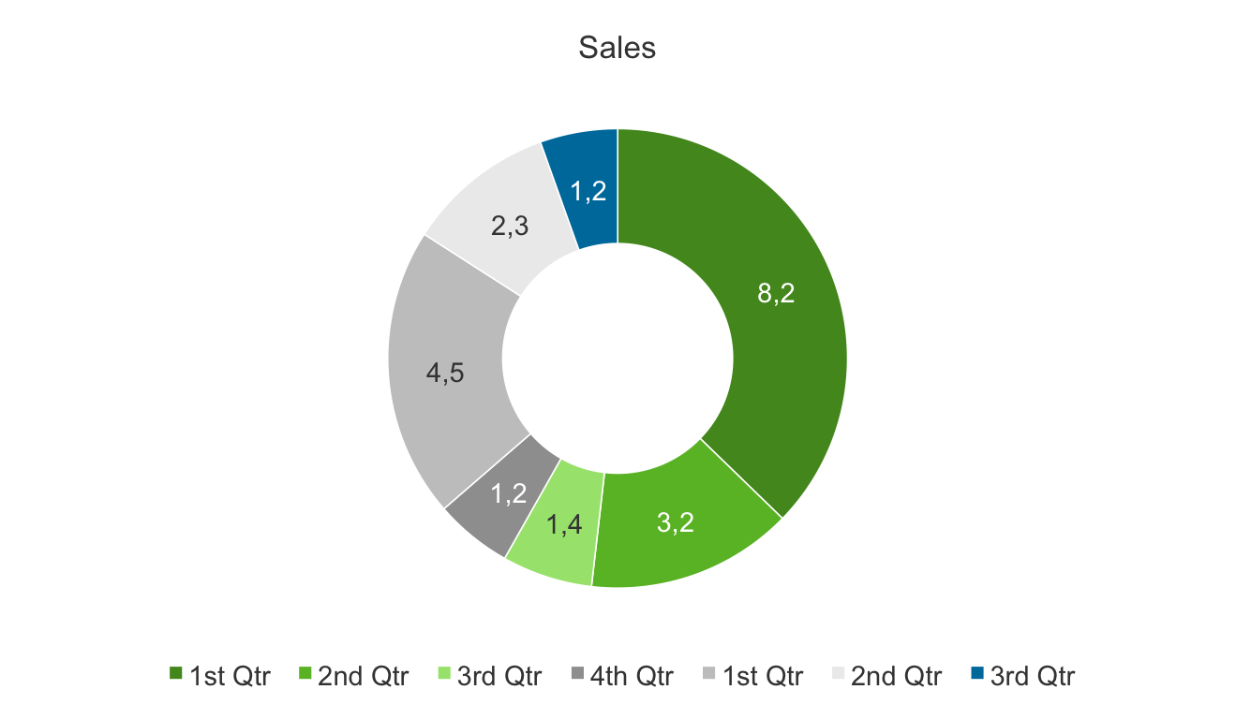
Example of pie chart

Slide 26
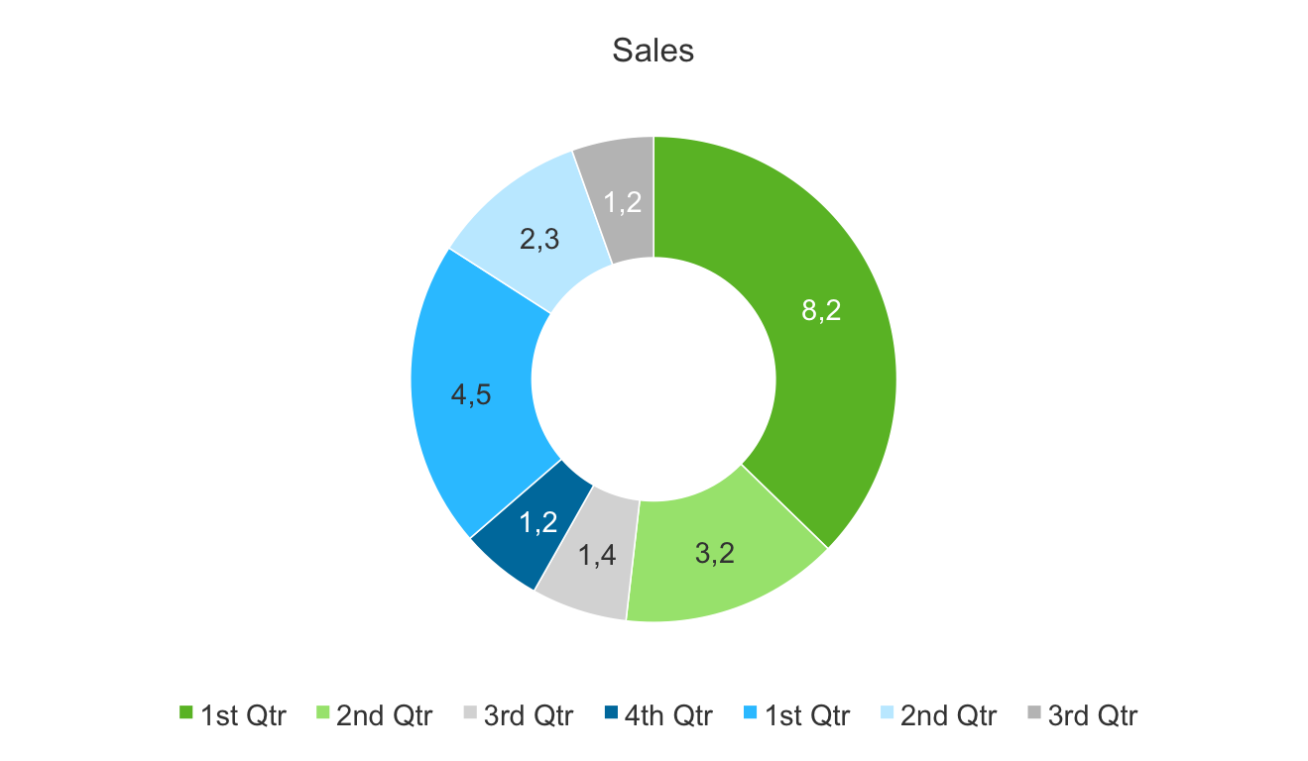
Example of pie chart

Slide 27
Bullet 1
Bullet 2
Bullet 3
Bullet 4
Bullet 5
Bullet 6

Slide 28
Green block placeholders

Slide 29
Main point in green and subsidiary points in white
Bullet 1
Bullet 2
Bullet 3
Bullet 4
Bullet 5
Bullet 6

Slide 30
Bullet 1
Bullet 1
Sub heading
Bullet 1
Sub heading
Sub heading

Slide 32
Sub title
Content
Sub title
Content
Sub title
Content
Sub title
Content

Slide 34
Full page image with caption
Click on icon to add picture – example on following page

Slide 35

Full page image with caption
Change text colour if necessary, depending on image
Select image and delete, then replace with your image

Slide 36
Main title
Introduction level
First level bullet
Second level bullet
Third level bullet
I have amended this sizing a little from the old template, as this is more practical for everyday, typical Dimension Data content – this is my recommendation!

Slide 37
Main title
Introduction level
First level bullet
Second level bullet
Third level bullet
I have amended this sizing a little from the old template, as this is more practical for everyday, typical Dimension Data content – this is my recommendation!

Slide 38
Click on icon to add picture – example on following page

Slide 39
Click on icon to add picture – example on following page

Slide 40


Slide 42


Slide 43
Text to describe image or diagram on left hand side

Slide 44
“First line of pullout quote or introduction with a key word highlighted”
First level bullet indented with key word

Slide 45
“First line of pullout quote or introduction with a key word highlighted”
First level bullet indented with key word

