Slide 1

Basic PowerShell
An object oriented shell- and scripting language

Slide 2
Basic PowerShell
What
History
Basic usage
Functions and Modules
Useful Tools
PowerShell Core
Q & A
Notes:
Background
What is powershell
Shell
Cmd and Unix commands
Brief History
Versions
Evolution
vNext
Basic usage
Basic commands
Variables, Pipelines and functions
Data output (out-grid, to general file)
$profile
Aliases
Creating functions and Modules
Basic functions
Modules setup
Install scripts
Useful Tools
ISESteroids
PoshGit
VS Code
PowerShell Core
What is it
Mac and brief look
Q and A

Slide 3
What
What is PowerShell?
An object oriented scripting and shell language.
Designed for task automation and configuration management.
Based on the .NET framework where cmdlets represent small classes as system commands.
Notes:
What:
You can create objects with a set of functions and a constructor
Cmdlets (command-let)
Performs a single function and is the most common element for PowerShell automation. A cmdlet is generally written in a language such as C# and compiled. Like all other PowerShell commands, a cmdlet performs an action and returns a .NET object.

Slide 4

History
PowerShell 1.0
PowerShell 3.0
PowerShell 5.0
Server 2008
Win 8
Server 2012
Win 10
2006
2009
2012
2013
2014
2016
Win 7
Server 2008 R2
Win 8.1
Server 2012 R2
PowerShell 2.0
(ISE introduced)
PowerShell 4.0
PowerShell 6.0 Alpha
https://4sysops.com/archives/powershell-versions-and-their-windows-version/
Notes:
V1
Installable: XP, Vista, Server 2003
V2
ISE Added
Installable: XP, Vista, Server 2003 + 2008
V3
Installable: Win 7, Server 2008 R2
V4
Installable: Win 7, Server 2008 R2, Server 2012
V5
Installable: Win 8.1, Server 2012 R2
V6
Installable on multiple platforms
Still in beta
PowerShell is forward compatible
Forward => as long the script has the required modules and functions accessible Functions that disappeared or aren’t available in newer versions will fail.

Slide 5
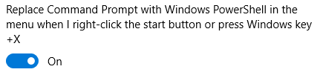
Basic usage
PowerShell Terminal
Ctrl + Space: starts autocomplete (interactive)
Tab to scroll through available options
“-” used to set a specific parameter, also has autocomplete.
Copy selected text with Ctrl + C or by pressing enter.
Past text with Ctrl + V or by right clicking.
Microsoft is replacing cmd prompt by PowerShell from build 14791 of Windows 10. It is still here, but not as acceceble.
e.g. in the WIN + X menu cmd is replaced by PowerShell. But you can change this setting by searching for PowerShell in the settings:

Slide 6
Basic commands
Command | Descriptions | Useful options
Update-Help | Update your local help information to enable display of full help details
Get-Help <command> | Get help about a command | -ShowWindow
Get-Command | Shows the available commands in your session | -Verb
Get-Item | Return a specific file or directory
Get-ChildItem | Return the content of a directory | -Recurse -Filter
Get-Content | Read the content of a file
Copy-Item | Copy file or directory | -Recurse
Notes:
Win + X , A
Update-Help
Required to run as admin
Start powershell from explorer
Get-help Get-Item
Get-help Get-Item -ShowWindow
Get-Item .\
Get-ChildItem .\
Get-ChildItem .\ -Recurse
Get-Content .\demo-basic-commands\folder2\hello.txt
Commands can be called case insensetive

Slide 7
Pipelines
Piping works virtually everywhere in PowerShell.
Windows PowerShell does not pipe text between commands. it pipes objects.
Examples:
Get child items as paged output in the terminal:
Get-ChildItem -Path C:\WINDOWS\System32 | Out-Host -Paging
Show child items as grid view: Get-ChildItem .\ -Recurse | Out-GridView
Get child items of directory, visualise and print the made selections name:
Get-ChildItem .\ -Recurse |
Out-GridView -PassThru |
foreach { Write-Host $_.Name -ForegroundColor Green }
Notes:
Get-ChildItem .\ -Recurse | Out-GridView

Slide 8
Aliases
Aliases are easily created using the Set-Alias:
For example:
Set-Alias g git
You can get a list of the configured aliases using Get-Alias:
For example:
Get-Alias
Get-Alias g*
Storing Aliases can be done using the $profile
If not stored, they will be gone after your PS session closes

Slide 9
Aliases compared
CMD Command | UNIX Command | PS Command | PS Alias
dir | ls | Get-ChildItem | gci
cls | clear | Clear-Host (function) | cls
del, erase, rmdir | rm | Remove-Item | ri
copy | cp | Copy-Item | ci
move | mv | Move-Item | mi
rename | mv | Rename-Item | rni
type | cat | Get-Content | gc
cd | cd | Set-Location | sl
md | mkdir | New-Item | ni
pushd | pushd | Push-Location | pushd
popd | popd | Pop-Location | popd

Slide 10
Variables
Variables are defined like:
$myVar
variables are "loosely typed”
Some PowerShell default variables:
Variable | Purpose
$env | Contains environment values like APPDATA path, computer name, …
$_ | Contains the current object in the pipeline. E.g inside a foreach
$false, $true | Contains it’s representing value so you don’t need to use text.
$profile | Contains the full path of the Windows PowerShell profile for the current user and the current host application
https://docs.microsoft.com/en-us/powershell/module/microsoft.powershell.core/about/about_variables?view=powershell-5.1
Notes:
"loosely typed“ = they are not limited to a particular type of object. A single variable can even contain a collection (an "array") of different types of objects at the same time.

Slide 11
Comparison Operators
Operators are “text’ based e.g. –eg = equal
Work by default on variables and arrays
8 -eq 7
> False
5,6,7,8 -eq 7
> 7
5,6,7,8 -lt 7
> 5
6
"Euricom Cruise!" -match "Euri"
> True
https://docs.microsoft.com/en-us/powershell/module/microsoft.powershell.core/about/about_comparison_operators?view=powershell-5.1
Notes:
Operators are text based

Slide 12
Loops
For Loop
Do While
Do Until
While
For-each
Inline
Function
# For loop
for ($i = 1; $i -lt 5; $i += 1)
{
Write-Host $i
}
# Foreach loops
Get-ChildItem .\ -Recurse |
foreach { Write-Host $_.Name -ForegroundColor Green }
Get-ChildItem .\ -Recurse |
%{ Write-Host $_.Name -ForegroundColor Green }
foreach ($item in Get-ChildItem .\ -Recurse)
{
Write-Host $item
}
http://www.tomsitpro.com/articles/powershell-for-loop,2-845.html
Notes:
http://www.tomsitpro.com/articles/powershell-for-loop,2-845.html

Slide 13
Basic Functions
Function names:
Public functions start with a Verb e.g. Write-HelloWorld (Get-Verb: gets verbs that are approved for use in Windows PowerShell commands.)
Private functions (functions net exposed by a modules) can have any name
Parameters:
Can be any type or typed
Can be called by name or by order
Additional parameters are available in $args
Return data:
Every output that isn’t captured is returned to the pipeline

Slide 14
Modules
PowerShell modules allows you to group and load multiple functions.
There are 4 types of modules:
Script Modules (psm1)
Separately loaded scripts
Set of scripts in a folder structure
Binary Module
A .NET Framework Assembly (dll)
Allows for more complex cmdlets that for example can use multithreading
Manifest Module (psd1)
Does not contain any specific cmdlet code
Used for loading different modules, pre-processing scripts, package other modules resources.
Dynamic Module
Modules created on the fly using New-Module
https://msdn.microsoft.com/en-us/library/dd878324(v=vs.85).aspx
Notes:
The main purpose of a module is to allow the modularization (ie, reuse and abstraction) of Windows PowerShell code.
We will look further to Script Modules

Slide 15
Basic Script Module
Module name is based on the spm1 filename
Get-Module shows the loaded modules
Example Module:
function Calc-sum {
param(
[int] $a,
[int] $b
)
return $a + $b
}
Export-ModuleMember -Function Calc-sum
Loading the module:
Import-Module -Name ".\BasicScriptModule.psm1" -Force
> Get-Module
ModuleType Version Name ExportedCommands
---------- ------- ---- ----------------
Script 0.0 BasicScriptModule Calc-sum

Slide 16
Automatic Script Modules
PSMODULE path

Slide 17
$Profile

Slide 18
Useful Tools

Slide 19
PowerShell Core

Slide 20
Table
Financial | Column 1 | Highlight column | Right aligned
Sub heading level
Row 2 |  |  | 7,078.89
Row 3
Row 4

Slide 21
Table
Features | Detail
Sub heading level
Row 2 | Top and left aligned bullets
Row 3
Row 4

Slide 22
Table
Features | Detail
Sub heading level
Row 2 | Top and left aligned bullets
Row 3
Row 4

Slide 23
Alternative grey layout option
Introduction level
First level bullet
Second level bullet
Third level bullet

Slide 24
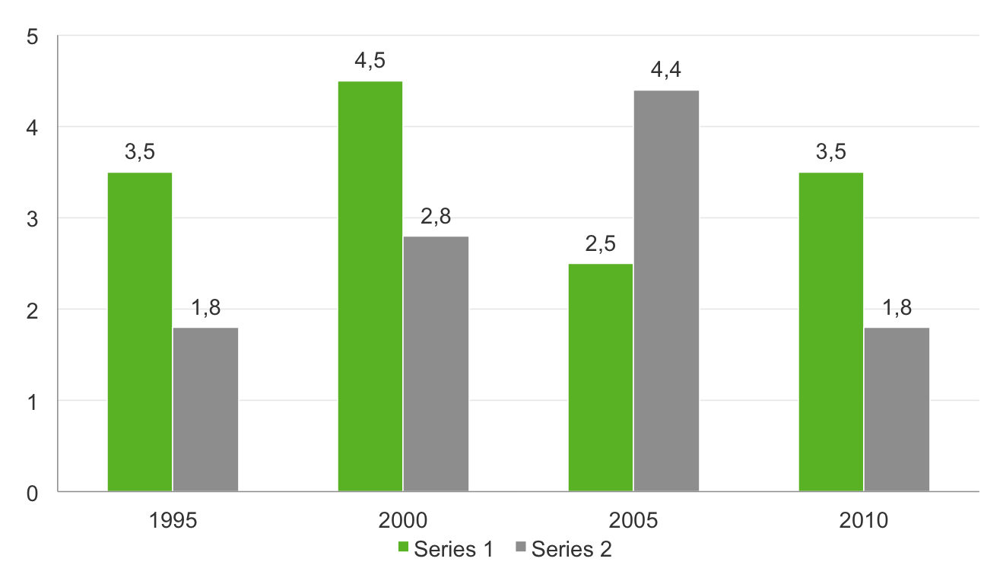
Example of column graph: 2 colours
Chart title

Slide 25
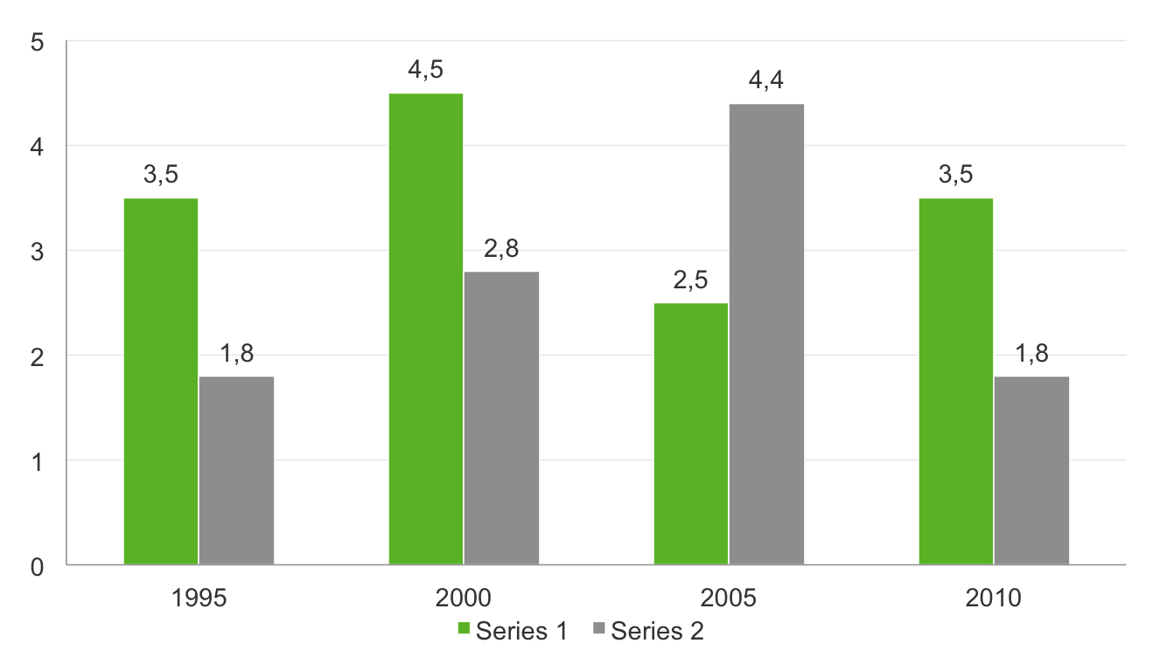
Example of column graph: 2 colours on grey background
Chart title

Slide 26
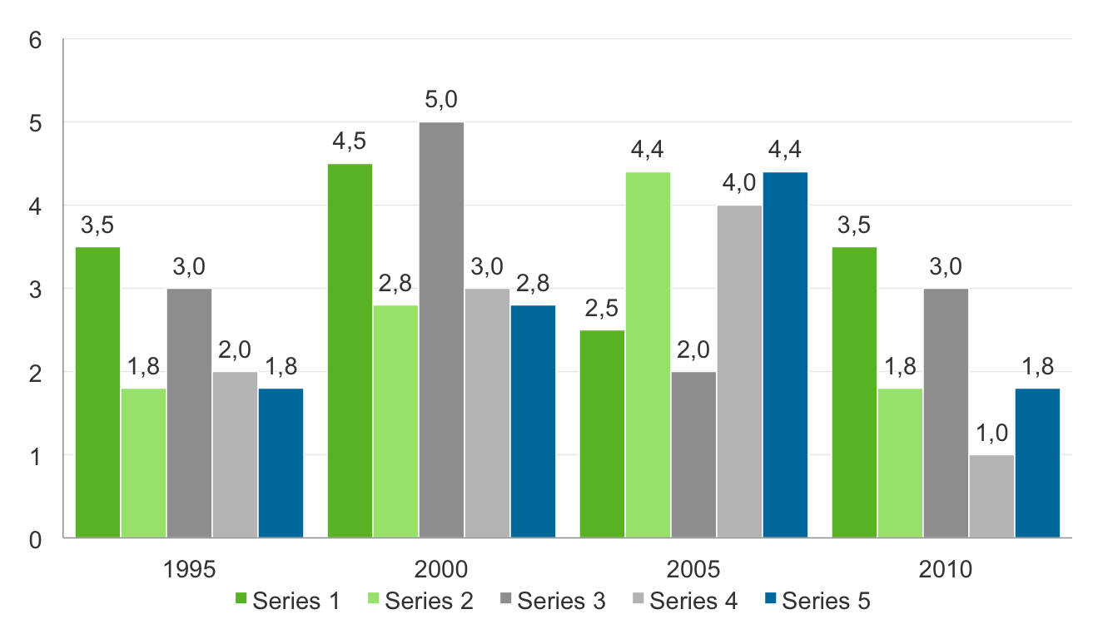
Example of column graph: 3 or more colours
Chart title

Slide 27
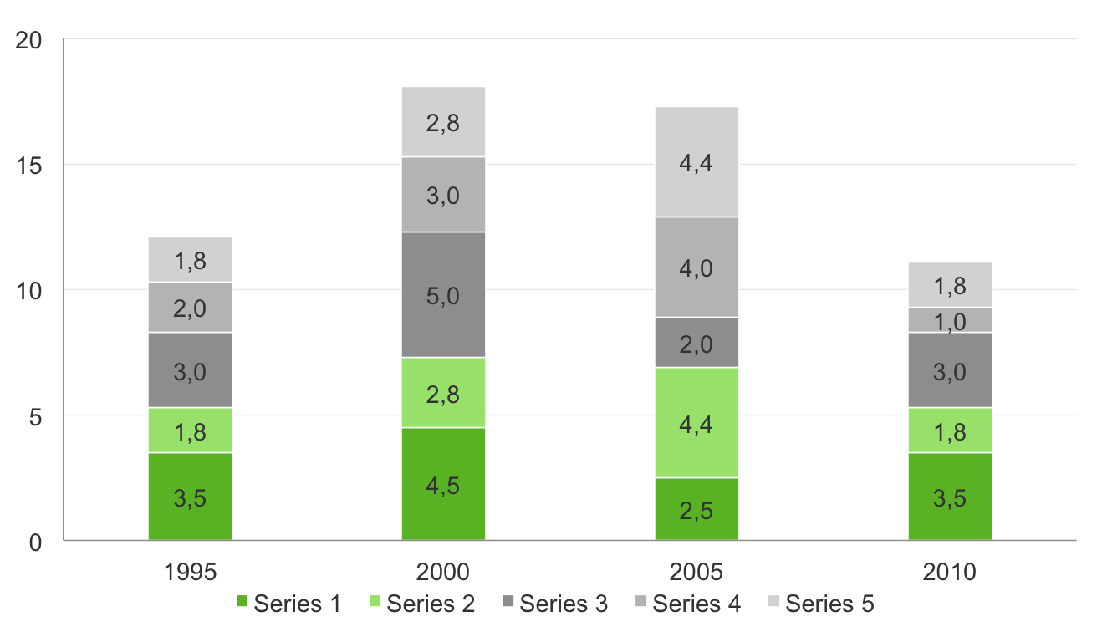
Example of column graph: 3 or more colours
Chart title

Slide 28
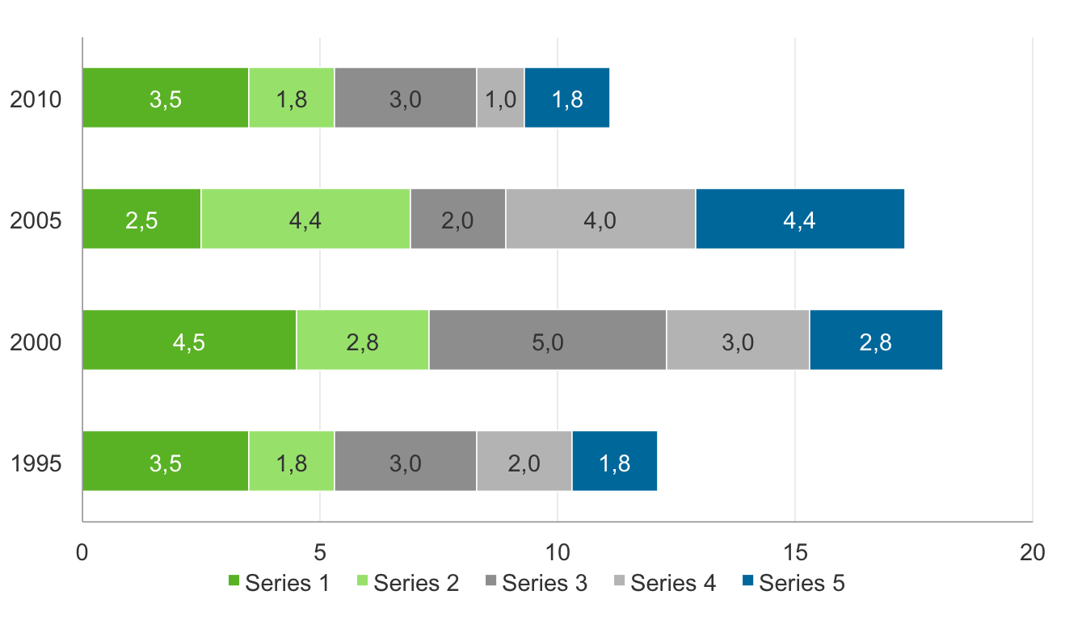
Example of column graph: 3 or more colours
Chart title

Slide 29
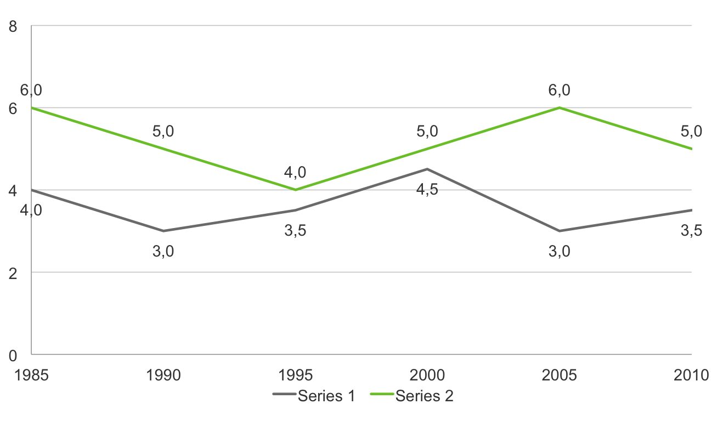
Example of column graph: 3 or more colours
Chart title

Slide 30
To set graph as default for new graphs:
Select example graph on following page
Click on chart tools>design tab and select “save as template” Choose a name for your default
On next page, click on the graph icon
Add your data
Select the graph and click on chart tools>design tab, then select “change chart type”
Select “templates” and click on your saved template

Slide 31
Click on graph icon and add data Please see instruction on previous page

Slide 32
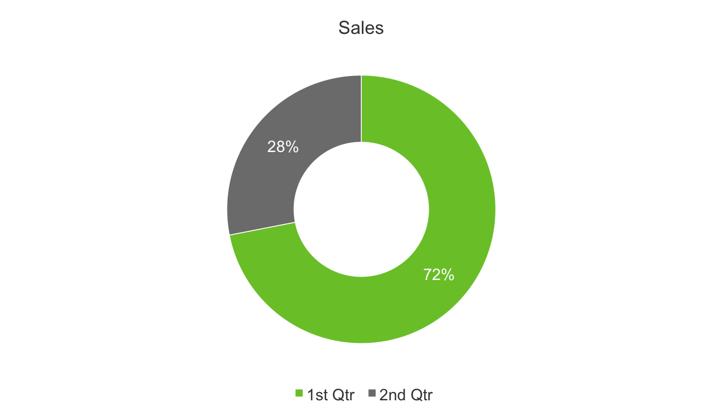
Example of pie chart: 2 colours only

Slide 33
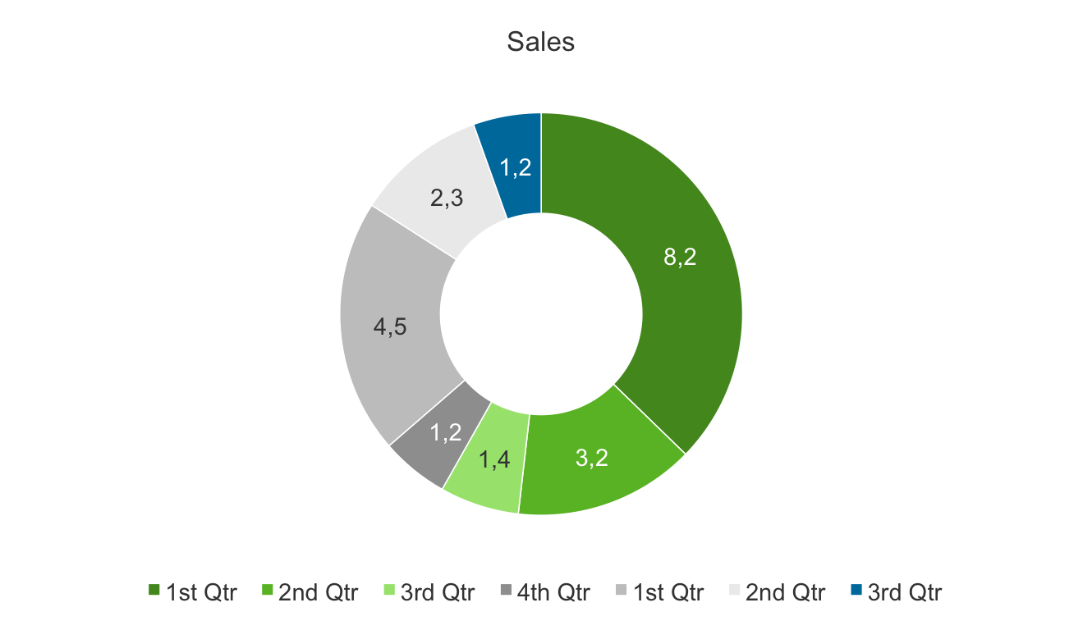
Example of pie chart

Slide 34
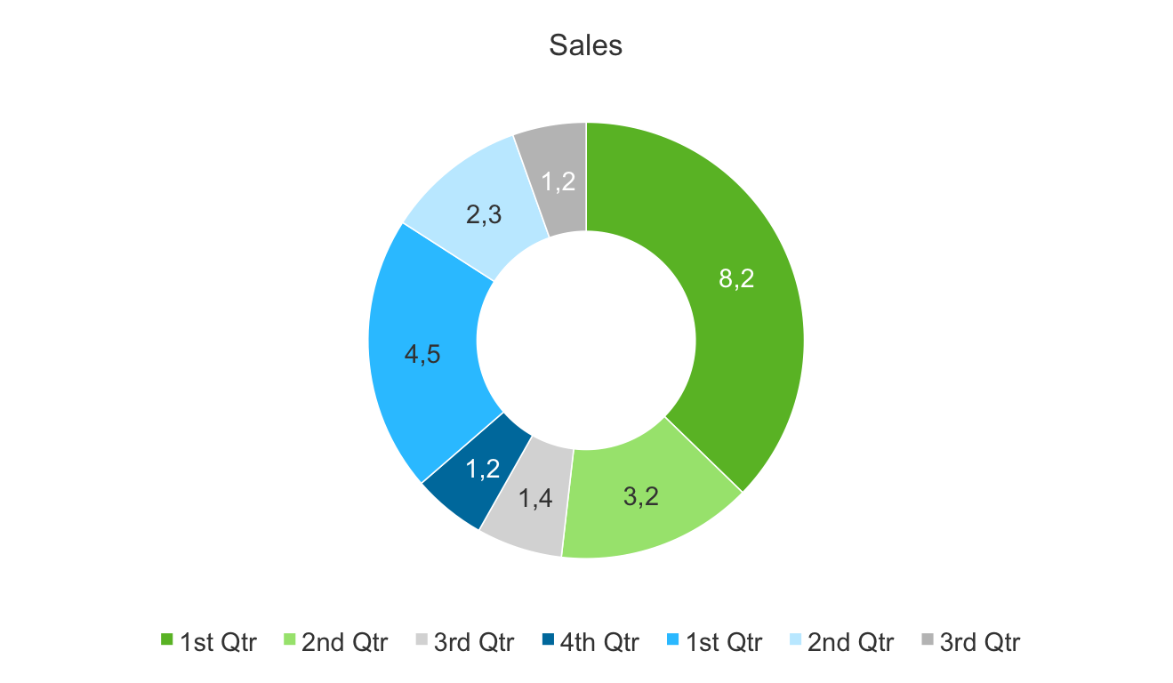
Example of pie chart

Slide 35
Bullet 1
Bullet 2
Bullet 3
Bullet 4
Bullet 5
Bullet 6

Slide 36
Green block placeholders

Slide 37
Main point in green and subsidiary points in white
Bullet 1
Bullet 2
Bullet 3
Bullet 4
Bullet 5
Bullet 6

Slide 38
Bullet 1
Bullet 1
Sub heading
Bullet 1
Sub heading
Sub heading

Slide 40
Sub title
Content
Sub title
Content
Sub title
Content
Sub title
Content

Slide 42
Full page image with caption
Click on icon to add picture – example on following page

Slide 43

Full page image with caption
Change text colour if necessary, depending on image
Select image and delete, then replace with your image

Slide 44
Main title
Introduction level
First level bullet
Second level bullet
Third level bullet
I have amended this sizing a little from the old template, as this is more practical for everyday, typical Dimension Data content – this is my recommendation!

Slide 45
Main title
Introduction level
First level bullet
Second level bullet
Third level bullet
I have amended this sizing a little from the old template, as this is more practical for everyday, typical Dimension Data content – this is my recommendation!

Slide 46
Click on icon to add picture – example on following page

Slide 47
Click on icon to add picture – example on following page

Slide 48


Slide 50


Slide 51
Text to describe image or diagram on left hand side

Slide 52
“First line of pullout quote or introduction with a key word highlighted”
First level bullet indented with key word

Slide 53
“First line of pullout quote or introduction with a key word highlighted”
First level bullet indented with key word

