Slide 1

Basic PowerShell
An object oriented shell- and scripting language

Slide 2
Basic PowerShell
History
Basic usage
Functions and Modules
Useful Tools
PowerShell Core
Q & A
Notes:
Background
What is powershell
Shell
Cmd and Unix commands
Brief History
Versions
Evolution
vNext
Basic usage
Basic commands
Variables, Pipelines and functions
Data output (out-grid, to general file)
$profile
Aliases
Creating functions and Modules
Basic functions
Modules setup
Install scripts
Useful Tools
ISESteroids
PoshGit
VS Code
PowerShell Core
What is it
Mac and brief look
Q and A

Slide 3
History

Slide 4
Basic Usage

Slide 5
Functions and Modules

Slide 6
Useful Tools

Slide 7
PowerShell Core

Slide 8
Table
Financial | Column 1 | Highlight column | Right aligned
Sub heading level
Row 2 |  |  | 7,078.89
Row 3
Row 4

Slide 9
Table
Features | Detail
Sub heading level
Row 2 | Top and left aligned bullets
Row 3
Row 4

Slide 10
Table
Features | Detail
Sub heading level
Row 2 | Top and left aligned bullets
Row 3
Row 4

Slide 11
Alternative grey layout option
Introduction level
First level bullet
Second level bullet
Third level bullet

Slide 12
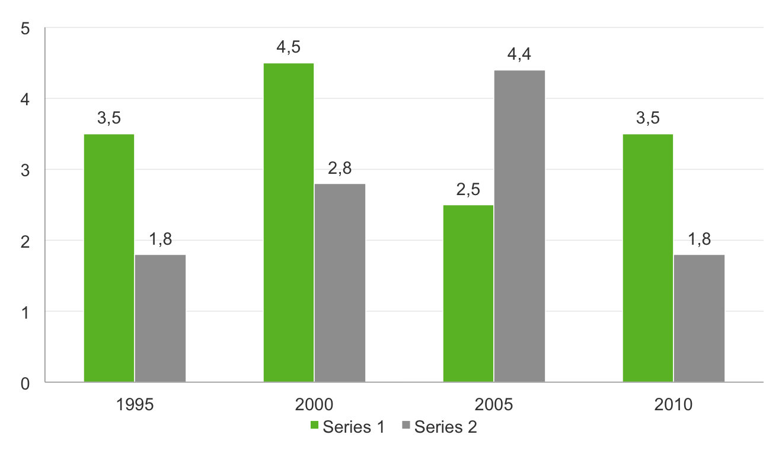
Example of column graph: 2 colours
Chart title

Slide 13
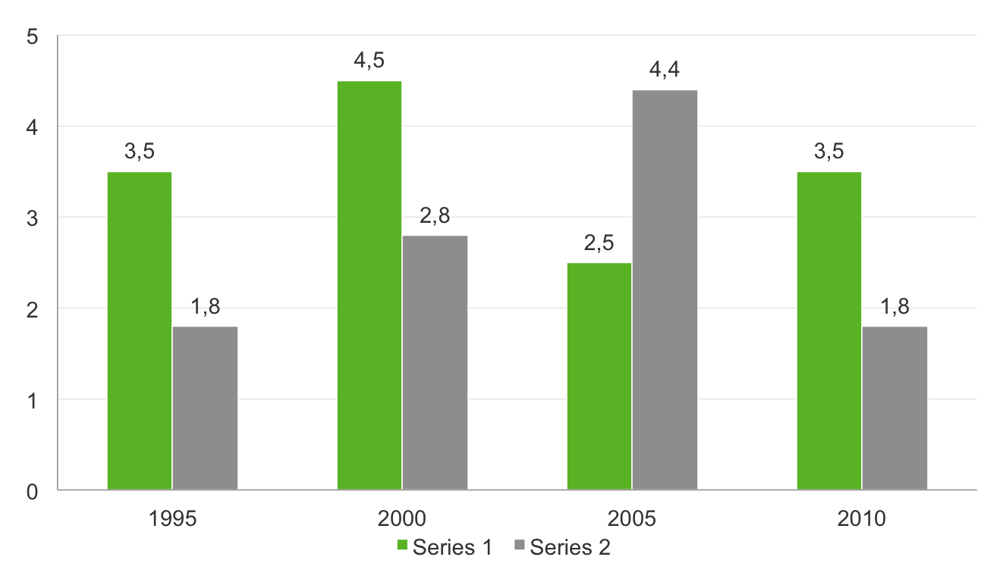
Example of column graph: 2 colours on grey background
Chart title

Slide 14
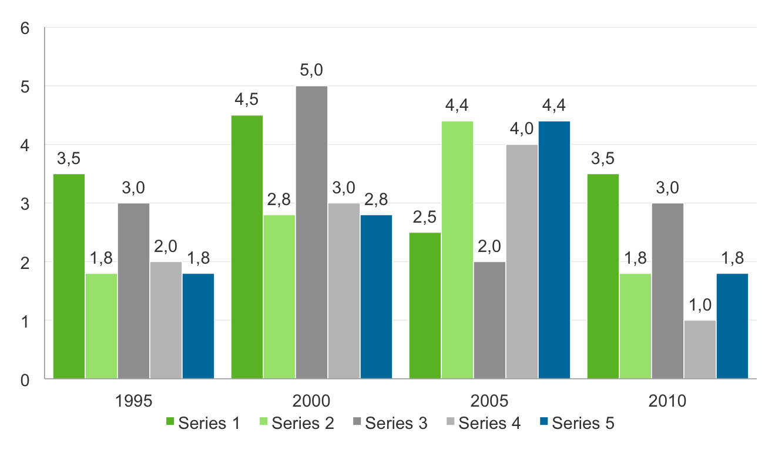
Example of column graph: 3 or more colours
Chart title

Slide 15
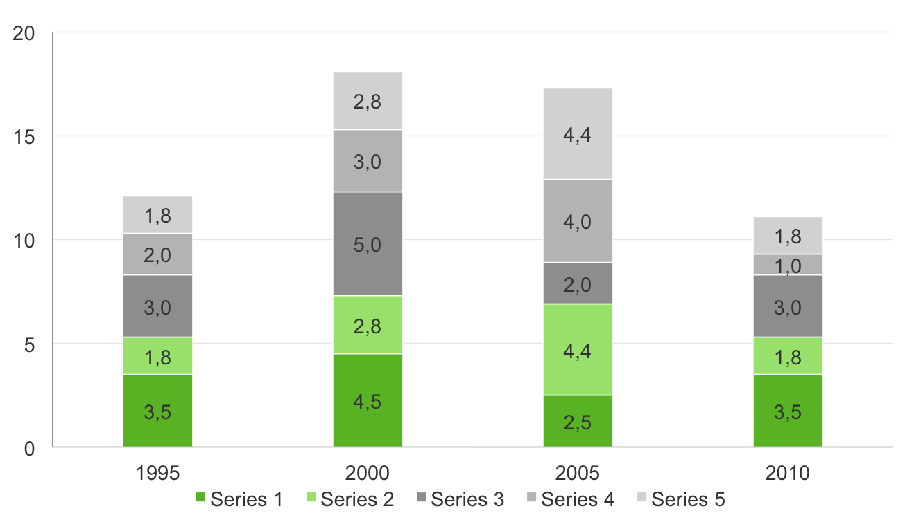
Example of column graph: 3 or more colours
Chart title

Slide 16
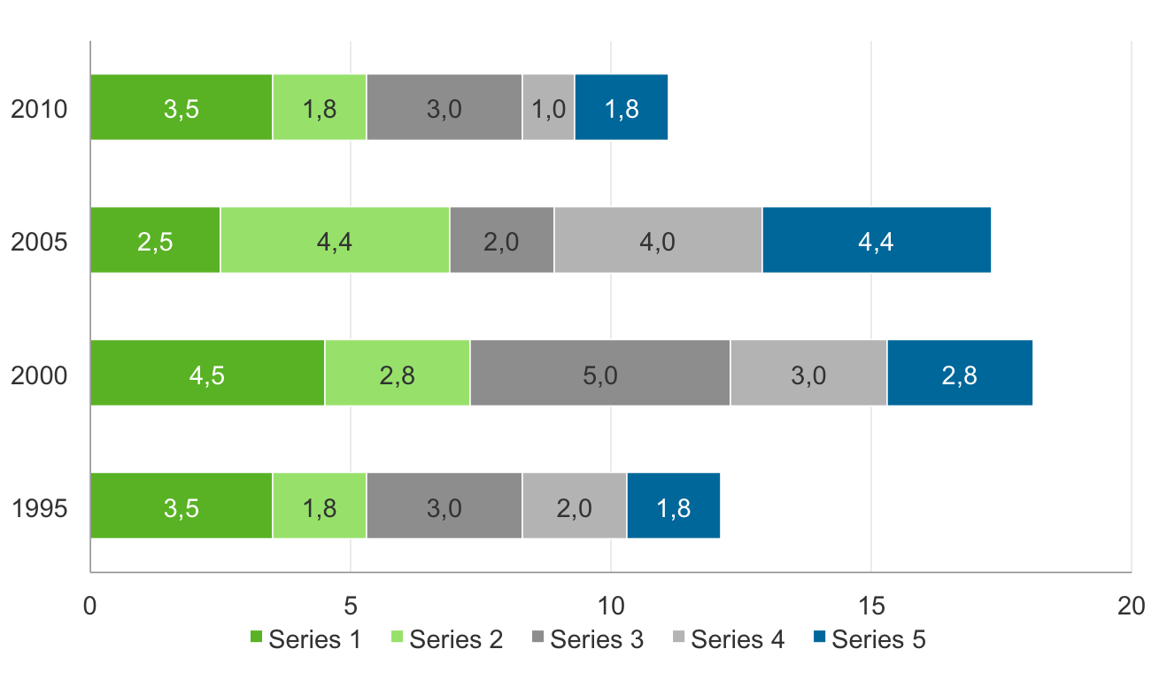
Example of column graph: 3 or more colours
Chart title

Slide 17
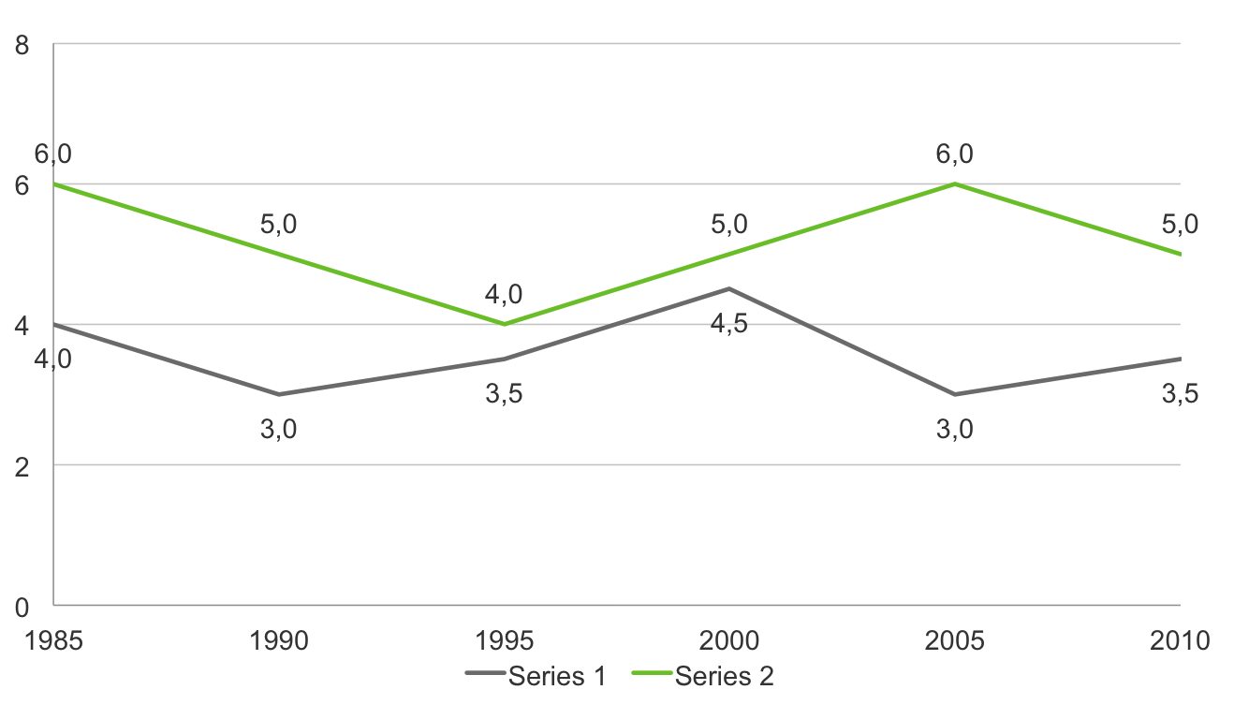
Example of column graph: 3 or more colours
Chart title

Slide 18
To set graph as default for new graphs:
Select example graph on following page
Click on chart tools>design tab and select “save as template” Choose a name for your default
On next page, click on the graph icon
Add your data
Select the graph and click on chart tools>design tab, then select “change chart type”
Select “templates” and click on your saved template

Slide 19
Click on graph icon and add data Please see instruction on previous page

Slide 20
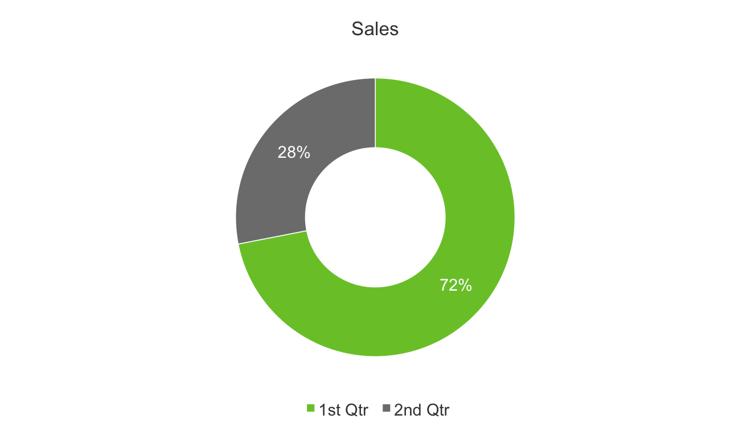
Example of pie chart: 2 colours only

Slide 21
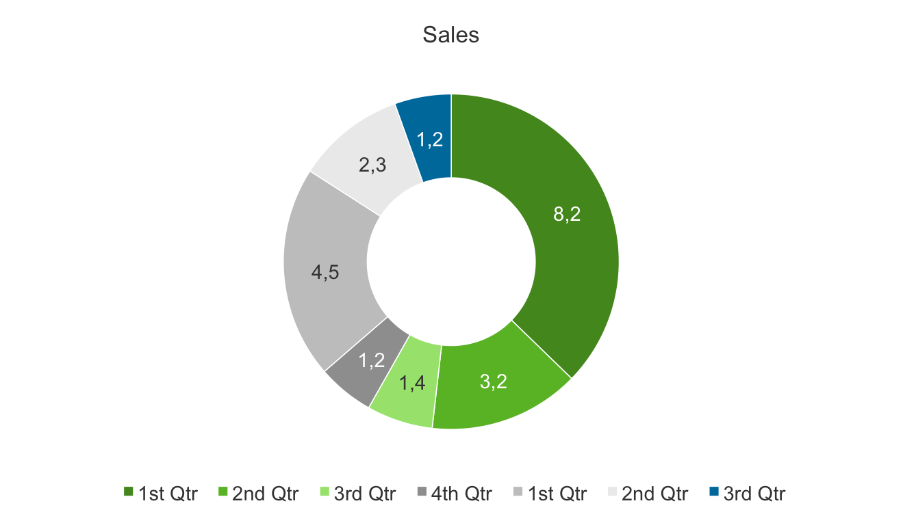
Example of pie chart

Slide 22
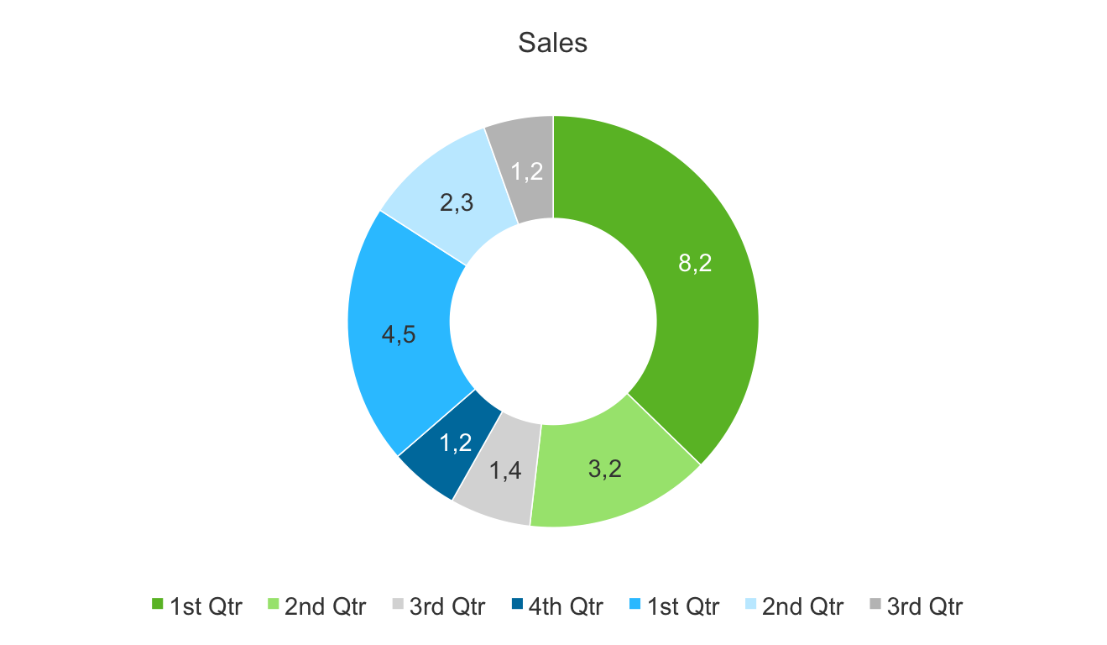
Example of pie chart

Slide 23
Bullet 1
Bullet 2
Bullet 3
Bullet 4
Bullet 5
Bullet 6

Slide 24
Green block placeholders

Slide 25
Main point in green and subsidiary points in white
Bullet 1
Bullet 2
Bullet 3
Bullet 4
Bullet 5
Bullet 6

Slide 26
Bullet 1
Bullet 1
Sub heading
Bullet 1
Sub heading
Sub heading

Slide 28
Sub title
Content
Sub title
Content
Sub title
Content
Sub title
Content

Slide 30
Full page image with caption
Click on icon to add picture – example on following page

Slide 31

Full page image with caption
Change text colour if necessary, depending on image
Select image and delete, then replace with your image

Slide 32
Main title
Introduction level
First level bullet
Second level bullet
Third level bullet
I have amended this sizing a little from the old template, as this is more practical for everyday, typical Dimension Data content – this is my recommendation!

Slide 33
Main title
Introduction level
First level bullet
Second level bullet
Third level bullet
I have amended this sizing a little from the old template, as this is more practical for everyday, typical Dimension Data content – this is my recommendation!

Slide 34
Click on icon to add picture – example on following page

Slide 35
Click on icon to add picture – example on following page

Slide 36


Slide 38


Slide 39
Text to describe image or diagram on left hand side

Slide 40
“First line of pullout quote or introduction with a key word highlighted”
First level bullet indented with key word

Slide 41
“First line of pullout quote or introduction with a key word highlighted”
First level bullet indented with key word

