Slide 1
C
Carter's Equipment Request Portal
User Guide & Training Manual
Carter's Retail Inc. • Powered by Wachter

Slide 2
What We'll Cover
1. Getting Started
Logging in, signing up, and navigating the portal
2. Dashboard
Your personalized home base with quick stats and actions
3. Service Catalog
Three request types: New Store, Replacement, and Support
4. New Store Equipment Request
Ordering full equipment bundles for new stores
5. Replacement Item Request
Picking individual items from the stockroom
6. General Support Request
Submitting non-equipment support cases
7. Tracking Requests
Viewing, filtering, and managing your requests
8. Store Directory
Browsing all Carter's store locations
9. Knowledge Base
Self-service guides and documentation
10. Administration
Managing users, products, stores, and articles
Carter's Retail Inc. — Equipment Request Portal User Guide

Slide 3
Getting Started
How to access the Carter's Equipment Portal

Slide 4
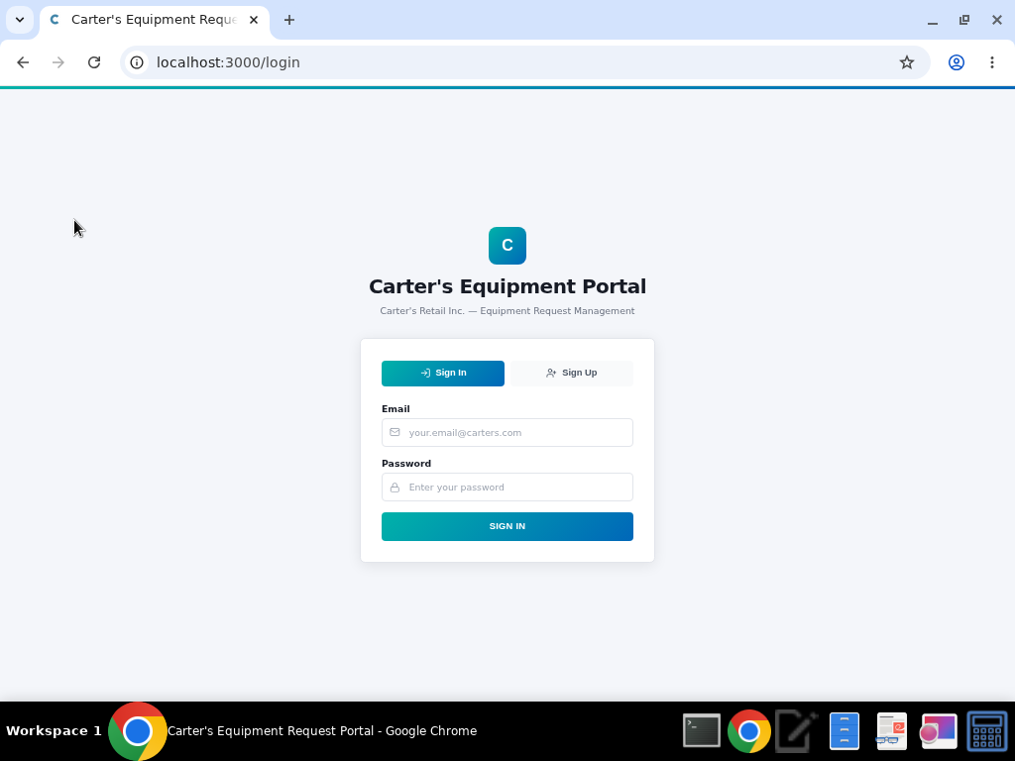
Signing In
1. Navigate to the portal URL in your web browser
2. Enter your email address and password
3. Click 'Sign In' to access the portal
4. You'll be redirected to your personalized Dashboard
5. Your role (Requester, Fulfiller, or Admin) determines which features are available
Carter's Retail Inc. — Equipment Request Portal User Guide

Slide 5
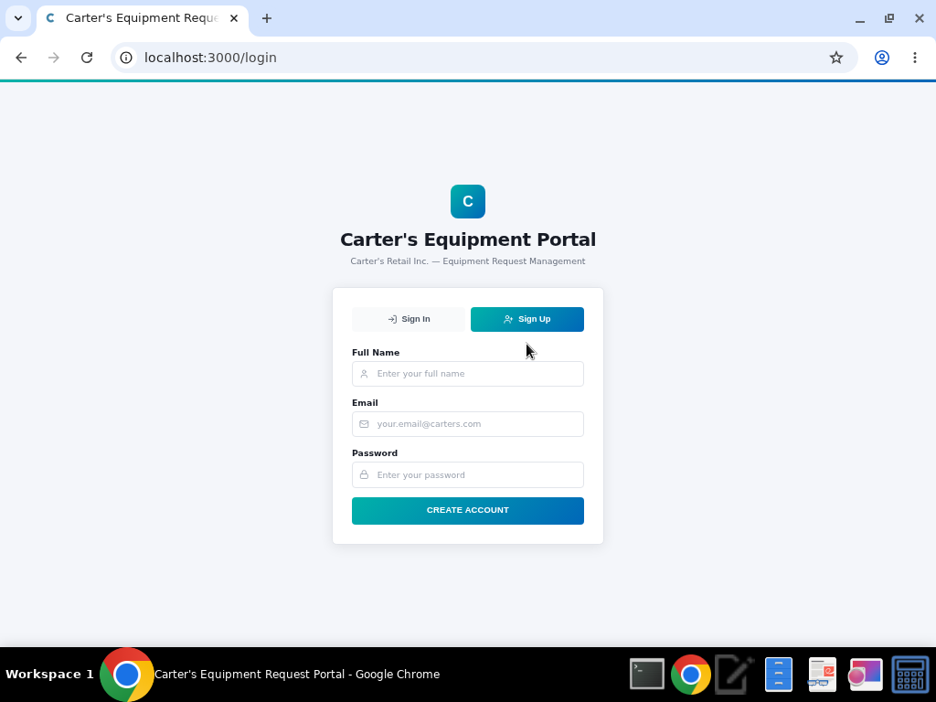
Creating a New Account
1. Click the 'Sign Up' tab on the login page
2. Enter your full name, email, and password
3. Click 'Create Account' to register
4. New accounts are created with 'Requester' role by default
5. An Admin can later upgrade your role if needed
Carter's Retail Inc. — Equipment Request Portal User Guide

Slide 6
Dashboard
Your personalized home base for equipment management

Slide 7
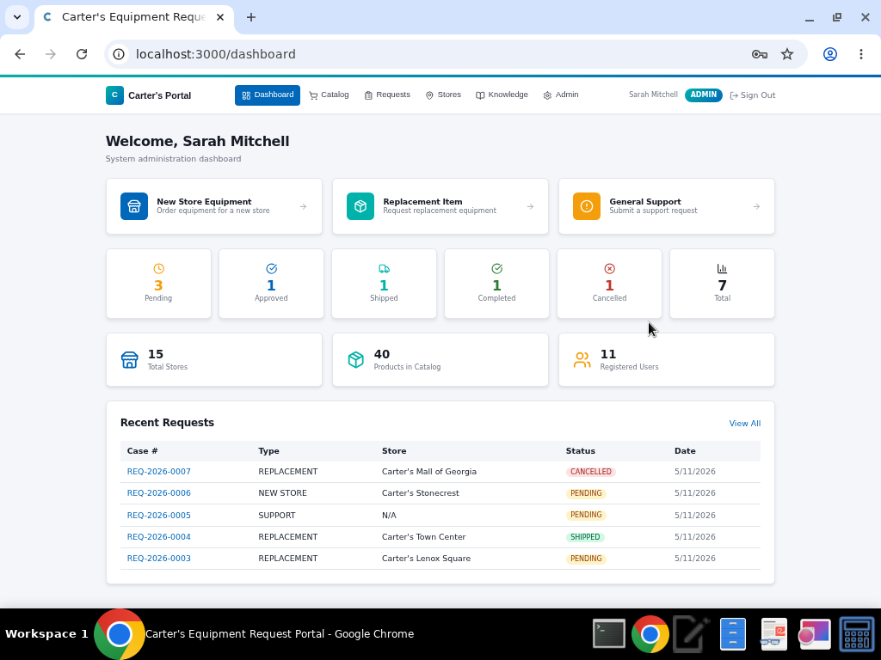
Dashboard Overview
1. See a personalized welcome message with your role
2. Quick action cards let you jump directly to request forms
3. Status counters show Pending, Approved, Shipped, Completed, and Cancelled requests
4. Admins also see total store, product, and user counts
5. Recent requests table shows your latest activity with direct links to details
Carter's Retail Inc. — Equipment Request Portal User Guide

Slide 8
Service Catalog
Three ways to request equipment and support

Slide 9
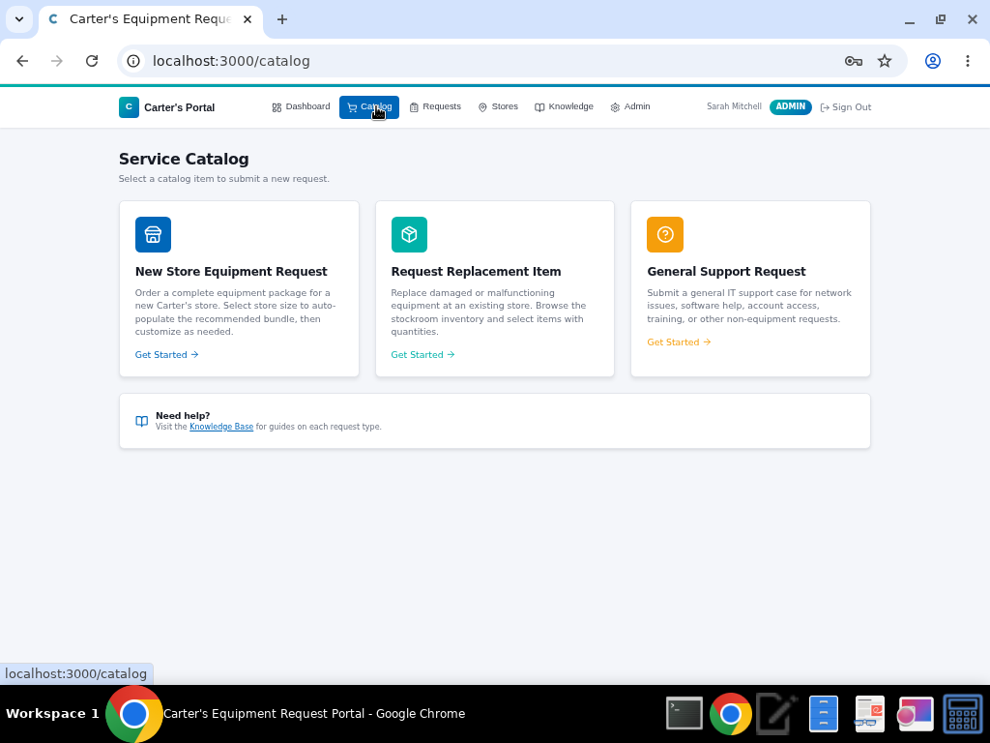
Service Catalog
1. Click 'Catalog' in the top navigation bar
2. New Store Equipment — Order a full equipment bundle for a new store opening
3. Replacement Item — Request specific replacement items from the stockroom
4. General Support — Submit a non-equipment IT support case
5. Each card links to its respective request form
6. Need help? The Knowledge Base link at the bottom provides guides
Carter's Retail Inc. — Equipment Request Portal User Guide

Slide 10
New Store Equipment
Ordering complete equipment bundles for new locations

Slide 11
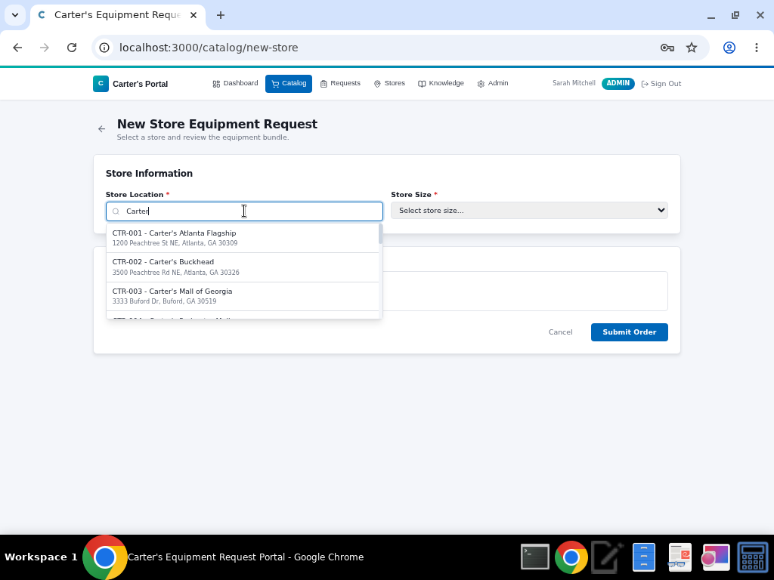
Step 1: Select Store & Size
1. Search for the store by name or site number (e.g. 'CTR-001')
2. Select the store from the dropdown results
3. The store address will display for confirmation
4. Choose the store size: Small, Medium, or Large
5. The system automatically loads the recommended equipment bundle
Carter's Retail Inc. — Equipment Request Portal User Guide

Slide 12
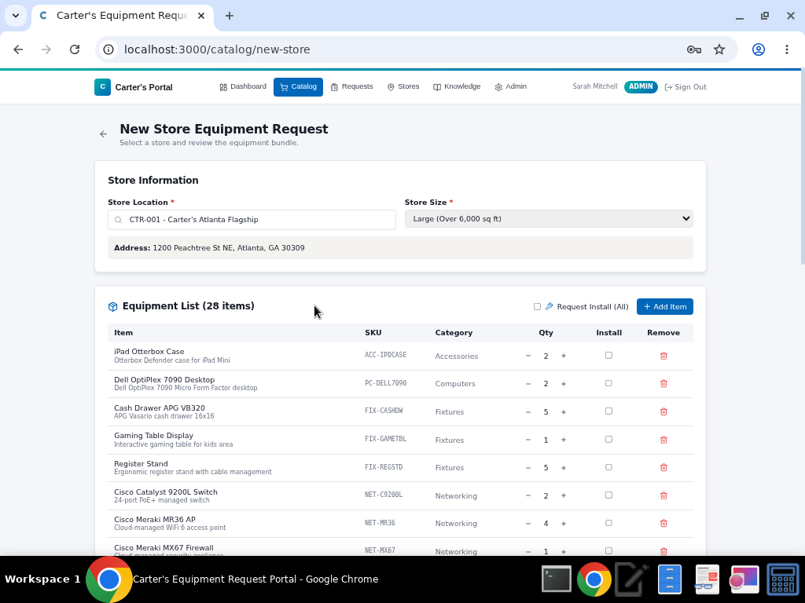
Step 2: Review Equipment Bundle
1. The equipment list auto-populates based on store size
2. Large stores receive 28 items across all categories
3. Adjust quantities using the – and + buttons
4. Check 'Install' for items that need professional installation
5. Use 'Request Install (All)' to check all items at once
6. Click '+ Add Item' to add products not in the bundle
7. Remove unwanted items with the red trash icon
Carter's Retail Inc. — Equipment Request Portal User Guide

Slide 13
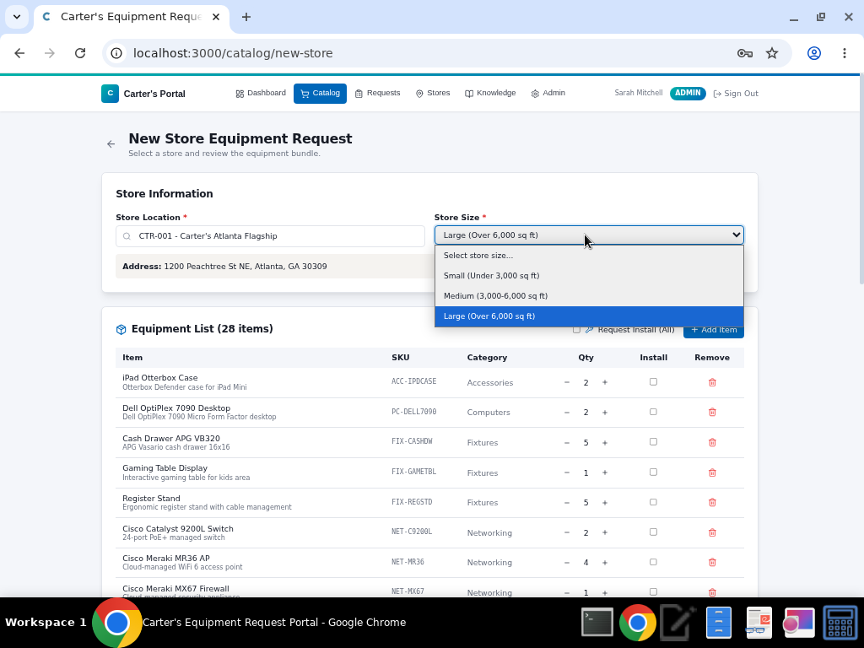
Store Size Options
1. Small (Under 3,000 sq ft) — Basic bundle with ~10 items
2. Medium (3,000–6,000 sq ft) — Standard bundle with ~18 items
3. Large (Over 6,000 sq ft) — Full bundle with ~28 items
4. Bundles include Networking, POS, Fixtures, Security, Signage, and more
5. Click 'Submit Order' when your equipment list is finalized
Carter's Retail Inc. — Equipment Request Portal User Guide

Slide 14
Replacement Items
Requesting individual equipment replacements

Slide 15
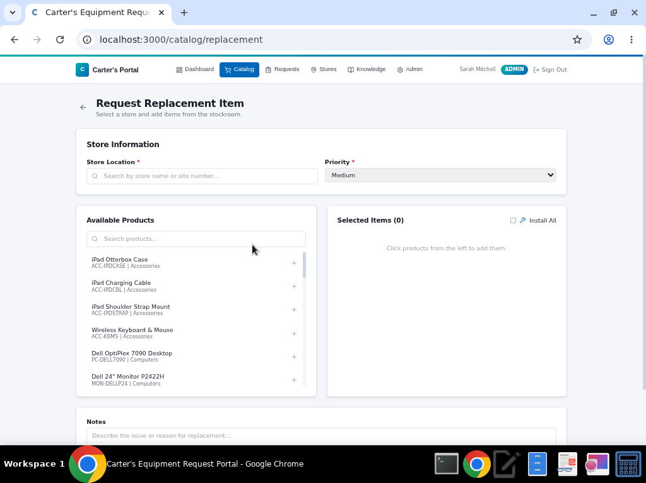
Replacement Item Request
1. Search and select the store location that needs equipment
2. Set the request priority (Low, Medium, High, Urgent)
3. Browse the Available Products list on the left panel
4. Use the search bar to filter products by name or category
5. Click the + icon to add a product to your Selected Items
6. Adjust quantities and check 'Install All' if needed
7. Add notes describing the issue or reason for replacement
8. Click 'Submit Request' when ready
Carter's Retail Inc. — Equipment Request Portal User Guide

Slide 16
General Support
For non-equipment IT issues and requests

Slide 17
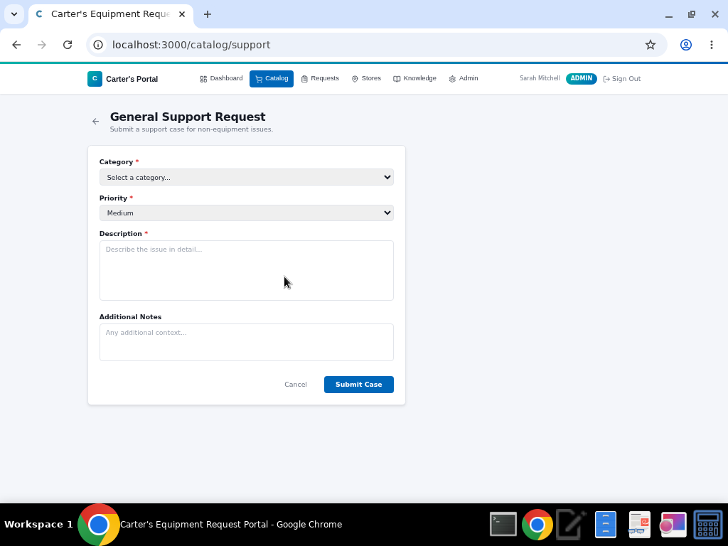
General Support Request
1. Select a category: Network, Software, Hardware, Account, or Other
2. Set the priority level (affects response time)
3. Write a detailed description of the issue
4. Add any additional notes or context
5. Click 'Submit Case' to create a support ticket
6. Response times: Urgent (2hr), High (4hr), Medium (1 day), Low (3 days)
Carter's Retail Inc. — Equipment Request Portal User Guide

Slide 18
Tracking Requests
Monitor and manage all your equipment requests

Slide 19
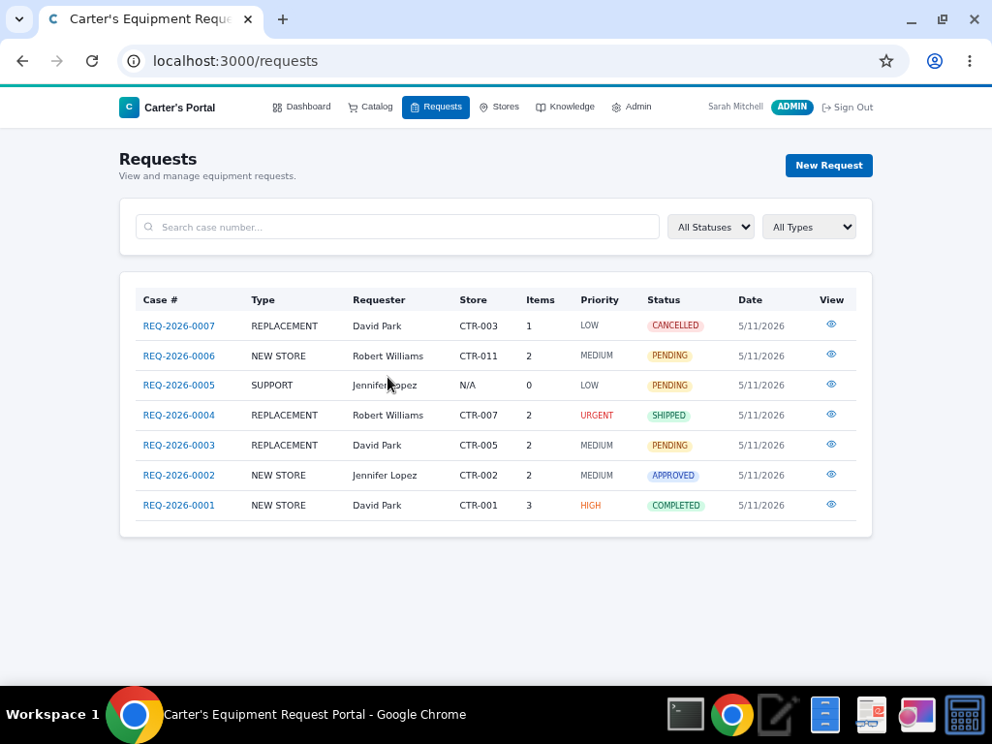
Requests List
1. Click 'Requests' in the navigation bar to see all requests
2. Search by case number using the search bar
3. Filter by status: Pending, Approved, Shipped, Completed, Cancelled
4. Filter by type: New Store, Replacement, or Support
5. Each row shows case number, type, requester, store, priority, and status
6. Click the eye icon or case number to view full details
7. Admins and Fulfillers can see all requests; Requesters see only their own
Carter's Retail Inc. — Equipment Request Portal User Guide

Slide 20
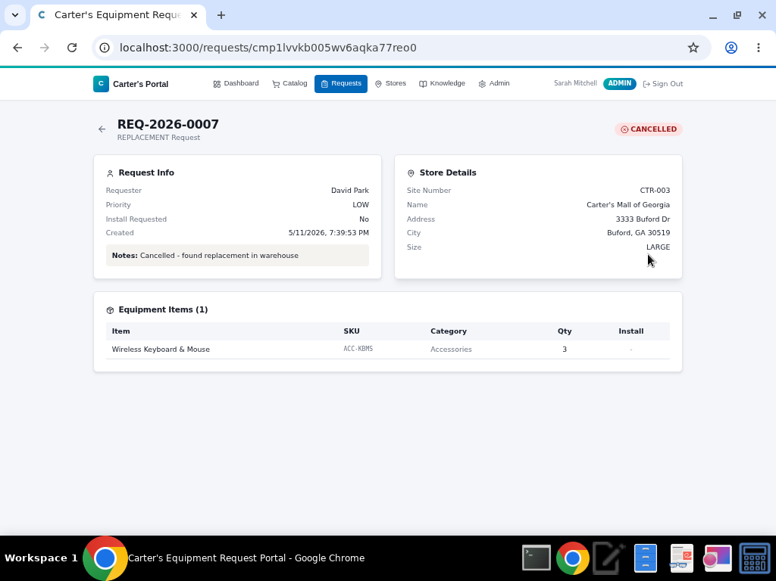
Request Detail View
1. View complete request information including requester and store details
2. See the full equipment items list with SKUs, categories, and quantities
3. Track the current status with a color-coded badge
4. Notes and installation preferences are displayed
5. Fulfillers and Admins can update the status (Approve, Ship, Complete, Cancel)
6. Status changes trigger email notifications to the requester
Carter's Retail Inc. — Equipment Request Portal User Guide

Slide 21
Store Directory
Browse all Carter's retail locations

Slide 22
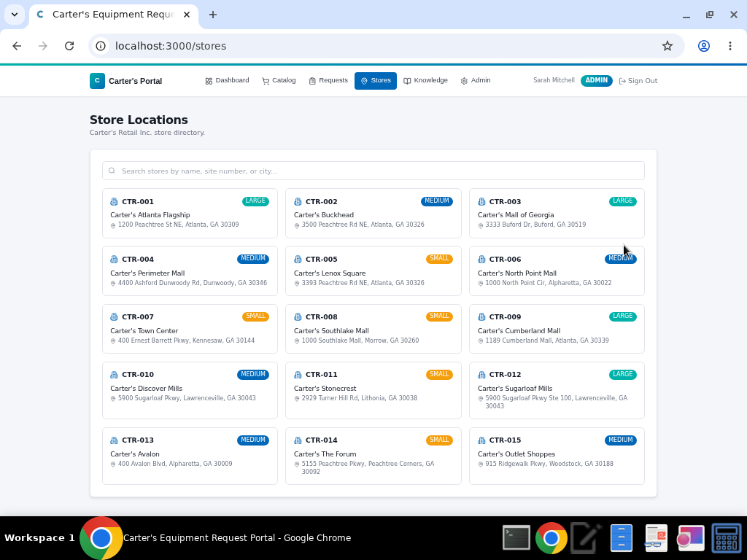
Store Locations
1. Click 'Stores' in the navigation to view all locations
2. Each card shows the site number, store name, and full address
3. Store size badges (Small, Medium, Large) are color-coded
4. Use the search bar to filter by name, site number, or city
5. 15 Carter's locations across Georgia are pre-loaded
Carter's Retail Inc. — Equipment Request Portal User Guide

Slide 23
Knowledge Base
Self-service guides and documentation

Slide 24
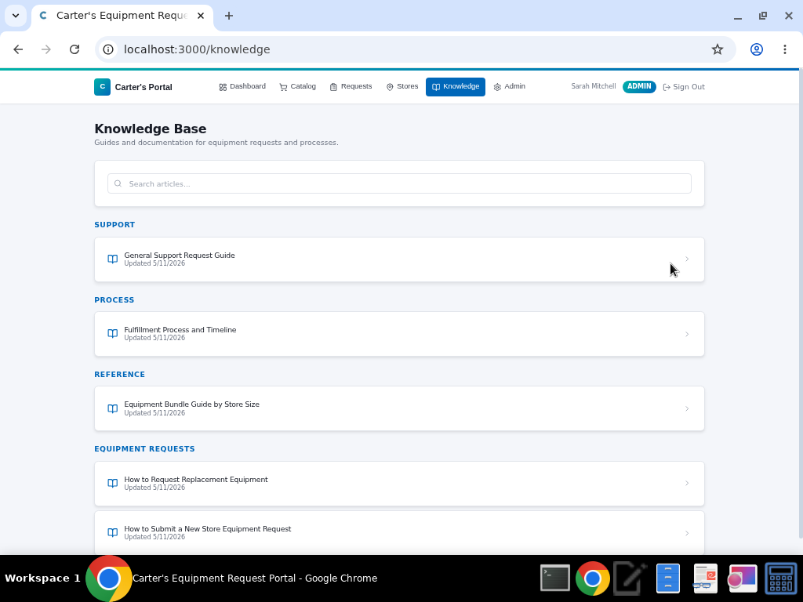
Knowledge Base
1. Click 'Knowledge' in the navigation bar
2. Articles are organized by category: Support, Process, Reference, Equipment Requests
3. Search articles by title or content using the search bar
4. Click any article to read the full guide
5. Topics include: How to submit requests, fulfillment timelines, bundle guides, and more
Carter's Retail Inc. — Equipment Request Portal User Guide

Slide 25
Administration
System management for Admin users only

Slide 26
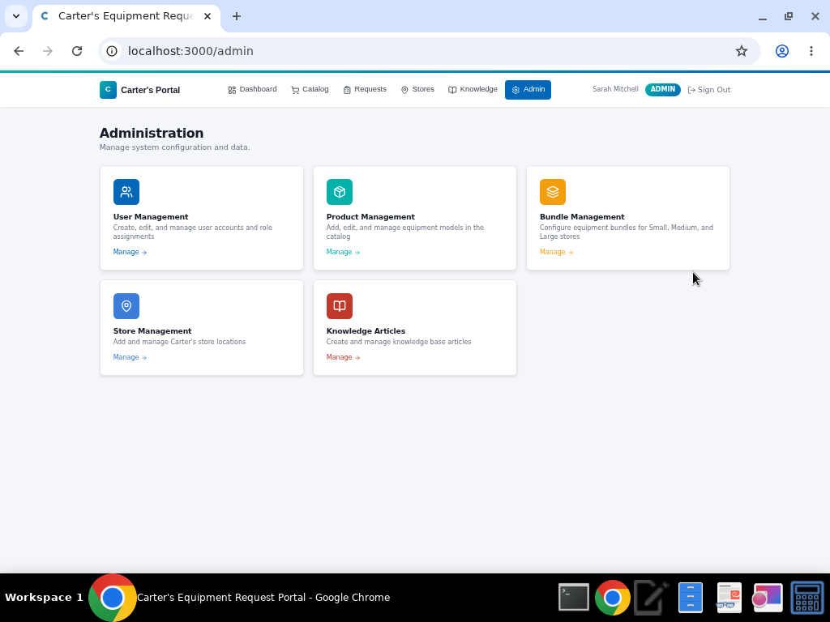
Admin Hub
1. The Admin panel is only visible to users with the Admin role
2. Five management areas: Users, Products, Bundles, Stores, and Knowledge Articles
3. Click 'Manage' on any card to enter that management section
4. All changes take effect immediately across the portal
Carter's Retail Inc. — Equipment Request Portal User Guide

Slide 27
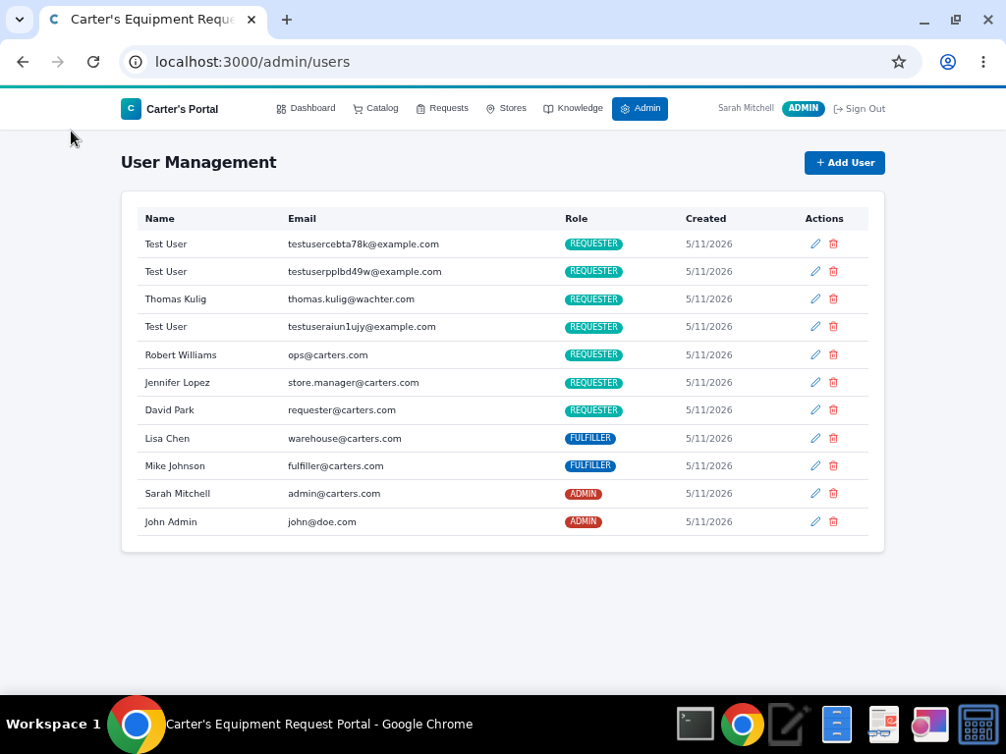
User Management
1. View all registered users with name, email, role, and creation date
2. Click '+ Add User' to create a new account
3. Assign roles: Requester, Fulfiller, or Admin
4. Use the pencil icon to edit a user's details or change their role
5. Use the trash icon to remove a user
6. Role changes take effect on the user's next login
Carter's Retail Inc. — Equipment Request Portal User Guide

Slide 28
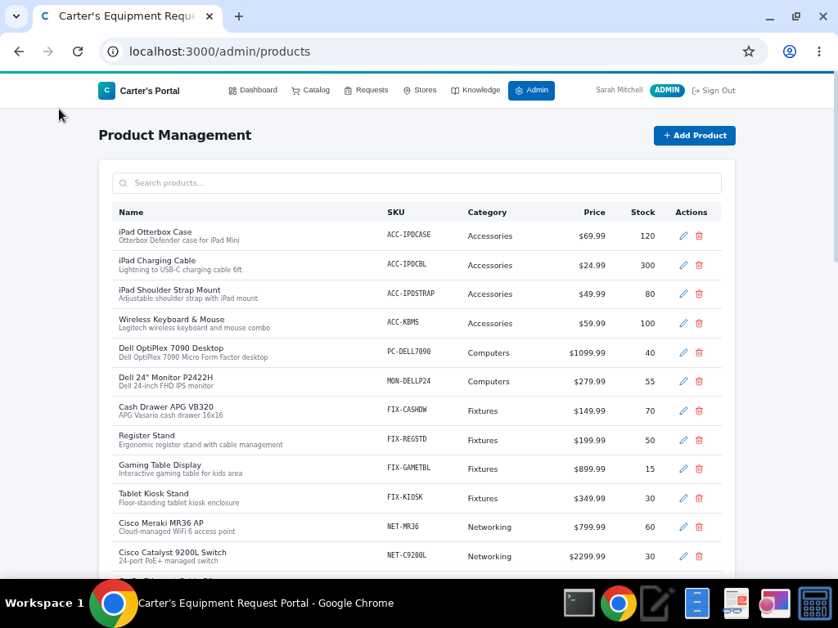
Product Management
1. View the complete equipment catalog with names, SKUs, categories, prices, and stock levels
2. Search products using the search bar
3. Click '+ Add Product' to add new equipment models
4. Edit product details (name, description, price, stock) with the pencil icon
5. Deactivate products with the trash icon (they're hidden, not deleted)
6. Products span 9 categories: Accessories, Computers, Fixtures, Networking, POS, Printers, Security, Signage, Telecom
Carter's Retail Inc. — Equipment Request Portal User Guide

Slide 29
User Roles & Permissions
REQUESTER
FULFILLER
ADMIN
✓ Create equipment and support requests
✓ View their own request history and status
✓ Browse the store directory
✓ Access the Knowledge Base
✓ Default role for new sign-ups
✓ All Requester permissions, plus:
✓ View ALL requests across the organization
✓ Approve, Ship, Complete, or Cancel requests
✓ Status changes trigger email notifications
✓ Manage the fulfillment lifecycle
✓ All Fulfiller permissions, plus:
✓ Access the Admin panel
✓ Manage users (create, edit, delete, assign roles)
✓ Manage the product catalog and equipment bundles
✓ Manage store locations and knowledge articles
Carter's Retail Inc. — Equipment Request Portal User Guide

Slide 30
Questions?
Contact your system administrator or visit the Knowledge Base for additional help.
Carter's Retail Inc. • Powered by Wachter

