Slide 1
Inez Yoon
Last
Carriage
Notes:
a 2D action game built in C++ with SDL on top of a custom hybrid ECS-based engine. The goal of the project was not only to make a playable game, but also to design a modular engine architecture that supports map-driven stages, reusable entities, and separated gameplay systems.

Slide 2
Game Concept
01
Notes:
a 2D action game built in C++ with SDL on top of a custom hybrid ECS-based engine. The goal of the project was not only to make a playable game, but also to design a modular engine architecture that supports map-driven stages, reusable entities, and separated gameplay systems.

Slide 3
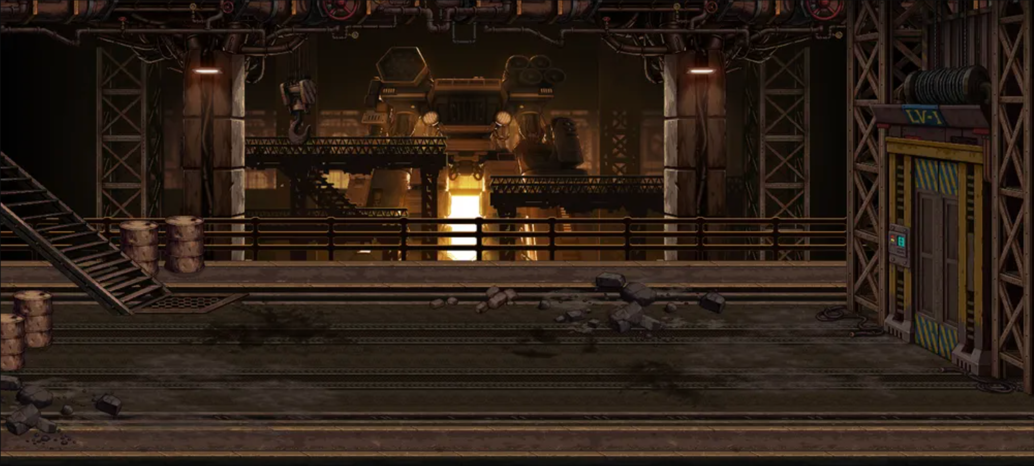
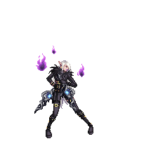

Notes:
The game is set on a dystopian survival train where the player starts in the rear section and moves forward through connected stages. The gameplay loop is simple and clear: the player explores each area, fights enemies, collects items, and uses doors to progress to the next section.

Slide 4
Engine
Architecture
02

Slide 5
Hybrid ECS Architecture
01
02
03
Entities
Components
Systems
Player
Enemies
Items
Doors
Data
Matching
Entities and Components
©
BY SLIDESGO
CREDITS
Notes:
The engine uses a hybrid ECS architecture. Entities represent objects like the player, enemies, items, and doors. Components store data, and systems process entities with matching components. I also use helper classes outside the ECS, such as the map loader and stage manager, to keep parsing and stage transitions separate from gameplay logic.

Slide 6
Map Pipeline
TMX Map
MapLoader
MapData
Map
Systems
ECS Entities
StageManager
Notes:
One of the strongest architectural parts is the map pipeline: TMX files are parsed by MapLoader, stored in MapData, wrapped by Map, and then converted into gameplay entities by StageManager. This makes the level design data-driven instead of hardcoded.

Slide 7
Main Systems
03

Slide 8
Main Systems
Movement
System
Combat
System
Item
System
Door
System
Render
System
Game
Context
Notes:
The game loop is organized through several focused systems. The Game class mainly initializes SDL, starts the first stage, runs the loop, and delegates work to the systems. The main systems are movement, combat, item interaction, door transitions, and rendering. Shared runtime state such as the active map, camera, player entity, cooldown timers, UI font, and pending stage changes is stored in GameContext, which helps systems coordinate without tightly coupling everything to one large class.

Slide 9
Engine Extensibility
04

Slide 10
Engine Extensibility
Map-driven Spawns
Factories
<objectgroup id="2" name="Spawn Layer">
</objectgroup>
<objectgroup id="3" name="Enemy Layer">
</objectgroup>
<objectgroup id="4" name="Item Layer">
</objectgroup>
ItemFactory.cpp
PlayerFactory.cpp
EnemyFactory.cpp
BulletFactory.cpp
DoorFactory.cpp
Notes:
To demonstrate extensibility, the engine supports map-driven gameplay content. Enemy spawn points, item spawns, collision areas, named player spawn points, and doors are all defined in the map and loaded at runtime. Then the stage manager clears old stage entities and respawns the correct objects for the next area.
I also use factories to create players, enemies, items, and doors, which keeps entity setup consistent and reusable. For enemies, the factory already supports multiple types like patrol, shooter, flying, and boss variants, showing how the engine can scale to different gameplay behaviors.

Slide 11
Engine Extensibility
Factories
ItemFactory.cpp
PlayerFactory.cpp
EnemyFactory.cpp
BulletFactory.cpp
DoorFactory.cpp
Notes:
To demonstrate extensibility, the engine supports map-driven gameplay content. Enemy spawn points, item spawns, collision areas, named player spawn points, and doors are all defined in the map and loaded at runtime. Then the stage manager clears old stage entities and respawns the correct objects for the next area.
I also use factories to create players, enemies, items, and doors, which keeps entity setup consistent and reusable. For enemies, the factory already supports multiple types like patrol, shooter, flying, and boss variants, showing how the engine can scale to different gameplay behaviors.

Slide 12
Challenges
05

Slide 13
— Faker
1 UP 25000
2 UP 003200
“If you cannot spot a troll in your team, well, it’s you.”
©
BY SLIDESGO
CREDITS
Notes:
Me trolling: getting sick, build one mono system at the first time -> refactoring was disgusting
The biggest challenge was Time constraints. balancing engine development with making a complete playable game was so difficult with my health concerns. To manage scope, I focused on a stable gameplay slice with movement, combat, items, and stage progression.

Slide 14

DEMO
1 UP 25000
2 UP 003200
©
BY SLIDESGO
CREDITS
Notes:
player movement
shooting and reload
item pickup
enemy encounter
door transition to another stage

Slide 15
THANKS!
1 UP 25000
2 UP 003200
THANKS!
ANY QUESTIONS?
©
BY SLIDESGO
CREDITS

