Slide 1

Building a Small Language
with
Inez Yoon

Slide 2
00
Intro
Basic terminology
Notes:
Before I get into the core topics, i’d like to introduce basic terminology

Slide 3
Programing
Language
A way to communicate instructions to a computer
Syntax + Semantics by a formal language
Meet us
Notes:
So, what’s the programing language?
It’s the language let computer understand what human say
Syntax ( form )
Semantics ( meaning )
Java, Python, C, and Ocaml

Slide 4
Small
Language
A domain-specific or minimal programming language
>> Simple syntax and semantics
>> Learn quickly and easily
Meet us
Notes:
But what is a small language?
A domain-specific or minimal programming language.
Let’s say, if you work at NASA, you may want to develop a language for astronaut to control space machines quickly
Or, make a language for fun.

Slide 5
01
Syntax
A human language to a programming language
Notes:
Before I dive into individual core concepts, I’d like to introduce brief steps of SYNTAX,
This is important to translate a human readable language to a programming language

Slide 6
let x = 5 + 3
Syntax: Concrete Syntax
Notes:
Are you able to understand this representation? YES
Concrete syntax
Human-readable representation (e.g., let x = 5).
Unfortunately, compiler doesn’t understand this

Slide 7
Compiler: ???
Syntax: Abstract Syntax
Notes:
Abstract Syntax
So to babysitting the compiler, we need abstract syntax tree and backus nauer form

Slide 8
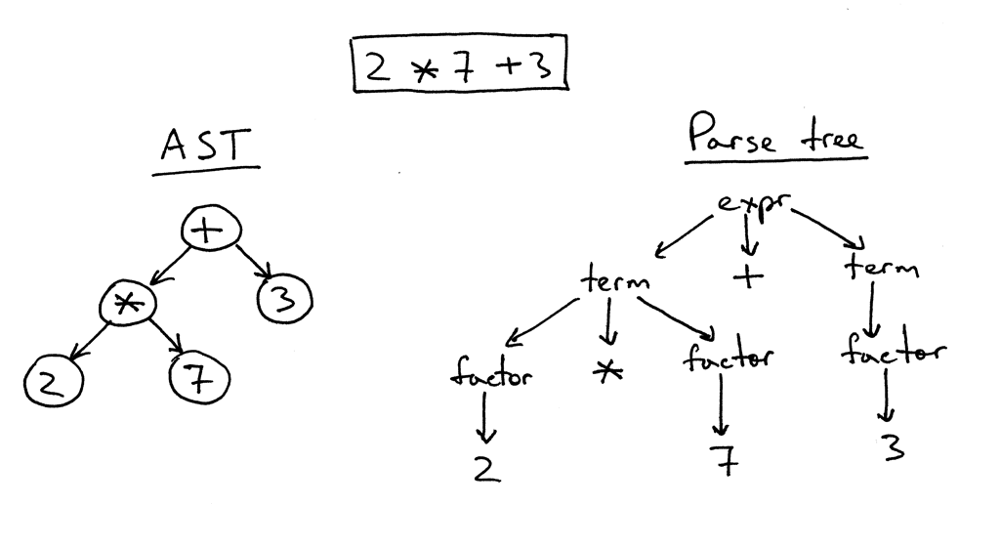
Syntax: Abstract Syntax Tree
Notes:
Abstract Syntax Tree (AST)
The AST is a tree-like data structure that represents the hierarchical organization of the grammar. Each node corresponds to a language construct, and its children represent its components.
Abstract Syntax Tree (AST)
This is an example of Abstract syntax tree
If we want to interpret human language,
2 multiply 7 plus 3

Slide 9
expr ::= INT
| IDENT
| expr "+" expr
| "(" expr ")"
| "let" IDENT "=" expr
Syntax for compiler: Backus-Naur form
Notes:
backus nauer form
is a notation used to describe the syntax of programming languages or other formal languages.
Suppose we want to define a language that supports:
Integers (42)
Addition (5 + 3)
Parentheses ((1 + 2))
Variables and assignments (let x = 5)
Here’s how we could define its grammar:

Slide 10
Core Concepts
Evaluation
Parsing
Lexing
Type inference
Notes:
Parsing, evaluation, and type inference.

Slide 11
02
Parsing & Lexing
Breaking down string into small meaningful unit
Notes:
What is parsing?
parsing is a technique used to analyze and interpret the syntax of a text or program to extract relevant information
So it breaks down a complex set of data structures or code into smaller, more manageable components that can be analyzed and understood.
lexing is the process of breaking down a string. into meaningful units, indepdendent of context.

Slide 12
Lexer
The 1st Core Component
Notes:
The first stage in interpreting or compiling a program.
Converts a raw sequence of characters (source code) into tokens

Slide 13
let x = 5 + 3
The 1st Core Component: Lexer (source file to tokens)
Notes:
Tokens are the smallest meaningful units in a program, such as:
Quiz = how many tokens? 6
let (keyword)
x (identifier)
= (operator)
5 (number literal)
+ (operator)
3 (number literal)

Slide 14
Ocamllex lexer.mll
The 1st Core Component: Lexer (source file to tokens)
Notes:
How to Implement in OCaml?
Use libraries like ocamllex, a lexer generator tool. Or custom tokenizer
(that produces a lexical analyzer from a set of regular expressions with associated semantic actions)
Define rules for recognizing different tokens using regular expressions.
produces OCaml code for a lexical analyzer in file lexer.ml
These functions have the same names as the entry points.

Slide 15
Module Lexing module lexing: sig..end
The 1st Core Component: Lexer (source file to tokens)
Notes:
https://ocaml.org/manual/5.2/api/Lexing.html
The run time library generated by ocamllex:
Lexing functions take as argument a lexer buffer,
and return the semantic attribute of the corresponding entry point

Slide 16
Lexing.from_channel
Lexing.from_string
Lexing.from_function
The 1st Core Component: Lexer (source file to tokens)
Notes:
https://ocaml.org/manual/5.2/api/Lexing.html
The functions Lexing.from_channel, Lexing.from_string and Lexing.from_function
create lexer buffers that read from
an input channel, a character string, or any reading function, respectively.

Slide 17
let x = 5 + 3
The 1st Core Component: Lexer (source file to tokens)
Notes:
So, this human language
Let x equals to 5 plus 3 becomes

Slide 18
[LET, IDENT("x"), EQUAL, INT(5), PLUS, INT(3)]
The 1st Core Component: Lexer (source file to tokens)
Notes:
Like this : it breaks down into small tokens
Lexer

Slide 19
Parser
The 2nd Core Component
Notes:
takes input data (typically text) and builds a data structure , such as Abstract Syntax Tree

Slide 20
let x = 5 + 3
The 1st Core Component: Parser(grammar)
Notes:
The same example
This human language for the tree would be

Slide 21
let(“x”, Add(int(5), int(3))
The 1st Core Component: Parser(grammar)
Notes:
It gets ready to build a data structure

Slide 22
Mehir
The 1st Core Component: Parser(grammar)
Notes:
Tools: Parser Generators like Menhir (next)
What is Menhir?
Menhir is a parser generator for OCaml, much like yacc or bison in C.
It automates the process of turning a grammar into a working parser.
It works with OCaml code to process tokens and build an AST.
Steps to Use Menhir
Define Tokens Tokens are declared in a .mly file (the grammar file). You can generate these tokens using a lexer like ocamllex.
Example (tokens.mly):
menhir
Copy code
%token <int> INT
%token LET IDENT EQUAL PLUS EOF
<int> specifies that INT tokens carry an integer value.
Write Grammar Rules Use Menhir to define the grammar rules and specify how to construct the AST.
Example (parser.mly):
%start <expr> main
%%
main:
| LET IDENT EQUAL expr { Let ($2, $4) }
| expr { $1 }
expr:
| INT { Int ($1) }
| expr PLUS expr { Add ($1, $3) }
xplanation:
main is the entry point for the parser.
The rules:
LET IDENT EQUAL expr creates a Let node in the AST.
expr PLUS expr creates an Add node.
INT creates an Int node.
Generate the Parser Run Menhir to compile the grammar into OCaml code:
menhir parser.mly
4. Integrate the Parser Combine the generated parser with the lexer to create a complete parser.
Example OCaml Code:
let parse tokens =
let lexbuf = Lexing.from_string tokens in
try
Parser.main Lexer.tokenize lexbuf
with
| Parser.Error -> failwith "Syntax error"
. Why Use Parser Generators like Menhir?
Advantages:
Automation: Automates the tedious and error-prone task of writing parsers manually.
Efficiency: Generates optimized code for parsing.
Error Handling: Provides built-in error reporting mechanisms for invalid syntax.
Maintainability: Easy to update and extend grammar rules as the language evolves.
Integration: Works seamlessly with OCaml, allowing you to focus on the logic instead of low-level parsing details.

Slide 23
Menhir for
grammar rules and
construct the AST
The 1st Core Component: Parser(grammar)
Notes:
Write Grammar Rules Use Menhir to define the grammar rules and specify how to construct the AST.
Or you can construct by yourself if the program is not complex
Example (parser.mly):
%start <expr> main
%%
main:
| LET IDENT EQUAL expr { Let ($2, $4) }
| expr { $1 }
expr:
| INT { Int ($1) }
| expr PLUS expr { Add ($1, $3) }

Slide 24
Run Menhir to compile
The 1st Core Component: Parser(grammar)
Notes:
Write Grammar Rules Use Menhir to define the grammar rules and specify how to construct the AST.
Example (parser.mly):
%start <expr> main
%%
main:
| LET IDENT EQUAL expr { Let ($2, $4) }
| expr { $1 }
expr:
| INT { Int ($1) }
| expr PLUS expr { Add ($1, $3) }

Slide 25
parser + lexer -> a complete parser
The 1st Core Component: Parser(grammar)
Notes:
4. Integrate the Parser Combine the generated parser with the lexer to create a complete parser.
Example OCaml Code:
let parse tokens =
let lexbuf = Lexing.from_string tokens in
try
Parser.main Lexer.tokenize lexbuf
with
| Parser.Error -> failwith "Syntax error"

Slide 26
Evaluation
The 2nd Core Component: Evaluation
Notes:
Evaluation refers to the process of determining the value of an expression or a variable.
It is simply computing the result of an expression.

Slide 27
The 2nd Core Component: Evaluation
Substitution
Environmental
Notes:
To evaluate the value, there are two models

Slide 28
The 2nd Core Component: Evaluation
Substitution
Environmental
Notes:
To evaluate the value, there are two models
First, substitution model
Replace variables with their bound values during evaluation.
Simple but inefficient for large programs.

Slide 29
The 2nd Core Component: Evaluation
Substitution
Environmental
Notes:
Second, the environmental model.
Use a dictionary to map variables to values.
Supports closures and lexical scoping.

Slide 30
let x = 3 + 5 in
let f = fun y -> x + y in
let x = 10 in
f 2
The 2nd Core Component: Evaluation
Notes:
Environmental evaluation
0. Initial Environment (Global Scope)
Start with an empty environment {}.
1. Evaluate let x = 3 + 5 in ...
3 + 5 evaluates to 8.
Extend the environment: {x -> 8}. // x binding with 8
2.Evaluate let f = fun y -> x + y in ...
Define a function f where:
Code: fun y -> x + y
Closure: Captures the current environment {x -> 8}.
Extend the environment: {x -> 8, f -> (| fun y -> x + y, {x -> 8} |)}.
Evaluate let x = 10 in ...
Shadow the previous binding of x with 10.
Extend the environment: {x -> 10, f -> (| fun y -> x + y, {x -> 8} |)}.
Evaluate f 2
Look up f in the environment. It is (| fun y -> x + y, {x -> 8} |).
Use the captured environment {x -> 8} to evaluate f 2:
Substitute y = 2: x + y → 8 + 2.
Result: 10.

Slide 31
Type Inference
The 3rd Core Component: Type Inference
Notes:
refers to the automatic detection of the type of an expression in a formal language
Also, it ensures programs are well-formed and prevent certain runtime errors.

Slide 32
The 3rd Core Component- Semantic Analysis
Type Checking
Scope Resolution
Validation Usage
Notes:
Key Goals of Semantic Analysis

Slide 33
The 3rd Core Component- Semantic Analysis
(5 + 3) (* valid *)
(5 + “hello”) (* invalid *)
Type Checking
Scope Resolution
Validation Usage
Notes:
First, type checking
Ensures that operations in the program are applied to compatible types.
Example Rules:
Adding two integers (5 + 3) is valid.
Adding an integer and a string (5 + "hello") is invalid.
Detects type mismatches during compilation or interpretation.

Slide 34
The 3rd Core Component- Semantic Analysis
Type
Checking
Scope
Resolution
Validation Usage
Notes:
Second, scope resolution
Ensures that variables and functions are defined before they are used.
Maintains a symbol table (a mapping of names to their definitions) to track:
Variable declarations.
Function definitions.
Nested scopes (e.g., local variables in functions).

Slide 35
The 3rd Core Component- Semantic Analysis
Let("x", Int 5, Add(Var "x", Int 3)) (* AST *)
let rec eval expr env =
match expr with
| Int n -> n
| Var name -> (
match List.assoc_opt name env with
| Some value -> value
| None -> failwith ("Undefined variable: " ^ name))
| Let (name, value, body) ->
let value = eval value env in
let new_env = (name, value) :: env in
eval body new_env
Notes:
Second, scope resolution
Ensures that variables and functions are defined before they are used.
Maintains a symbol table (a mapping of names to their definitions) to track:
Variable declarations.
Function definitions.
Nested scopes (e.g., local variables in functions).

Slide 36
The 3rd Core Component- Semantic Analysis
add(a: int, b: int)
add(5, “hello”) (* invalid *)
Type
Checking
Scope
Resolution
Validation
Usage
Notes:
Ensures that functions are called with the correct number and type of arguments.
Example Rules:
A function defined as add(a: int, b: int) must receive two integers.
A call like add(5, "hello") is invalid.

Slide 37
03
Building a Simple Interpreter
Bring all Lexer, Parser and Semantic Analysis together!
Notes:
Now, it’s time to bring all lexer, parser and semantic analysis together

Slide 38
Tokenizing (lexer)
Building a Simple Interpreter
Notes:
First, we did

Slide 39
Parsing
Building a Simple Interpreter
Notes:
Second,

Slide 40
Evaluation
Building a Simple Interpreter
Notes:
3. Evaluation
What is Evaluation?
Evaluation traverses the AST and computes the result of the expression.
Steps to Build an Evaluator:
Define a recursive function that walks the AST.
Apply operations based on the node type.

Slide 41
let rec eval expr =
match expr with
| Int n -> n
| Add (left, right) ->
eval left + eval right
| Mul (left, right) ->
eval left * eval right
| Paren e -> eval e
Building a Simple Interpreter: Evaluation
Notes:
3. Evaluation
What is Evaluation?
Evaluation traverses the AST and computes the result of the expression.
Steps to Build an Evaluator:
Define a recursive function that walks the AST.
Apply operations based on the node type.

Slide 42
3 + 5 * (10 - 2)
Building a Simple Interpreter: Evaluation
Notes:
Workflow
Input:

Slide 43
[INT 3;
PLUS; INT 5; MULT; LPAREN; INT 10; MINUS; INT 2; RPAREN; EOF]
Building a Simple Interpreter: Evaluation
Notes:
Tokenizing

Slide 44
Add(Int 3, Mul(Int 5, Paren(Sub(Int 10, Int 2))))
Building a Simple Interpreter: Evaluation
Notes:
Parsing - in ast

Slide 45
Evaluation result
43
Building a Simple Interpreter: Evaluation
Notes:
Evaluation
43

Slide 46
05
Catculator
Demo and Code walk through

Slide 47
07
Practical
Applications
So, what’s good for making a programming language?
Notes:
6. Practical Applications and Wrap-Up (1-2 minutes)
Applications of Custom Languages
Domain-specific languages (DSLs).
Scripting engines, educational tools, or experimental programming paradigms.
Key Takeaways
OCaml is a great tool for learning and building interpreters due to its type system and pattern matching.

Slide 48
Challenges 😭
Polymorphism, mutability, scoping rules
Practical Applications
Notes:
Challenges
Handling scoping rules (lexical vs. dynamic).
Polymorphism and mutability.

Slide 49
Challenges 😭
Evaluation model vs. System complexity
Practical Applications
Notes:
Design Decisions
Trade-offs in evaluation models and type system complexity.

Slide 50
Pattern matching
Strong typing
Recursion
Practical Applications
Notes:
So far, i’ve noticed that
OCaml as an Implementation Language has strengths :
Pattern matching, strong typing, efficient recursion.

Slide 51


