Slide 1
Urban V2X Self-Organizing 3D Networks with BF-Enabled UAVs

Slide 2




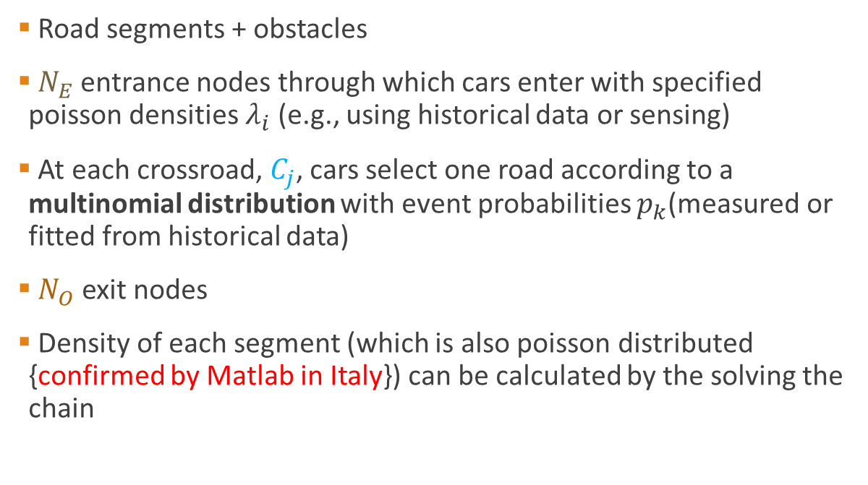






Environment
Vehicles enter
Vehicles exit
Road segments + obstacles
$N_{E}$entrance nodes through which cars enter with specified poisson densities $λ_{i}$ (e.g., using historical data or sensing)
At each crossroad, $C_{j}$, cars select one road according to a multinomial distribution with event probabilities $p_{k}$(measured or fitted from historical data)
$N_{O}$ exit nodes
Density of each segment (which is also poisson distributed {confirmed by Matlab in Italy}) can be calculated by the solving the chain
Road segment
O
Sink State
$$p_{2,2}$$
$$C_{2}$$
$$E_{1}$$
$$p_{2,1}$$
O
$$p_{1,2}$$
$$C_{1}$$
$$p_{1,1}$$
$$λ_{1}$$
Source State
$$E_{2}$$
$$λ_{2}$$

Slide 3
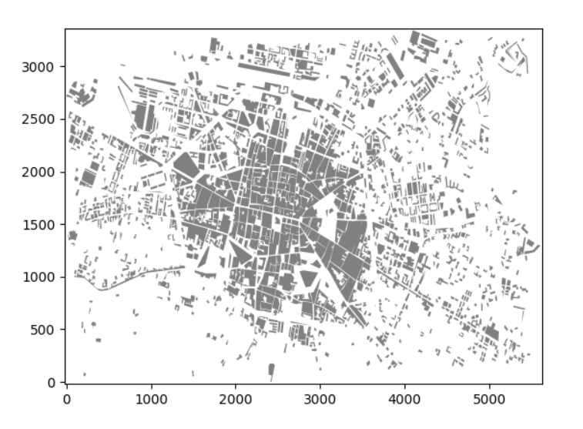
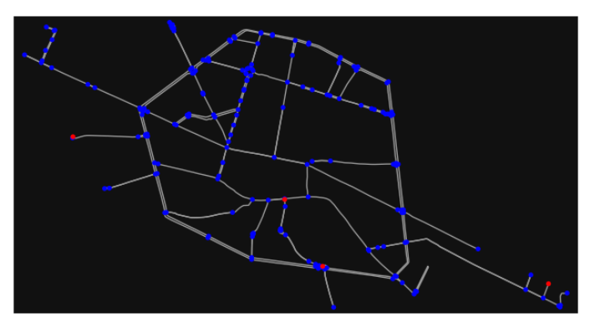
Bologna – E.g., Disaster

Slide 4
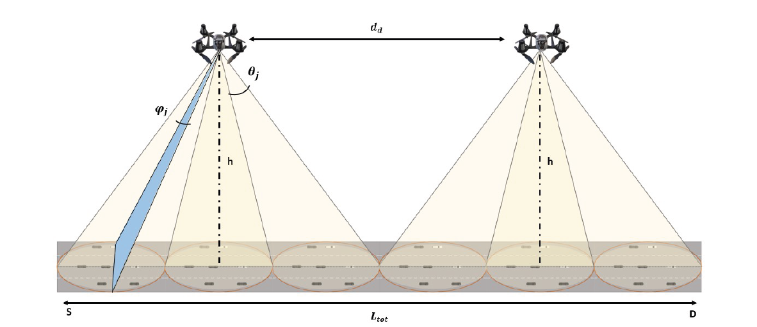
Footprints and Visibility
Required regions (ellipses) to be covered by a beam are defined on all segments
Only a subset of footprint-regions is visible from a given UAV location due to obstacles
Visibility (2D) between any two locations can be obtained using visibility algorithms from computational geometry
UAV
Vehicles enter
Vehicles exit

Slide 5
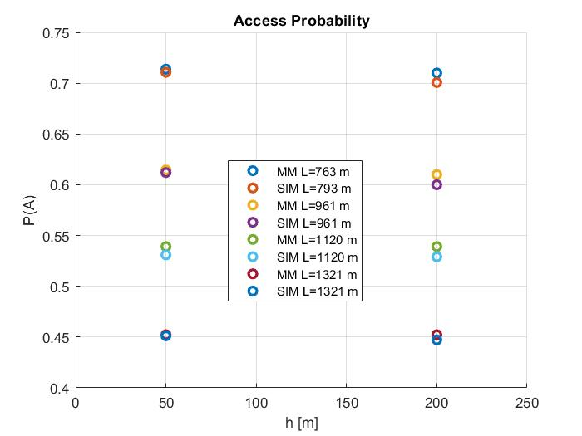
Access Probability Model
UAV
Vehicles enter
Vehicles exit

Slide 6
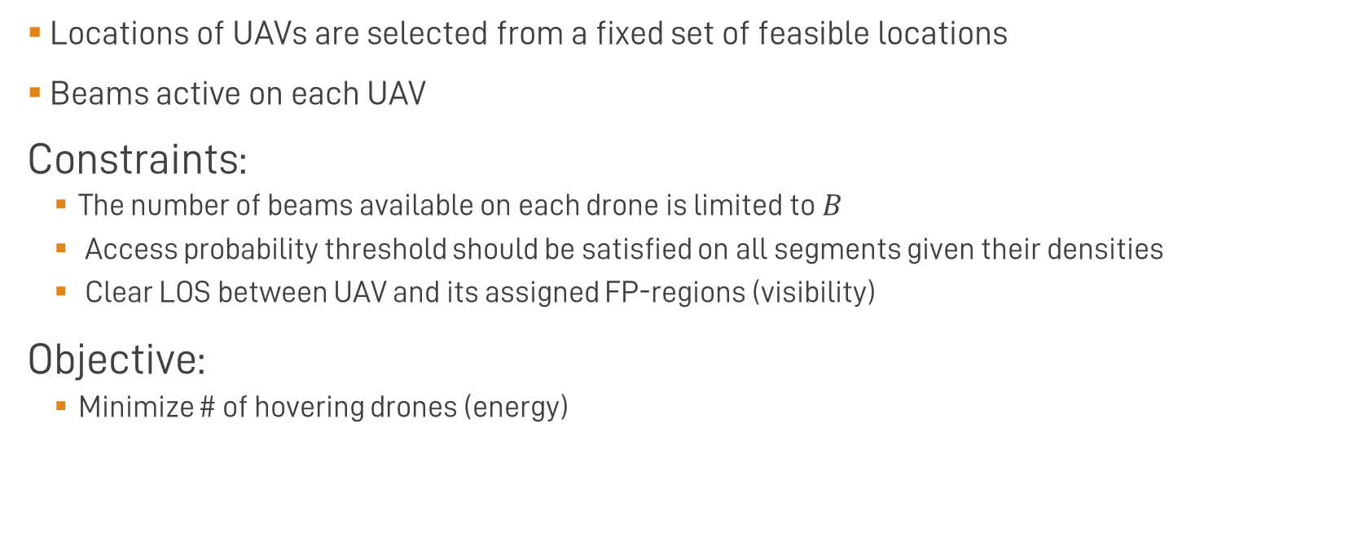
Decision Variables and Formulation
Locations of UAVs are selected from a fixed set of feasible locations
Beams active on each UAV
Constraints:
The number of beams available on each drone is limited to $B$
Access probability threshold should be satisfied on all segments given their densities
Clear LOS between UAV and its assigned FP-regions (visibility)
Objective:
Minimize # of hovering drones (energy)

Slide 7
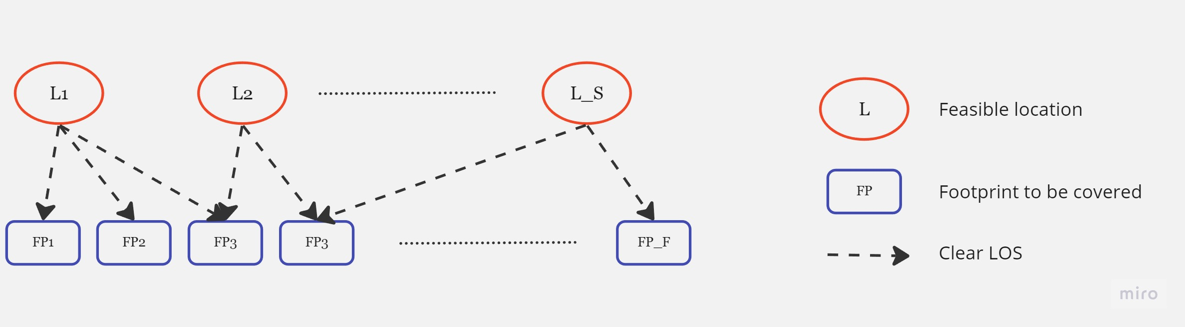
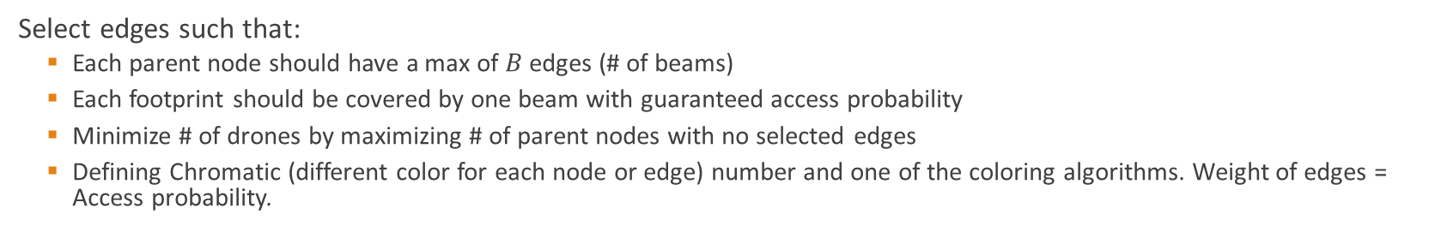
Graph description
Select edges such that:
Each parent node should have a max of $B$ edges (# of beams)
Each footprint should be covered by one beam with guaranteed access probability
Minimize # of drones by maximizing # of parent nodes with no selected edges
Defining Chromatic (different color for each node or edge) number and one of the coloring algorithms. Weight of edges = Access probability.

Slide 8



Integer (Binary) Linear Programming
$$j=\{1,…,S\}$$
$$i=\{1,…,F\}$$
Define $x_{ij}=\{0 or 1\}$ as a binary variable that determines whether drone $j$ is serving FP $i$ or not
The objective function is then to minimize
$$\sum_{j=1}^{S}{y_{j}}$$
$$y_{j}=min⁡\left(1, \sum_{i=1}^{F}{x_{ij}}\right)$$
with following constraints:
$$\sum_{i=1}^{F}{x_{ij}}≤B for all j∈\left\{1,..,S\right\}$$
$$\sum_{j=1}^{S}{x_{ij}}=1 for all i∈\left\{1,..,F\right\}$$
$$x_{ij}≤w_{ij}$$

Slide 9

Integer (Binary) Linear Programming
Removing the min function:
$$y_{j}=min⁡\left(1, \sum_{i=1}^{F}{x_{ij}}\right)$$
$$\sum_{i=1}^{F}{x_{ij}}≤By_{j} for all j∈\left\{1,..,S\right\}$$
$$y_{j}≤1$$
$$y_{j}≤\sum_{i=1}^{F}{x_{ij}}$$
$$y_{j}∈\{0,1\}$$

Slide 10
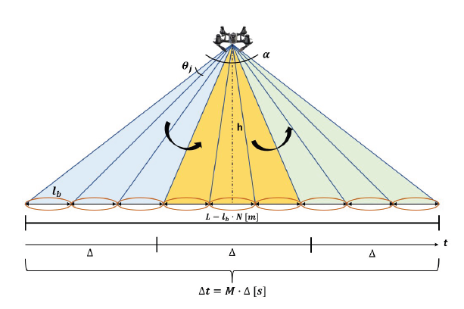
Analytical Description of Access Probability and RRA Strategy for Vehicular Application
Access Probability
Probability that a GUE can successfully transmit in uplink its traffic demand
Probability that a GUE is both covered by one active beams and it has enough resources assigned

Slide 11
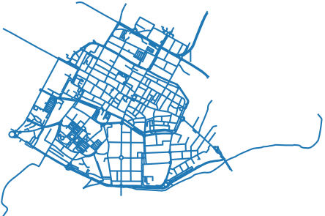
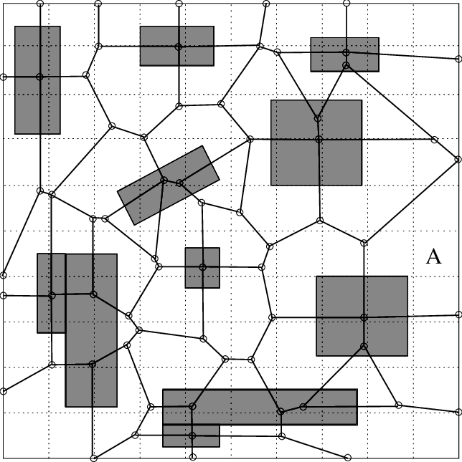
Future extensions
UAVs can also serve moving pedestrians -> dynamic density
Use real city (e.g., Bologna streets from OSM)
Consider backhaul
Pedestrians are moving according to realistic obstacle mobility model
[Amit Jardosh, Elizabeth M. Belding-Royer, Kevin C. Almeroth, and Subhash Suri. 2003. Towards realistic mobility models for mobile ad hoc networks. In Proceedings of the 9th annual international conference on Mobile computing and networking (MobiCom '03). Association for Computing Machinery, New York, NY, USA, 217–229. https://doi.org/10.1145/938985.939008]

Slide 12
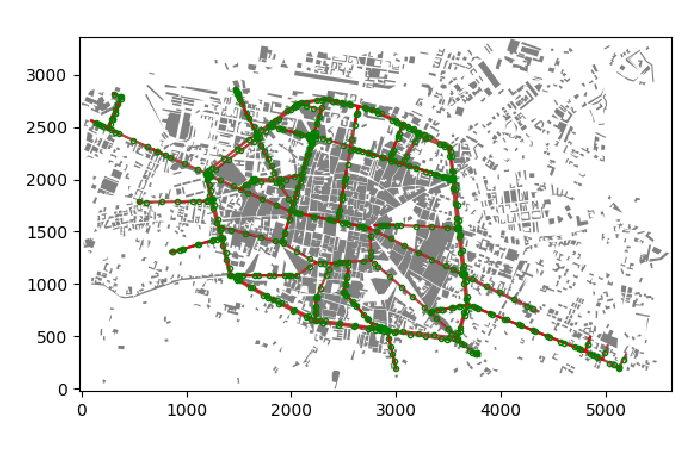
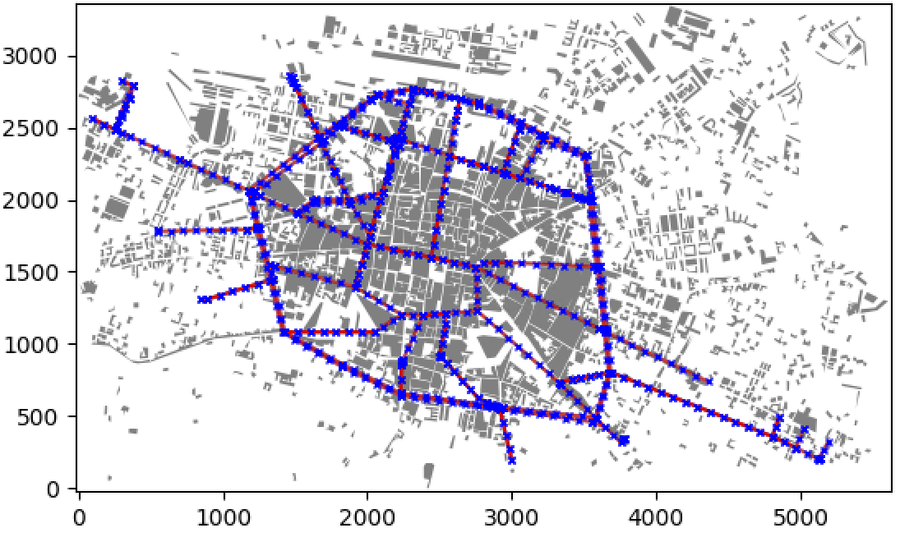
Footprints in City + Possible Locations

Slide 13
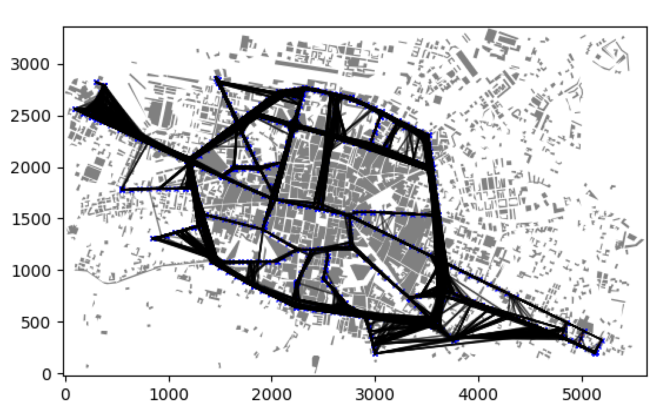
Visibility

Slide 14
Vehicles Movement
Density of each street is updated at each time step
In the end we will wait to reach steady state densities to obtain results
However, there is a problem with calculating expected steady state densities

Slide 15
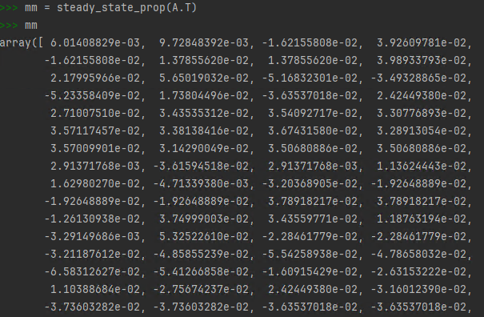
Note 1: Steady-State Densities
Two ways:
Using Markov chain formulation with defining sink and source nodes, then obtaining transition matrix then steady state probabilities: I get negative probabilities in some places
Using a system of linear equations: matrix is singular (I get 4 dependent rows out of 185)
All nodes are reachable from each other.
Couldn’t figure out how to check periodicity of chain yet.

Slide 16
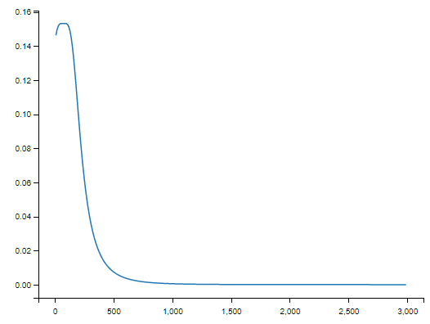
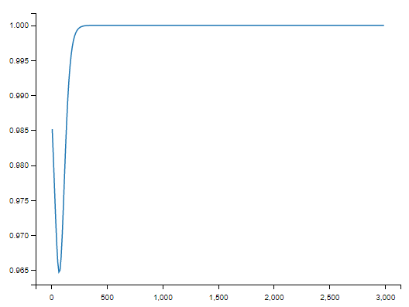

Note 2: Beamforming gain
Angle across minor axis was not accounted for in Matlab, but it was in Python
Outage probability vs. Distance from footprint
Unlimited beamforming gain
Outage probability vs. Distance from footprint
Limited beamforming gain

Slide 17
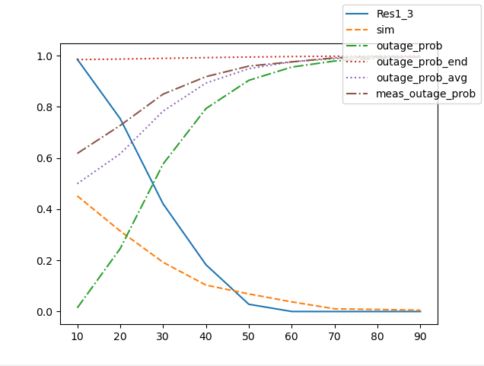
Note 3: Access Probability
Not converging
Taking outage probability to center of beam seems not a good choice
Maybe avg?

