Slide 1







Slide 2
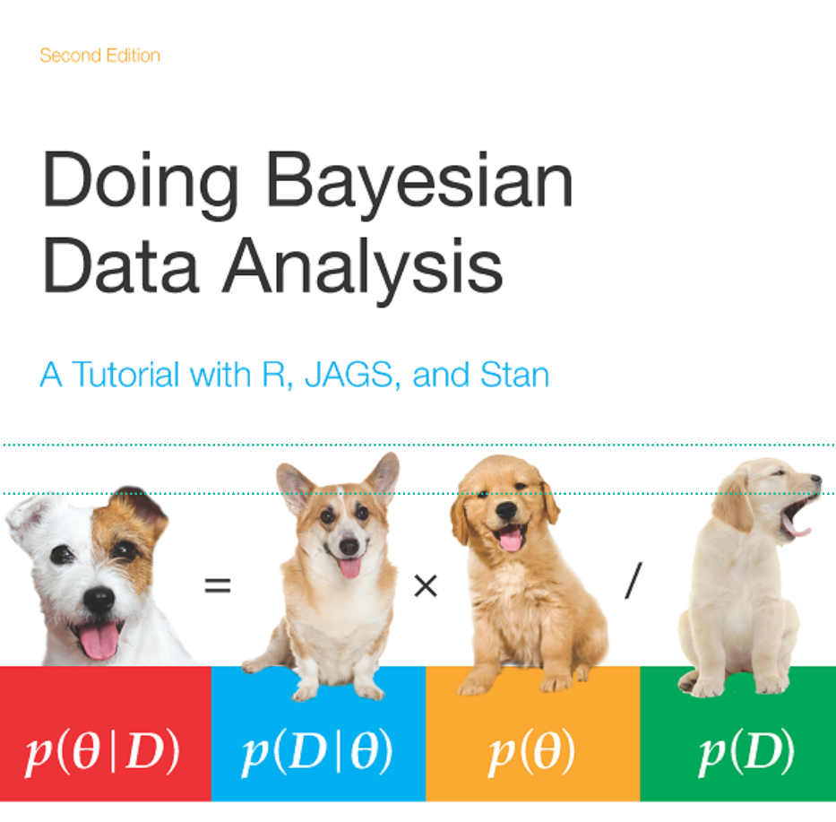

Slide 3
Coming next
Edgar Merkle Journey to efficient sampling in multivariate normal latent variable model
Ariane Kehlbacher Implementing an Almost Ideal Demand System of mobility expenditure
Ben Goodrich Kolmogorov and Stan
Session chair: Mitzi Morris

Slide 4
Coming next
Bill Gillespie Bayesian modeling workflow for pharmacometrics applications using bbr.bayes with Stan/Torsten
Edward Roualdes Access Stan models from your favorite language with BridgeStan
Jeff Soules MCMC-Monitor: Browser-based Monitoring of Stan MCMC Samplers
Session chair: Mike Lawrence
Lunch (12-2PM): Holmes Lounge

Slide 5
Coming next
Aditya Ravuri Dimensionality Reduction via Probabilistic Inference
Chetkar Jha A Bayesian Nonparametric approach for modeling temporal local clusters
Chirag Modi Delayed rejection HMC for sampling multiscale distributions
Room: Hillman 70 Session chair: Andrew Johnson
Arya Pourzanjani Estimating Tumor Growth/Inhibition Dynamics
Yanan Long Immune System and Neuro Disorders and Peri- and Postpartum Health Factors
Sydney Dimmock Bayesian analysis of brain oscillation phase data in Stan
Room: Hillman 60 Session chair: Eric Novik

