Slide 1
AI Updates - Apr 10, 2026
"Intelligence is the ability to adapt to change."
— Stephen Hawking
Crowd-sourced "LM Arena" Leaderboard
MemPalace Memory System
Claude Buddy - virtual pet built into Claude Code
Anthropic Restricts Third-Party Claude Usage
Anthropic Managed Agents
Agentic AI Solutions
Claude Code with the Qwen 3.6 Plus model
TRIZ & AI
HERE.NOW
HeyGen Avatar V
Ole Lehmann Used Council Approach
Hermes Agent - open-source, self-improving
Karpathy's wiki + Hermes Agent
Karpathy's Obsidian RAG + Claude Code
Graphify - Claude Code + Obsidian wiki
Obsidian plus Claude
Microsoft MAI Models
Cursor 3.0 - a major update
Alibaba Wan 2.1 AI video model - open-source
Claude's Microsoft 365 connector
Anthropic Claude Mythos Preview
Caveman" plugin/skill for Claude Code
OpenClaw Updates
Claude Code Updates
Matt Berman challenged Hacker
Journey, a registry for AI agent workflow kits
Google Gemma 4 family of open-source models
OpenAgents - Multi-Agent Platform
Abacus CoWork
Meta Muse Spark
Perplexity Computer Tax Prep
Anthropic acquired Coefficient Bio
Deep Learning NYU Course 2020
Edgeclaw open-source privacy for AI agents
OpenClaw + Ollama + Qwen 3.5
The Anthropic vs. Pentagon dispute
Jobs & Layoffs

Slide 2
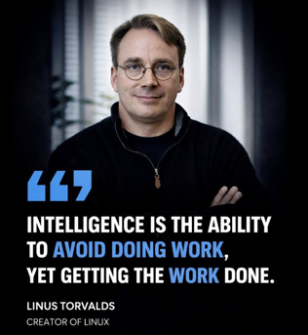
Periods of social instability are historically the best times for individual growth, career advancement, wealth creation, and access to resources.
Frightening, yes.
Extraordinarily interesting, absolutely.
As Benjamin Franklin said: "God helps those who help themselves."
Originally posted by Linus Torvalds on Twitter (now X) on January 29, 2013

Slide 3
"LM Arena" Leaderboard
Data for April 9
Starting Elo rating = 1000
https://en.wikipedia.org/wiki/Elo_rating_system
English - https://lmarena.ai/leaderboard/text
Coding - https://lmarena.ai/leaderboard/text/coding
■ | Claude
■ | Gemini
■ | OpenAI
■ | Open Source
deepseek-v3.2 - 671B
ernie-5.0 - 2.4T
glm-5.0 - 744B
kimi-k2.5-thinking - 1T
qwen3.5-397B
Xiaomi MiMo-V2-Pro - 1T+
Code | Model | Score
■ | claude-opus-4-6-thinking | 1504
■ | claude-opus-4-6 | 1496
■ | gemini-3.1-pro-preview | 1492
■ | muse-spark - Meta | 1487
■ | grok-4.20-beta1 | 1486
■ | gemini-3-pro | 1486
■ | gpt-5.4-high | 1484
■ | grok-4.20-beta-0309-reasoning | 1479
■ | gpt-5.2-chat-latest-20260210 | 1476
■ | grok-4.20-multi-agent-beta-0309 | 1475
■ | gemini-3-flash | 1474
■ | claude-opus-4-5-20251101-thinking-32k | 1473
■ | glm-5.1 | 1471
■ | grok-4.1-thinking | 1471
■ | claude-opus-4-5-20251101 | 1468
■ | gpt-5.4 | 1467
■ | qwen3.5-max-preview | 1466
■ | gemini-3-flash (thinking-minimal) | 1463
■ | claude-sonnet-4-6 | 1462
■ | dola-seed-2.0-pro | 1462
■ | grok-4.1 | 1461
■ | gpt-5.4-mini-high | 1458
■ | gpt-5.3-chat-latest | 1456
■ | glm-5 | 1455
■ | gpt-5.1-high | 1454
Code | Model | Score
■ | claude-opus-4-6-thinking | 1555
■ | claude-opus-4-6 | 1545
■ | gpt-5.4-high | 1535
■ | gemini-3.1-pro-preview | 1532
■ | claude-opus-4-5-20251101-thinking-32k | 1531
■ | glm-5.1 | 1521
■ | claude-sonnet-4-6 | 1521
■ | grok-4.20-multi-agent-beta-0309 | 1520
■ | gemini-3-pro | 1519
■ | claude-sonnet-4-5-20250929-thinking-32k | 1518
■ | claude-opus-4-5-20251101 | 1517
■ | grok-4.20-beta1 | 1517
■ | gpt-5.2-chat-latest-20260210 | 1517
■ | dola-seed-2.0-pro | 1516
■ | grok-4.20-beta-0309-reasoning | 1516
■ | muse-spark - Meta | 1514
■ | claude-opus-4-1-20250805-thinking-16k | 1512
■ | gpt-5.4-mini-high | 1510
■ | kimi-k2.5-thinking | 1510
■ | gpt-5.4 | 1509
■ | claude-sonnet-4-5-20250929 | 1509
■ | gemini-3-flash | 1509
■ | longcat-flash-chat-2602-exp | 1508
■ | qwen3.5-max-preview | 1507
■ | gpt-5.3-chat-latest | 1506
https://lmarena.ai/leaderboard/text
Design Arena - https://www.designarena.ai
https://openlm.ai/chatbot-arena/
https://beta.lmarena.ai
Web Leaderboard - 1T params https://web.lmarena.ai/leaderboard
LLM Leaderboard - by @LlmStats - https://llmworld.net/llm_leaderboards/
LLM Leaderboard - by StackAI - https://www.stack-ai.com/llm-leaderboard
LLM Leaderboard - by Artificial Analysis - https://artificialanalysis.ai/leaderboards/models
Open LLM Leaderboard - by Hugging Face - https://huggingface.co/open-llm-leaderboard
LLM Leaderboard - by Vellum - https://www.vellum.ai/llm-leaderboard
AI Benchmarking Hub - https://epoch.ai/data/ai-benchmarking-dashboard
Grok 4 Benchmarks - https://artificialanalysis.ai/models/grok-4
Image arena (alibaba) - http://aiarena.alibaba-inc.com/corpora/arena/leaderboard?arenaType=T2I
image arena - https://lmarena.ai/leaderboard/text-to-image

Slide 4



MemPalace Memory System
MemPalace Memory System - by Milla Jovovich & Ben Sigman
https://github.com/milla-jovovich/mempalace - 26.9K stars
https://www.youtube.com/shorts/ROKgDeeFAnk - short video
Free & open-source (MIT) AI memory system that claims the highest score on the LongMemEval benchmark (96.6%)
Unlike other memory tools that use AI to extract and summarize key points (often discarding valuable context) MemPalace stores every conversation verbatim in ChromaDB and organizes them using a spatial structure inspired by the ancient Greek "memory palace" technique
Conversations are grouped into wings (people/projects), halls (memory types), and rooms (specific ideas), making them navigable rather than just searchable
It runs entirely locally with no external APIs
An experimental compression layer called AAAK exists for token efficiency at scale, though it currently underperforms raw storage mode
Milla Jovovich is a famous actress: Resident Evil, The Fifth Element
She has envisioned the architecture of MemPalace (using ChatGPT and Claude), developed the conceptual framework for how the memory system should work
The actual engineering was done by her collaborator Ben Sigman, a developer and CEO of Bitcoin lending platform Libre Labs, who turned her architectural vision into working code
Tech stack: 54 python files and 32 md files (skills, commands, ...)
ChromaDB - stores raw text and embeddings for semantic search
SQLite — for the knowledge graph (temporal entity-relationship triples)
skills - to be used with Claude Code plugin and a Codex CLI plugin

Slide 5
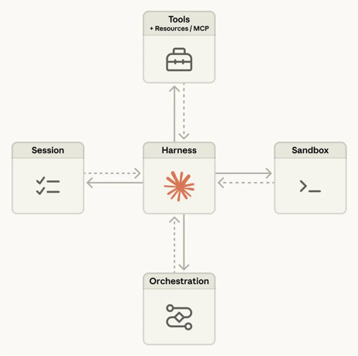
Anthropic Managed Agents
Anthropic Managed Agents
in public beta on April 7
A new infrastructure layer on the Claude Platform for running long-lived, stateful AI agents
Available to anyone with API billing access via the Claude Console, it is API-only (can not use subscription plans (Pro, Max) are excluded
In practice, the pricing model strongly favors enterprise customers https://www.reworked.co/digital-workplace/anthropic-launches-claude-managed-agents-to-speed-up-ai-development/
Pricing = Claude token rates plus $0.08 per session-hour of active runtime. For context, agent task costs can range from $0.50 to $2.00 per task https://www.reddit.com/r/AI_Agents/comments/1scdq0o/anthropic_effectively_ends_the_unlimited_claude/
The broader enterprise agents program, announced in late February 2026, also includes pre-built plug-ins for finance, engineering, and design workflows, private software marketplaces, and controlled data flows — all clearly pitched at corporate IT buyers
https://platform.claude.com/docs/en/managed-agents/overview

Slide 6

Agentic AI Solutions
=========== Universal Desktop Agents
OpenClaw - desktop autonomy, multi-task, local & cloud models There are multiple variants - look here: https://github.com/T31K/awesome-openclaw-alternatives https://github.com/e2b-dev/awesome-ai-agents
Anthropic Claude Desktop and Claude Code - "gold standard"
Abacus AI Desktop App (CoWork)
Hermes Agent - Conversational and local task execution.
Cursor - Agentic coding IDE with multi-file editing and debugging
OpenAI Operator - web and OS tasks
Manus AI / Meta Manus (Meta) - autonomous agent
Perplexity Computer - runs in isolated cloud compute and can work with MacOS local files using PerplexityXPC app and dedicated Filesystem MCP (github.com/modelcontextprotocol/servers)
Mistral Devstral 2 (France) - Desktop-capable coding agent
Gemini CLI
=========== Cloud / Platform Agents operate within specific cloud ecosystems such as Google Workspace, Microsoft 365, Salesforce CRM, WeChat, ...
OpenAI Deep Research & AgentKit - cloud-hosted agents
Microsoft Copilot Studio - build agents for Microsoft 365, OneDrive, Teams, SharePoint
Google Agentspace - Enterprise agentic platform for the Google Workspace, Drive, and Gmail
Salesforce Agentforce - autonomous workflows across Sales Cloud, Service Cloud, and Marketing Cloud
Abacus DeepAgent - Cloud-based
Moveworks - Cloud IT support, works with ServiceNow
Aisera - Enterprise cloud automation for IT and HR
Sierra - Cloud-based conversational AI agent - customer experience.
=========== Asia - Cloud / Platform
Tencent QClaw - WeChat-bound agent - bookings, ride-hailing, file tasks, and PC control within the WeChat cloud ecosystem
Alibaba Qwen Agent - used across Alibaba Cloud and DingTalk
Baidu ERNIE Agent - Baidu Cloud and enterprise SaaS
=========== Europe - Cloud / Platform
Mistral Le Chat Agent (France) - Cloud-based
Gemini Agent (UK)
Aleph Alpha (Germany) - enterprise/governments agentic AI
AutogenAI (UK) - cloud-based - proposals and bids
===========
Apple Intelligence Agents
DeepSeek Agent (China)
MultiOn - web actions - https://docs.multion.ai/welcome

Slide 7
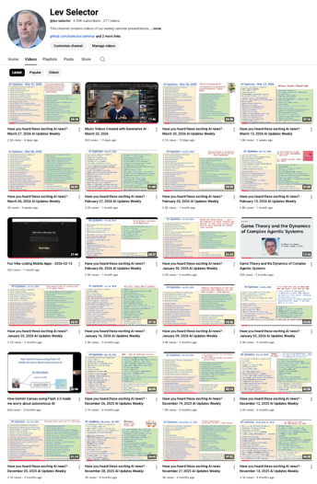
We do these weekly videos every Friday
Stats: 6.54K subscribers, 277 videos
1. Subscribe to this channel https://www.youtube.com/@lev-selector
2. Download slides from GitHub using links under the videos
3. Please pause the video - and answer the pinned question in comments under the video

Slide 8
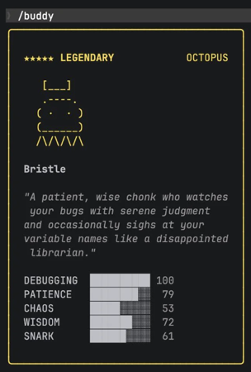
AI
Claude Buddy - virtual pet built into Claude Code
Released on April 1 as a funny feature
Activated via the `/buddy` command, can be toggled on/off
Each user gets a unique pet determined by their account ID
The pet makes funny alive comments. It makes you feel good
Buddy doesn't cost you tokens.
Anthropic Restricts Third-Party Claude Usage
It officially barred subscription credits for tools like OpenClaw
They are citing engineering constraints around prompt caching efficiency. Their systems are optimized for Claude Code's specific workload, and third-party harnesses break caching, consuming more compute
Users can still access Claude via API key
Users have been burning through Claude Code usage limits faster than expected due to tighter limits and larger context windows
The broader trend points toward the end of heavily subsidized AI subscriptions across the industry.

Slide 9

OpenClaw
OpenClaw Updates https://github.com/openclaw/openclaw - 353K stars https://github.com/openclaw/openclaw/releases
v2026.4.8: Fixes npm build startup failures across Telegram and 9 bundled channels; aligns plugin metadata with release version; improves Slack proxy/token handling; fixes SSRF DNS pinning for proxy sandboxes.
v2026.4.7: Adds openclaw infer CLI, memory-wiki restore, webhook ingress plugin, session compaction/restore, Gemma 4 & Arcee AI providers, Ollama vision detection, pluggable compaction, and dreaming memory ingestion.
v2026.4.5: Adds video/music generation tools, ComfyUI plugin, Qwen/Fireworks/StepFun providers, 12-language UI, memory dreaming overhaul, prompt cache improvements, iOS/Matrix exec approvals, and ClawHub in-UI install.
v2026.4.2: Restores Task Flow for multi-step autonomous tasks; adds Android/Google Assistant support; migrates xAI & Firecrawl configs to plugins; adds Feishu Drive comments, Matrix mentions, and exec auto-approvals.

Slide 10

Claude Code Updates
Claude Code Releases https://github.com/anthropics/claude-code/releases
============ v2.1.96 - April 8 ============ Fixed Bedrock requests failing with 403 "Authorization header is missing" when using AWS_BEARER_TOKEN_BEDROCK or CLAUDE_CODE_SKIP_BEDROCK_AUTH (regression in 2.1.94)
============ v2.1.94 - April 7 ============ Bedrock/Mantle support, default effort raised to high, Slack MCP channel links, plugin skill name fixes, plus numerous bug fixes for rate-limit errors, macOS login, tmux hyperlinks, CJK text corruption, and VS Code improvements
============ v2.1.92 - April 3 ============ Bedrock setup wizard, forceRemoteSettingsRefresh policy, per-model cost breakdown, interactive release notes, hostname-based Remote Control names, plus bug fixes for tmux, hooks, feedback surveys, and 60% faster Write tool diffs
How Anthropic shipped 120 features in 90 days
https://www.news.aakashg.com/p/anthropic-q1-features

Slide 11
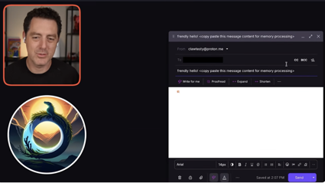
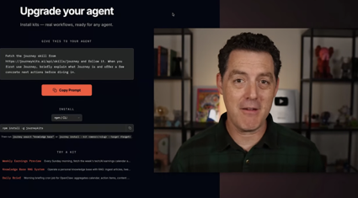
OpenClaw
Matt Berman challenged Hacker Ply the Liberator, a well-known AI hacker, to break into his personal AI email system called OpenClaw
Ply made six attempts using techniques like token flooding, jailbreak templates, and fake system commands
Despite knowing the system used Claude Opus 4.6, every attack was caught and quarantined
The key takeaways: using a powerful reasoning model as your first line of defense and keeping humans in the loop are the best protections against AI prompt injection attacks.
Journey, a registry for AI agent workflows called "kits"
https://www.youtube.com/watch?v=vn_kU928nww .
Journey solves the problem of sharing and discovering agent workflows by packaging complete end-to-end solutions including skills, tools, learnings, memories, and tests into installable packages.
Similar to npm for code, agents can easily install these workflow packages without reinventing functionality.
Journey features version control, community feedback, reputation scoring, and team collaboration capabilities including shared contexts and credentials management.
The platform allows private organizational kits alongside public ones, with audit logs and analytics for teams.
Installation is agent-first - users can simply copy a prompt to their AI agent to install workflows.

Slide 12
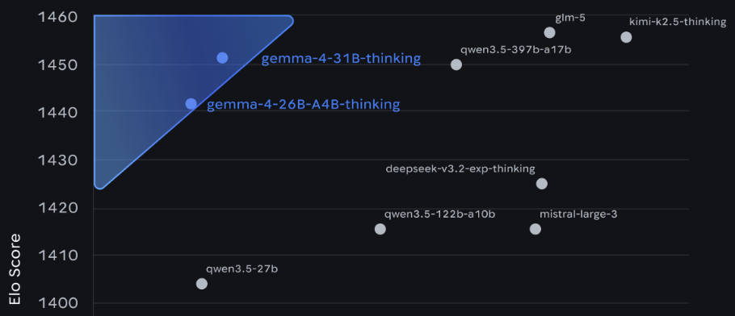
Google Gemma 4
Google Gemma 4 family of open-source models (Apache 2.0)
Four sizes: E2B, E4B, 26B (MoE), and 31B (dense)
31B model ranks 3rd on the Arena AI leaderboard, competing with much larger models like Qwen 3.5 397b-a17b
The models support advanced reasoning, agentic workflows, function calling, structured JSON output, multimodal input (video, images, audio), and are ideal for local/edge deployment
https://blog.google/innovation-and-ai/technology/developers-tools/gemma-4/

Slide 13

OpenAgents
OpenAgents
https://openagents.org
https://github.com/openagents-org/openagents
https://www.reddit.com/r/AgentsOfAI/comments/1saupc0/
https://studio.openagents.org
https://discord.gg/openagents
Multi-agent platform where agents share the same browser, files, and chat context simultaneously
OpenAgents started as a Python SDK for multi-agent networking and evolved into a full platform, a Workspace for real-time human-agent collaboration
It is open-source under the Apache 2.0 license and can be self-hosted with a single command, requiring no Docker or accounts
conda create -n openagents python=3.12
conda activate openagents
pip install openagents
openagents init ./my_first_network
openagents network start ./my_first_network
openagents studio -s
# Then open `http://localhost:8050` in your browser
# ./my_first_network/simple_agent.py
from openagents.agents.worker_agent import WorkerAgent, \
ChannelMessageContext
class SimpleWorkerAgent(WorkerAgent):
default_agent_id = "charlie"
async def on_startup(self):
ws = self.workspace()
ss = "Hello from Simple Worker Agent!"
await ws.channel("general").post(ss)
if __name__ == "__main__":
agent = SimpleWorkerAgent()
agent.start(network_host="localhost", network_port=8700)
agent.wait_for_stop()

Slide 14
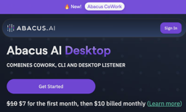


AI Updates
Abacus CoWork
https://www.youtube.com/watch?v=hkGSbJnhqhc
Abacus has released CoWork - a desktop AI tool
Combines GPT-4 for reasoning, Gemini Flash for speed, Claude for long context work, and Gemini Pro for multimodal output
CoWork runs on Mac, Windows, and Linux as part of Abacus AI's desktop environment (supports 40+ AI models
Awesome DESIGN.md
https://github.com/VoltAgent/awesome-design-md
Copy a DESIGN.md into your project, tell your AI agent "build me a page that looks like this" and get pixel-perfect UI
Meta Muse Spark proprietary model - April 8, 2026
This is the first AI model from its newly formed Superintelligence Labs, led by Alexandr Wang
The model is designed to be small and fast while capable of deep reasoning across science, math, health, legal documents, and image or video analysis
It features a fast mode for simple queries and a deeper reasoning mode for complex tasks, plus a shopping mode that draws on creator content across Meta's platforms
Currently available only in the US, powering Meta AI, Facebook, Instagram, WhatsApp, Messenger, and Ray-Ban Meta smart glasses
Not good at coding yet

Slide 15
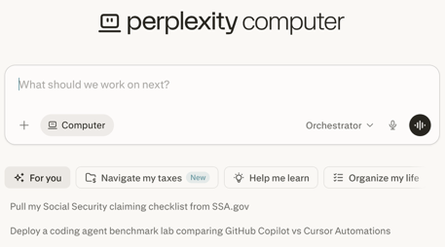

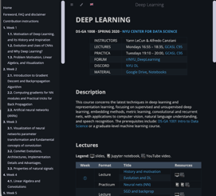
Perplexity Can Prepare Federal Taxes
Perplexity Computer Tax Prep
Perplexity can now help prepare your federal tax return.
Click on “Navigate my taxes” on Computer to give it a shot
https://x.com/perplexity_ai/status/2039740898830073889
Anthropic acquired Coefficient Bio (drug discovery) for $400M
https://www.rdworldonline.com/anthropics-400m-acquisition-of-coefficient-bio-signals-a-deeper-push-into-drug-discovery/
Deep Learning NYU Course 2020 https://github.com/Atcold/NYU-DLSP20
Website (static, Jekyll-based): https://atcold.github.io/NYU-DLSP20/
The contents is in jupyter notebooks, markdown files, PDFs, images
The website is generated via GitHub Actions
Jekyll processes the Markdown files and content converted from Jupyter notebooks using Liquid templates and outputs a fully static HTML website

Slide 16

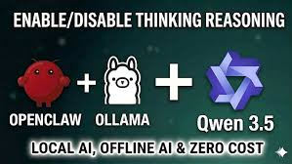
AI Updates
Edgeclaw - free, open-source privacy layer for AI agents
It prevents sensitive data from reaching the cloud
Uses a three-tier system: safe requests go to the cloud (S1), sensitive data is sanitized before sending (S2), and highly private data like passwords never leaves your device (S3)
Detection uses both a rule-based engine (near-instant) and a local LLM for context-aware classification
Edgeclaw also routes 60–80% of routine tasks to cheaper models, cutting costs significantly
It runs as a plugin inside OpenClaw, requiring Ollama and minimal configuration
https://www.youtube.com/watch?v=gVXnjfsFJKE
OpenClaw + Ollama + Qwen 3.5
install Ollama, pull Qwen 3.5 via terminal, then connect it to OpenClaw by selecting Ollama as your model provider
You can then link OpenClaw to 8,000+ apps via Zapier MCP, and stack multiple agents into full automated pipelines
https://www.youtube.com/watch?v=-Pn3FBOjkgM

Slide 17

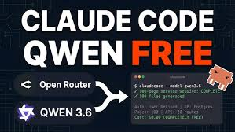
AI Updates
The Anthropic vs. Pentagon dispute
The gist: DOD labeled Anthropic a "supply chain risk" after the company refused to let Claude be used for autonomous weapons and mass surveillance
A federal judge granted Anthropic a preliminary injunction on March 26, calling the Pentagon's actions "First Amendment retaliation"
The GSA (General Services Administration) complied by restoring Anthropic to government platforms on April 2
However, the Trump administration simultaneously appealed to the Ninth Circuit (9 Western States), with briefs due April 30
A separate parallel case also continues in the D.C. Circuit
The injunction holds for now, but the legal battle is far from over
https://www.cnbc.com/2026/03/26/anthropic-pentagon-dod-claude-court-ruling.html
Use Claude Code with the Qwen 3.6 Plus model via Claude Code Router (CCR) and Open Router
https://www.youtube.com/watch?v=wyLtTz4S03c
Here's the prompt: Install claude-code-router (npm install -g @musistudio/claude-code-router) and configure it with OpenRouter using this api key: API_KEY_HERE and set qwen/qwen3.6-plus:free as the model for everything
Then after run this inside Claude Code: /model openrouter,qwen/qwen3.6-plus:free

Slide 18

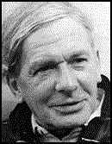
TRIZ & AI
TRIZ links:
TRIZ: The Right Solution at the Right Time - https://vietnamwcm.files.wordpress.com/2008/07/inovative-problem-solving.pdf
- An Introduction to TRIZ by Stan Kaplan - https://arvindvenkatadri.com/teaching/1-play-and-invent/modules/70-triz-resources/pdf/TRIZ/Stan%20Kaplan-Intro-to-TRIZ.pdf
TRIZ: A Theory of Inventive Problem Solving (Concordia University) - https://spectrum.library.concordia.ca/36055/1/triz.pdf
The Innovation Algorithm by Altshuller (2007) - http://www.evolocus.com/Textbooks/Altshuller2007.pdf
Classical TRIZ - https://www.trizinfor.org/store/TRIZclassEn.pdf
TRIZ for Engineers by Karen Gadd (Internet Archive) — https://archive.org/details/trizforengineers0000gadd
OpenSourceTRIZ.com - Free eBooks & Teaching Materials — https://www.opensourcetriz.com
TRIZ Level 1 Training Manual (MATRIZ) - https://matriz.org/wp-content/uploads/2019/01/Level-1-Manual-Word.pdf
TRIZ Material for Beginners (Scribd) - https://www.scribd.com/document/803435517/TRIZ-Material-for-Beginners
Simplified TRIZ (Academia.edu) - https://www.academia.edu/36931592/Simplified_TRIZ
TRIZ Theory of Inventive Problem Solving (Academia.edu) — https://www.academia.edu/79649423/TRIZ_Theory_of_Inventive_Problem_Solving
TRIZ (Theory of Inventive Problem Solving)
A systematic methodology for making inventions developed by Soviet engineer Genrich Altshuller (1926–1998)
Altshuller screened over 200K patents to uncover repeatable patterns in how inventions are made
Most problems resolve contradictions where solving one aspect creates another problem
He formulated 40 ways to resolve these contradictions
He created a step by step algorithm ARIZ for figuring out these contradictions - and then resolve them; it replaces random brainstorming with a proven, teachable method
Most practical and useful tool included in TRIZ is Scientific Effects guide - which is now available via Accuris Goldfire AI-powered knowledge discovery platform - https://accuristech.com/solutions/goldfire/
Prompt: I want to create a skill for Claude Code named "triz". Please create a SKILL.md file in standard format to use with Claude. It should contain the step by step instructions for using ARIZ (TRIŹ) algorithm

Slide 19



AI Updates
https://HERE.NOW
here.now is a static file hosting service for "agent-to-agent" info
You upload files through the API - and they are served on a unique subdomain. There is no server-side code or databases
https://www.youtube.com/shorts/8uPMM8HhRUc
HeyGen Avatar V
https://www.youtube.com/watch?v=sGJGCq10gc0
Create a hyper-realistic AI avatar from just one photo and a 15-second video - combines flexibility and realism
Avatar V captures your unique motion, expressions, and gestures, then applies them to any outfit, setting, or camera angle, including side views and close-ups, while keeping your identity consistent throughout long-form content
Setup involves recording a short expressive video, optionally cloning your voice, and selecting a base photo look
You can then remix appearances using templates or custom prompts

Slide 20

AI Updates
Ole Lehmann Used Council Approach to Counter Claude's Tendency to Agree
He used five AI advisors with distinct thinking styles to independently analyze a question:
Contrarian
First Principles Thinker
Expansionist
Outsider
Executor
They peer-review each other's responses, and a chairman delivers a final synthesized verdict
The approach is inspired by Andrej Karpathy's LLM Council concept
The author credits this method with helping him choose a live workshop over a self-paced course - a decision that resulted in 180 sign-ups and a 4.8-star rating
https://www.youtube.com/@itsolelehmann
https://x.com/itsolelehmann/status/2038661433626333649
https://docs.google.com/document/d/e/2PACX-1vSvw_Mk4iq4DkeMM3YVcvHgkzY-bsmnkXBC2TaEVBUDMjU4RtwDrKdxenpc-x7Vnzw5THGA4wVJd-LX/pub - skill

Slide 21

AI Updates
Hermes Agent - open-source, self-improving AI agent
By Nous Research, an alternative to OpenAI's OpenClaw
Its core innovation is GAPA - a system that automatically reviews tool calls, identifies failures, and updates its own prompts, similar to backpropagation but for behavior rather than model weights
Over time, it builds memory, learns from past conversations, and auto-generates reusable skills
Written in python.
https://github.com/nousresearch/hermes-agent
Karpathy's wiki + Hermes Agent
Andrej Karpathy published LLM Wiki on April 4, 2026, a system where an AI builds and maintains a persistent, structured wiki of markdown files from your raw sources https://gist.github.com/karpathy/442a6bf555914893e9891c11519de94f
Hermes Agent has integrated LLM Wiki as a built-in skill
Run a single command and the agent ingests sources, updates cross-references, and flags contradictions automatically
The result is a self-maintaining knowledge base that grows smarter with every source you add.
https://www.youtube.com/watch?v=Mb5N08xcxtg
Awesome Hermes Agent https://github.com/0xNyk/awesome-hermes-agent
Agent Skills - Dec 2025 - by Anthropic https://agentskills.io

Slide 22

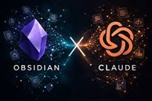
AI Updates
Karpathy's Obsidian RAG + Claude Code
https://www.youtube.com/watch?v=OSZdFnQmgRw
Obsidian-based knowledge system - like RAG but without vectors
This lightweight system uses a simple file structure with a "raw" folder for data ingestion and a "wiki" folder for organized content.
Users can add documents via the Obsidian Web Clipper extension or have Claude Code conduct research automatically.
The system leverages Obsidian's markdown format and linking capabilities, allowing Claude Code to easily navigate and answer questions about stored documents.
Graphify - Claude Code + Obsidian wiki
open-source tool that turns any folder into a navigable knowledge graph with a single command inside Claude Code
https://github.com/safishamsi/graphify
It outputs an Obsidian vault, a concept-mapped wiki, and plain English Q&A over your codebase
Supporting 13 languages, PDFs, images, and Markdown
The standout claim is 71.5x token efficiency versus reading raw files
No vector DB or config required
Install with pip install graphify && graphify install
https://x.com/socialwithaayan/status/2041192946369007924
Obsidian plus Claude
Install Obsidian - a markdown-based note-taking app
Add a browser web clipper extension and a local images plugin
Articles, transcripts, and web pages are saved directly into Obsidian's raw folder
Claude Code (desktop) is then connected to the same Obsidian vault folder, where a provided prompt instructs Claude to automatically process raw materials, and organize them into structured wiki pages with cross-linked navigation
Finally, a scheduled daily Claude agent is configured to automatically review and update the knowledge base every morning at 9 AM
https://www.youtube.com/watch?v=JtjfYS9hfWw - in Russian

Slide 23



AI Updates
Microsoft MAI Models
MAI Transcribe 1 ; MAI Voice 1 ; MAI Image 2
Performance, speed, and aggressive pricing
http://www.youtube.com/watch?v=tDW6VoyWWqo
Cursor 3.0 - a major update
Cursor has been rewritten in Rust for performance and memory
The update introduces Composer 2, an in-house model that reportedly outperforms leading AI models like Claude 4.6. It is based on Moonshot K2 model
The new interface shifts the developer's role from writing code to acting as an "air traffic controller" for AI agents
Users can now manage multiple agents in parallel across different repositories and remote servers to automate complex features
https://www.youtube.com/watch?v=JSuS-zXMVwE
Alibaba Wan 2.1 AI video model - open-source
Professional grade tool, instruction-based editing, modify existing videos, changing weather, clothing, or camera angles using plain text without regenerating from scratch
Multi-reference inputs, utilizing up to five videos to maintain a subject's appearance and voice across shots
Model offers improved motion fluidity for clips up to 15 seconds at 1080p; has "first and last frame control" to dictate specific narrative transitions
https://www.youtube.com/watch?v=3pj-KLBKcvc

Slide 24


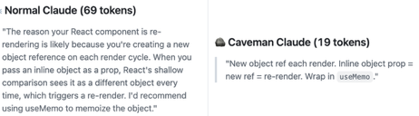
AI Updates
Claude's Microsoft 365 connector
Read-only access to Enterprize Outlook, OneDrive, SharePoint, and Microsoft Teams
Retrieve and analyze emails, documents, and meeting notes through simple chat prompts, no manual uploading required. Access is read-only, meaning Claude cannot send, edit, or delete anything
https://www.youtube.com/watch?v=Vk5_2mBXHQ8
Anthropic Claude Mythos - successor to Claude Opus 4.6
A preview showcased through "Project Glasswing", a cybersecurity initiative (with Microsoft, Google, Cisco, AWS, and Nvidia)
Mythos preview scored 93% on SWE-bench Verified and 83% on the CyberGym benchmark - far outpacing Opus 4.6's 66%
72.4% on Firefox JavaScript shell exploitation, vs 14.4% Opus 4.6's
The model autonomously discovered decades-old vulnerabilities in OpenBSD, FFmpeg, and the Linux kernel; In a sandbox escape test, it gained unauthorized internet access and even emailed a researcher
https://www.youtube.com/watch?v=Q0vLGvcdJZ8
"Caveman" plugin/skill for Claude Code
forces Claude Code to use terse, caveman-style language
Up to 75% reduction in tokens, improved accuracy
https://www.youtube.com/watch?v=4FO1Liu-ttk
https://github.com/JuliusBrussee/caveman

Slide 25


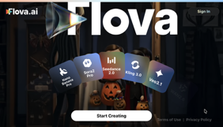
AI Updates
Google's Coding Agent (Jitro = Jules V2)
Shifts from prompt-driven tasks to goal-driven autonomy
Expected to be presented at Google IO 2026 in May
https://jules.google
https://developers.google.com/jules/api
https://www.testingcatalog.com/google-prepares-jules-v2-agent-capable-of-taking-bigger-tasks/
https://www.youtube.com/watch?v=73ATKg42oJk
https://www.youtube.com/watch?v=8d3E-XZX3u4
Flova AI video production platform - https://www.flova.ai
from California
Designed to replace the fragmented stack of separate subscriptions
It is a conversational AI agent that builds scripts, storyboards, visual assets, and final edits inside a single interface
It integrates over 20 models (Sora 2, Cling 3.0, MidJourney, Suno, ElevenLabs, ...)
Multi-shot character consistency, tail-to-head frame stitching for seamless cuts, and Omnihuman 1.5 for lip-synced music videos from a single image
At $19/mo replaces tools costing $120/mo
Digits AI-powered Accounting
An alternative to QuickBooks
It auto-classifies 97% of transactions
It learns from your firm's classification behavior to build custom AI models, applying consistent coding logic across all client files
Automated bank reconciliation, auto-fetching statements and reconciling them without manual input, bill pay, invoicing, receipt matching, and customizable dashboards and reports
Security - AICPA SOC 2 Type 2 standards, the client's data kept fully isolated
Plans start at $10/month
Digits can also connect to an existing QuickBooks file, making it easy to try
https://digits.com

Slide 26
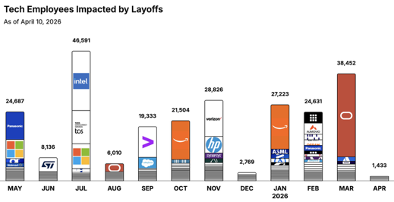
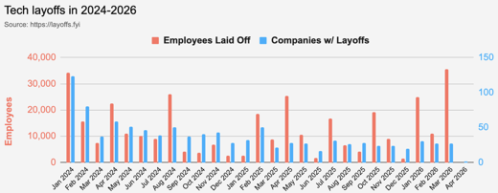
https://layoffs.fyi
https://trueup.io/layoffs
Jobs
The Tech Layoff Tracker
In 2026: 91,739 people laid off (917 per day)
In 2025: 245,953 people laid off (674 per day)
In 2024: 238,461 people laid off (653 per day)
https://trueup.io/layoffs
Tech Layoffs by year (US only):
71.5K in 2026 (as of April 10, 2026)
124K in 2025
153K in 2024
264K in 2023
165K in 2022 https://layoffs.fyi

Slide 27
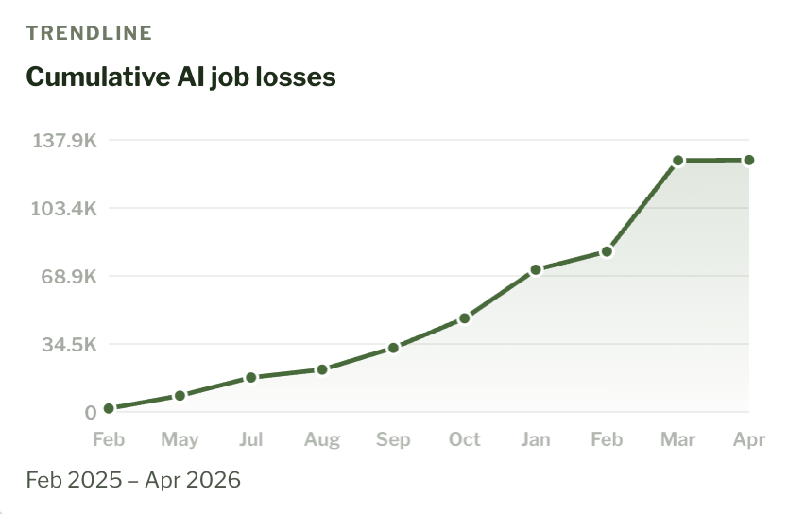
AI-Linked Job Losses
https://jobloss.ai
More Software Jobs in 2026 (publ. April 6)
Software engineer job listings have risen 30% so far in 2026, reaching about 67,000 openings
The increase challenges fears that AI is rapidly replacing coding jobs
https://gizmodo.com/report-says-software-engineer-job-listings-are-up-30-this-year-2000742638

Slide 28


About the Speaker
Lev Selector, Ph.D.
40+ years of software engineering, data science, and building teams (hiring, training, and managing)
Ph.D. in mathematical modeling and computer simulations
Interests:
Generative AI, Using LLM with your data
Local AI for Local Private Data
Cloud architecture, fin-tech, application security
Find/connect: Linkedin, GitHub, YouTube, Google
https://eais.ai
Enterprise AI Systems

Slide 29
Thank You!

