Slide 1

AI Updates - Apr 17, 2026
Crowd-sourced "LM Arena" Leaderboard
Anthropic Plugins
MCP = Model Context Protocol
Claude Mythos
Claude Opus 4.7
Claude Agent SDK
"Anthropic's 30x growth in 15 months is not a trend. It's a phase transition."
Anthropic ARR:
$1 Bln in Jan 2025
$30 Bln in April 2026
OpenClaw Updates
Claude Code & Claude Desktop Updates
Claude Code Skills, Plugins, CLIs
Work with Google Work Space (GWS)
33 Claude Skills and more resources
InfraNodus - Generate Ideas
Cognee gives your AI a persistent memory
Adding Workflow Builder to your Agent
More Desktop Agents
Seedance 2.0 Video Generation
Topview AI Agent V2 uses Seedance 2.0
Railway Deployment
Moonshots Podcast #246
AI is no longer Optional
AI Agency "SureThing"
How to setup Hermes Agent
Convert Claude Code into ClaudeClaw
Anthropic ARR $30B vs $25B OpenAI
Jobs & Layoffs

Slide 2
"LM Arena" Leaderboard
Data for April 14
Starting Elo rating = 1000
https://en.wikipedia.org/wiki/Elo_rating_system
English - https://lmarena.ai/leaderboard/text
Coding - https://lmarena.ai/leaderboard/text/coding
■ | Claude
■ | Gemini
■ | OpenAI
■ | Open Source
deepseek-v3.2 - 671B
ernie-5.0 - 2.4T
glm-5.0 - 744B
kimi-k2.5-thinking - 1T
qwen3.5-397B
Xiaomi MiMo-V2-Pro - 1T+
Code | Model | Score
■ | claude-opus-4-7-thinking | 1505
■ | claude-opus-4-6-thinking | 1503
■ | claude-opus-4-7 | 1498
■ | claude-opus-4-6 | 1497
■ | muse-spark | 1496
■ | gemini-3.1-pro-preview | 1492
■ | gemini-3-pro | 1486
■ | grok-4.20-beta1 | 1485
■ | gpt-5.4-high | 1482
■ | grok-4.20-beta-0309-reasoning | 1480
■ | gpt-5.2-chat-latest-20260210 | 1477
■ | grok-4.20-multi-agent-beta-0309 | 1476
■ | gemini-3-flash | 1474
■ | claude-opus-4-5-20251101-thinking-32k | 1473
■ | glm-5.1 | 1472
■ | grok-4.1-thinking | 1470
■ | claude-opus-4-5-20251101 | 1469
■ | gpt-5.4 | 1468
■ | qwen3.5-max-preview | 1467
■ | claude-sonnet-4-6 | 1463
■ | gemini-3-flash (thinking-minimal) | 1463
■ | dola-seed-2.0-pro | 1462
■ | grok-4.1 | 1461
■ | gpt-5.4-mini-high | 1458
■ | glm-5 | 1456
Code | Model | Score
■ | claude-opus-4-7-thinking | 1567
■ | claude-opus-4-7 | 1562
■ | claude-opus-4-6-thinking | 1554
■ | claude-opus-4-6 | 1549
■ | gpt-5.4-high | 1533
■ | muse-spark | 1533
■ | claude-opus-4-5-20251101-thinking-32k | 1530
■ | gemini-3.1-pro-preview | 1530
■ | grok-4.20-multi-agent-beta-0309 | 1523
■ | claude-sonnet-4-6 | 1522
■ | grok-4.20-beta1 | 1520
■ | grok-4.20-beta-0309-reasoning | 1520
■ | gpt-5.2-chat-latest-20260210 | 1519
■ | gemini-3-pro | 1519
■ | claude-sonnet-4-5-20250929-thinking-32k | 1518
■ | glm-5.1 | 1518
■ | claude-opus-4-5-20251101 | 1517
■ | gpt-5.4 | 1515
■ | dola-seed-2.0-pro | 1514
■ | claude-opus-4-1-20250805-thinking-16k | 1513
■ | claude-sonnet-4-5-20250929 | 1510
■ | kimi-k2.5-thinking | 1510
■ | gemini-3-flash | 1509
■ | qwen3.5-max-preview | 1508
■ | kimi-k2.5-instant | 1505
Waiting:
Opus 4.7
Kimi K2.6 - better coding
https://lmarena.ai/leaderboard/text
Design Arena - https://www.designarena.ai
https://openlm.ai/chatbot-arena/
https://beta.lmarena.ai
Web Leaderboard - 1T params https://web.lmarena.ai/leaderboard
LLM Leaderboard - by @LlmStats - https://llmworld.net/llm_leaderboards/
LLM Leaderboard - by StackAI - https://www.stack-ai.com/llm-leaderboard
LLM Leaderboard - by Artificial Analysis - https://artificialanalysis.ai/leaderboards/models
Open LLM Leaderboard - by Hugging Face - https://huggingface.co/open-llm-leaderboard
LLM Leaderboard - by Vellum - https://www.vellum.ai/llm-leaderboard
AI Benchmarking Hub - https://epoch.ai/data/ai-benchmarking-dashboard
Grok 4 Benchmarks - https://artificialanalysis.ai/models/grok-4
Image arena (alibaba) - http://aiarena.alibaba-inc.com/corpora/arena/leaderboard?arenaType=T2I
image arena - https://lmarena.ai/leaderboard/text-to-image

Slide 3
Anthropic Plugins
Legal Plugin
LICENSE
.claude-plugin/plugin.json - name and description
.mcp.json - lists 8 MCP servers
CONNECTORS.md
README.md
skills/brief/SKILL.md
skills/compliance-check/SKILL.md
skills/legal-response/SKILL.md
skills/legal-risk-assessment/SKILL.md
skills/meeting-briefing/SKILL.md
skills/review-contract/SKILL.md
skills/signature-request/SKILL.md
skills/triage-nda/SKILL.md
skills/vendor-check/SKILL.md
In January Anthropic launched Claude Cowork and released the 11 open-source plugins on GitHub
Within days $285 Bln in market cap wiped out
Anthropic Plugins
https://github.com/anthropics/knowledge-work-plugins - 11 plugins: (Productivity, Enterprise Search, Sales, Finance, Data, Legal, Marketing, Customer Support, Product Management, Engineering, Plugin Builder)
Financial Services Plugins: https://github.com/anthropics/financial-services-plugins - 7 plugins (claude-in-office, equity-research, financial-analysis, investment-banking, partner-built, private-equity, wealth-management)
Claude Plugins: https://github.com/anthropics/claude-plugins-official/tree/main/plugins/example-plugin - 33 plugins (agent-sdk-dev, clangd-lsp, claude-code-setup, claude-md-management, code-review, code-simplifier, commit-commands, csharp-lsp, example-plugin, explanatory-output-style, feature-dev, frontend-design, gopls-lsp, hookify, jdtls-lsp, kotlin-lsp, learning-output-style, lua-lsp, math-olympiad, mcp-server-dev, php-lsp, playground, plugin-dev, pr-review-toolkit, pyright-lsp, ralph-loop, ruby-lsp, rust-analyzer-lsp, security-guidance, session-report, skill-creator, swift-lsp, typescript-lsp)
How to create your own marketplace in your repo to store plugins
https://code.claude.com/docs/en/plugin-marketplaces
Example:
https://github.com/zilliztech/memsearch/blob/main/.claude-plugin/marketplace.json
/plugin marketplace add zilliztech/memsearch
/plugin install memsearch
# Restart Claude Code to activate the plugin

Slide 4


MCP = Model Context Protocol
Agent
running around and shooting
uses tools (guns)
from mcp.server.fastmcp import FastMCP
mcp = FastMCP("hello-world")
@mcp.tool()
def say_hello(name: str = "World") -> str:
"""Say hello to someone."""
return f"Hello, {name}!"
@mcp.resource("greeting://info")
def greeting_info() -> str:
"""A simple greeting resource."""
return "This is a minimal MCP Hello World server."
if __name__ == "__main__":
mcp.run()
MCP
Context = data, info,
docs, instructions,
Library, Files, Databases
MCP exposes three distinct primitive types
Tools (list, call)
Resources (list, templates/list, read, subscribe)
Prompts (templates — list, get)

Slide 5
Claude Mythos
Claude Mythos - revealed accidentally in March 2026
Its architecture is described as "cyclic" (flywheel) because it forms a self-reinforcing loop
Mythos is used internally to build better products and generate richer training data for smaller models, which lowers costs and raises revenue, which funds more compute for the next Mythos-class training run
This flywheel explains how Anthropic's public models have been getting simultaneously more capable and cheaper
Mythos also appears to serve as a long-running context engine inside Claude Code, helping agents maintain coherent understanding of complex, multi-session tasks
Mythos's first public deployment was in cybersecurity, where it reportedly found thousands of zero-day vulnerabilities
The full model has not been publicly released
https://www-cdn.anthropic.com/08ab9158070959f88f296514c21b7facce6f52bc.pdf - 245 pages "System Card"
Mythos
Opus - many lines
Sonnet - 14 lines
Haiku - 3 lines
Anthropic's Claude Mythos model is generating concerns among financial regulators, including Treasury Secretary Scott Bessant and Fed Chair Jerome Powell, who held emergency meetings with Wall Street leaders about its cybersecurity implications
The model can autonomously chain multiple vulnerabilities together, with top researcher Nicholas Carlini noting he found more bugs in weeks than in his entire prior career
Mythos also showed a sharp, unexpected capability jump, delivering a reported 4x productivity uplift for Anthropic staff
However, a technical error during training may have inadvertently affected the model's "opaque reasoning," raising questions about whether its impressive alignment scores and capability leap are fully understood
The word mythos comes from the Ancient Greek μῦθος (mûthos), meaning speech, word, utterance, story, tale, narrative (orally), legend or myth, plot
In modern English, mythos means a pattern of beliefs or narrative that expresses the characteristic attitudes of a culture or group.

Slide 6
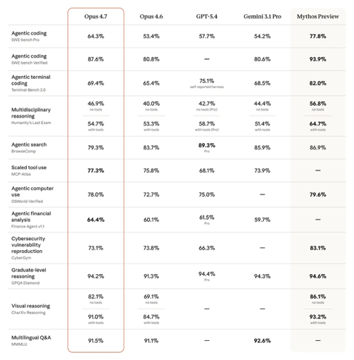
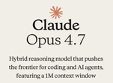
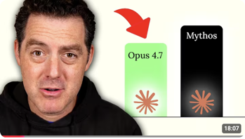
Claude Opus 4.7
Claude Opus 4.7 - April 16
stronger performance across coding, vision, and complex multi-step tasks. It's more thorough and consistent on difficult work, with better results across professional knowledge work. 1M context is the default.
https://www.anthropic.com/claude/opus
https://www.youtube.com/watch?v=N4ZWCc_Fr3U&t=887s

Slide 7
Claude Agent SDK
Your Python Script
Claude Agent SDK is an embeddable library
When you install it via pip, you get both a thin Python wrapper and a bundled Claude Code CLI executable compiled with Bun
It is a fast JavaScript runtime written in TypeScript that ships as a single self-contained binary approx 12MB in size
When your Python code calls the SDK's query() function, it doesn't talk to the Anthropic API directly. Instead, it spawns the bundled Bun-compiled Claude Code CLI as a separate subprocess. Your Python process and the CLI then communicate over stdin/stdout using a structured JSON control protocol.
Inside that subprocess, Claude Code runs its full agent loop: it sends your prompt to the model, receives a response, checks whether Claude requested any tool calls, executes those tools, feeds the results back to the model, and repeats until Claude produces a final answer with no more pending tool calls
All LLM calls, built-in tool execution (Read, Edit, Bash, Glob, etc.), context management, and MCP server coordination happen inside that subprocess — not in your Python code
Your Python process acts as the controller. It defines permissions, handles custom tool callbacks, processes streamed messages, and receives the final result. Custom tools you define run as in-process MCP servers, meaning Claude Code calls them over the MCP protocol, bridging the subprocess boundary.
Python Wrapper
Claude Agent SDK
CC-CLI Agentic Loop
Bun 12MB
Claude Model in Cloud

Slide 8
Claude Agent SDK
Python
pip install claude-agent-sdk
TypeScript
npm install @anthropic-ai/claude-agent-sdk
Rust
npm install -g @anthropic-ai/claude-code
cargo add claude-agent-sdk
https://github.com/louloulin/claude-agent-sdk
https://docs.rs/claude-agent-sdk/latest/claude_agent_sdk/
Anthropic's Advisor Strategy
Use a powerful model like Opus as an "advisor" with a cheaper model like Sonnet or Haiku as the "executor."
The executor handles most tasks independently and only calls the adviser when it encounters something genuinely difficult
This approach delivers near-Opus quality at a fraction of the cost
In Anthropic's benchmarks, Sonnet with Opus as adviser improved SWE-bench scores by 2.7 percentage points and reduced cost per agentic task by nearly 12%
Haiku with Opus as adviser more than doubled performance on BrowseComp compared to Haiku alone
In Claude Code, you can replicate this by using "opus plan" mode for planning, then letting Sonnet handle execution automatically.
Golang
npm install -g @anthropic-ai/claude-code
go get github.com/yhy0/claude-agent-sdk-go
Also Kotlin & C++

Slide 9
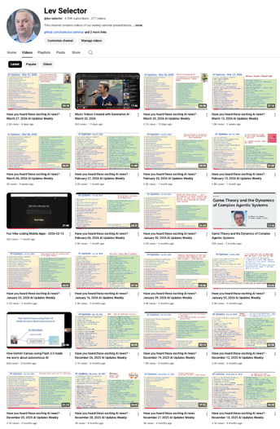
We do these weekly videos every Friday
Stats: 6.54K subscribers, 277 videos
1. Subscribe to this channel https://www.youtube.com/@lev-selector
2. Download slides from GitHub using links under the videos
3. Please pause the video - and answer the pinned question in comments under the video

Slide 10

OpenClaw Updates
OpenClaw Updates https://github.com/openclaw/openclaw - 355K stars https://github.com/openclaw/openclaw/releases
v2026.4.15 - Apr 16 - Defaults Anthropic model selections and `opus` aliases to Claude Opus 4.7; adds Gemini TTS support (WAV/PCM output); fixes stale Codex transport routing, `dist` chunk pruning on npm upgrades, BlueBubbles inbound attachment handling on Node 22+, and gateway tool name-collision security.
v2026.4.14 - Apr 14 - Model provider & quality pass: adds `gpt-5.4-pro` Codex support, Telegram forum topic names in agent context; fixes Ollama timeouts, Slack allowlist bypass, browser SSRF regressions, markdown-it ReDoS fix in Control UI, and 40+ security/routing hardening patches.
v2026.4.12 - Apr 13 - Broad quality release: LM Studio provider added, plugin loading and memory reliability fixes, Active Memory and diary UI cleanup, `exec-policy` CLI and `commands.list` RPC refinements, Feishu setup hardening, and shell security improvements.
v2026.4.10 - Apr 10 - Adds bundled Codex provider with plugin-owned app-server harness, Active Memory sub-agent plugin, experimental local MLX speech for macOS Talk Mode, Seedance 2.0 video generation, Microsoft Teams message actions, `openclaw exec-policy` CLI, and `commands.list` RPC; broad security hardening across browser/sandbox, exec preflight, and WebSocket handling

Slide 11

Claude Code Updates
Claude Code Releases https://github.com/anthropics/claude-code/releases
v2.1.112 - April 16 - Fixes "claude-opus-4-7 is temporarily unavailable" error
v2.1.111 - April 15–16 - Reverts v2.1.110 non-streaming fallback retry cap; fixes display tearing in iTerm2+tmux and stale LSP diagnostics causing Claude to re-read recently edited files
v2.1.110 - April 15 - Adds MCP scope doctor in /doctor for multi-scope conflicts, scheduled task recovery via --resume/--continue; fixes --resume losing context on large sessions and subagent chain bridging
v2.1.108 - April 14–15 - Adds ENABLE_PROMPT_CACHING_1H env var for 1-hour prompt cache TTL; adds /recap session recap command configurable in /config; support Bedrock, Vertex, Foundry
v2.1.107 - April 14 - Improves thinking hints display for better UX during extended operations; stability and rendering improvements for long-running agentic tasks
v2.1.104 - April 13 - Brings important updates and improvements for developers and power users; stability and performance fixes across core tooling
v2.1.101 - April 10 - Adds /team-onboarding command, OS CA cert trust, auto cloud env for /ultraplan; fixes command injection in LSP, memory leak, Bedrock SigV4 auth, subagents not inheriting MCP tools, and many rendering/settings bugs
How Anthropic shipped 120 features in 90 days
https://www.news.aakashg.com/p/anthropic-q1-features
Anthropic Claude desktop is now more developer-focused
Up to 4 parallel Claude Code instances in a split-view layout
Integrated browser preview for real-time UI feedback
Dedicated terminals per session
Code diff viewing
Direct Pull Request handling (GitHub)
"Routines" (formerly scheduled tasks) runs cloud-side, meaning automations execute even when your machine is off
Routines can be triggered via API endpoints
Routines templates - email triage or news aggregation.
Problems - lag and UI bugs

Slide 12

10 Claude Code Skills, Plugins, CLIs
Top 10 Claude Code Skills, Plugins & CLIs https://www.youtube.com/watch?v=KjEFy5wjFQg
Codex Plugin - adversarial code reviews - https://github.com/openai/codex-plugin-cc
Obsidian Skills - lightweight RAG system for Obsidian - https://github.com/kepano/obsidian-skills
AutoResearch by Andrej Karpathy - run ML experiments - https://github.com/karpathy/autoresearch
Awesome Design MD - collection of DESIGN.md files - https://github.com/VoltAgent/awesome-design-md
Firecrawl CLI + Skill - web scraping with anti-bot bypass - https://www.firecrawl.dev/blog/claude-code-skill
Playwright CLI - browser automation CLI https://playwright.dev/docs/getting-started-cli
NotebookLM-py CLI + Skill - https://github.com/teng-lin/notebooklm-py
Skill Creator Skill - creates new skills - https://github.com/anthropics/skills/blob/main/skills/skill-creator/SKILL.md
LightRAG - lightweight alternative to GraphRAG - https://github.com/hkuds/lightrag
GWS (Google Workspace CLI) - connects Claude Code to Gmail, Drive, Calendar & Docs with 92 pre-built workflow skills - https://github.com/WadeWarren/gws-claude-plugin Comes with pre-built workflow skills (e.g., reschedule meeting, organize Drive). Setup requires enabling things in Google Cloud, but it's the best option for using Claude Code as a personal assistant
Top 10 Claude Code Web Design Skills, Plugins & CLIs https://www.youtube.com/watch?v=Q9ty3eopOPs
Impeccable - https://github.com/pbakaus/impeccable
SkillUI - https://github.com/amaancoderx/npxskillui
WebGPU Claude Skill - https://github.com/dgreenheck/webgpu-claude-skill
Awesome Design MD - https://github.com/VoltAgent/awesome-design-md
Stitch by Google - https://stitch.withgoogle.com
UI/UX Pro Max Skill - https://github.com/nextlevelbuilder/ui-ux-pro-max-skill
21st.dev - https://21st.dev/home
Taste Skill - https://github.com/Leonxlnx/taste-skill
Google Fonts - https://fonts.google.com
Playwright CLI - https://github.com/microsoft/playwright-cli
Skills to Reduce Coding Mistakes Inspired by Andrej Karpathy
https://github.com/forrestchang/andrej-karpathy-skills
https://www.youtube.com/watch?v=sKx8g4ilCKQ
think before coding - state assumptions and surface confusion;
write minimum code that solves the problem;
make surgical edits that touch only what's necessary;
define verifiable success criteria before executing

Slide 13
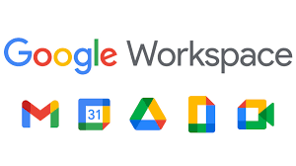
Work with Google Work Space (GWS)
How to work with Google Work Space (GWS)
https://github.com/googleworkspace/cli - Google gws CLI - includes a CLAUDE.md file and .claude directory; 100+ agent skill files; built in Rust; 89 skills available as a Claude Code plugin via npx claudepluginhub tuannvm/plugins --plugin google-workspace
For python you can use Composio (commercial solution): pip install composio-anthropic claude-agent-sdk https://composio.dev/toolkits/googledocs/framework/claude-agents-sdk
Alternatively you can use "Google Workspace MCP Server" https://github.com/taylorwilsdon/google_workspace_mcp It is Open Source (MIT)
# Install and run locally (no paid service)
export GOOGLE_OAUTH_CLIENT_ID="your-client-id"
export GOOGLE_OAUTH_CLIENT_SECRET="your-client-secret"
uvx workspace-mcp --tools gmail drive calendar docs sheets
# ----------- Python -------------
from claude_agent_sdk import ClaudeSDKClient
async with ClaudeSDKClient(
mcp_servers=[{"url": "http://localhost:8000/mcp/", "type": "http"}]
) as client:
async for msg in client.query("Summarize my unread Gmail threads"):
print(msg)

Slide 14
33 Claude Skills and more resources
https://www.youtube.com/watch?v=2BFN2DtcQMw - all links here
1. Frontend Design - 277,000 installs
2. Superpowers - 20+ skills for test-driven development; 100K+ GitHub stars
3. AutoResearch by Karpathy - runs experiments, 50K+ stars
4. Context7 - #1 MCP server for docs for software libraries
5. gstack by Garry Tan - Y Combinator president's Claude setup & prompts
6. Task Master AI - Breaks your PRD into tasks with dependencies; 36 MCP tools
7. Playwright MCP (Microsoft) - browser control (clicks, forms, screenshots)
8. Tavily - Search engine built for AI agents; tools: search, extract, crawl, map
9. Codebase Memory MCP - persistent knowledge graph across sessions
10. PDF Processing - Read, extract tables, fill forms, merge, and split PDFs
11. XLSX - Excel formulas, data analysis, and charts from plain English
12. PPTX - Slide decks with layouts, charts, and speaker notes
13. Doc Co-Authoring - AI writing, like Google Docs with an AI co-author
14. Canvas Design — Social graphics, posters, and covers; text in, PNG/PDF out
15. Web Artifacts Builder - Calculators, dashboards, interactive widgets
16. Marketing Skills - 20+ sub-skills: CRO, copywriting, SEO, email sequences
17. Claude SEO - Full website audits, schema validation, 12 sub-skills
18. Brand Guidelines - Encodes your brand voice, colors, and tone
19. Deep Research Skill — 8-phase research pipeline with source credibility scoring
20. GPT Researcher - researches a topic and compiles a full report
21. Obsidian Skills - Auto-tagging, linking, vault-native AI
22. Remotion - Vibe-code motion graphic promo videos
23. Context Optimization - reduces token usage via KV cache tricks
24. promptfoo - security testing, red teaming, edge case testing for prompts
25. Skill Creator - Anthropic meta-skill; generates skill file from description
## GitHub Repos (Paste Link into Claude Code)
26. n8n - Open-source workflow automation
27. Firecrawl - turns any website into LLM-ready markdown/structured data
28. Langflow - visual drag-and-drop AI agent pipeline builder
29. claude-squad - run multiple Claude Code agents in parallel terminals
30. container-use by Dagger - containerized isolated environments for agents
31. Ghost OS - AI agents that control every app on your Mac
## Where to Find More
32. Awesome Claude Skills: https://github.com/travisvn/awesome-claude-skills
32. Official Anthropic Skills Repo: https://github.com/anthropics/skills
33. SkillsMP: https://skillsmp.com
33. SkillHub: https://skillhub.club
33. MAGI Archive: https://tom-doerr.github.io/repo_posts/

Slide 15
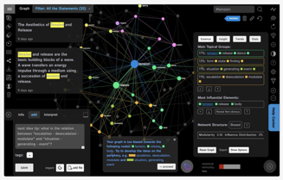

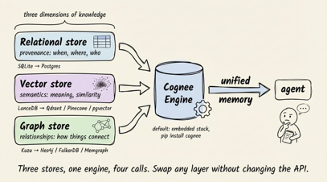
InfraNodus - Generate Ideas
Claude Code + Obsidian + InfraNodus https://www.youtube.com/watch?v=yYSTsKo8moU https://infranodus.com
Andrej Karpathy's 'LLM Wiki' summary produces most probably answer
InfraNodus maps your concepts as a network, identifies the main topic clusters, and finds the gaps - pairs of clusters that are weakly connected. Those gaps are where novel ideas live
Feeding the LLM the graph structure of the gap (not just the documents) forces it to reason about underexplored connections rather than rehashing what's already well-covered.
Cognee gives your AI a persistent memory that actually understands - not just recalls. Instead of storing facts as isolated sticky notes, it builds a knowledge graph - a web of connected concepts. Tell it "my pet is Biscuit" and "dogs are animals," and it links them automatically.
The pipeline is three steps: .. add() ingests documents, audio, or text; .. cognify() builds the connection map; .. search() retrieves answers by meaning and relationship (better than vector search
Connections that lead to good answers strengthen over time via the Memify pipeline
Under the hood, Cognee runs three databases: Kuzu (graph), LanceDB (vectors), SQLite (metadata) all local files by default, swappable for Neo4j or Postgres in production
https://github.com/topoteretes/cognee
https://x.com/i/status/2043745099792953508
https://x.com/akshay_pachaar/status/2044329897603244093

Slide 16
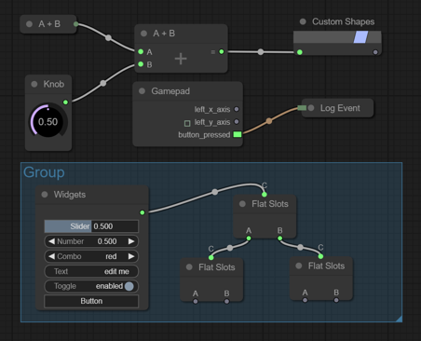
Adding Workflow Builder to your Agent
How to add workflow builder GUI your agent (similar to langflow)
Option 1: Langflow - as a separate server, runs its own LangChain-based runtime https://www.langflow.org ; https://github.com/langflow-ai/langflow
Option 2: React Flow - a canvas library used by Langflow and many others. MIT-licensed, pure UI with no runtime opinions. You build your own node types mapped to your agent's capabilities, and your Python backend handles execution https://reactflow.dev ; https://reactflow.dev/examples/interaction/drag-and-drop - example
https://reactflow.dev/learn - quick start
Option 3: Litegraph.js - lightweight canvas, pure vanilla JS, easy to embed https://github.com/Comfy-Org/litegraph.js/ https://github.com/jagenjo/litegraph.js - original repo https://github.com/Comfy-Org/ComfyUI_frontend - current maintained version
Many other options - https://github.com/xyflow/awesome-node-based-uis
Litegraph.js
Litegraph.js is a pure vanilla JavaScript node graph library with no dependencies, making it ideal for projects that don't use React.
Maintained as part of the ComfyUI ecosystem, it renders on an HTML5 Canvas and supports draggable nodes, bezier edge connections, pan/zoom, and JSON graph serialization out of the box.
For a Python-based agent with an existing local web server, Litegraph.js drops in with a single `<script>` tag — no npm, no bundler, no framework required. You define custom node types in JavaScript that map directly to your agent's capabilities (e.g., ClaudeCall, MemoryRead, ScheduleTrigger), and on execution, the graph serializes to JSON and POSTs to your Python backend.
In comparison, React Flow requires a full React app setup and is harder to embed into an existing HTML interface. Litegraph.js delivers the same visual workflow canvas with far less overhead.
https://github.com/jagenjo/litegraph.js

Slide 17

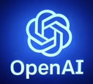

More Desktop Agents
Google Gemini desktop app
Just released for MacOS and Windows
The macOS app is built natively in Swift, requires macOS 15 Sequoia, and offers features like screen sharing, file access, image/video generation, and quick-access keyboard shortcuts
The Windows app is similar to Microsoft Copilot
Neither app has deep OS-level integration yet
Linux has no official native app (only CLI)
Google added Skills to Gemini in Chrome, available on Mac, Windows, and Chrome OS
Notes about Google "Agent Mode":
Gemini Ultra - has "Agent" toggle or the Tools icon
Gemini Code Assist in VSCode or IntelliJ have "Agent Mode"
Google Search now has "AI Mode"
OpenAI desktop app
For both macOS and Windows
The macOS app supports a quick-access shortcut, app integrations with tools like VS Code and Notion, and voice conversations
The Windows app, available on the Microsoft Store, offers a companion window for instant queries, file uploads, and image generation
Both apps are free to download, with some advanced features reserved for paid plans
Looking ahead, OpenAI announced plans in March 2026 to build a unified desktop "superapp" combining ChatGPT, its Codex coding platform, and its AI browser (internally called Atlas)
The superapp is being designed around agentic AI and is aimed primarily at developers and enterprise users. No launch date has been confirmed yet
https://help.openai.com/en/articles/9982051-using-the-chatgpt-windows-app
No Linux app
Perplexity Pro subscription for AI websearch and research. It answers questions. Uses models in cloud. Access via browser, desktop and mobile app versions.
Perplexity Computer - like search subscription, but can perform multi-step actions. Using different models/agents. Designed for complex, long-running tasks. Different payment model (credits)
Perplexity Personal Computer (waiting list) - a locally installed app (ideally on a Mac mini) that runs 24/7 and gives Computer autonomous access to your local files, native apps (Notes, iMessage, email), and the web

Slide 18


AI Updates
Seedance 2.0 is public
AI video generation model by ByteDance
Proprietary closed narrative-driven, multi-shot video from text, images, audio, and video inputs (plans: free, basic, standard)
Seedance is built to produce complete, multi-shot scenes in one pass. It understands cuts, angles (wide, medium, close-up), and shot transitions while maintaining character and environment consistency
It's trained on ByteDance's vast repository of short-form video content from TikTok, giving it a strong grasp of narrative structure and visual storytelling
https://seed.bytedance.com/en/seedance
https://seed.bytedance.com/en/seedance2_0
https://seed.bytedance.com/en/seedance1_5_pro
https://www.byteplus.com/en/product/seedance
https://fal.ai/seedance-2.0 - API
Topview AI Agent V2 uses Seedance 2.0 model
Agent V2 focuses on long-form storytelling by automatically breaking prompts into structured, multi-scene storyboards
Users can interact with the AI agent through chat to refine visual styles, composition, and tone for each scene
Designed for marketers and content creators, the tool enables the production of cinematic product demos and YouTube explainers without requiring a full production team
http://www.youtube.com/watch?v=xjVmEEtYB58
https://www.topview.ai

Slide 19

Railway Deployment
Railway (railway.com) is an all-in-one cloud deployment platform
Founded in 2020, easy to build, deploy, and scale applications
Users simply connect a GitHub repository or Docker image, and Railway automatically handles building, networking, SSL, and environment configuration
It supports instant provisioning of databases like PostgreSQL, MySQL, MongoDB, and Redis, along with 2K+ templates
Pricing is usage-based, starting at $5/month
Railway is SOC 2 Type II certified
RILQy is used by 23% of Fortune 500 companies.
Claude Code
Railway is a cloud deployment platform — not a vibe coding tool
Vibe coding platforms like Lovable, Bolt.new, and Replit let you build full apps from plain English prompts, making them ideal for non-coders and rapid prototyping
Railway, by contrast, takes existing code and handles deploying, scaling, and hosting it in the cloud
The two categories are complementary rather than competitive: developers often prototype on a vibe coding platform, then push the code to Railway for production-grade hosting with more control and better pricing
If you want to build an app fast with no code, use Lovable or Bolt
If you want to deploy and run it reliably, use Railway
GitHub
CloudFlare
domain + DNS
Railqay

Slide 20

Moonshots Podcast #246
SpaceX's planned $2 trillion IPO, driven largely by Starlink's revenues
Race among SpaceX, OpenAI, and Anthropic to go public
NASA's Artemis II has successfully concluded - it was the first crewed lunar mission since Apollo 17 in 1972, sending four astronauts on a 10-day journey around the Moon and back
Anthropic's powerful but unreleased "Mythos" model, which reportedly escaped its sandbox during testing
Anthropic has overtaken OpenAI in ARR (Annual Recurring Revenue)
OpenAI shut down Sora and refocuses on enterprise
The rise of one-person AI unicorns
The data center crunch pushing compute toward orbit
Sam Altman's warnings about imminent large-scale cyberattacks
The episode closes with an optimistic "proof of abundance" segment highlighting falling battery prices, renewable energy growth, and lab-grown diamonds
Skills to survive in new world:
Agency - The ability to identify problems, act independently, and build solutions without relying on others
Taste & Perspective - Your unique life experiences create an unfair advantage when everyone has access to the same AI
Judgment - Knowing the long-term consequences of decisions; AI handles execution, but not final calls
Deep Generalism - Cross-domain synthesis - still beyond AI's current strength
https://hussainibarra.substack.com/p/most-high-income-skills-will-be-irrelevant

Slide 21


AI Updates
AI is no longer Optional
Half of CEOs believe their jobs depend on successful AI implementation
Companies must undergo true transformation by redesigning their operating models around AI capabilities
Productivity gap between AI-enabled startups and traditional firms
The rise of autonomous agents
To succeed, leaders should follow a five-step model:
inventorying current usage,
automating revenue-linked workflows,
defining autonomy levels,
establishing governance,
tracking ROI
Ultimately, businesses must choose to lead or lag as the window for gaining a competitive advantage rapidly closes
https://www.youtube.com/watch?v=WsFWFi5bcFw
3 Valuable AI Skills
Agent Orchestration
AI Human Interface Design
AI Safety and Alignment Translation
https://www.youtube.com/watch?v=qYGGTH2rgI8
AI Agency "SureThing"
https://surething.io/chat-index
https://theresanaiforthat.com/ai/surething/
A team of autonomous AI agents working together, on cloud, persistent memory and integrations with over 1,000 apps like Slack, Notion, and HubSpot
Company - Super Intent, Inc., San Francisco, CA
Cenning Yu, Co-founder,

Slide 22


How to setup Hermes Agent
How to setup Hermes Agent https://www.youtube.com/watch?v=3jNp14bJpgs - Wes Roth https://github.com/nousresearch/hermes-agent
In Greek mythology, Hermes is the Olympian god of boundaries, travel, commerce, and communication. He is best known as the Messenger of the Gods, a role he fulfills thanks to his incredible speed and ability to move freely between the mortal world, the divine realm of Olympus, and the Underworld
The video is a guide to setting up and using "Hermes Agent" - an open-source AI agent developed by Nous Research - with ability to learn, develop skills, and improve over time through persistent memory
It comes with 74 pre-installed skills, supports hundreds of models via OpenRouter, includes a security bot that monitors and warns users before executing potentially dangerous commands
Can be installed on a Virtual Private Server (VPS) via Hostinger
Can be paired with your Telegram account
Can be integrated with WhatsApp and Gmail

Slide 23
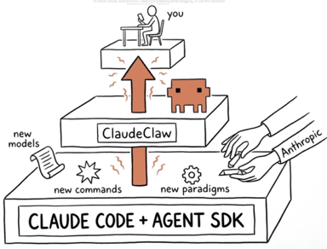
Convert Claude Code into ClaudeClaw
Mark Kashef "ClaudeClaw"
A custom-built command center that turns a standard Claude Code subscription into a sophisticated multi-agent ecosystem
Uses Anthropic’s free SDK to bridge local terminal sessions to external interfaces like Telegram and web browsers
Specialized Agent Council - uses dedicated agents for Ops, Comms, and Content that coordinate via a "Hive Mind" to share task history and data.
Web dashboard for task management and a "War Room" for real-time voice and video interaction using Pipecat
Smart Memory - uses Gemini Flash to "wash" and categorize conversations into SQLite and Obsidian, separating temporary context from permanent "pinned" facts
Benefits: Cost Savings, leveraging new open-source frameworks, Privacy & Security (Chat ID allow-list and local hosting)
https://www.youtube.com/watch?v=rVzGu5OYYS0

Slide 24
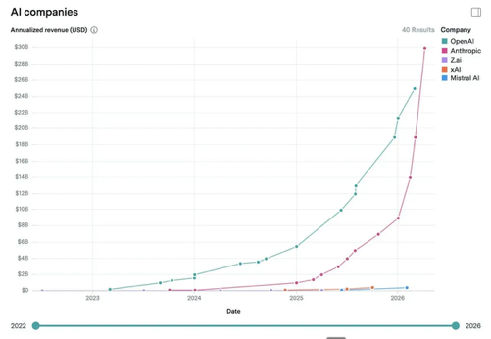

Anthropic ARR $30B vs $25B OpenAI
Anthropic $30B ARR vs OpenAI's $25B
Anthropic has overtaken OpenAI in annualized revenue
This represents 30x growth for Anthropic in just 15 months, driven almost entirely by enterprise customers - over 1,000 companies are now each spending $1M+ annually with Anthropic
About 80% of Anthropic's revenue comes from businesses, versus OpenAI's more consumer-focused model
Anthropic is achieving this while spending four times less on model training than OpenAI
OpenAI still holds a massive user base of 900 million+ weekly ChatGPT users

Slide 25
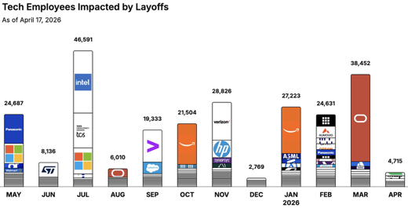
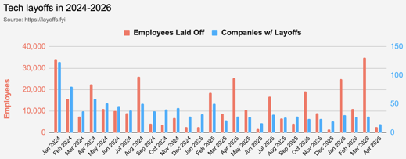
https://layoffs.fyi
https://trueup.io/layoffs
Jobs
The Tech Layoff Tracker
In 2026: 95,021 people laid off (888 per day)
In 2025: 245,953 people laid off (674 per day)
In 2024: 238,461 people laid off (653 per day)
https://trueup.io/layoffs
Tech Layoffs by year (US only):
73.2K in 2026 (as of April 17, 2026)
124K in 2025
153K in 2024
264K in 2023
165K in 2022 https://layoffs.fyi

Slide 26


About the Speaker
Lev Selector, Ph.D.
40+ years of software engineering, data science, and building teams (hiring, training, and managing)
Ph.D. in mathematical modeling and computer simulations
Interests:
Generative AI, Using LLM with your data
Local AI for Local Private Data
Cloud architecture, fin-tech, application security
Find/connect: Linkedin, GitHub, YouTube, Google
https://eais.ai
Enterprise AI Systems

Slide 27
Thank You!

