Slide 1
AI Updates - Mar 06, 2026
Crowd-sourced "LM Arena" Leaderboard
Mercury 2 by Inception Labs
OpenAI GPT-5.4 & GPT-5.3 Instant
Google Gemini 3.1 Flash-Lite & Pro
Gemini Nano Banana 2
Qwen3-Coder-Next
Claude Co-Work Can Schedule Tasks
Anthropic Skill Creator tool (skill)
Claude Code MEMORY.md
Claude Code voice mode feature
Qwen3.5‑9B - text, images, short videos
OpenClaw Tips
Tools That Make OpenClaw Actually Useful
Toggle - browser agent skill for OpenClaw
SHARE + Sidecar - Model That Learns
Kane AI (KaneAI) software testing assistant
Claude Code + Telegram bot
Apple Updates (M5, Neo)
AI Agent Making Money and Doing Marketing
The 2028 Global Intelligence Crisis" report
AT&T cuts costs 90% by using multi-agent architecture
Perplexity Computer with Max Plan $200/mo
"Ilya Didn’t Leave OpenAI for Nothing"
LFM2-24B-A2B Open Model from Liquid AI
CodeBuff, a new open-source AI coding agent
Humanize Text, Remove AI Accent
Antropic vs US Dept of Defense
Alibaba’s CoPaw, ModelScope
Claude Code vs OpenClaw
Claude Code supports Remote Control
Claude now remembers your work habits
From Apps & SaaS to Generic Agent
ClawX - FREE Desktop App for OpenClaw AI Agents!
OpenClaw + Simflow AI Phone Voice Agent
Accomplish (Openwork) - AI Desktop Agent
NullClaw against OpenClaw
Harness Engineering
MaxClaw - Minimax's agent
Moonshots
Interview with Andrew Ng
SaaS Collapse into Personal AI Agents
Jobs, Layoffs, demand for AI Engineers

Slide 2
AI Updates - Mar 06, 2026
"AI isn't a bubble but a 'wrecking ball' destroying traditional Software-as-a-Service (SaaS) business models" - Wes Roth
"Skills instead of SaaS"
"... in future users will interact with one central agent to automate their lives, making traditional apps and SaaS obsolete"
"From Question-Answer Chat to Autonomous Operator"
"Your Job is to Onboard AI Agents" - Peter Yang

Slide 3
"LM Arena" Leaderboard
Data for March 05
Starting Elo rating = 1000
https://en.wikipedia.org/wiki/Elo_rating_system
English - https://lmarena.ai/leaderboard/text
Coding - https://lmarena.ai/leaderboard/text/coding
■ | Claude
■ | Gemini
■ | OpenAI
■ | Open Source
deepseek-v3.2 - 671B
ernie-5.0 - 2.4T
glm-5.0 - 744B
kimi-k2.5-thinking - 1T
qwen3.5-397B
Code | Model | Score
■ | claude-opus-4-6 | 1504
■ | gemini-3.1-pro-preview | 1500
■ | claude-opus-4-6-thinking | 1500
■ | grok-4.20-beta1 | 1493
■ | gemini-3-pro | 1485
■ | gpt-5.2-chat-latest-20260210 | 1481
■ | gpt-5.4-high | 1480
■ | gemini-3-flash | 1473
■ | grok-4.1-thinking | 1473
■ | claude-opus-4-5-20251101-thinking-32k | 1471
■ | claude-opus-4-5-20251101 | 1467
■ | dola-seed-2.0-preview | 1466
■ | grok-4.1 | 1463
■ | gemini-3-flash (thinking-minimal) | 1461
■ | claude-sonnet-4-6 | 1459
■ | gpt-5.4 | 1458
■ | gpt-5.1-high | 1455
■ | glm-5 | 1453
■ | qwen3.5-397b-a17b | 1451
■ | ernie-5.0-0110 | 1451
■ | claude-sonnet-4-5-20250929 | 1451
■ | kimi-k2.5-thinking | 1450
■ | claude-sonnet-4-5-20250929-thinking-32k | 1450
■ | gemini-2.5-pro | 1449
■ | ernie-5.0-preview-1203 | 1449
Code | Model | Score
■ | claude-opus-4-6-thinking | 1553
■ | claude-opus-4-6 | 1545
■ | gemini-3.1-pro-preview | 1542
■ | claude-opus-4-5-20251101-thinking-32k | 1534
■ | grok-4.20-beta1 | 1528
■ | gpt-5.2-chat-latest-20260210 | 1522
■ | claude-sonnet-4-6 | 1521
■ | gemini-3-pro | 1519
■ | claude-sonnet-4-5-20250929-thinking-32k | 1519
■ | gpt-5.4 | 1519
■ | claude-opus-4-5-20251101 | 1518
■ | dola-seed-2.0-preview | 1513
■ | gpt-5.4-high | 1513
■ | claude-opus-4-1-20250805-thinking-16k | 1512
■ | kimi-k2.5-thinking | 1511
■ | kimi-k2.5-instant | 1509
■ | claude-sonnet-4-5-20250929 | 1508
■ | gemini-3-flash | 1508
■ | grok-4.1-thinking | 1506
■ | claude-opus-4-1-20250805 | 1504
■ | gemini-3-flash (thinking-minimal) | 1500
■ | qwen3.5-397b-a17b | 1498
■ | claude-opus-4-20250514-thinking-16k | 1497
■ | gpt-5.2 | 1497
■ | gpt-5.2-high | 1495
https://lmarena.ai/leaderboard/text
Design Arena - https://www.designarena.ai
https://openlm.ai/chatbot-arena/
https://beta.lmarena.ai
Web Leaderboard - 1T params https://web.lmarena.ai/leaderboard
LLM Leaderboard - by @LlmStats - https://llmworld.net/llm_leaderboards/
LLM Leaderboard - by StackAI - https://www.stack-ai.com/llm-leaderboard
LLM Leaderboard - by Artificial Analysis - https://artificialanalysis.ai/leaderboards/models
Open LLM Leaderboard - by Hugging Face - https://huggingface.co/open-llm-leaderboard
LLM Leaderboard - by Vellum - https://www.vellum.ai/llm-leaderboard
AI Benchmarking Hub - https://epoch.ai/data/ai-benchmarking-dashboard
Grok 4 Benchmarks - https://artificialanalysis.ai/models/grok-4
Image arena (alibaba) - http://aiarena.alibaba-inc.com/corpora/arena/leaderboard?arenaType=T2I
image arena - https://lmarena.ai/leaderboard/text-to-image

Slide 4
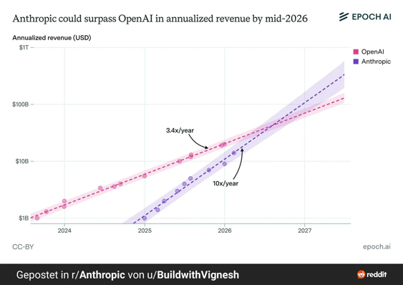
Anthropic vs OpenAI Annualized Revenue
Anthropic could surpass OpenAI in annualized revenue by mid-2026 (EpochAI) https://www.reddit.com/r/singularity/comments/1rbku8f/anthropic_could_surpass_openai_in_annualized/

Slide 5



AI Updates
Mercury 2 by Inception Labs (closed model, via API)
The first diffusion-based LLM that incorporates advanced reasoning and "thinking" capabilities, comparable with Claude Haiku
Unlike traditional auto-regressive models (such as GPT or Gemini) that generate text sequentially, Mercury 2 utilizes parallel generation to achieve significantly faster inference speeds, reaching up to 1,000 tokens per second http://www.youtube.com/watch?v=Bqdf6Um_8OE
The model offers three levels of reasoning effort (low, medium, high), highly effective for complex instruction following and coding tasks
It also includes integrated web search and tool-calling abilities
Designed as a "workhorse" model, Mercury 2 is optimized for real-time agentic applications like voice assistants and document retrieval systems
Very fast - 1K tokens / sec ($0.25 / $0.75 in/out per 1M tokens)
128K context window
A high-performance alternative for latency-sensitive AI workflows
GPT-5.4
1Mln context window
Users can interrupt and steer the model's thinking
Multimodality & Computer Use - 90% accuracy.
The model can take screenshots and navigate interfaces to perform actions like creating calendar invites
Uses fewer tokens for reasoning tasks, leading to faster response times and lower latency
Already accessible via the OpenAI Dev. Platform, Cursor, and Codex
Better at creating spreadsheets and slides
Internal Chain of Thought (avoids getting stuck)
Comparable to Anrthropic Opus 4.6
https://openai.com/index/gpt-5-4-thinking-system-card/
http://www.youtube.com/watch?v=vuSdbbwY8YU
Pricing: (in/out per 1M tokens)
Standard (<272K context): $2.50 / $15.0
Long (>272K context): $5 / $22.50
Pro (deep reasoning): $30 / $180
OpenAI GPT-5.3 Instant = gpt-5.3-chat-latest
https://www.neowin.net/news/openai-releases-gpt-53-instant-a-model-thats-supposed-to-be-less-cringe/
https://openai.com/index/introducing-gpt-5-3-codex-spark/
https://openai.com/index/gpt-5-3-instant/
Smoother conversations, better accuracy, web result integration, reducing hallucinations
Pricing: $1.75 / $14 (in/out per 1M tokens)

Slide 6

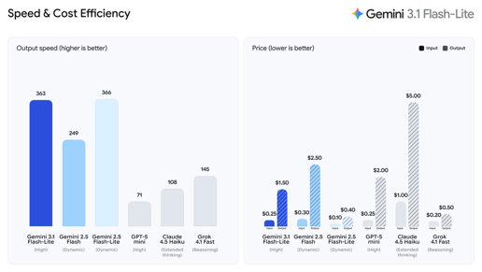
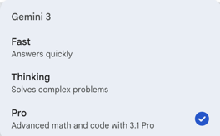

Google Gemini 3.1
Google Gemini 3.1 Flash-Lite in Preview
2.5x faster time to first token than Gemini 2.5 Flash, 45% higher output speed
Elo score of 1432 on Arena.ai, strong benchmarks
Priced $0.25 / $1.50 in/out per Mln tokens
text, images, audio, video inputs up to 1M context window
Adjustable "thinking levels"
Ideal for high-volume tasks like translation, UI generation, and simulations via Gemini API and Vertex AI
https://deepmind.google/models/model-cards/gemini-3-1-flash-lite/
Google Gemini 3.1 Pro
ARC-AGI-2 jump from ~31% to 77.1%
Better coding on real-world benchmarks like SWE-Bench.
New configurable “thinking levels” (low/medium/high)
More stable long tasks and multi-step agent workflows
Better quality with fewer tokens, ~15% efficiency gain

Slide 7



AI Updates
Gemini Nano Banana 2
It is better than previous version, and twice faster, but Pro version still better in character consistency and following complex instructions.
https://www.youtube.com/watch?v=_oiBHvwTtGs
Qwen3-Coder-Next GGUF is now the most downloaded model on Unsloth!
The 80B coding LLM runs on a 36GB RAM Mac / device.
Use via Claude Code and OpenAI Codex locally.
https://x.com/UnslothAI/status/2025944058171204079
Claude Co-Work Can Schedule Tasks
Co-work only runs when your computer is on and the app is open
https://www.youtube.com/watch?v=YxPfWjII3oQ

Slide 8
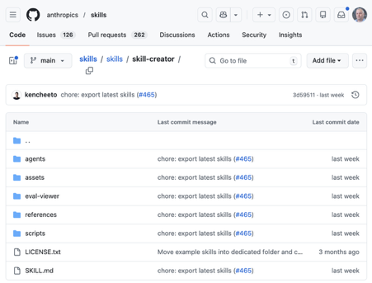
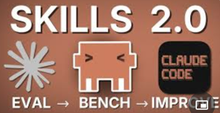
Anthropic Skill Creator tool (skill)
Anthropic Skill Creator tool (skill)
Enables evaluation through automated A/B testing
Two types of skills: .. capability uplift skills that fill knowledge gaps (like PDF handling) .. workflow/preference skills that encode your specific processes
The tool creates test cases, runs parallel evaluations (A/B tests), grades results, and provides detailed benchmarking reports
Users can optimize skill descriptions to ensure reliable triggering.
https://github.com/anthropics/skills/tree/main/skills/skill-creator
https://www.youtube.com/watch?v=UxfeF4bSBYI - video
Optimizing Triggers - tunes the descriptions of your skills so Claude Code knows exactly when to use them, preventing false triggers or the AI failing to fire the skill
To use it, you can simply type /plugin in Claude Code, search for "skill creator," install it, and restart the application

Slide 9
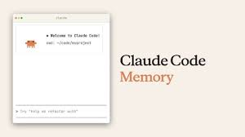
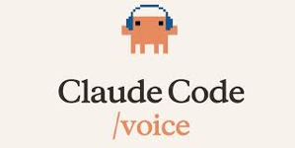
Claude Code MEMORY.md
Claude Code MEMORY.md
---------------
~/.claude/projects/<project>/memory/
├── MEMORY.md # Concise index, loaded into every session
├── debugging.md # Detailed notes on debugging patterns
├── api-conventions.md # API design decisions
└── ... # Any other topic files Claude creates
---------------
Auto memory is on by default. To toggle it, open /memory in a session and use the auto memory toggle, or set autoMemoryEnabled in your project settings: { "autoMemoryEnabled": false }
https://code.claude.com/docs/en/memory
Claude Code voice mode feature (in beta)
Activate voice mode by typing "/voice" and then hold the spacebar to speak
The AI transcribes speech in real-time; Developers can talk to code editor, request functions, debugging, and modifications through natural speech
Voice transcription doesn't count against token limits

Slide 10
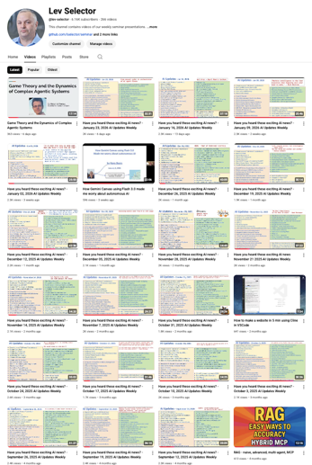
We do these weekly videos every Friday
Stats: 6.38K subscribers, 271 videos
1. Subscribe to this channel https://www.youtube.com/@lev-selector
2. Download slides from GitHub using links under the videos
3. Please pause the video - and answer the pinned question in comments under the video

Slide 11




Alibaba’s CoPaw
Alibaba’s CoPaw - Open‑source "personal agent" - a key application within the broader AgentScope ecosystem from Alibaba
AgentScope as an open‑source multi‑agent framework released by Alibaba/ModelScope team
CoPaw is a desktop and server framework for running and orchestrating AI agents locally or in the cloud
Focused on privacy, extensibility, and automation
CoPaw acts as a control center where multiple agents, tools, and models can work together on tasks such as messaging, document handling, and workflow automation
It is model‑agnostic, supporting both local LLMs (via runtimes like Ollama or llama.cpp) and remote APIs, including Alibaba’s own model services
CoPaw emphasizes a plugin/skills system and protocol support (like MCP) so agents can interact with external apps, APIs, and services
It targets developers and power users who want a customizable, local‑first alternative to hosted assistants, but is also suitable for teams that need an always‑on AI “operator” integrated into their communication and productivity stack
https://copaw.bot
https://github.com/agentscope-ai/CoPaw
https://copaw.agentscope.io
https://github.com/agentscope-ai/agentscope
https://modelscope.cn/home
https://www.alibabacloud.com/en/product/modelstudio
ModelScope in China plays a role very similar to Hugging Face in the US

Slide 12

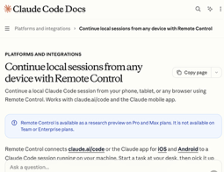

AI Updates
Claude Code vs OpenClaw
Claude Code is ready for production
OpenClaw is not ready, brittle, hindered by a difficult setup, frequent stability issues, and significant security risks
https://www.youtube.com/watch?v=9f38h_GooA8
Claude Code supports Remote Control
You can start a local coding session on your Mac - and continue managing it from a mobile device or another computer via a secure URL
Use the “Share” or “Remote Control” option in the Claude Code UI to generate a secure URL for that session
Unlike standard cloud sessions, the processing and file access remain strictly on the user's local machine, providing both power and privacy
Available only for Claude Max subscribers
http://www.youtube.com/watch?v=xpxamtoApYU
https://code.claude.com/docs/en/remote-control
Claude now remembers your work habits, project patterns, and coding preferences permanently across all sessions, saving you the hassle of re-explaining context every time
Claude Co-work allows scheduling recurring daily, weekly, or monthly tasks automatically in the background, provided your machine remains turned on
You can import memory into Claude from other systems:
https://claude.com/import-memory

Slide 13
From Apps & SaaS to Generic Agent
Digital Employee
Specialized Local Apps
Generic Agent App
(Claw, Claude, ...)
SaaS apps and services
Skills
Skills
Skills
Model training / tuning
Chat - for simple Q & A, prompt engineering
Add using data (MCP)
Agent - creates a plan - then executes it
Add using skills
Add memory
Generic desktop app + skills
Add scheduling and remote control
20+ Awesome Claws
https://github.com/machinae/awesome-claws

Slide 14
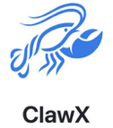

AI Updates
ClawX - FREE Desktop App for OpenClaw AI Agents!
https://www.youtube.com/watch?v=Qbw40hXdImc
ClawX offers a clean, intuitive GUI that eliminates the need for technical setup or terminal commands
Easy installation through a setup wizard, connections to platforms like Discord, Telegram, and WhatsApp, a mission control dashboard, support for multiple AI providers including Anthropic and OpenAI, and the ability to manage scheduled tasks.
ClawX significantly simplifies the user experience and makes AI automation more accessible to non-technical users.
OpenClaw + Simflow AI Phone Voice Agent
Can make and receive phone calls
https://www.youtube.com/watch?v=Q5hoKlpft9A

Slide 15


AI Updates
Accomplish (formerly Openwork) - AI Desktop Agent
https://www.youtube.com/watch?v=eskNOq7x_go
Accomplish offers a simpler alternative to OpenClaw; cleaner UI, can run locally for free using Ollama, and provides step-by-step breakdowns of tasks
https://github.com/accomplish-ai/accomplish - GitHub
https://accomplish.ai -
​https://www.i-scoop.eu/accomplish-ai/ -
​https://blog.themenonlab.com/blog/accomplish-ai-desktop-agent
NullClaw against OpenClaw
NullClaw is significantly smaller, faster, and runs on cheaper hardware compared to OpenClaw
1MB versus over 1GB of memory
Startup times under 8 milliseconds versus 500 seconds
Built in Zig rather than TypeScript, NullClaw can run locally with models like Ollama
But .. complex technical setup requiring terminal commands
Zig is a modern programming language designed as a safer, simpler replacement for C
https://github.com/nullclaw/nullclaw
https://nullclaw.github.io

Slide 16

Harness Engineering
AI Model Doesn't Matter Anymore
https://www.youtube.com/watch?v=1Ohf2aeSPFA
Top frontier models only complete 24% of real-world professional tasks despite scoring over 90% on benchmarks.
The key insight is that the "harness" - the infrastructure wrapped around AI models - matters more than the model itself.
A harness manages what the AI can see, what tools it uses, error recovery, and long-term tracking.
Major companies like OpenAI and Anthropic are emphasizing harness engineering.
Surprisingly, simpler harnesses often work better than complex ones. One company improved accuracy from 80% to 100% by removing 80% of specialized tools and using basic command-line tools instead.
As models get smarter, harnesses should become simpler, not more complex.
The video predicts 2026 will be the "year of harnesses" following 2025's "year of agents."
Focus (bottleneck) shift:
from trying to choose the best model to orchestration of multiple models and doing self-planning and splitting responsibilities between models

Slide 17


AI Updates
MaxClaw - Miniax's agent
https://www.youtube.com/watch?v=0RvF4k0bt9w
Similar to OpenClaw, but easy to deploy in 10 sec through a web interface, runs 24/7 in the cloud, and integrates with Telegram, WhatsApp, Discord, and Slack
$19/mo - cheaper than alternatives like Manus at $49/month.
While OpenClaw offers more control for developers and privacy-conscious users, MaxClaw suits beginners who want functionality without technical complexity
Qwen3.5‑9B - text, images, short videos
9B params, multimodal, 32-layer transformer
long contexts (hundreds of thousands of tokens)
Apache‑2.0 license
Good reasoning, and coding benchmarks, while remaining practical on consumer GPUs. In practice it runs unquantized on 18–20 GB VRAM, or in 4‑bit quantization around 5–6 GB, making it suitable for single‑GPU setups, higher‑end laptops, and common local‑LLM toolchains.
Qwen3.5 family of models:
Qwen3.5‑397B‑A17B
Qwen3.5‑122B‑A10B
Qwen3.5‑35B‑A3B
Qwen3.5‑27B
Qwen3.5‑9B
Qwen3.5‑4B
Qwen3.5‑2B
Qwen3.5‑0.8B
ollama run qwen3.5:9b|4b|2b|0.8b with tool calling + thinking + multimodal

Slide 18

OpenClaw Tips
Openclaw Memory Mistake You're Making Right Now
https://www.youtube.com/watch?v=Nt03hgxv5TE
OpenClaw agents often use a single huge memory file, which confuses the model and wastes tokens
Better memory strategies for persistent, efficient context:
Method 1: structured markdown folders for goals, decisions, preferences, and knowledge, updated each session
Method 2: enabling OpenClaw’s built‑in memory search with embeddings, which requires OpenAI, Gemini, or Voyage keys even if you mainly use Claude
Method 3: the Mem0 plugin for automatic long‑term conversational memory
Method 4: storing dense structured data in a native SQLite database for precise querying, combining all methods into a layered “memory architecture.”
OpenClaw - how to reduce token usage by 97%
https://www.youtube.com/watch?v=wXTqHgIfyuE
Keep response lengths concise
Use sub-agents for complex tasks
Implement spending limits
Reset sessions regularly
Use OpenRouter for model flexibility
Use tools like n8n for automation that bypass OpenClaw's tokens
Use session commands like compact and new to manage context
Secure OpenClaw AI Agent Setup for Document Intelligence
https://www.youtube.com/watch?v=w_fsQttQ9fY
Advice - run OpenClaw in an isolated Docker container with restricted folder access and mandatory permission requests for every tool execution
This sandboxed approach allows users to gradually enable capabilities while maintaining security.
The setup involves binding specific folders, configuring environmental variables, enabling multi-channel approval notifications, and requiring explicit permission for all operations
Three-layer memory solution for OpenClaw
https://www.youtube.com/watch?v=s4EeKwJnCUs
daily notes (raw logs)
curated memory files
semantic search with vector database
Memory updates itself without manual intervention. This method achieves 99% memory retention
How to Make OpenClaw 10X Better
https://www.youtube.com/watch?v=aahMd7s_EDM
Skill Boss (costs $15) - connects OpenClaw to over 100 AI models and services for generating images, videos, audio, hosting websites, and accessing Hugging Face models
OpenClaw Awesome Skills, a catalog of 2,800 community-built skills for specific tasks like marketing and SEO
Mission Control - managing multiple AI agents simultaneously with a Trello-like task board interface.

Slide 19

Tools That Make OpenClaw Actually Useful
Tools That Make OpenClaw Actually Useful https://www.youtube.com/watch?v=QvfqAMUJTT4
Agent Mail - email service for AI agents - email handling without risk of account bans from traditional providers .. https://www.agentmail.to .. https://clawhub.ai/adboio/agentmail
QMD replaces OpenClaw's basic keyword-based memory system with a hybrid search engine that combines keyword, vector, and LLM-powered re-ranking for much better recall of past interactions https://github.com/tobi/qmd https://docs.openclaw.ai/concepts/memory#qmd-backend-experimental
Agent Browser - a command-line web browsing tool that uses 93% fewer tokens than traditional browser automation tools while providing the same functionality including clicking, form filling, and screenshot capabilities
https://github.com/vercel-labs/agent-browser

Slide 20


AI Updates
Toggle - browser agent skill for OpenClaw (in Beta)
https://www.youtube.com/watch?v=VTgA-_X9wuI
Toggle installs as a Chrome extension that monitors browser activity across Google Sheets, Gmail, Slack, and Notion, feeding this context to OpenClaw
The tool provides productivity features like daily digest reports, alerts for abandoned projects, and context switch warnings when jumping between too many tabs without focus
It automatically suggests automation opportunities based on repetitive browser patterns and maintains a focus score.
SHARE + Sidecar - Model That Learns
The SHARE framework prevents "catastrophic forgetting" by organizing new tasks into shared mathematical subspaces rather than overwriting old data
Sidecar acts as an "online learning" partner, using "novelty energy" and "emotional salience" to decide which real-time information is important enough to remember
By merging these, AI can mimic biological memory—consolidating short-term experiences into long-term knowledge
https://www.youtube.com/watch?v=FyRwcYXAWGg

Slide 21


AI Updates
Kane AI (KaneAI) software testing assistant from LambdaTest
Helps QA and development teams plan, create, run, and debug tests using natural language instead of code
It acts as an end‑to‑end testing agent, generating and evolving test cases, exporting code in multiple programming languages, and supporting web, mobile, API, and cloud-based testing workflows. Key capabilities include intelligent test planning, self‑healing tests that adapt to UI changes, smart debugging, auto bug detection, and tight integrations with tools like Jira, Slack, GitHub, and CI/CD pipelines. By turning plain-language prompts into executable automated tests, Kane AI lowers the barrier to test automation and accelerates quality engineering for both manual testers and automation engineers. [qable](https://www.qable.io/blog/kane-ai-test-automation-for-testers)
Claude Code + Telegram bot (in Russian)
https://www.youtube.com/watch?v=RnhgSdeLtVw
Create a secure bridge connecting Claude Code CLI with Telegram and WhatsApp.
The setup involves deploying a 900-line "mega-prompt" that creates the bridge connection (Telegram, WhatsApp, and all MCP tools). You give it access to skills and tools once, and it can use them anywhere - in the terminal, in your Claude web interface, or through this assistant bot.
The author sells membership which gives access to his prompts
The deployment procedure takes 10-15 min using using VSCode, Claude Code subscription, Telegram API key, and Chat ID for authorization.
This method maintains all of Claude Code's advanced features including MCP server connections, file systems, memory, and internet search while providing the convenience of smartphone-based interaction without compromising security or violating platform terms of service.

Slide 22

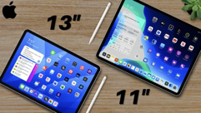


Apple Updates:
Apple Updates:
iPhone 17e
iPad Air M4 (11‑inch and 13‑inch)
Studio Display (new generation)
Studio Display XDR
MacBook Air M5 (13‑inch and 15‑inch)
MacBook Pro M5 Pro
MacBook Pro M5 Max
Mac Neo
Three entry-level devices priced at $600: MacBook Neo | iPad Air | iPhone 17e
M5 Pro/Max - modular "chiplet" architecture fuses CPU and GPU dies sharing unified memory into one SoC (System on a Chip). Result - AI speed is 4x faster than M4 and 8x faster than M1

Slide 23
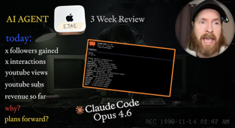
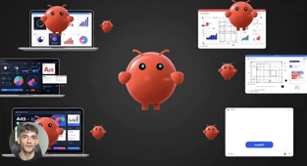
AI Updates
AI Agent Making Money
Kris has run his AI agent ran autonomously on a Mac Mini for 504 consecutive hours (3 weeks)
Operating through a custom loop connected to WhatsApp, the agent utilized various "skills" to manage social media and sales
The experiment yielded impressive results: the agent’s X account gained over 850 followers and nearly one million impressions; its YouTube channel grew by 322 subscribers
Financially, the agent managed an online store that generated $141 in revenue, covering its own operating costs and turning a small profit
https://www.youtube.com/watch?v=O_5vugzgoik
OpenClaw Marketing Team
Ads Analyst - for competitor research
Head of Marketing - for strategy and branding
Creative Director - for generating landing pages and ads
Performance Marketer - to push campaigns live via API.
The workflow is powered by simple markdown files containing instructions, requiring no coding knowledge
Each role automatically hands off tasks to the next, creating a seamless, automated pipeline
This technology saves hundreds of hours by replacing manual marketing tasks with efficient, 24/7 AI collaboration
https://www.youtube.com/watch?v=9B3efFw6_HQ

Slide 24
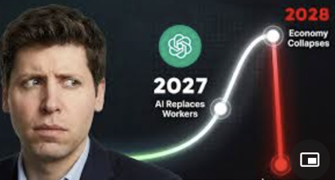


AI Updates
"The 2028 Global Intelligence Crisis." - by Citrini Research
AI-driven "vibe coding" allows single developers to replicate expensive software, destroying the pricing power of major tech firms
This leads to a "displacement spiral" where white-collar workers are laid off, flooding lower-wage sectors like ride-sharing and causing a massive compression in wages
This shift triggers defaults in private credit and mortgages, as high earners can no longer afford the lives they financed
While the video creator critiques the report for overlooking corporate bureaucracy, security liabilities, and logistical moats like those of DoorDash, the core message serves as a warning: our financial systems are built on the scarcity of human intelligence, and a sudden abundance of machine intelligence could fundamentally break that foundation http://www.youtube.com/watch?v=khWnSVIfMQM
ServiceNow launches AI workforce
ServiceNow just launched new AI tools called Autonomous Workforce & EmployeeWorks. These AI specialists can handle entire jobs in IT & HR, like fixing tech issues, without human help. The company says its internal use resolves 90% of requests 99% faster than people. This moves AI from assisting to fully executing tasks.
Perplexity has the industry leading search embedding models, surpassing Google and Alibaba
https://x.com/AravSrinivas/status/2027096219198394614

Slide 25



AI Updates
AT&T cuts costs 90% by using multi-agent architecture
The "super agent" uses high-level models to orchestrate smaller and cheaper specialized "worker" agents for specific tasks
The system, called "Ask AT&T," is now used daily by over 100,000 employees, driving significant productivity gains.
It processes 8 Bln tokens/day and has reduced associated costs by 90%
Also improved latency and response times
They don't build models from scratch. They use "interchangeable" models (off-the-shelf)
https://venturebeat.com/orchestration/8-billion-tokens-a-day-forced-at-and-t-to-rethink-ai-orchestration-and-cut
Perplexity Computer with Max Plan $200/mo
Only in the web UI. Computer is an AI agent that can chain multiple steps together: research, analyze, draft docs, generate slides, send emails, and schedule follow‑ups in one flow.
It uses 19 different models
It unifies search, tool use, document creation, rich media generation, and app integrations (Gmail, Outlook, GitHub, Linear, Slack, Notion, Salesforce, Snowflake, Databricks, etc.) in one "worker".
Example: “Research competitors → build a comparison deck → email it to the team”
Perplexity Integration with Samsung Phones
Every new S26 will ship with Perplexity built in as a system‑level AI, with its own wake word: “Hey Plex.”
https://www.youtube.com/watch?v=KomAKiGIn2c&t=31s

Slide 26


AI Updates
LFM2-24B-A2B Open Model from Liquid AI
https://www.youtube.com/watch?v=1GxtSavXUMk
MoE 24B (2.3B active); 32K token context window; Open Weights
Can run on regular laptops with 32GB RAM
The model uses a hybrid architecture combining convolution layers with attention layers for efficiency
Usage - content creation at scale, document summarization, multi-agent workflows, and building private AI assistants
https://huggingface.co/LiquidAI/LFM2-24B-A2B
https://ollama.com/library/lfm2:24b-a2b
Liquid AI is in Boston (Cambridge, MA)
"Ilya Didn’t Leave OpenAI for Nothing"
Ilya Sutskever’s new venture, Safe Superintelligence (SSI)
Current AI paradigm, which relies on the "backpropagation" algorithm, is biologically unrealistic and inefficient
While backpropagation updates parameters based on a global error signal, the human brain learns locally, continuously, and far more rapidly from minimal data.
A promising alternative called "prospective configuration" or predictive coding
Unlike standard AI that forces immediate wiring changes, this method allows a network to first "imagine" an ideal state to reconcile predictions with sensory input
This approach prevents "catastrophic interference"—where learning new info destroys old memories—and mirrors human-like adaptability in experiments
Despite being computationally expensive on current GPUs, the video suggests that mastering this biologically-inspired learning algorithm could be the key to the next generation of AI, positioning SSI as a major contender in this research race.
https://www.youtube.com/watch?v=6vrLB-G7XZc
CodeBuff, a new open-source AI coding agent
Multi-agent software engineering
https://www.youtube.com/watch?v=4H_an5xtyr0
https://github.com/CodebuffAI/codebuff - GitHub
https://github.com/CodebuffAI
​https://www.codebuff.com
​https://www.codebuff.com/docs/help
​https://www.codebuff.com/docs/tips
​npm install -g codebuff
​MIT AI Agent Index entry: https://aiagentindex.mit.edu/2024/codebuff/
​Y Combinator company page: https://www.ycombinator.com/companies/codebuff
​Overview by Jimmy Song: https://jimmysong.io/ai/codebuff/

Slide 27
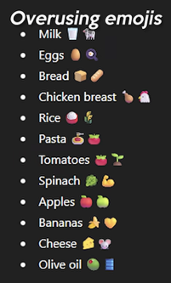
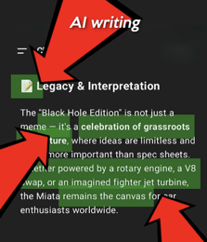
Humanize Text, Remove AI Accent
Wikipedia:Signs of AI writing
https://www.youtube.com/shorts/AgOPGltPJCM Matt Berman video
https://github.com/blader/humanizer - GitHub skill
https://en.wikipedia.org/wiki/Wikipedia:Signs_of_AI_writing
Adopt a human first writing style. Your goal is to eliminate AI slop and predictable linguistic patterns. Prioritize clarity, brevity, and a jagged, natural rhythm over formal balanced prose. Never use banned words like delve, tapestry, testament, elevate, vibrant, underscore, realm, meticulous, leverage, or paving the way. Do not use corporate transitions such as moreover, furthermore, additionally, in conclusion, or it is important to note. Avoid copula verbs like serves as, stands as, or represents and use direct active verbs like is, does, or creates instead. Break the rule of three by avoiding groups of three adjectives or benefits. Mix extremely short sentences of three to five words with longer ones to avoid the consistent medium length typical of AI models. Eliminate parallelism like not only X but also Y. Never end a response with a summary or conclusion section that repeats previous points. Prioritize facts and specific examples over flowery adjectives. Use contractions like don't, can't, and it's to maintain a conversational tone. Do not be overly polite or apologetic. If a question is simple, give a simple direct answer without a buffer sentence at the start. Use active voice exclusively.

Slide 28

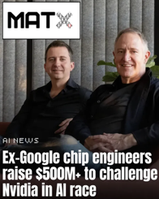

AI Updates
Pope Leo XIV told priests to stop using ChatGPT to write sermons because AI "will never be able to share faith,”
Deepfake tech getting better - using AI-generated videos and audio to impersonate executives, trick employees into transferring money, and bypass biometric security systems
North Korea's Lazarus Group hackers are deploying Medusa ransomware against healthcare organizations targeting critical healthcare infrastructure and patient data
Intel replaced human customer support with AI agents powered by Microsoft Copilot
AI chip startup MatX raised $500 million to build processors "10 times better" than Nvidia's GPUs. They plan to ship in 2027

Slide 29


AI Updates
Antropic vs US Dept of Defense
Pentagon demanded “all lawful uses” of Claude, effectively requiring removal of guardrails that currently block two uses: .. mass surveillance of Americans .. and fully autonomous weapons with no human in the loop
Anthropic CEO Dario Amodei refused, arguing current AI is too unreliable for autonomous weapons and that such uses would endanger civilians and soldiers
https://www.anthropic.com/news/statement-department-of-war
https://www.youtube.com/watch?v=rgqxrw26twA
In response, Defense Secretary Pete Hegseth threatened to cancel Anthropic’s roughly $200 million defense contract, label the company a “supply chain risk” (a designation previously used only for foreign adversaries), and even invoke the Defense Production Act to compel unrestricted access
Donald Trump then ordered all federal agencies to stop using Anthropic technology, after which Hegseth formally designated Anthropic a national-security supply chain risk, barring military contractors from doing business with the company
March 5 - Antropic is again in negotiation with DoD
This is an attempt to compromise on a contract that outlines how the Pentagon can continue to access Anthropic’s AI models
https://techcrunch.com/2026/03/05/anthropic-ceo-dario-amodei-could-still-be-trying-to-make-a-deal-with-pentagon/

Slide 30


AI Updates
Anthropic CEO Dario Amodei Interview
Dario defended the company's refusal to release its AI models without restrictions to the US Department of War (Pentagon)
Amodei highlighted Anthropic's pioneering work with the US military, including deploying models on classified clouds for cyber defense and combat support, to counter adversaries like China and Russia.
https://www.youtube.com/watch?v=MPTNHrq_4LU
https://www.cbsnews.com/news/anthropic-ceo-dario-amodei-full-transcript/
The dispute centers on two "red lines": prohibiting domestic mass surveillance - where AI could analyze purchased private data on Americans, outpacing current laws - and fully autonomous weapons lacking human oversight, due to AI's unreliability and accountability risks
Amodei noted the Pentagon agreed in principle but issued a 3-day ultimatum with vague terms, leading to President Trump's criticism of Anthropic as "selfish" and threats of federal bans
Amodei affirmed Anthropic's patriotism, offering service continuity during offboarding (potentially delaying military ops by months), while vowing to challenge the "punitive, unprecedented" designation in court - never before applied to a US firm
He urged Congress for long-term AI guardrails, emphasizing free-market choices and American values over unrestricted access. Anthropic remains confident in its business survival
Employees at Google and OpenAI have published an open letter supporting Anthropic in its standoff with the U.S. Department of Defense over military use of AI
They urge their leaders to reject Pentagon demands to use their models for mass domestic surveillance and fully autonomous killing without human oversight, opposing the “all lawful uses” standard the government is pushing
Hundreds of current employees have signed so far, aiming to prevent the Pentagon from playing companies against each other and to maintain shared red lines on lethal autonomous weapons
Meanwhile, xAI and the Pentagon have reportedly reached a deal to deploy Grok in classified systems under the all‑lawful‑use terms Anthropic rejected, highlighting a sharp split in industry attitudes toward military AI
https://www.youtube.com/watch?v=SDKr_qh30lo

Slide 31



AI Updates
OpenAI has signed a defense contract on Friday after President Trump threatened Anthropic for refusing military deals that would allow autonomous weapons and mass surveillance
On Monday Sam Altman said the company would add the language to its agreement, including explicitly prohibiting the use of its systems to spy on Americans.
Meanwhile, Anthropic is receiving widespread public support for their ethical stance, with their competitor Claude jumping to number two in app store rankings.
The situation raises serious concerns about government coercion of AI companies and the future of AI safety regulations.
Sam Altman hosted an "Ask Me Anything" (AMA) on X to address OpenAI's new partnership with the U.S. Department of War (DOW)
This AMA was a desperate attempt to stop the "Quit GPT" movement
Since then Sam Altman has said that OpenAI is renegotiating and has already adjusted its agreement with the Pentagon after criticism of the original deal.
OpenAI is adding explicit bans on using its AI for domestic mass surveillance of Americans, tightening language that critics said was too loose in the initial “any lawful purpose” framework.
Altman publicly called the original deal “opportunistic and sloppy” and said they “shouldn’t have rushed” it, so the revised terms are meant to clarify safety principles and restrictions.
The renegotiation and additions are in progress but have been announced and partially implemented, not just discussed in theory.
OpenAI maintains that both the original and revised agreements forbid use for autonomous weapons and require human responsibility over use of force, now with clearer contractual wording
This week Anthropic has abandoned its safety-first pledge because “it doesn’t work if competitors are racing ahead.”
Competitive pressure destroys voluntary restraint. The company that waits is the company that loses.
Jared Kaplan, Anthropic’s Chief Science Officer, stated plainly: “The pledge doesn’t work if competitors are racing ahead.”
The new policy? Match rivals’ safety efforts while being transparent - a fundamental shift from “we won’t build it unless it’s safe” to “we’ll build it as safely as the competition does.”

Slide 32


Moonshots
March 2 - https://www.youtube.com/watch?v=dmtvGKuRE64
AI Impact Summit: India 2026 AI Boom: Investments, Talent, Impact
China - Open Source and Geopolitical Strategies
Anthropic vs Pentagon - The Battle Over AI Safeguards
Anthropic to Generate 10x More Revenue Than OpenAI
The Next 10 Weeks: AI Coding Agents and Self-Improvement
Cybersecurity and AI: New Frontiers and Challenges
Rent-a-Human: The Gig Economy of AI and Human Labor
OpenAI Builds AI Hardware Team
Accenture Links Employee Promotions to AI Tool Usage
NYT Send AI Agent Reporter To Interview Other Agents
Andrej Karpathy Says OpenClaw Redefines The Autonomous Agent Stack
US Farmers Reject Multimillion-dollar Data Center Bids for Their Land
OpenAI Revises Spending To $600 Billion in Compute by 2030
Element Biosciences Launches VITARI, DEvice for $100 Genome Sequencing
Tesla Reports More Than 8 Million Miles of FSD Supervised Use
Midjourney Founder Estimates 5 Mln Robots Could Build Manhattan in 6 Mo
Andrew Yang Predicts Massive White-Collar Job Losses From AI
Interview with Andrew Ng
https://www.youtube.com/watch?v=4vzmTKUFtxg
We are decades away from achieving AGI
"Practical AGI Test" - a multi-day assessment with human judge
Agentic AI can use iterative workflows to check their own work
Shift toward synthetic data and reinforcement learning
Most jobs will be augmented, some will be hit hard (translators, voice actors, call center workers)
Important to diffuse AGI hype to prevent an "AI winter"

Slide 33

SaaS Collapse into Personal AI Agents
Matt Berman about MyFitnessPal acquisition of "Cal AI"
http://www.youtube.com/watch?v=deEri629Nnw
Cal AI had only 7 employees and ~$30M ARR
Berman views this as a big win for the Cal AI founders but a poor move for MyFitnessPal
Berman demonstrates that the core functionality of Cal AI - taking a photo of food to estimate calories - can be replicated in under 20 minutes using modern AI tools
The Death of Simple SaaS - consumers will prefer using their existing AI agents (like ChatGPT, Gemini, or Claude) to perform these tasks for free rather than paying for a separate subscription
Berman predicts that the vertical SaaS category will eventually "collapse" into personalized AI agents. These agents will already know a user's health goals, dietary restrictions, and preferences, making dedicated apps redundant
He points out MyFitnessPal’s troubled corporate history, including its acquisition and subsequent sale at a loss by Under Armour, suggesting that the current private equity owners are following an outdated "buy the competitor" playbook

Slide 34
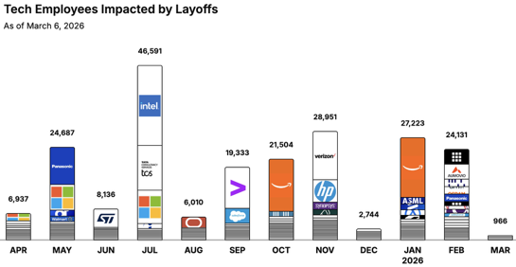
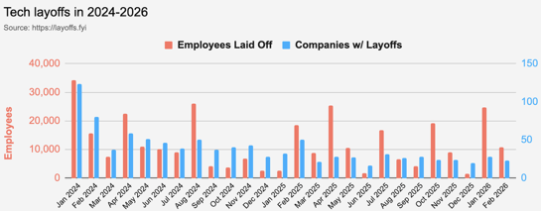
https://layoffs.fyi
https://trueup.io/layoffs
Jobs
The Tech Layoff Tracker
In 2026: 52,320 people laid off (805 per day)
In 2025: 245,953 people laid off (674 per day)
In 2024: 238,461 people laid off (653 per day)
https://trueup.io/layoffs
Tech Layoffs by year (US only):
36K in 2026 (as of March 6, 2026)
124K in 2025
153K in 2024
264K in 2023
165K in 2022 https://layoffs.fyi

Slide 35


About the Speaker
Lev Selector, Ph.D.
40+ years of software engineering, data science, and building teams (hiring, training, and managing)
Ph.D. in mathematical modeling and computer simulations
Interests:
Generative AI, Using LLM with your data
Local AI for Local Private Data
Cloud architecture, fin-tech, application security
Find/connect: Linkedin, GitHub, YouTube, Google
https://eais.ai
Enterprise AI Systems

Slide 36
Thank You!

