Slide 1

Semantic Segmentation for Autonomous Vehicles in Rural Environments
DEPARTMENT OF INFORMATION AND ELECTRICAL ENGINEERING AND APPLIED MATHEMATICS-UNISA
Machine Learning Project Work – A.Y. 2024/2025
Group 30 members:
  Infante Angelo
  Senatore Annachiara

Slide 2
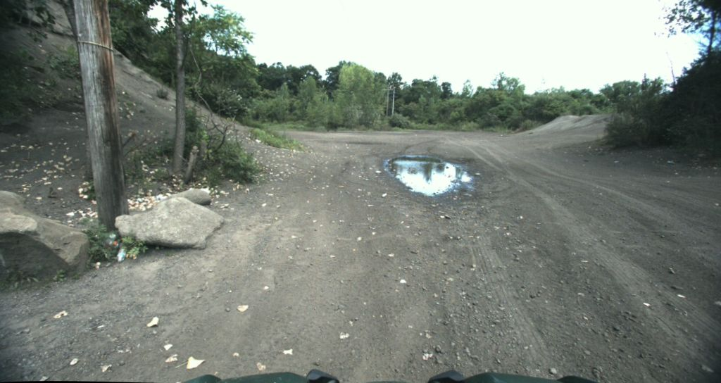
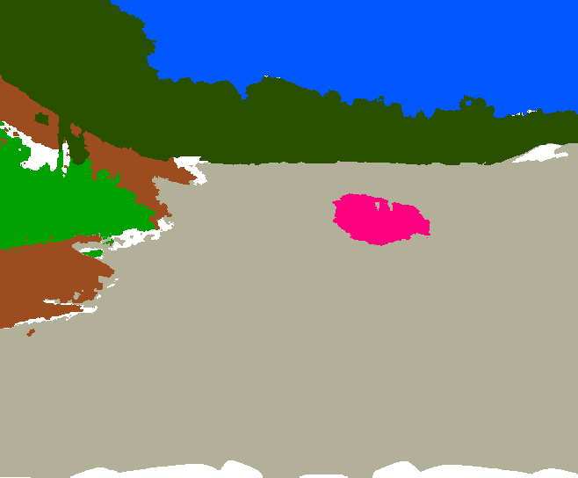
Project Goals
Perform semantic segmentation on RGB images;
Classify each pixel into 9 semantic categories;
Ensure real-time inference on resource-constrained devices;

Slide 3
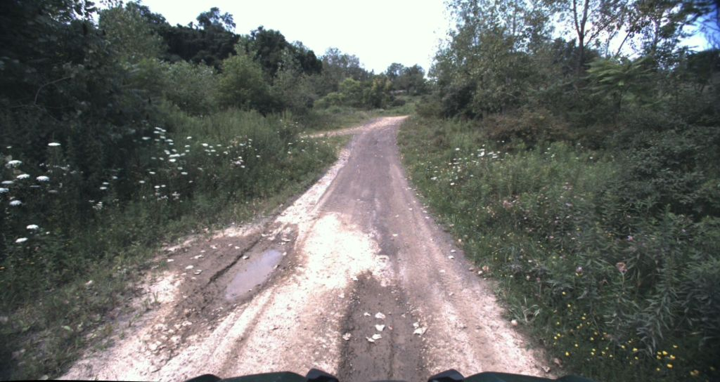
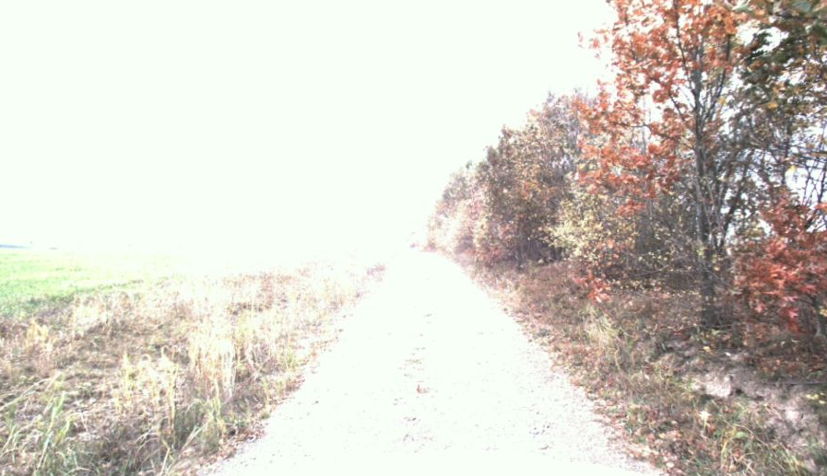

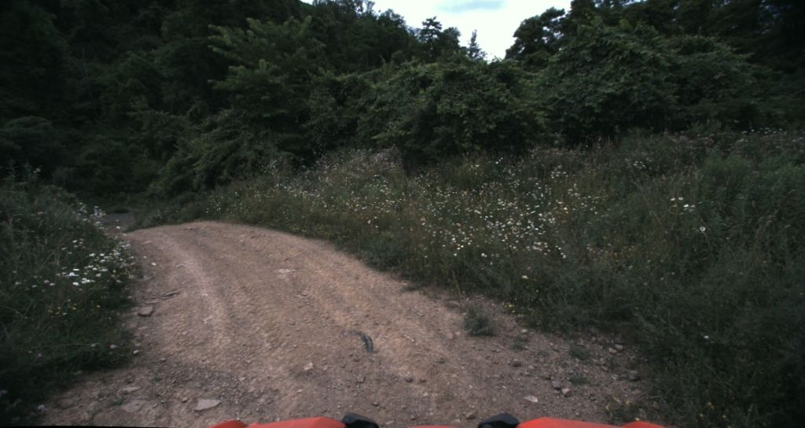
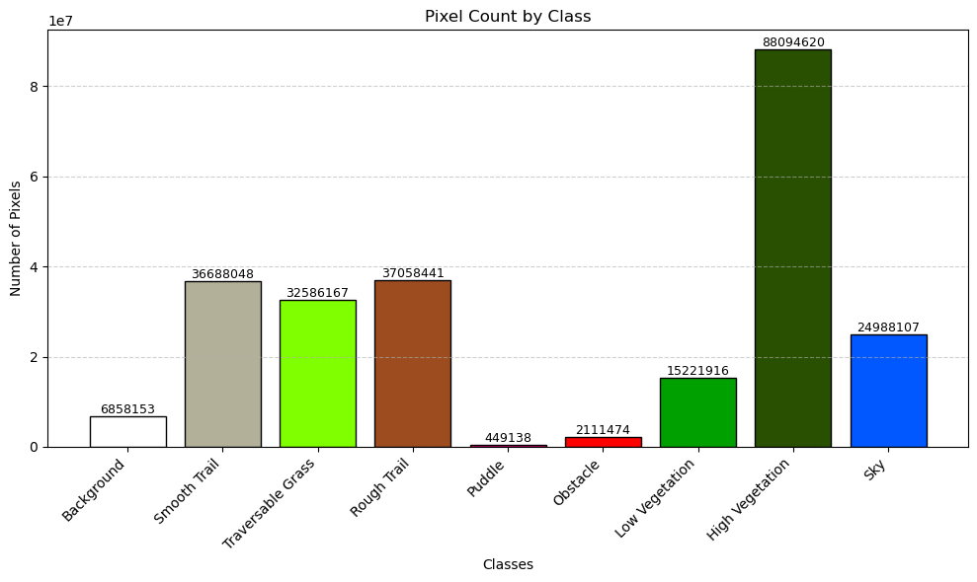
Dataset Description
The dataset is composed of 931 images;
The images are captured in rural environments under different conditions;
Data augmentation applied to balance class distribution;

Slide 4
Functional & Non-Functional Requirements
Functional Requirements
The system must perform semantic segmentation on RGB images.
Each pixel must be classified into one of 9 predefined semantic classes.
The output must be a segmentation mask with integer values from 0 to 8.
Non-Functional Requirements
The system must operate entirely within the Google Colab environment.
GPU memory usage must not exceed:
5 GB during training
4 GB during inference
The model must ensure real-time or near-real-time inference speed.
Constraints
The dataset is fixed: no external images allowed.
The entire pipeline must be transparent, explainable, and reproducible.
All code, training scripts, and model weights must be included in a single, self-contained Colab notebook.

Slide 5
DeepLabV3 + MobileNetV3 Large
Overview of the Architecture
The architecture is broadly divided into two main components:
Encoder: A series of convolutional blocks that progressively reduce the spatial dimension of the image, extracting compact latent representations.
Each block includes:
  2D Convolutions
  Batch Normalization
  ReLU Activation Function
  MaxPooling for Downsampling
Decoder: reconstructs the segmentation map from the latent representation, using:
  Transposed Convolution (deconvolution).
  Skip connections (optional) to improve spatial reconstruction.

Slide 6
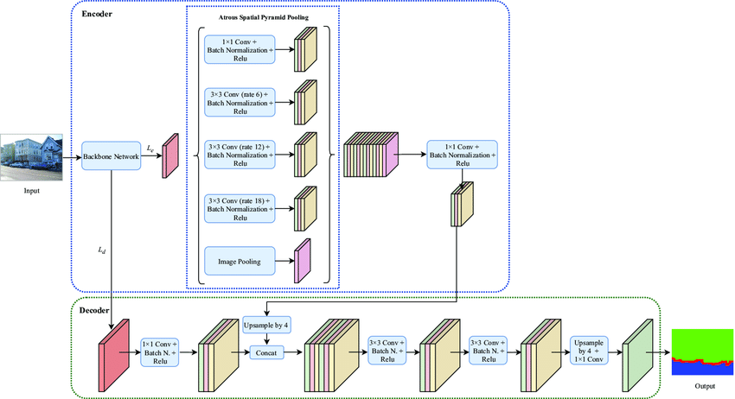

Main Components
Backbone: MobileNetV3 Large
Lightweight, optimized for edge devices
Pretrained on ImageNet for faster convergence
ASPP Module (Atrous Spatial Pyramid Pooling)
Captures multi-scale context using atrous convolutions
Handles objects of varying sizes
Decoder
Restores spatial resolution via upsampling
Combines low- and high-level features for better boundary accuracy
Advantages
Efficient memory usage
High accuracy with minimal computational cost

Slide 7
Data Preprocessing & Augmentation
All images resized to 512×512 for model compatibility.
Normalization using ImageNet statistics.
Data augmentation with Albumentations:
Random crop, flip, rotate, affine transforms
Brightness/contrast adjustment, blur, perspective
Augmentations applied only during training
Masks transformed synchronously to preserve alignment

Slide 8
Model Implementation
Implemented in PyTorch with modular, reusable components
Custom Dataset class handles loading, normalization, RGB-to-ID conversion
Model built using torchvision's DeepLabV3 + MobileNetV3
Training loop includes logging with TensorBoard
Predict function for single-image inference with optional resizing

Slide 9
Training Details
5-fold Cross-Validation: Employed for robust model evaluation and to ensure generalization ability.
Data Augmentation:
On-the-fly, applied during training to increase data variability, enhance generalization, and optimize storage.
Optimizer:
Adam, used with an initial learning rate of 0.001 for efficient and effective convergence.
Loss Function:
Combined loss of
0.7 × Dice Loss + 0.3 × Focal Loss
(with γ=2.0 for Focal Loss).
Hyperparameter
Batch Size: 8
Learning Rate: 1e-4
Number of Folds: 5
Number of Epochs: 20

Slide 10
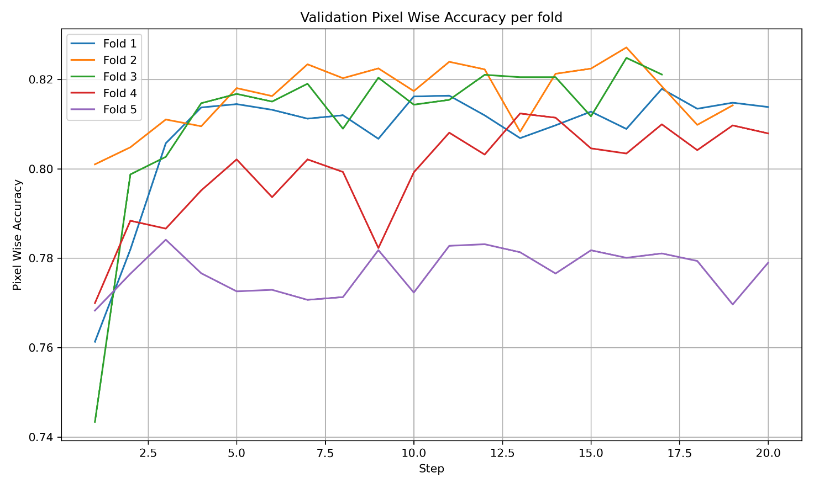
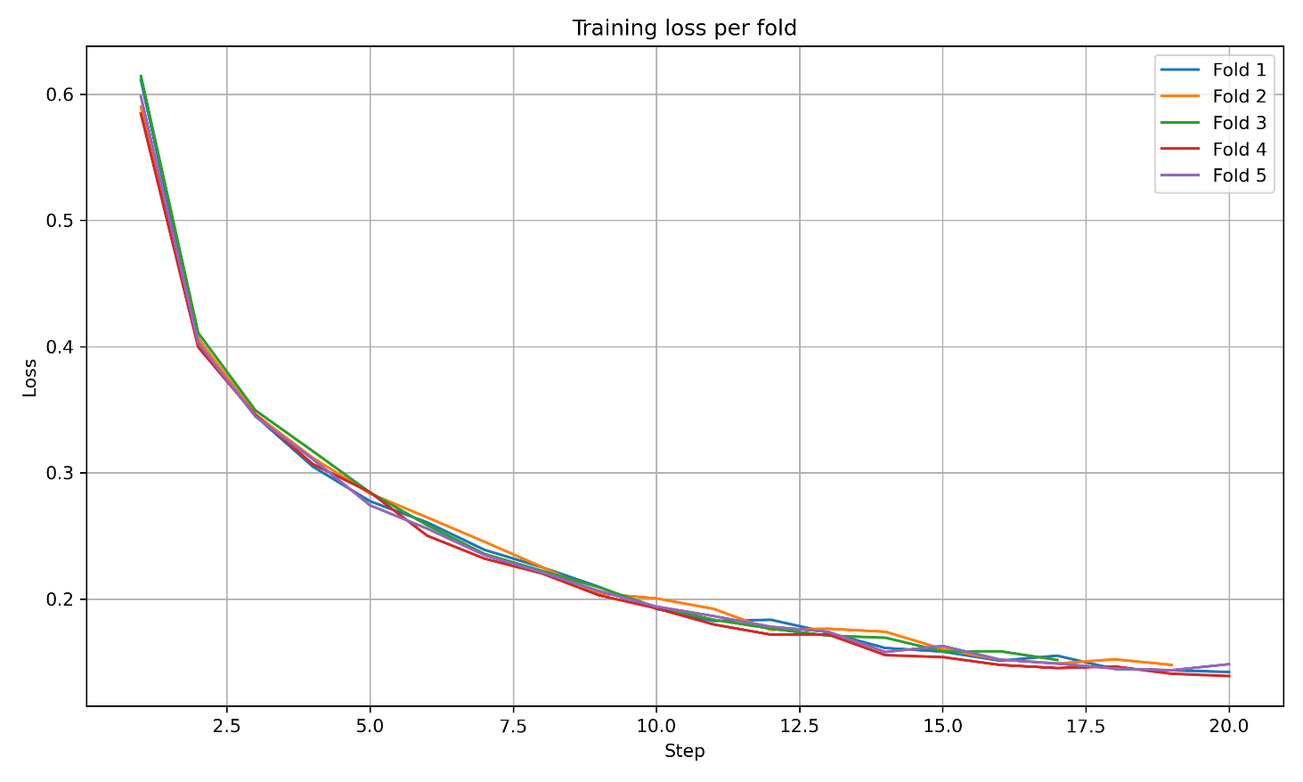
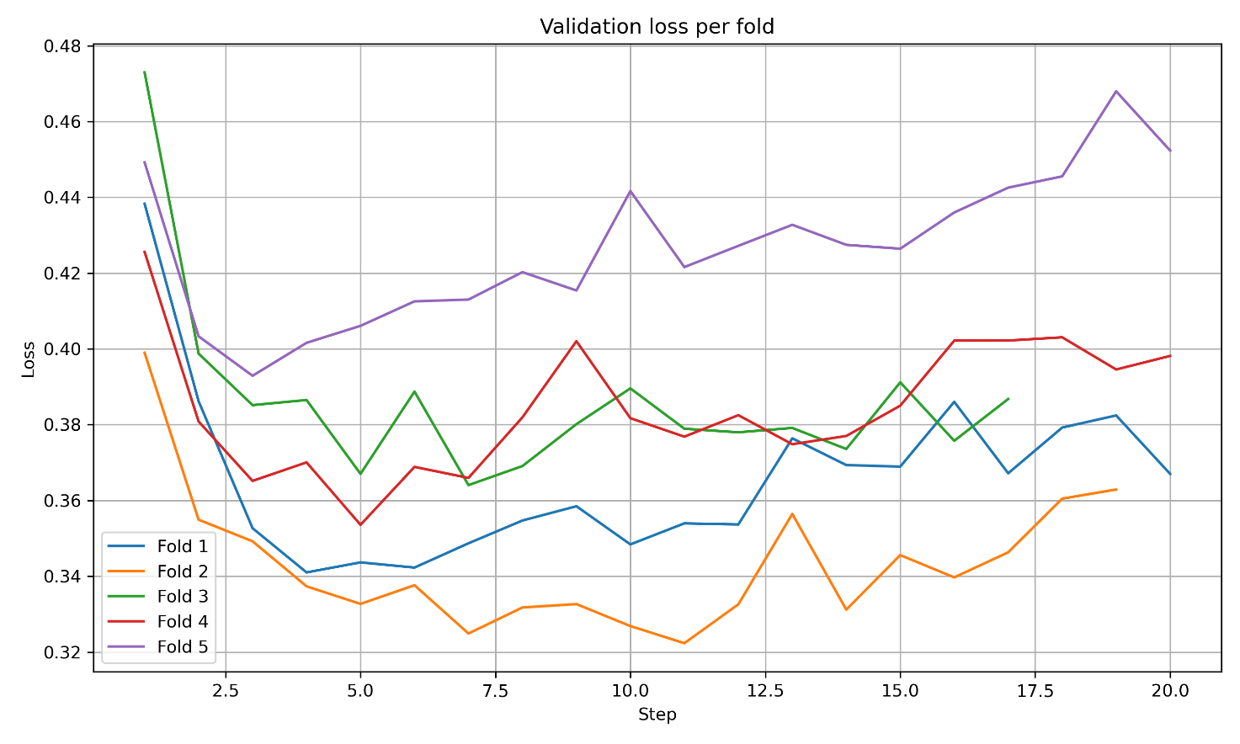
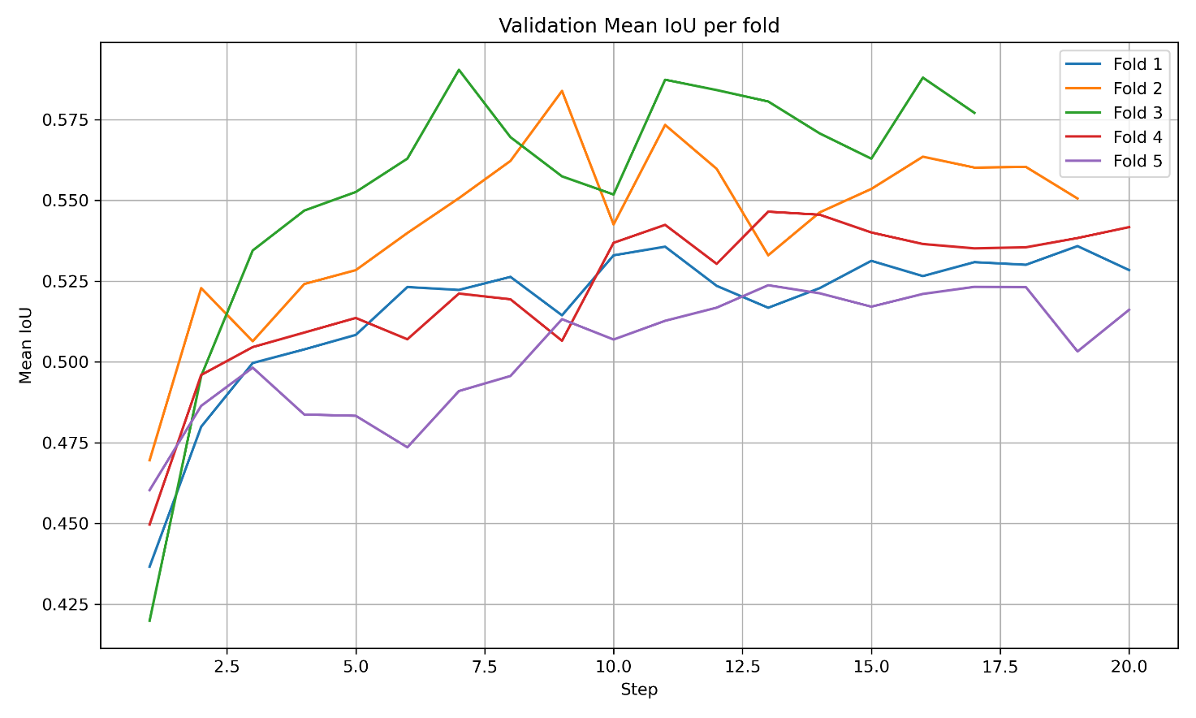
RESULTS
This are the results obtained from an example using cross-validation with the various choices, using 5 folds and 20 training epochs.
Validation Pixel Accuracy per fold
Training Loss per fold
Validation Loss per fold
Validation Mean Intersection over Union per fold
Intersection over Union (IoU) : 0.58

Slide 11
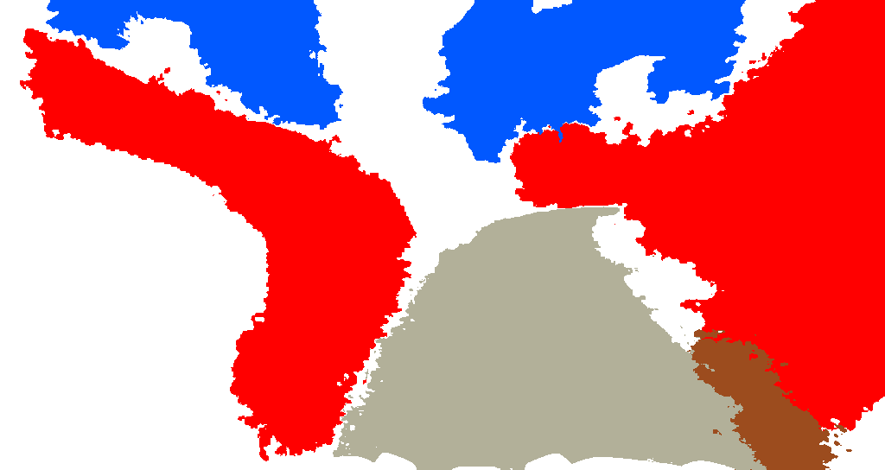
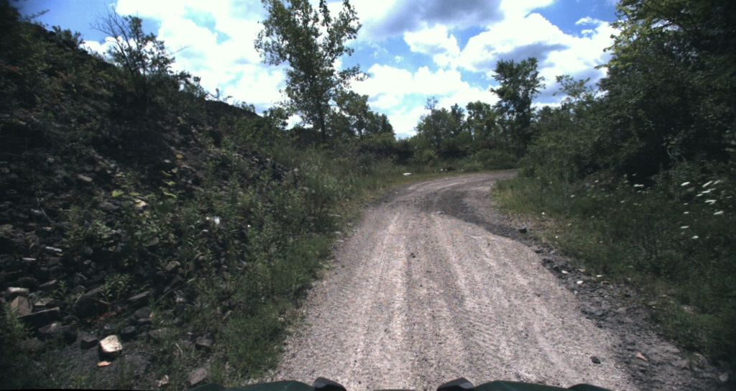
Project Summary & Key Findings
The average Intersection over Union (IoU), which remained stable around 0.55, confirms the validity of the approach in terms of reproducibility and reliability.
Noted that:
  By eliminating 63 bad samples and then training the model with 868 starting samples, the performance relative to the average IoU on validation settled around 0.6, showing a slight improvement.

Slide 12
THANK YOU
FOR THE ATTENTION

