Slide 1
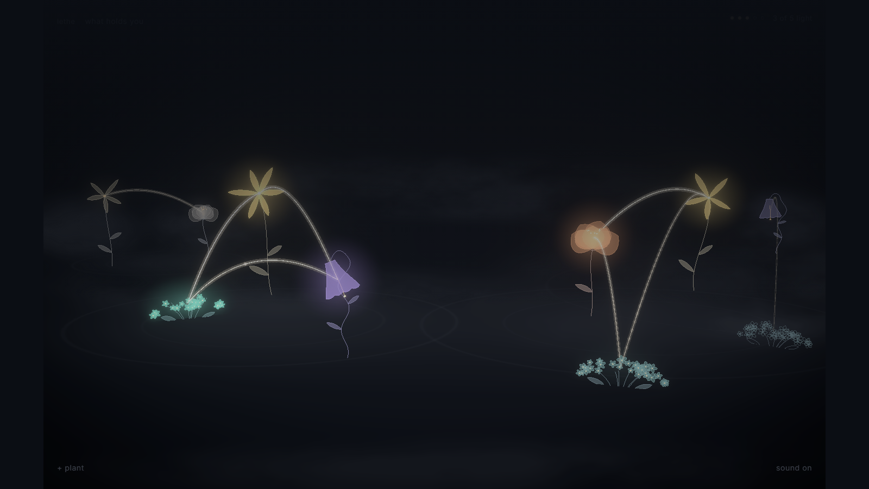
a garden that forgets
lethe
a life becomes a garden
what would you choose to keep in bloom?
Notes:
0:00–0:15 A life becomes a garden
I built Lethe: a garden where memories become flowers.
Stand still for the opening. Look at the audience. Let the picture settle before speaking.
Source: Lethe project reference captures in docs/presentation/assets/garden.png. The example life is fictional. Verify the actual episode outcome before presenting.

Slide 2

a moment for the room
hold one memory
in your mind
you can keep it to yourself.
what kind of fragment is it?
a sentence
a song
a place
a photograph
someone’s voice. a familiar room. one ordinary moment.
Notes:
0:15–0:30 A memory of your own
Think of one memory. Keep it to yourself. Is it a sentence, a song, a place, or a photograph?
Leave five seconds for thought. Choose a kind if someone volunteers one. Never ask for a personal story.

Slide 3
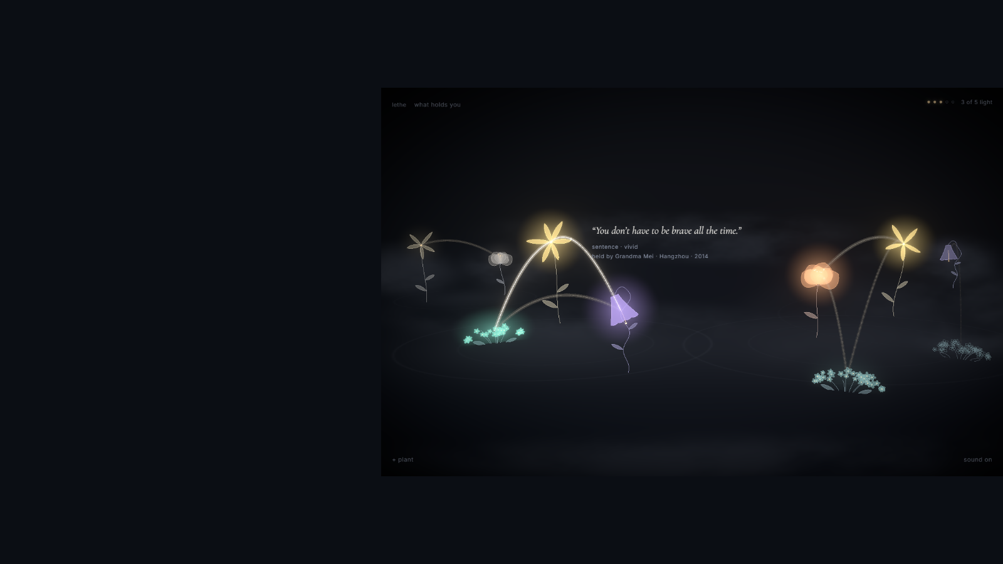
one fictional life
her words
“You don’t have
to be brave all the
time.”
grandma mei’s kitchen.
the music she played.
different moments, one person.
Notes:
0:30–0:50 Grandma Mei’s words
In this fictional life, Grandma Mei said, “You don’t have to be brave all the time.” Her kitchen and music share the same person, so threads join them.
Read the quote warmly. Pause. Move your gaze from the flower to the audience rather than reading every label.
Source: Lethe project reference captures in docs/presentation/assets/memory.png. The example life is fictional. Verify the actual episode outcome before presenting.

Slide 4

a choice for the audience
one light.
where would you place it?
raise a hand for the memory you would tend.
grandma mei’s words
the library rooftop
care travels to memories connected to her
a place that matters on its own
both choices belong to the same life.
we’ll take your choice into the living garden.
Notes:
0:50–1:10 One light and your choice
One light remains. Grandma Mei’s words, or the library rooftop? Raise a hand. Let’s take your choice into the garden.
Ask for raised hands once, then stop talking. Carry the room's choice into the live garden. Either answer is meaningful. If the room stays quiet, choose Grandma Mei and proceed.

Slide 5
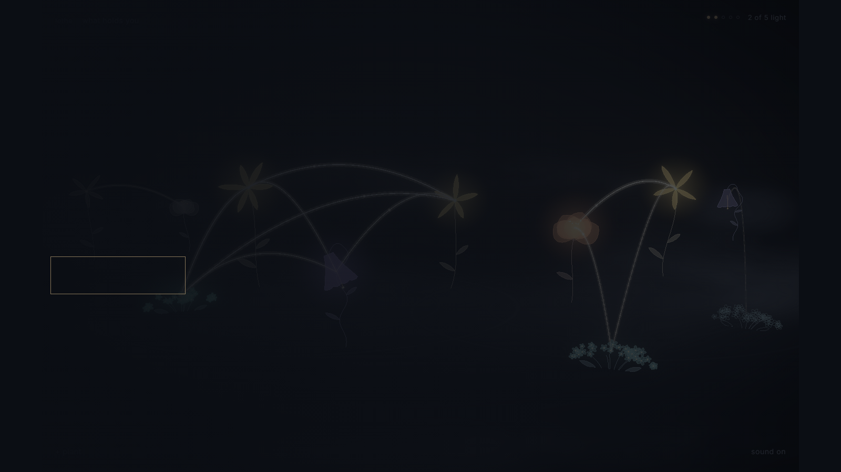
the audience’s choice, in the game
the living garden
choose what to tend.
plant a fragment. let a season pass.
open the garden
recording fallback
the live game uses its real rules. the recorded route is a fallback.
Notes:
1:10–2:10 The living garden
Watch where the care travels. I’ll plant a fragment, then let a season pass.
Click open the garden. Switch back to PowerPoint after the live visit. Allow 90 seconds in the showcase or 60 seconds in the three-minute cut. Open your local recording separately if needed, and explain that its route follows a fixed choice.
Source: Lethe project reference captures in docs/presentation/assets/first-thread.png. The example life is fictional. Verify the actual episode outcome before presenting.

Slide 6
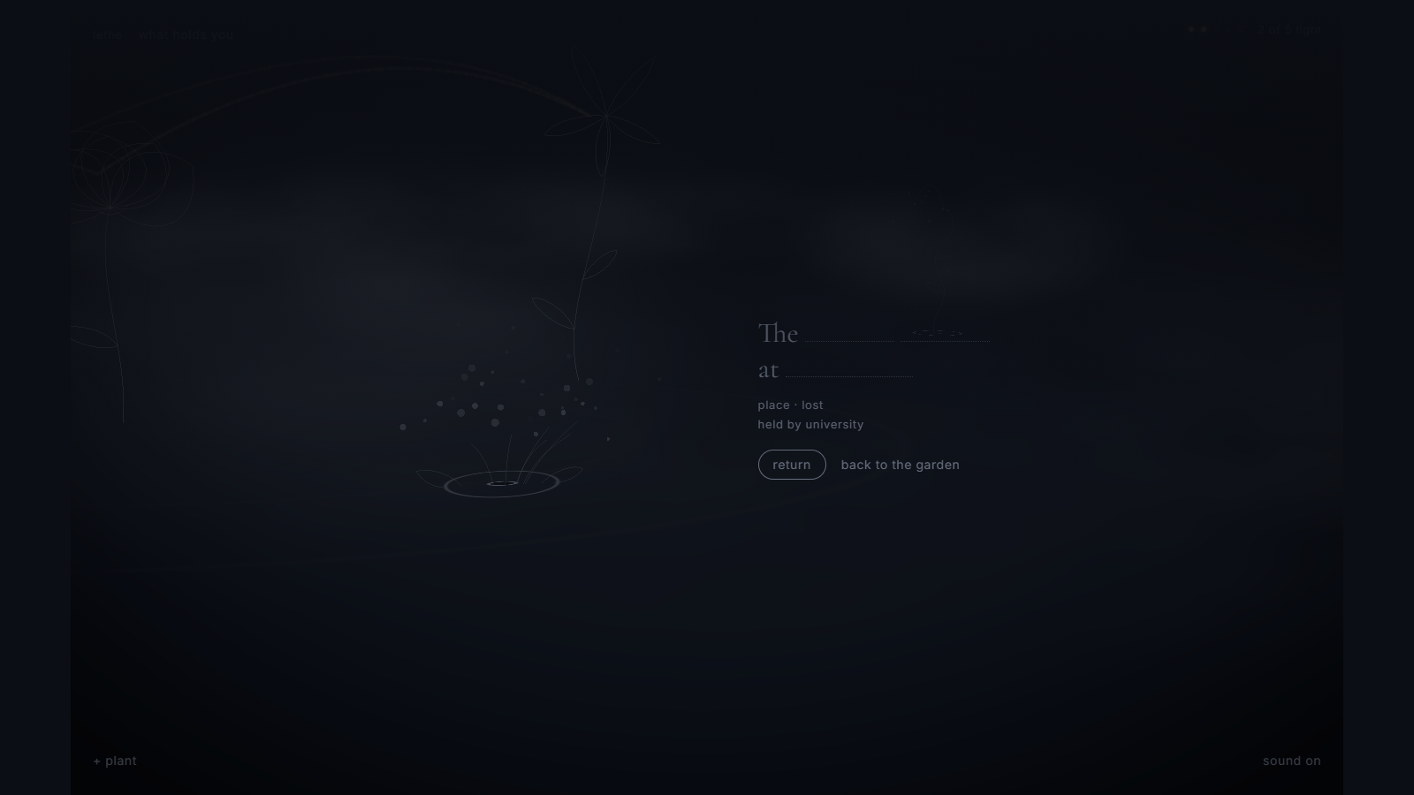
a pause, rather than a verdict
a seed remains
the words remain.
we can return to them.
for now, this space is quiet.
let this moment breathe
Notes:
2:10–2:25 The quiet space
A seed remains. Its words are still there. We can return later. For now, leave this space quiet.
Hold four seconds of silence. If the room kept the rooftop alive, discuss another actual lost seed or loss in general. Do not claim their rooftop disappeared.
Source: Lethe project reference captures in docs/presentation/assets/loss.png. The example life is fictional. Verify the actual episode outcome before presenting.

Slide 7
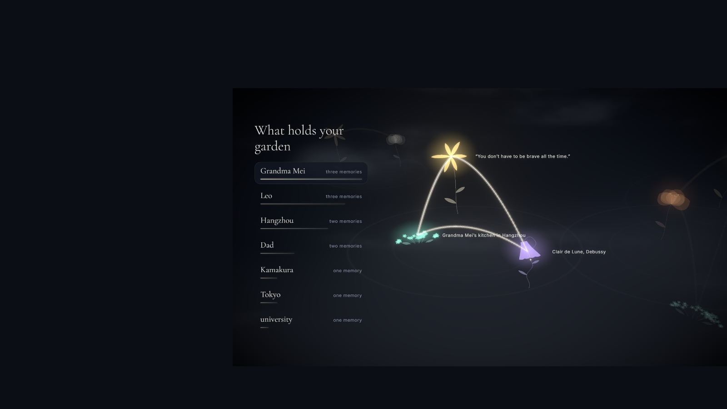
the world becomes a portrait
what holds
this life
people and places emerge
from the memories that remain.
reveal the relationships
grandma mei
leo
hangzhou
Notes:
2:25–2:45 What holds this life
The garden reveals the people and places holding this life together. A different choice can leave a different shape.
Click once to reveal the relationship names after the picture settles. Keep your voice quieter than at the opening.
Source: Lethe project reference captures in docs/presentation/assets/reveal.png. The example life is fictional. Verify the actual episode outcome before presenting.

Slide 8
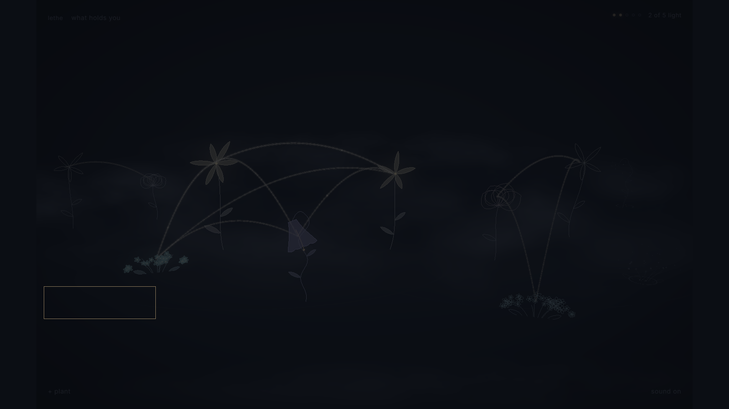
return to the memory you imagined
you cannot keep every
moment in bloom
what you tend gives the garden its shape
what would your garden carry?
plant a memory
if this stayed with you, plant a memory of your own.
lethe-nine.vercel.app
Notes:
2:45–3:00 What will you carry
You cannot keep every moment in bloom. What you tend gives the garden its shape. Try Lethe, and plant a memory of your own.
End on the audience’s own imagined memory. Say the invitation once. Hold the final view.
Source: Lethe project reference captures in docs/presentation/assets/dusk.png. The example life is fictional. Verify the actual episode outcome before presenting.
Invite the audience to try Lethe at the site link on the slide.

