Slide 1
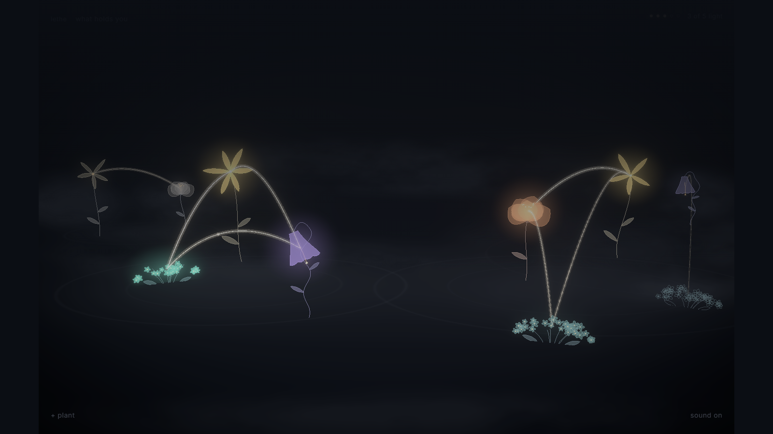
a garden that forgets
lethe
a life becomes a garden
what would you choose to keep in bloom?
Notes:
0:00–0:15 A life becomes a garden
Before I show you the garden, I want to give you a place in it. Lethe turns the fragments of a life into flowers and relationships.
Stand still for the opening. Look at the audience. Let the picture settle before speaking.
Source: Lethe project reference captures in docs/presentation/assets/garden.png. The example life is fictional. Verify the actual episode outcome before presenting.

Slide 2

a moment for the room
hold one memory
in your mind
you can keep it to yourself.
what kind of fragment is it?
a sentence
a song
a place
a photograph
someone’s voice. a familiar room. one ordinary moment.
Notes:
0:15–0:40 A memory of your own
Take a moment to think of a memory. You can keep it private. Perhaps it is something someone said, or a place you can still walk through in your mind. What kind of fragment is it? Keep that moment with you while we explore.
Leave five seconds for thought. Choose a kind if someone volunteers one. Never ask for a personal story.

Slide 3
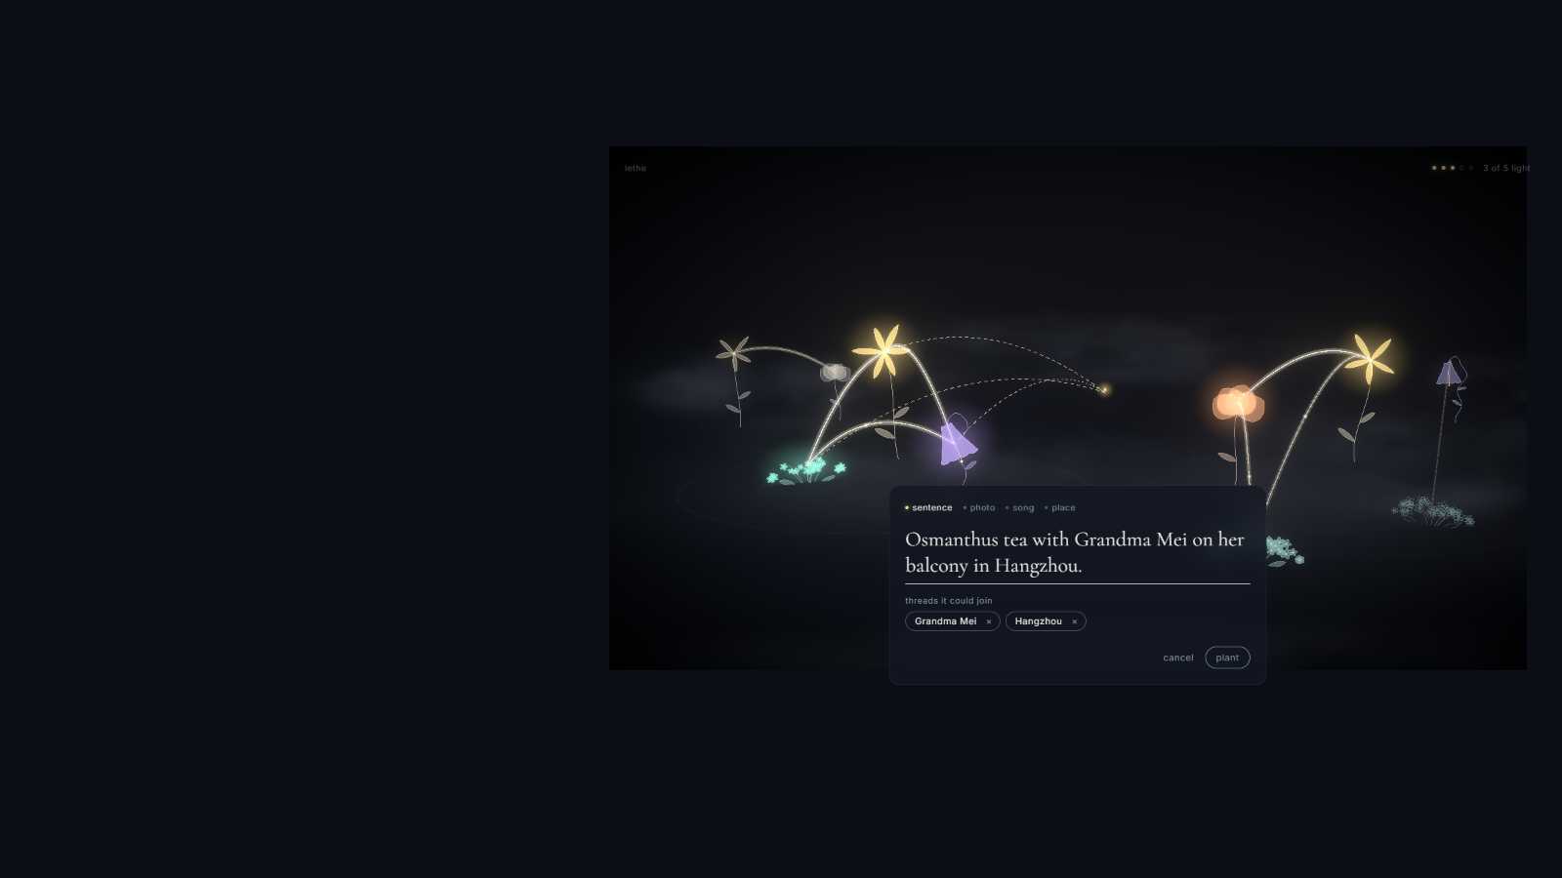
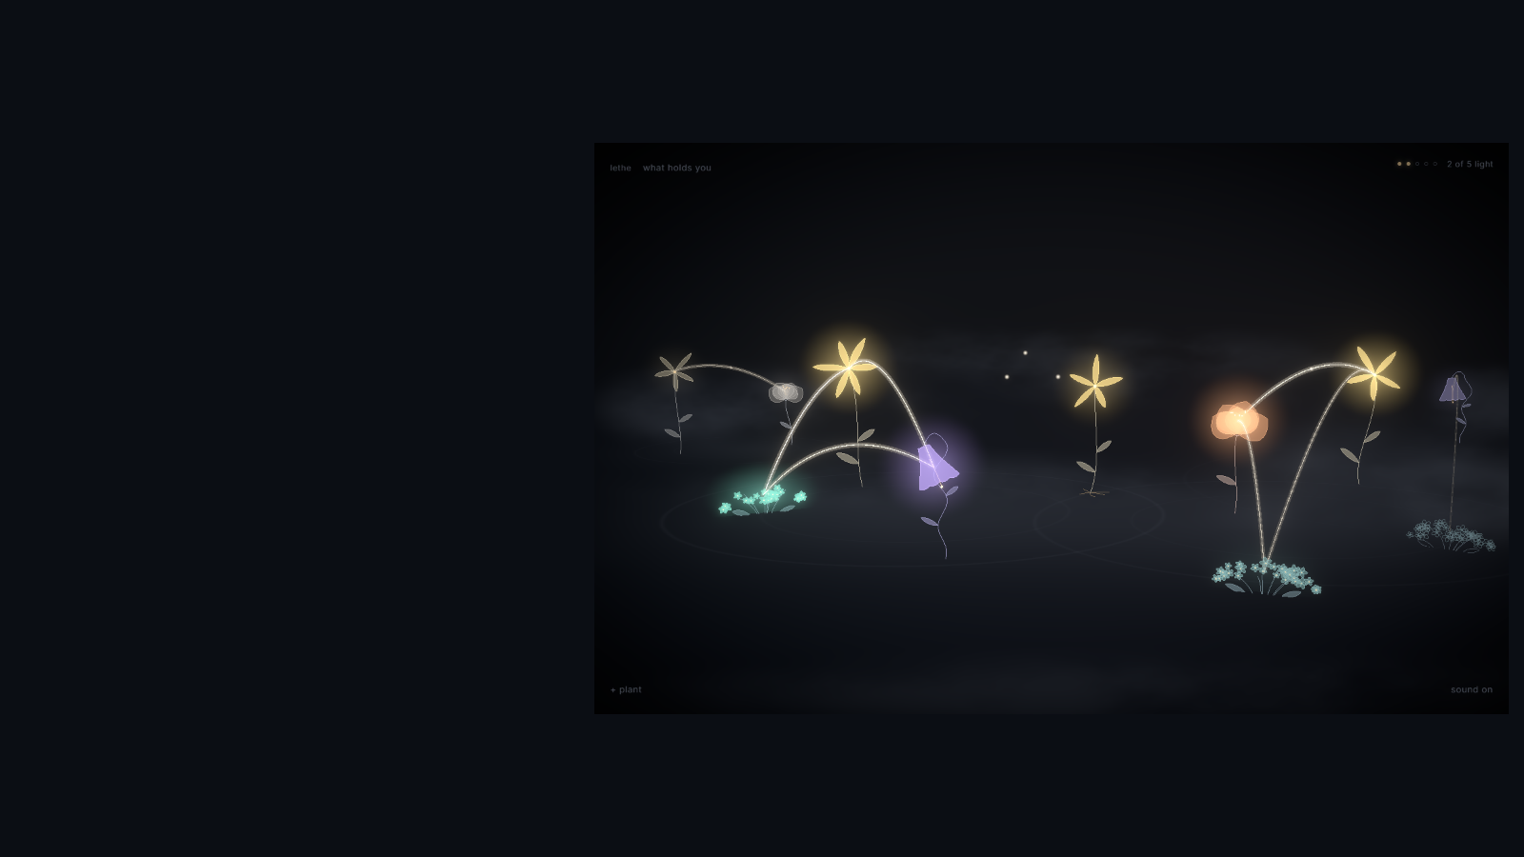
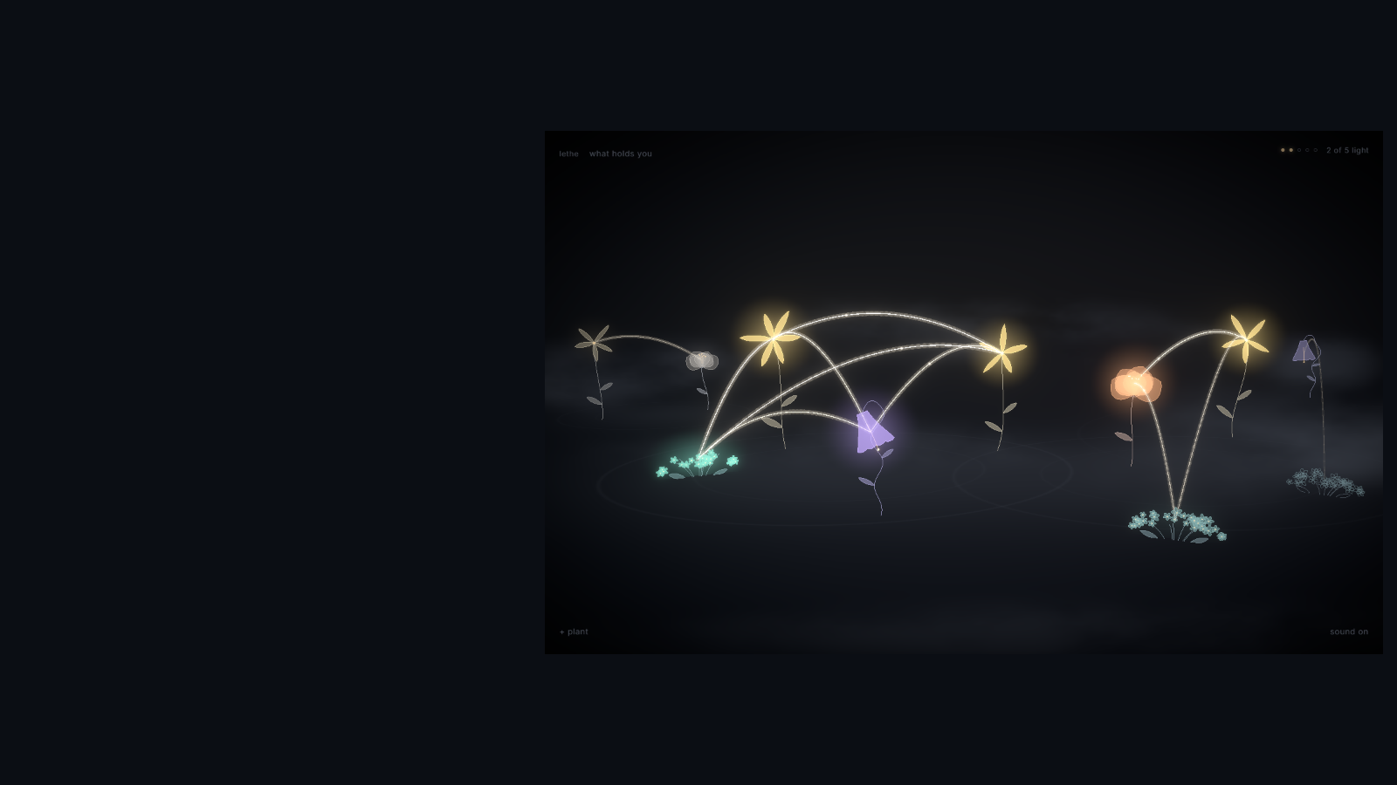
a memory becomes a place
a fragment
takes root
the words become a flower.
its connections become part of the
world.
a seed, a flower, a first thread
a waiting seed, with the threads it could join
Notes:
0:40–1:05 A fragment takes root
A memory begins as a seed. Its words become a flower, with a shape that belongs to that memory. When it opens, it can find other moments that share a person or a place. Growing the world begins with one fragment.
Click once to reveal the bloom. Pause. Click again to reveal its first thread. Then advance to the next slide. These captures preview the actual game.
Source: Lethe project reference captures in docs/presentation/assets/planting.png, bloom.png, first-thread.png. The example life is fictional. Verify the actual episode outcome before presenting.

Slide 4
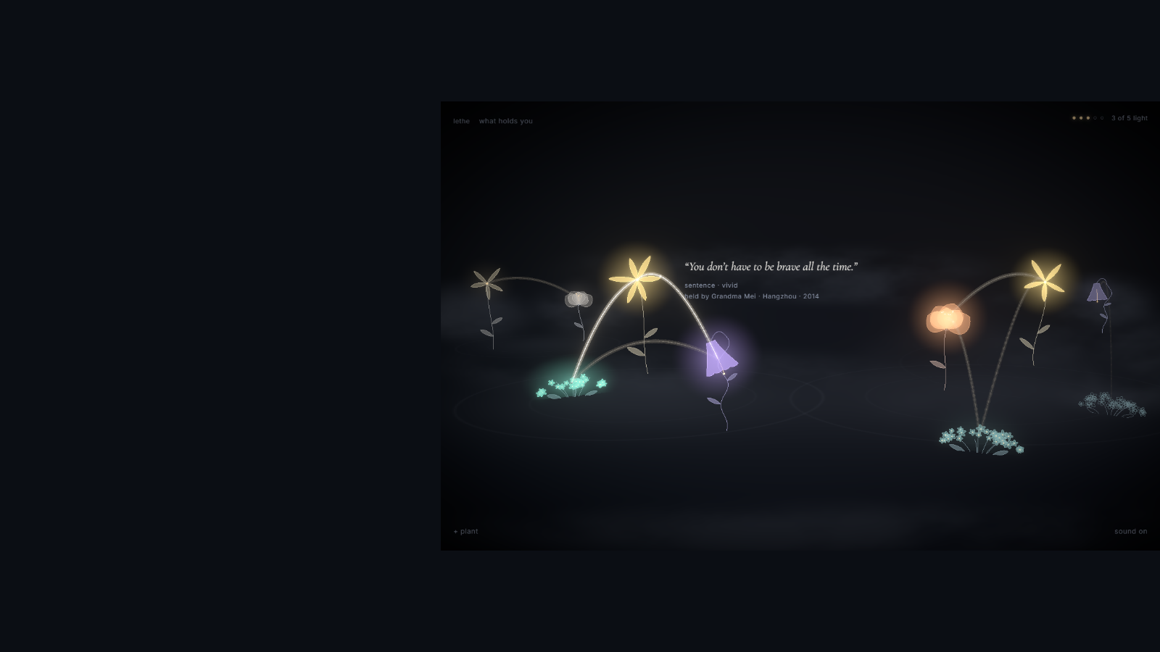
one fictional life
her words
“You don’t have
to be brave all the
time.”
grandma mei’s kitchen.
the music she played.
different moments, one person.
Notes:
1:05–1:40 Grandma Mei’s words
Here is one fragment from the fictional example life. Grandma Mei said, “You don’t have to be brave all the time.” A kitchen, a song, and these words might live in separate places on a phone. In this garden, you can see what they share. You can see Grandma Mei across them.
Read the quote warmly. Pause. Move your gaze from the flower to the audience rather than reading every label.
Source: Lethe project reference captures in docs/presentation/assets/memory.png. The example life is fictional. Verify the actual episode outcome before presenting.

Slide 5
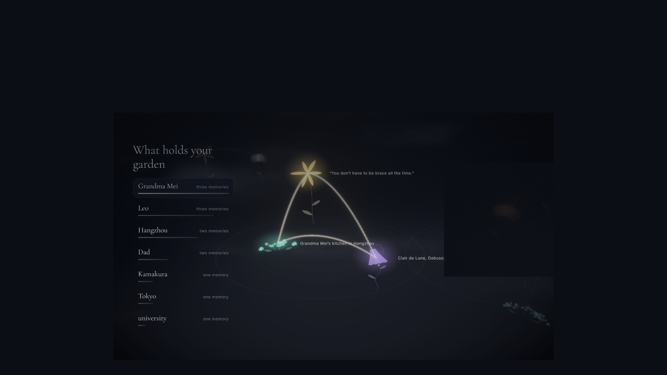
relationships become visible
what the fragments share
care follows these threads
her words, her
kitchen, and her
music share grandma
mei
Notes:
1:40–2:05 What the fragments share
These threads make relationships visible. Shared people and places help memories hold each other up. Tending one sends some of that care to its neighbors. A new memory can strengthen a connection that was already part of the life.
Click once to reveal the explanation. Point to the actual thread. Speak about shared names, not physical closeness.
Source: Lethe project reference captures in docs/presentation/assets/reveal.png. The example life is fictional. Verify the actual episode outcome before presenting.

Slide 6

a choice for the audience
one light.
where would you place it?
raise a hand for the memory you would tend.
grandma mei’s words
the library rooftop
care travels to memories connected to her
a place that matters on its own
both choices belong to the same life.
we’ll take your choice into the living garden.
Notes:
2:05–2:35 One light and your choice
There is one light left in this episode. Would you tend Grandma Mei’s words, letting care reach her connected memories? Or would you tend the library rooftop, a place that matters on its own? Raise a hand for the one you would choose. I will carry your choice into the garden.
Ask for raised hands once, then stop talking. Carry the room's choice into the live garden. Either answer is meaningful. If the room stays quiet, choose Grandma Mei and proceed.

Slide 7
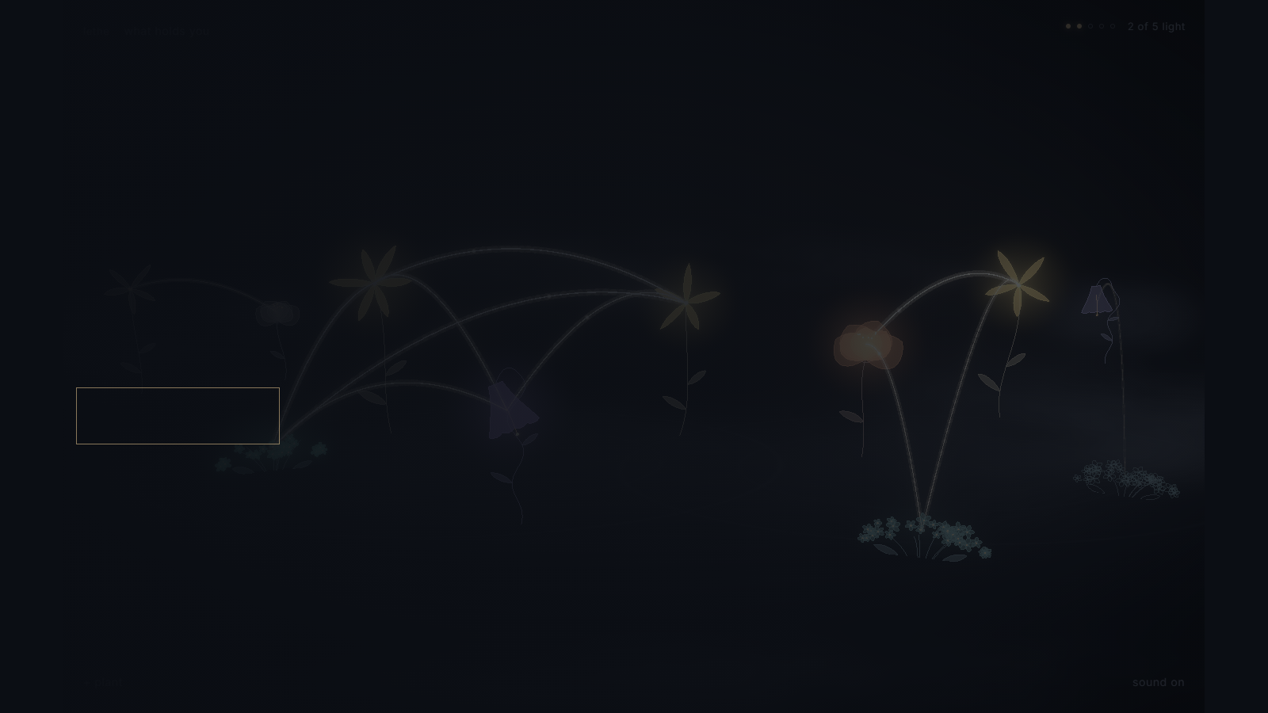
the audience’s choice, in the game
the living garden
choose what to tend.
plant a fragment. let a season pass.
open the garden
recording fallback
the live game uses its real rules. the recorded route is a fallback.
Notes:
2:35–4:05 The living garden
Let’s see what that choice does. I will tend the memory you chose, plant a related fragment, and let a season pass. Watch the light reach its neighbors. Then watch the garden change.
Click open the garden. Switch back to PowerPoint after the live visit. Allow 90 seconds in the showcase or 60 seconds in the three-minute cut. Open your local recording separately if needed, and explain that its route follows a fixed choice.
Source: Lethe project reference captures in docs/presentation/assets/first-thread.png. The example life is fictional. Verify the actual episode outcome before presenting.

Slide 8

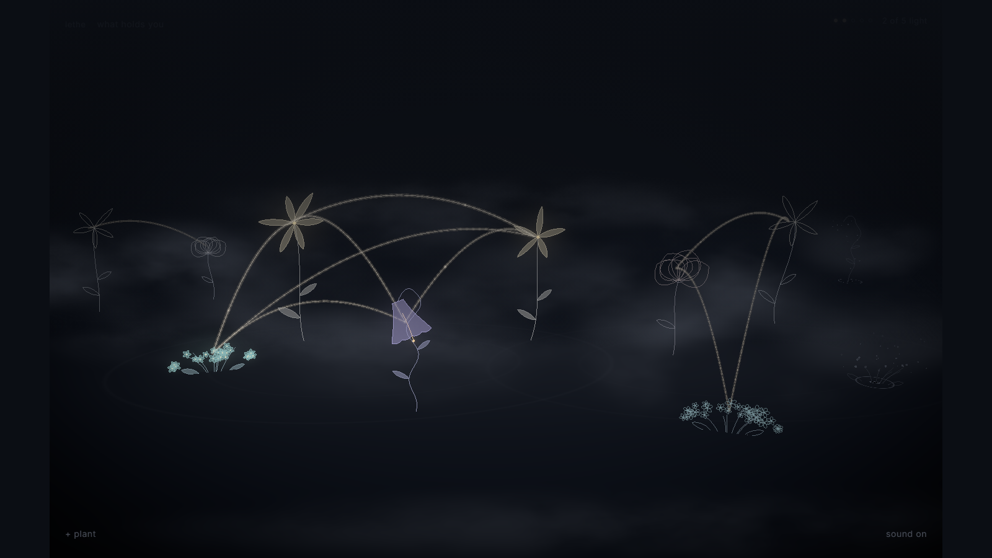
attention has consequences
a season passes
some moments keep their color.
others settle into dusk.
let dusk settle
Notes:
4:05–4:30 A season passes
The garden changes. Some flowers keep their color. Some become outlines. Care and connection affect what remains, and the spaces that grow quiet become part of the world too.
Click once for the three-second dusk reveal. Describe the actual outcome from the garden. This comparison illustrates the reference garden, rather than simulating the audience choice.
Source: Lethe project reference captures in docs/presentation/assets/garden.png, dusk.png. The example life is fictional. Verify the actual episode outcome before presenting.

Slide 9
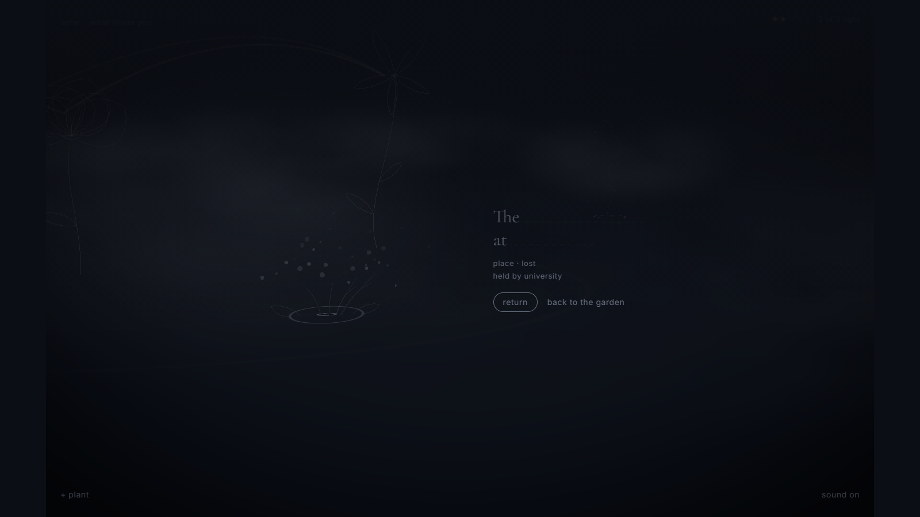
a pause, rather than a verdict
a seed remains
the words remain.
we can return to them.
for now, this space is quiet.
let this moment breathe
Notes:
4:30–4:45 The quiet space
A lost flower leaves a seed. Its original words remain, and we can return to it. For now, I leave the space quiet.
Hold four seconds of silence. If the room kept the rooftop alive, discuss another actual lost seed or loss in general. Do not claim their rooftop disappeared.
Source: Lethe project reference captures in docs/presentation/assets/loss.png. The example life is fictional. Verify the actual episode outcome before presenting.

Slide 10
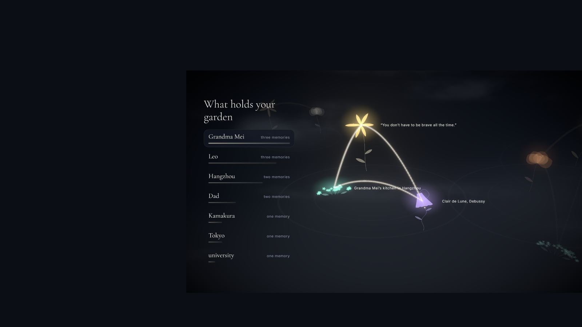
the world becomes a portrait
what holds
this life
people and places emerge
from the memories that remain.
reveal the relationships
grandma mei
leo
hangzhou
Notes:
4:45–5:10 What holds this life
When the camera rises, the world becomes a portrait. You can see the people and places that hold the memories together. Another person might care for different moments. Their attention would give this same life another shape.
Click once to reveal the relationship names after the picture settles. Keep your voice quieter than at the opening.
Source: Lethe project reference captures in docs/presentation/assets/reveal.png. The example life is fictional. Verify the actual episode outcome before presenting.

Slide 11
beyond the fictional garden
a world you can
make your own
plant your own memories and discover their connections.
each flower grows from a stable identity
shared people and places create relationships
your personal garden lives in this browser
planting works with local tagging. an optional provider can receive memory text and known entity names to improve suggestions.
Notes:
5:10–5:35 A world you can make your own
The example life is fictional. You can plant your own memories too. Flowers keep a stable identity, and shared names form relationships. Your personal garden lives in this browser. Planting works with local tagging, with an optional provider for better suggestions.
Keep this brief. Answer implementation questions afterward. Do not claim provider-enabled tagging keeps every word on the device.

Slide 12
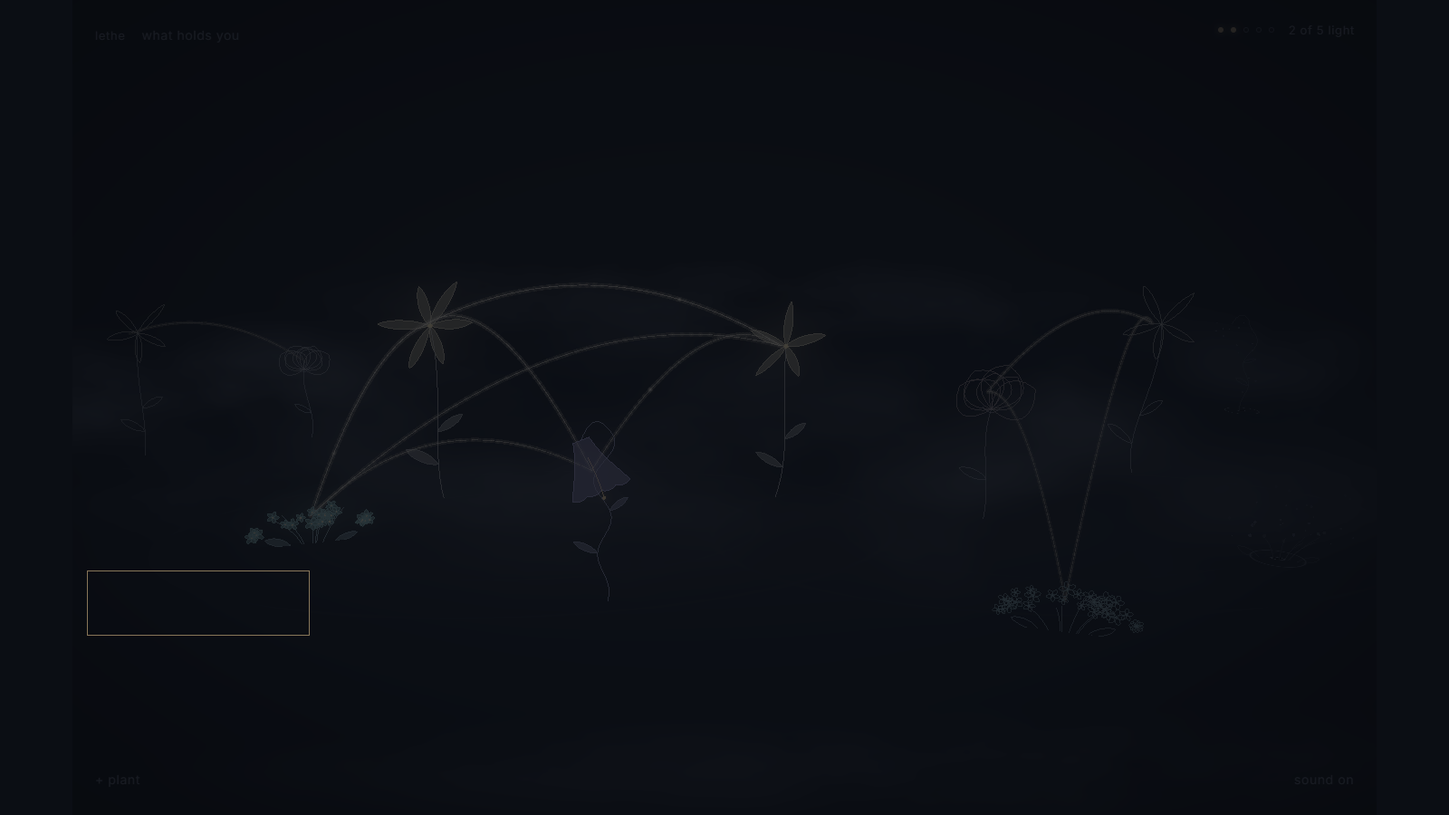
return to the memory you imagined
you cannot keep every
moment in bloom
what you tend gives the garden its shape
what would your garden carry?
plant a memory
if this stayed with you, plant a memory of your own.
lethe-nine.vercel.app
Notes:
5:35–6:00 What will you carry
Return to the memory you imagined at the beginning. What would you grow around it? You cannot keep every moment in bloom. What you tend gives the garden its shape. Try Lethe. If it stays with you, plant a memory of your own.
End on the audience’s own imagined memory. Say the invitation once. Hold the final view.
Source: Lethe project reference captures in docs/presentation/assets/dusk.png. The example life is fictional. Verify the actual episode outcome before presenting.
Invite the audience to try Lethe at the site link on the slide.

