Slide 1
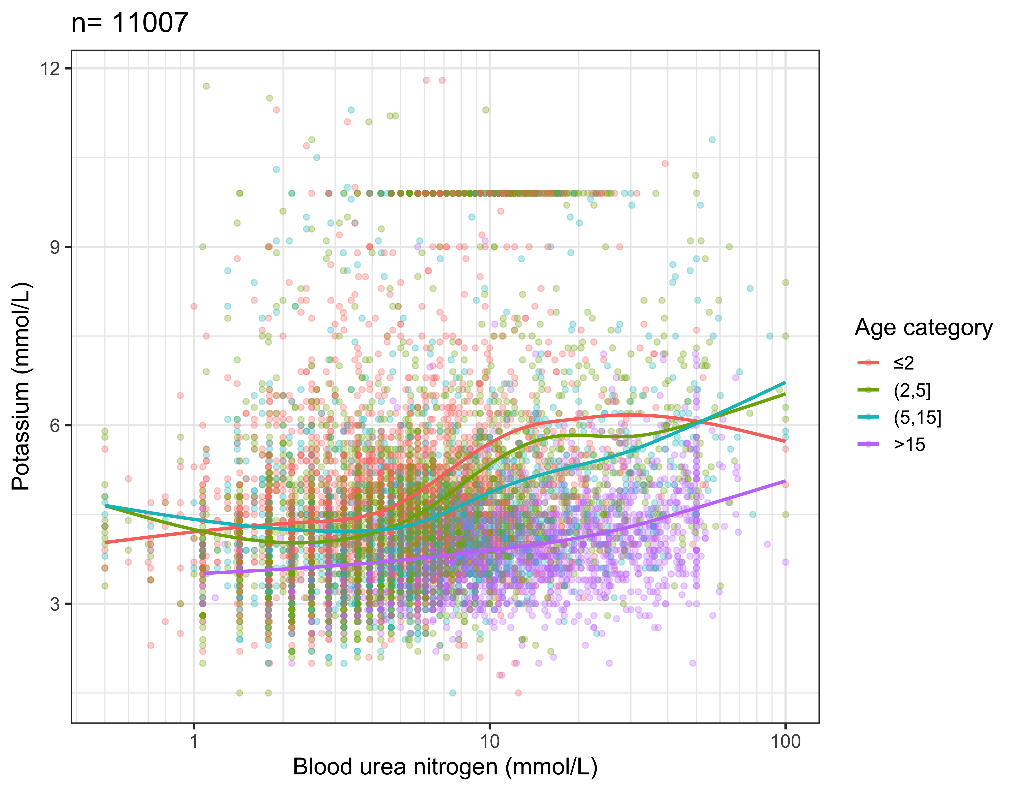
These data were collected in:
AQUAMAT
SEAQUAMAT
TRACT
FEAST
Adults in Vietnam

Slide 2
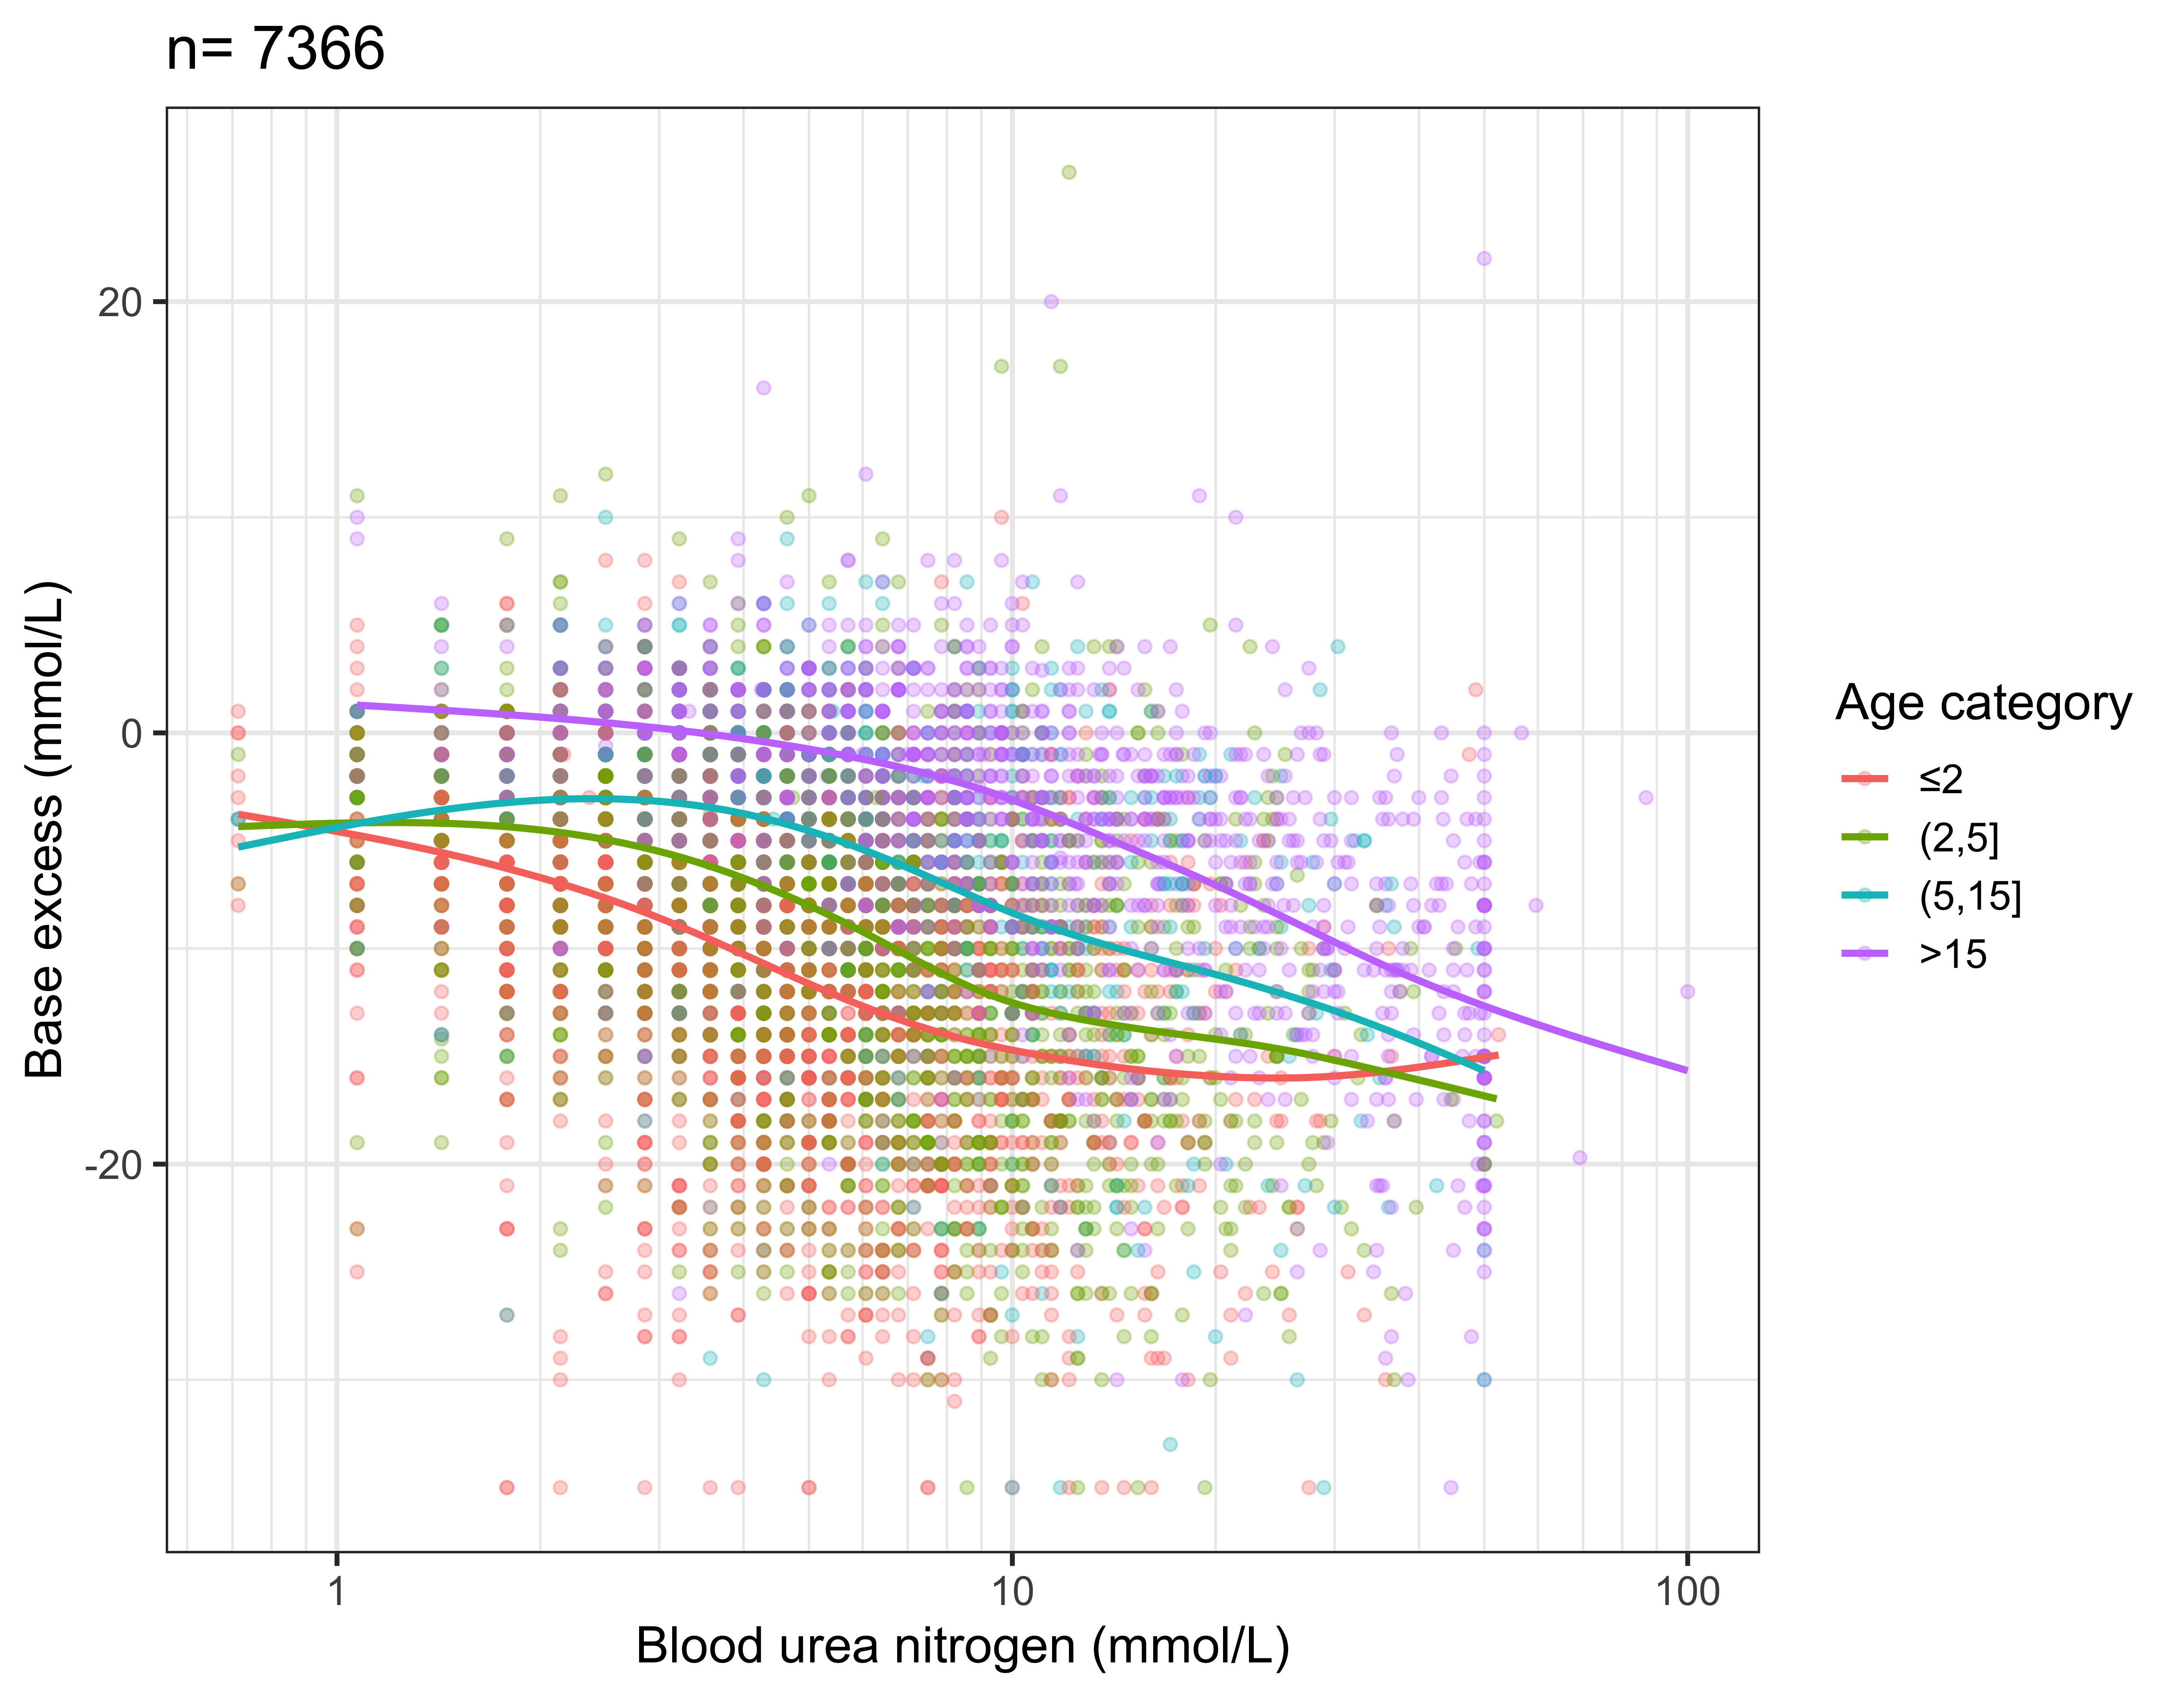
These data were collected in:
AQUAMAT
SEAQUAMAT
FEAST

Slide 3
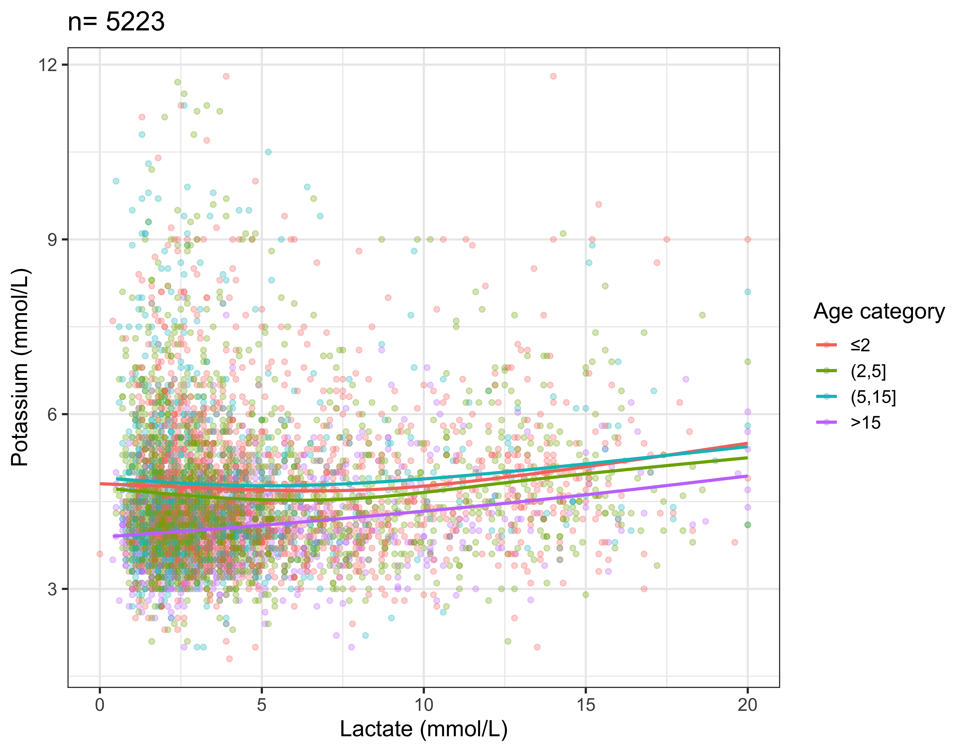
These data were collected in:
TRACT
FEAST
Ugandan studies
Vietnam adults

Slide 4
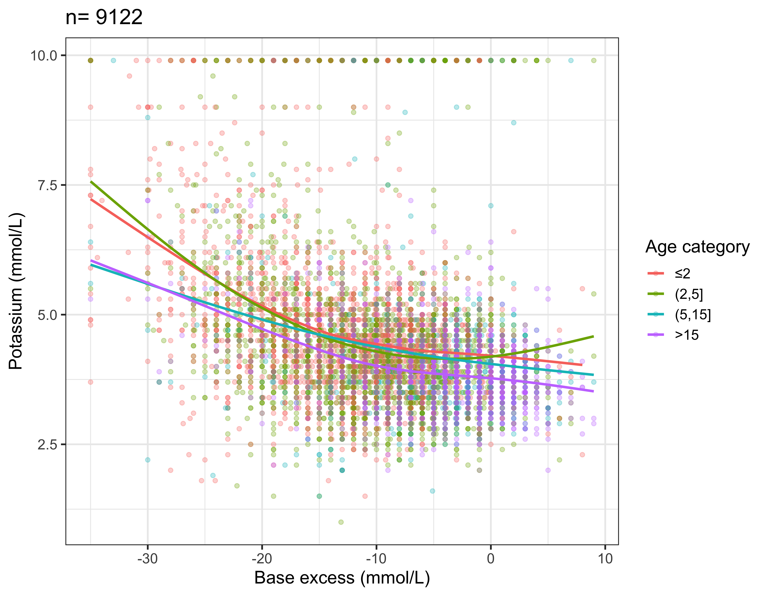
These data were collected in:
AQUAMAT
SEAQUAMAR
FEAST
KEMRI Cohort
Ugandan studies

