Slide 1
What are we trying to do
We aim to standardise definitions of renal impairment for adults and children by comparing the prognostic values of specific absolute thresholds in a large pooled database of over 15,000 children and adults recruited into prospective studies of severe malaria.

Slide 3
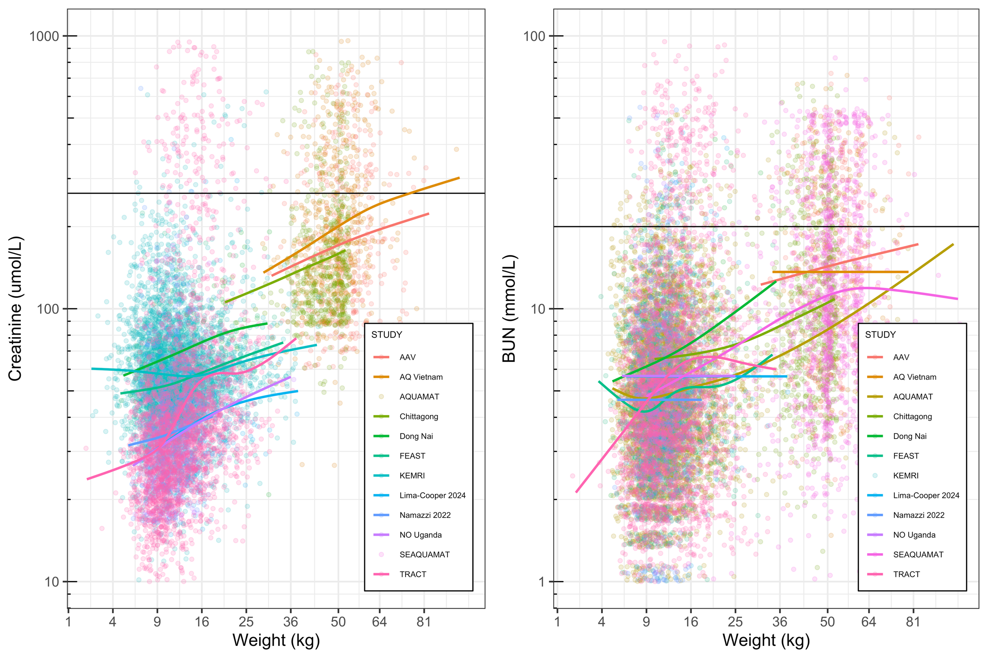
AQUAMAT & SEAQUAMAT did not measure creatinine
KEMRI cohort did not measure BUN

Slide 4
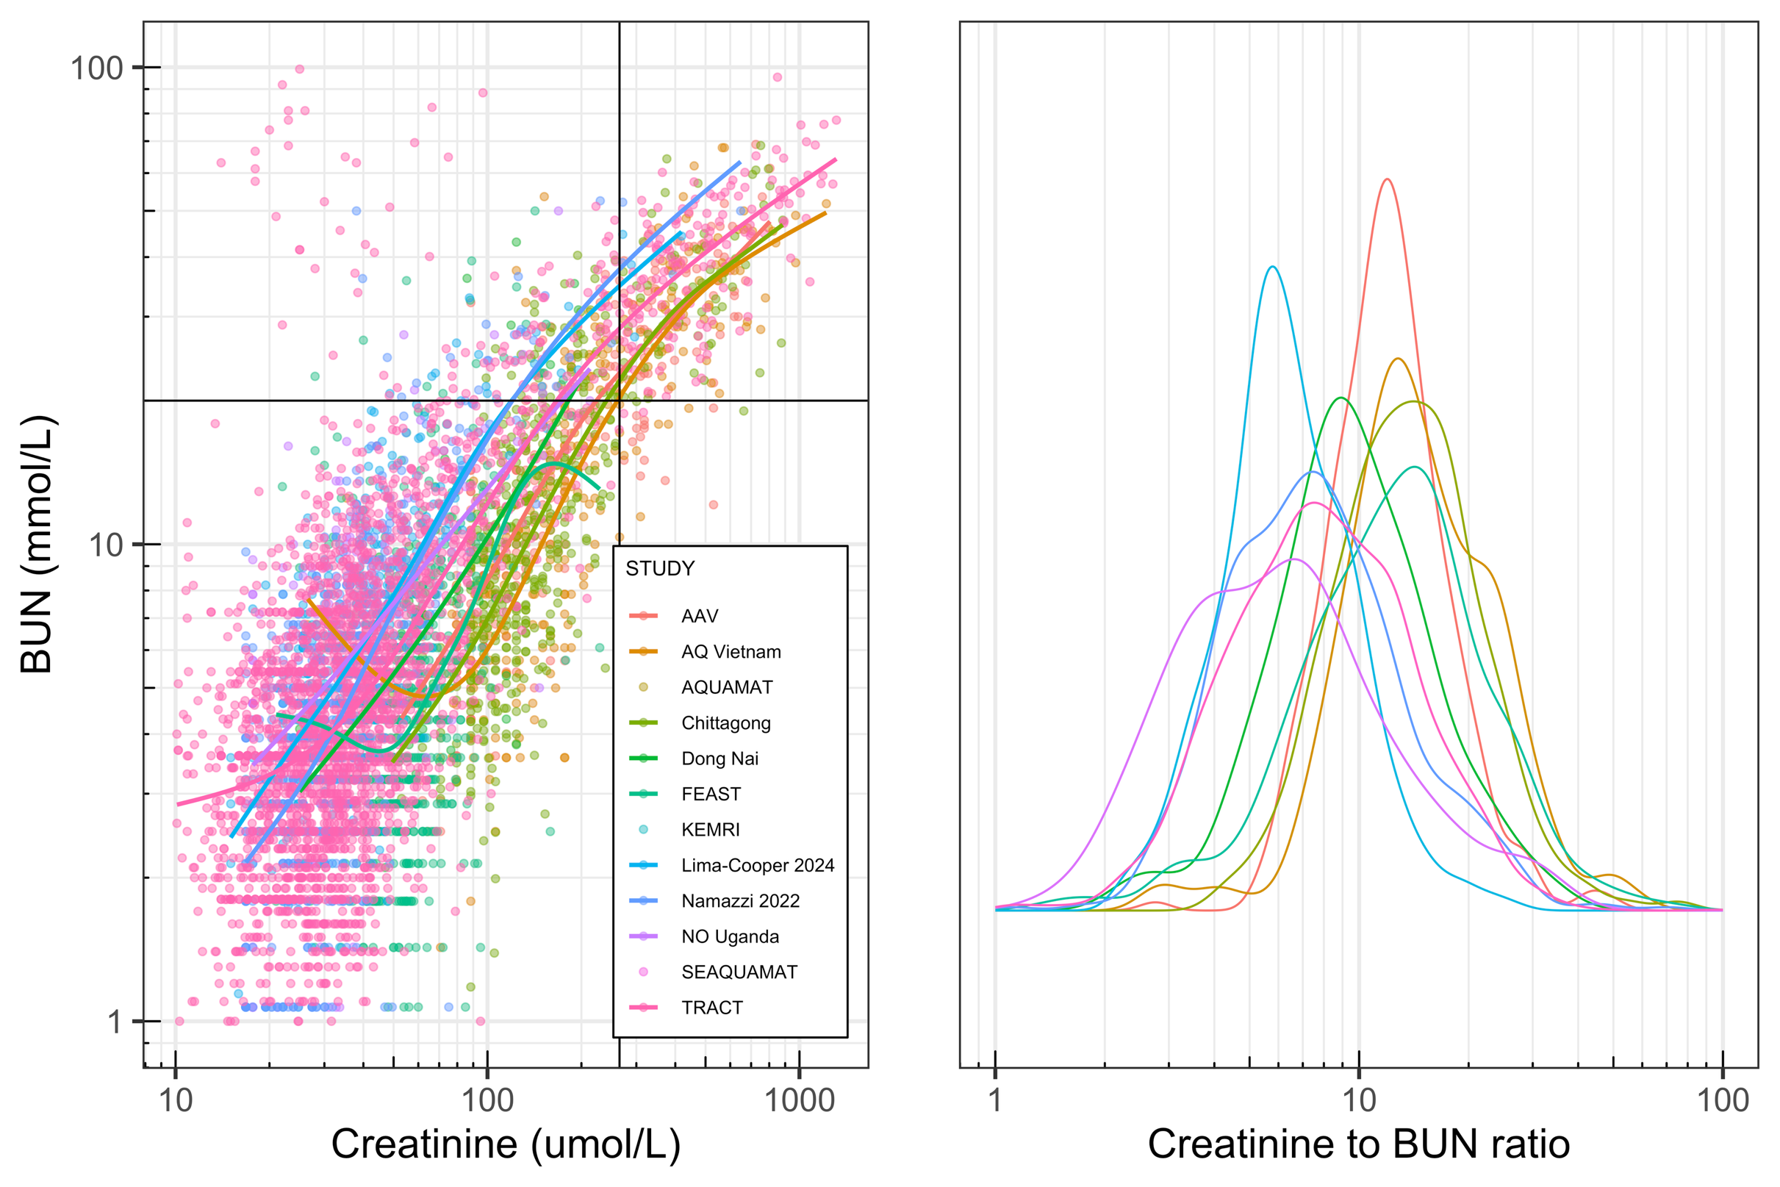
~5000 patients have both measured

Slide 5
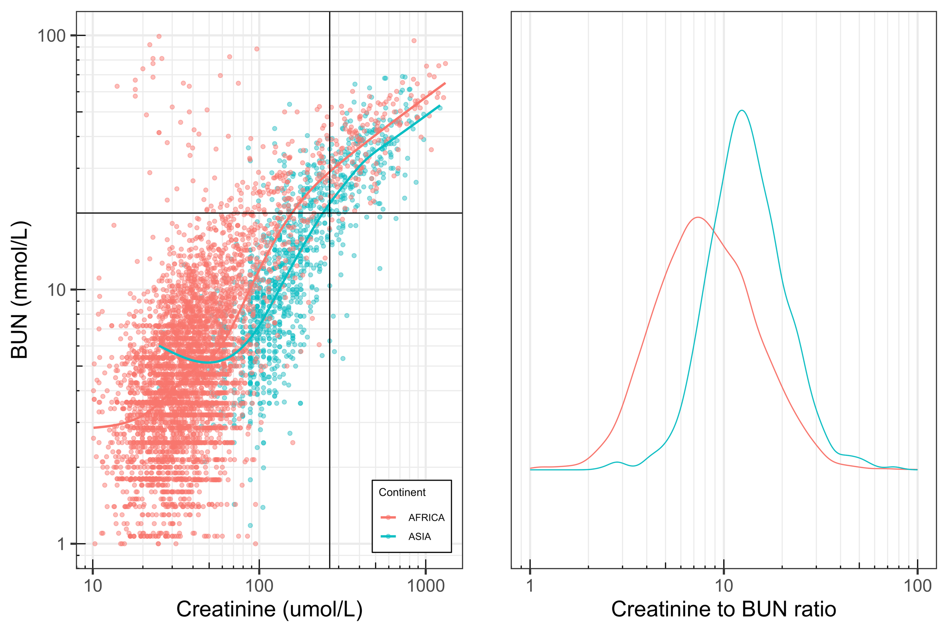
Variation in ratio of Creatinine/BUN
Adults appear to have higher creatinine values for a given BUN value

Slide 6
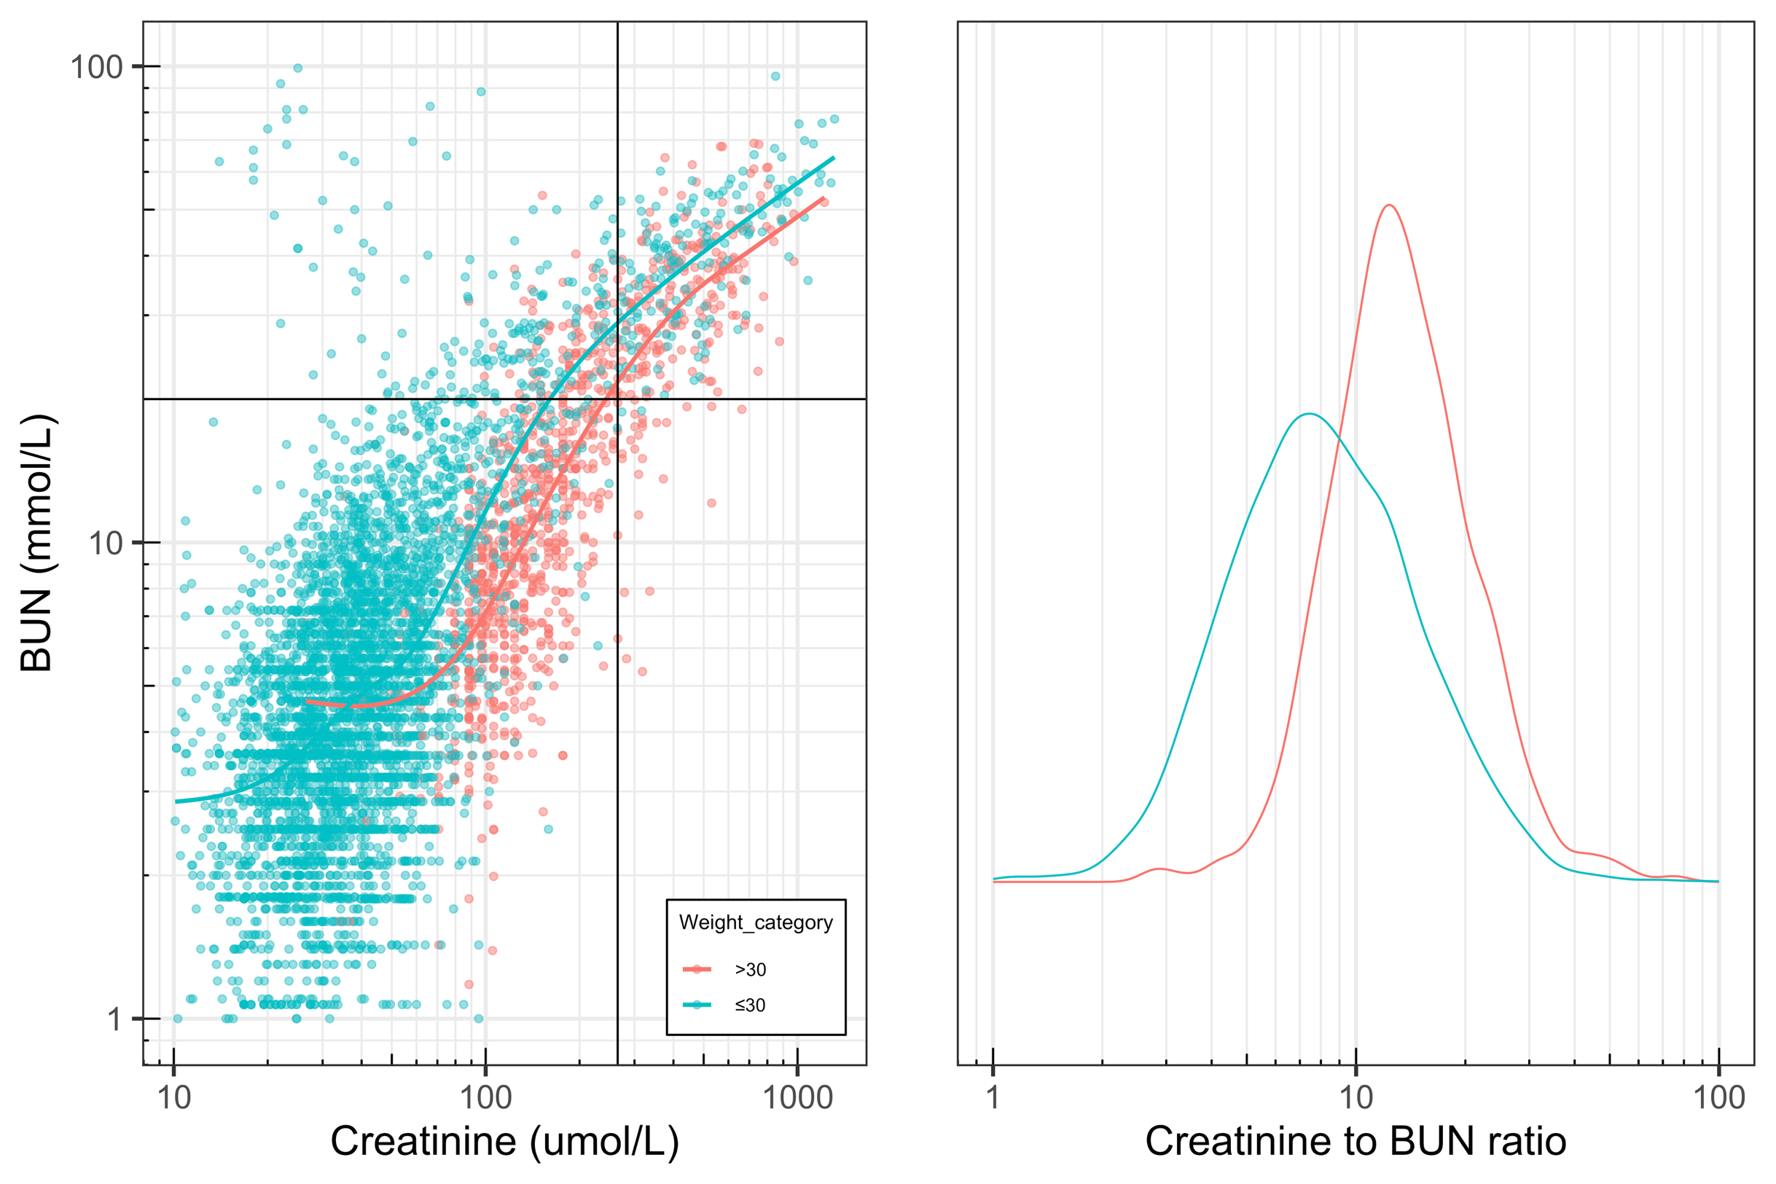
Variation in ratio of Creatinine/BUN
Adults appear to have higher creatinine values for a given BUN value
For every 10 kg increase in weight, you get ~25% increase in creatinine, versus a 15% increase in BUN

Slide 7
Variation in ratio of Creatinine/BUN
Adults appear to have higher creatinine values for a given BUN value

Slide 8
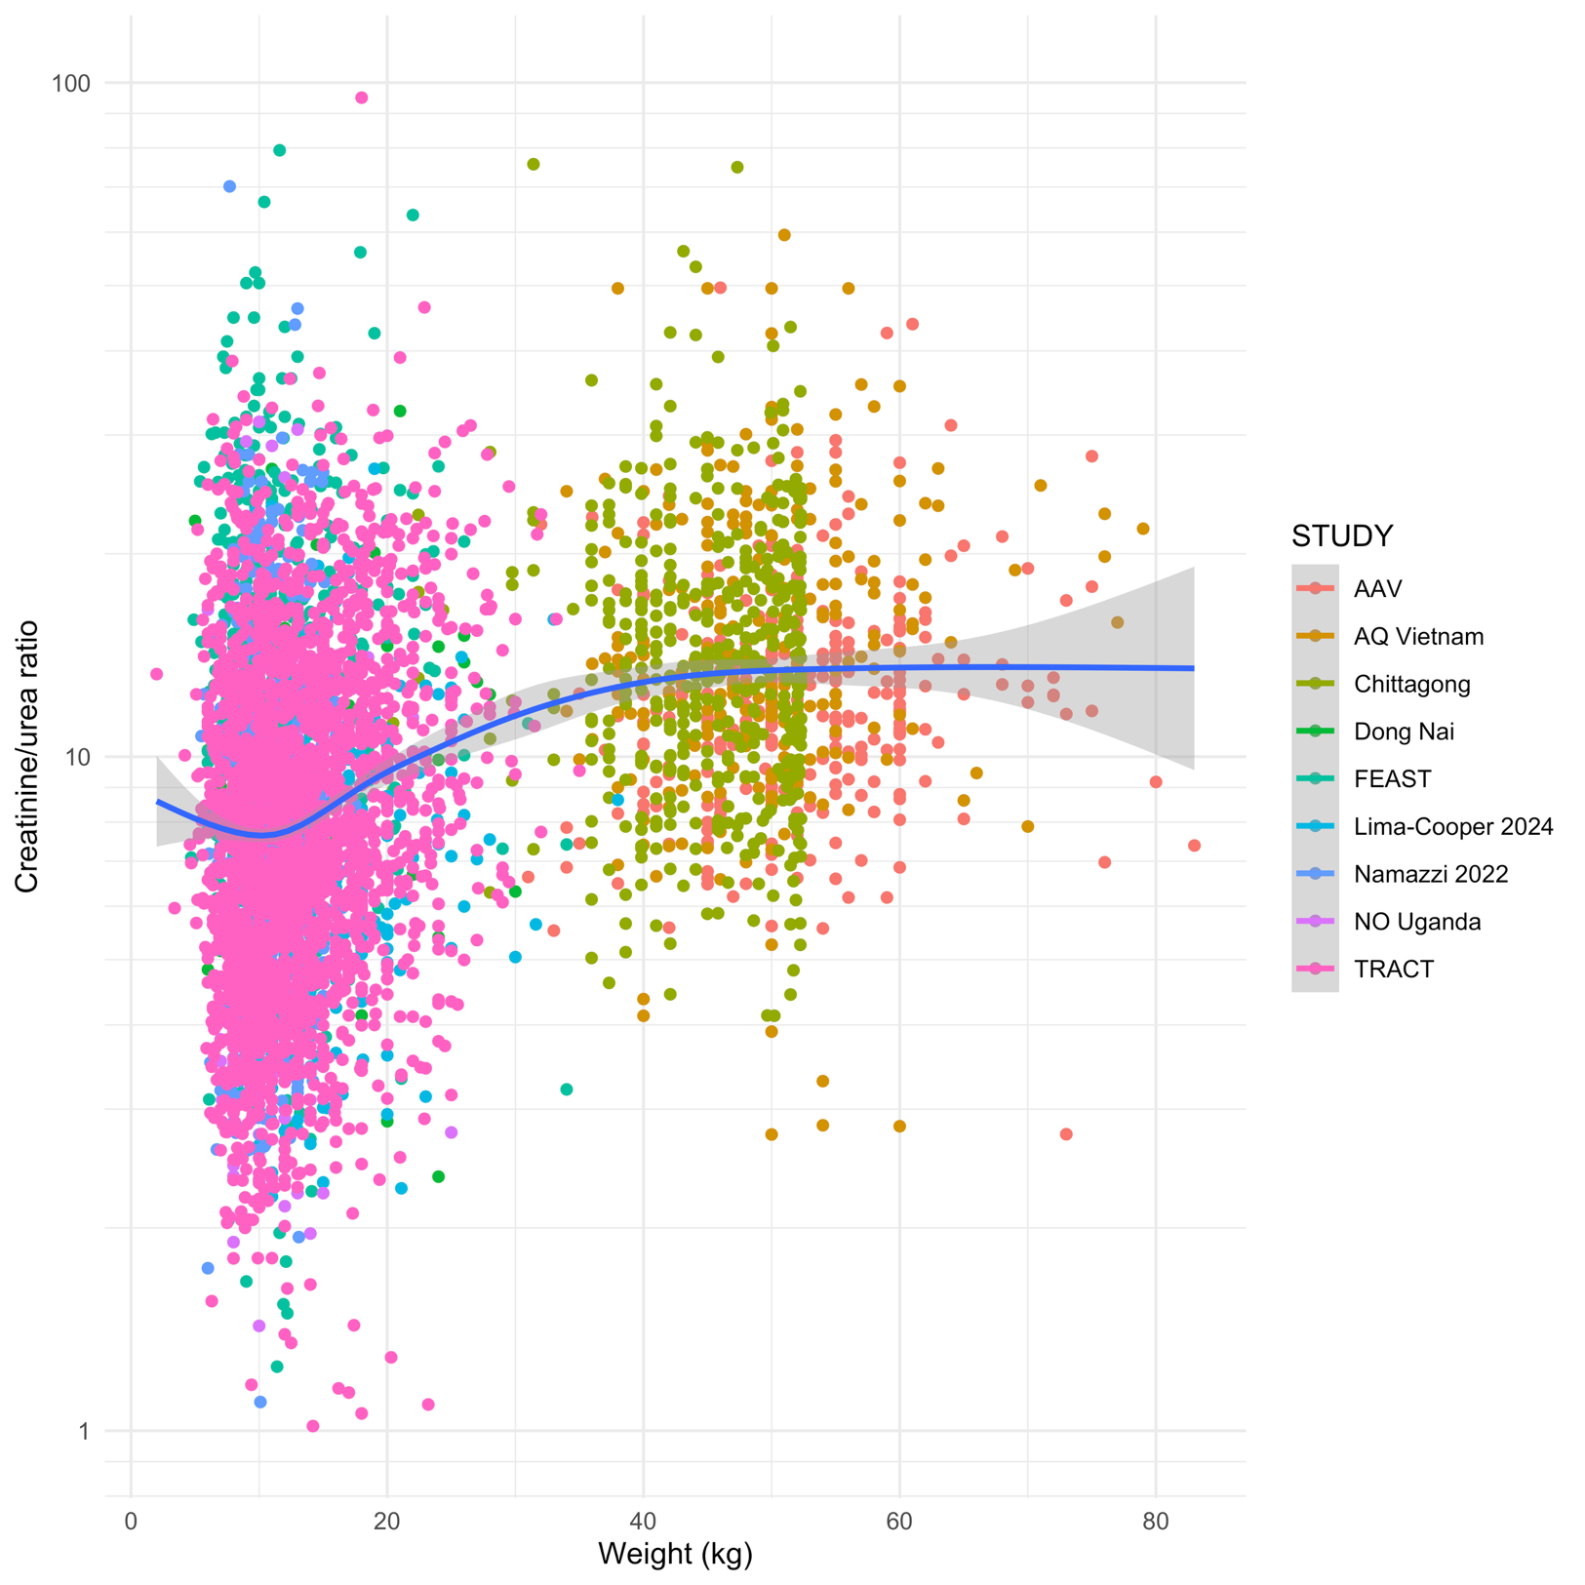
Variation in ratio of Creatinine/BUN
Adults appear to have higher creatinine values for a given BUN value

Slide 9
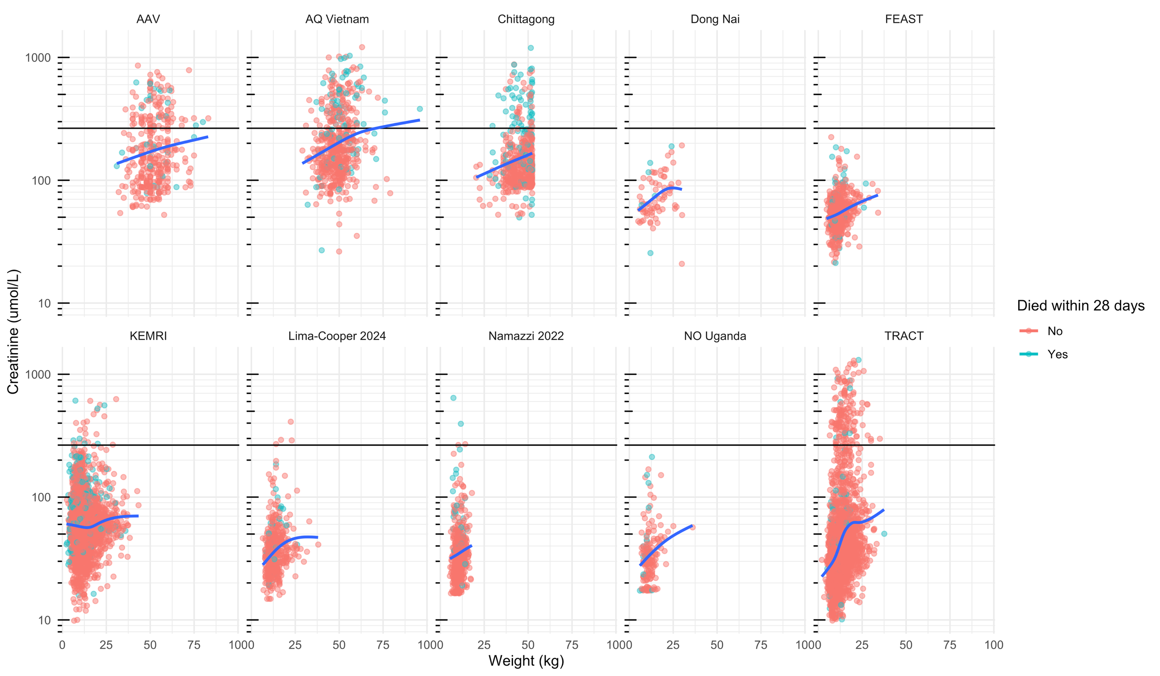

Slide 10
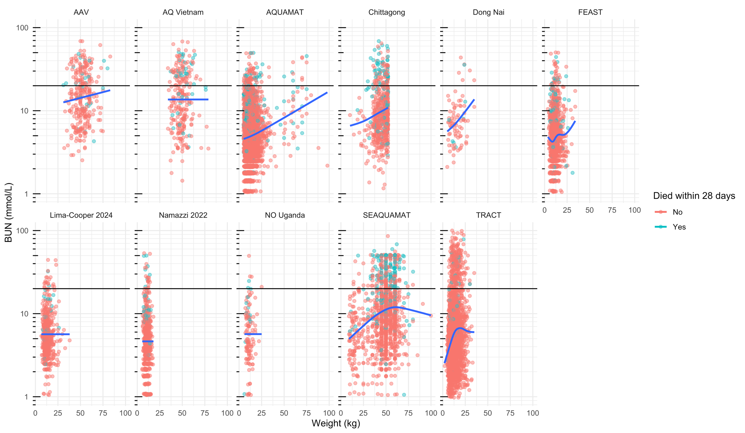

Slide 11
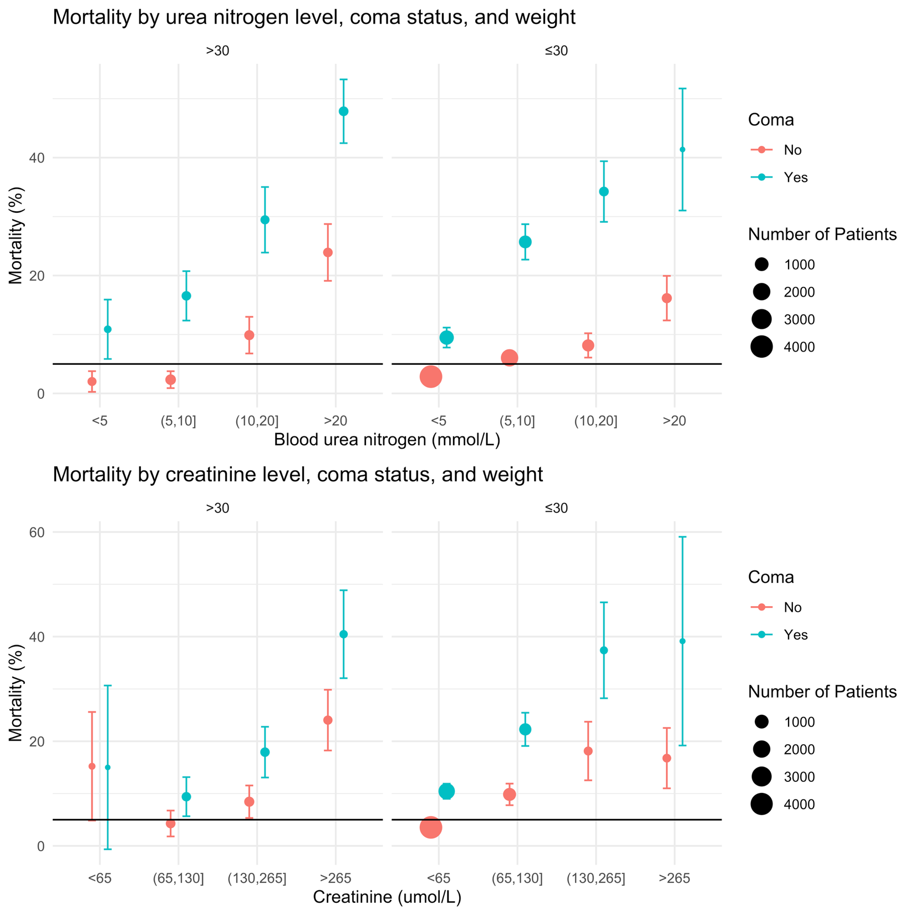
Non-parametric – mortality by subgroups:
Weight (<30, >30kg)
Coma on admission (yes/no)
Creatinine levels or BUN levels on admission

Slide 12
Modelling relationship between creatinine or BUN and death
We adjust for coma status: this is recorded in nearly all patients and is the strongest predictor of death
The main threshold of interest would be for non comatose patients
We fit penalized splines on the log₁₀ BUN or Creatinine, stratified either by weight (cut-off of 30kg) or by Age (<2, 2-5, 5-15, >15) or by study
We evaluate threshold as a BUN or Creatinine value such that the Probability(Mortality>5%) is above some threshold (e.g. 0.8)

Slide 13
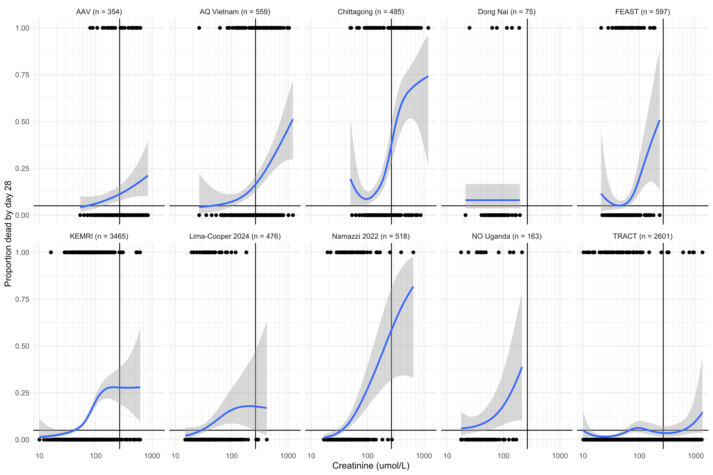
Individual study fits
TRACT (study of transfusion in severely anemic children is a clear outlier

Slide 14
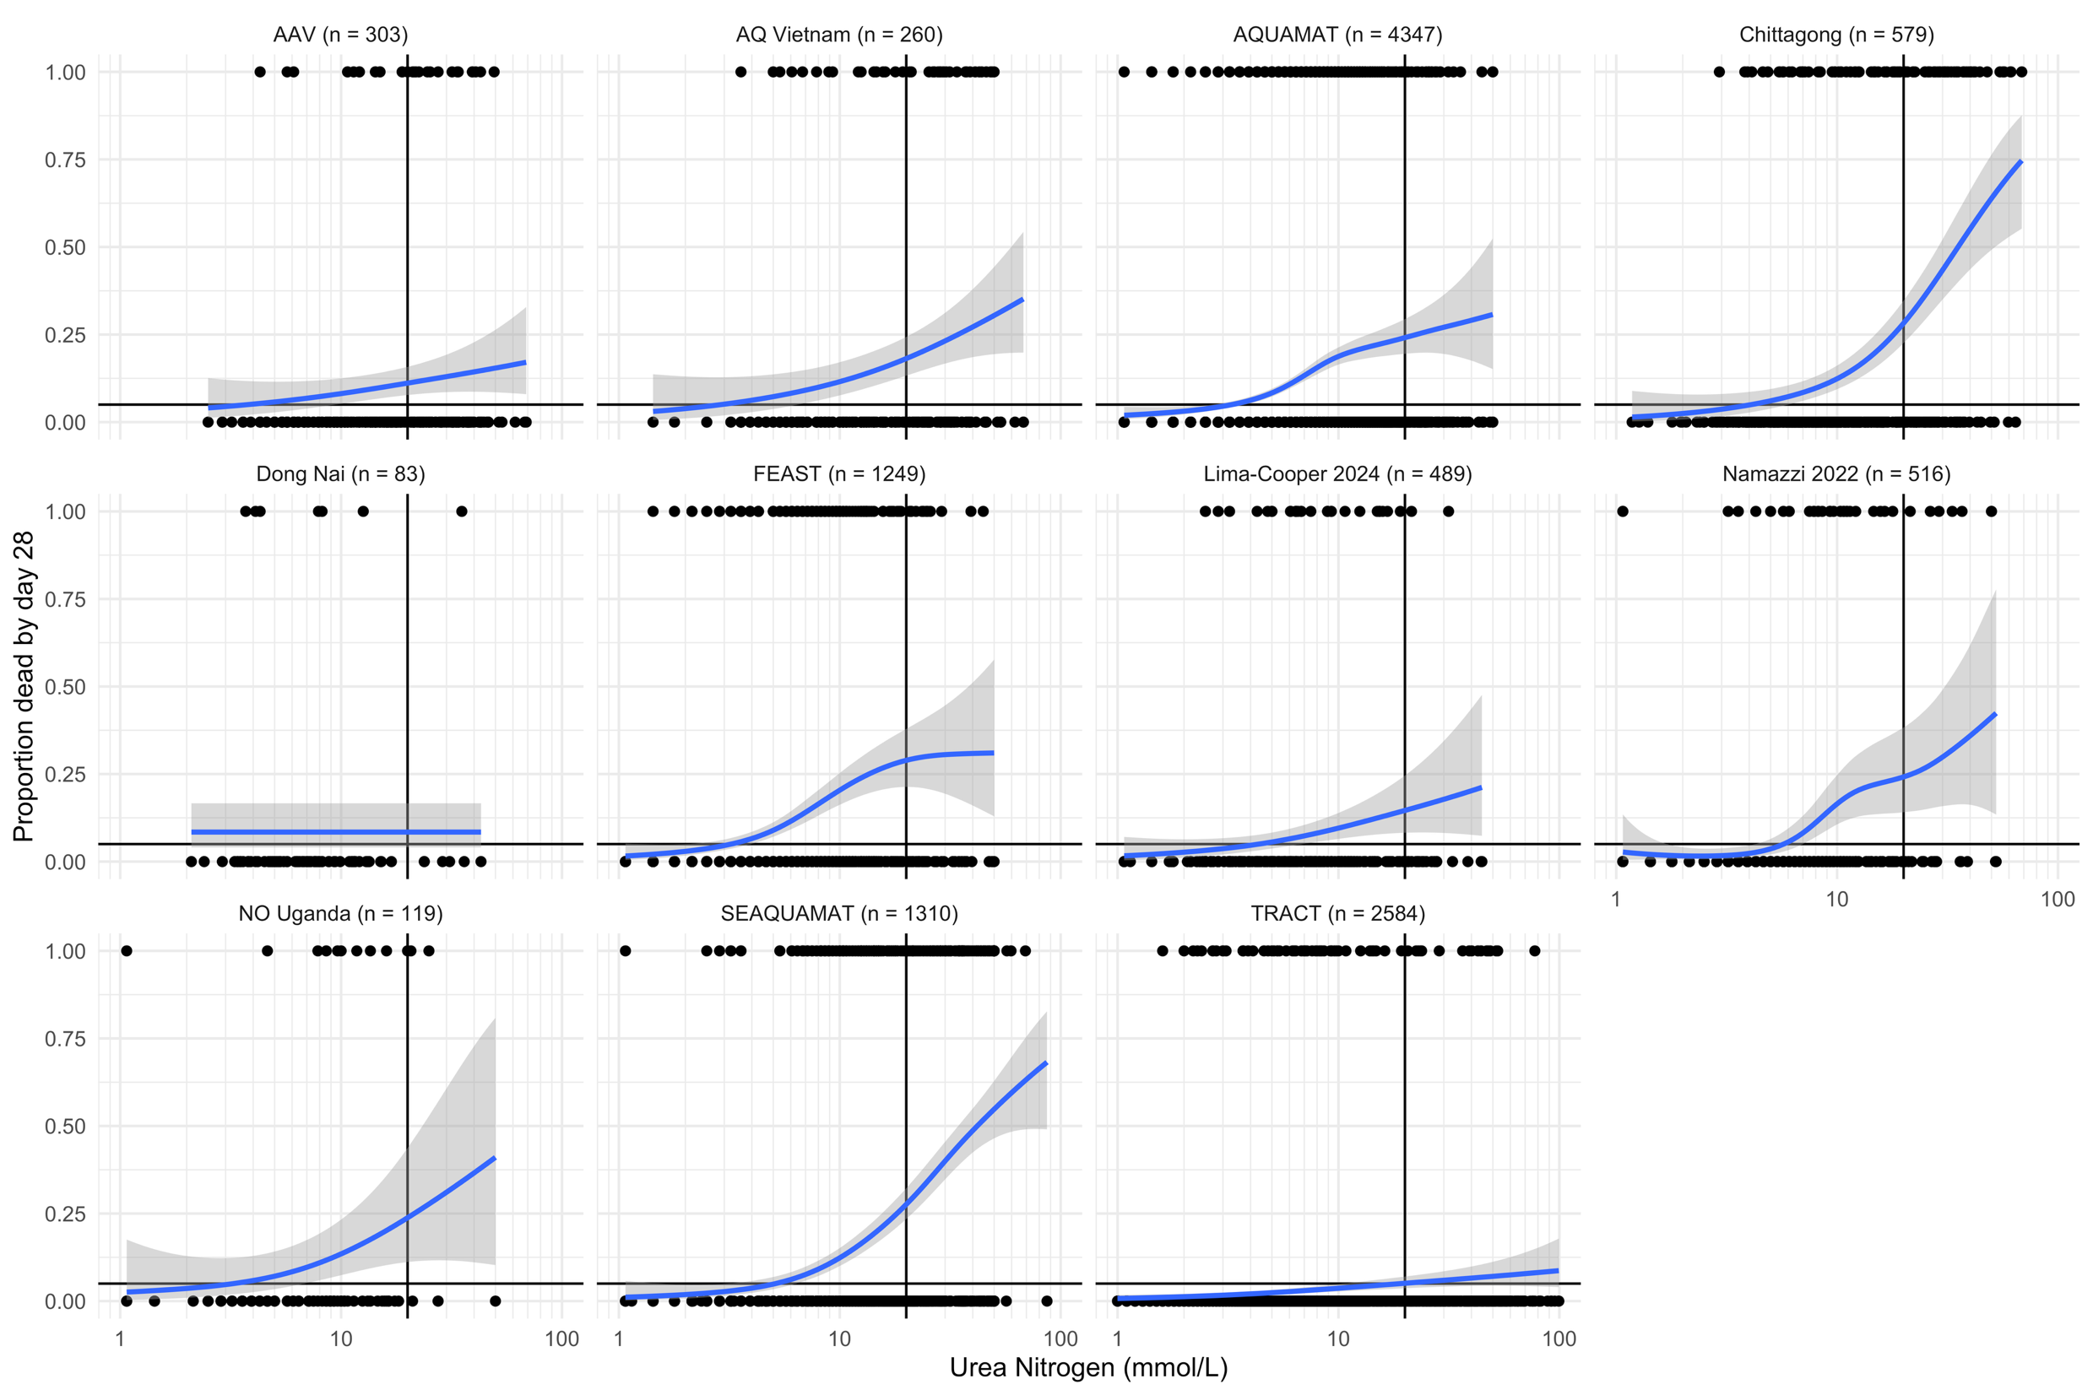
Individual study fits
TRACT (study of transfusion in severely anemic children is a clear outlier

Slide 15
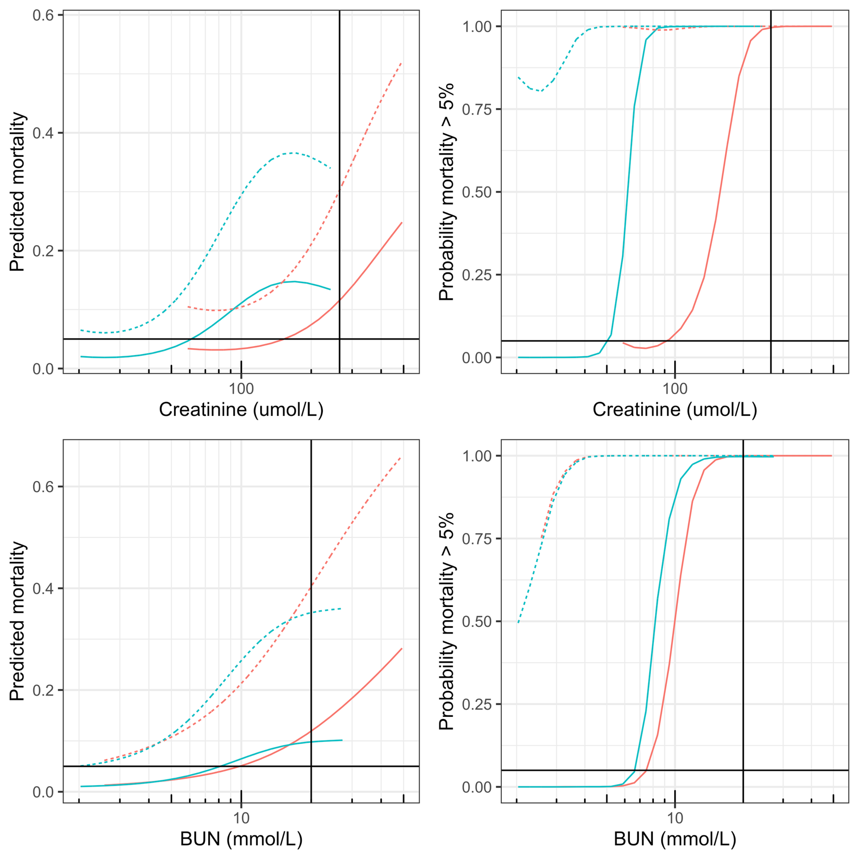
All data
Adults (>30kg)
Children (<30kg)
>100 higher
Not comatose
Comatose
~20% higher

Slide 16
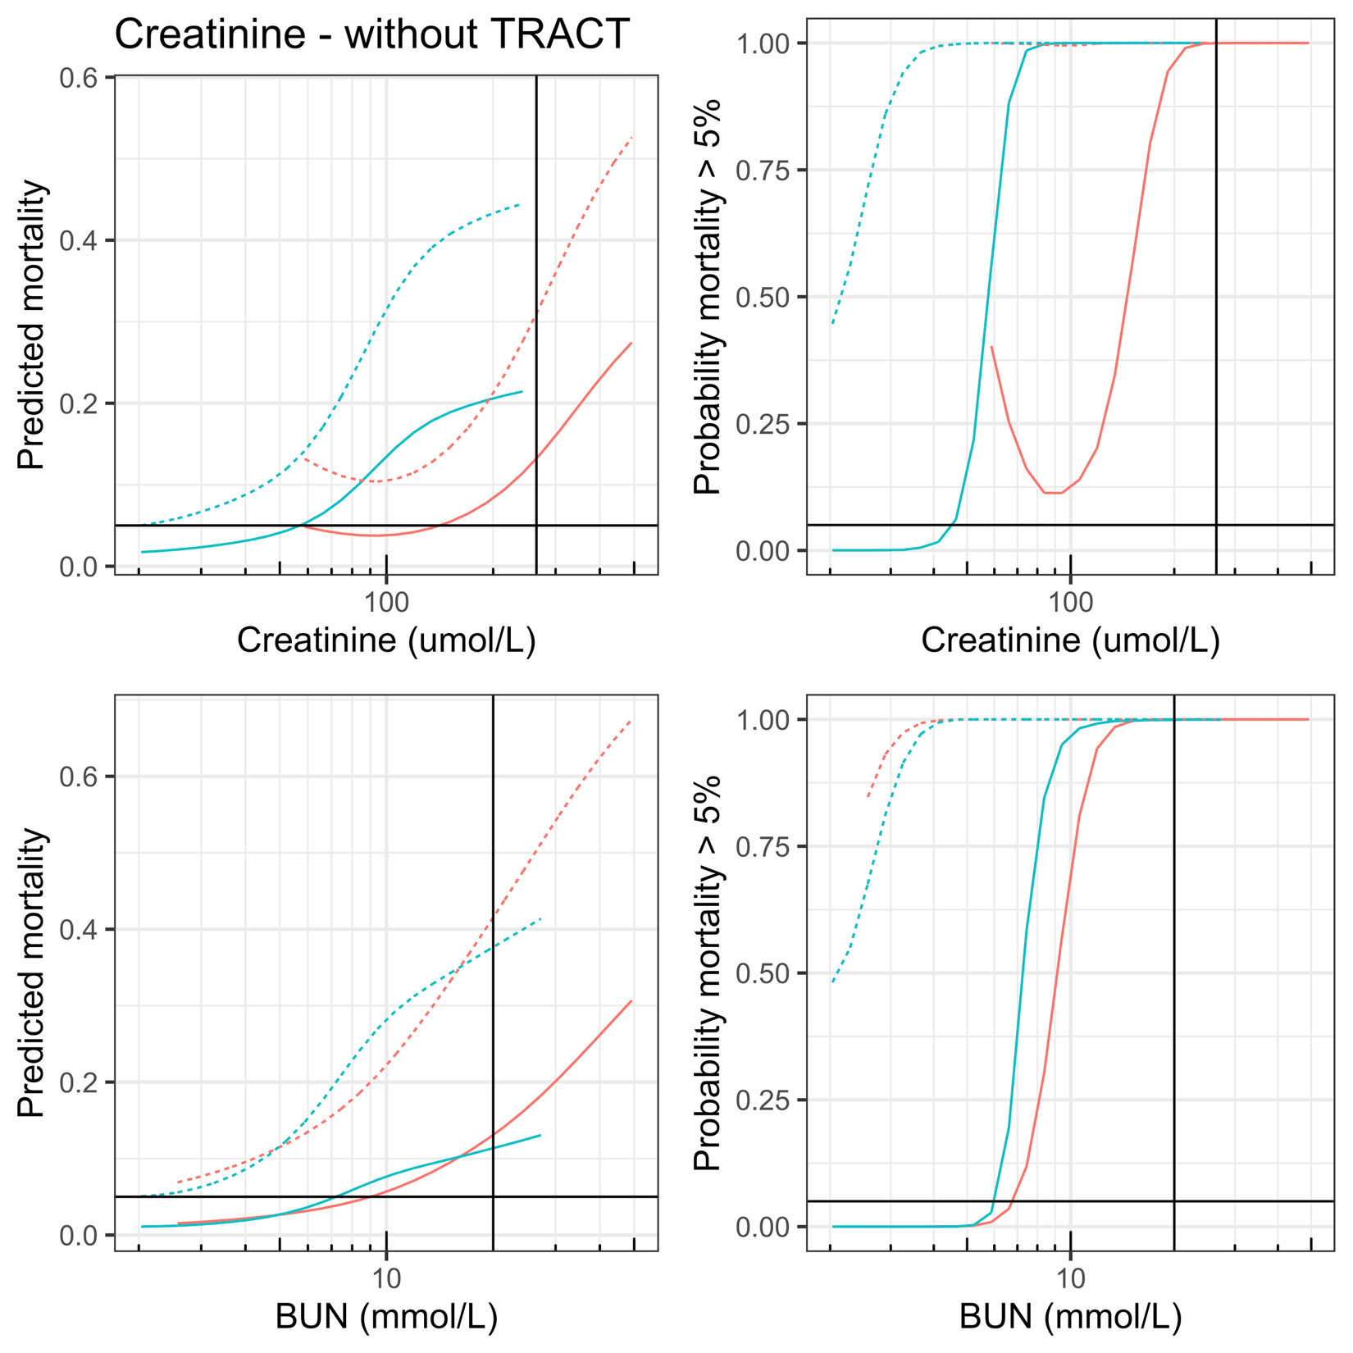
Removing TRACT
Adults (>30kg)
Children (<30kg)
>100% higher
Not comatose
Comatose
~20% higher

Slide 17
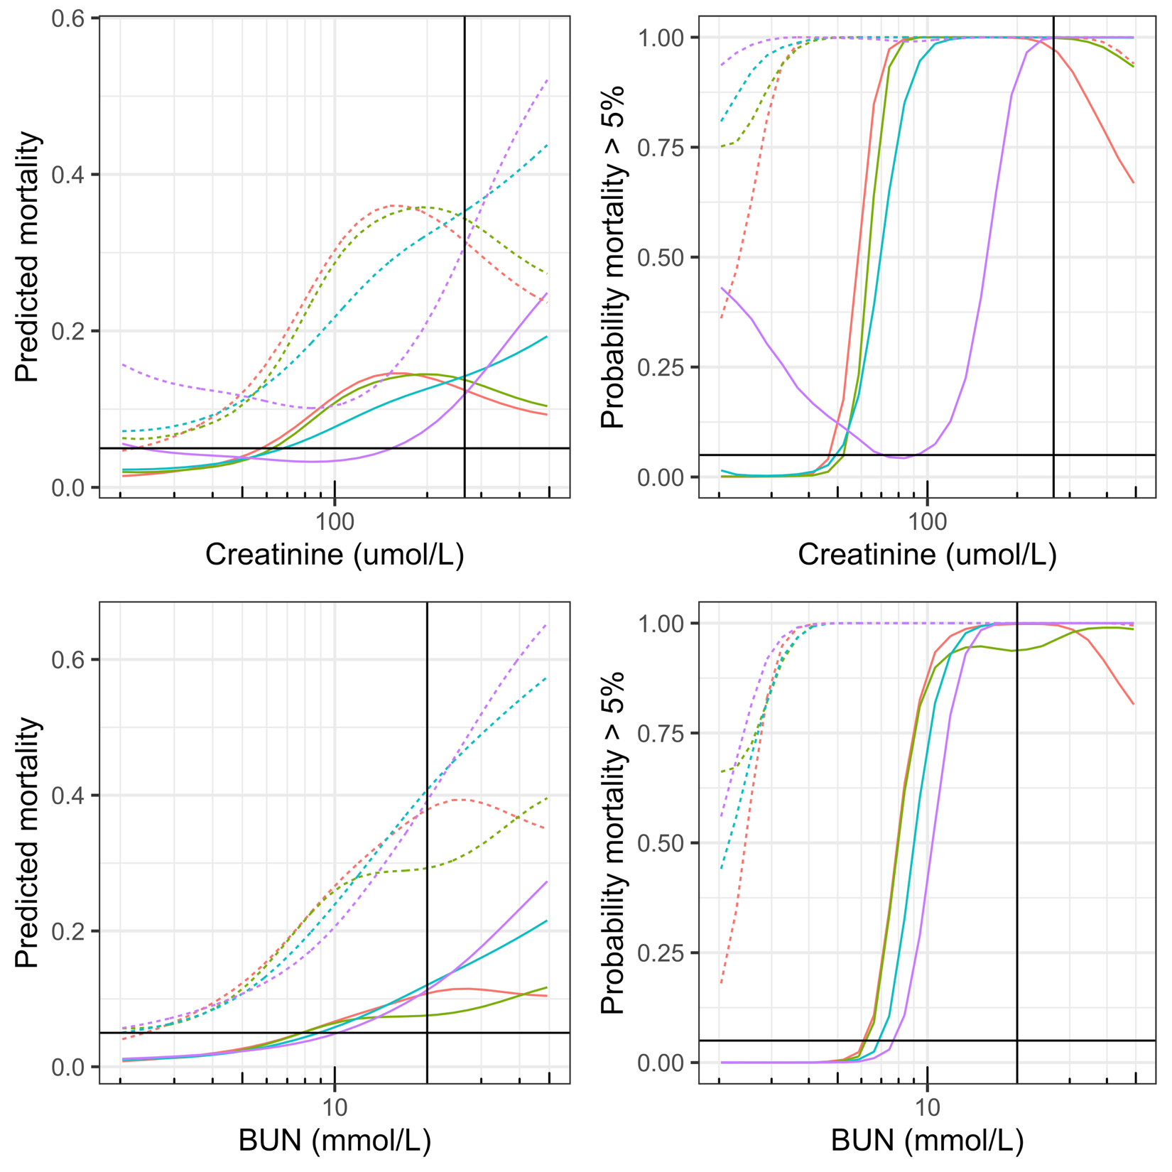
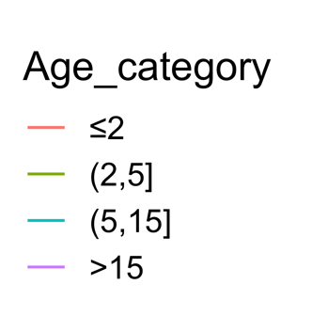
Stratifying by age
Adults (>30kg)
Children (<30kg)
Not comatose
Comatose
Massive age effect for creatinine
Small age effect for BUN

Slide 18
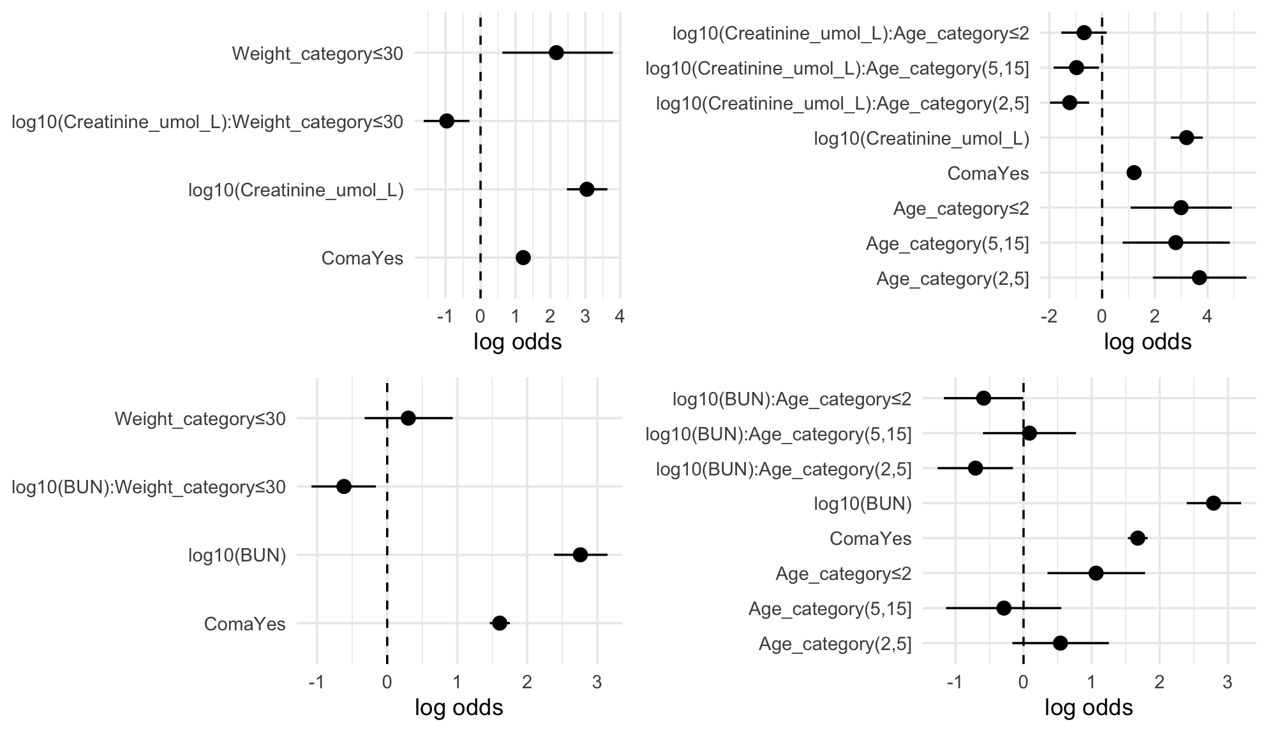
Which is a better predictor of death? Creatinine or BUN
Univariate analysis looking at heterogeneity by weight/age
There is clear heterogeneity of effect between adults and children:
Adults: log-odds for 10x increase in Cr is ~3
Children: log-odds is ~2
For BUN:
Adults: log-odds is ~2.7
Children: log-odds ~2
Interaction terms

Slide 19
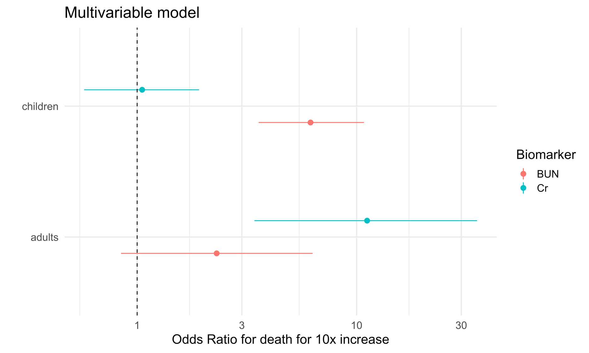
Which is a better predictor of death? Creatinine or BUN
When I put both in a model, BUN is a better predictor of death in children, whereas Cr is a better predictor in adults. Very strong heterogeneity

