Slide 1
Web-based behavioral experiments
for online data collection
Paxton Fitzpatrick
November 6, 2020

Slide 2
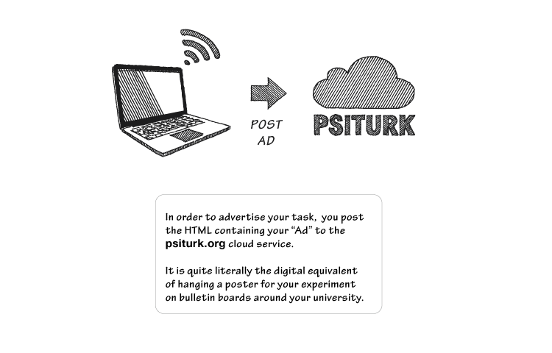


Overview
Goal: Create a behavioral experiment that:
can be run both in-lab and online
handles complex stimuli and responses
is self-isolated and efficient
works on any computer
is easy to design and test

Slide 3



Overview
Brief overview of framework: 3 powerful tools
Create an experiment ready for online deployment
Live demo
(🤞)
github.com/paxtonfitzpatrick/psiturk-experiment-template

Slide 4
What is MTurk?
Crowdsourcing platform created by Amazon
“Requesters” post “HITs" (Human Intelligence Tasks) for “workers” to complete
HITs range from simple to complex
Image labeling for ML
Audio transcription
Writing product descriptions for websites
Full behavioral experiments

Slide 5
Why use MTurk?
Large participant pool…
100,000 – 200,000 MTurk workers¹
2,000–12,000 active online at any time¹
Typical lab can reach to 7,300 participants per posting²
50% of pool refreshed every 7 months²
…enables fast data collection
30,002 participants in 6 weeks (no restrictions)³
9,770 participants in 8 weeks (US-only, “master workers”-only)⁴
Personal experience: 10 participants in ~2 hours (US-only, “master workers”-only)
¹Difallah et al., 2018
²Stewart et al., 2015
³Milland, 2015
⁴Casey et al., 2017

Slide 6
Why use MTurk?
Participant pool is diverse…
Significantly more diverse than typical college samples^{5,6,7}
More diverse than community samples recruited from college towns⁸
Slightly more diverse than standard internet samples⁷
More representative of US population than in-person convenience samples⁹
…and specific populations can be subsampled
Geographic area (US-only, Ohio-only, etc.)
Other voluntarily provided info (age, ethnicity, marital status, handedness, online usage, etc.)
¹Difallah et al., 2018
²Stewart et al., 2015
³Milland, 2015
⁴Casey et al., 2017
⁵Berinsky et al., 2012
⁶Sheehan & Pitman, 2016
⁷Buhrmester et al., 2011
⁸Krupnikov & Levine, 2014
⁹Berinsky et al., 2017

Slide 7
Why use MTurk?
But what about data quality and validity?
Classic behavioral findings replicate well
Cognitive biases, logical fallacies, and strategic behavior¹⁰
Response time-dependent measures (Stroop, switching, flanker, attentional blink, subliminal priming)¹¹
MTurk data matches or exceeds in-person psychometric validity^{7,12}
¹Difallah et al., 2018
²Stewart et al., 2015
³Milland, 2015
⁴Casey et al., 2017
⁵Berinsky et al., 2012
⁶Sheehan & Pitman, 2016
⁷Buhrmester et al., 2011
⁸Krupnikov & Levine, 2014
⁹Berinsky et al., 2017
¹¹Crump et al., 2013
¹²Shapiro et al., 2013
¹⁰Paolacci & Chandler, 2014

Slide 8
Why use MTurk?
But what about data quality and validity?
MTurk workers appear to be honest and engaged
High test-retest reliability, comparable to in-person
After 1 week¹²
After 3 weeks^{7,13}
After 6 months¹⁴
Direct assessments of attentiveness are comparable to in-person^{5,15}
No more likely to cheat than college student samples¹⁶
¹Difallah et al., 2018
²Stewart et al., 2015
³Milland, 2015
⁴Casey et al., 2017
⁵Berinsky et al., 2012
⁶Sheehan & Pitman, 2016
⁷Buhrmester et al., 2011
⁸Krupnikov & Levine, 2014
⁹Berinsky et al., 2017
¹⁰Paolacci & Chandler, 2014
¹¹Crump et al., 2013
¹²Shapiro et al., 2013
¹³Holden et al., 2013
¹⁴Mason & Suri, 2012
¹⁵Paolacci et al.,
¹⁶Suri et al., 2011

Slide 9
Experiment structure
my_experiment/
├── exp/
└── data/

Slide 10














my_experiment/
├── exp/
└── data/
What is Docker?
Self-contained, isolated software environments
Create, share, and deploy applications & services
Popular tool in production environments

Slide 11
my_experiment/
├── exp/
└── data/
Why use Docker?
Run multiple experiments on the same computer
Avoid package, path, port, etc. conflicts
Experiment will run the same on any computer
Great for sharing reproducible experiment code
Easily manage all experiment-related services

Slide 12
my_experiment/
├── exp/
└── data/
Core concepts
Image
“Template” environment with everything needed to perform a certain task
Container
A running instance of an image
Dockerfile
File containing instructions to build an image
docker-compose
Tool for defining and running multiple, coordinated containers
Docker Hub
GitHub-like site with repositories of pre-built images

Slide 13
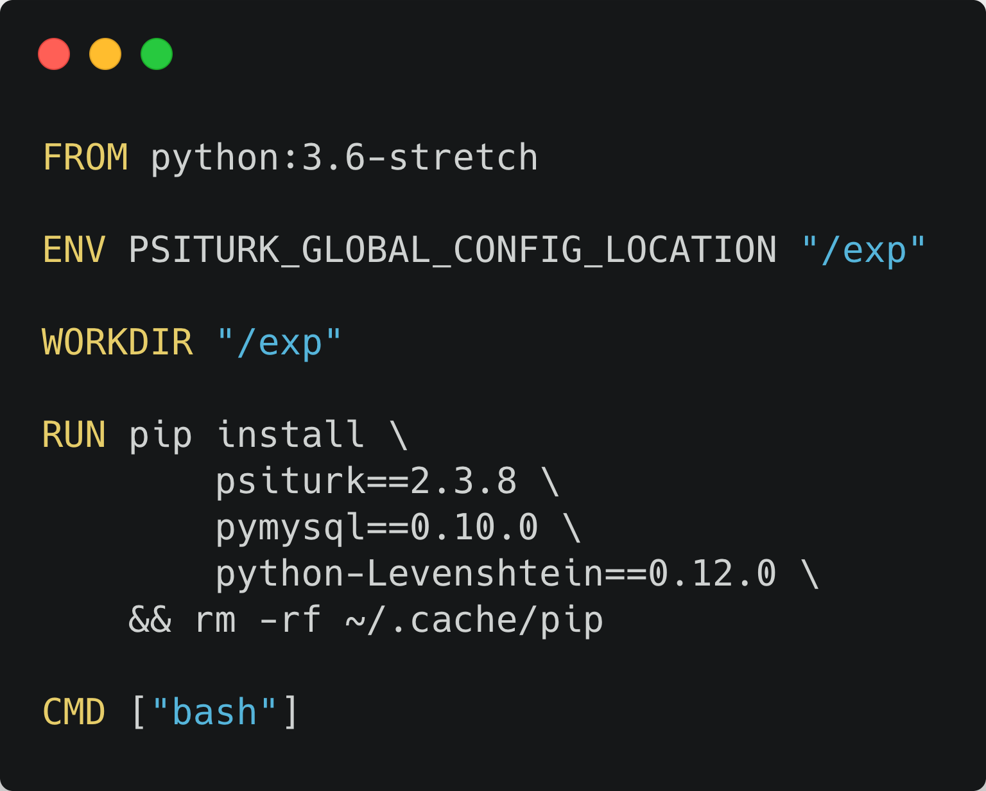
my_experiment/
├── exp/
└── data/
Dockerfile

Slide 14
my_experiment/
├── exp/
└── data/
Dockerfile
Specify the base image to build from
Set environment variable (tells psiTurk where to look for .psiturkconfig)
Set the working directory for running containers
Install psiTurk and some extra required packages
Clearing caches helps keep image small
Set the command executed when running a container (launch a bash shell)
–
{

Slide 15
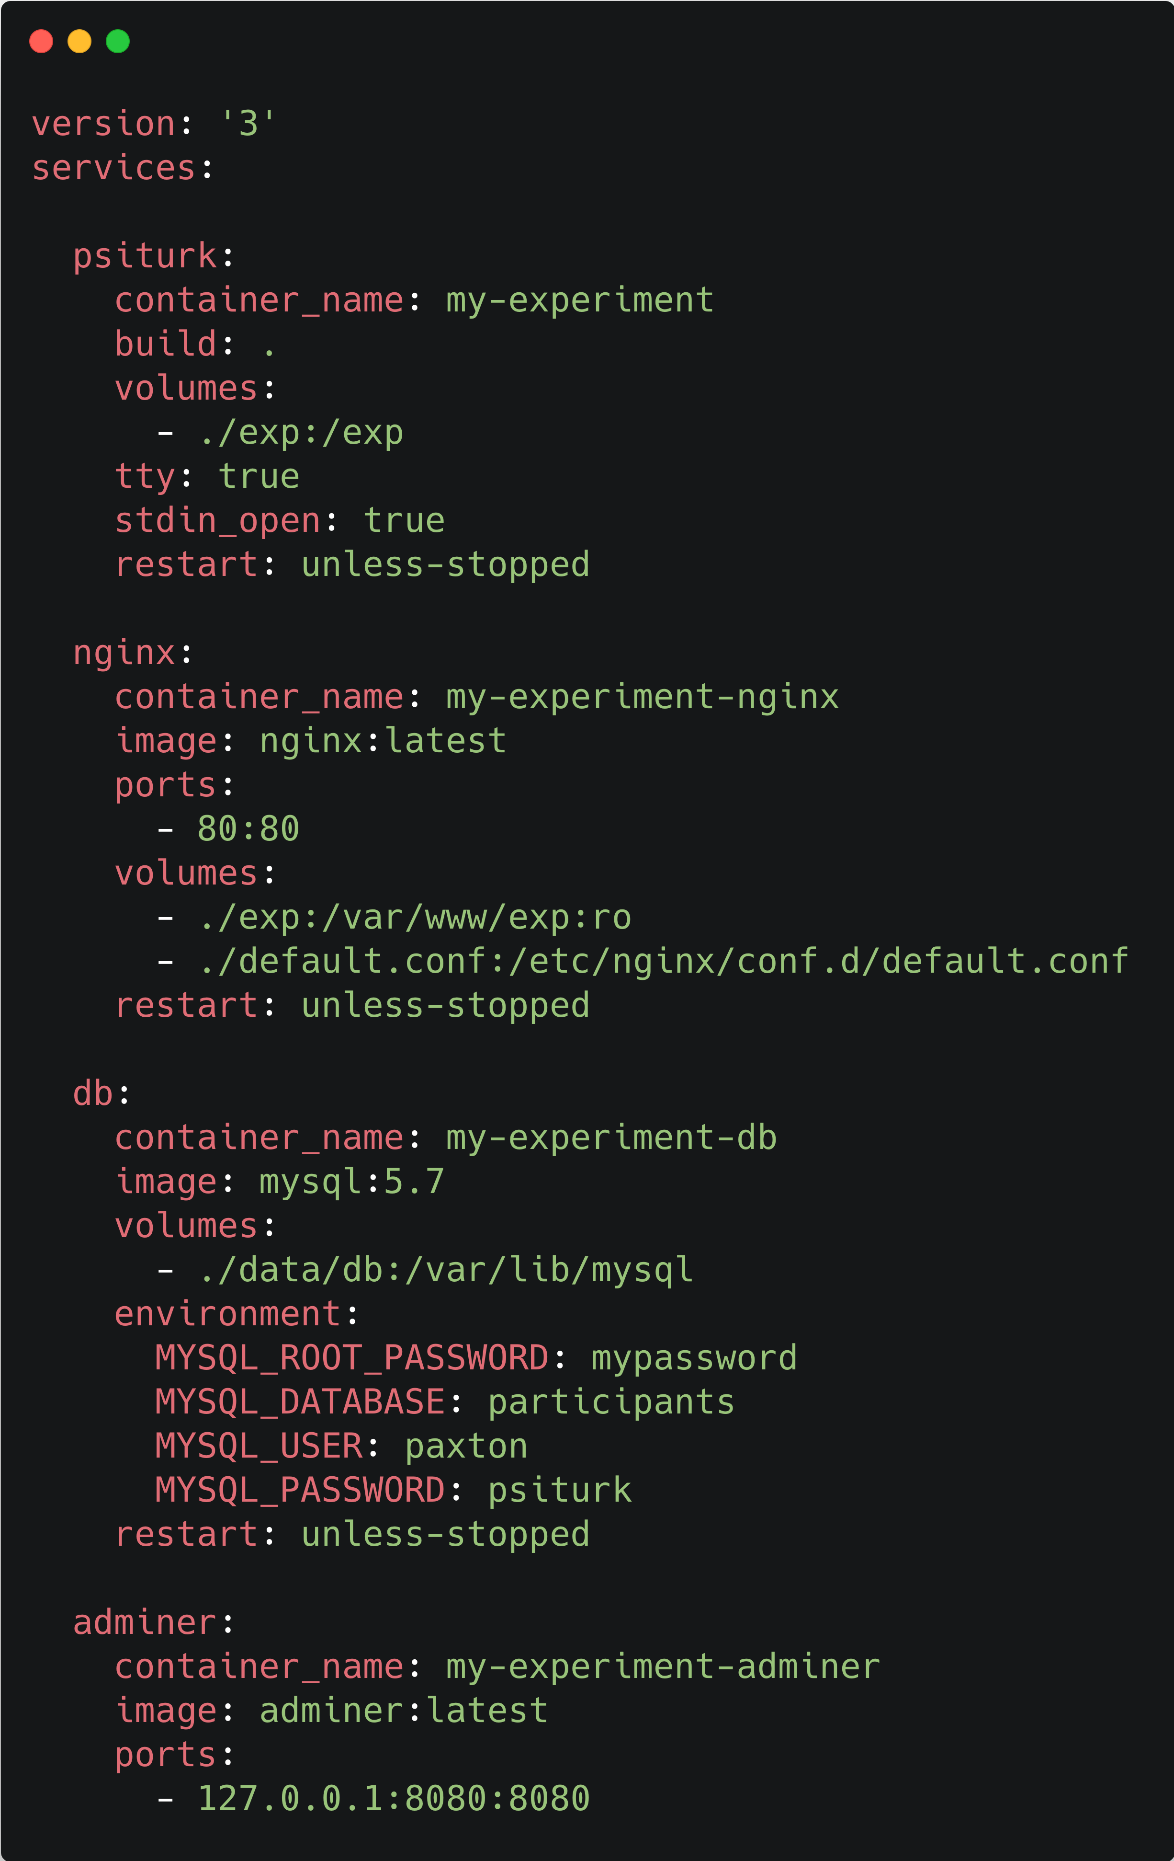
my_experiment/
├── exp/
└── data/
docker-compose.yml
We need 3 support services to run on MTurk
Normally complex to configure, tedious to manage
But Docker makes this much easier!
All 3 available on Docker Hub as ready-to-run images
docker-compose: build, start and stop entire setup with a single command
Configure full application in docker-compose.yml

Slide 16
my_experiment/
├── exp/
└── data/
docker-compose.yml
Container 1: psiTurk server
Path to Dockerfile
Mount the host directory exp to /exp in the container
Allocate a pseudo-TTY and send stdin to the container (so we can run an interactive shell)
If the container fails for some reason, restart it unless we explicitly stopped it.
{
––

Slide 17
my_experiment/
├── exp/
└── data/
docker-compose.yml
Container 2: NGINX
(reverse proxy server for load balancing)
Pull the nginx:latest image from Docker Hub
Map host port 80 to container port 80
Create two mount points:
host exp directory ⮕ NGINX web root
NGINX config file ⮕ expected location

Slide 18
my_experiment/
├── exp/
└── data/
docker-compose.yml
Container 3: MySQL database
(greater concurrency than default SQLite DB)
Pull the mysql:5.7 image from Docker Hub
Mount data/db directory on host to a/var/lib/mysql in container
Set container environment variables:
Password for MySQL root user (required)
Name of DB created in the container
Username/password for psiTurk to write to DB
{
––

Slide 19
my_experiment/
├── exp/
└── data/
docker-compose.yml
Container 4: Adminer
(PHP app for viewing/downloading data)
Pull the adminer:latest image from Docker Hub
Map host port 8080 to container port 8080 (allows us to access Adminer via a web browser)

Slide 20
my_experiment/
├── exp/
└── data/
docker-compose.yml

Slide 21
Experiment structure
my_experiment/
├── exp/
└── data/

Slide 22
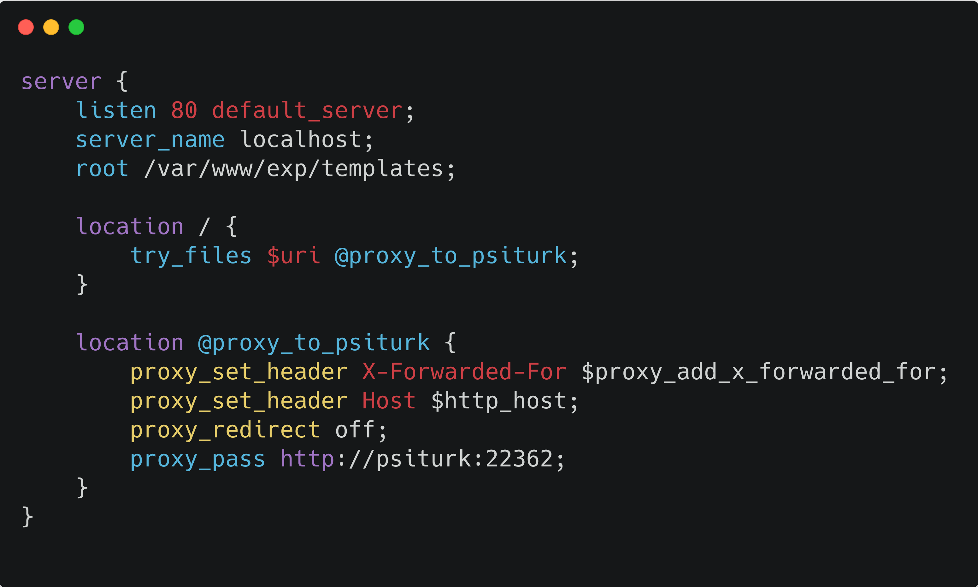
Experiment structure
my_experiment/
├── exp/
├── data/
├── Dockerfile
├── docker-compose.yml
└── default.conf

Slide 23
Experiment structure
my_experiment/
├── exp/
├── data/
│ └── db/
├── Dockerfile
├── docker-compose.yml
└── default.conf

Slide 24
my_experiment/
├── exp/
├── data/
├── Dockerfile
├── docker-compose.yml
└── default.conf
What is psiTurk?
Framework for creating & running browser-based behavioral experiments
Flask app, Python web server, JavaScript library
Interfaces with MTurk

Slide 25
my_experiment/
├── exp/
├── data/
├── Dockerfile
├── docker-compose.yml
└── default.conf
Why use psiTurk?
MTurk experiments must be web-based (no PsychoPy, Psychtoolbox, etc.)
Wraps and simplifies every part of the process
Configuring & running web server
Error logging
Interfacing with reverse proxy
Authenticating with AWS
Hosting ad on secure server
Testing in MTurk sandbox
Configuring & posting HIT
Setting requirements/restrictions
Providing consent form
Saving data
Approving/rejecting HITs
Expiring/deleting HITs
Checking account balance
Compensating participants
Granting bonuses
Run experiment locally with no changes
Compare/validate MTurk data
Fully in-person studies
Handles heavy stimuli/data other options can’t

Slide 26
Anatomy of a
Psiturk experiment
my_experiment/
├── exp/
├── data/
├── Dockerfile
├── docker-compose.yml
└── default.conf

Slide 27
Anatomy of a
Psiturk experiment
my_experiment/
├── exp/
├── data/
├── Dockerfile
├── docker-compose.yml
└── default.conf
my_experiment/
├── exp/
├── data/
├── Dockerfile
├── docker-compose.yml
└── default.conf

Slide 28
my_experiment/
├── exp/
├── data/
├── Dockerfile
├── docker-compose.yml
└── default.conf
Anatomy of a
Psiturk experiment
exp/
├── .psiturkconfig
├── config.txt
├── custom.py
├── static/
└── templates/
psiTurk and AWS credentials psiturk.readthedocs.io/en/latest/amt_setup.html psiturk.readthedocs.io/en/latest/psiturk_org_setup.html
Full psiTurk & Mturk configuration
Define custom URLs for complex designs (optional)
Static files
Bare-bones HTML templates
exp/
├── .psiturkconfig
├── config.txt
├── custom.py
├── static/
└── templates/

Slide 29
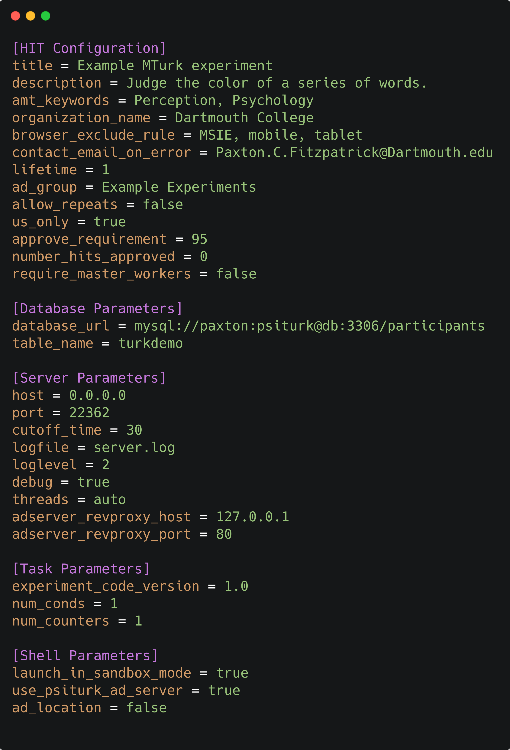
my_experiment/
├── exp/
├── data/
├── Dockerfile
├── docker-compose.yml
└── default.conf
exp/
├── .psiturkconfig
├── config.txt
├── custom.py
├── static/
└── templates/
config.txt

Slide 30
my_experiment/
├── exp/
├── data/
├── Dockerfile
├── docker-compose.yml
└── default.conf
exp/
├── .psiturkconfig
├── config.txt
├── custom.py
├── static/
└── templates/
config.txt
HIT Configuration
HIT Configuration: participant eligibility
Ineligible browsers/devices
How long HIT listing is visible
Participate once or multiple times
Restrict to US-based participants
Percentage of previous HITs approved
Number of previous HITs approved
“Master worker” designation by MTurk (5% compensation fee)

Slide 31
my_experiment/
├── exp/
├── data/
├── Dockerfile
├── docker-compose.yml
└── default.conf
exp/
├── .psiturkconfig
├── config.txt
├── custom.py
├── static/
└── templates/
config.txt
Database Parameters
Sqlalchemy connection string (fields from docker-compose.yml)
Table name (arbitrary)

Slide 32
my_experiment/
├── exp/
├── data/
├── Dockerfile
├── docker-compose.yml
└── default.conf
exp/
├── .psiturkconfig
├── config.txt
├── custom.py
├── static/
└── templates/
config.txt
Server Parameters
{
––
Correspond to default.conf

Slide 33
my_experiment/
├── exp/
├── data/
├── Dockerfile
├── docker-compose.yml
└── default.conf
exp/
├── .psiturkconfig
├── config.txt
├── custom.py
├── static/
└── templates/
config.txt
Server Parameters
{
––
Correspond to default.conf
Maximum time (min) participants may take to complete the experiment
Correspond to docker-compose.yml
{
––

Slide 34
my_experiment/
├── exp/
├── data/
├── Dockerfile
├── docker-compose.yml
└── default.conf
exp/
├── .psiturkconfig
├── config.txt
├── custom.py
├── static/
└── templates/
templates/
Study advertisement page
Shown after completing experiment
Fill in with IRB-approved consent form
Redirects to ad.html
Shown when an error occurs
The main experiment
templates/
├── ad.html
├── complete.html
├── consent.html
├── default.html
├── error.html
└── exp.html

Slide 35
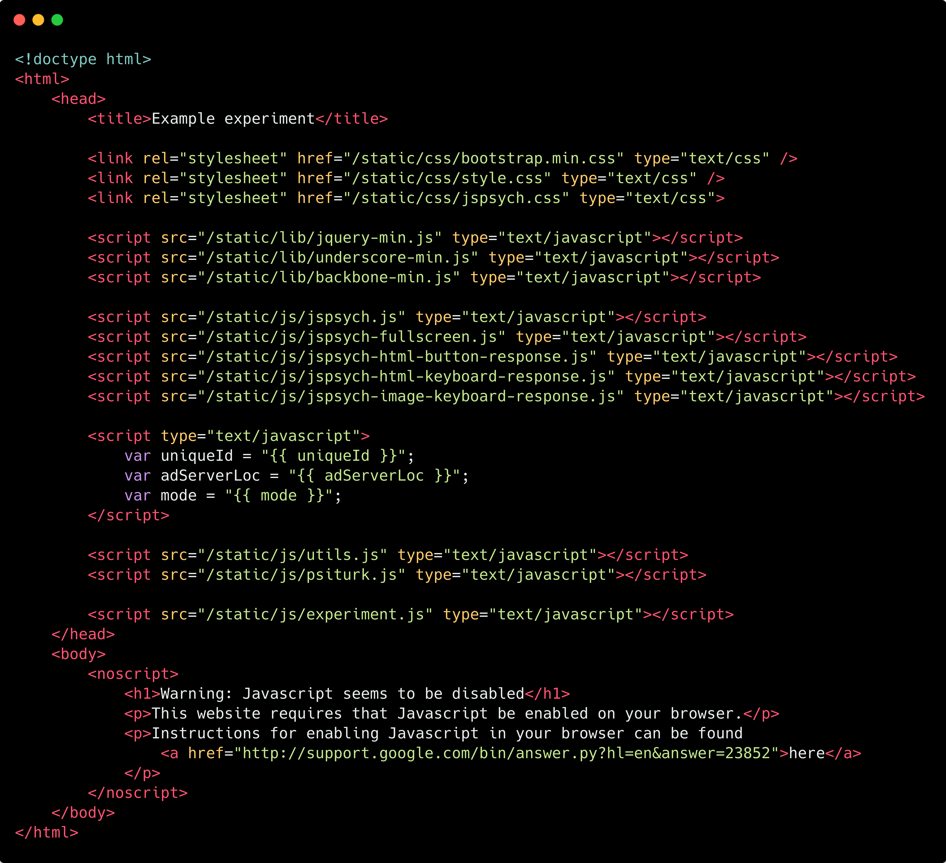
my_experiment/
├── exp/
├── data/
├── Dockerfile
├── docker-compose.yml
└── default.conf
exp/
├── .psiturkconfig
├── config.txt
├── custom.py
├── static/
└── templates/
templates/
├── ad.html
├── complete.html
├── consent.html
├── default.html
├── error.html
└── exp.html
templates/

Slide 36
my_experiment/
├── exp/
├── data/
├── Dockerfile
├── docker-compose.yml
└── default.conf
exp/
├── .psiturkconfig
├── config.txt
├── custom.py
├── static/
└── templates/
templates/
├── ad.html
├── complete.html
├── consent.html
├── default.html
├── error.html
└── exp.html
templates/

Slide 37
my_experiment/
├── exp/
├── data/
├── Dockerfile
├── docker-compose.yml
└── default.conf
exp/
├── .psiturkconfig
├── config.txt
├── custom.py
├── static/
└── templates/
templates/
├── ad.html
├── complete.html
├── consent.html
├── default.html
├── error.html
└── exp.html
templates/

Slide 38
my_experiment/
├── exp/
├── data/
├── Dockerfile
├── docker-compose.yml
└── default.conf
exp/
├── .psiturkconfig
├── config.txt
├── custom.py
├── static/
└── templates/
templates/
├── ad.html
├── complete.html
├── consent.html
├── default.html
├── error.html
└── exp.html
templates/
{
–
Required block, but fields provided by the psiTurk server
Generated dynamically at runtime

Slide 39
my_experiment/
├── exp/
├── data/
├── Dockerfile
├── docker-compose.yml
└── default.conf
exp/
├── .psiturkconfig
├── config.txt
├── custom.py
├── static/
└── templates/
templates/
├── ad.html
├── complete.html
├── consent.html
├── default.html
├── error.html
└── exp.html
templates/
HTML body is empty, content is rendered by jsPsych

Slide 40
my_experiment/
├── exp/
├── data/
├── Dockerfile
├── docker-compose.yml
└── default.conf
exp/
├── .psiturkconfig
├── config.txt
├── custom.py
├── static/
└── templates/
templates/
├── ad.html
├── complete.html
├── consent.html
├── default.html
├── error.html
└── exp.html
templates/

Slide 41
my_experiment/
├── exp/
├── data/
├── Dockerfile
├── docker-compose.yml
└── default.conf
exp/
├── .psiturkconfig
├── config.txt
├── custom.py
├── static/
└── templates/
static/
Stylesheets for experiment pages
Font libraries
Experiment stimuli
External JavaScript libraries
Main experiment functionality
static/
├── css/
├── fonts/
├── images/
├── lib/
└── js/

Slide 42
my_experiment/
├── exp/
├── data/
├── Dockerfile
├── docker-compose.yml
└── default.conf
exp/
├── .psiturkconfig
├── config.txt
├── custom.py
├── static/
└── templates/
static/
static/
├── css/
│ ├── bootstrap.min.css
│ ├── style.css
│ └── jsPsych.css
├── fonts/
├── images/
├── lib/
└── js/

Slide 43
my_experiment/
├── exp/
├── data/
├── Dockerfile
├── docker-compose.yml
└── default.conf
exp/
├── .psiturkconfig
├── config.txt
├── custom.py
├── static/
└── templates/
static/
static/
├── css/
├── fonts/
├── images/
├── lib/
└── js/

Slide 44
my_experiment/
├── exp/
├── data/
├── Dockerfile
├── docker-compose.yml
└── default.conf
exp/
├── .psiturkconfig
├── config.txt
├── custom.py
├── static/
└── templates/
static/
├── css/
├── fonts/
├── images/
├── lib/
└── js/
js/
js/
├── experiment.js
├── utils.js
├── jspsych.js
├── jspsych-html-button-response.js
├── jspsych-html-keyboard-response.js
└── jspsych-image-keyboard-response.js

Slide 45
static/
├── css/
├── fonts/
├── images/
├── lib/
└── js/
What is jsPsych?
Javascript library for running behavioral experiments in the browser
Main library with “plugins” for stages and tasks
Experiment constructed as a “timeline” of plugins
Tons of provided plugins & a template to build from

Slide 46
static/
├── css/
├── fonts/
├── images/
├── lib/
└── js/
Why use jsPsych?
Makes creating psiTurk experiment much easier
Makes experiment code easier to understand
psiturk.js functions invisible, generated at runtime

Slide 47
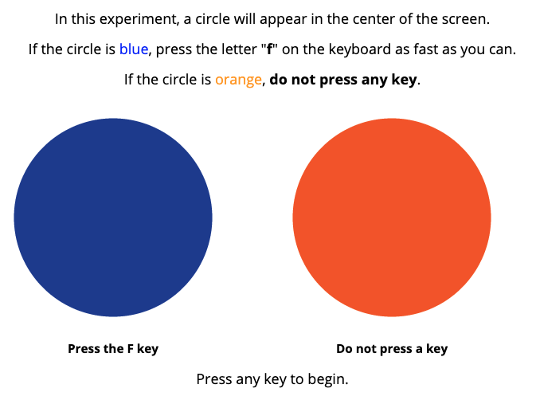
static/
├── css/
├── fonts/
├── images/
├── lib/
└── js/
js/
├── experiment.js
├── utils.js
├── jspsych.js
├── jspsych-html-button-…js
├── jspsych-html-keyboard-…js
└── jspsych-image-keyboard-…js
experiment.js
Go/No-go task

Slide 48
Demo

