Slide 1
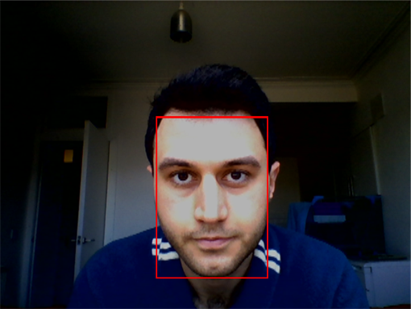
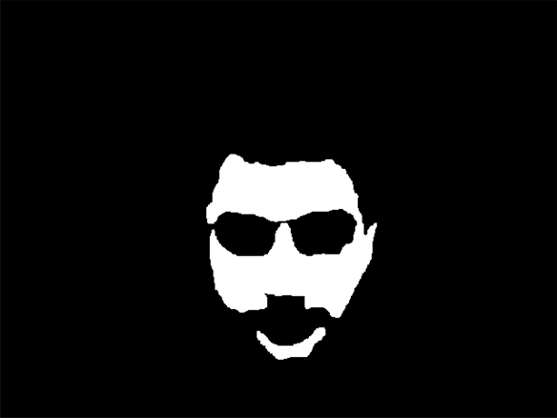
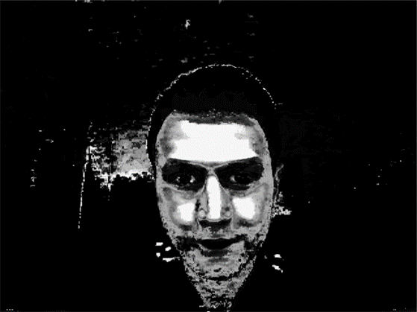
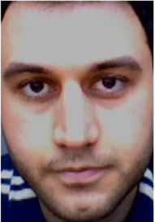
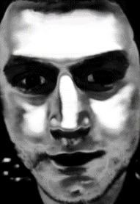
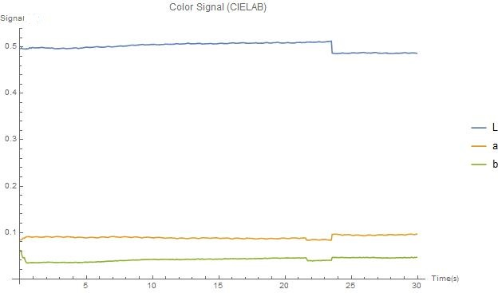
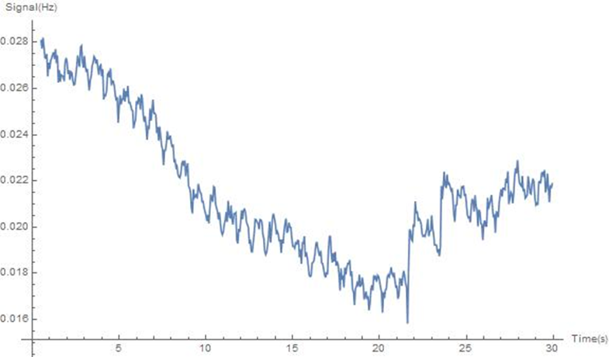
Heartbeat Measurement Using Video Processing
Face Recognition & Cropped Stabilized Image of the Face
Skin Mask
ODISIO’S Skin Detection Method
Face Color Signals (CIELAB/ODISIO)
Blend of Channels (Heartbeat)

