Slide 1
British Airways Customer Booking Prediction Analysis
Machine Learning Model to Predict Customer Bookings

Slide 2
Project Overview
Data Overview
Objective: Predict whether a customer will complete a flight booking or not
Business Context: Understanding factors that influence bookings to help improve marketing strategies and increase overall customer experience
customer_booking.csv
50k rows
Columns
Num of passengers
Sales channel
Type of trip
Purchase lead
Length of stay
Flight hour
Flight day
Route
Booking origin
Wants extra baggage or not
Has a preferred seat or not
Wants an in-flight meal or not
Flight duration
Completed Booking or Not

Slide 3
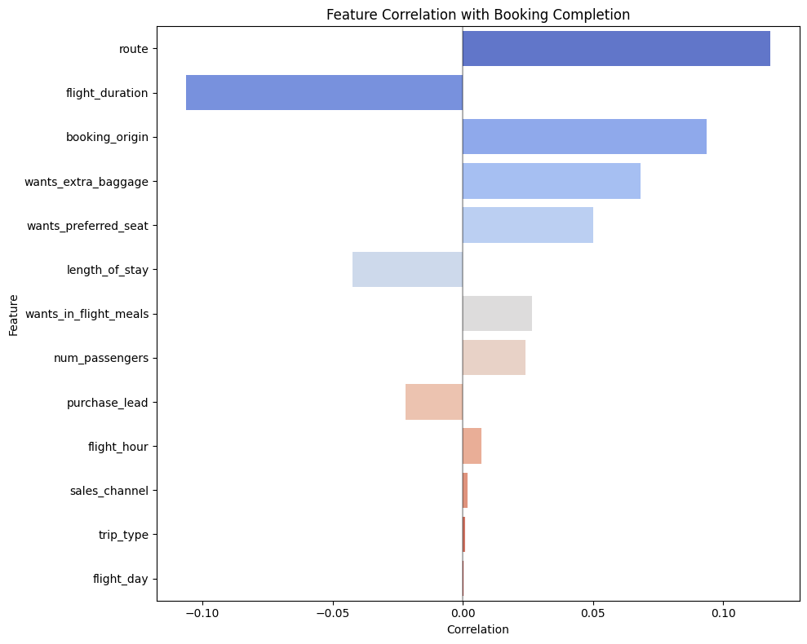
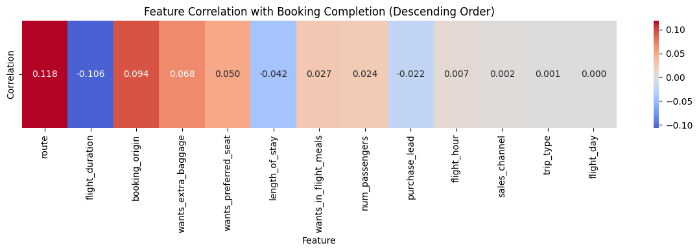

Slide 4
Modelling – Random Forest
Training Process
Split the data into training and testing sets of 80/20
Training: 40k rows
Testing: 10k rows
Fit the Random Forest model on the training data

Slide 5
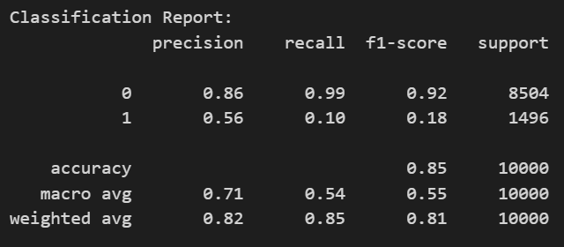
Modelling – Random Forest
The model correctly predicts the outcome (whether a booking was completed or not) 85% of the time
F1-Score (0.1750): This gives a better overall measure of performance for imbalanced datasets. The low F1-score for Class 1 indicates a significant imbalance issue, which is due to the target variable having an overwhelming number of non-bookings
--- Model Performance Metrics ---
Accuracy: 0.8539
Precision: 0.5636
Recall: 0.1036
F1 Score: 0.1750

Slide 6

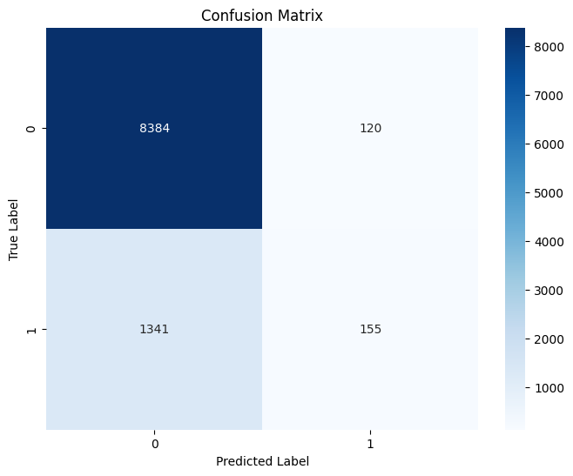
Modelling – Random Forest
The matrix strengthens the imbalance claim. The model is very good at predicting completed bookings (large number in the top-left) but poor at predicting not completed bookings (small number in the bottom-right).

Slide 7
Modelling – Random Forest
5-fold cross validation
Cross-validation scores: [0.852625 0.852625 0.851875 0.85275 0.8525 ]
Mean CV accuracy: 0.8525
The model's performance is relatively stable across different folds of the data as there are minimal differences among them
Standard deviation: 0.0003
The numeric proof of the model’s consistent accuracy across different folds

Slide 8
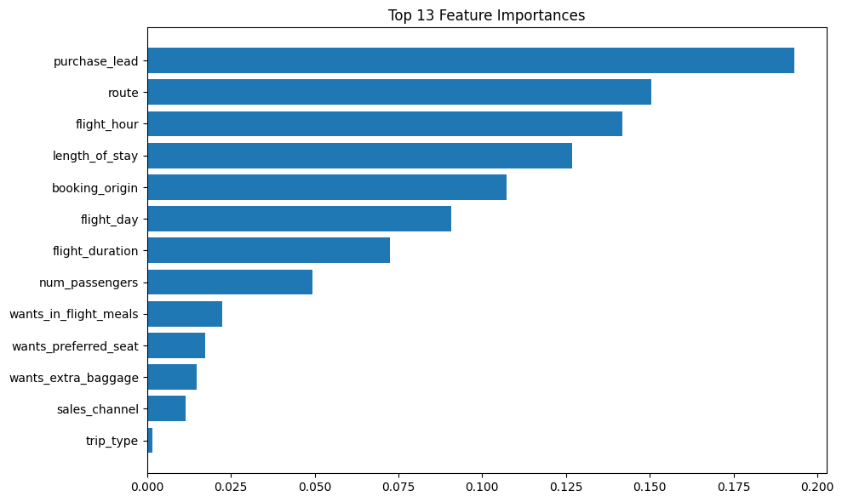
The "Purchase Lead" is by far the most dominant feature, suggesting that the timing of the booking is crucial.
“Route” importance suggests that certain routes may have different booking completion patterns.
Features related to the flight itself (hour, day, duration) and booking details (length of stay, origin) are generally more important than the optional service features.

Slide 9
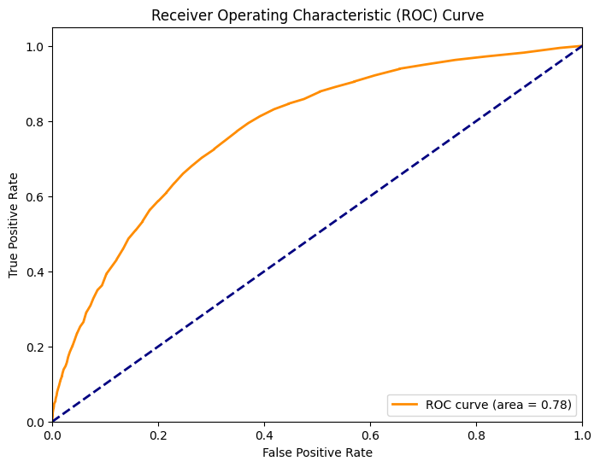
The shape of the curve is above the diagonal line, indicating a better than random performance
An ROC curve area of 0.78 means that the model has a 78% chance of correctly ranking a randomly chosen positive case higher than a randomly chosen negative case.

