Slide 1
British Airways Web Review Analysis

Slide 2
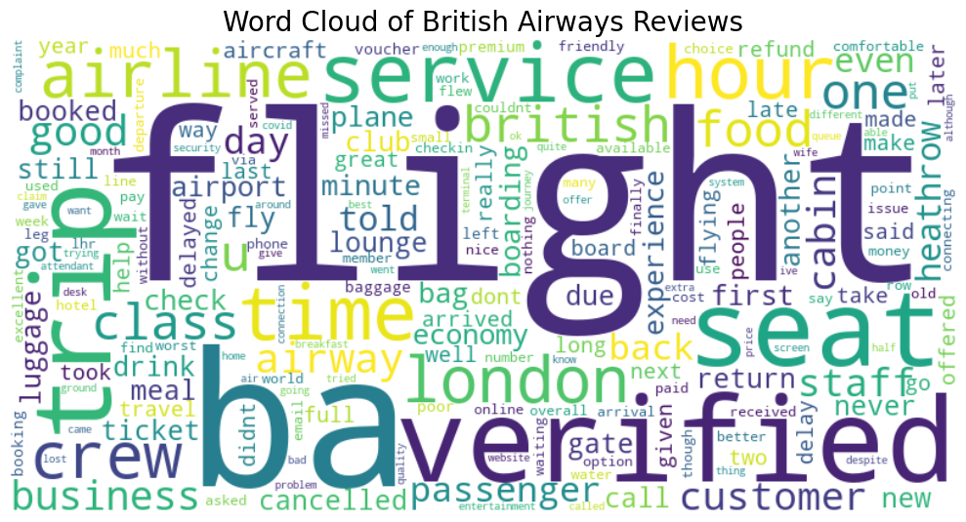
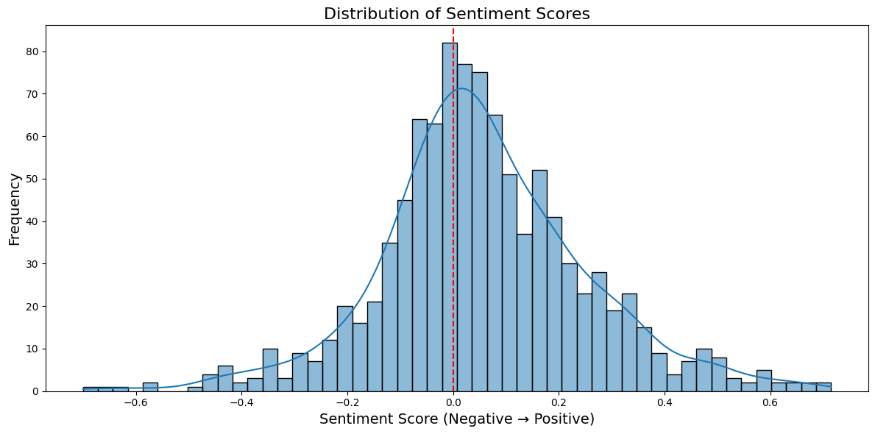
Overview Analysis
Primary concerns regarding the airline has the keyword
Flight
Service
“ba” for British Airways
This already indicates that the dataset is valid enough for analysis
The word cloud hold enough variety of positive and negative.
Positive: “good”, “great”, “friendly”
Negative: “delayed”, “cancelled”, “problem”
Neutral

Slide 3
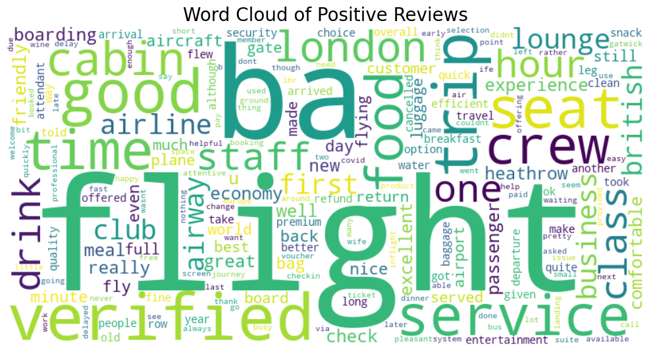
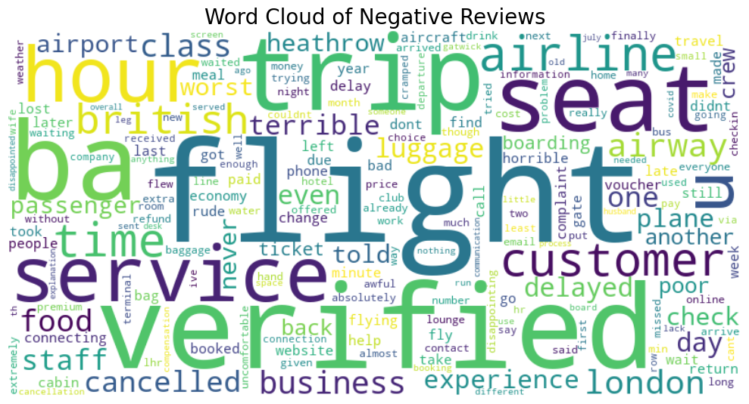
Wordcloud – Positive Reviews
Most frequent words: flight, service, staff, crew, good, food, time, class, cabin.
Wordcloud – Negative Reviews
Most frequent words: flight, service, delay, cancelled, terrible, seat, luggage, hour, refund.

Slide 4
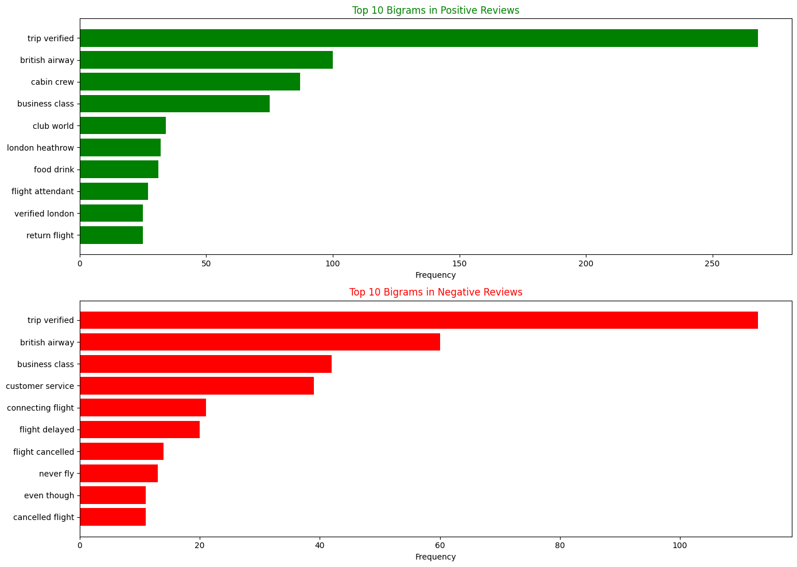
Bigrams
A bigram is a sequence of two adjacent elements from a string of tokens, which can be letters, syllables, or words.

Slide 5
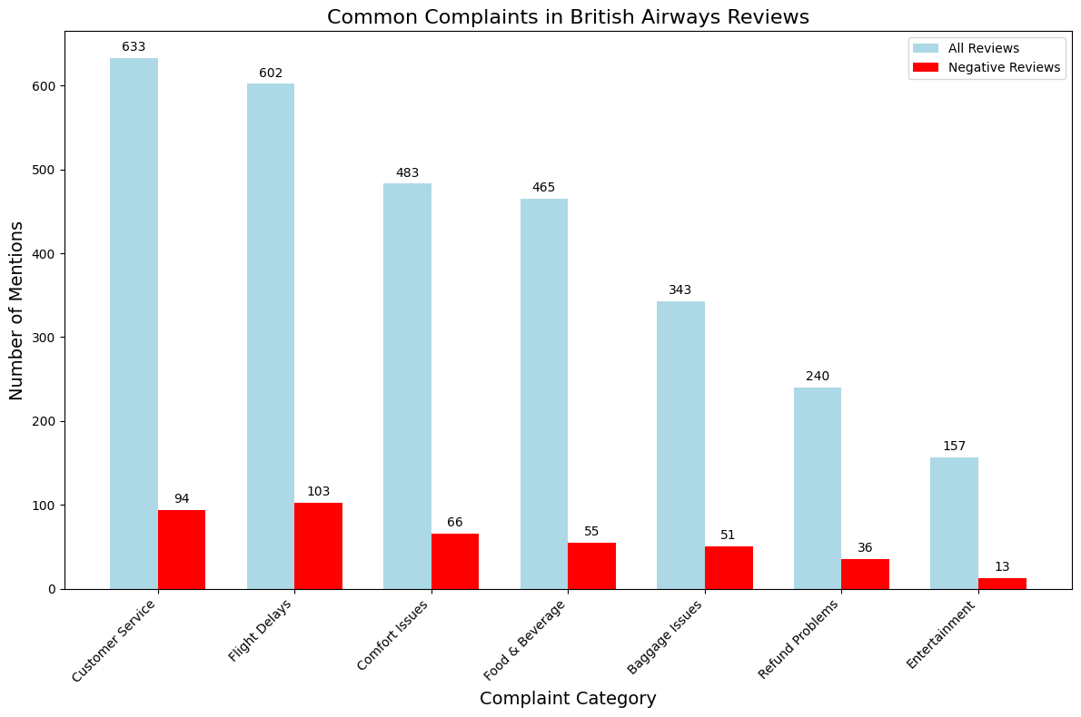
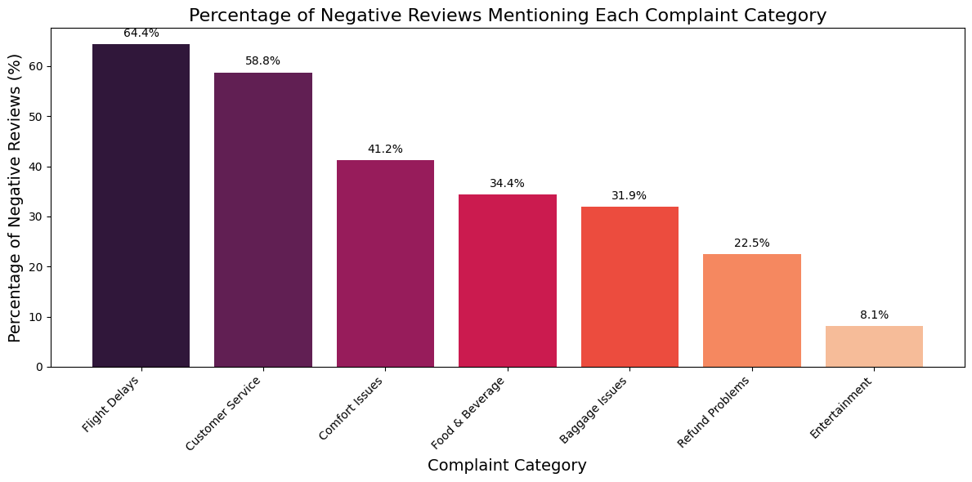
Complaint Categorization
Customer Service
Flight Delays
Comfort Issues
Food & Beverage
Baggage Issues
Refund Problems
Entertainment

