Slide 1
Drone DATASETS

Slide 2
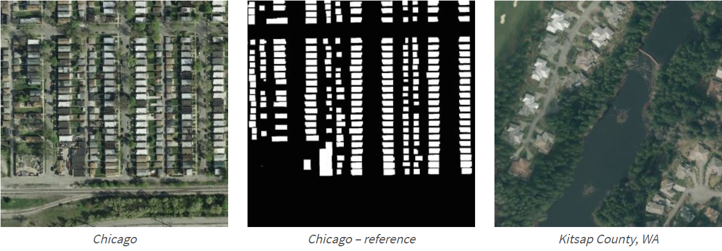
Inria Aerial Image Labeling https://project.inria.fr/aerialimagelabeling/ Coverage of 810 km² (405 km² for training and 405 km² for testing) Aerial orthorectified color imagery with a spatial resolution of 0.3 m

Slide 3
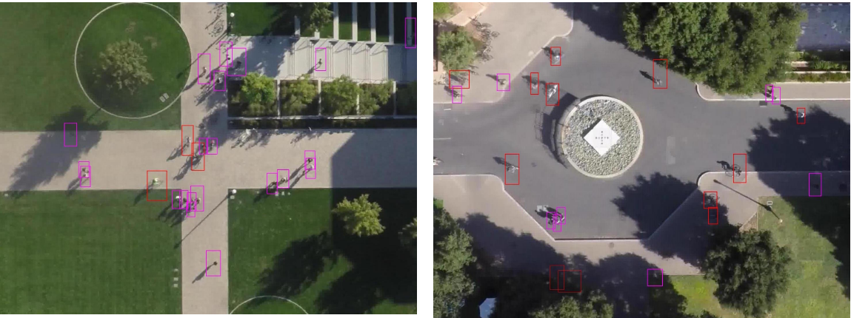
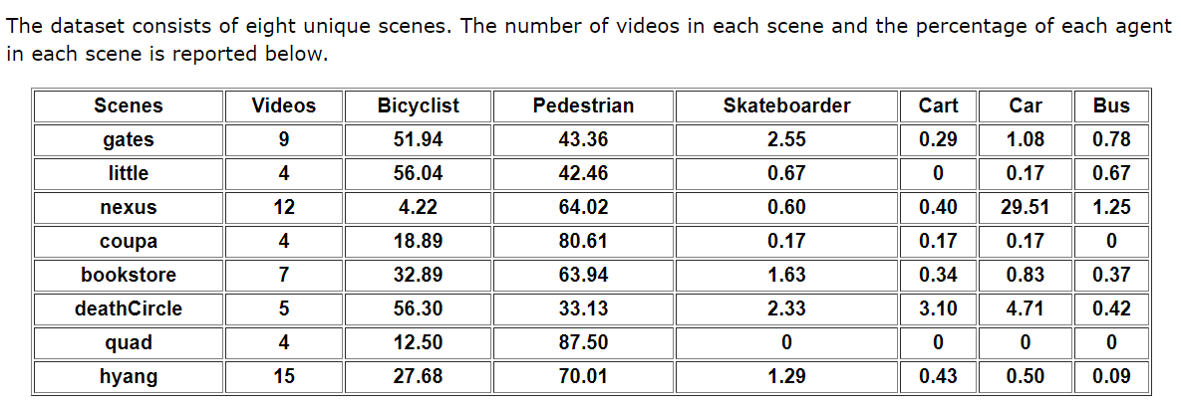
Stanford Drone Dataset https://cvgl.stanford.edu/projects/uav_data/ 69 GB of images collected over different scenes

Slide 4
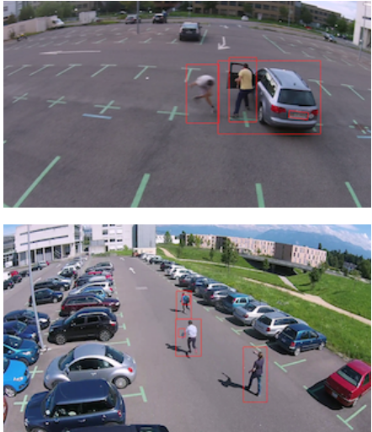
Mini-drone video dataset https://www.epfl.ch/labs/mmspg/downloads/mini-drone/ 38 videos
The created dataset consists of 38 different contents captured in full HD resolution, with a duration of 16 to 24 seconds each, shot with the mini-drone Phantom 2 Vision+ in a parking lot.

Slide 5
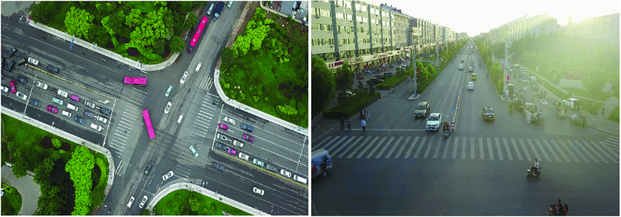
Visdrone https://github.com/VisDrone/VisDrone-Dataset
The benchmark dataset consists of 288 video clips formed by 261,908 frames and 10,209 static images, captured by various drone-mounted cameras, covering a wide range of aspects including location (taken from 14 different cities separated by thousands of kilometers in China), environment (urban and country), objects (pedestrian, vehicles, bicycles, etc.), and density (sparse and crowded scenes).

Slide 6
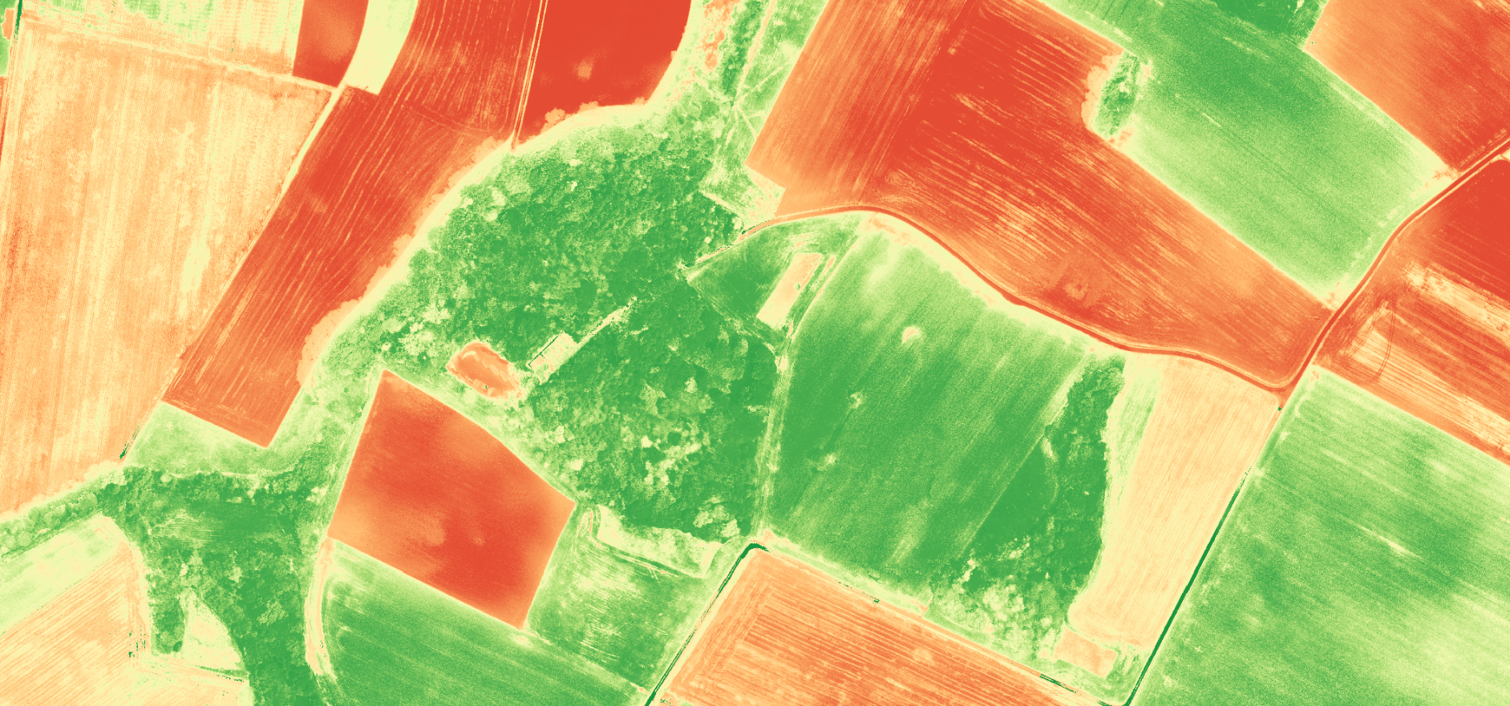
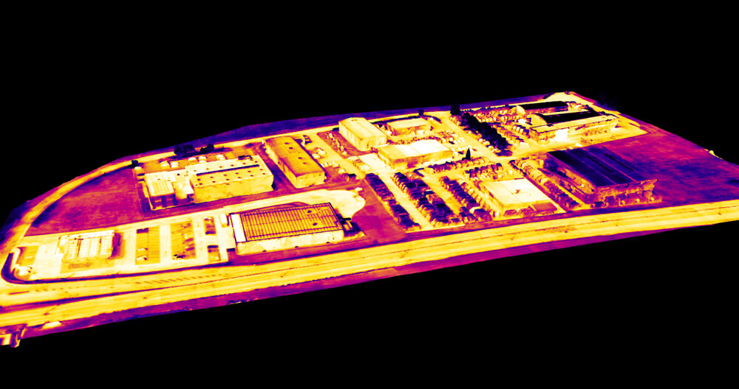
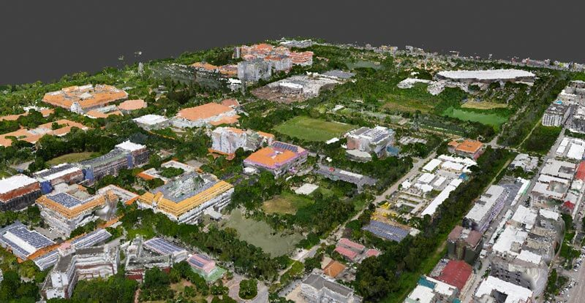
Sensefly Datasets
Thermal Industrial estate 777 grey + 777 rgb
Mixed used fields 12740
University Campus 443
Quarry 136
Industrial estate 113
And more

Slide 7
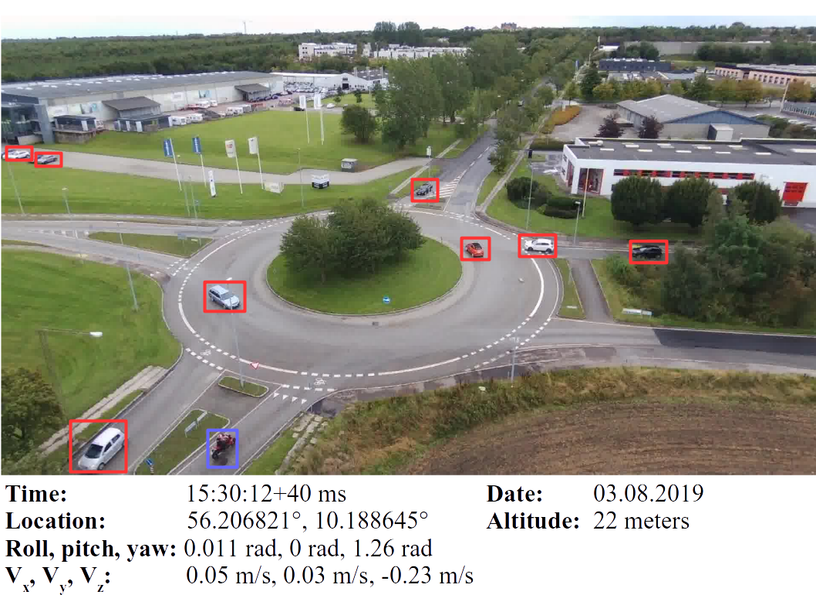
AU-AIR
AU-AIR dataset is the first multi-modal UAV dataset for object detection.
It meets vision and robotics for UAVs having the multi-modal data from different on-board sensors, and pushes forward the development of computer vision and robotic algorithms targeted at autonomous aerial surveillance.AU-AIR has several features:Object detection in aerial images
>2 hours raw videos
32,823 labelled frames
132,034 object instances
8 object categories related to traffic surveillance
Frames are also labelled with time, GPS, IMU, altitude, linear velocities of the UAV

Slide 8
https://www.kaggle.com/kmader/drone-videos
Found 5 videos and 5 flight files of drone surveillance

