Slide 1

SCAAI Research Application
Applicant name: aboli marathe
INSTITUTE: PUNE INSTITUTE OF COMPUTER TECHNOLOGY

Slide 2
Compare the CNN, YOLO and RetinaNet architectures for performance over benchmark datasets.
-PROBLEM STATEMENT

Slide 3
DataSet Description
Datasets Used
COCO 2014: 80 classes, 82,783 training, 40,504 validation, and 40,775 testing images

Slide 4
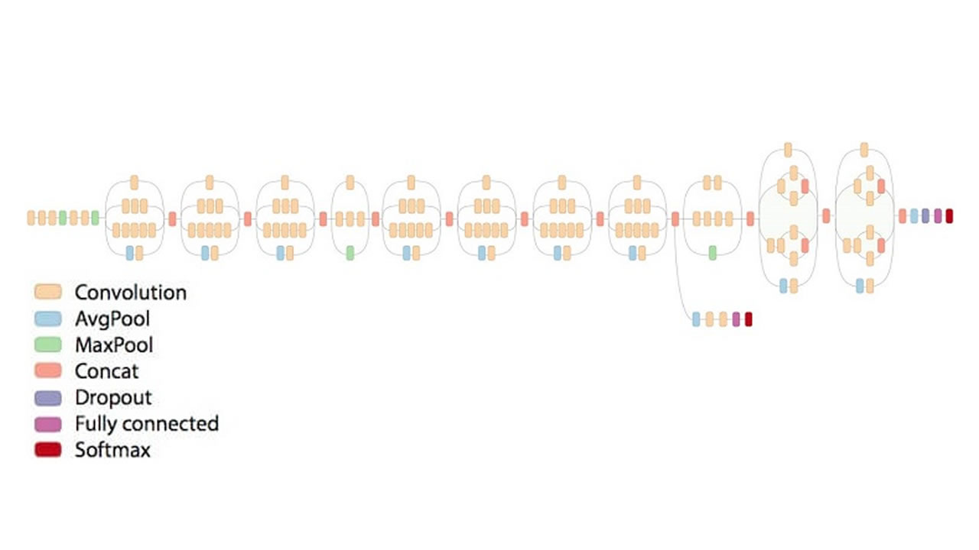
CNN – INCEPTION V3

Slide 5
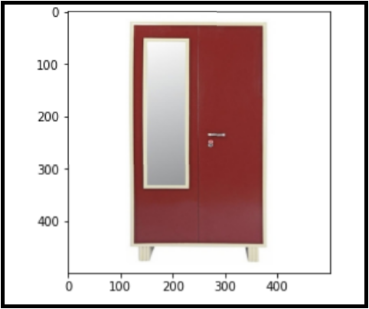
Test Image Results

Slide 6
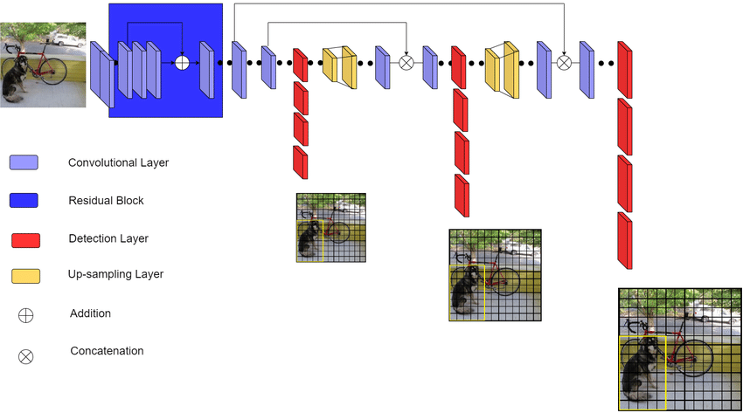
YOLO V3

Slide 7
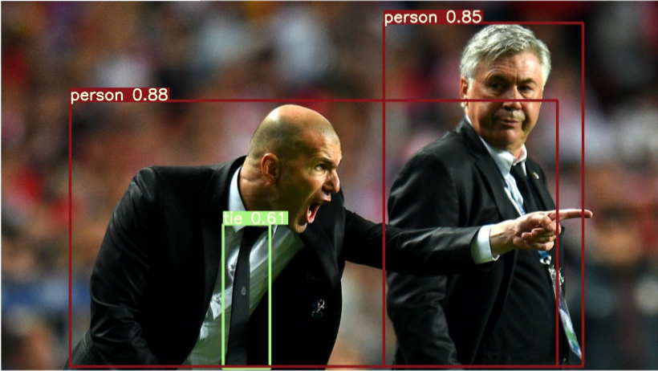
Test Image Results

Slide 8
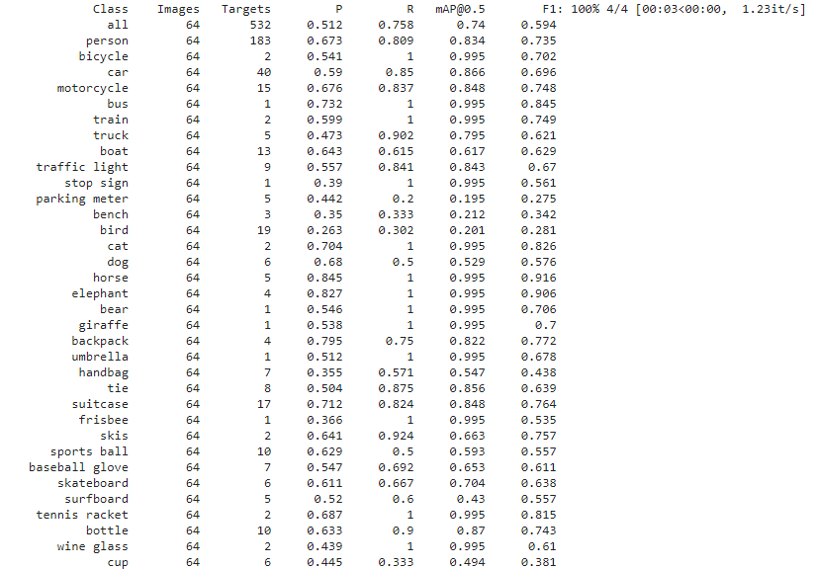

Slide 9
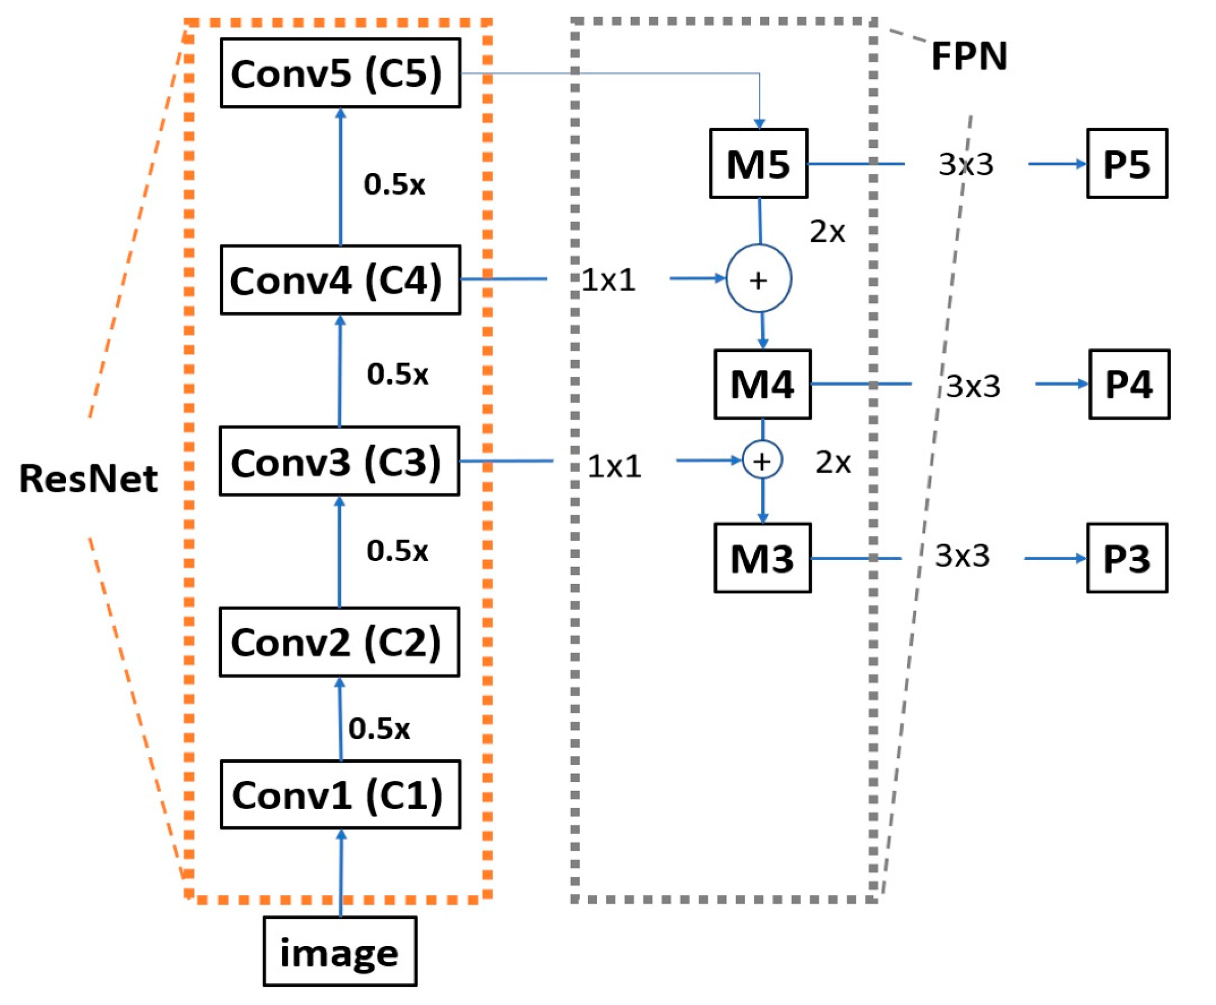
RetinaNet

Slide 10
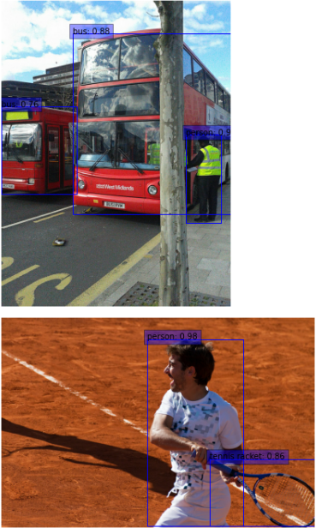
Test Image Results

Slide 11
RESULTS
Architecture | Precision (mAP) | F1- Score | Recall | Accuracy | Training Time
CNN –Inception V3 | 0.22 | 0.250 | 0.29 | 78 | Pretrained
YOLO V3 | 0.21 | 0.266 | 0.43 | 84 | 2 days
RetinaNet | 0.318 | 0.300 | 0.306 | 86.8 | 6 hrs

Slide 12
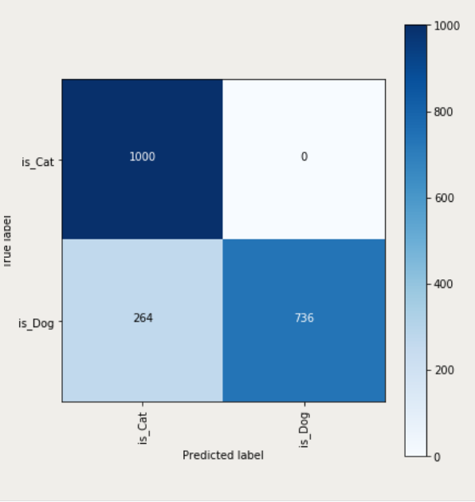
RetinaNet Confusion Matrix

Slide 13
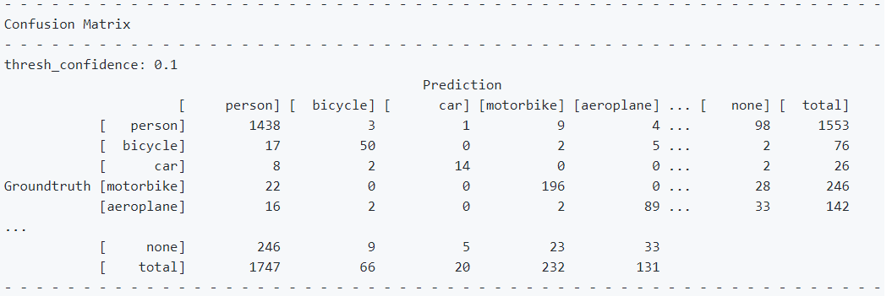
YOLO V3 Confusion Matrix

Slide 14
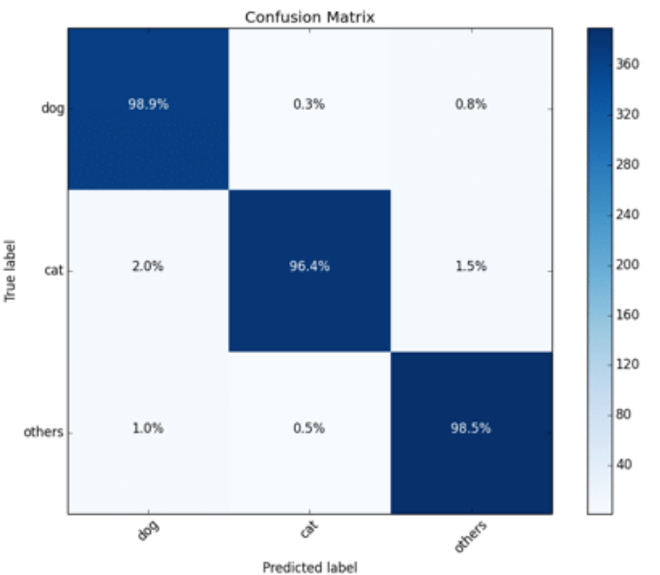
INCEPTION V3 Confusion Matrix

Slide 15
INTERESTING POINTS
Feature Pyramid Network (FPN) is a feature extractor designed for such pyramid concept with accuracy and speed in mind. It replaces the feature extractor of detectors like Faster R-CNN and generates multiple feature map layers (multi-scale feature maps) with better quality information than the regular feature pyramid for object detection.
FPN extracts feature maps and later feeds into a detector, says RPN, for object detection. RPN applies a sliding window over the feature maps to make predictions on the objectness (has an object or not) and the object boundary box at each location.
Instead of trying to reduce outliers or predictions where the model’s prediction is far off from the truth, Focal Loss reduces the weight (or impact) the values it predicted correctly carry. The loss function is just a mathematical way of saying how far off a guess is from the real value of a datapoint.

Slide 16
Conclusion
RetinaNet has the best performance in terms of mAP and training time
Upon analysis of architecture, the ResNet+FPN as backbone for feature extraction, plus two task-specific subnetworks for classification and bounding box regression may be the reason for this performance.
RetinaNet can have ~100k boxes with the resolve of class imbalance problem using focal loss.

Slide 17
References
Source Code: https://github.com/Infernolia/Basic_Object_Detection
Light-Weight RetinaNet for Object Detection- Yixing Li, Fengbo Ren
Recurrent RetinaNet: A Video Object Detection Model Based on Focal Loss- Xiaobo Li, Haohua Zhao, Liqing Zhang
YOLOv3: An Incremental Improvement- Joseph Redmon, Ali Farhadi
Bag of Tricks for Image Classification with Convolutional Neural Networks- Tong He, Zhi Zhang, Hang Zhang, Zhongyue Zhang, Junyuan Xie, Mu Li;

Slide 18

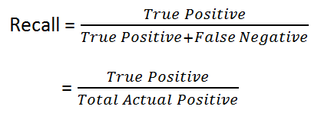

Appendix
Precision is a good measure to determine, when the costs of False Positive is high. For instance, email spam detection. In email spam detection, a false positive means that an email that is non-spam (actual negative) has been identified as spam (predicted spam). The email user might lose important emails if the precision is not high for the spam detection model.
For instance, in fraud detection or sick patient detection. If a fraudulent transaction (Actual Positive) is predicted as non-fraudulent (Predicted Negative), the consequence can be very bad for the bank.

