Slide 1

3
Differentiation
Copyright © Cengage Learning. All rights reserved.

Slide 2
Basic Differentiation Rules and Rates of Change
3.2
Copyright © Cengage Learning. All rights reserved.

Slide 3
Objectives
Find the derivative of a function using the Constant Rule.
Find the derivative of a function using the Power Rule.
Find the derivative of a function using the Constant Multiple Rule.
Find the derivative of a function using the Sum and Difference Rules.

Slide 4
Objectives
Find the derivatives of the sine function and of the cosine function.
Find the derivatives of exponential functions.
Use derivatives to find rates of change.

Slide 5
The Constant Rule

Slide 6
The Constant Rule
We have used the limit definition to find derivatives. In this section you will be introduced to several “differentiation rules” that allow you to find derivatives without the direct use of the limit definition.

Slide 7
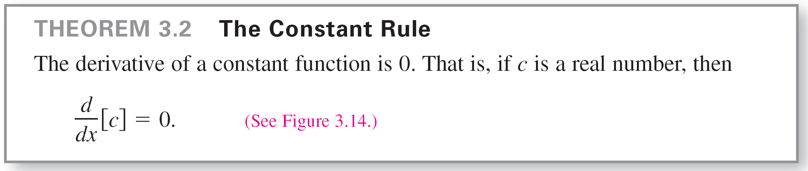
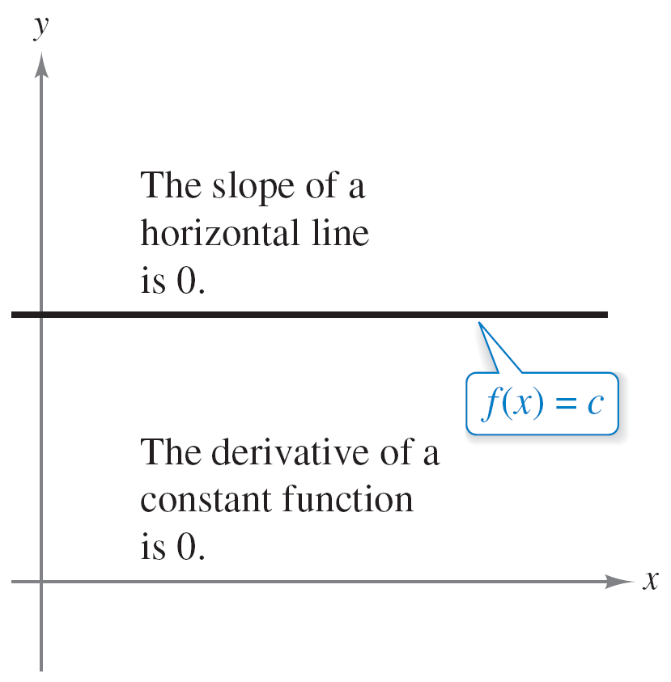
The Constant Rule
Notice that the Constant Rule is equivalent to saying that the slope of a horizontal line is 0. This demonstrates the relationship between slope and derivative.
Figure 3.14

Slide 8
Example 1 – Using the Constant Rule
Function Derivative
a. y = 7 dy/dx = 0
b. f (x) = 0 f ′(x) = 0
c. s(t) = –3 s′(t) = 0
d. y = kπ ², k is constant y ′ = 0

Slide 9
The Power Rule

Slide 10
The Power Rule
Before proving the next rule, it is important to review the procedure for expanding a binomial.
(x + Δx)² = x² + 2xΔx + (Δx)²
(x + Δx)³ = x³ + 3x²Δx + 3x(Δx)² + (Δx)³
(x + Δx)⁴ = x⁴ + 4x³Δx + 6x²(Δx)² + 4x(Δx)³ + (Δx)⁴
(x + Δx)⁵ = x⁵ + 5x⁴Δx + 10x³(Δx)² + 10x²(Δx)³ + 5x(Δx)⁴ + (Δx)⁵
The general binomial expansion for a positive integer n is
(Δx)² is a factor of these terms.

Slide 11
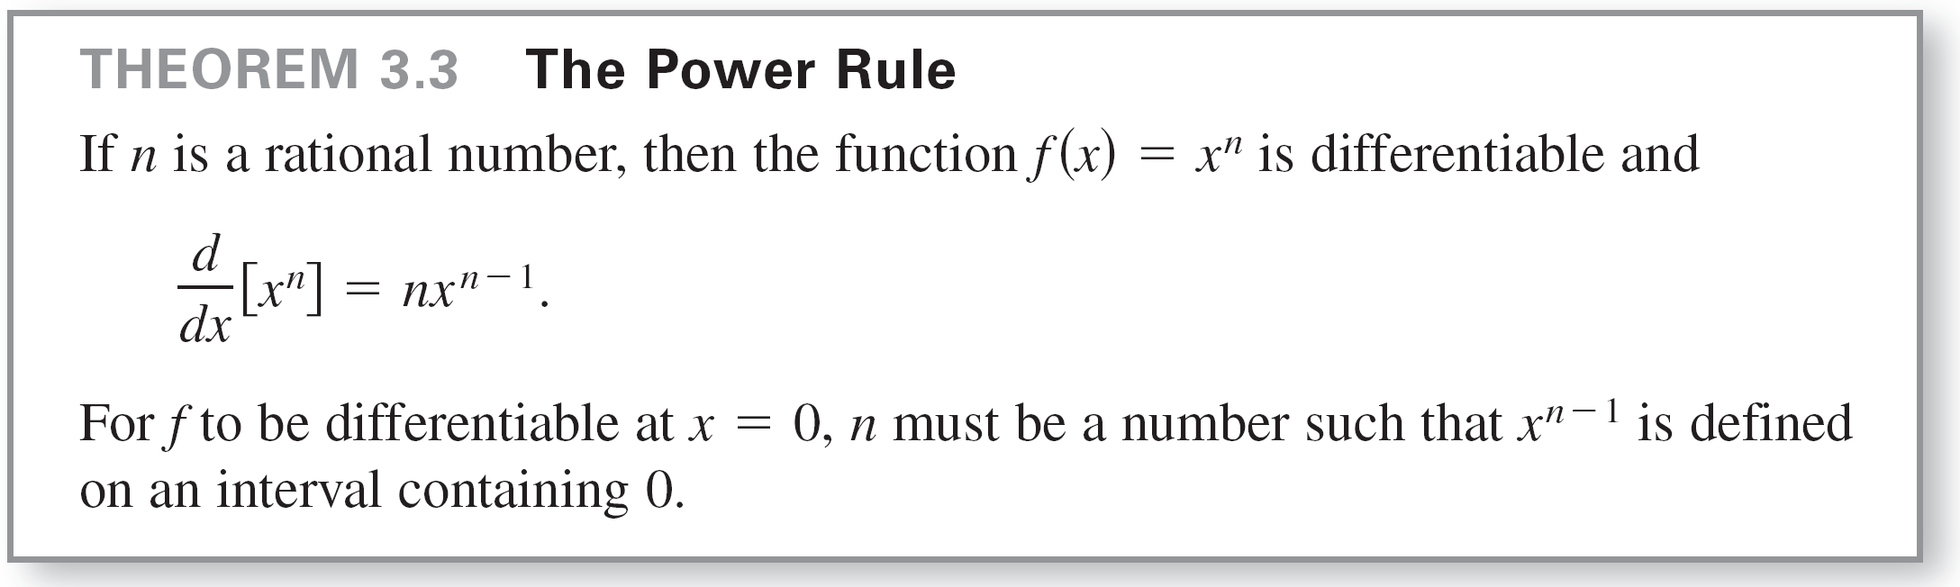
The Power Rule
This binomial expansion is used in proving a special case of the Power Rule.

Slide 12
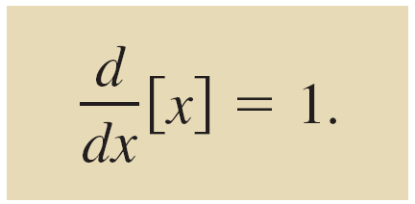
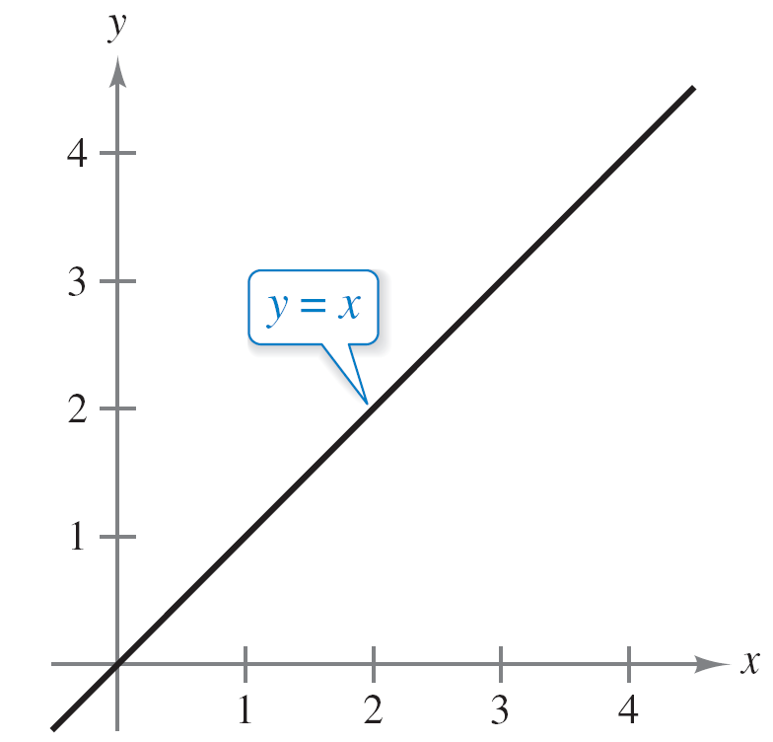
The Power Rule
When using the Power Rule, the case for which n = 1 is best thought of as a separate differentiation rule. That is,
This rule is consistent with the fact that the slope of the line y = x is 1, as shown in Figure 3.15.
Power Rule when n = 1
The slope of the line y = x is 1.
Figure 3.15

Slide 13
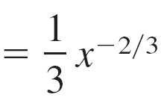

Example 2 – Using the Power Rule
Function Derivative
a.
b.
c.

Slide 14
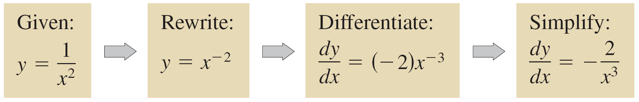
The Power Rule
In Example 2(c), note that before differentiating, 1/x² was rewritten as x ^{–2}. Rewriting is the first step in many differentiation problems.

Slide 15
The Constant Multiple Rule

Slide 16
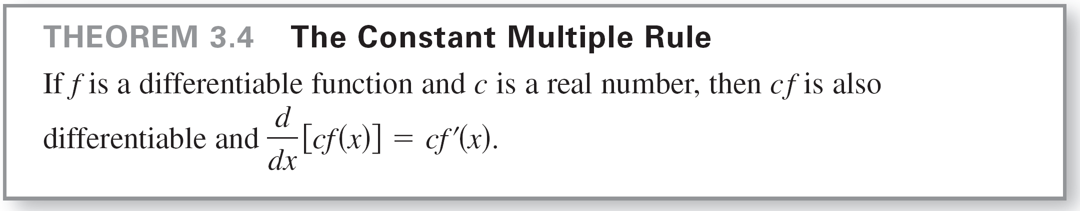
The Constant Multiple Rule
Informally, the Constant Multiple Rule states that constants can be factored out of the differentiation process, even when the constants appear in the denominator.

Slide 17
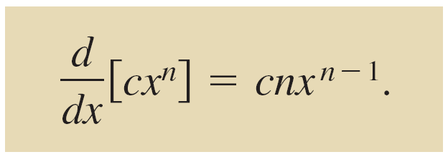
The Constant Multiple Rule
The Constant Multiple Rule and the Power Rule can be combined into one rule. The combination rule is

Slide 18
The Sum and Difference Rules

Slide 19
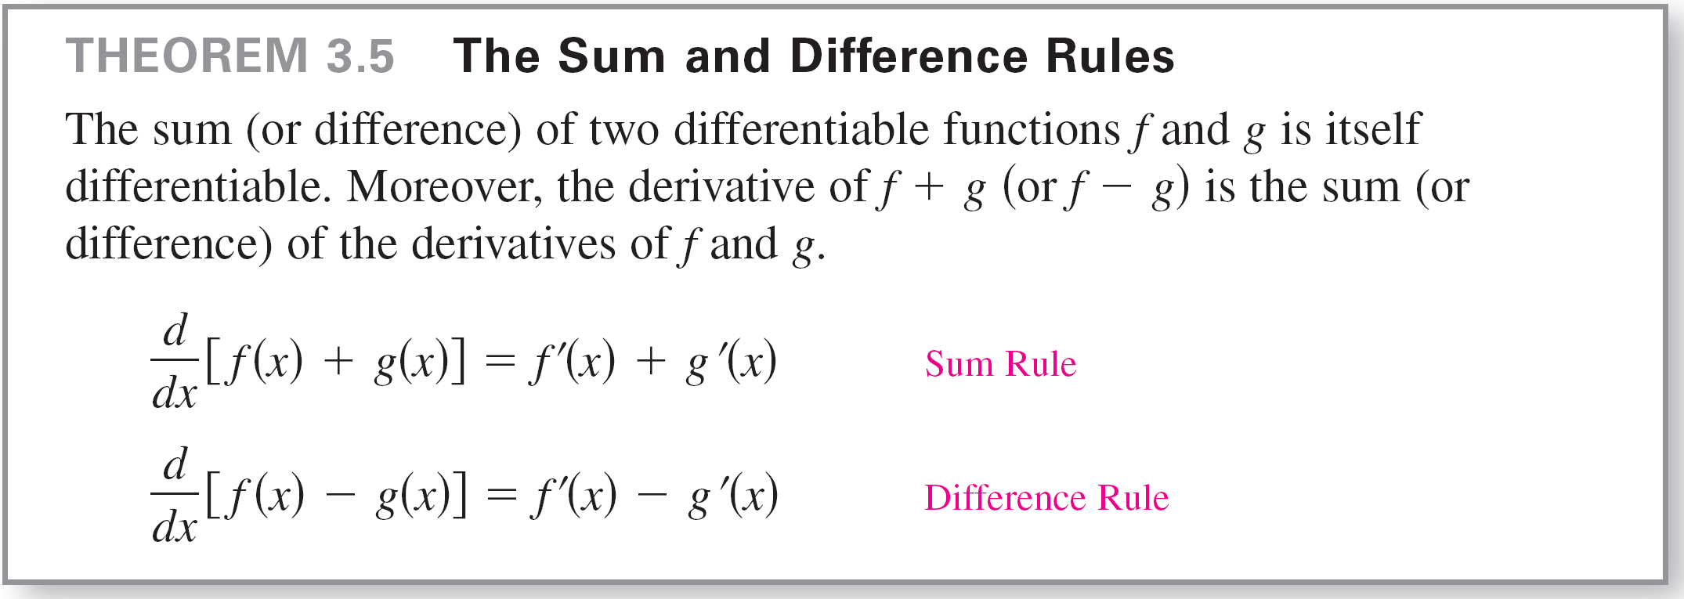
The Sum and Difference Rules
The Sum and Difference Rules can be extended to any finite number of functions. For instance, if F(x) = f (x) + g(x) – h(x), then F′(x) = f ′(x) + g′(x) – h′(x).

Slide 20
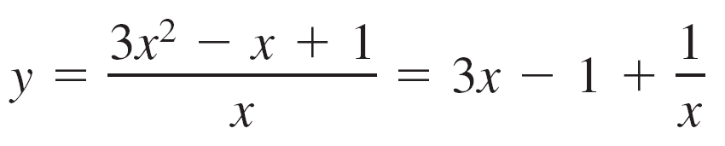
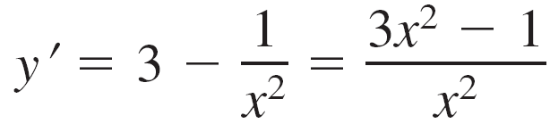
Example 7 – Using the Sum and Difference Rules
Function Derivative
a. f (x) = x³ – 4x + 5 f ′(x) = 3x² – 4
b. g(x) = + 3x³ – 2x g′(x) = –2x³ + 9x² – 2
c. = 3x – 1 +

Slide 21
Derivatives of the Sine and Cosine Functions

Slide 22
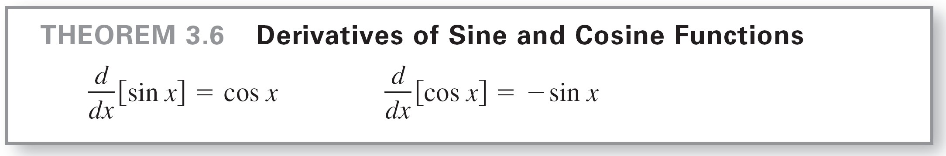
Derivatives of the Sine and Cosine Functions
We have studied the following limits.
These two limits can be used to prove differentiation rules for the sine and cosine functions.

Slide 23
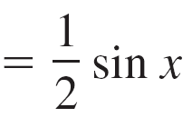
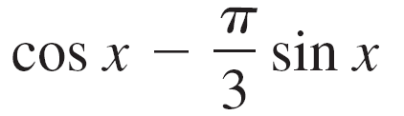
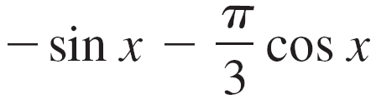
Example 8 – Derivatives Involving Sines and Cosines
Function Derivative
a. y = 2 sin x y ′ = 2 cos x
b.
c. y = x + cos x y ′ = 1 – sin x
d.

Slide 24
Derivatives of Exponential Functions

Slide 25
Derivatives of Exponential Functions
One of the most intriguing (and useful) characteristics of the natural exponential function is that it is its own derivative. Consider the following argument.
Let f (x) = e^{x}.

Slide 26
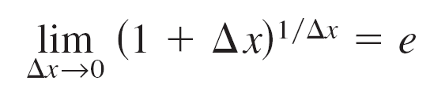
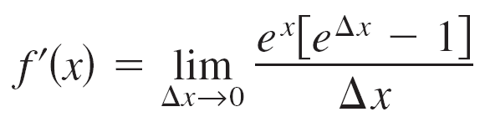
Derivatives of Exponential Functions
The definition of e
tells you that for small values of Δx, you have e ≈ (1 + Δx)^{1/Δx}, which implies that e^{Δx} ≈ 1 + Δx. Replacing e^{Δx} by this approximation produces the following.

Slide 27
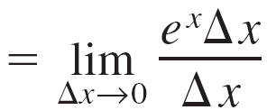
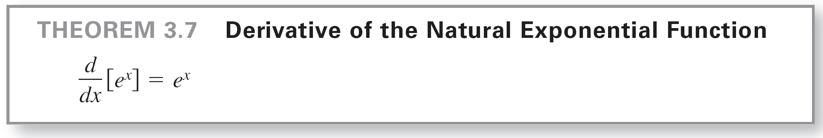
Derivatives of Exponential Functions
This result is stated in the next theorem.

Slide 28
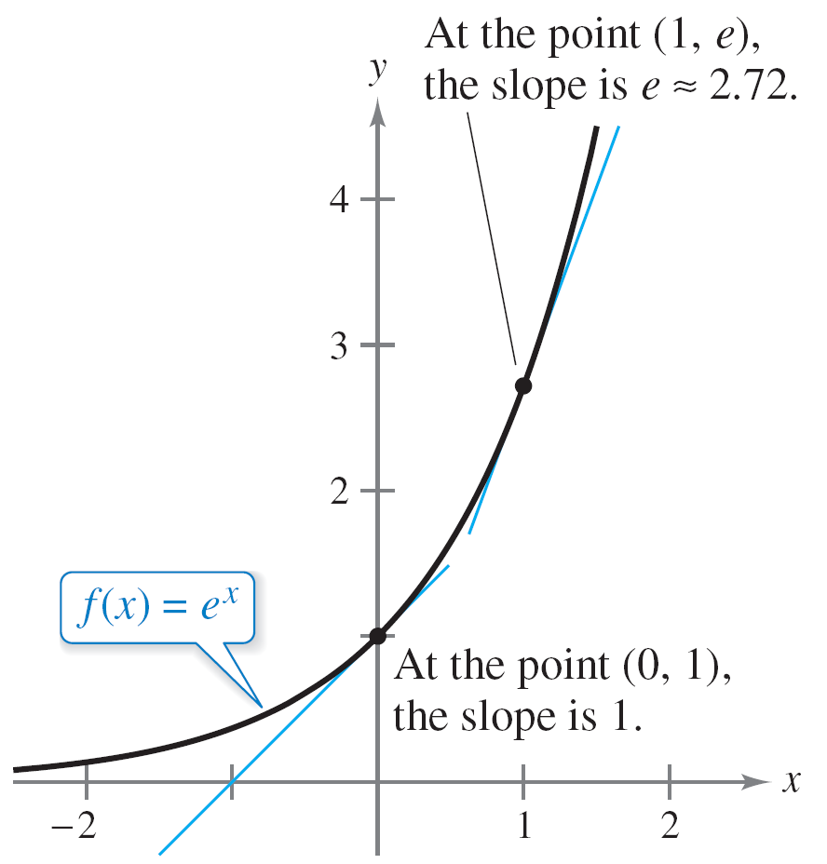
Derivatives of Exponential Functions
You can interpret Theorem 3.7 graphically by saying that the slope of the graph of f (x) = e^{x} at any point (x, e^{x}) is equal to the y-coordinate of the point, as shown in Figure 3.20.
Figure 3.20

Slide 29
Example 9 – Derivatives of Exponential Functions
Find the derivative of each function.
a. f (x) = 3e^{x} b. f (x) = x² + e^{x} c. f (x) = sin x – e^{x}
Solution:
a.
b.
c.

Slide 30
Rates of Change

Slide 31
Rates of Change
We have seen how the derivative is used to determine slope. The derivative can also be used to determine the rate of change of one variable with respect to another.
Applications involving rates of change occur in a wide variety of fields. A few examples are population growth rates, production rates, water flow rates, velocity, and acceleration.
A common use for rate of change is to describe the motion of an object moving in a straight line.

Slide 32
Rates of Change
In such problems, it is customary to use either a horizontal or a vertical line with a designated origin to represent the line of motion.
On such lines, movement to the right (or upward) is considered to be in the positive direction, and movement to the left (or downward) is considered to be in the negative direction.
The function s that gives the position (relative to the origin) of an object as a function of time t is called a position function.

Slide 33
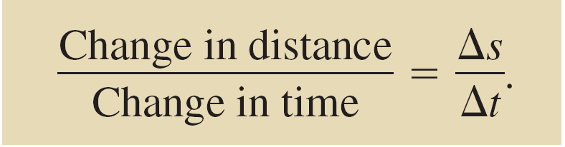
Rates of Change
If, over a period of time Δt, the object changes its position by the amount Δs = s(t + Δt) – s(t), then, by the familiar formula
the average velocity is
Average velocity

Slide 34
Example 10 – Finding Average Velocity of a Falling Object
A billiard ball is dropped from a height of 100 feet. The ball’s height s at time t is the position function
s = –16t² + 100
where s is measured in feet and t is measured in seconds. Find the average velocity over each of the following time intervals.
a. [1, 2] b. [1, 1.5] c. [1, 1.1]
Position function

Slide 35
Example 10(a) – Solution
For the interval [1, 2], the object falls from a height of
s(1) = –16(1)² + 100
to a height of s(2) = –16(2)² + 100
The average velocity is
= –48 feet per second.
= 84 feet
= 36 feet.

Slide 36
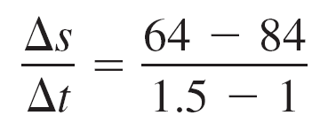
Example 10(b) – Solution
cont’d
For the interval [1, 1.5], the object falls from a height of 84 feet to a height of s(1.5) = –16(1.5)² + 100 = 64 feet.
The average velocity is
= –40 feet per second.

Slide 37
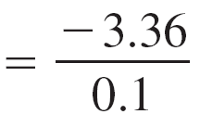
Example 10(c) – Solution
cont’d
For the interval [1, 1.1], the object falls from a height of 84 feet to a height of s(1.1) = –16(1.1)² + 100 = 80.64 feet.
The average velocity is
= –33.6 feet per second.
Note that the average velocities are negative, indicating that the object is moving downward.

Slide 38
Rates of Change
Suppose that in Example 10 you wanted to find the instantaneous velocity (or simply the velocity) of the object when t = 1.
Just as you can approximate the slope of the tangent line by calculating the slope of the secant line, you can approximate the velocity at t = 1 by calculating the average velocity over a small interval [1, 1 + Δt] (see Figure 3.21).
The average velocity between t₁and t₂ is the slope of the secant line, and the
instantaneous velocity at t₁ is the slope of the tangent line.
Figure 3.21

Slide 39
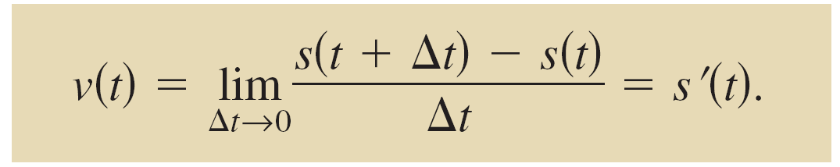
Rates of Change
By taking the limit as Δt approaches zero, you obtain the velocity when t = 1. Try doing this—you will find that the velocity when t = 1 is –32 feet per second.
In general, if s = s(t) is the position function for an object moving along a straight line, then the velocity of the object at time t is
In other words, the velocity function is the derivative of the position function.
Velocity function

Slide 40
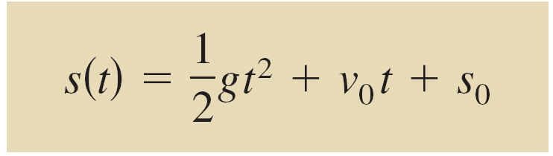
Rates of Change
Velocity can be negative, zero, or positive. The speed of an object is the absolute value of its velocity. Speed cannot be negative.
The position of a free-falling object (neglecting air resistance) under the influence of gravity can be represented by the equation
where s₀ is the initial height of the object, v₀ is the initial velocity of the object, and g is the acceleration due to gravity.
Position function

Slide 41
Rates of Change
On Earth, the value of g is approximately –32 feet per second per second or –9.8 meters per second per second.

