Slide 1
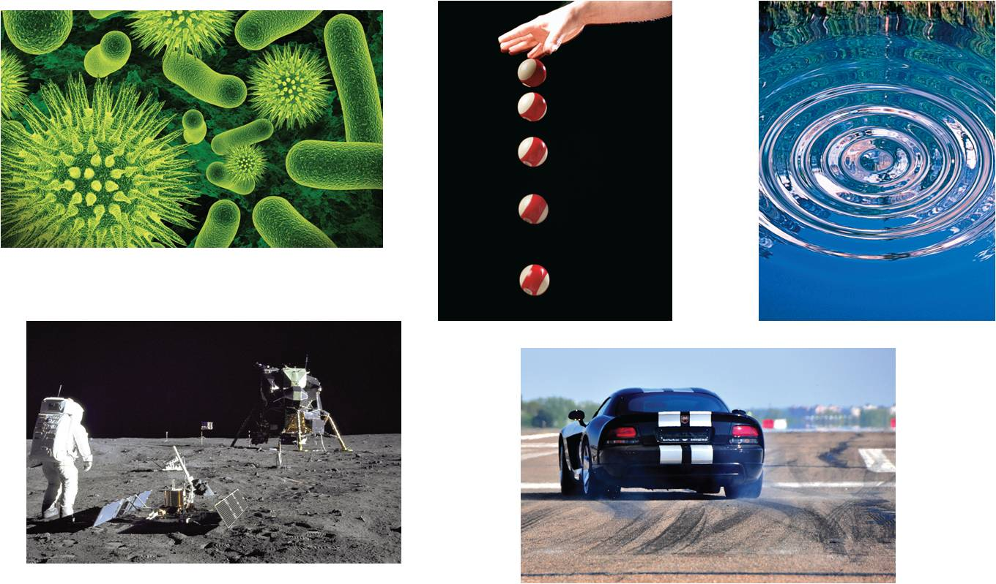
3
Differentiation
Copyright © Cengage Learning. All rights reserved.

Slide 2
Product and Quotient Rules and Higher-Order Derivatives
3.3
Copyright © Cengage Learning. All rights reserved.

Slide 3
Objectives
Find the derivative of a function using the Product Rule.
Find the derivative of a function using the Quotient Rule.
Find the derivative of a trigonometric function.
Find a higher-order derivative of a function.

Slide 4
The Product Rule

Slide 5
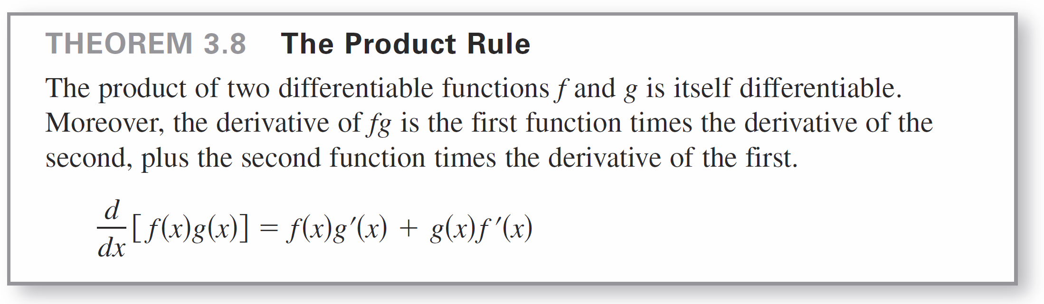
The Product Rule
We have learned that the derivative of the sum of two functions is simply the sum of their derivatives.
The rules for the derivatives of the product and quotient of two functions are not as simple.

Slide 6
The Product Rule
The Product Rule can be extended to cover products involving more than two factors. For example, if f, g, and h are differentiable functions of x, then
So, the derivative of y = x² sin x cos x is

Slide 7
The Product Rule
The derivative of a product of two functions is not (in general) given by the product of the derivatives of the two functions.
To see this, try comparing the product of the derivatives of
f (x) = 3x – 2x²
and
g(x) = 5 + 4x
with the derivative in Example 1.

Slide 8
Example 1 – Using the Product Rule
Find the derivative of h(x) = (3x – 2x²)(5 + 4x).
Solution:
= (3x – 2x²)(4) + (5 + 4x)(3 – 4x)
= (12x – 8x²) + (15 – 8x – 16x²)
= –24x² + 4x + 15
Derivative
of second
Derivative
of First
First
Second
Apply Product Rule.

Slide 9
The Product Rule
In Example 1, you have the option of finding the derivative with or without the Product Rule.
To find the derivative without the Product Rule, you can write
D_{x} [(3x – 2x²)(5 + 4x)] = D_{x} [–8x³ + 2x² + 15x]
= –24x² + 4x + 15.

Slide 10
The Quotient Rule

Slide 11
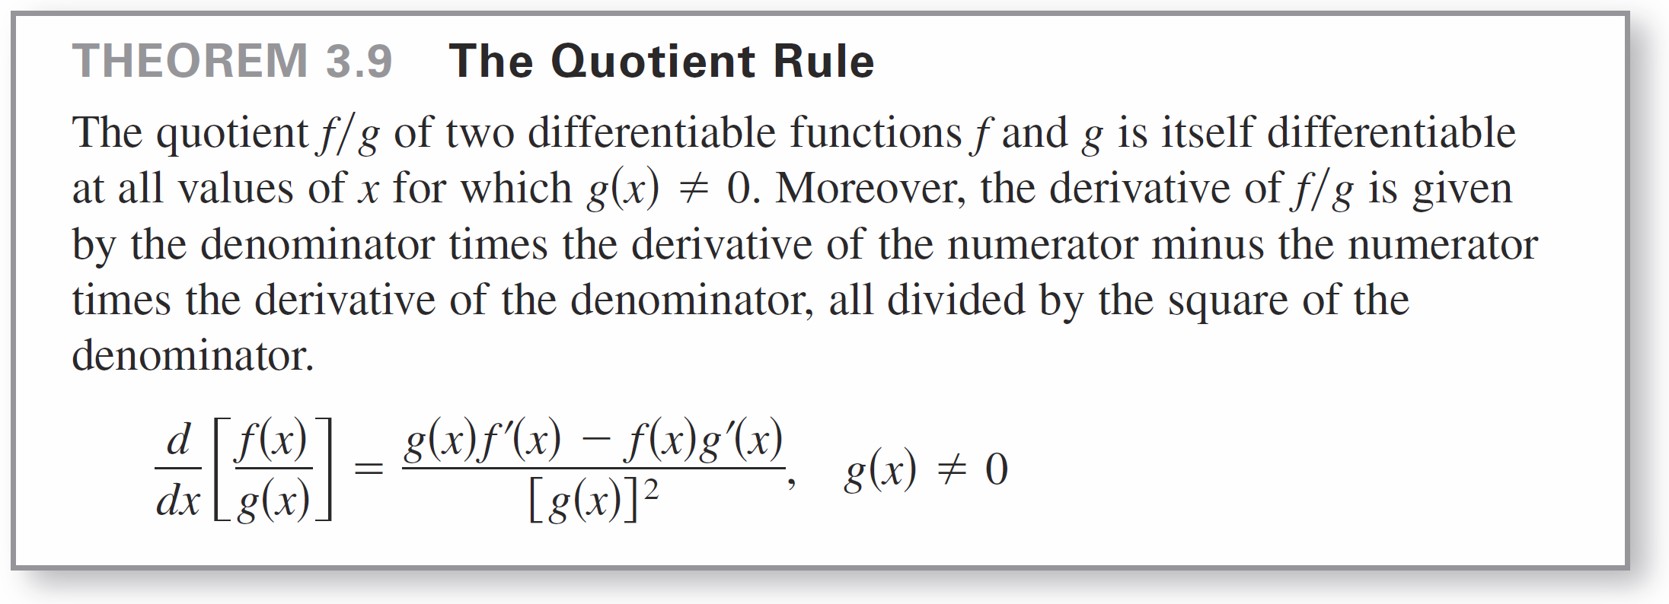
The Quotient Rule

Slide 12
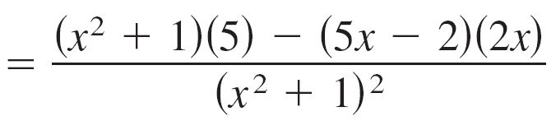
Example 4 – Using the Quotient Rule
Find the derivative of
Solution:
Apply Quotient Rule.

Slide 13
The Quotient Rule
Note the use of parentheses in Example 4. A liberal use of parentheses is recommended for all types of differentiation problems.
For instance, with the Quotient Rule, it is a good idea to enclose all factors and derivatives in parentheses, and to pay special attention to the subtraction required in the numerator.

Slide 14
Derivatives of Trigonometric Functions

Slide 15
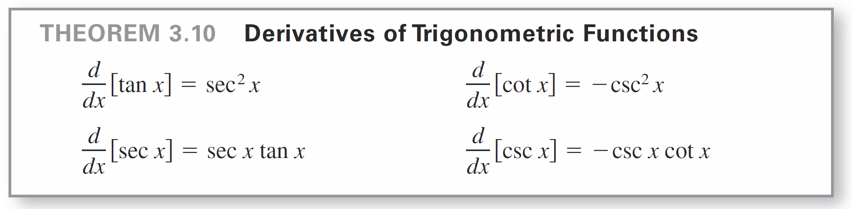
Derivatives of Trigonometric Functions
Knowing the derivatives of the sine and cosine functions, you can use the Quotient Rule to find the derivatives of the four remaining trigonometric functions.

Slide 16
Example 8 – Differentiating Trigonometric Functions
Function Derivative
a. y = x – tan x
b. y = x sec x y ′ = x(sec x tan x) + (sec x)(1)
= (sec x)(1 + x tan x)

Slide 17
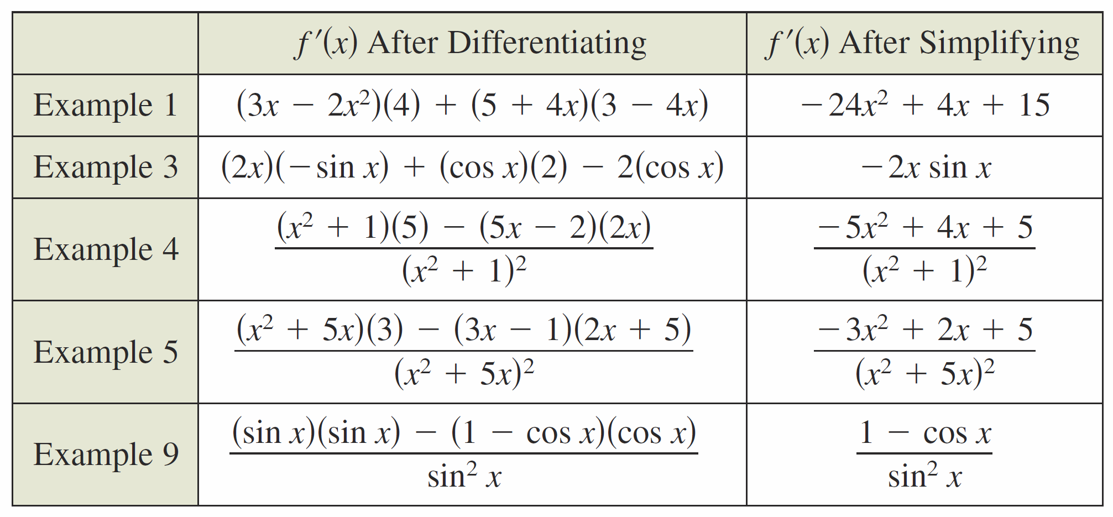
Derivatives of Trigonometric Functions
The summary below shows that much of the work in obtaining a simplified form of a derivative occurs after differentiating.
Note that two characteristics of a simplified form are the absence of negative exponents and the combining of like terms.

Slide 18
Higher-Order Derivatives

Slide 19
Higher-Order Derivatives
Just as you can obtain a velocity function by differentiating a position function, you can obtain an acceleration function by differentiating a velocity function.
Another way of looking at this is that you can obtain an acceleration function by differentiating a position function twice.
s(t)
v(t) = s ′(t)
a(t) = v ′(t) = s ′′(t)
The function a(t) is the second derivative of s(t) and is denoted by s ′′(t).
Position function
Velocity function
Acceleration function

Slide 20
Higher-Order Derivatives
The second derivative is an example of a higher-order derivative. You can define derivatives of any positive integer order. For instance, the third derivative is the derivative of the second derivative. Higher-order derivatives are denoted as shown below.

Slide 21
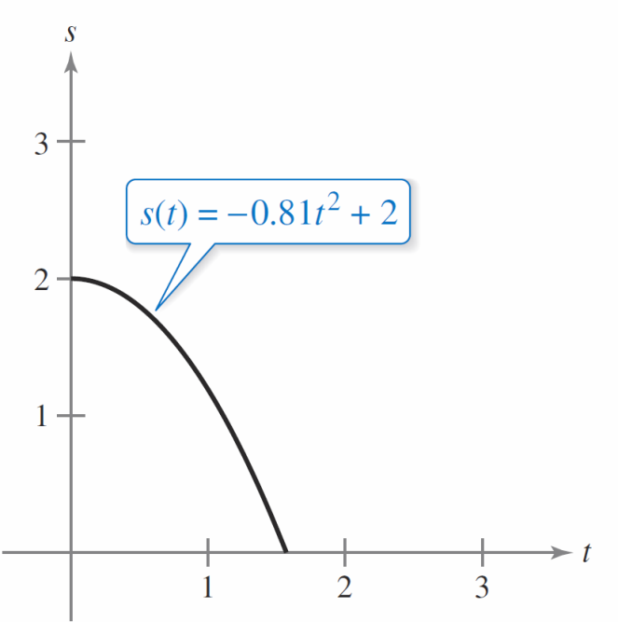
Example 10 – Finding the Acceleration Due to Gravity
Because the moon has no atmosphere, a falling object on the moon encounters no air resistance. In 1971, astronaut David Scott demonstrated that a feather and a hammer fall at the same rate on the moon. The position function for each of these falling objects is
s(t) = –0.81t² + 2
where s(t) is the height in meters and t is the time in seconds, as shown in the figure at the right. What is the ratio of Earth’s gravitational force to the moon’s?

Slide 22
Example 10 – Solution
To find the acceleration, differentiate the position function twice.
s(t) = – 0.81t² + 2
s ′(t) = –1.62t
s ′′(t) = –1.62
Position function
Velocity function
Acceleration function

Slide 23

Example 10 – Solution
cont’d
So, the acceleration due to gravity on the moon is –1.62 meters per second per second.
Because the acceleration due to gravity on Earth is –9.8 meters per second per second, the ratio of Earth’s gravitational force to the moon’s is

