Slide 1
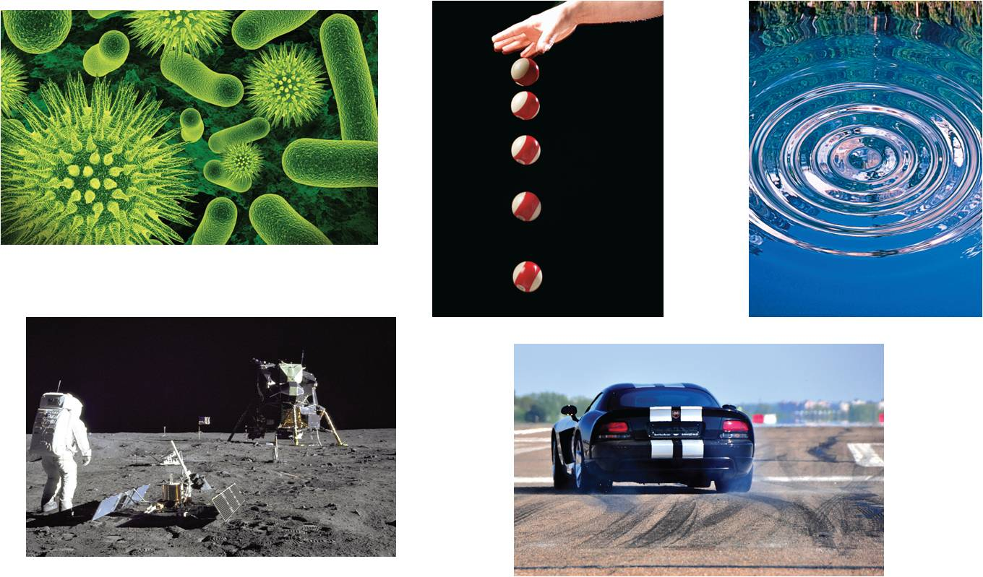
3
Differentiation
Copyright © Cengage Learning. All rights reserved.

Slide 2
3.5
Implicit Differentiation
Copyright © Cengage Learning. All rights reserved.

Slide 3
Objectives
Distinguish between functions written in implicit form and explicit form.
Use implicit differentiation to find the derivative of a function.
Find derivatives of functions using logarithmic differentiation.

Slide 4
Implicit and Explicit Functions

Slide 5
Implicit and Explicit Functions
Up to this point, most functions have been expressed in explicit form. For example, in the equation y = 3x² – 5, the variable y is explicitly written as a function of x. Some functions, however, are only implied by an equation.
For instance, the function y = 1/x is defined implicitly by the equation
xy = 1.
To find dy/dx for this equation. you can write y explicitly as a function of x and then differentiate.
Implicit form

Slide 6
Implicit and Explicit Functions
Implicit Form Explicit Form Derivative
This strategy works whenever you can solve for the function explicitly.
You cannot, however, use this procedure when you are unable to solve for y as a function of x.
For instance, how would you find dy/dx for the equation x² – 2y³ + 4y = 2? For this equation, it is difficult to express y as a function of x explicitly. To find dy/dx, you can use implicit differentiation.

Slide 7
Implicit and Explicit Functions
To understand how to find dy/dx implicitly, you must realize that the differentiation is taking place with respect to x.
This means that when you differentiate terms involving x alone, you can differentiate as usual.
However, when you differentiate terms involving y, you must apply the Chain Rule, because you are assuming that y is defined implicitly as a differentiable function of x.

Slide 8
Example 1 – Differentiating with Respect to x
a.
b.
c.
Variables agree: use Simple Power Rule.
Variables agree
u^{n}
nu^{n – 1}
u ′
Variables disagree: use Chain Rule.
Variables disagree
Chain Rule:

Slide 9
Example 1 – Differentiating with Respect to x
cont’d
d.
Product Rule
Chain Rule
Simplify.

Slide 10
Implicit Differentiation

Slide 11
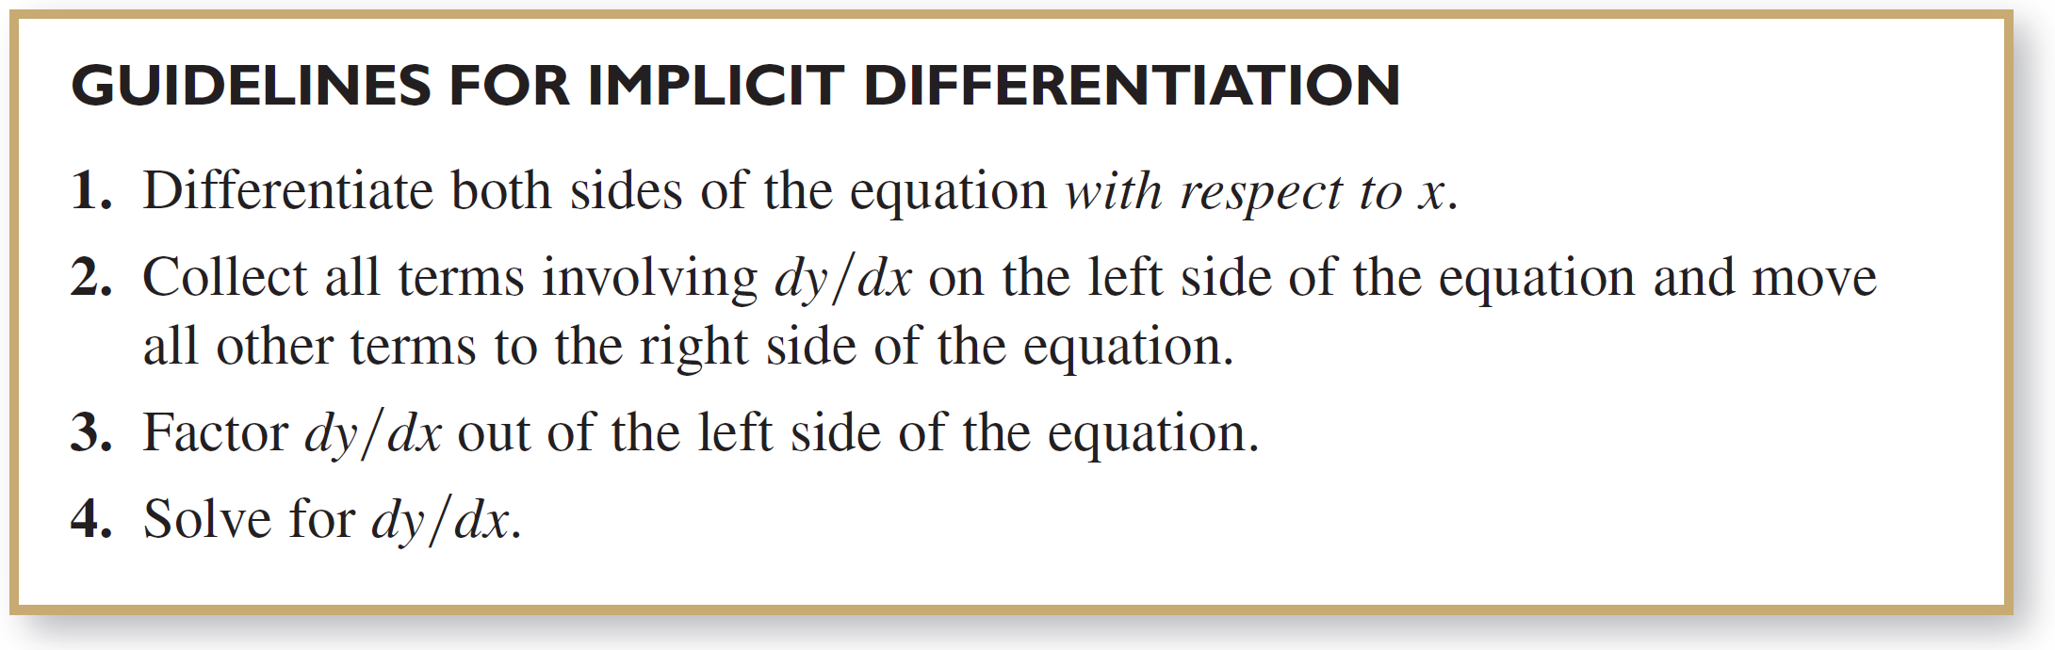
Implicit Differentiation
In Example 2, note that implicit differentiation can produce an expression for dy/dx that contains both x and y.

Slide 12
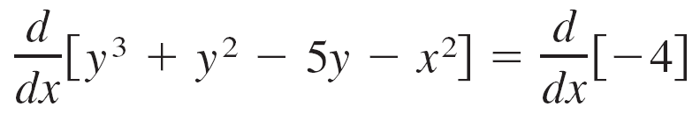
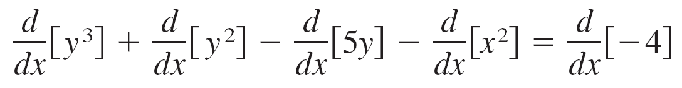
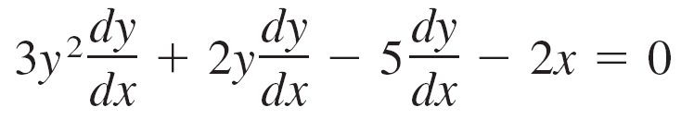
Example 2 – Implicit Differentiation
Find dy/dx given that y³ + y² – 5y – x² = –4.
Solution:
1. Differentiate both sides of the equation with respect to x.

Slide 13
Example 2 – Solution
cont’d
2. Collect the dy/dx terms on the left side of the equation and move all other terms to the right side of the equation.
3. Factor dy/dx out of the left side of the equation.
4. Solve for dy/dx by dividing by (3y² + 2y – 5).

Slide 14
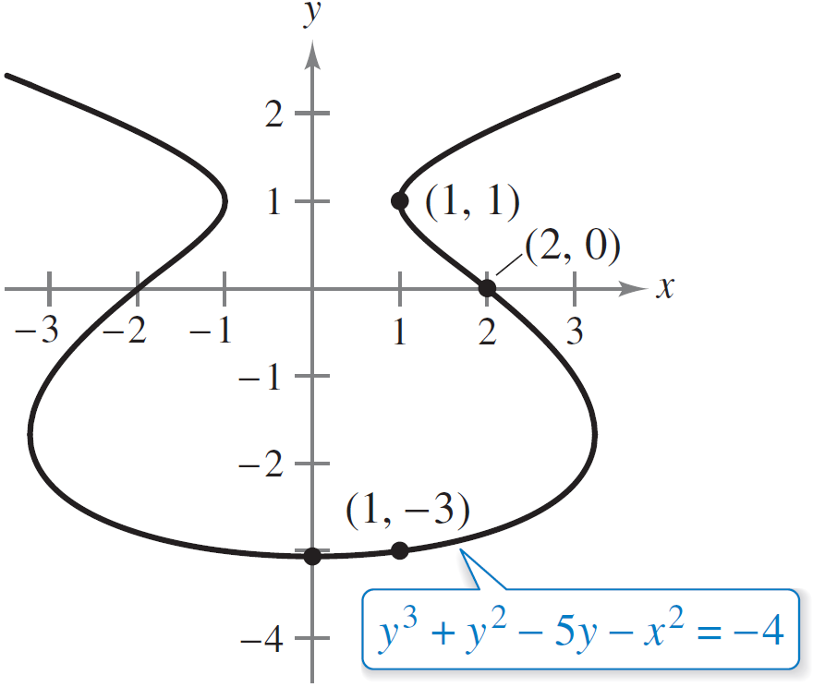
Implicit Differentiation
To see how you can use an implicit derivative, consider the graph shown in Figure 3.26.
Point on Graph Slope of Graph
(2, 0)
(1, –3)
x = 0 0
(1, 1) Undefined
Figure 3.26

Slide 15
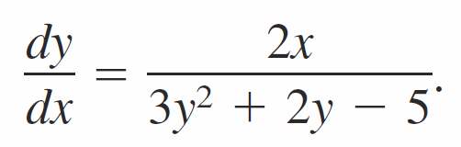
Implicit Differentiation
The implicit equation
y³ + y² – 5y – x² = –4
has the derivative
From the graph, you can see that y is not a function of x. Even so, the derivative found in Example 2 gives a formula for the slope of the tangent line at a point on this graph.
The slopes at several points on the graph are shown to the left of the graph.

Slide 16
Implicit Differentiation
It is meaningless to solve for dy/dx in an equation that has no solution points. (For example, x² + y² = –4 has no solution points.)
If, however, a segment of a graph can be represented by a differentiable function, then dy/dx will have meaning as the slope at each point on the segment.
Recall that a function is not differentiable at (a) points with vertical tangents and (b) points at which the function is not continuous.

Slide 17
Logarithmic Differentiation

Slide 18
Logarithmic Differentiation
On occasion, it is convenient to use logarithms as aids in differentiating nonlogarithmic functions. This procedure is called logarithmic differentiation.

Slide 19
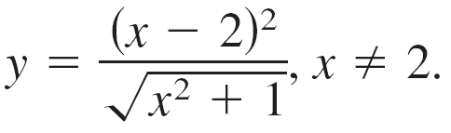
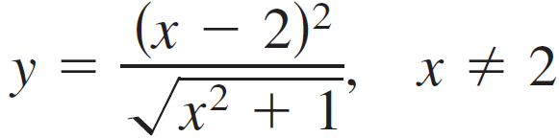
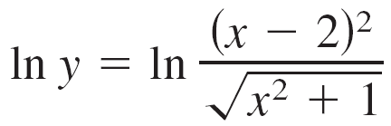
Example 9 – Logarithmic Differentiation
Find the derivative of
Solution:
Note that y > 0 for all x ≠ 2. So, ln y is defined. Begin by taking the natural logarithm of each side of the equation. Then apply logarithmic properties and differentiate implicitly. Finally, solve for y ′.
Write original equation.
Take natural log of each side.

Slide 20
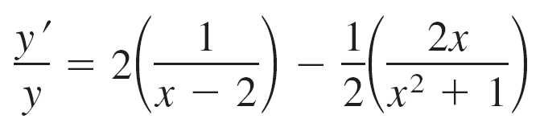
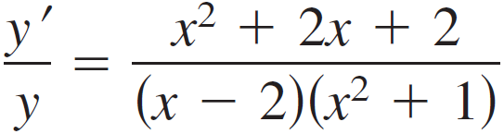
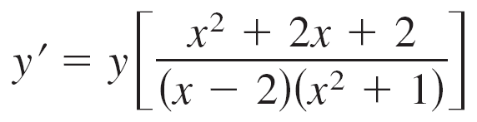
Example 9 – Solution
cont’d
Logarithmic properties
Differentiate.
Simplify.
Solve for y ′.

Slide 21
Example 9 – Solution
cont’d
Substitute for y.
Simplify.

