Slide 1
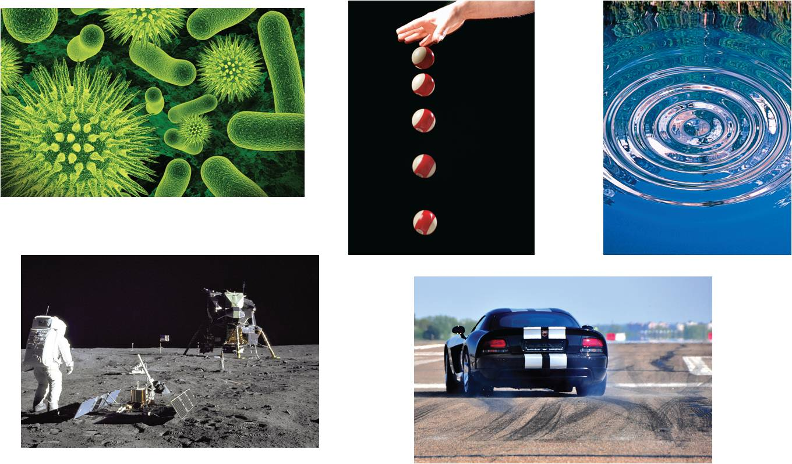
3
Differentiation
Copyright © Cengage Learning. All rights reserved.

Slide 2
The Derivative and
the Tangent Line Problem
3.1
Copyright © Cengage Learning. All rights reserved.

Slide 3
Objectives
Find the slope of the tangent line to a curve at a point.
Use the limit definition to find the derivative of a function.
Understand the relationship between differentiability and continuity.

Slide 4
The Tangent Line Problem

Slide 5
The Tangent Line Problem
Calculus grew out of four major problems that European mathematicians were working on during the seventeenth century.
1. The tangent line problem
2. The velocity and acceleration problem
3. The minimum and maximum problem
4. The area problem
Each problem involves the notion of a limit, and calculus can be introduced with any of the four problems.

Slide 6
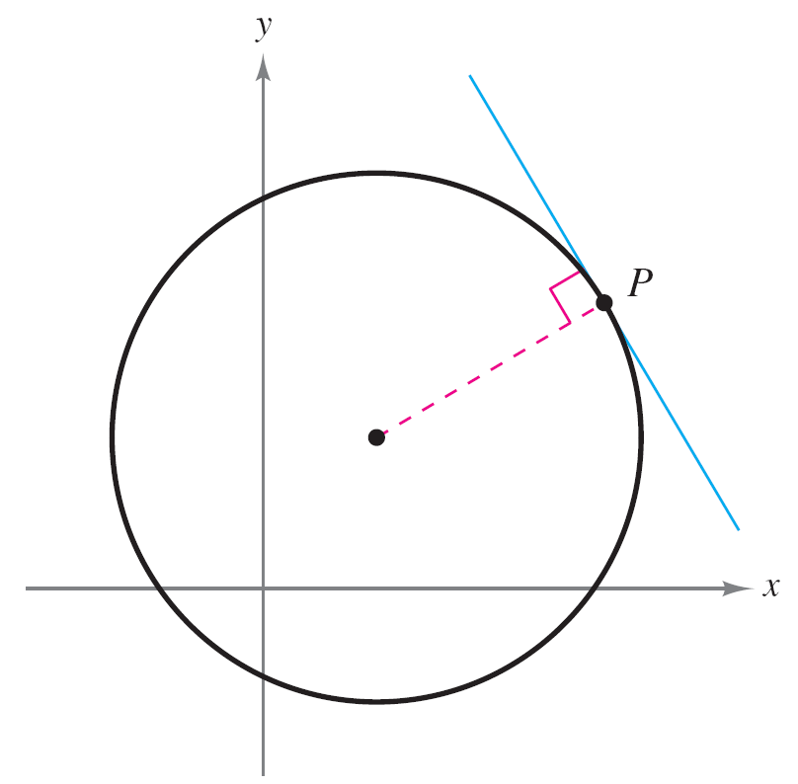
The Tangent Line Problem
What does it mean to say that a line is tangent to a curve at a point? For a circle, the tangent line at a point P is the line that is perpendicular to the radial line at point P, as shown in Figure 3.1.
Tangent line to a circle
Figure 3.1

Slide 7
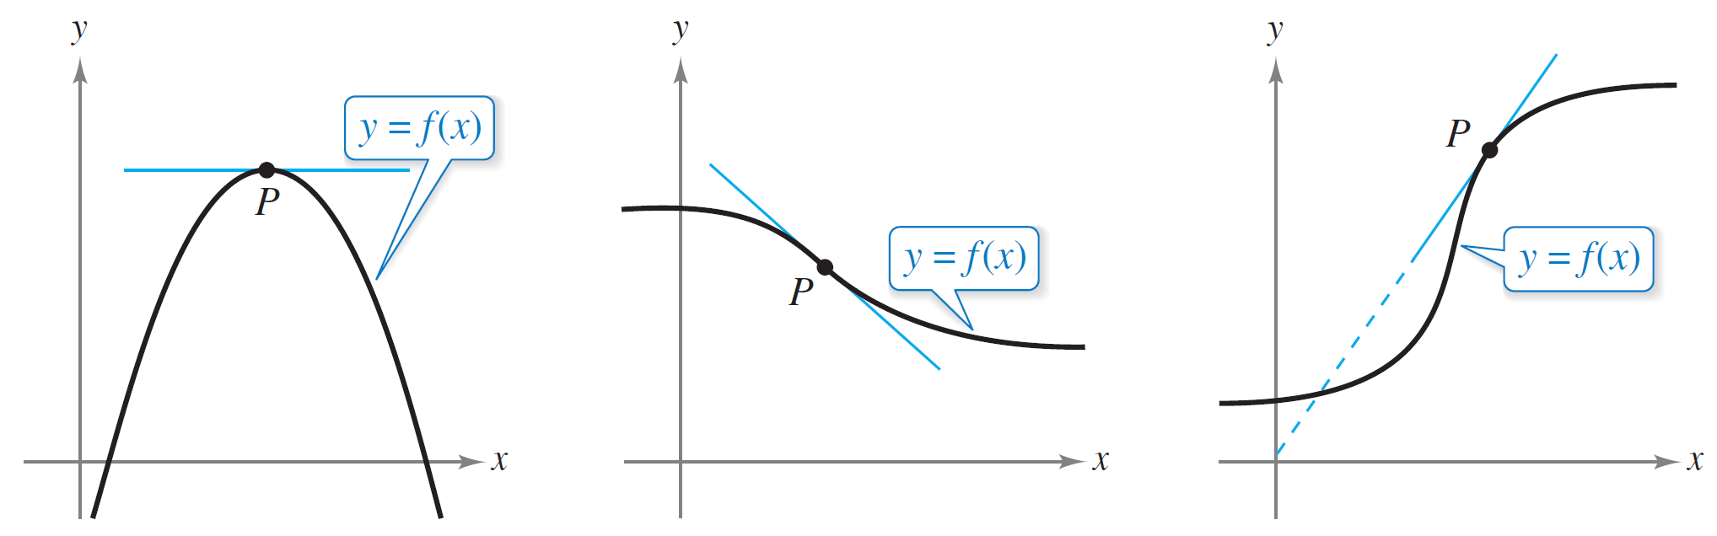
The Tangent Line Problem
For a general curve, however, the problem is more difficult. For instance, how would you define the tangent lines shown in Figure 3.2?
Tangent line to a curve at a point
Figure 3.2

Slide 8
The Tangent Line Problem
You might say that a line is tangent to a curve at a point P when it touches, but does not cross, the curve at point P.
This definition would work for the first curve shown in Figure 3.2, but not for the second.
Or you might say that a line is tangent to a curve when the line touches or intersects the curve at exactly one point.
This definition would work for a circle, but not for more general curves, as the third curve in Figure 3.2 shows.

Slide 9
The Tangent Line Problem
Essentially, the problem of finding the tangent line at a point P boils down to the problem of finding the slope of the tangent line at point P.
You can approximate this slope using a secant line through the point of tangency and a second point on the curve, as shown in Figure 3.3.
The secant line through (c, f (c))
and (c + Δx, f (c + Δx))
Figure 3.3

Slide 10
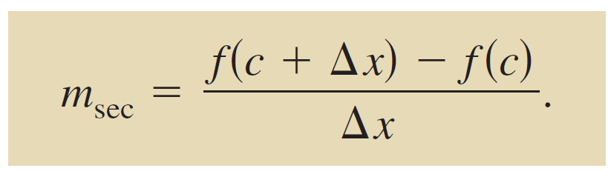
The Tangent Line Problem
If (c, f (c)) is the point of tangency and (c + Δx, f (c + Δx)) is a second point on the graph of f, the slope of the secant line through the two points is given by substitution into the slope formula
The right-hand side of this equation is a difference quotient.
Slope of secant line

Slide 11
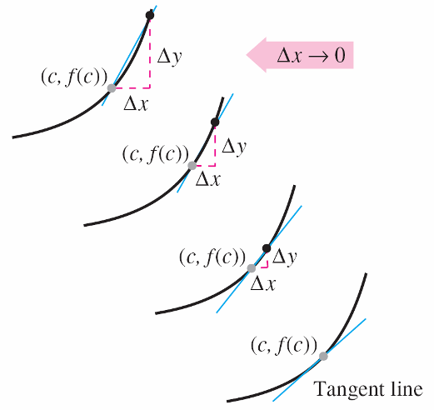
The Tangent Line Problem
The denominator Δx is the change in x, and the numerator Δy = f (c + Δx) – f (c) is the change in y.
The beauty of this procedure is that you can obtain more and more accurate approximations of the slope of the tangent line by choosing points closer and closer to the point of tangency, as shown in Figure 3.4.
Tangent line approximations
Figure 3.4

Slide 12
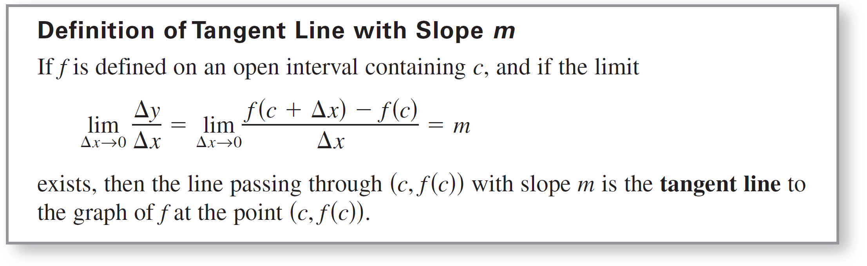
The Tangent Line Problem
The slope of the tangent line to the graph of f at the point (c, f (c)) is also called the slope of the graph of f at x = c.

Slide 13
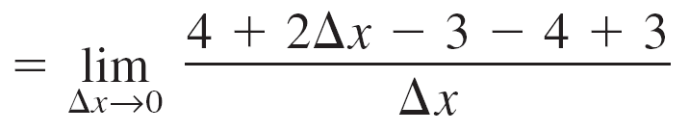
Example 1 – The Slope of the Graph of a Linear Function
To find the slope of the graph of f (x) = 2x – 3 when c = 2, you can apply the definition of the slope of a tangent line, as shown.

Slide 14
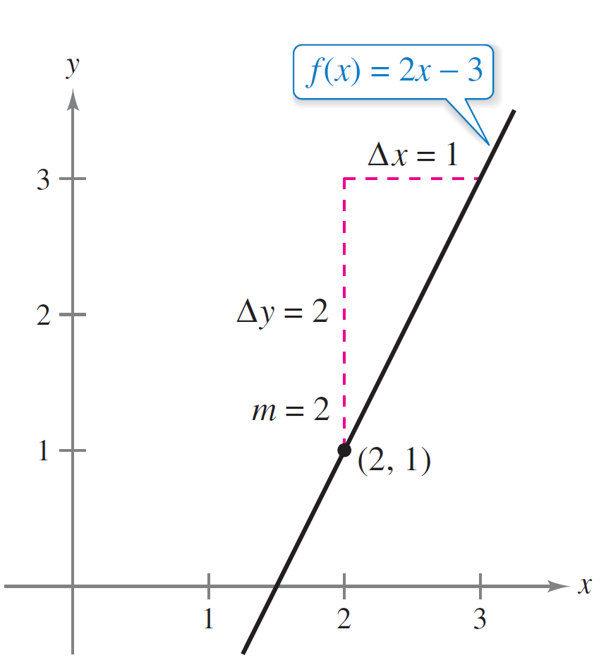
Example 1 – Solution
cont’d
= 2
The slope of f at (c, f (c)) = (2, 1) is m = 2, as shown in Figure 3.5.
The slope of f at (2, 1) is m = 2.
Figure 3.5

Slide 15
The Tangent Line Problem
The graph of a linear function has the same slope at any point. This is not true of nonlinear functions.
The definition of a tangent line to a curve does not cover the possibility of a vertical tangent line. For vertical tangent lines, you can use the following definition.
If f is continuous at c and
then the vertical line x = c passing through (c, f (c)) is a vertical tangent line to the graph of f.

Slide 16
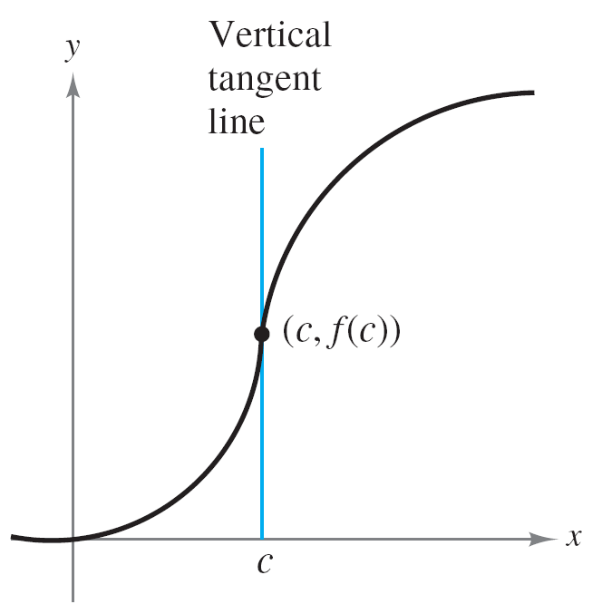
The Tangent Line Problem
For example, the function shown in Figure 3.7 has a vertical tangent line at (c, f (c)).
When the domain of f is the closed interval [a, b], you can extend the definition of a vertical tangent line to include the endpoints by considering continuity and limits from the right (for x = a) and from the left (for x = b).
The graph of f has a vertical tangent line at (c, f (c)).
Figure 3.7

Slide 17
The Derivative of a Function

Slide 18
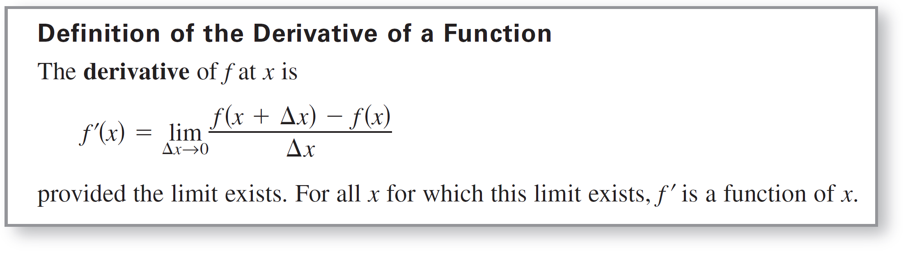
The Derivative of a Function
You have now arrived at a crucial point in the study of calculus. The limit used to define the slope of a tangent line is also used to define one of the two fundamental operations of calculus—differentiation.

Slide 19
The Derivative of a Function
Be sure you see that the derivative of a function of x is also a function of x.
This “new” function gives the slope of the tangent line to the graph of f at the point (x, f (x)), provided that the graph has a tangent line at this point.
The process of finding the derivative of a function is called differentiation.
A function is differentiable at x when its derivative exists at x and is differentiable on an open interval (a, b) when it is differentiable at every point in the interval.

Slide 20
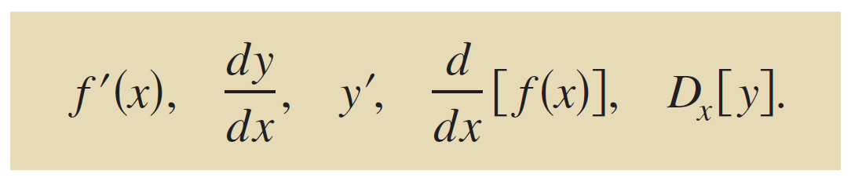
The Derivative of a Function
In addition to f ′(x), other notations are used to denote the derivative of y = f (x).
The most common are
The notation dy/dx is read as “the derivative of y with respect to x” or simply “dy, dx.”
Notation for derivatives

Slide 21
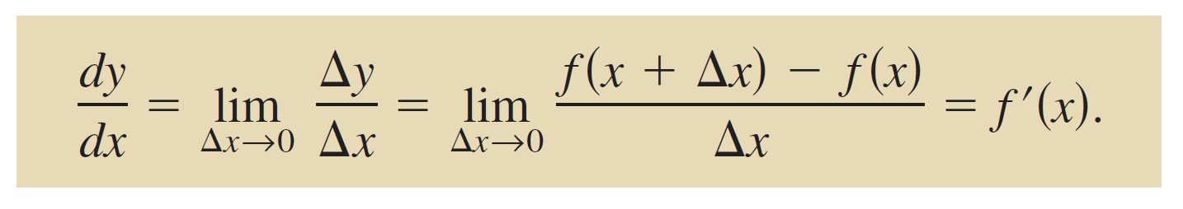
The Derivative of a Function
Using limit notation, you can write

Slide 22
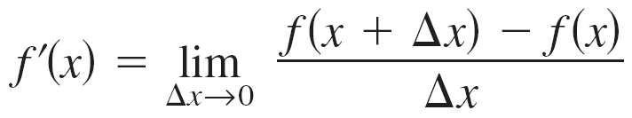
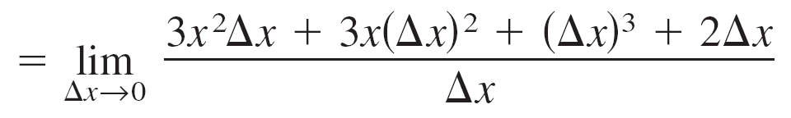
Example 3 – Finding the Derivative by the Limit Process
To find the derivative of f (x) = x³ + 2x, use the definition of the derivative as shown.
Definition of derivative

Slide 23

Example 3 – Solution
cont’d

Slide 24
The Derivative of a Function
Remark:
Remember that the derivative of a function f is itself a function, which can be used to find the slope of the tangent line at the point (x, f (x)) on the graph of f.

Slide 25
Differentiability and Continuity

Slide 26
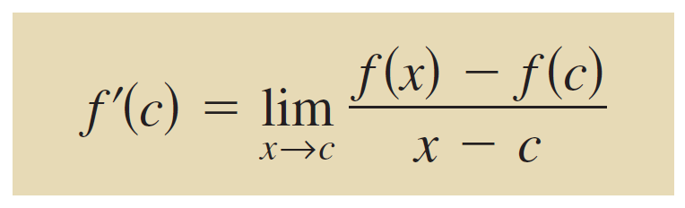
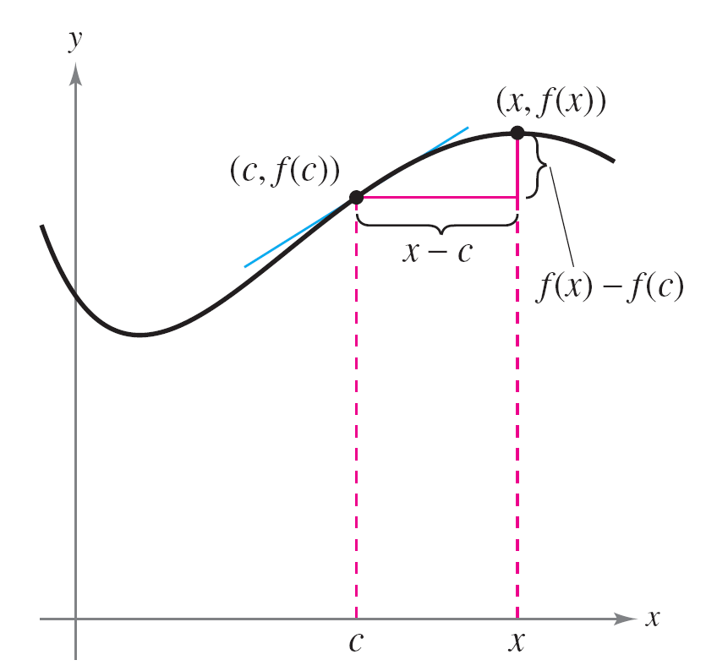
Differentiability and Continuity
The alternative limit form of the derivative is useful in investigating the relationship between differentiability and continuity. The derivative of f at c is
provided this limit exists (see Figure 3.10).
Alternative form of derivative
As x approaches c, the secant line approaches the tangent line.
Figure 3.10

Slide 27
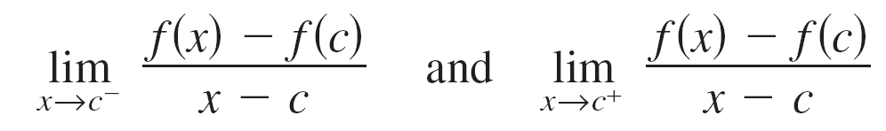
Differentiability and Continuity
Note that the existence of the limit in this alternative form requires that the one-sided limits
exist and are equal. These one-sided limits are called the derivatives from the left and from the right, respectively.
It follows that f is differentiable on the closed interval [a, b] when it is differentiable on (a, b) and when the derivative from the right at a and the derivative from the left at b both exist.

Slide 28
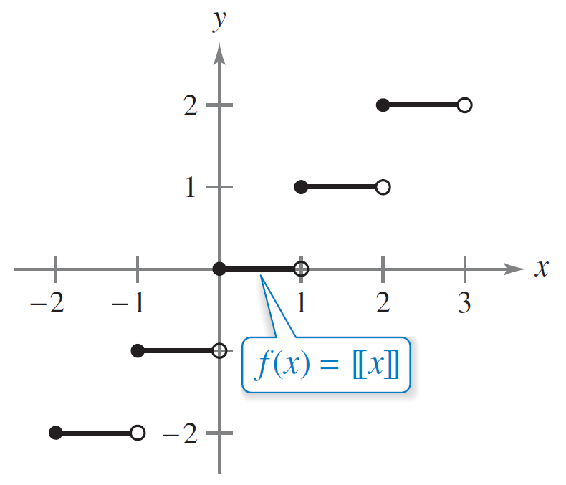
Differentiability and Continuity
When a function is not continuous at x = c, it is also not differentiable at x = c. For instance, the greatest integer function
is not continuous at x = 0, and so it is not differentiable at x = 0, (see Figure 3.11).
The greatest integer function is not differentiable at x = 0, because it is not continuous at x = 0.
Figure 3.11

Slide 29
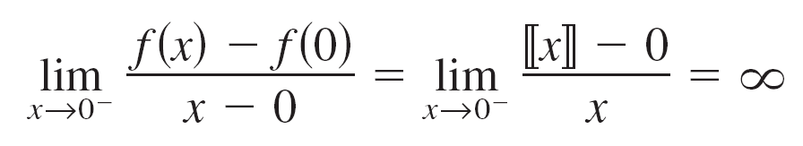
Differentiability and Continuity
You can verify this by observing that
and
Derivative from the left
Derivative from the right

Slide 30
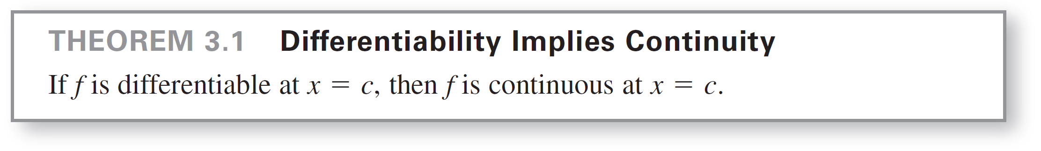
Differentiability and Continuity
Although it is true that differentiability implies continuity (as in Theorem 3.1), the converse is not true.
That is, it is possible for a function to be continuous at x = c and not differentiable at x = c.

Slide 31
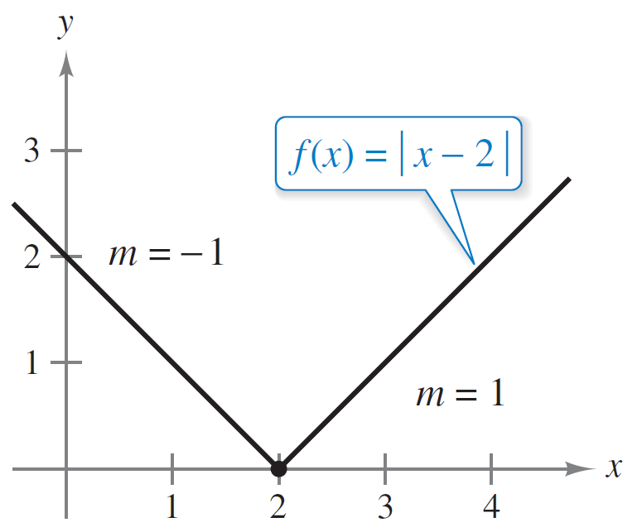
Example 6 – A Graph with a Sharp Turn
The function
f (x) = | x – 2 |
shown in Figure 3.12 is continuous at x = 2.
f is not differentiable at x = 2 because the
derivatives from the left and from the right
are not equal.
Figure 3.12

Slide 32
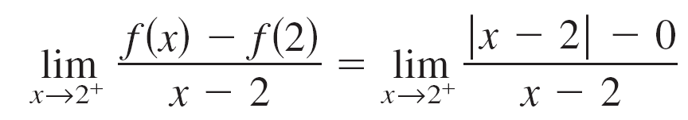
Example 6 – A Graph with a Sharp Turn
cont’d
The one-sided limits, however
= –1
and
= 1
are not equal.
Derivative from the left
Derivative from the right

Slide 33
Example 6 – A Graph with a Sharp Turn
cont’d
So, f is not differentiable at x = 2 and the graph of f does
not have a tangent line at the point (2, 0).

Slide 34
Differentiability and Continuity
From Example 6, you can see that a function is not
differentiable at a point at which its graph has a sharp turn or a vertical tangent line.

Slide 35
Differentiability and Continuity
The relationship between continuity and differentiability is summarized below.
1. If a function is differentiable at x = c, then it is continuous at x = c. So, differentiability implies continuity.
2. It is possible for a function to be continuous at x = c and not be differentiable at x = c. So, continuity does not imply differentiability (see Example 6).

