Slide 1
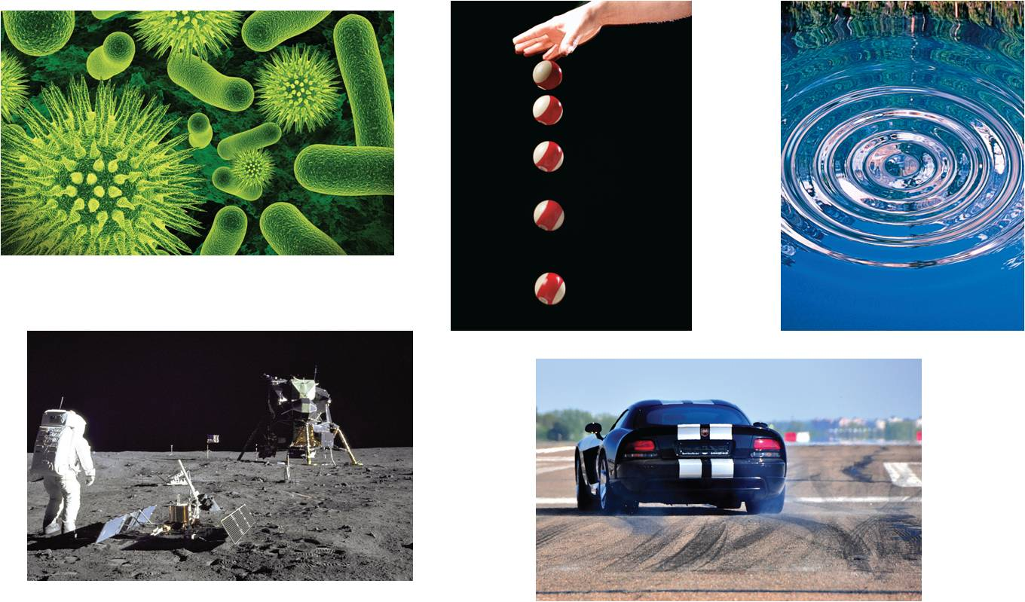
3
Differentiation
Copyright © Cengage Learning. All rights reserved.

Slide 2
3.4
The Chain Rule
Copyright © Cengage Learning. All rights reserved.

Slide 3
Objectives
Find the derivative of a composite function using the Chain Rule.
Find the derivative of a function using the General Power Rule.
Simplify the derivative of a function using algebra.

Slide 4
Objectives
Find the derivative of a transcendental function using the Chain Rule.
Find the derivative of a function involving the natural logarithmic function.
Define and differentiate exponential functions that have bases other than e.

Slide 5
The Chain Rule

Slide 6
The Chain Rule
This section has yet to discuss one of the most powerful differentiation rules—the Chain Rule.
This rule deals with composite functions and adds a surprising versatility to the rules that we have discussed.

Slide 7
The Chain Rule
For example, compare the functions shown below. Those on the left can be differentiated without the Chain Rule, and those on the right are best differentiated with the Chain Rule.
Without the Chain Rule With the Chain Rule
y = x² + 1 y =
y = sin x y = sin 6x
y = 3x + 2 y = (3x + 2)⁵
y = e^{x} + tan x y = e^{5x} + tan x²

Slide 8
The Chain Rule
Basically, the Chain Rule states that if y changes dy/du
times as fast as u, and u changes du/dx times as fast as x,
then y changes (dy/du)(du/dx) times as fast as x.

Slide 9
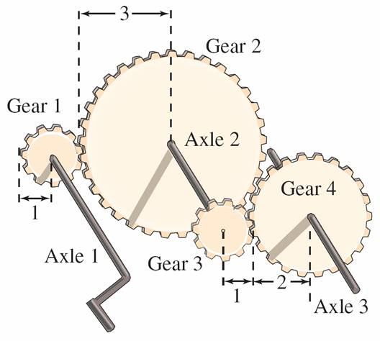
Example 1 – The Derivative of a Composite Function
A set of gears is constructed so that the second and third gears are on the same axle (see Figure 3.24).
Axle 1: y revolutions per minute
Axle 2: u revolutions per minute
Axle 3: x revolutions per minute
Figure 3.24

Slide 10
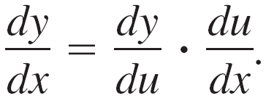
Example 1 – The Derivative of a Composite Function
cont’d
As the first axle revolves, it drives the second axle, which in turn drives the third axle. Let y, u, and x represent the numbers of revolutions per minute of the first, second, and third axles, respectively. Find dy/du, du/dx, and dy/dx, and show that
Solution:
Because the circumference of the second gear is three times that of the first, the first axle must make three revolutions to turn the second axle once.

Slide 11
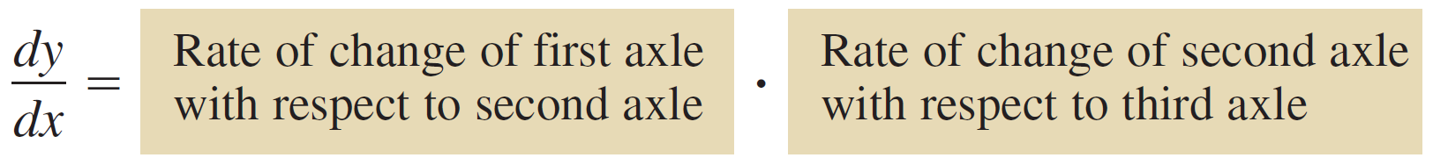
Example 1 – Solution
cont’d
Similarly, the second axle must make two revolutions to turn the third axle once, and you can write
Combining these two results, you know that the first axle must make six revolutions to turn the third axle once. So, you can write

Slide 12

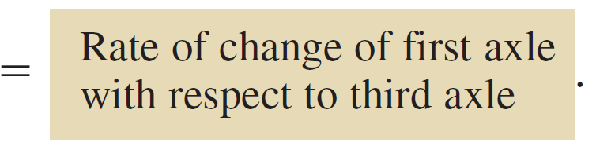
Example 1 – Solution
cont’d
In other words, the rate of change of y with respect to x is the product of the rate of change of y with respect to u and the rate of change of u with respect to x.

Slide 13
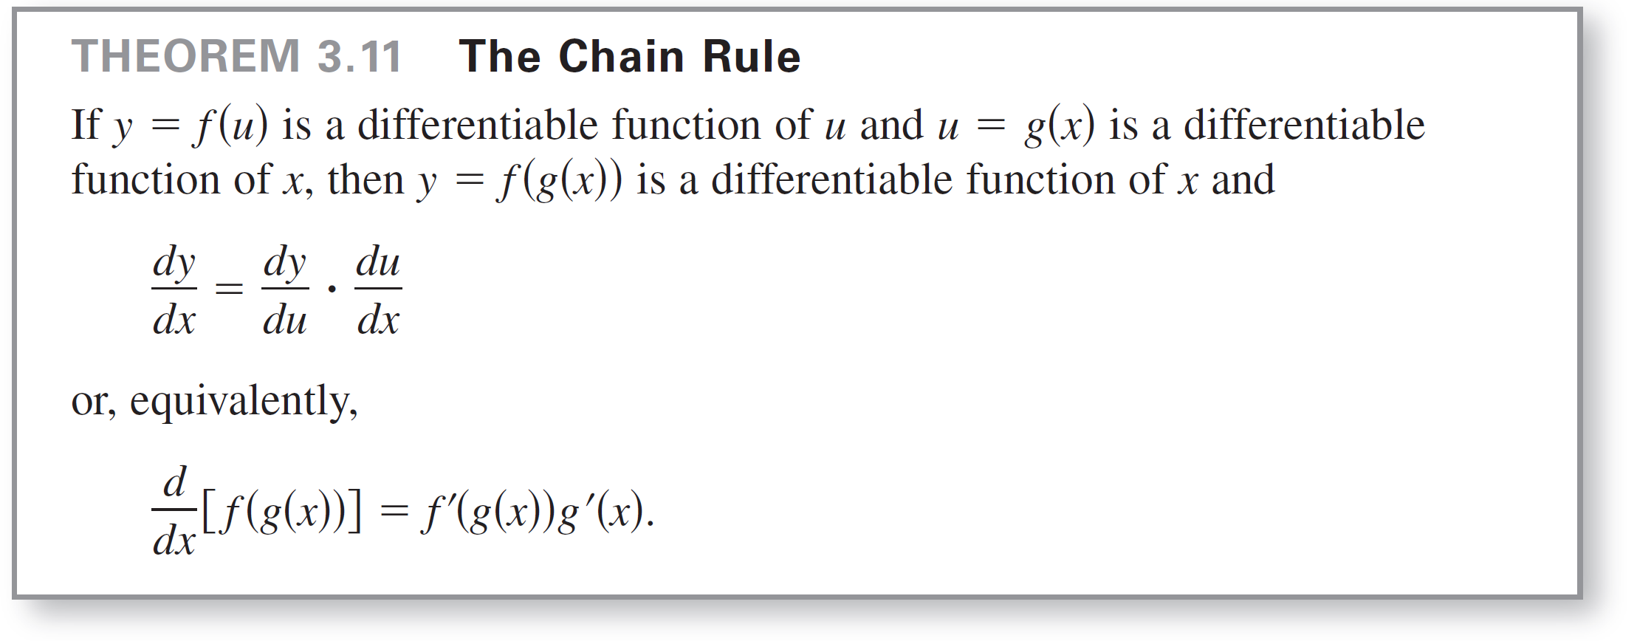
The Chain Rule
Example 1 illustrates a simple case of the Chain Rule. The general rule is stated below.

Slide 14

The Chain Rule
When applying the Chain Rule, it is helpful to think of the composite function f ° g as having two parts—an inner part and an outer part.
The derivative of y = f (u) is the derivative of the outer function (at the inner function u) times the derivative of the inner function.

Slide 15
The General Power Rule

Slide 16
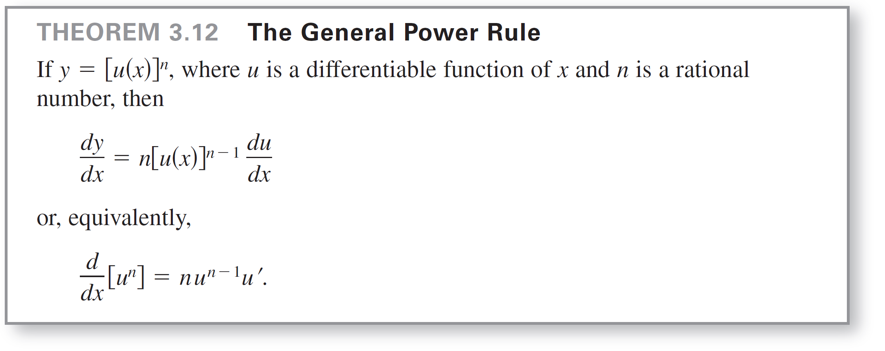
The General Power Rule
The function y = (x² + 1)³ is an example of one of the most common types of composite functions, y = [u(x)]^{n}.
The rule for differentiating such functions is called the General Power Rule, and it is a special case of the Chain Rule.

Slide 17

Example 4 – Applying the General Power Rule
Find the derivative of f (x) = (3x – 2x²)³.
Solution:
Let u = 3x – 2x². Then
f (x) = (3x – 2x²)³
and, by the General Power Rule, the derivative is
f ′(x) = 3(3x – 2x²)² [3x – 2x²]
= 3(3x – 2x²)²(3 – 4x).
= u³
Apply General Power Rule.
Differentiate 3x – 2x².

Slide 18
Simplifying Derivatives

Slide 19
Simplifying Derivatives
The next example demonstrate techniques for
simplifying the “raw derivatives” of functions involving
products, quotients, and composites.

Slide 20


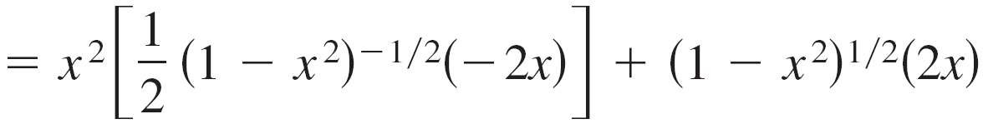
Example 7 – Simplifying by Factoring Out the Least Powers
Find the derivative of
Solution:
Write original
function.
Rewrite.
Product Rule
General Power Rule

Slide 21
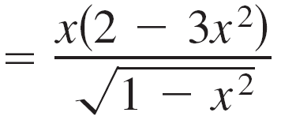
Example 7 – Solution
cont’d
Simplify.
= –x³(1 – x²)^{–1/2} + 2x(1 – x²)^{1/2}
= x(1 – x²)^{–1/2}[–x²(1) + 2(1 – x²)]
Factor.
Simplify.

Slide 22
Transcendental Functions and the Chain Rule

Slide 23
Transcendental Functions and the Chain Rule
The “Chain Rule versions” of the derivatives of the six trigonometric functions and the natural exponential function are as follows.
[sin u] = (cos u) u ′
[cos u] = –(sin u) u ′
[tan u] = (sec² u) u ′
[cot u] = –(csc² u) u ′

Slide 24
Transcendental Functions and the Chain Rule
[sec u] = (sec u tan u) u ′
[csc u] = –(csc u cot u) u ′
[e^{u}] = e^{u}u ′

Slide 25


Example 10 – The Chain Rule and Transcendental Functions
a. y = sin 2x
y ′ = cos 2x [2x]
b. y = cos(x – 1)
y ′ = –sin(x – 1) [x – 1]
= (cos 2x)(2)
= 2 cos 2x
= –sin(x – 1)

Slide 26


Example 10 – The Chain Rule and Transcendental Functions
cont’d
c. y = e^{3x}
y ′ = e^{3x} [3x]
= 3e^{3x}

Slide 27
The Derivative of the Natural Logarithmic Function

Slide 28
The Derivative of the Natural Logarithmic Function
Up to this point, derivatives of algebraic functions have been algebraic and derivatives of transcendental functions have been transcendental.
The next theorem looks at an unusual situation in which the derivative of a transcendental function is algebraic. Specifically, the derivative of the natural logarithmic function is the algebraic function 1/x.

Slide 29
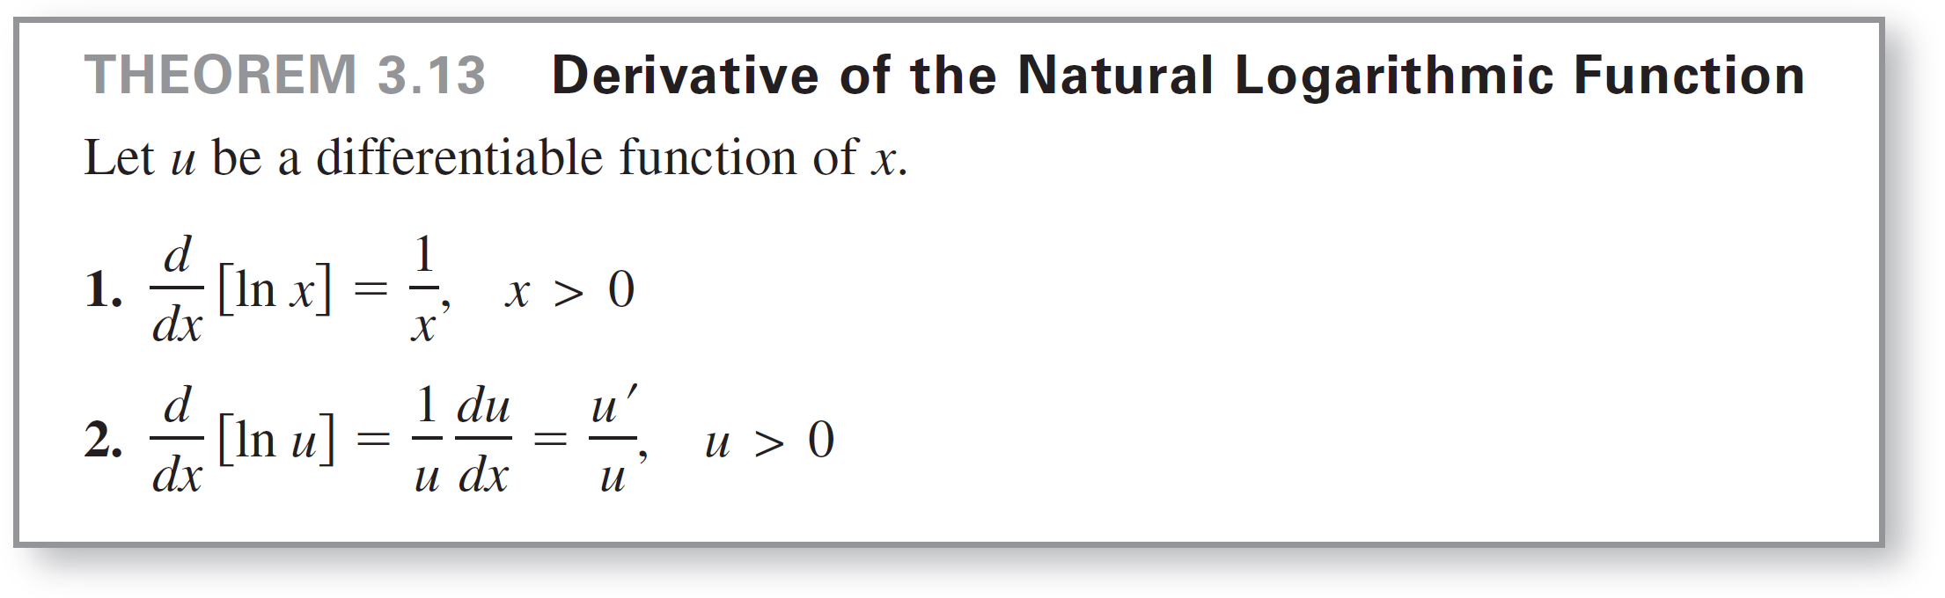
The Derivative of the Natural Logarithmic Function

Slide 30
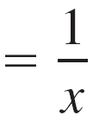
Example 13 – Differentiation of Logarithmic Functions
a.
b.
u = 2x
u = x² + 1

Slide 31
Example 13 – Differentiation of Logarithmic Functions
cont’d
Product Rule
c.
d.
Chain Rule

Slide 32
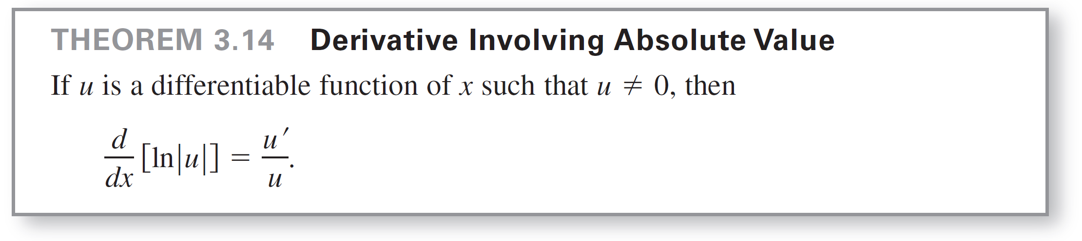
The Derivative of the Natural Logarithmic Function
Because the natural logarithm is undefined for negative numbers, you will often encounter expressions of the form ln| u |.
Theorem 3.14 states that you can differentiate functions of the form y = ln| u | as though the absolute value notation was not present.

Slide 33
Bases Other than e

Slide 34
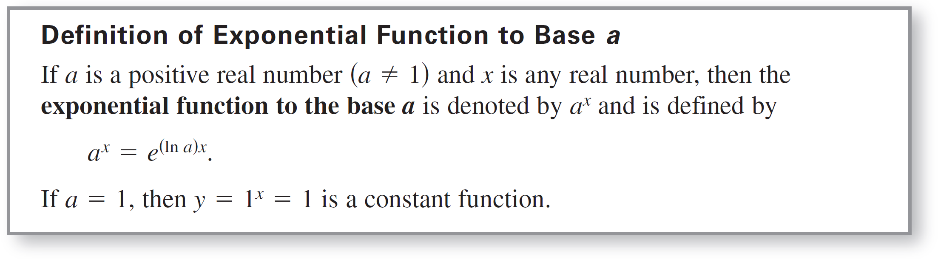
Bases Other than e
The base of the natural exponential function is e. This “natural” base can be used to assign a meaning to a general base a.

Slide 35
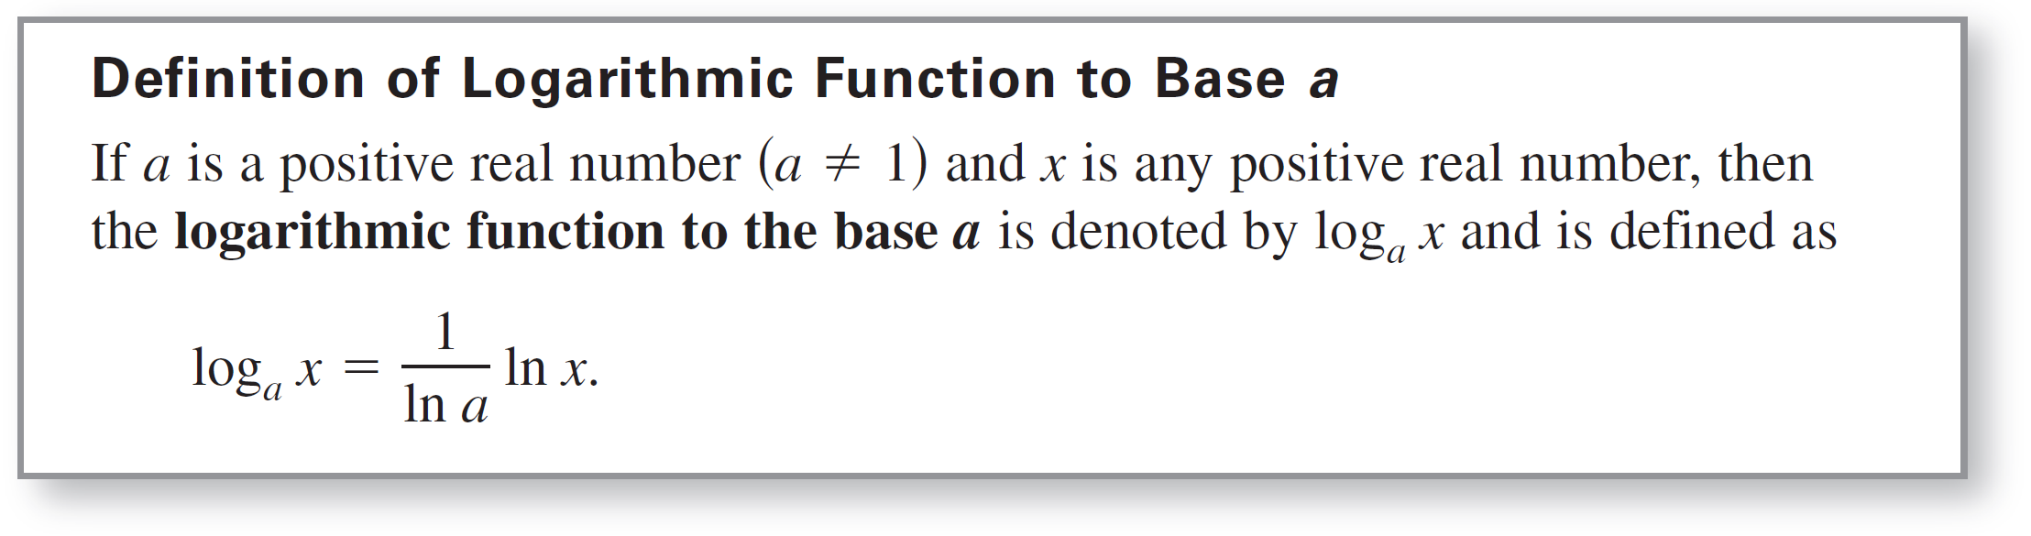
Bases Other than e
Logarithmic functions to bases other than e can be defined in much the same way as exponential functions to other bases are defined.

Slide 36
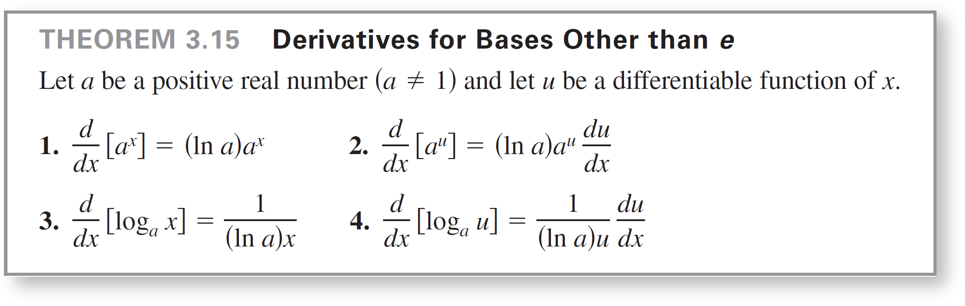
Bases Other than e
To differentiate exponential and logarithmic functions to other bases, you have two options: (1) use the definitions of a^{x} and log_{a} x and differentiate using the rules for the natural exponential and logarithmic functions, or (2) use the differentiation rules for bases other than e given in the theorem.

Slide 37
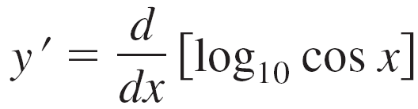
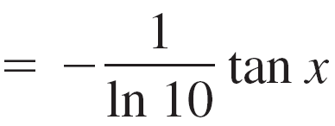
Example 16 – Differentiating Functions to Other Bases
a. y ′ = [2^{x}]
b. y ′ = [2^{3x}]
c.
= (ln 2)2^{x}
= (ln 2)2^{3x}(3)
= (3 ln 2)2^{3x}

Slide 38
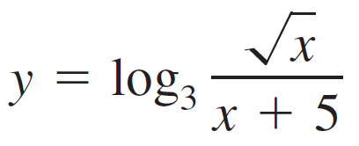
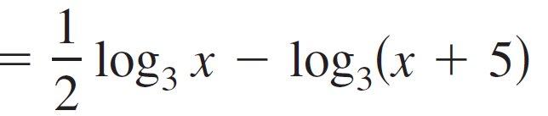
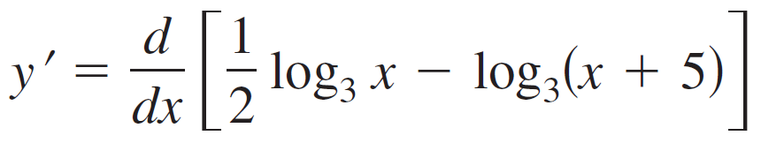
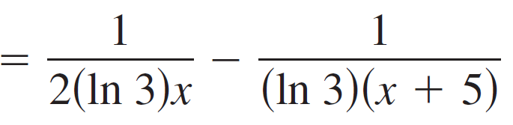
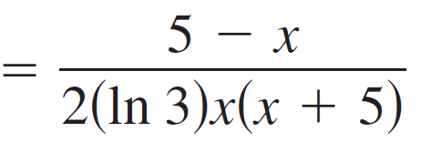
Example 16 – Differentiating Functions to Other Bases
cont’d
d. After rewriting the function below using logarithmic properties
you can apply Theorem 3.15 to find the derivative of the function.

Slide 39
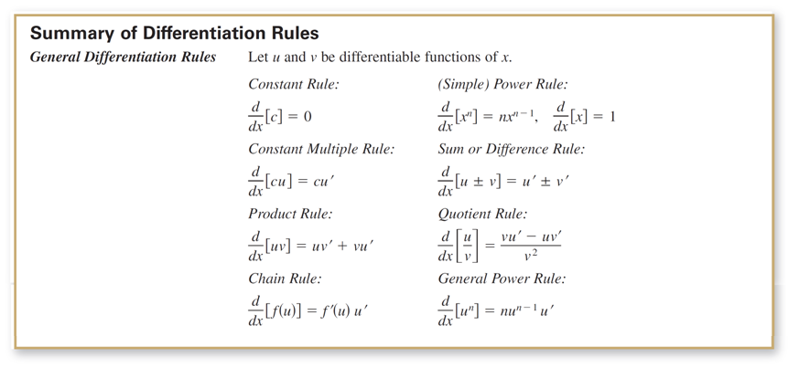
Bases Other than e
This section concludes with a summary of the differentiation rules studied so far.

Slide 40
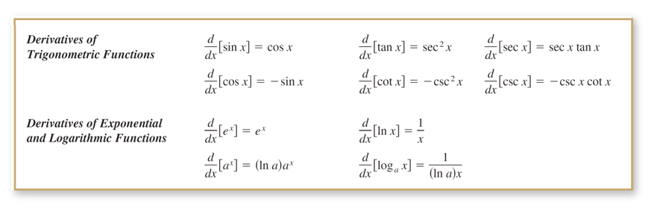
Bases Other than e
cont’d

