Slide 1

2
Limits and Their Properties
Copyright © Cengage Learning. All rights reserved.

Slide 2
2.1
A Preview of Calculus
Copyright © Cengage Learning. All rights reserved.

Slide 3
Objectives
Understand what calculus is and how it compares with precalculus.
Understand that the tangent line problem is basic to calculus.
Understand that the area problem is also basic to calculus.

Slide 4
What Is Calculus?

Slide 5
What Is Calculus?
Calculus is the mathematics of change. For instance, calculus is the mathematics of velocities, accelerations, tangent lines, slopes, areas, volumes, arc lengths, centroids, curvatures, and a variety of other concepts that have enabled scientists, engineers, and economists to model real-life situations.
Although precalculus mathematics also deals with velocities, accelerations, tangent lines, slopes, and so on, there is a fundamental difference between precalculus mathematics and calculus.
Precalculus mathematics is more static, whereas calculus is more dynamic.

Slide 6
What Is Calculus?
Here are some examples.
• An object traveling at a constant velocity can be analyzed with precalculus mathematics. To analyze the velocity of an accelerating object, you need calculus.
• The slope of a line can be analyzed with precalculus mathematics. To analyze the slope of a curve, you need calculus.
• The curvature of a circle is constant and can be analyzed with precalculus mathematics. To analyze the variable curvature of a general curve, you need calculus.

Slide 7
What Is Calculus?
• The area of a rectangle can be analyzed with precalculus mathematics. To analyze the area under a general curve, you need calculus.
Each of these situations involves the same general strategy—the reformulation of precalculus mathematics through the use of a limit process.
So, one way to answer the question “What is calculus?” is to say that calculus is a “limit machine” that involves three stages.

Slide 8
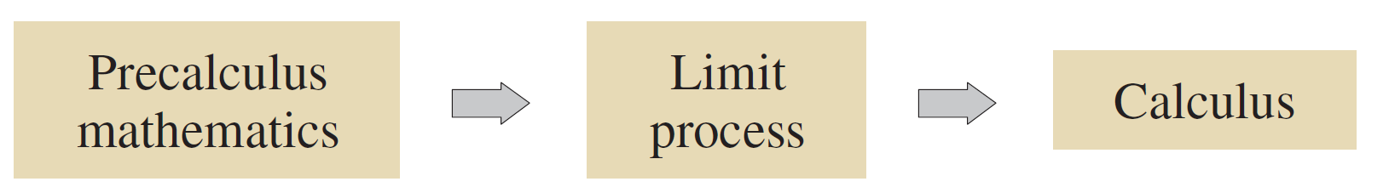
What Is Calculus?
The first stage is precalculus mathematics, such as the slope of a line or the area of a rectangle.
The second stage is the limit process, and the third stage is a new calculus formulation, such as a derivative or integral.
Some students try to learn calculus as if it were simply a collection of new formulas.

Slide 9
What Is Calculus?
This is unfortunate. If you reduce calculus to the memorization of differentiation and integration formulas, you will miss a great deal of understanding, self-confidence, and satisfaction.
Some familiar precalculus concepts coupled with their calculus counterparts are listed.

Slide 10
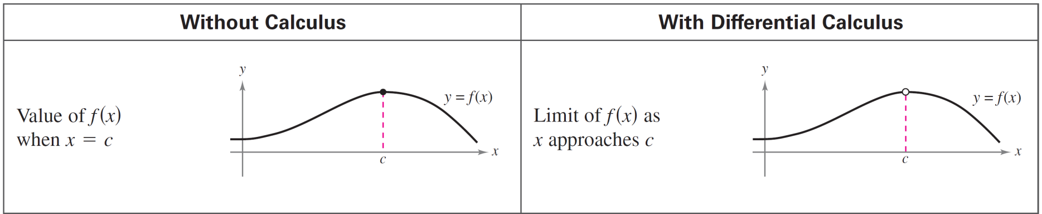
What Is Calculus?
Throughout the text, your goal should be to learn how precalculus formulas and techniques are used as building blocks to produce the more general calculus formulas and techniques.

Slide 11
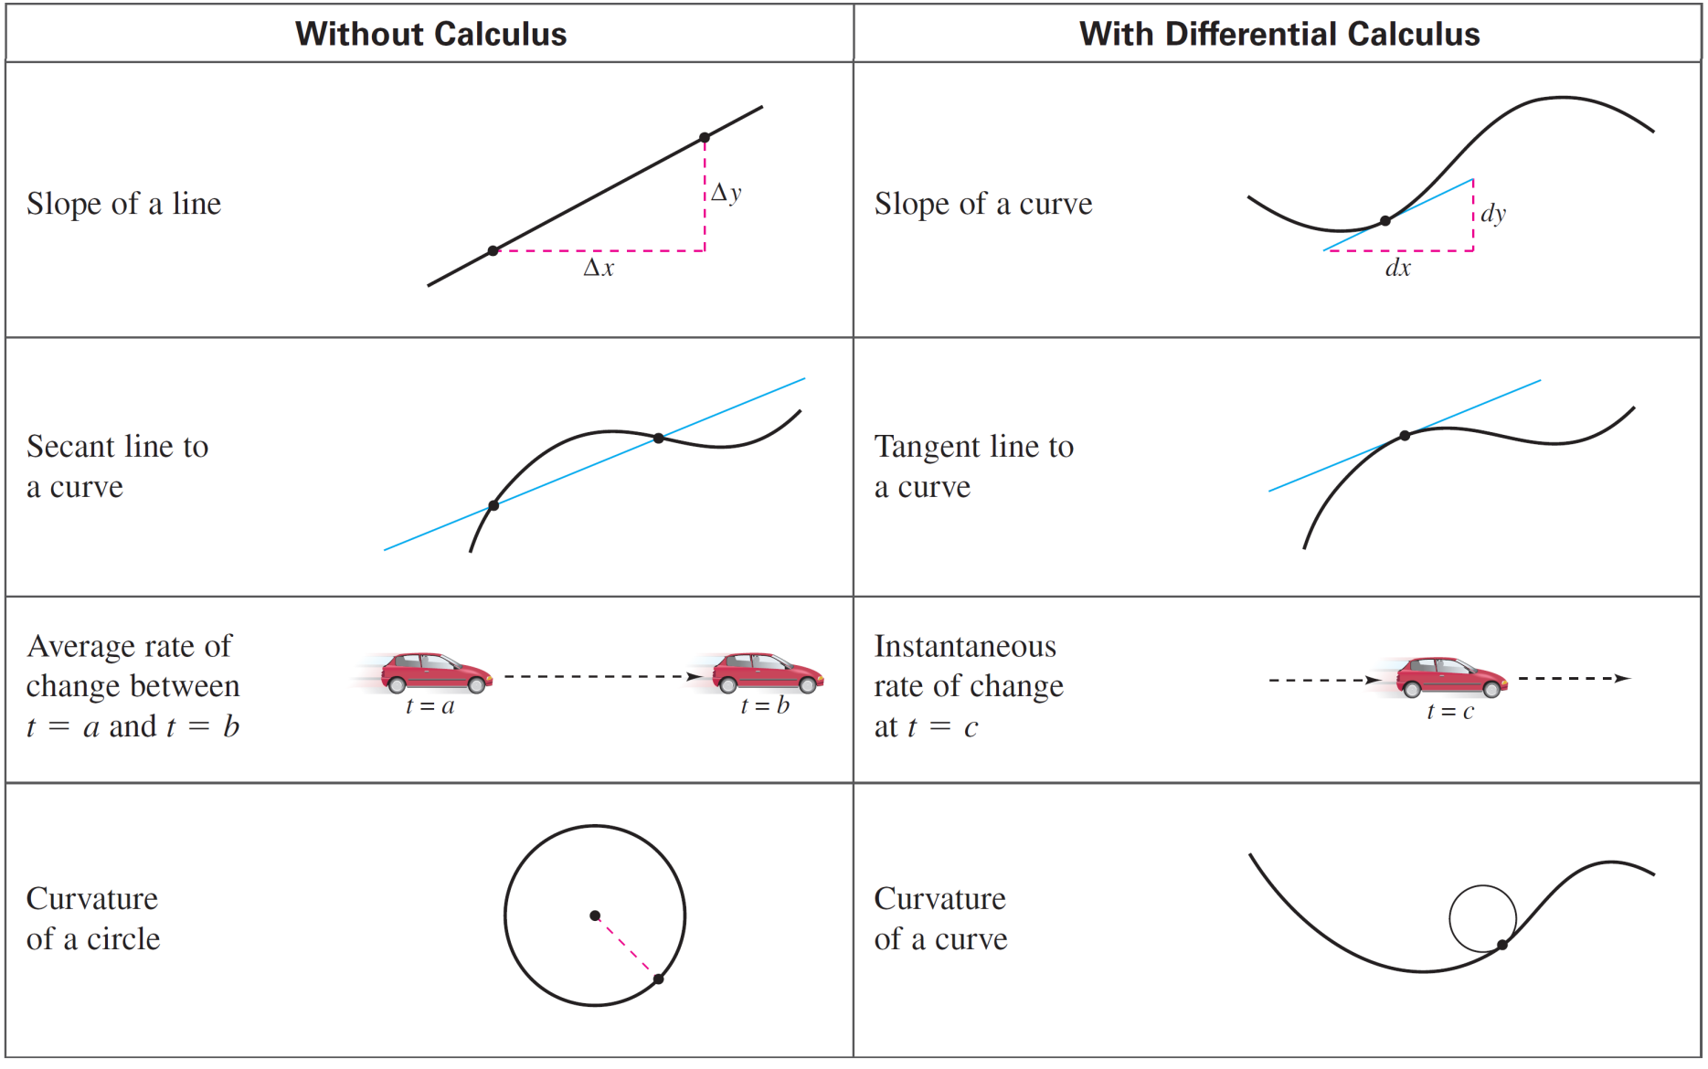
What Is Calculus?
cont’d

Slide 12
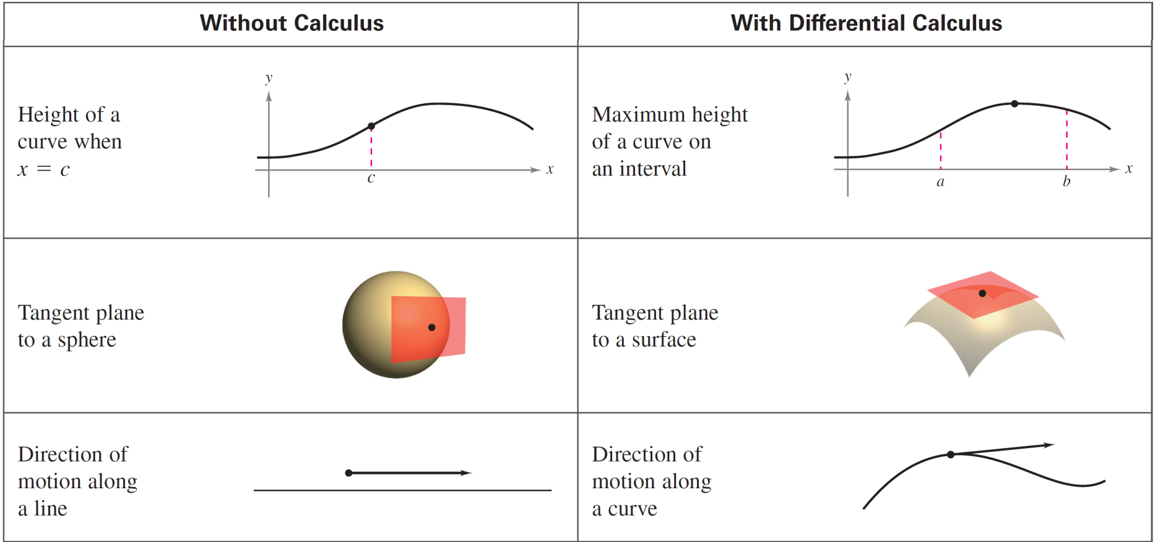
What Is Calculus?
cont’d

Slide 13
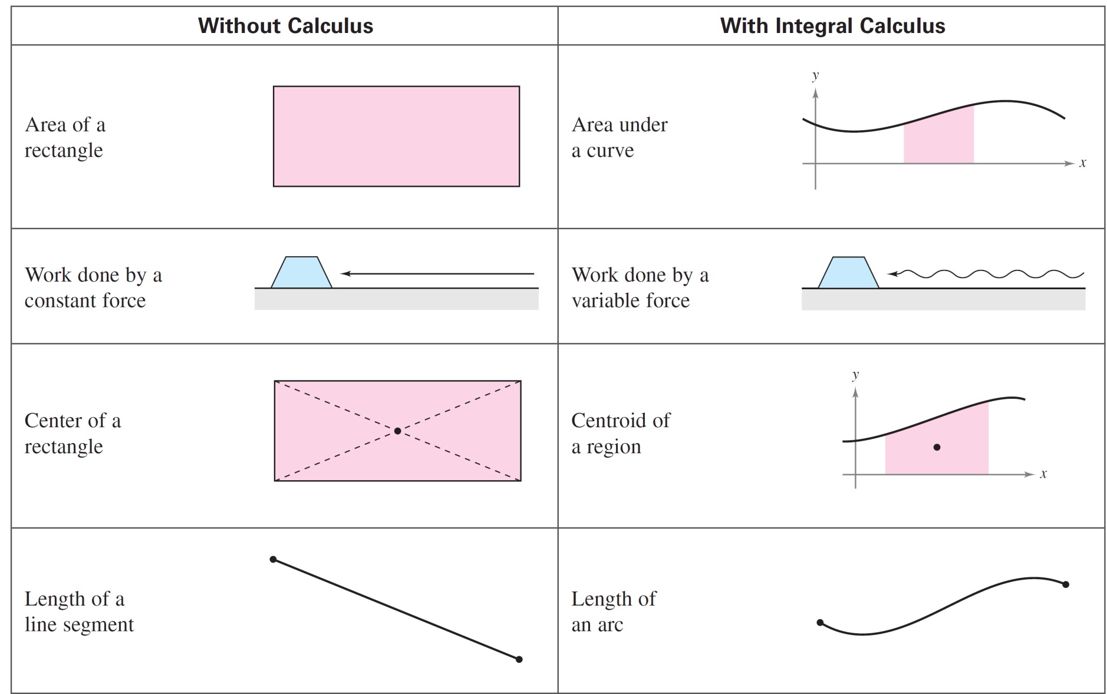
What Is Calculus?
cont’d

Slide 14
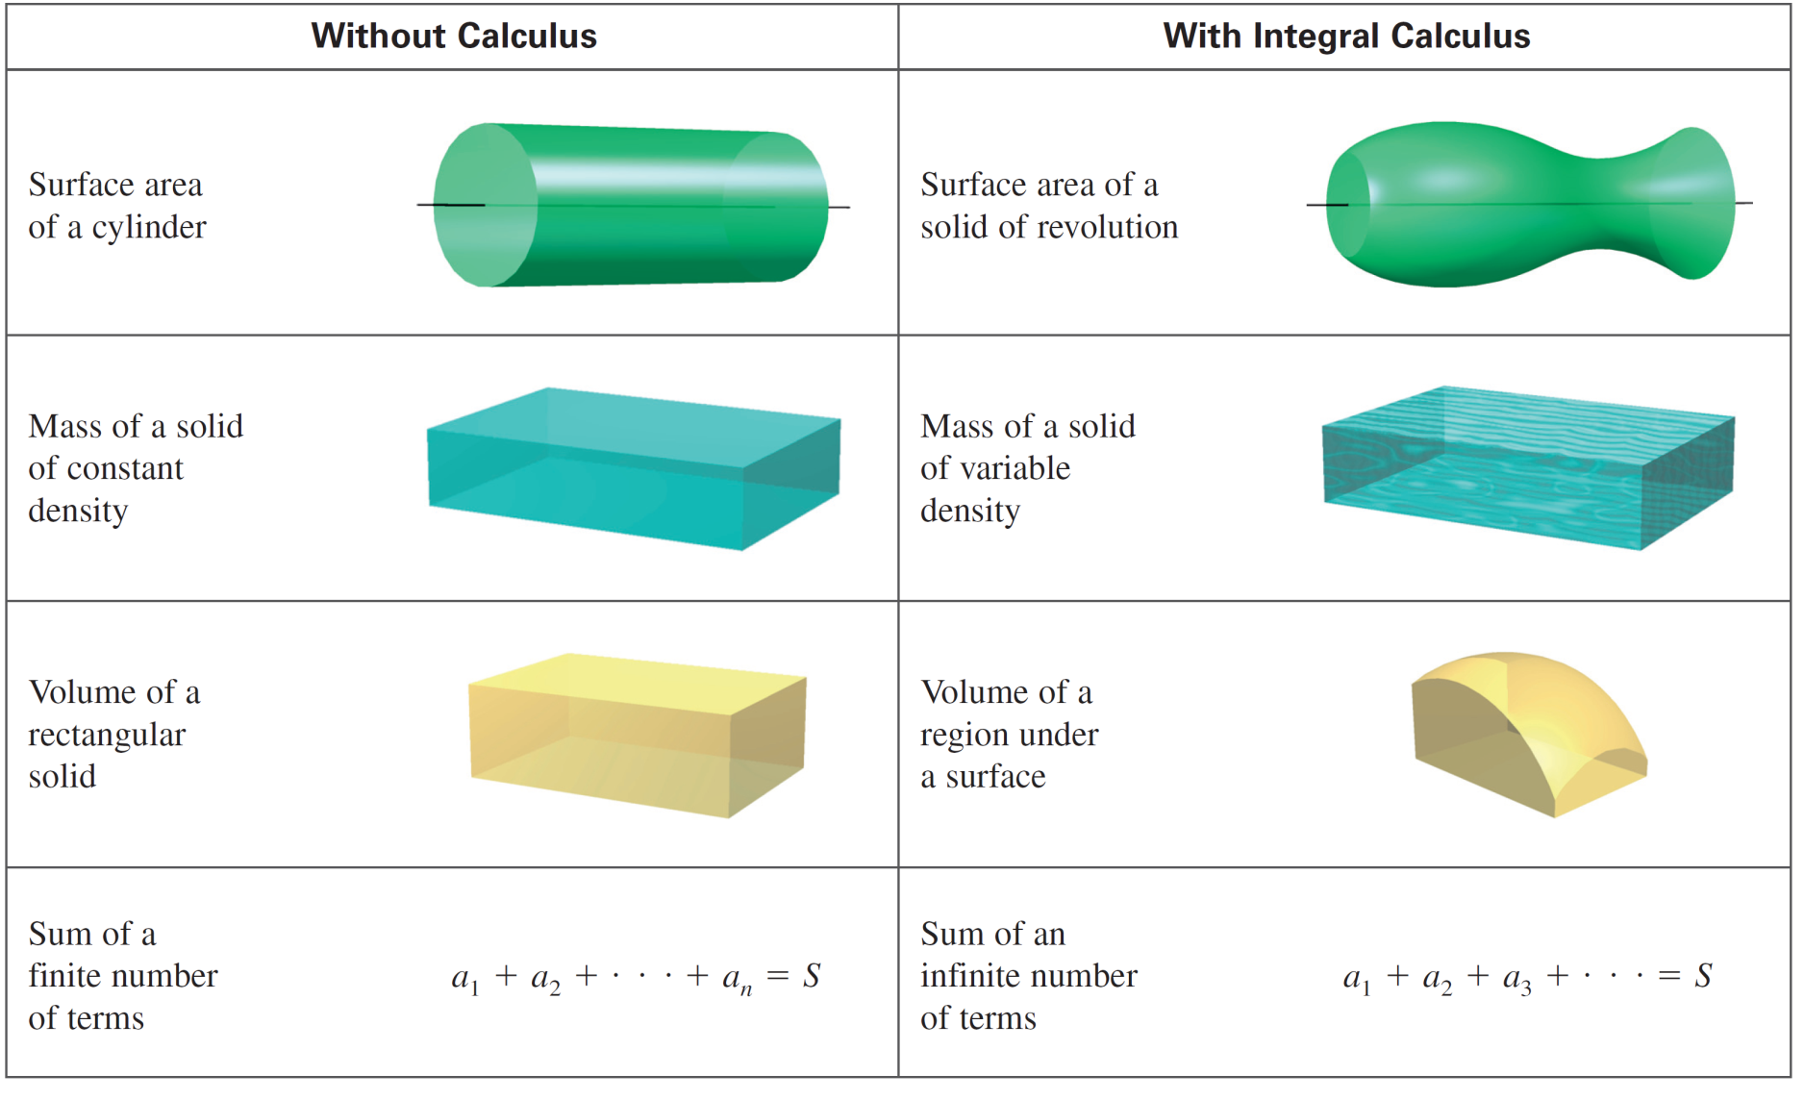
What Is Calculus?
cont’d

Slide 15
The Tangent Line Problem

Slide 16
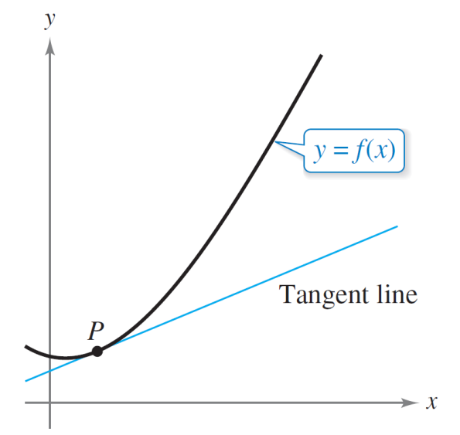
The Tangent Line Problem
The notion of a limit is fundamental to the study of calculus.
The following brief descriptions of two classic problems in calculus—the tangent line problem and the area problem—should give you some idea of the way limits are used in calculus.
In the tangent line problem, you are given a function f and a point P on its graph and are asked to find an equation of the tangent line to the graph at point P, as shown in Figure 2.1.
The tangent line to the graph of f at P
Figure 2.1

Slide 17
The Tangent Line Problem
Except for cases involving a vertical tangent line, the problem of finding the tangent line at a point P is equivalent to finding the slope of the tangent line at P.
You can approximate this slope by using a line through the point of tangency and a second point on the curve, as shown in Figure 2.2(a).
Such a line is called a secant line.
The secant line through (c, f (c)) and (c + Δx, f (c + Δx))
Figure 2.2(a)

Slide 18
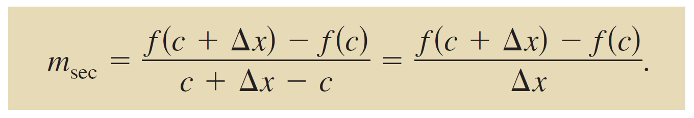
The Tangent Line Problem
If P(c, f (c)) is the point of tangency and
Q(c + Δx, f (c + Δx))
is a second point on the graph of f, then the slope of the secant line through these two points can be found using precalculus and is

Slide 19
The Tangent Line Problem
As point Q approaches point P, the slope of the secant line
approaches the slope of the tangent line, as shown in
Figure 2.2(b).
When such a “limiting position” exists, the slope of the tangent line is said to be the limit of the slopes of the secant lines.
As Q approaches P, the secant lines approach the tangent line.
Figure 2.2(b)

Slide 20
The Area Problem

Slide 21
The Area Problem
In the tangent line problem, you saw how the limit process can be applied to the slope of a line to find the slope of a general curve.
A second classic problem in calculus is finding the area of a plane region that is bounded by the graphs of functions.
This problem can also be solved with a limit process. In this case, the limit process is applied to the area of a rectangle to find the area of a general region.

Slide 22
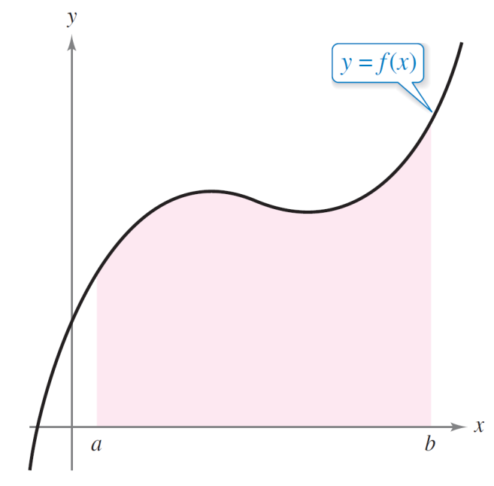
The Area Problem
As a simple example, consider the region bounded by the graph of the function y = f (x), the x-axis, and the vertical lines x = a and x = b, as shown in Figure 2.3.
Area under a curve
Figure 2.3

Slide 23
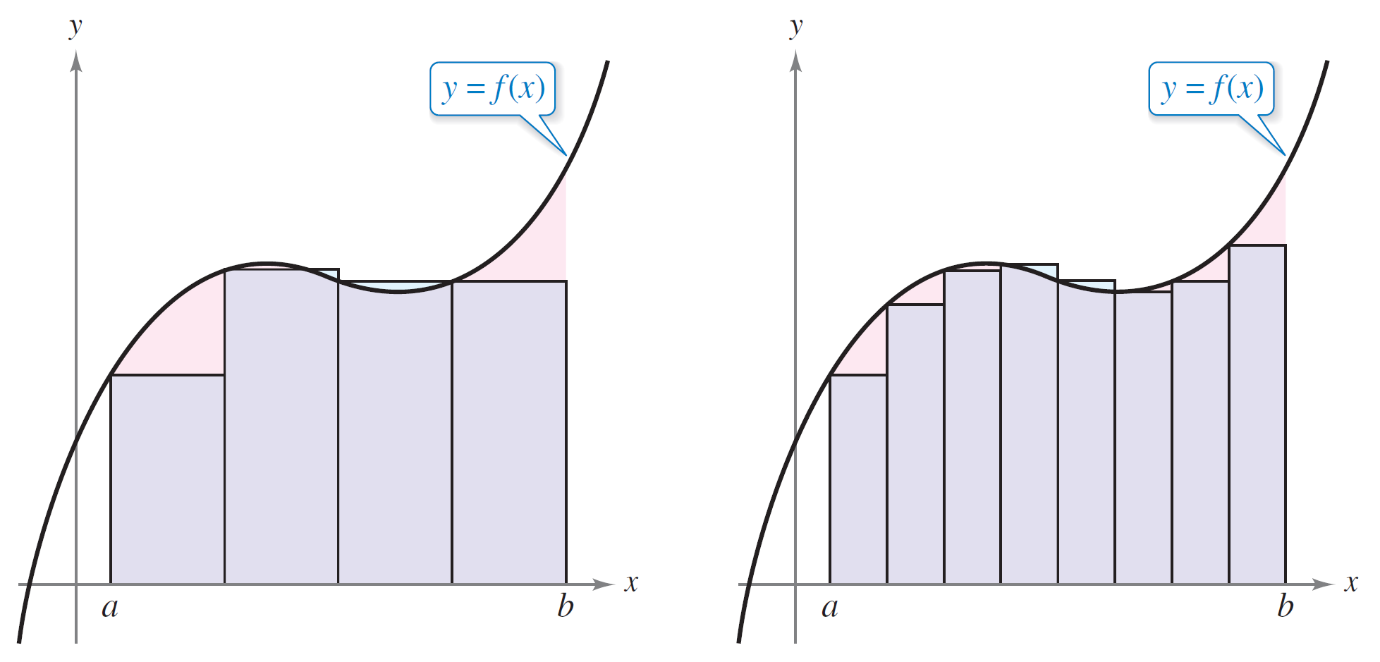
The Area Problem
You can approximate the area of the region with several rectangular regions, as shown in Figure 2.4.
Approximation using four rectangles
Approximation using eight rectangles
Figure 2.4

Slide 24
The Area Problem
As you increase the number of rectangles, the approximation tends to become better and better because the amount of area missed by the rectangles decreases.
Your goal is to determine the limit of the sum of the areas of the rectangles as the number of rectangles increases without bound.

