Slide 1

2
Limits and Their Properties
Copyright © Cengage Learning. All rights reserved.

Slide 2
Finding Limits Graphically and Numerically
2.2
Copyright © Cengage Learning. All rights reserved.

Slide 3
Objectives
Estimate a limit using a numerical or graphical approach.
Learn different ways that a limit can fail to exist.
Study and use a formal definition of limit.

Slide 4
An Introduction to Limits

Slide 5
An Introduction to Limits
To sketch the graph of the function
for values other than x = 1, you can use standard curve-sketching techniques. At x = 1, however, it is not clear what to expect.

Slide 6
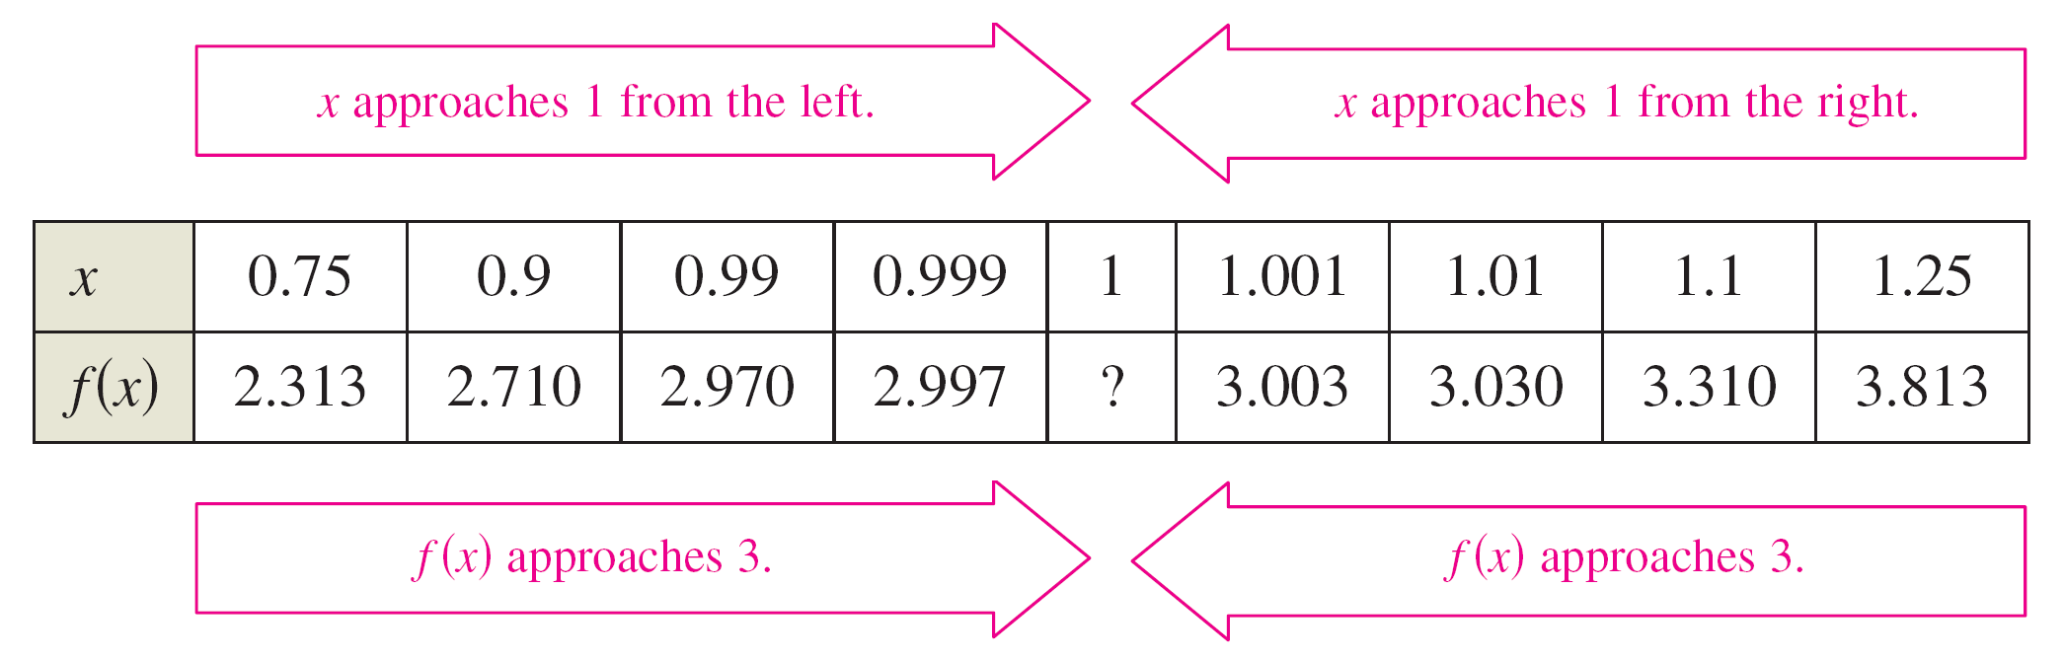
An Introduction to Limits
To get an idea of the behavior of the graph of f near x = 1, you can use two sets of x-values—one set that approaches 1 from the left and one set that approaches 1 from the right, as shown in the table.

Slide 7
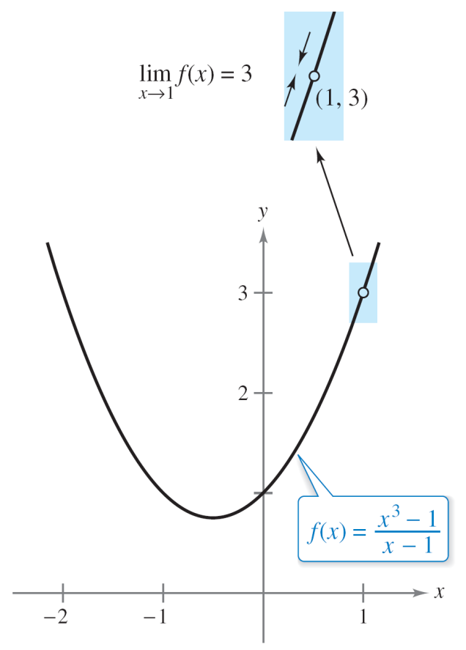
An Introduction to Limits
The graph of f is a parabola that has a gap at the point (1, 3), as shown in Figure 2.5.
Although x cannot equal 1, you can move arbitrarily close to 1, and as a result f (x) moves arbitrarily close to 3.
The limit of f (x) as x approaches 1 is 3.
Figure 2.5

Slide 8
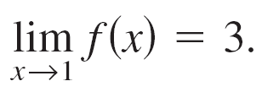
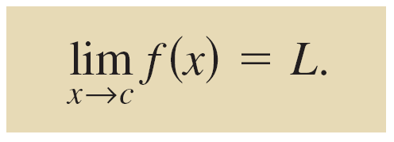
An Introduction to Limits
Using limit notation, we can write
This discussion leads to an informal definition of limit. If f (x) becomes arbitrarily close to a single number L as x approaches c from either side, then the limit of f (x), as x approaches c, is L.
This limit is written as
This is read as “the limit of f (x) as x approaches 1 is 3.”

Slide 9
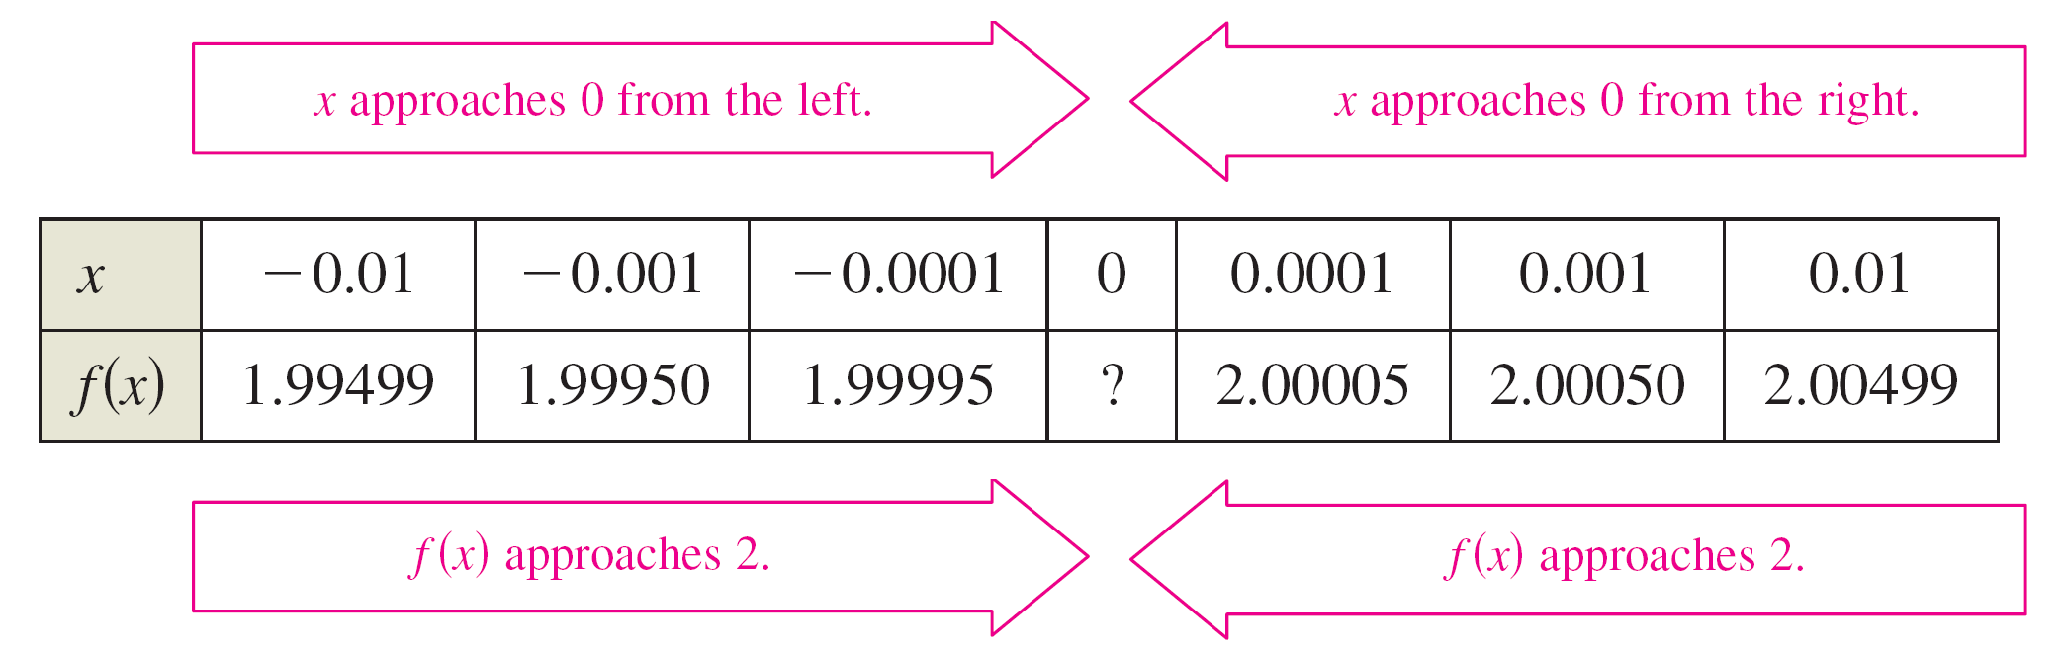
Example 1 – Estimating a Limit Numerically
Evaluate the function at several
x-values near 0 and use the results to estimate the limit
Solution:
The table lists the values of f (x) for several x-values near 0.

Slide 10
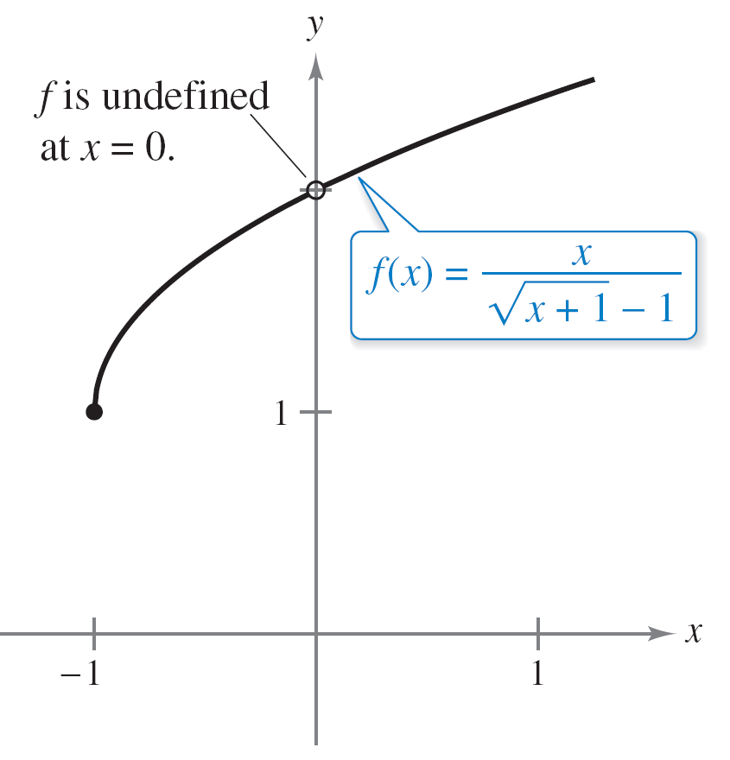
Example 1 – Solution
cont’d
From the results shown in the table, you can estimate the limit to be 2. This limit is reinforced by the graph of f (see Figure 2.6).
The limit of f (x) as x approaches 0 is 2.
Figure 2.6

Slide 11
An Introduction to Limits
In Example 1, note that the function is undefined at x = 0 and yet f (x) appears to be approaching a limit as x approaches 0.
This often happens, and it is important to realize that the existence or nonexistence of f (x) at x = c has no bearing on the existence of the limit of f (x) as x approaches c.

Slide 12
Limits That Fail to Exist

Slide 13
Example 3 – Different Right and Left Behavior
Show that the limit does not exist.

Slide 14
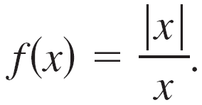
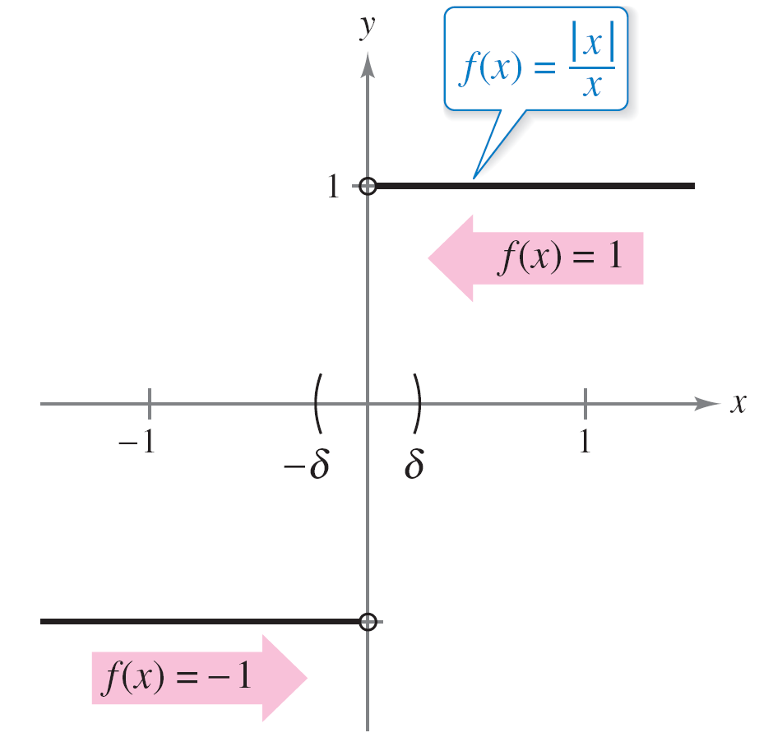
Example 3 – Solution
Consider the graph of the function
In Figure 2.8 and from the definition of absolute value,
x, if x ≥ 0
–x, if x < 0
you can see that
1, if x > 0
–1, if x < 0
| x | =
Definition of
absolute value
=
.
does not exist.
Figure 2.8

Slide 15
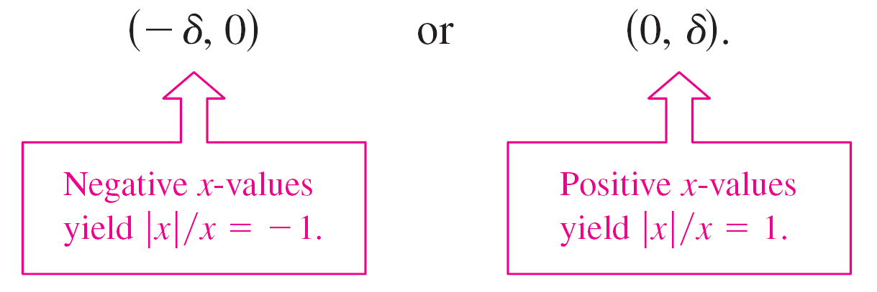
Example 3 – Solution
cont’d
So, no matter how close x gets to 0, there will be both positive and negative x-values that yield f (x) = 1 or f (x) = –1.
Specifically, if δ (the lowercase Greek letter delta) is a positive number, then for x-values satisfying the inequality 0 < | x | < δ, you can classify the values of | x |/x as follows.

Slide 16
Example 3 – Solution
cont’d
Because | x |/x approaches a different number from the right
side of 0 than it approaches from the left side, the limit
does not exist.

Slide 17
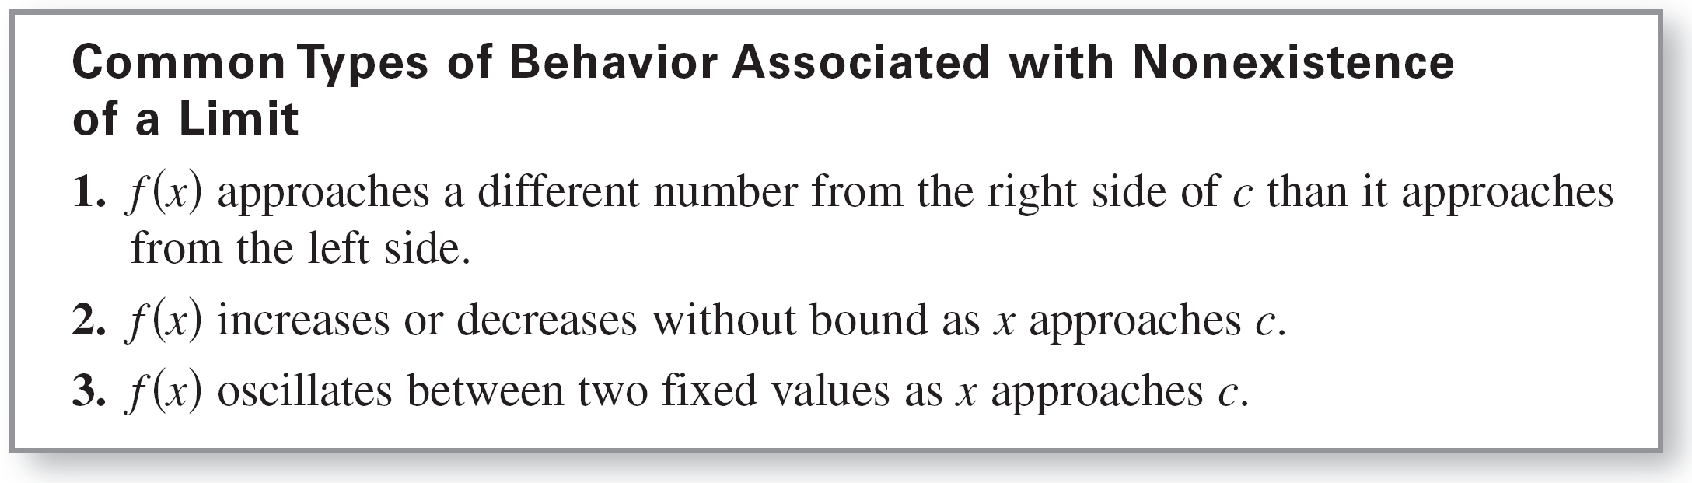
Limits That Fail to Exist
There are many other interesting functions that have unusual limit behavior.

Slide 18
Limits That Fail to Exist
An often cited one is the Dirichlet function.
0, if x is rational
1, if x is irrational.
Because this function has no limit at any real number c, it is not continuous at any real number c.
f (x) =

Slide 19
A Formal Definition of Limit

Slide 20
A Formal Definition of Limit
Consider again the informal definition of limit. If f (x) becomes arbitrarily close to a single number L as x approaches c from either side, then the limit of f (x) as x approaches c is L, written as
At first glance, this definition looks fairly technical.

Slide 21
A Formal Definition of Limit
Even so, it is informal because exact meanings have not yet been given to the two phrases
“f (x) becomes arbitrarily close to L”
and
“x approaches c.”
The first person to assign mathematically rigorous meanings to these two phrases was Augustin-Louis Cauchy.
His ε-δ definition of limit is the standard used today.

Slide 22
A Formal Definition of Limit
In Figure 2.12, let ε (the lowercase Greek letter epsilon) represent a (small) positive number.
Then the phrase “f (x) becomes arbitrarily close to L” means that f (x) lies in the interval (L – ε, L + ε).
Using absolute value, you can write this as
| f (x) – L | < ε.
The ε-δ definition of the limit of f (x) as
x approaches c
Figure 2.12

Slide 23
A Formal Definition of Limit
Similarly, the phrase “x approaches c” means that there exists a positive number δ such that x lies in either the interval (c – δ, c) or the interval (c, c + δ ).
This fact can be concisely expressed by the double inequality
0 < | x – c | < δ.
The first inequality
0 < | x – c |
expresses the fact that x ≠ c.
The distance between x and c is more than 0.

Slide 24
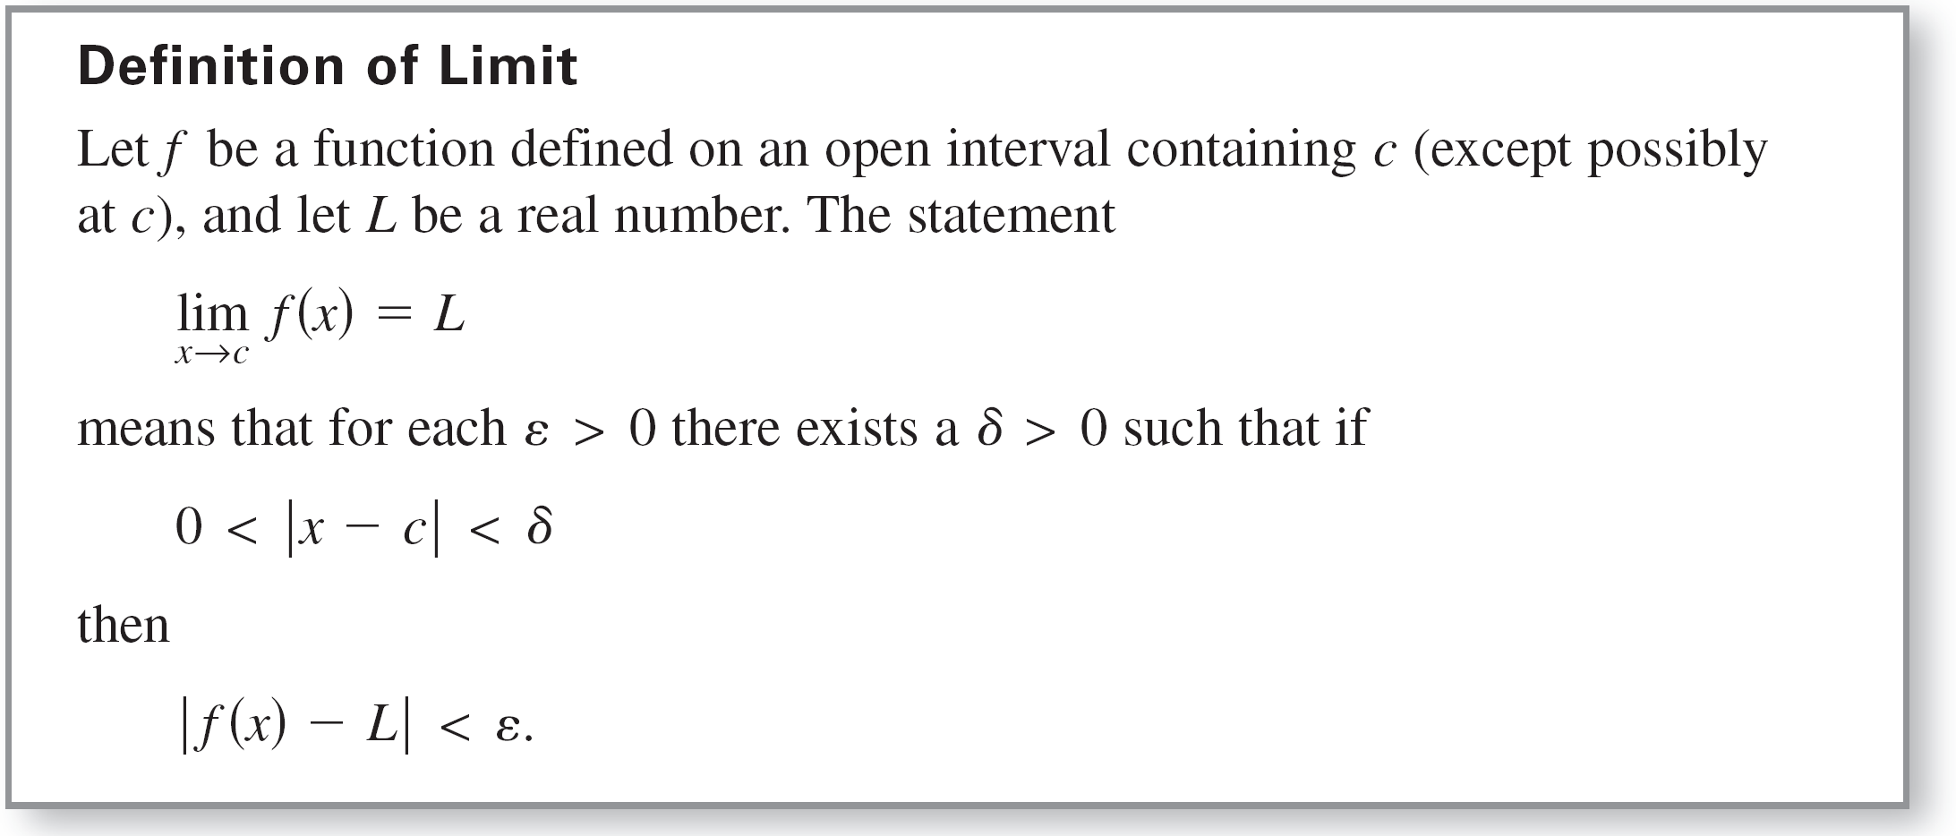
A Formal Definition of Limit
The second inequality
| x – c | < δ
says that x is within a distance δ of c.
x is within δ units of c.

Slide 25
A Formal Definition of Limit
Some functions do not have limits as x approaches c, but those that do cannot have two different limits as x approaches c. That is, if the limit of a function exists, then the limit is unique.
The next example should help you develop a better understanding of the ε-δ definition of limit.

Slide 26
Example 7 – Using the ε-δ Definition of Limit
Use the ε-δ definition of limit to prove that
Solution:
You must show that for each ε > 0, there exists a δ > 0 such that | (3x – 2) – 4 | < ε whenever 0 < | x – 2 | < δ.
Because your choice of δ depends on ε, you need to establish a connection between the absolute values | (3x – 2) – 4 | and | x – 2 |.
| (3x – 2) – 4 | = | 3x – 6 |
= 3| x – 2 |

Slide 27
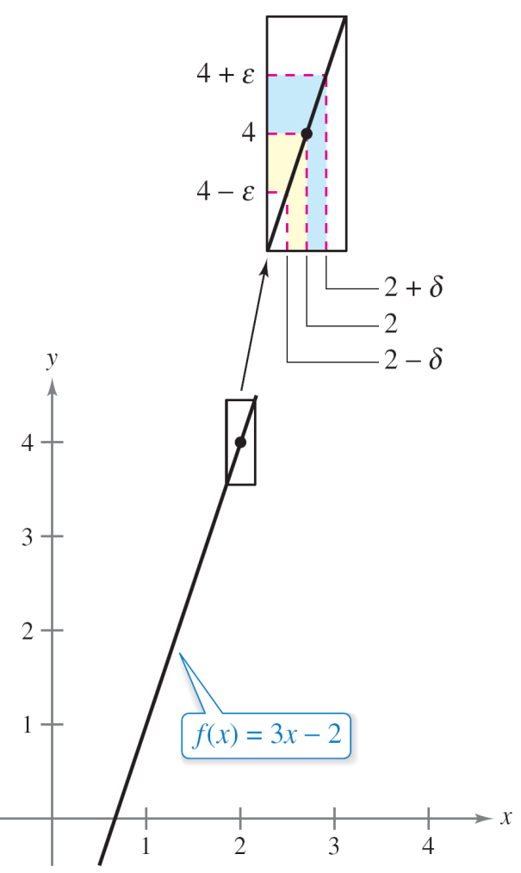
Example 7 – Solution
cont’d
So, for a given ε > 0 you can choose δ = ε/3. This choice works because
0 < | x – 2 | < δ =
implies that
| (3x – 2) – 4 | = 3| x – 2 | <
= ε
As shown in Figure 2.14, for x-values within δ of 2 (x ≠ 2), the values of f (x) are within ε of 4.
The limit of f (x) as x approaches 2 is 4.
Figure 2.14

