Slide 1

2
Limits and Their Properties
Copyright © Cengage Learning. All rights reserved.

Slide 2
2.3
Evaluating Limits Analytically
Copyright © Cengage Learning. All rights reserved.

Slide 3
Objectives
Evaluate a limit using properties of limits.
Develop and use a strategy for finding limits.
Evaluate a limit using dividing out technique.
Evaluate a limit using the rationalizing technique.
Evaluate a limit using the Squeeze Theorem.

Slide 4
Properties of Limits

Slide 5
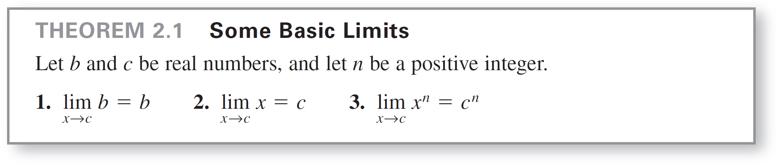
Properties of Limits
We have learned that the limit of f (x) as x approaches c does not depend on the value of f at x = c. It may happen, however, that the limit is precisely f (c). In such cases, the limit can be evaluated by direct substitution. That is,
Such well-behaved functions are continuous at c.
Substitute c for x.

Slide 6
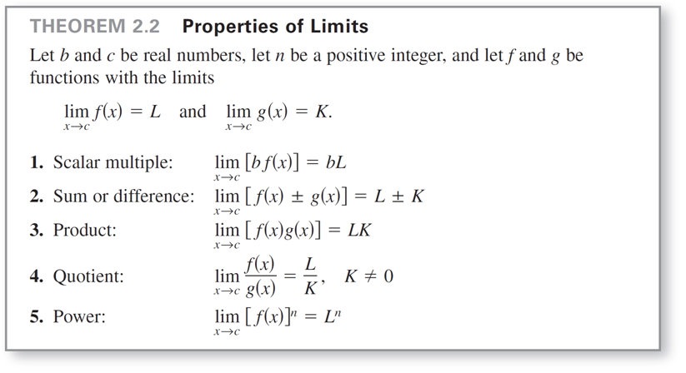
Properties of Limits

Slide 7
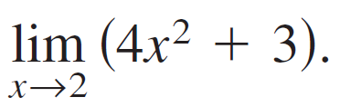
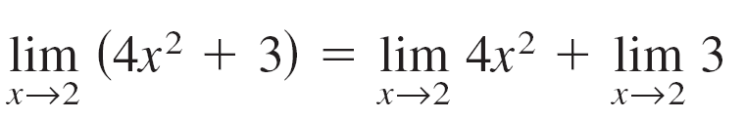
Example 2 – The Limit of a Polynomial
Find the limit:
Solution:
Property 2, Theorem 2.2
Property 1, Theorem 2.2
Properties 1 and 3,
Theorem 2.1
Simplify.

Slide 8

Properties of Limits
In Example 2, note that the limit (as x approaches 2) of the polynomial function p(x) = 4x² + 3 is simply the value of p at
x = 2.
This direct substitution property is valid for all polynomial and rational functions with nonzero denominators.

Slide 9
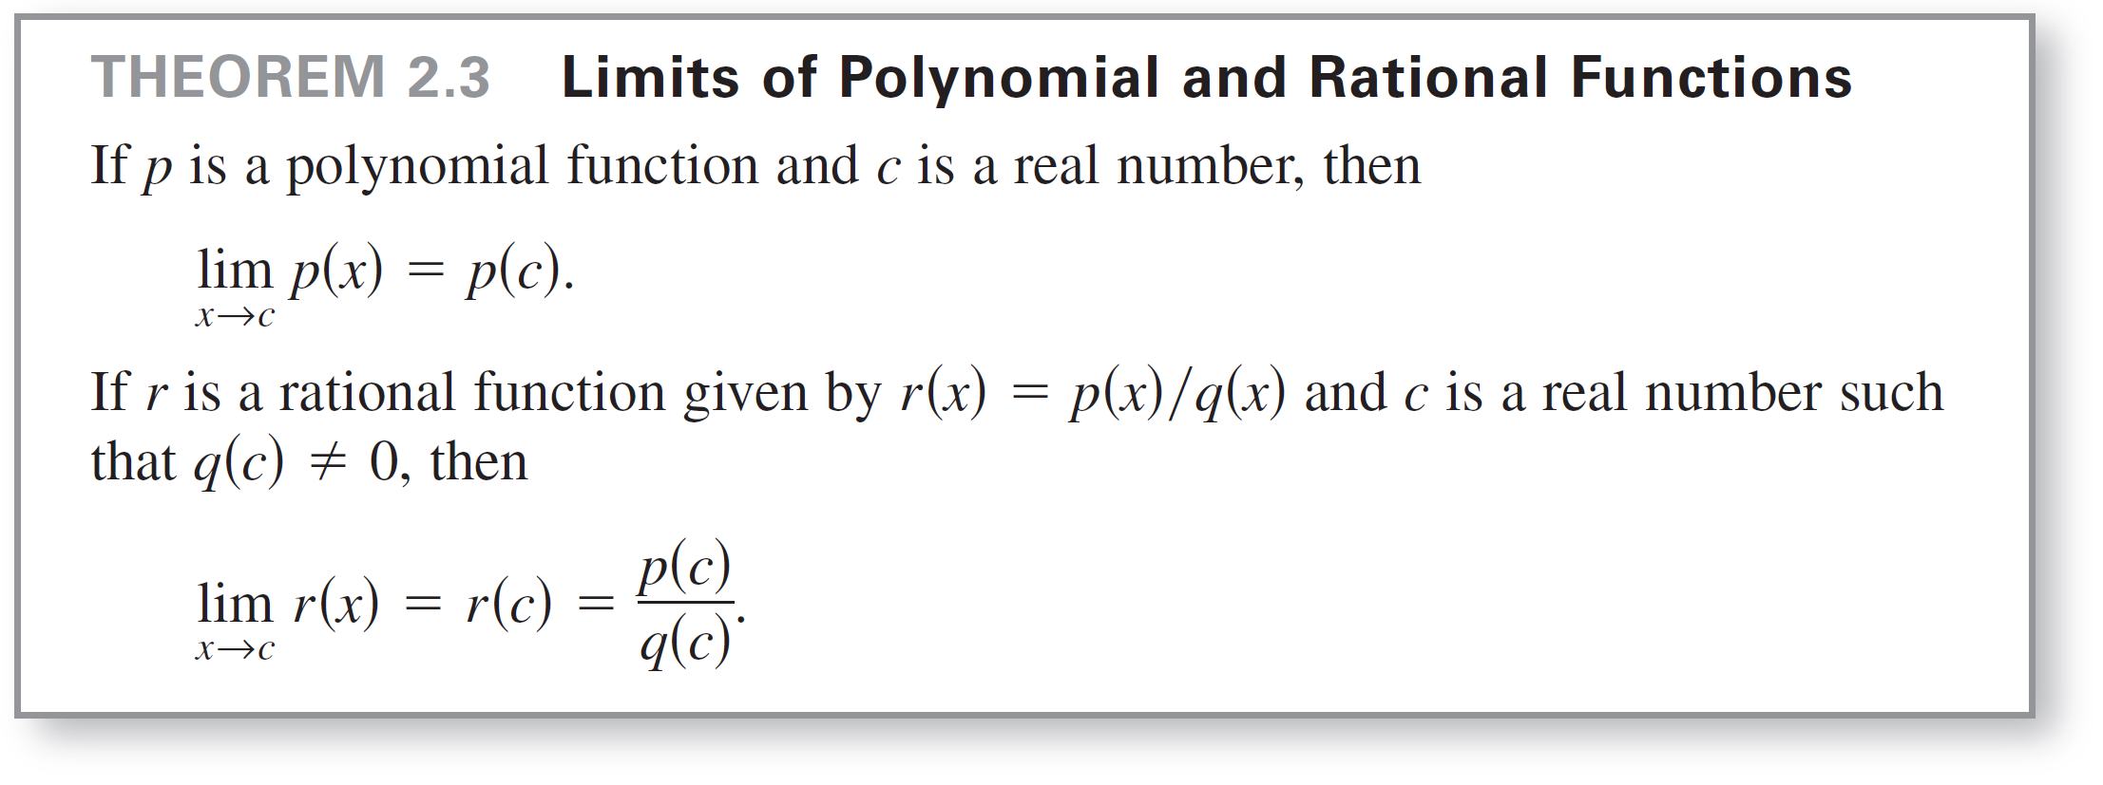
Properties of Limits

Slide 10
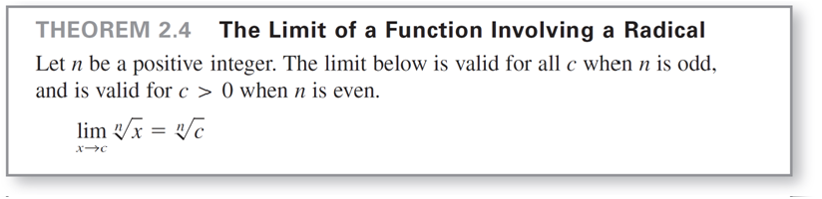
Properties of Limits
Polynomial functions and rational functions are two of the three basic types of algebraic functions. The following theorem deals with the limit of the third type of algebraic function—one that involves a radical.

Slide 11
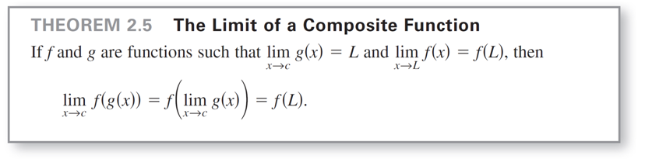
Properties of Limits
The following theorem greatly expands your ability to evaluate limits because it shows how to analyze the limit of a composite function.

Slide 12
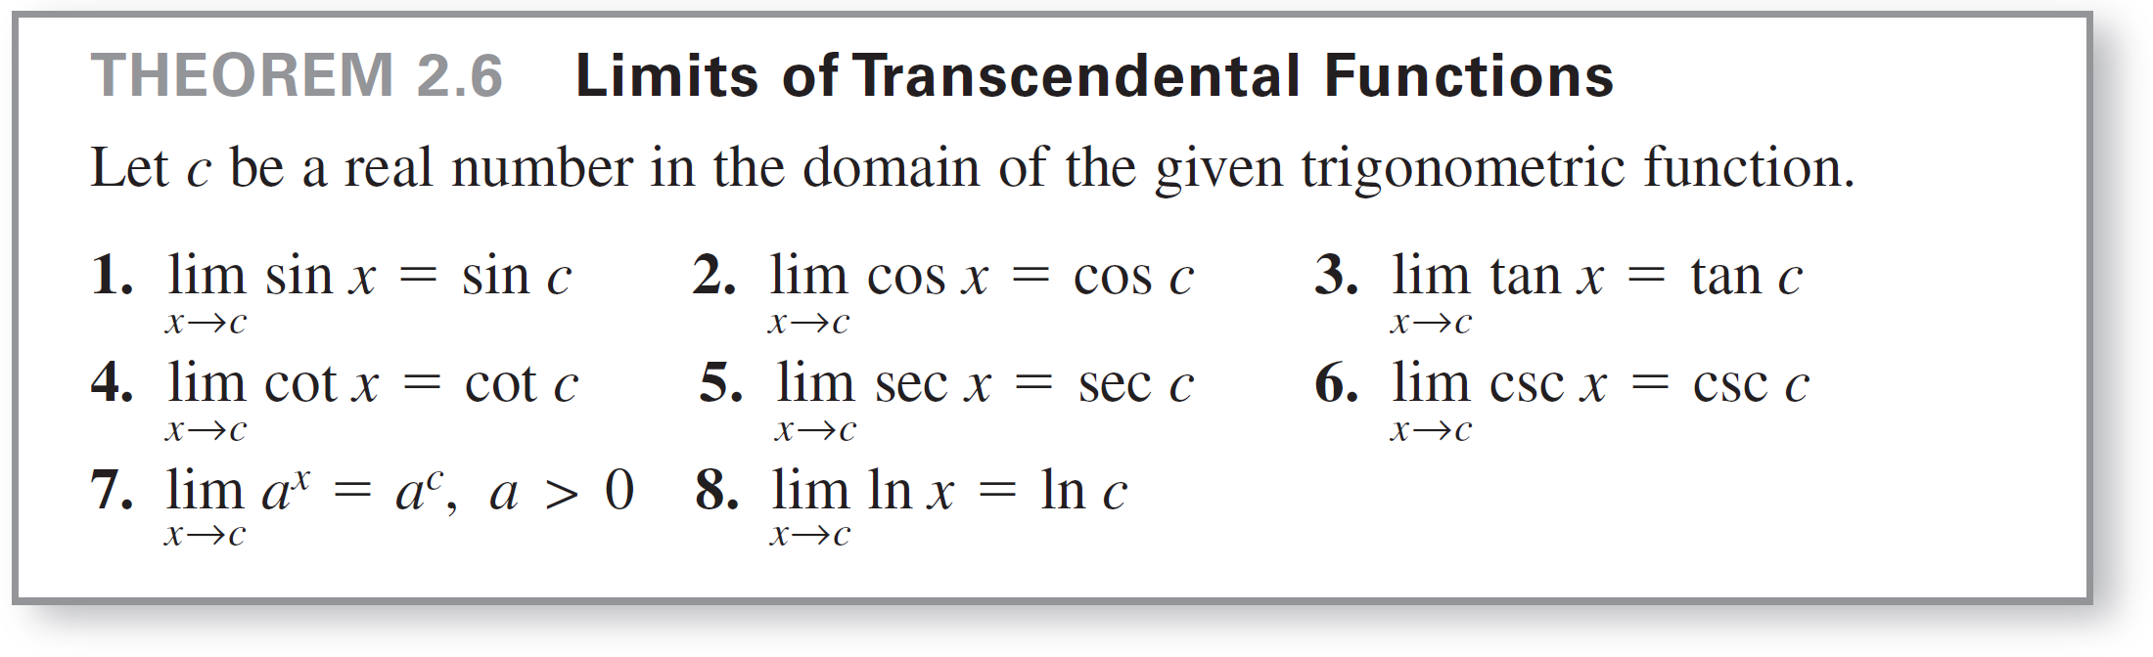
Properties of Limits
We have seen that the limits of many algebraic functions can be evaluated by direct substitution. The basic transcendental functions (trigonometric, exponential, and logarithmic) also possess this desirable quality, as shown in the next theorem.

Slide 13
A Strategy for Finding Limits

Slide 14
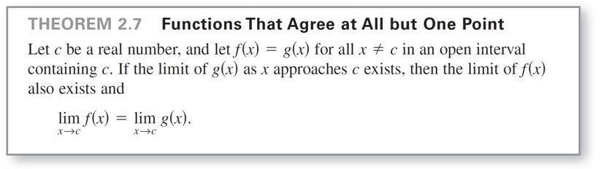
A Strategy for Finding Limits
We have studied several types of functions whose limits can be evaluated by direct substitution.
This knowledge, together with the following theorem, can be used to develop a strategy for finding limits.

Slide 15
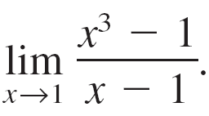
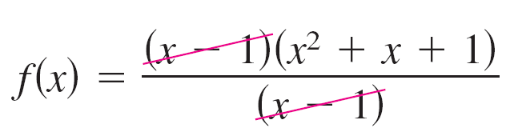
Example 6 – Finding the Limit of a Function
Find the limit:
Solution:
Let f (x) = (x³ – 1)/(x – 1). By factoring and dividing out like factors, you can rewrite f as
= x² + x + 1
= g(x), x ≠ 1.

Slide 16
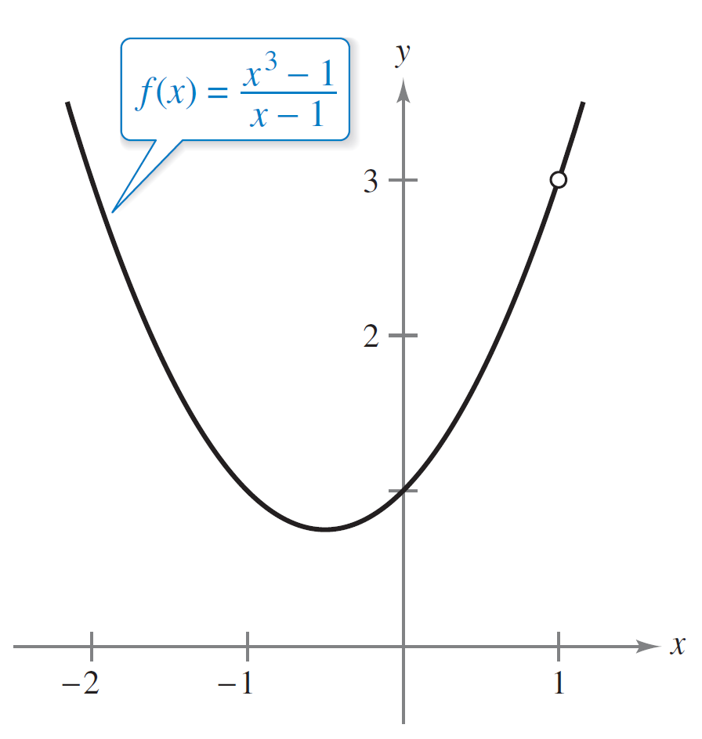
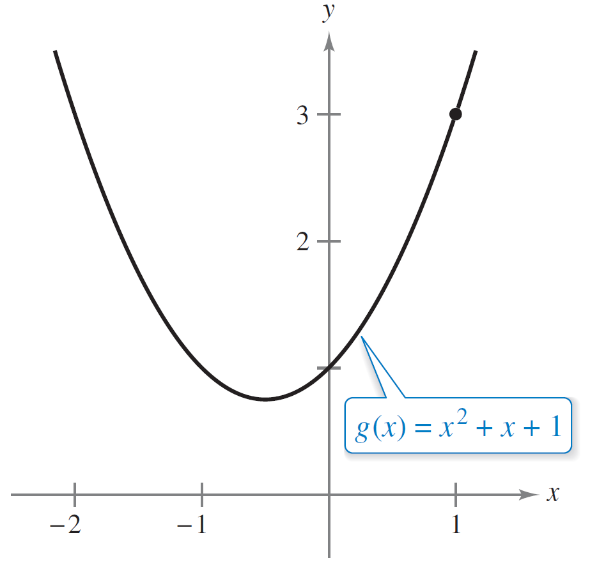
Example 6 – Solution
cont’d
So, for all x-values other than x = 1, the functions f and g agree, as shown in Figure 2.17.
f and g agree at all but one point.
Figure 2.17

Slide 17
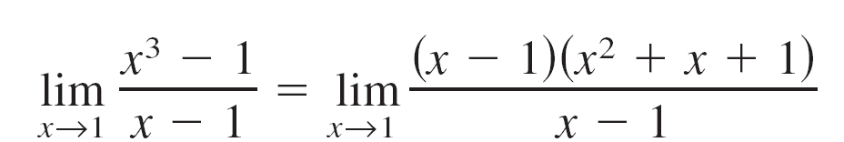
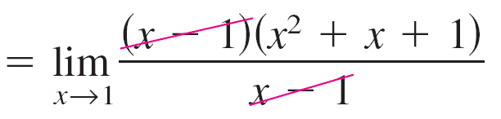


Example 6 – Solution
cont’d
Because exists, you can apply Theorem 2.7 to
conclude that f and g have the same limit at x = 1.
Factor.
Divide out like factors.
Apply Theorem 2.7.
Use direct substitution.
Simplify.

Slide 18
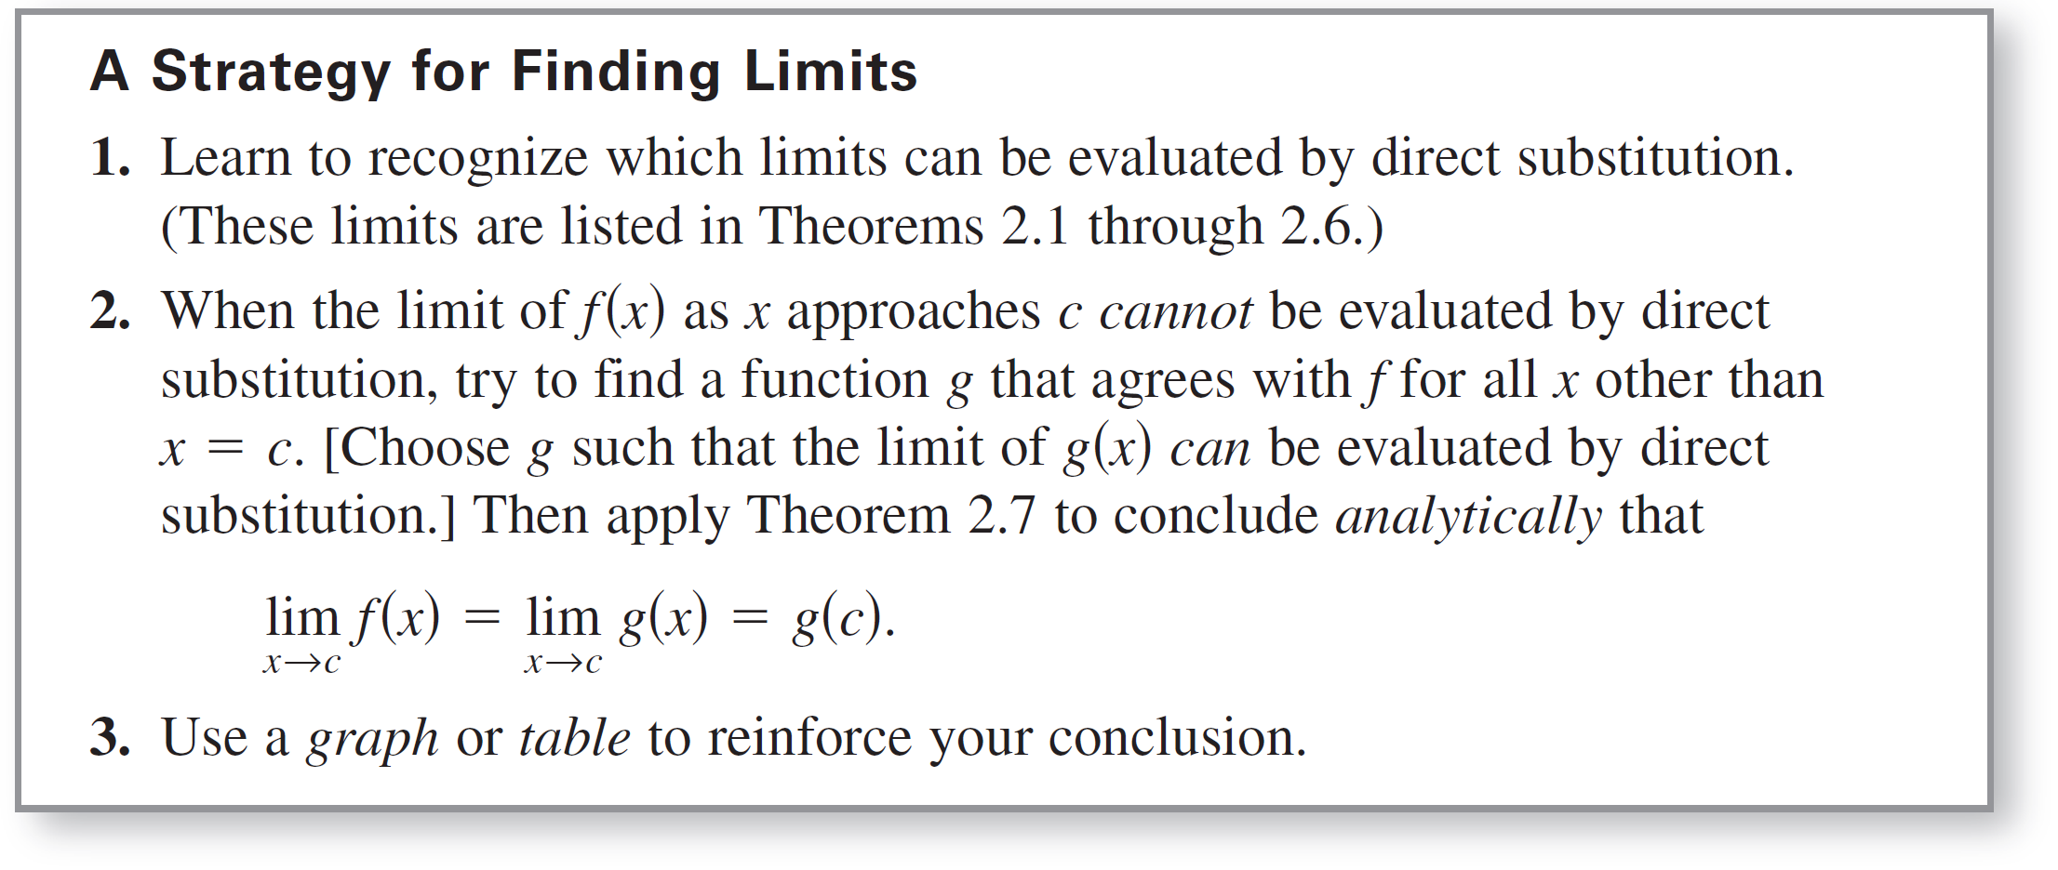
A Strategy for Finding Limits

Slide 19
Dividing Out Technique

Slide 20
Dividing Out Technique
One procedure for finding a limit analytically is the dividing out technique.
This technique involves dividing out common factors, as shown in Example 7.

Slide 21
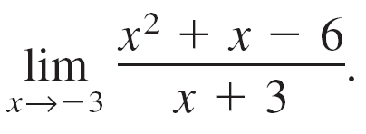
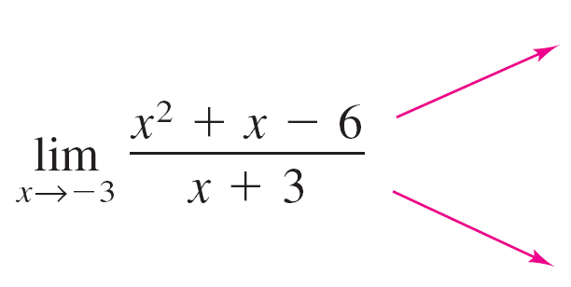
Example 7 – Dividing Out Technique
Find the limit:
Solution:
Although you are taking the limit of a rational function, you cannot apply Theorem 2.3 because the limit of the denominator is 0.
Direct substitution fails.

Slide 22
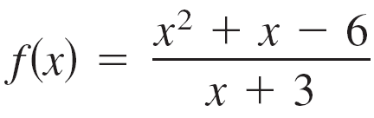

Example 7 – Solution
cont’d
Because the limit of the numerator is also 0, the numerator and denominator have a common factor of (x + 3).
So, for all x ≠ –3 you can divide out this factor to obtain

Slide 23

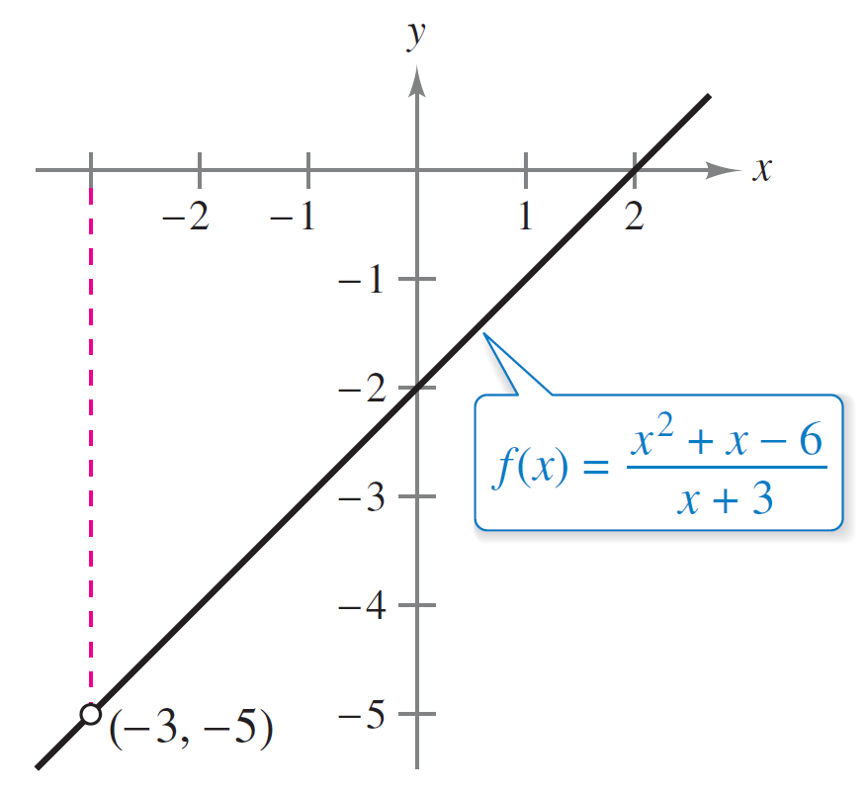
Example 7 – Solution
cont’d
Using Theorem 2.7, it follows that
This result is shown graphically in Figure 2.18.
Note that the graph of the function f coincides with the graph of the function g(x) = x – 2, except that the graph of f has a gap at the point (–3, –5).
Apply Theorem 2.7.
Use direct substitution.
f is undefined when x = –3
Figure 2.18

Slide 24
Dividing Out Technique
In Example 7, direct substitution produced the meaningless fractional form 0/0.
An expression such as 0/0 is called an indeterminate form because you cannot (from the form alone) determine the limit. When you try to evaluate a limit and encounter this form, remember that you must rewrite the fraction so that the new denominator does not have 0 as its limit.
One way to do this is to divide out like factors. Another way is to use rationalizing technique.

Slide 25
Rationalizing Technique

Slide 26
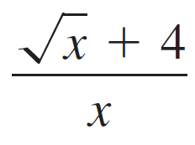


Rationalizing Technique
Another way to find a limit analytically is the rationalizing technique, which involves rationalizing the numerator of a fractional expression.
Recall that rationalizing the numerator means multiplying the numerator and denominator by the conjugate of the numerator.
For instance, to rationalize the numerator of
multiply the numerator and denominator by the conjugate of which is

Slide 27
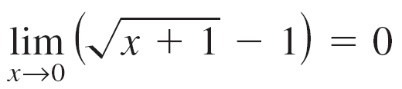
Example 8 – Rationalizing Technique
Find the limit:
Solution:
By direct substitution, you obtain the indeterminate form 0/0.
Direct substitution fails.

Slide 28
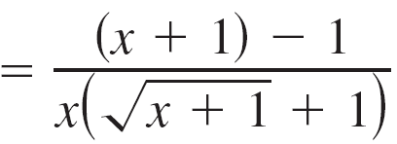
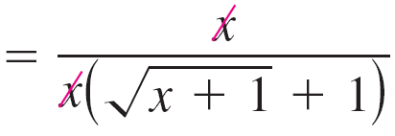
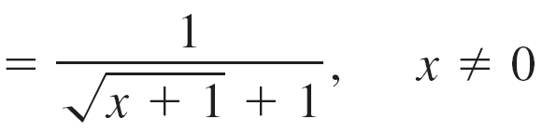
Example 8 – Solution
cont’d
In this case, you can rewrite the fraction by rationalizing the numerator.

Slide 29
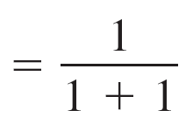
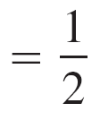
Example 8 – Solution
cont’d
Now, using Theorem 2.7, you can evaluate the limit as shown.

Slide 30

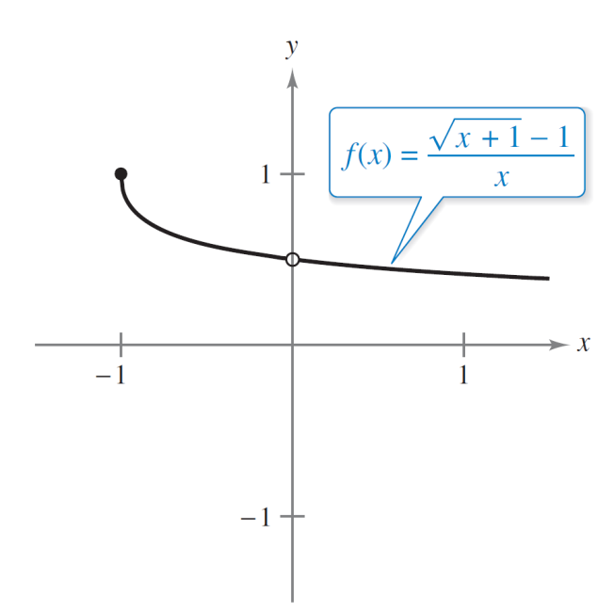
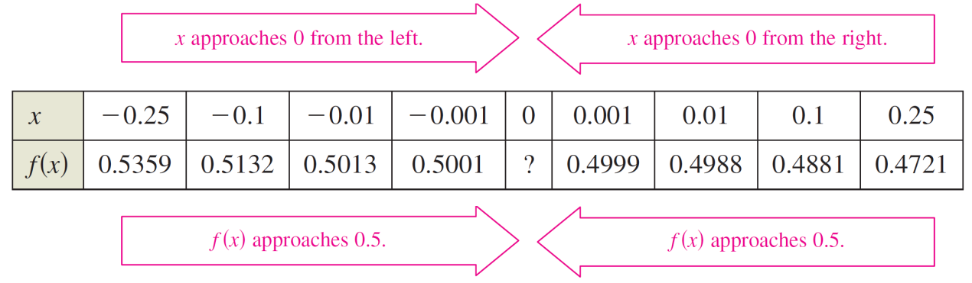
Example 8 – Solution
cont’d
A table or a graph can reinforce your conclusion that the
limit is (See Figure 2.20.)
The limit of f (x) as x approaches 0 is
Figure 2.20

Slide 31
The Squeeze Theorem

Slide 32
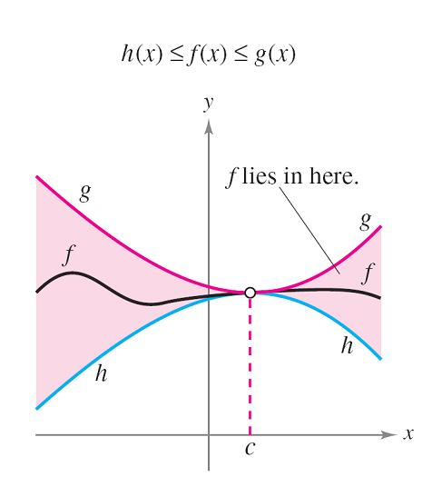
The Squeeze Theorem
The next theorem concerns the limit of a function that is squeezed between two other functions, each of which has the same limit at a given x-value, as shown in Figure 2.21.
The Squeeze Theorem
Figure 2.21

Slide 33
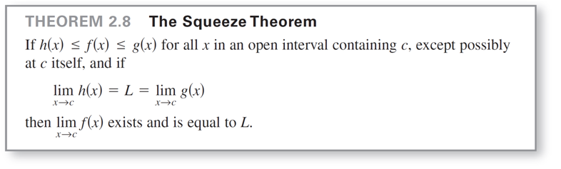
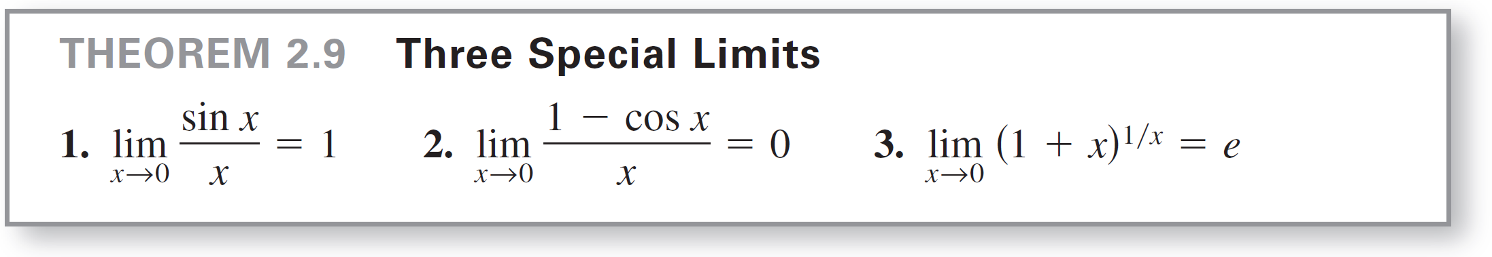
The Squeeze Theorem
You can see the usefulness of the Squeeze Theorem (also called the Sandwich Theorem or the Pinching Theorem).

Slide 34
Example 9 – A Limit Involving a Trigonometric Function
Find the limit:
Solution:
Direct substitution yields the indeterminate form 0/0.
To solve this problem, you can write tan x as (sin x)/(cos x)
and obtain

Slide 35
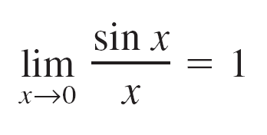
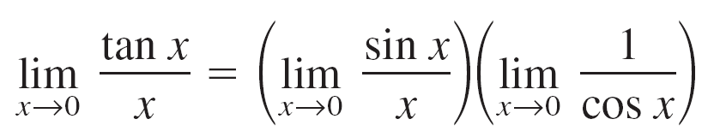
Example 9 – Solution
cont’d
Now, because
and
you can obtain

Slide 36
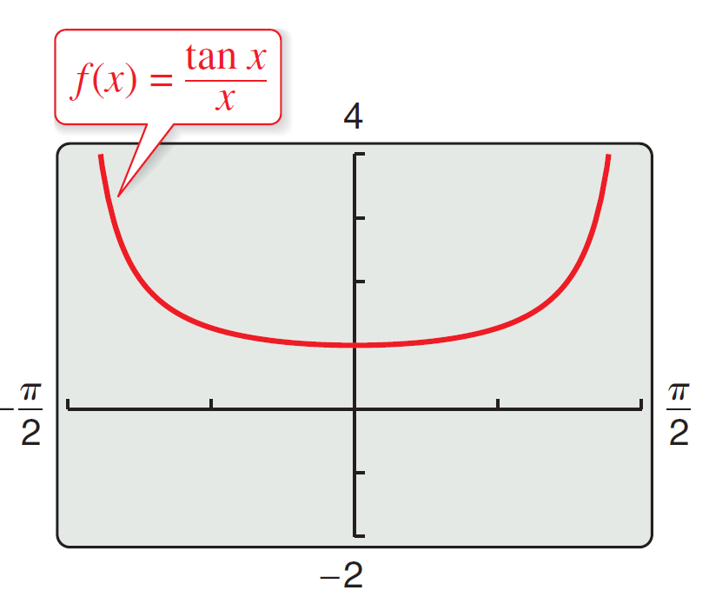
Example 9 – Solution
cont’d
= (1)(1)
= 1.
(See Figure 2.23.)
The limit of f (x) as x approaches 0 is 1.
Figure 2.23

