Slide 1

2
Limits and Their Properties
Copyright © Cengage Learning. All rights reserved.

Slide 2
Continuity and One-Sided Limits
2.4
Copyright © Cengage Learning. All rights reserved.

Slide 3
Objectives
Determine continuity at a point and continuity on an open interval.
Determine one-sided limits and continuity on a closed interval.
Use properties of continuity.
Understand and use the Intermediate Value Theorem.

Slide 4
Continuity at a Point and on an Open Interval

Slide 5
Continuity at a Point and on an Open Interval
In mathematics, the term continuous has much the same meaning as it has in everyday usage.
To say that a function f is continuous at x = c means that there is no interruption in the graph of f at c.
That is, its graph is unbroken at c and there are no holes, jumps, or gaps.

Slide 6
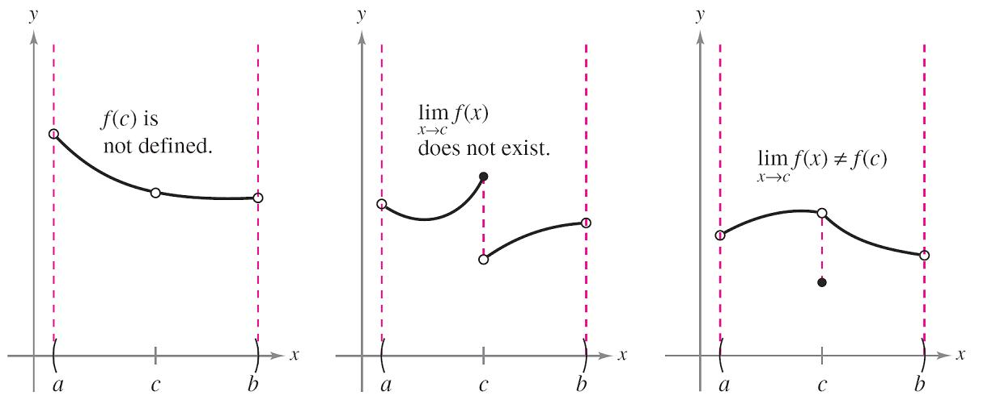
Continuity at a Point and on an Open Interval
Figure 2.25 identifies three values of x at which the graph of f is not continuous. At all other points in the interval (a, b), the graph of f is uninterrupted and continuous.
Three conditions exist for which the graph of f is not continuous at x = c.
Figure 2.25

Slide 7
Continuity at a Point and on an Open Interval
In Figure 2.25, it appears that continuity at x = c can be destroyed by any one of three conditions.
1. The function is not defined at x = c.
2. The limit of f (x) does not exist at x = c.
3. The limit of f (x) exists at x = c, but it is not equal to f (c).

Slide 8
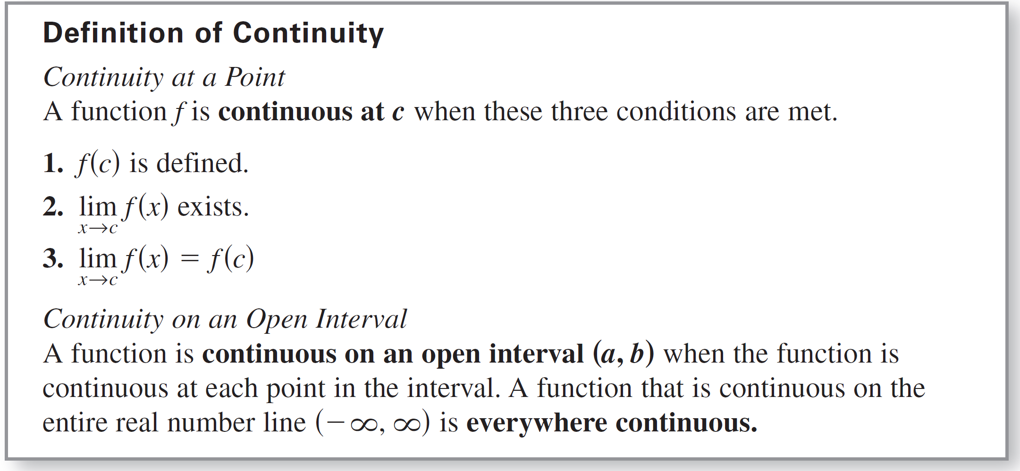
Continuity at a Point and on an Open Interval
If none of the three conditions is true, the function f is called continuous at c, as indicated in the important definition below.

Slide 9
Continuity at a Point and on an Open Interval
Consider an open interval I that contains a real number c. If a function f is defined on I (except possibly at c), and f is not continuous at c, then f is said to have a discontinuity at c.
Discontinuities fall into two categories: removable and
nonremovable.
A discontinuity at c is called removable when f can be made continuous by appropriately defining (or redefining) f (c).

Slide 10
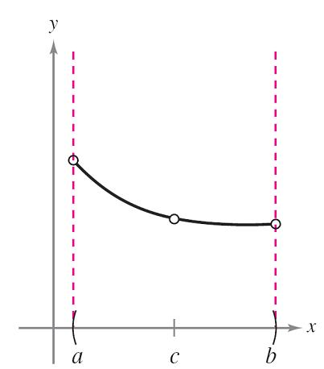
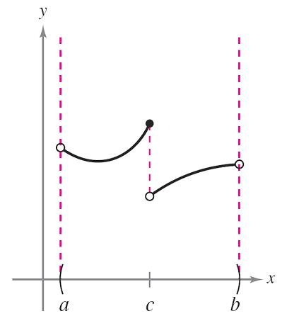
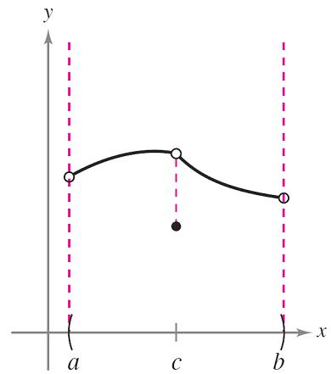
Continuity at a Point and on an Open Interval
For instance, the functions shown in Figures 2.26(a) and (c) have removable discontinuities at c, and the function shown in Figure 2.26(b) has a nonremovable discontinuity at c.
(a) Removable discontinuity
(b) Nonremovable discontinuity
(c) Removable discontinuity
Figures 2.26

Slide 11

Example 1 – Continuity of a Function
Discuss the continuity of each function.
a.
b.
c.
d.

Slide 12
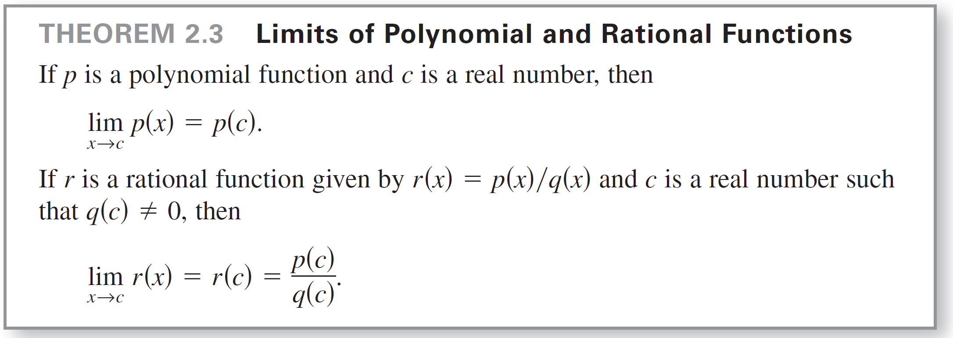
Example 1(a) – Solution
The domain of f is all nonzero real numbers. From Theorem 2.3, you can conclude that f is continuous at every x-value in its domain.

Slide 13
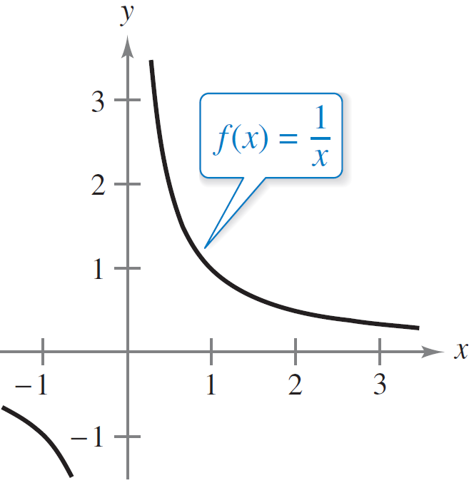
Example 1(a) – Solution
cont’d
At x = 0, f has a nonremovable discontinuity, as shown in Figure 2.27(a). In other words, there is no way to define f (0) so as to make the function continuous at x = 0.
Nonremovable discontinuity at x = 0.
Figure 2.27(a)

Slide 14
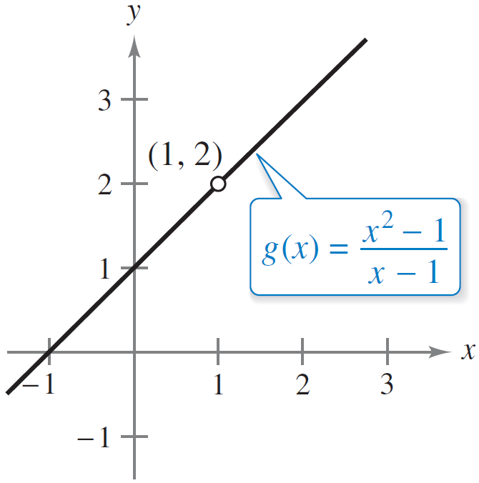
Example 1(b) – Solution
cont’d
The domain of g is all real numbers except x = 1. From Theorem 2.3, you can conclude that g is continuous at every x-value in its domain.
At x = 1, the function has a
removable discontinuity, as shown
in Figure 2.27(b). By defining g(1)
as 2, the “redefined” function
is continuous for all real numbers.
Removable discontinuity at x = 1
Figure 2.27(b)

Slide 15
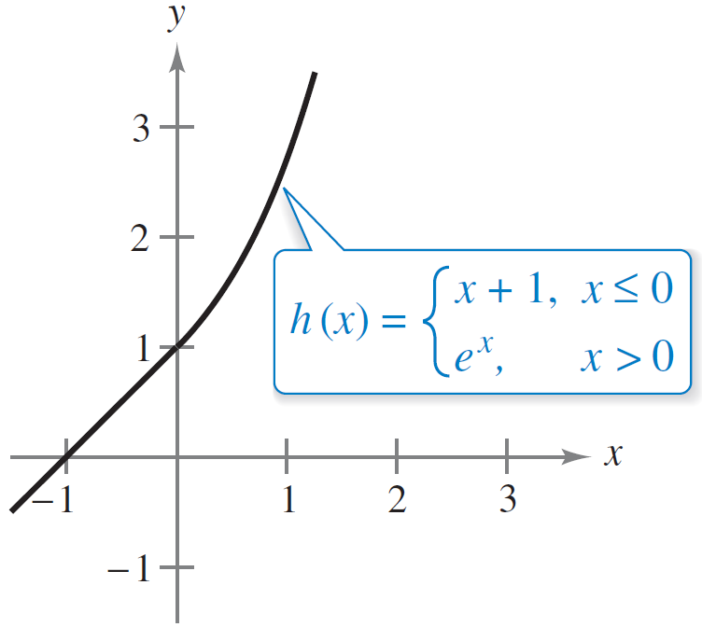
Example 1(c) – Solution
cont’d
The domain of h is all real numbers. The function h is
continuous on ( , 0) and (0, ), and, because
h is continuous on the entire real number line,
as shown in Figure 2.27(c).
Continuous on entire real number line
Figure 2.27(c)

Slide 16
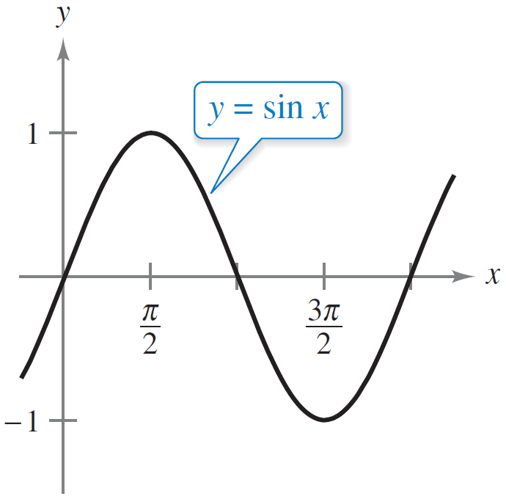
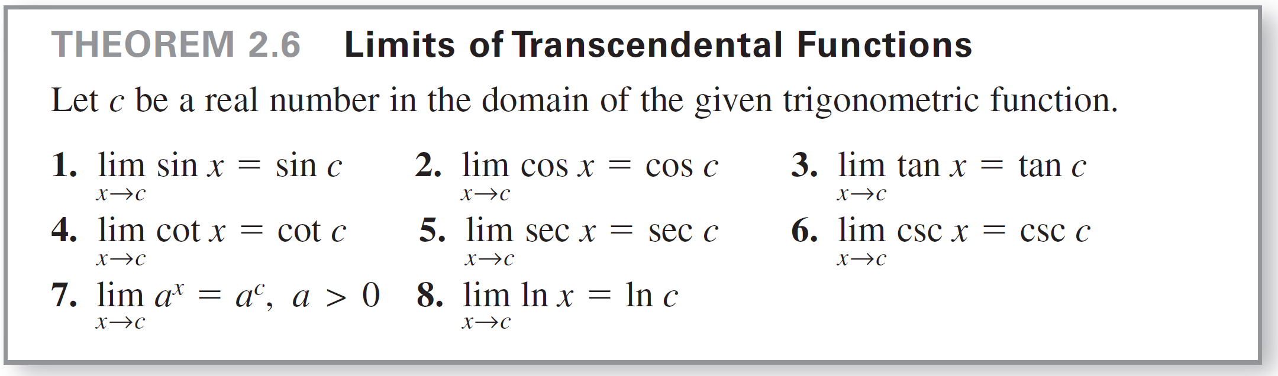
Example 1(d) – Solution
cont’d
The domain of y is all real numbers.
From Theorem 2.6, you can conclude
that the function is continuous on
its entire domain, ( , ),
as shown in Figure 2.27(d).
Continuous on entire real number line
Figure 2.27(d)

Slide 17
One-Sided Limits and Continuity on a Closed Interval

Slide 18
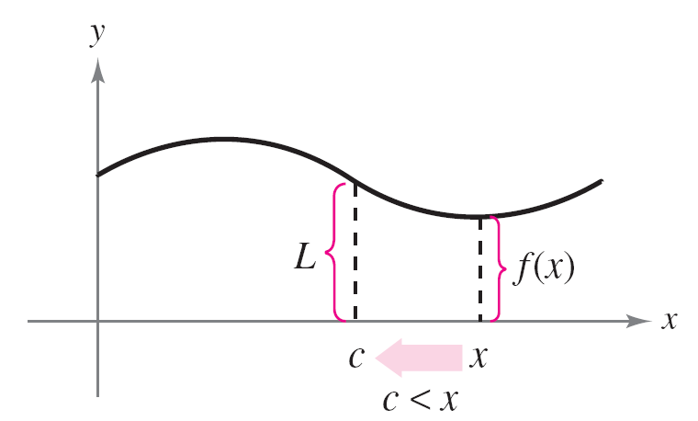
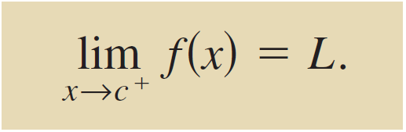
One-Sided Limits and Continuity on a Closed Interval
To understand continuity on a closed interval, you first need to look at a different type of limit called a one-sided limit.
For instance, the limit from the right (or right-hand limit) means that x approaches c from values greater than c [see Figure 2.28(a)]. This limit is denoted as
Limit from the right
Limit as x approaches c from the right.
Figure 2.28(a)

Slide 19
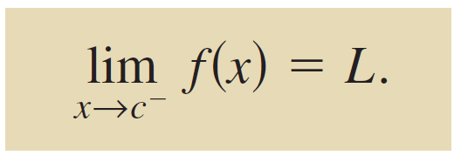
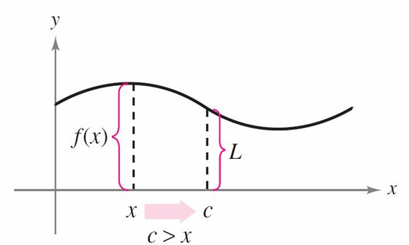
One-Sided Limits and Continuity on a Closed Interval
Similarly, the limit from the left (or left-hand limit) means that x approaches c from values less than c [see Figure 2.28(b)]. This limit is denoted as
Limit from the left
Limit as x approaches c from the left.
Figure 2.28(b)

Slide 20
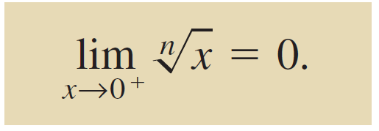
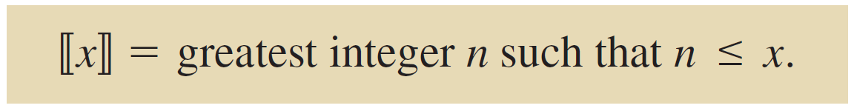

One-Sided Limits and Continuity on a Closed Interval
One-sided limits are useful in taking limits of functions involving radicals. For instance, if n is an even integer, then
One-sided limits can be used to investigate the behavior of step functions. One common type of step function is the greatest integer function defined as
For instance, and
Greatest integer function

Slide 21
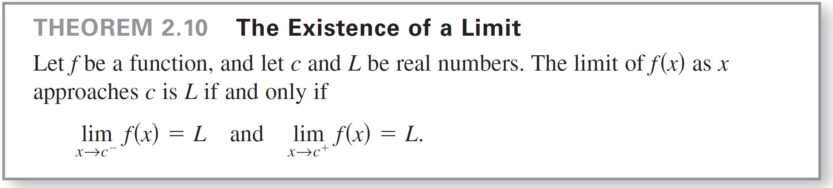
One-Sided Limits and Continuity on a Closed Interval
When the limit from the left is not equal to the limit from the right, the (two-sided) limit does not exist. The next theorem makes this more explicit.
The concept of a one-sided limit allows you to extend the definition of continuity to closed intervals.

Slide 22
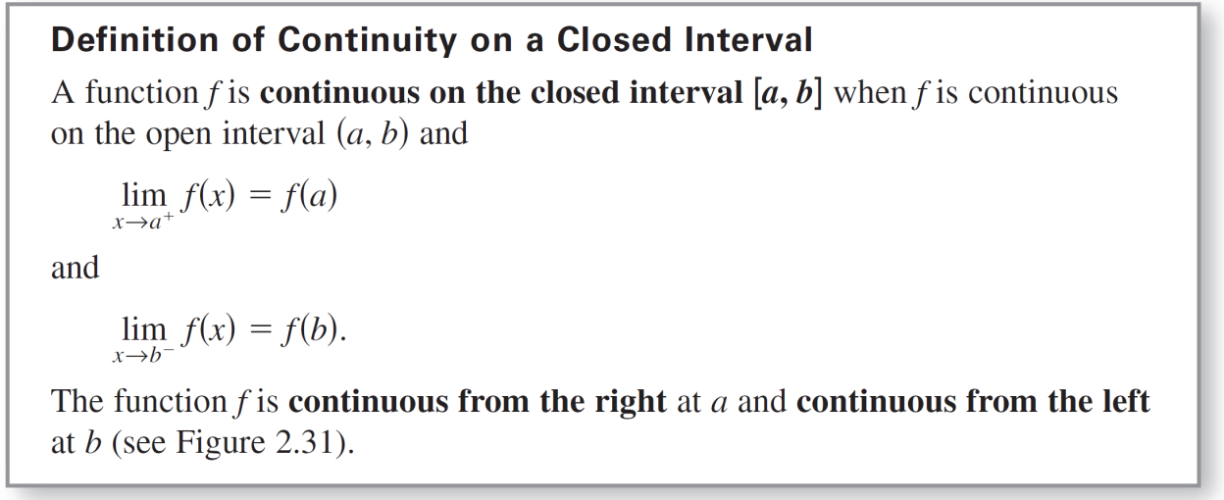
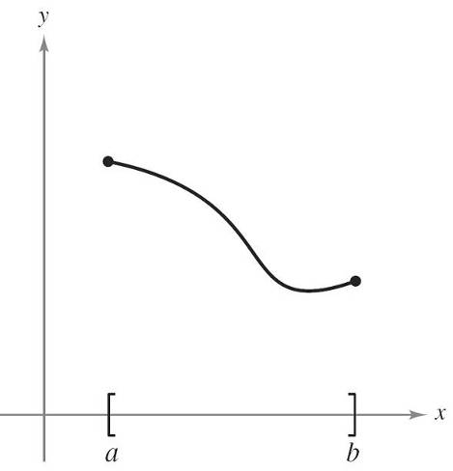
One-Sided Limits and Continuity on a Closed Interval
Basically, a function is continuous on a closed interval when it is continuous in the interior of the interval and exhibits one-sided continuity at the endpoints. This is stated formally in the next definition.
Continuous function on a closed interval
Figure 2.31

Slide 23

One-Sided Limits and Continuity on a Closed Interval
Similar definitions can be made to cover continuity on intervals of the form (a, b] and [a, b) that are neither open nor closed, or on infinite intervals. For example,
f (x) =
is continuous on the infinite interval and the function
g(x) =
is continuous on the infinite interval

Slide 24

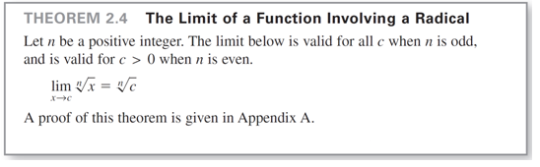
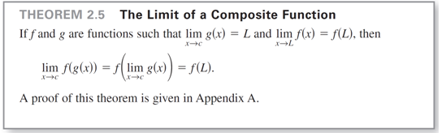
Example 4 – Continuity on a Closed Interval
Discuss the continuity of
Solution:
The domain of f is the closed interval [–1, 1]. At all points in the open interval (–1, 1), the continuity of f follows from Theorems 2.4 and 2.5.

Slide 25
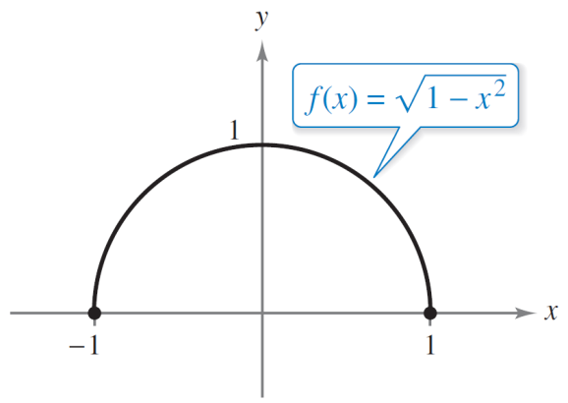
Example 4 – Solution
cont’d
Moreover, because
and
you can conclude that f is continuous on the closed interval [–1, 1], as shown in Figure 2.32.
Continuous from the right
Continuous from the left
f is continuous on [–1, 1].
Figure 2.32

Slide 26
Properties of Continuity

Slide 27
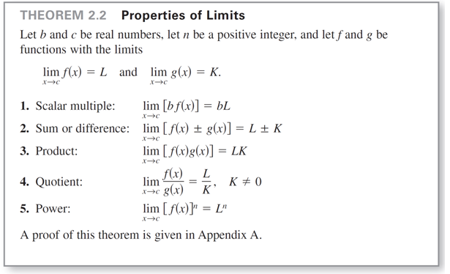
Properties of Continuity
You have studied several properties of limits. Each of those properties yields a corresponding property pertaining to the continuity of a function. For instance, Theorem 2.11 follows directly from Theorem 2.2.

Slide 28
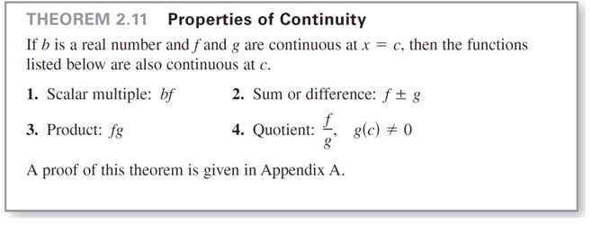
Properties of Continuity
The following types of functions are continuous at every point in their domains.
1. Polynomial: p(x) = a_{n}x^{n} + a_{n – 1}x^{n – 1} + . . . + a₁x + a₀

Slide 29

Properties of Continuity
2. Rational:
3. Radical:
4. Trigonometric: sin x, cos x, tan x, cot x, sec x, csc x,
5. Exponential and logarithmic: f (x) = a^{x}, f (x) = e^{x}, f (x) = ln x

Slide 30
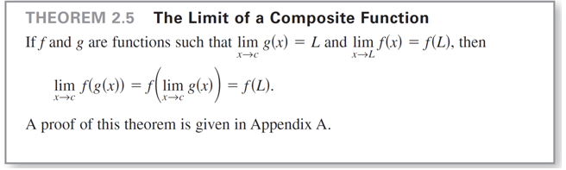
Properties of Continuity
By combining Theorem 2.11 with this list, you can conclude that a wide variety of elementary functions are continuous at every point in their domains.
The next theorem, which is a consequence of Theorem 2.5, allows you to determine the continuity of composite functions such as

Slide 31
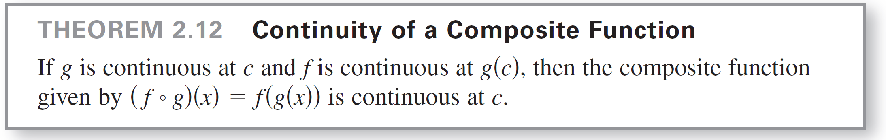
Properties of Continuity

Slide 32
Example 7 – Testing for Continuity
Describe the interval(s) on which each function is continuous.
a. f (x) = tan x
b.
c.

Slide 33
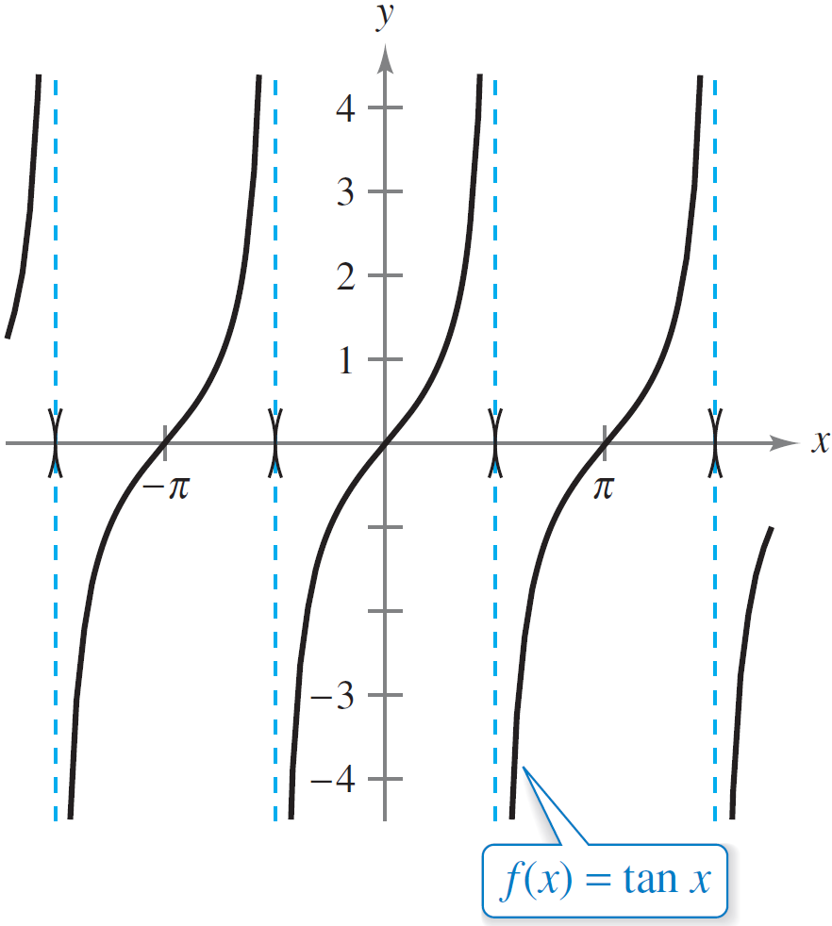
Example 7(a) – Solution
The tangent function f (x) = tan x is undefined at
n is an integer.
At all other points, f is continuous. So, f (x) = tan x is continuous on the open intervals
as shown in Figure 2.34(a).
f is continuous on each open
interval in its domain.
Figure 2.34(a)

Slide 34
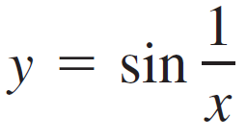
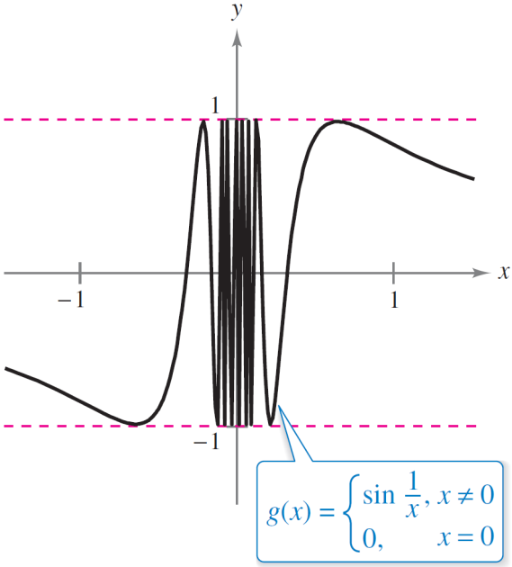
Example 7(b) – Solution
cont’d
Because y = 1/x is continuous except at x = 0 and the sine function is continuous for all real values of x, it follows from Theorem 2.12 that
is continuous at all real values except x = 0.
At x = 0, the limit of g(x) does not exist. So, g is continuous on the intervals ( , 0) and (0, ), as shown in Figure 2.34(b).
g is continuous on ( , 0) and (0, ).
Figure 2.34(b)

Slide 35
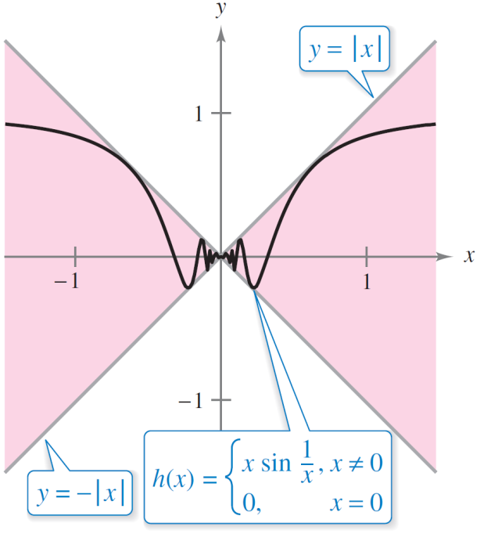
Example 7(c) – Solution
cont’d
This function is similar to the function in part (b) except that the oscillations are damped by the factor x. Using the Squeeze Theorem, you obtain
and you can conclude that
So, h is continuous on the entire
real line, as shown in Figure 2.34(c).
h is continuous on the entire real number line.
Figure 2.34(c)

Slide 36
The Intermediate Value Theorem

Slide 37
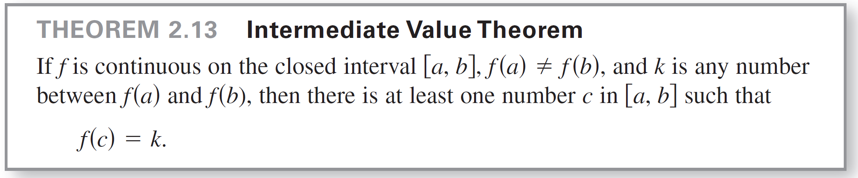
The Intermediate Value Theorem
Theorem 2.13 is an important theorem concerning the behavior of functions that are continuous on a closed interval.

Slide 38
The Intermediate Value Theorem
As an example of the application of the Intermediate Value Theorem, consider a person’s height. A girl is 5 feet tall on her thirteenth birthday and 5 feet 7 inches tall on her fourteenth birthday.
Then, for any height h between 5 feet and 5 feet 7 inches, there must have been a time t when her height was exactly h.
This seems reasonable because human growth is continuous and a person’s height does not abruptly change from one value to another.

Slide 39
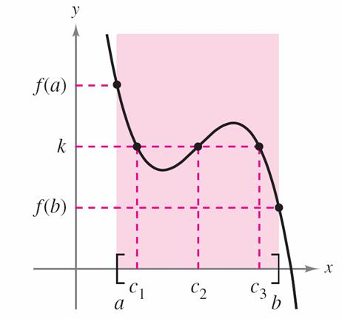
The Intermediate Value Theorem
The Intermediate Value Theorem guarantees the existence of at least one number c in the closed interval [a, b].
There may, of course, be more than one number c such that f (c) = k, as shown in Figure 2.35.
f is continuous on [a, b].
[There exist three c’s such that f (c) = k.]
Figure 2.35

Slide 40
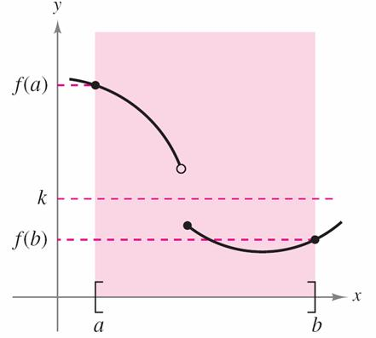
The Intermediate Value Theorem
A function that is not continuous does not necessarily exhibit the intermediate value property.
For example, the graph of the function shown in Figure 2.36 jumps over the horizontal line given by y = k, and for this function there is no value of c in [a, b] such that f (c) = k.
f is not continuous on [a, b].
[There are no c’s such that f (c) = k.]
Figure 2.36

Slide 41
The Intermediate Value Theorem
The Intermediate Value Theorem often can be used to locate the zeros of a function that is continuous on a closed interval.
Specifically, if f is continuous on [a, b] and f (a) and f (b) differ in sign, then the Intermediate Value Theorem guarantees the existence of at least one zero of f in the closed interval [a, b].

Slide 42
Example 8 – An Application of the Intermediate Value Theorem
Use the Intermediate Value Theorem to show that the polynomial function
f (x) = x³ + 2x – 1
has a zero in the interval [0, 1].

Slide 43
Example 8 – Solution
Note that f is continuous on the closed interval [0, 1]. Because
f (0) = 0³ + 2(0) – 1
= –1
and
f (1) = 1³ + 2(1) – 1
= 2
it follows that f (0) < 0 and f (1) > 0.

Slide 44
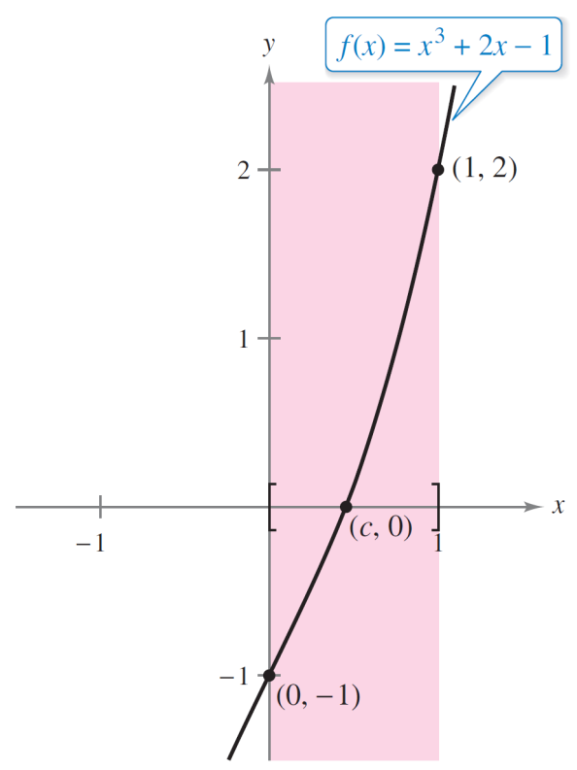
Example 8 – Solution
cont’d
You can therefore apply the Intermediate Value Theorem to conclude that there must be some c in [0, 1] such that
f (c) = 0
as shown in Figure 2.37.
f has a zero in the closed interval [0, 1].
f is continuous on [0, 1] with f (0) < 0 and f (1) > 0.
Figure 2.37

Slide 45
The Intermediate Value Theorem
The bisection method for approximating the real zeros of a continuous function is similar to the method used in Example 8.
If you know that a zero exists in the closed interval [a, b], then the zero must lie in the interval [a, (a + b)/2] or [(a + b)/2, b].
From the sign of f ([a + b]/2), you can determine which interval contains the zero. By repeatedly bisecting the interval, you can “close in” on the zero of the function.

