Slide 1
NLP + DEEP LEARNING PROJECT
What drivers claim,
and what the car says
Understanding Formula 1 team radio with speech and language models, and checking it against the car's telemetry
Presented by: ____________________
Notes:
Open with the one-line idea: we listen to F1 radio, work out what drivers claim, and check whether the car's data backs them up.

Slide 2
Agenda
01
Problem statement
05
Problems faced, and how we solved them
02
The dataset
06
Results
03
Literature review
07
Limitations and future scope
04
Methodology
08
Conclusion
2

Slide 3
01
Problem statement
What are we trying to understand, and why is it hard?
3

Slide 4
The problem
F1 drivers talk to their engineers over the radio at 300 km/h
During a race, drivers keep telling their engineers what's wrong: “no grip”, “he pushed me off”, “I've lost power”.
Teams and TV commentators take these at face value, but nobody really checks whether the car's own data agrees.
Our goal was a system that listens to one radio message and answers four questions about it on its own.
Why it matters: it's a rare case where spoken language can be checked against an independent, physical record.
ONE RADIO MESSAGE
“No grip at the rear!”
Who said it?
the driver, not the engineer
What is claimed?
tyre grip / degradation
How worked up?
raised voice
Does the car agree?
were lap times dropping?
PROBLEM STATEMENT
4
Notes:
Use the dark card as the running example: one message, four questions.

Slide 5
Four research questions, and why each is hard
T1 Claim type
T2 Telemetry check
T3 Arousal
T4 Consequences
What is the driver complaining about: tyres, traffic, pace, an incident, the engine?
Does the car's own sensor data back up what the driver said?
How worked up does the driver sound, from the words and from the voice?
Does a worked-up driver then go faster or slower?
Why it's hard
Why it's hard
Why it's hard
Why it's hard
The messages are short, noisy and full of jargon, and there were almost no labels
Public telemetry misses many sensors, and TV picks the dramatic moments
Engine noise, radio compression and g-forces all change how a voice sounds
Lap times swing by about 0.7 s anyway, so any effect may be tiny
And underneath all four, every clip mixes the driver's and the engineer's voices, with nothing to say who's talking.
PROBLEM STATEMENT
5

Slide 6
02
The dataset
Real broadcast radio, joined to real car telemetry
6

Slide 7
Radio data: F1 Team Radio (Hugging Face)
Broadcast clips with audio and transcripts, 2018–2025
14,681
44 h
radio clips in the dataset
of audio
43
149
drivers
Grands Prix
Every clip comes with its audio, a machine transcript, the driver, the race and the time it aired.
A typical clip lasts about 8 seconds, and many contain both driver and engineer.
2022 is missing completely and 2025 is thin, so our held-out test season is small.
It's listed as CC BY 4.0, but it's broadcast audio, so we used it for coursework only.
*2022 missing from the source; orange = 2025, the test season
THE DATASET
7

Slide 8
Inside one clip
What the raw data looks like, and why it's messy
A real transcript, exactly as stored (2020, Albon's channel)
Field | Meaning
driver_id | whose radio channel (not who speaks)
race_id | which Grand Prix
message_timestamp | UTC time the clip aired
audio | MP3, 44–48 kHz
transcription | machine ASR (with errors)
“The drink system is leaking a lot. Copy. We'll have a look on the grid. Copy. Yeah, I'm getting soaked here. Yeah, copy. Just make sure we have a spare balaclava.”
Two people share one recording, and nothing marks where one stops and the other starts.
The machine transcript mangles jargon: “SuperSalt” instead of supersoft.
Who said which sentence? The file doesn't say. Our pipeline has to work it out from the voices.
THE DATASET
8

Slide 9
Telemetry: what the car tells us
Fetched with FastF1 and joined to each radio clip by car number and time
Available (public)
Not available
148
Speed, throttle, brake on/off, RPM, gear, DRS (~3.7 Hz)
Lap and sector times, gaps, positions
Tyre compound and age, pit stops
Race-control messages, weather
Brake pressure or temperature
Tyre temperatures
Steering angle, ride height
Fuel load
→ claims about these can't be checked
of 149 races with telemetry
10,229
radio clips matched to a racing lap
139,995
We also built a lap-time model that predicts how fast each lap should be from fuel, tyre age, tyre type and traffic, so we can tell when a driver was genuinely slow.
On laps it hadn't seen, it's typically off by 0.70 s, compared with 1.12 s for a simple per-driver average.
clean laps for the lap-time model
THE DATASET
9

Slide 10
Our own labelled data
Hand-labelled by us, because no labels for these tasks existed
380
We defined the categories by what a car sensor could actually check.
133 of the 450 turned out to be the engineer, which shows how much the speaker step matters.
Grey classes have fewer than 30 examples, too few to learn from, so we left them out.
When we re-labelled repeated items, we agreed with ourselves 90% of the time.
turns labelled driver vs engineer
41
clips hand-transcribed (for WER)
450
utterances labelled: claim type + arousal
THE DATASET
10

Slide 11
03
Literature review
What already exists, what we borrowed, and the gap we fill
11

Slide 12
Related work: speech and language
Area | Key work | What it gives us | Gap for our problem
Speech recognition | Whisper (Radford et al., 2023) | Transcribes noisy speech well, and can be nudged with a prompt | Never tested on compressed race radio full of jargon
Speaker diarization | pyannote (Bredin, 2023); WeSpeaker (Wang et al., 2023) | Works out who spoke when, and fingerprints each voice | Tells voices apart, but not which one is the driver
Text encoders | DeBERTa-v3 (He et al., 2023) | A strong language model we can fine-tune | Usually needs thousands of labels; we had about 300
Large language models | GPT-3 few-shot (Brown et al., 2020); Qwen2.5 (2024) | Can classify from written instructions, without training | Unclear whether that beats fine-tuning on tiny, specialised data
Speech representations | WavLM (Chen et al., 2022); SUPERB layer weighting (Yang et al., 2021) | Rich audio features, and a way to choose which layers to use | Not yet tried for arousal in noisy radio
LITERATURE REVIEW
12

Slide 13
Related work: verification, fusion and method
Area | Key work | Our take
Claim verification | FEVER (Thorne et al., 2018) | Our evidence is sensor data, not text
Multimodal fusion | Constrained fusion (Lee et al., 2026) | We test gated fusion against simple joining
Emotion / arousal | Circumplex of affect (Russell, 1980) | Why we say “arousal”, not “stress”
Research practice | Pre-registration (Nosek et al., 2018); p-hacking (Simmons et al., 2011) | We fixed our decisions before seeing results
F1 data | FastF1; OpenF1 | Where our car data comes from
THE GAP WE FILL
Most fact-checking research checks written claims against written evidence.
We check spoken claims against a physical record, the car's telemetry, in an area with almost no labels.
And we test whether any apparent agreement survives a placebo control.
LITERATURE REVIEW
13

Slide 14
04
Methodology
How we tried to solve the problem: a six-stage pipeline
14

Slide 15
The pipeline at a glance
1
2
3
4
5
6
Radio audio
Who speaks?
Speech → text
What is claimed?
How aroused?
Car check
14,370 clips
pyannote + voice clustering
Whisper large-v3
DeBERTa · TF-IDF · LLM
WavLM fine-tuned
telemetry rules + neural
Before running each stage, we wrote down what would count as success, for example speaker accuracy of at least 85%.
Every model is compared with simple baselines: guessing the most common class, a model that never reads the words, and pure chance.
We always keep whole races together, so the same race never shows up in both training and testing.
METHODOLOGY
15

Slide 16
Speech stages: who spoke, and what they said
1. Diarization
2. Driver or engineer?
3. Speech to text
pyannote splits each clip into speaker turns, giving 29,134 turns across the 14,370 clips.
We group similar voices on each driver's channel, then name each group from what it says: engineers say “box”, drivers say “my tyres”.
Whisper large-v3 writes down the words with their timings. We nudged it with a prompt of driver names and F1 jargon, and measured the errors.
Our pipeline's actual output for the clip on slide 8
Driver
Driver
Driver
“drink system is leaking a lot copy we'll have a look on the grid copy”
“i'm getting soaked here”
“just make sure we have a spare balaclava”
Every turn was called “driver”, but “spare balaclava” is clearly the engineer, and the first turn merges both voices. This is why speaker accuracy is only 67%.
METHODOLOGY
16

Slide 17
Language and voice models
Claim type: three ways to use a language model
Arousal from audio: WavLM, partially fine-tuned
TF-IDF + logistic regression
Upper 6 layers trained
retrained on our data, with a learned weight per layer; out comes calm, raised or shouting
counts the words: our simple baseline
L12
L11
L10
DeBERTa-v3, fully fine-tuned
L9
L8
one shared model with two outputs: claim type and arousal
L7
L6
Lower 6 layers frozen
they keep what it already knows about sound
L5
LLM zero-shot (Qwen2.5-1.5B)
L4
no training at all, just our written category definitions
L3
L2
L1
METHODOLOGY
17

Slide 18
Checking the car, and testing it fairly
Rule-based check
Race-grouped splits
Unseen drivers
Written before we labelled anything. For example, a tyre claim counts as backed up if laps were at least 0.3 s slower than expected.
a race is never in both training and testing
we test on drivers the model never saw
Held-out season
Placebo control
train up to 2023, test on 2025 just once
repeat every check three laps before the message
Neural check
A 1-D CNN reads the car data, and each claim type looks for its own evidence through gated attention. We compare it with simply joining the inputs.
Real chance level
Effect size first
we simulate random guessing instead of assuming it
we work out the smallest detectable effect first
METHODOLOGY
18

Slide 19
05
Problems faced
What went wrong along the way, and how we fixed each one
19

Slide 20
Engineering problems → solutions
Problem | What we did | Outcome
Speaker separation would have taken about 19 hours: the model needed 10.9 GB on our 8 GB GPU | We found the memory overflow and cut the batch size from 32 to 4 | Same output, about 49× faster than real time
The official telemetry API, OpenF1, has no data before 2023 | We switched to FastF1, which reads the same feed for every season | Data for 148 of 149 races
Downloads were capped at 500 requests an hour | The script waits and retries on its own | It ran unattended overnight
The same “Thank you.” clip appeared in 204 different races | We removed every copy | No clip can leak between training and testing
Radio timestamps run late | We measured it: 82% of “box” calls are stamped after the car is in the pits | We match messages to laps, not exact seconds
We had no access to a paid LLM API | We ran an open model, Qwen2.5-1.5B, on our own GPU | That made the zero-shot LLM possible
PROBLEMS FACED
20

Slide 21
Research problems → solutions
Problem | What we did
Speaker identification only reached 67%, against a target of 85% | We reported it honestly, and trained every model only on messages a human confirmed were the driver
Only 317 verified driver messages, and some claim types were rare | We kept classes with at least 30 examples, and checked the result still holds at 20
The 2025 test season has just 37 items | Race-grouped cross-validation is our headline; 2025 is reported once as a check
Random guessing scores higher than you'd expect on small classes | We simulated the real chance level for every score
Data leakage could make scores look better than they are | Whole races stay in one fold, and 30 runs on shuffled labels scored exactly chance (0.499)
Training on our own rules would make the telemetry model circular | Instead, the neural model predicts the human label from the car data
Broadcasters choose the dramatic moments to air | A placebo: we repeat every car check three laps before the message
PROBLEMS FACED
21

Slide 22
06
Results
What worked, what didn't, and how sure we are
22

Slide 23
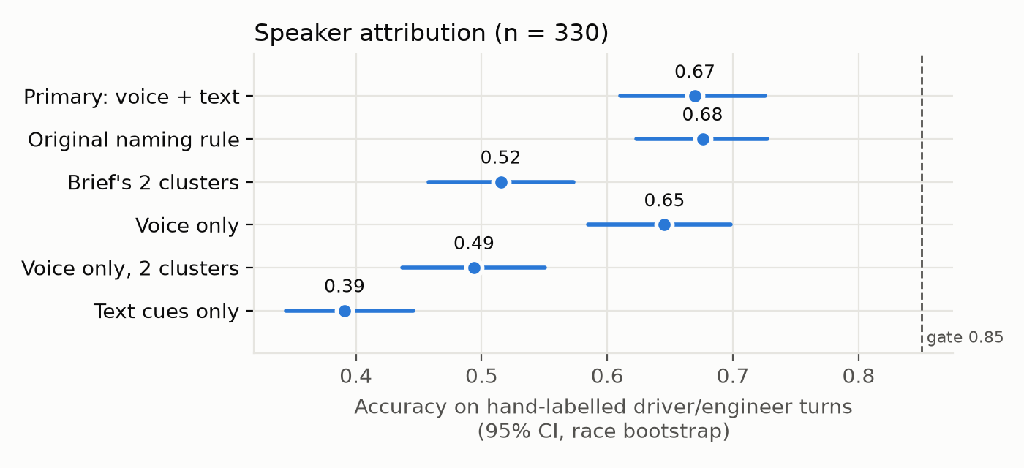
Speech: transcription and speaker identification
Telling driver from engineer: 67% correct, below our 85% target.
The voice helps far more than the words do: 65% vs 39%.
The prompt only cut errors by about 3%, well short of our 15% target.
About 3 words in 10 are still wrong on radio audio.
RESULTS
23

Slide 24
Main result: text identifies what the driver claims
Split | DeBERTa | TF-IDF | Context
Cross-validation | 0.43 | 0.47 | 0.32
Test season 2025 | 0.47 | 0.39 | 0.28
Unseen drivers | 0.48 | 0.45 | –
Reading the words helps: +0.11 over the context-only model (95% CI +0.04 to +0.18).
It holds on the unseen 2025 season, and on drivers the model never saw.
With this little data, DeBERTa and simple word counts do about equally well.
Chance level ≈ 0.21; race-grouped 5-fold cross-validation
RESULTS
24

Slide 25
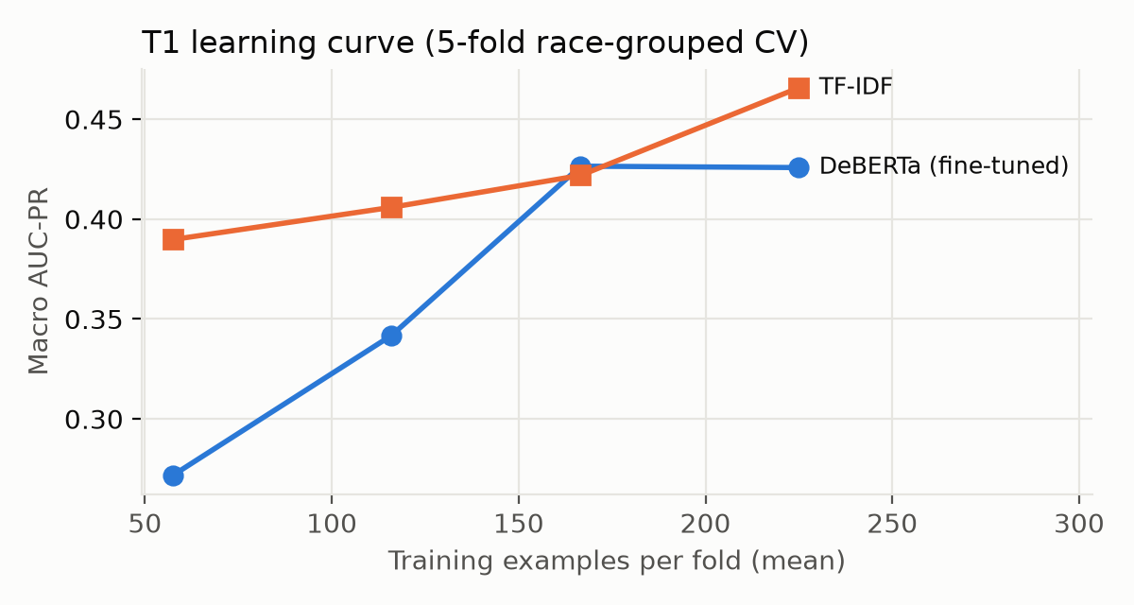
Surprise: a small LLM, told the rules, beats fine-tuning
+0.20
+0.16
LLM over fine-tuned DeBERTa
LLM over TF-IDF
The LLM never saw a single labelled example, only our written category definitions.
With only about 250 examples, telling a model the rule works better than making it learn the rule.
The learning curve on the left: DeBERTa improves fastest as data grows, but flattens well below the LLM.
We wrote the prompt once and never tuned it.
RESULTS
25

Slide 26
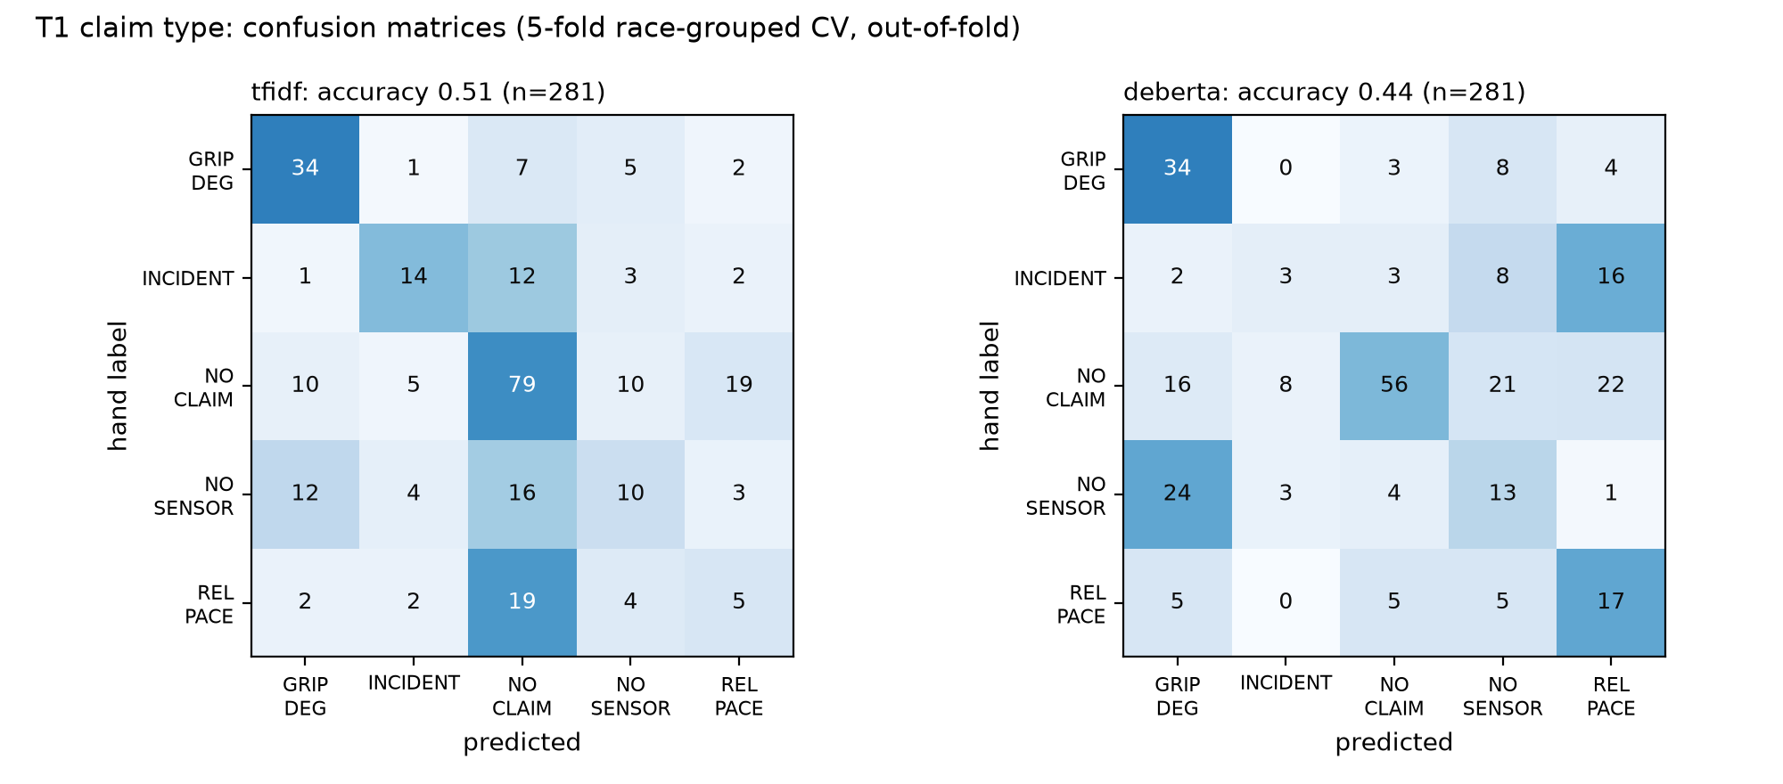
Where the models go wrong
When a driver describes an incident through another driver's behaviour, it gets read as a pace complaint.
Brake complaints, which we can't check, get mistaken for tyre complaints.
Some mistakes start earlier: “Enjoy one more tea guys” is a transcription error, not a model error.
TF-IDF is good at keywords like “contact” and “penalty”; DeBERTa is better on pace.
RESULTS
26

Slide 27
Arousal: you can hear it, and fine-tuning helps
Fine-tuning adds +0.11 over frozen WavLM (95% CI +0.03 to +0.19).
It still works on drivers it never heard: 0.51, against 0.34 for chance.
It leans slightly on the upper-middle layers, 10 and 11.
RESULTS
27

Slide 28
Does the car back up the claim? Not beyond chance
How often the car's data “agrees” with a claim, compared with normal laps and with three laps earlier.
No claim type is backed up more often than usual; every confidence interval includes zero.
Incidents look twice as common at a claim, but they were just as common before the driver spoke.
The neural model agrees: 0.31, the same as its placebo (0.31) and the context-only model (0.29).
What's going on: TV airs radio at eventful moments, and the placebo caught it.
RESULTS
28

Slide 29
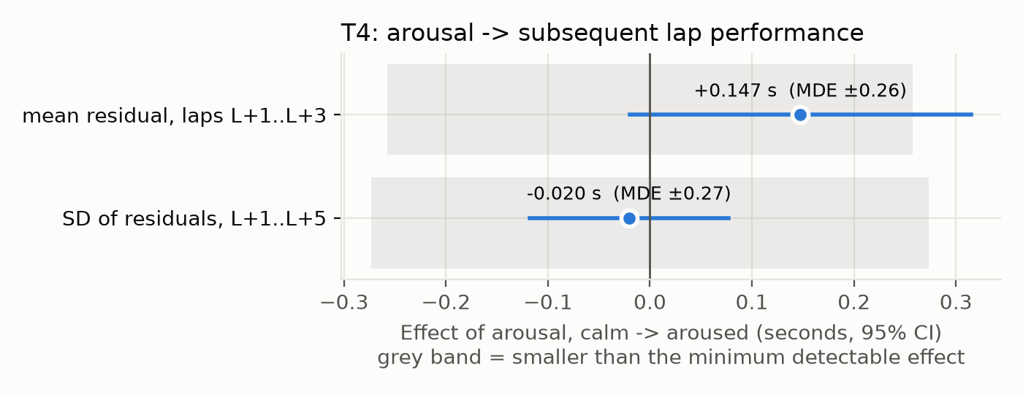
Does a worked-up driver then drive differently?
±0.26 s
smallest effect per lap we could detect, computed before fitting
Going from calm to worked up changes lap time by +0.15 s (95% CI -0.02 to +0.31).
That isn't significant, and a check with our hand labels shows no effect either.
We also found no sign that some drivers react differently from others.
In short: a clean null result, reported with its limits.
RESULTS
29

Slide 30
Results at a glance
Question | Result | Verdict
Claim type from text (T1) | DeBERTa 0.43 vs context 0.32; holds on unseen drivers and 2025 | Strong
Zero-shot LLM vs fine-tuning | LLM 0.63, +0.20 over DeBERTa | Strong
Arousal from audio (T3) | WavLM fine-tuned 0.55, +0.11 over frozen | Strong
Lap-time model | 0.70 s error vs 1.12 s baseline | Strong
ASR prompting | Only about a 3% gain, against a 15% target | Weak
Speaker identification | 67% correct, against an 85% target | Failed gate
Telemetry agrees with claims (T2) | No better than normal laps, and the placebo scores the same | Null
Arousal → next laps (T4) | +0.15 s, smaller than the ±0.26 s we could detect | Null
RESULTS
30

Slide 31
07
Limitations and future scope
Being honest about the edges, and where to go next
31

Slide 32
Limitations
One annotator
Small data
Speaker step
One person labelled everything, so we can't measure agreement between labellers.
Just 317 driver messages, and only 37 in the 2025 test season.
Only 67% accurate, so unlabelled clips still hold some engineer speech.
What we did: checked consistency: 90% on repeats
What we did: confidence intervals everywhere
What we did: trained only on verified driver speech
Missing sensors
Broadcast selection
Label influence
Public data has no brake, tyre-temperature or steering readings.
TV producers choose which radio to air, so it isn't a random sample.
The labeller saw the transcripts, which may favour text-based arousal.
What we did: a separate “can't be checked” class
What we did: the placebo control exposes it
What we did: audio-only model reported separately
LIMITATIONS AND FUTURE SCOPE
32

Slide 33
Future scope
1
More and better labels
2
LLM-assisted labelling
A second annotator to measure agreement, and more examples of rare claims like power and traffic.
Let the LLM suggest labels and have people correct them: faster, and our results suggest it's accurate.
3
Better speaker identification
4
Fine-tune speech recognition
Train a proper driver-vs-engineer classifier on our hand-labelled turns.
Fine-tune Whisper on hand-typed transcripts instead of only prompting it.
5
Richer telemetry
6
Other domains
Teams' own data, like tyre temperatures and brake pressure, would make many more claims checkable.
The same pipeline could work for aviation, emergency-services or industrial radio.
LIMITATIONS AND FUTURE SCOPE
33

Slide 34
08
Conclusion
What we learned, in short
34

Slide 35
Conclusion
We built a full pipeline on real F1 radio, from raw audio all the way to the car's data.
The words work: you can tell what a driver is claiming from what they say.
Rules beat a handful of labels: a small LLM given our definitions did better than fine-tuning.
You can hear arousal, and partially fine-tuning WavLM clearly helps.
The car rarely backs up a claim once you apply a placebo control.
We report the negative results too; that's what makes the positive ones believable.
IN ONE SENTENCE
Machines can understand what F1 drivers claim, best when simply told the rules, but public telemetry can't yet verify those claims.
CONCLUSION
35

Slide 36
References
Bredin, H. (2023). pyannote.audio 2.1 speaker diarization pipeline. Interspeech.
Brown, T. et al. (2020). Language models are few-shot learners. NeurIPS.
Chen, S. et al. (2022). WavLM: large-scale self-supervised pre-training for full stack speech processing. IEEE JSTSP 16(6).
Ciletti, M. (2025). F1 Team Radio Dataset. Hugging Face: MikCil/f1-team-radio.
He, P., Gao, J., Chen, W. (2023). DeBERTaV3. ICLR.
Lee, S. et al. (2026). Rethinking multimodal fusion for time series: text modalities need constrained fusion. arXiv:2603.22372.
Nosek, B. et al. (2018). The preregistration revolution. PNAS 115(11).
Qwen Team (2024). Qwen2.5 technical report. arXiv:2412.15115.
Radford, A. et al. (2023). Robust speech recognition via large-scale weak supervision (Whisper). ICML.
Russell, J. A. (1980). A circumplex model of affect. J. Personality and Social Psychology 39(6).
Simmons, J., Nelson, L., Simonsohn, U. (2011). False-positive psychology. Psychological Science 22(11).
Thorne, J. et al. (2018). FEVER: a large-scale dataset for fact extraction and verification. NAACL-HLT.
Wang, H. et al. (2023). WeSpeaker. ICASSP. · Yang, S. et al. (2021). SUPERB. Interspeech. · FastF1 (software).
Full reference list (25 entries) in the IEEE paper; PDFs and links in references/README.md
REFERENCES
36

Slide 37
Thank you
Questions?
Live demo: one radio message through the whole system (hand-picked examples, for illustration)
37

