Slide 1

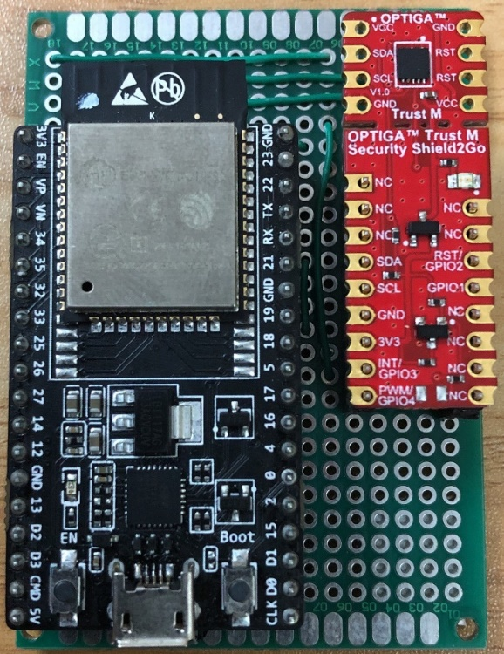
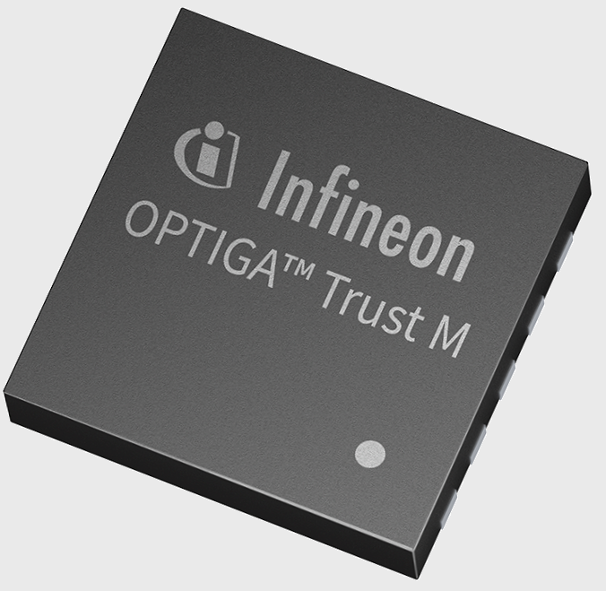
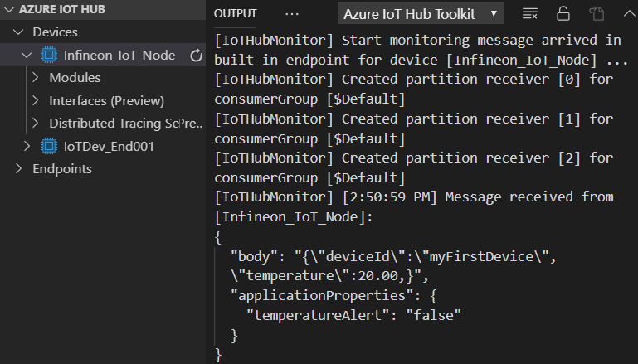
Connect 2 Azure
Secure connectivity using OPTIGA™ Trust M
Secure connectivity using OPTIGA™
Establishes a Secure Connection to Microsoft Azure cloud using OPTIGA™ Trust M
OPTIGA™ Trust M is a hardware security module (CC EAL 6+ certified hardware)
Performs the cryptographic operations during the TLS handshake.
Secure storage for private key(s) used for the client / node authentication.
Secure storage for device certificates and cloud server Trust Anchors.
IoT Node CA Registration
IoT Node Provisioning
IoT Node Controller and OPTIGA™ Integration overview
IoT Node with
OPTIGA™ Trust M
Microsoft
Azure
OPTIGA™ Trust M
IoT Node Controller
Toolbox Commands
Application
MQTT Service
TCP/IP
Communication
MQTT Service
IoT Node CA
Certificate
Generate Key Pair (ECC, RSA)
Key Derivation (ECDH, TLS 1.2 PRF)
TLS Stack
TLS Stack
Gen Random
Verify Signature
(ECDSA, RSA)
Encrypt/Decrypt (RSA)
Hash (SHA256)
Sign (ECDSA, RSA)
OPTIGA™ Library
Shielded Connection
Over I2C
Secure Storage
Storage Commands
Key Objects (E.g. RSA and ECC)
Read Data Object
Data Objects (E.g. Trust Anchors, Certificates, Pre-shared secrets, Counters and etc.)
Write Data Object
Protected Update of Data
Demo Setup
IoT Node
Monitor: Device Management tool
MQTT: Publish
Messages
Microsoft Azure
MQTT: Subscribe
Messages
ESP32 with
OPTIGA™ Trust M

