Slide 1
User manual of BSHL (Bridgepath for SystemVerilog and High-level language)
From master thesis topic, Enable re-use of UVM-SystemVerilog verification components in cocotb/PyUVM
Yilou Wang

Slide 2
Overview of BSHL project

Slide 3
Functions Pakaging strategy
Two categories
1. Library Functions:
Functions never changed by users (I still leave an imp in the template, but it is only for me to update or extend new functionality)
2. Interface Functions:
Functions needed to be adapted based on different cases -> provided as templates (Most of modifications are just variable-renaming, class-renaming for most of cases)

Slide 4
BSHL: Bridgepath for Systemverilog and High-level Languages
The test case and an implementation of interface functions or tasks
User space
BSHL package directory
Interface class including interface functions or tasks user has to implement
Virtual class including library functions or tasks user can freely call
Extensions for users to import pkgs and include files
An implementation of library functions or tasks
user-customizable
user-independent

Slide 5
BSHL: Bridgepath for Systemverilog and High-level Languages
Files Structure:

Slide 6
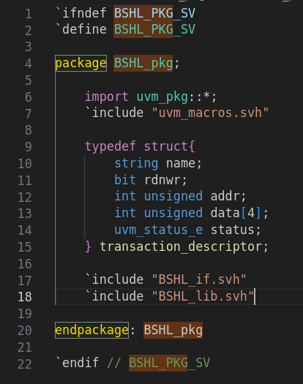
BSHL: Bridgepath for Systemverilog and High-level Languages
BSHL_pkg is a package that includes several components, among which are BSHL_if and BSHL_lib, as well as the type definition for transaction_descriptor, which is used for communication between SV and the HLL

Slide 7
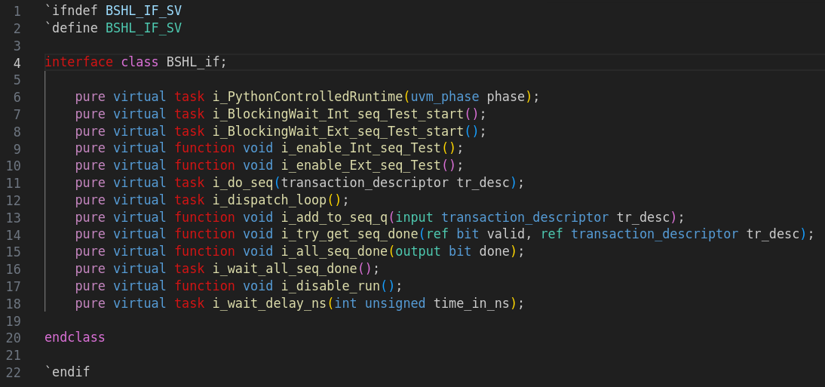
BSHL: Bridgepath for Systemverilog and High-level Languages
BSHL_if is an interface class that declares a series of user-customizable functions or tasks. All of these functions and tasks require user to implement them according to their specific project requirements. Therefore, BSHL_if serves as more of a specification, a contract, that outlines how users should utilize these functions or tasks.

Slide 8
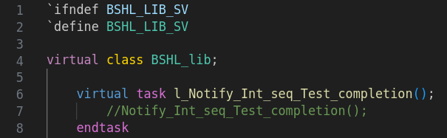
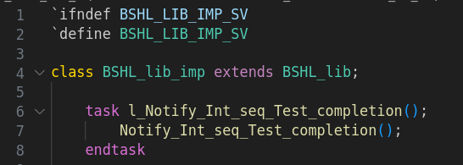
BSHL: Bridgepath for Systemverilog and High-level Languages
BSHL_lib serves as a library that houses all the functions or tasks that users do not need to modify or rewrite. Users are not required to understand the internal implementation of these functions. Users can directly call functions from within this library. Internally, BSHL_lib is essentially a virtual class, with BSHL_lib_imp being its derived class responsible for implementing all the library functions. This design facilitates future expansion or updates to the library functions without the need to expose these changes to users, making it user-independent.

Slide 9
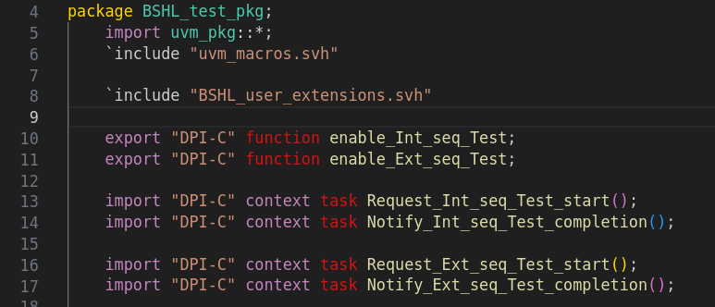
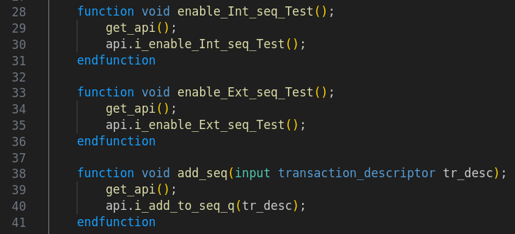
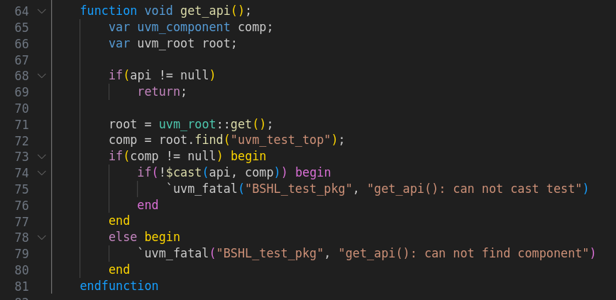
BSHL: Bridgepath for Systemverilog and High-level Languages
BSHL_test_pkg is a package that includes BSHL_user_extensions.svh. Additionally, this package defines and declares DPI-C functions and tasks. To ensure that the exported DPI-C functions can locate their implementations, there are also get_api functions and export-dpi functions void (calling the handle of BSHL_api).
When users are trying to understand this code, it is recommended to consider it conjunction with the code in BSHL_user_extensions.svh. While it might seem a bit odd at first glance, the idea is to extract all the codes that users need to manually adjust and place them in BSHL_user_extensions.svh. This approach means that users will not need to make any modifications to BSHL_test_pkg.sv itself.

Slide 10
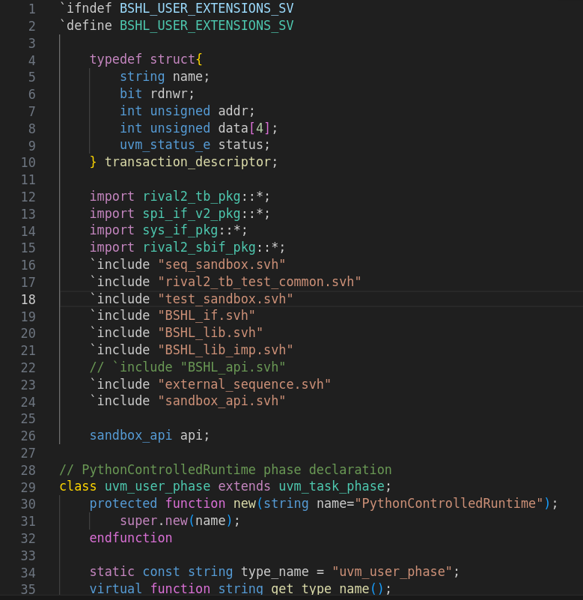
BSHL: Bridgepath for Systemverilog and High-level Languages
BSHL_user_extensions is a user-customizable component primarily responsible for importing additional packages, including extra files, defining transaction descriptor data structures, and adjusting the declaration of user-defined phase. Its main purpose is to adapt to various user cases by allowing users to customize these aspects to suit their specific needs. Ps: the handle “api” is used in BSHL_test_pkg.sv

Slide 11
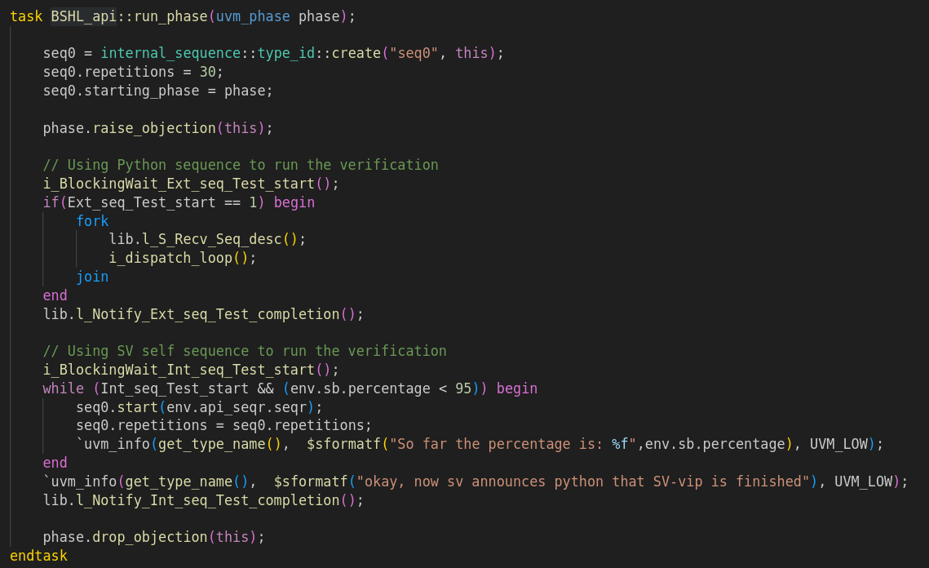
BSHL: Bridgepath for Systemverilog and High-level Languages
BSHL_api is the most crucial component, serving as both the implementation of BSHL_if and an extension of the uvm_test test case. User can use it as a reference for their own new implementations or make direct modifications to it. For this reason, it is referred to as an “api” rather than “if_imp”.
Within BSHL_api, you can find implementations of all the functions or tasks in BSHL_if. Additionally, it contains the run_phase of the uvm_test, where the simulation flow for the SV-VIP is specified.

Slide 12
How to integrate BSHL

Slide 13
Integration – Take RV2DEMO as an example

Slide 14
Integration-Step1: rebuild framework
You can take this as a reference to help you write your new test case
External sequence to support the “python sequence desciptor to sv” test
A new test case which extends the orginal one(test_sandbox)
Notes:
My recommendation is that BSHL test package imports the rival2 test package and create two files, one is external sequence if you want to enable the “external sequence sent to SV-VIP and dispatch to design” test.
And the another one is new_test_case file (extends test_sandbox.svh) and it is also an implementation of BSHL interface class.

Slide 15
Integration-Step2: inside the test case
Feel free to take the BSHL_api.svh as a reference
i_Dispatch_loop
i_Blockingwait() Ext_seq_Test_start
Ext_seq_Test Start?
l_Notify_Ext_seq_Test_completion
l_S_Recv_Seq_desc
Enable your own original Virtual sequence
l_Notify_Int_seq_Test_completion
Int_seq_Test Start?
i_Blockingwait Int_seq_Test_start
Start with “i” means interface functions or tasks
Start with “l” means library functions or tasks
Notes:
Inside the test case, the most important part is this simulation flow in run_phase. User can adapt every functions or tasks declared in Interface class to suit their specific needs. Let’t take BSHL_api as a reference to go through the run_phase flow. Firstly, test will wait for external sequence test start and after it is activated, it will start a fork join, one side is interface task dispatch loop, the other side is a library task Slave receive sequence descriptor. After receiving all sequence descriptor and the external sequence test, it will notify python test completion and wait for next internal test start. And follow the same logic to end internal test.

Slide 16
Integration–Step3: Add the “response/result back to python” part
Two cases
1. In the SV-vip sequence, there is already a response/result feedback mechanism (most mature and excellent vips typically have this feature).
2. Build a new feedback path
Notes:
There are two situations. One is SV-VIP already has a result feedback mechanism so that we can directly use this to sent the response back to python. But if there is not, we have to build a new feedback path. My recommendation is like this pic(also adapted in my example demo). Create a state monitor in virtual sequencer, and monitor in passive agent get the result from dut and sent it to state monitor to external sequence to c language to python.

Slide 17
Example integration details

Slide 18
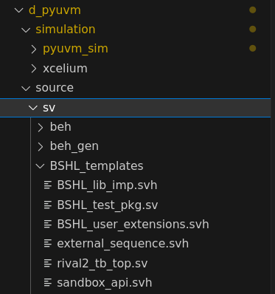
Integration details guide
In the new unit d_pyuvm, in source folder, create a BSHL_templates folder
Copy-paste the BSHL related files (from provided BSHL and rival2_tb_top.sv (your original Top-level tb)
Create two new files in this folder, external_sequence.svh and sandbox_api.svh

Slide 19
Intergration details guide
BSHL_user_extensions.svh
Notes:
From here, I will present some details of modification in specific files.

Slide 20
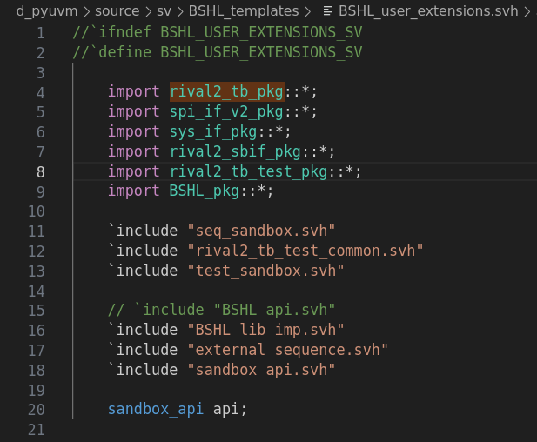
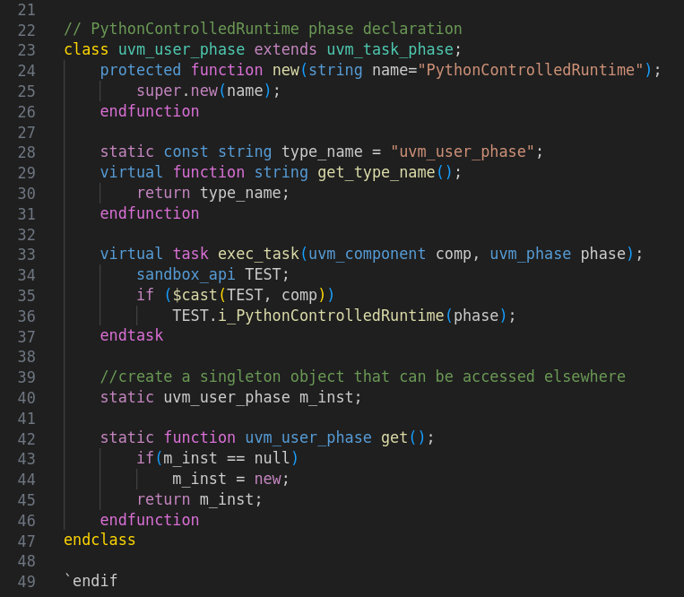
Integration – BSHL_user_extensions.svh
Red box shows the codes you need to modify or add
Notes:
Copy BSHL_user_extensions file in your work space. Import necessary pkgs and include needed files. And take care of renaming

Slide 21
Intergration details guide
external_sequence.svh
Notes:
This external sequence is based on your internal sequence in your project. You can extends the internal sequence and modify the body().

Slide 22
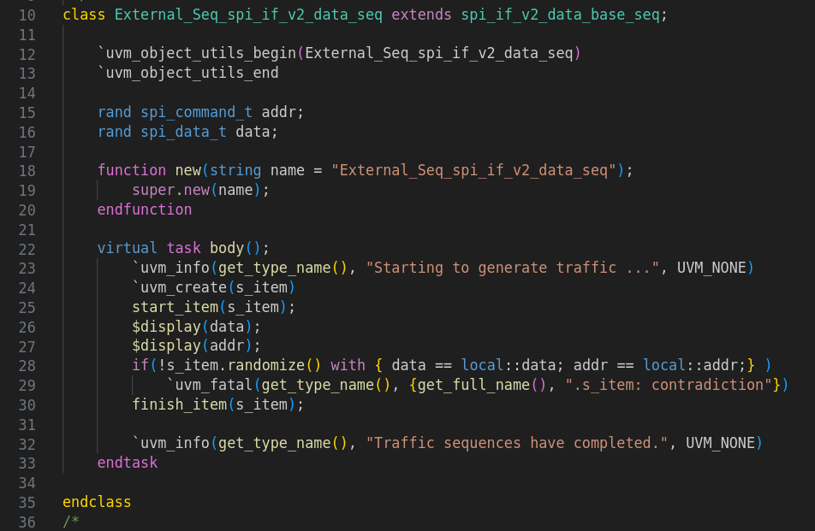
Integration – external_sequence.svh
Choose a target sequence and extends it to create your new external sequence
Notes:
Create a new file in your work space. The body task shoule be like this.

Slide 23
Intergration details guide
BSHL_api.svh
Notes:
This is the test case and also an implementation of interface class. My recommendation is a copy this BSHL_api and rename the new file and take this BSHL_api as a reference.

Slide 24
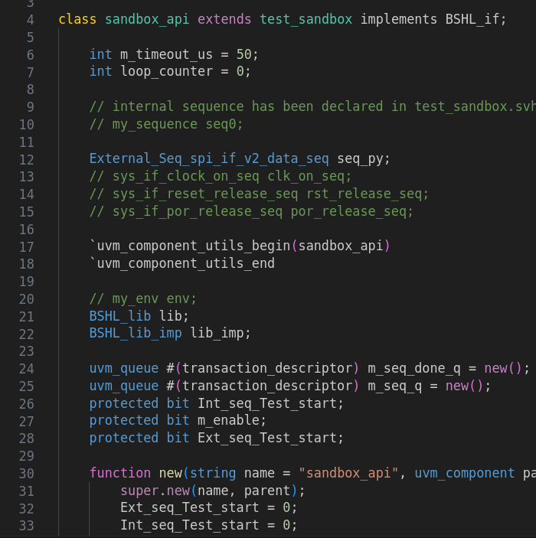
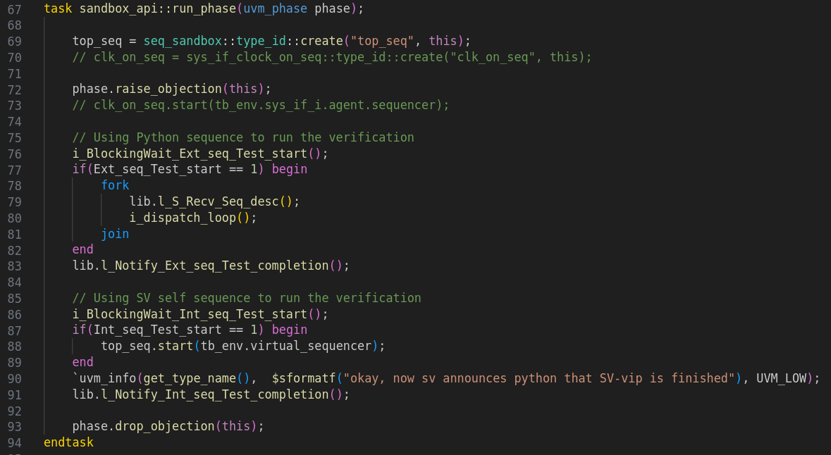
Integration – BSHL_api.svh
Notes:
Copy BSHL_api in BSHL/source/templates to your work space. Normally, I make this api extends the orginal test case(test_sandbox in rv2demo). And declare the external sequence. In run_phase, top_seq is the internal sequence declared in base class so we can directly create it and when internal test starts, activate this internal sequence to the correct sequencer.

Slide 25
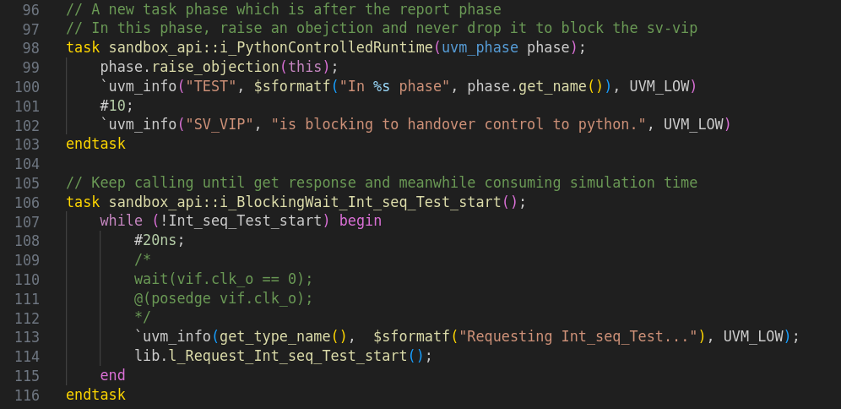
Integration – BSHL_api.svh
Notes:
These two interface tasks, you can do a little modification. i_PythonControlledRuntime task: inside it defines the process of this new user-defined phase, you can change it to some others. In my case, I just raise the objection and never drops to block the sv side. i_BlockingWait: Inside, it defines how sv-vip waits and comsumes the simulation time. The easiest way would be like this, waiting for a certain time interval. But you can utilize your internal clk signal for sure, if you have one.

Slide 26
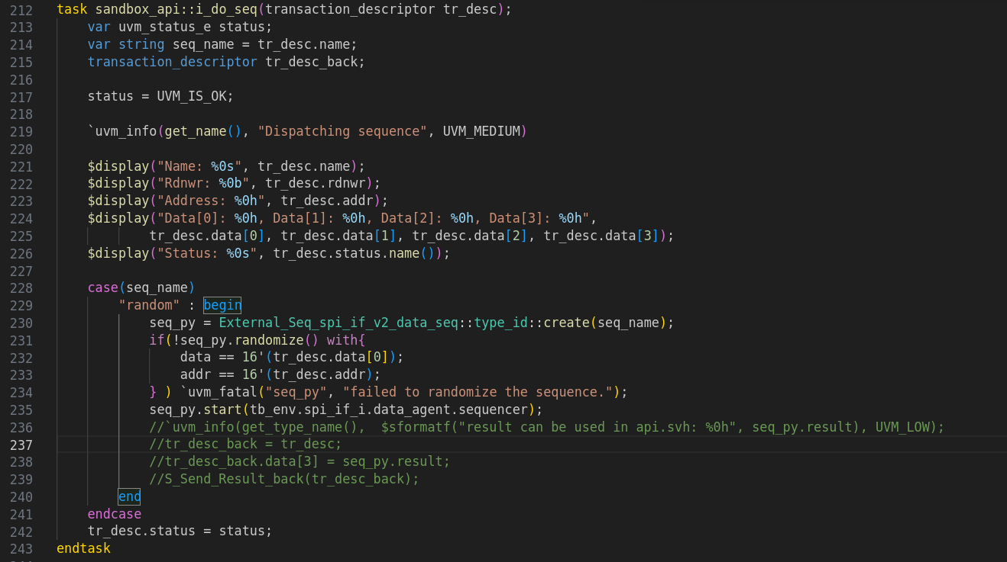
Integration – BSHL_api.svh
Notes:
In i_do_seq task: the point noted is choose the correct sequencer based on the external sequence you create

Slide 27
Intergration details guide
rival2_tb_top.sv
Notes:
The top level of your project

Slide 28
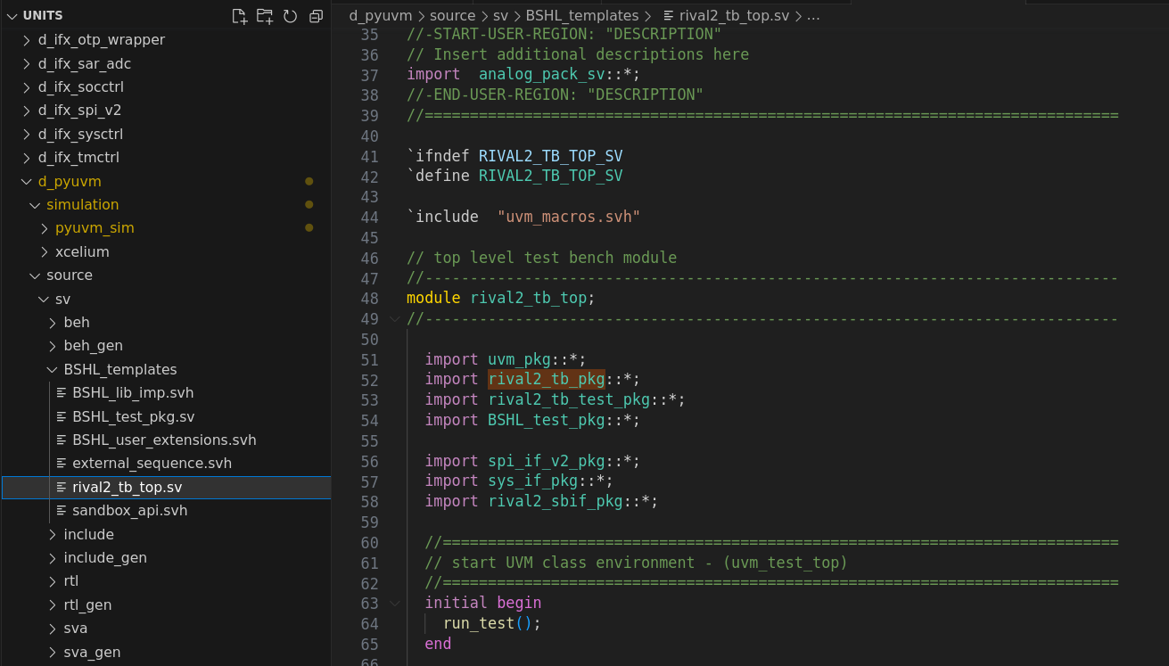
Integration – rival2_tb_top.sv
Notes:
Import the BSHL_test_pkg in your top_tb.sv

Slide 29
Intergration details guide
xrun_opts_4cocotb.f

Slide 30
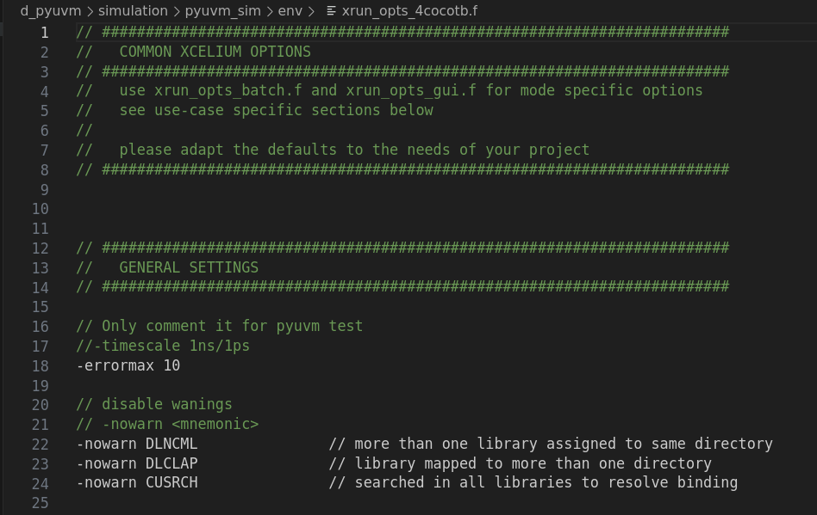
Intergration details guide
Cocotb makefile needs user mandatorily set the timescale. So copy-paste the original xrun_opts.f, give it a new name, like xrun_opts_4cocotb.f and comment the timescale line.

Slide 31
Intergration details guide
Makefile

Slide 32
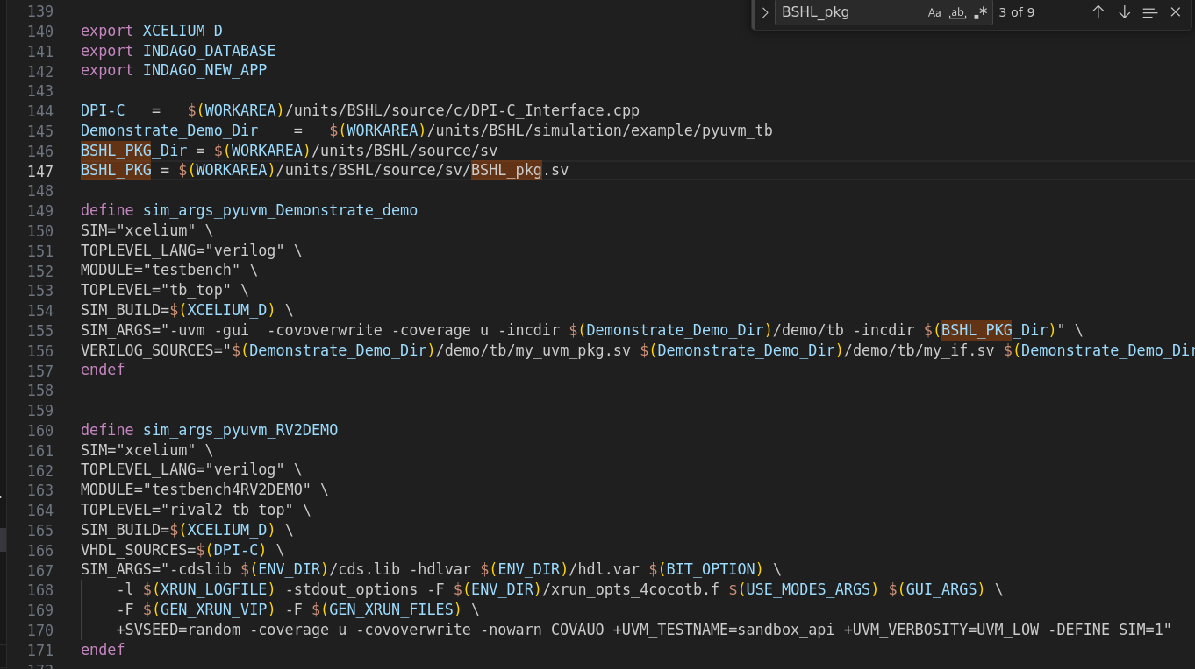
Intergration details guide /units/ d_pyuvm/simulation/pyuvm_sim /Makefile
Notes:
Some modifications that you need to add. You can directly copy and paste.

Slide 33
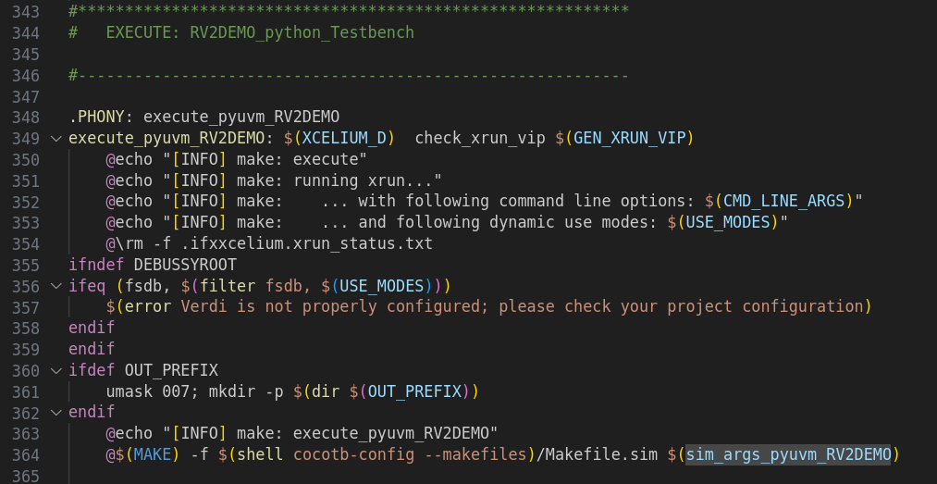
Intergration details guide /units/d_pyuvm/simulation/pyuvm_sim/Makefile

Slide 34
Intergration details guide
xrun_files.f

Slide 35
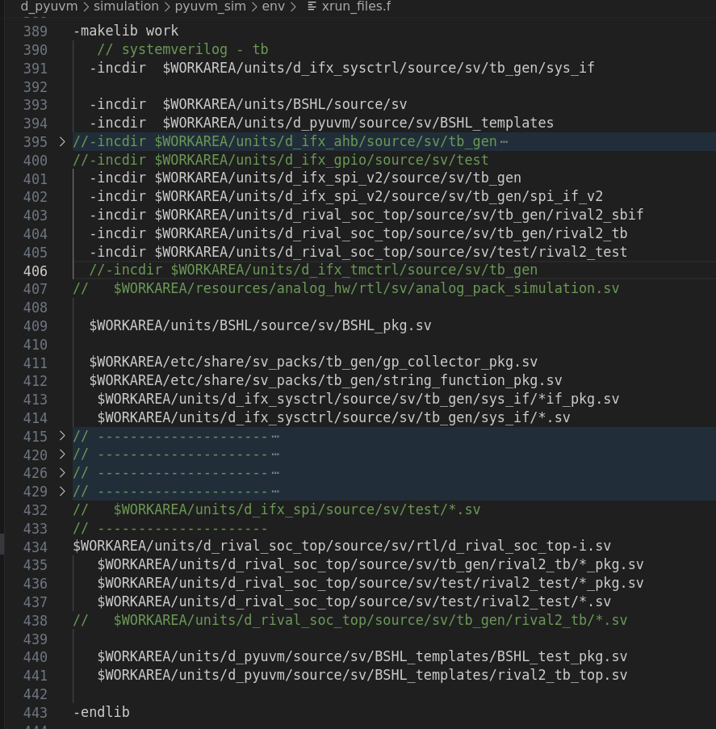
Intergration details guide /units/ d_pyuvm/simulation/pyuvm_sim /env/xrun_files.f
In python, we have a testbench and in sv, we reuse the original one. So copy-paste the original xrun_files.f and modify where the red box shows.
Notes:
To compile successfully, You need to manually add the dir and file path in xrun_files.f. Put it at the same place with othere pkgs.

Slide 36
Intergration details guide
Run simulation

Slide 37
Intergration details guide
Now you can run simulation through ifxxcelium execute_pyuvm_RV2DEMO –gui

