Slide 1


Infineon PSOC6 Lecture project status
Team: Enlightening wizards
Team Members: Knezevic Leontina, Gassner Manuel
1. Progress report
Achieved since the Introduction Lecture :
Reviewed lecture contents and deepened the understanding of all the software tools
Successfully connected the microcontroller to Deepcraft Studio via the private WiFi and hotspot
Initialized the necessary Deepcraft projects and configured the preprocessor for training the models
Started the initial phase of data collection
Coded the basic structure of the micropython programm
Activities planned until next meeting:
Conduct more data acquisition sessions over the weekend, involving multiple test subjects
Train the first AI-models based on our data
Begin to integrate the model into a micropython code
Issues / Support needed
Clarification between the “train”, “validation” and “test” datasets and their differences
How long to wait in the micropython main loop before the next iteration.

Slide 2
Infineon PSOC6 Lecture project status
2. Progress report
Achieved since last meeting:
Finished data collection, including data redistribution to train, validation and test sets.
Configured and built the preprocessor.
Configured and trained a model.
Found and ordered the suitable light bulb for the project.
Prepared the class for the light bulb in micropython.
Activities planned until next meeting
To fix the issues we faced in order to have our model ready for micropython integration.
To make our first tests of the model on the PSoC6.
To successfully connect the board and the light bulb.
Issues / Support needed
We had a persistent error while trying to generate the C99 code.
Error: Failed to generate code. Sequence contains no matching element.
After managing to generate the C99 code, the same issue arose while trying to convert it to micropython.

Slide 3
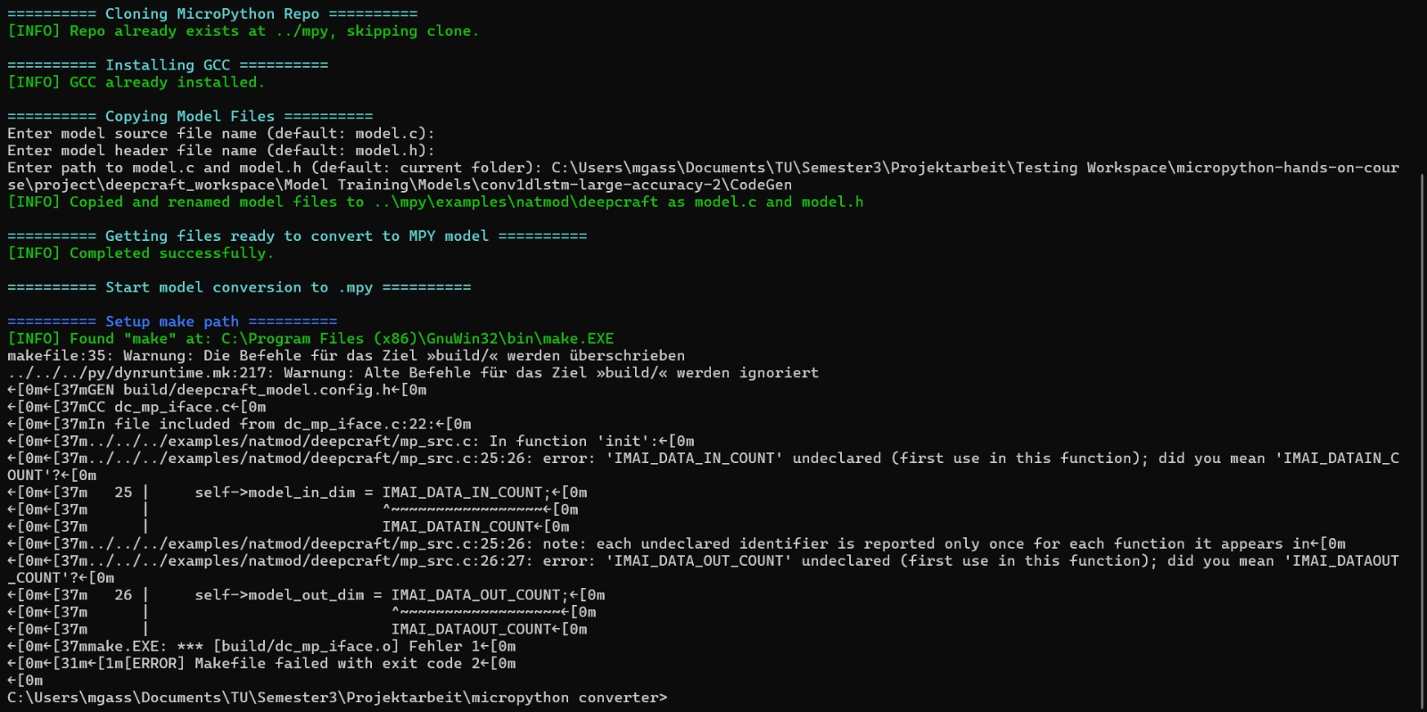
Make Error

Slide 4
Infineon PSOC6 Lecture project status
3. Progress report
Achieved since last meeting:
Still stuck on the model conversion
Activities planned until next meeting
Text
Show what you have planned for the project presentation and your submission, you have more room on the next slide
Issues / Support needed
text

Slide 5
Infineon PSOC6 Lecture presentation and final submission plans
Short project presentation:
Any special equipment need for demo at the demo Day ?

