Slide 1

Pharaoh Showcase

Slide 2
















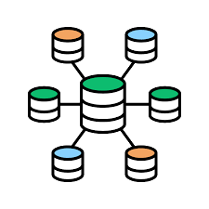
Pharaoh Overview
Data Sources Local Remote
Default Templates
Default Stylesheets
Pharaoh
Asset Generation Scripts using
Stylesheets Overrides
Templates Overrides
Templating & Documentation Engine
Output Formats
Asset Export
(HTML, PNG, ...)
Plots
Tables
Documents
Generated Assets
Asset Management Library
Asset Lookup & Import
Build Automation & Report Hosting

Slide 3
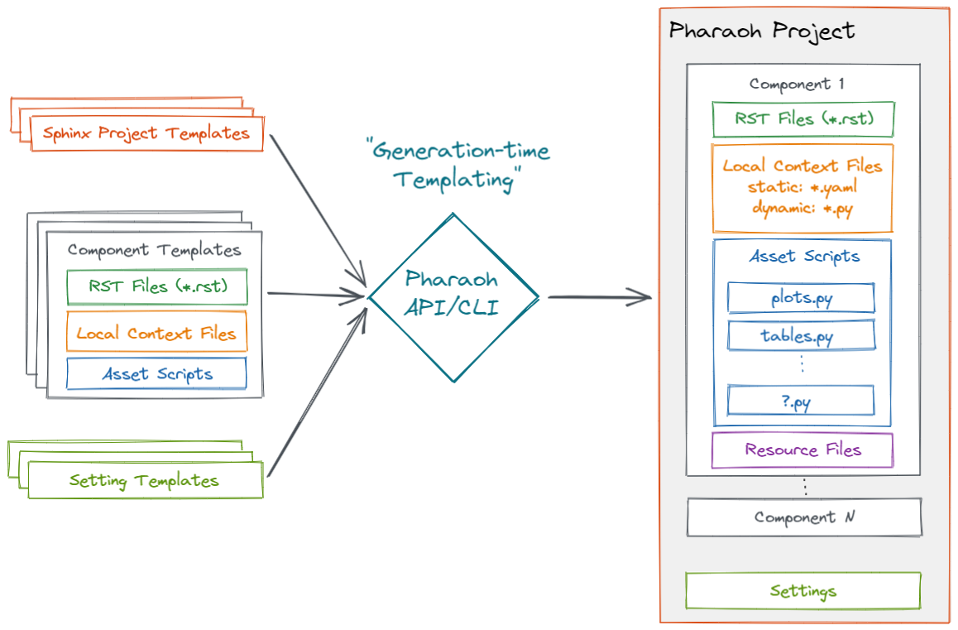
Generating Pharaoh Projects

Slide 4
Generating Pharaoh Projects
pharaoh new --settings "C:\...\my_custom_settings.yaml"
pharaoh env report.title "My Report"
pharaoh add --name dummy1 -t pharaoh_testing.simple --context "{'test_name':'dummy1'}"
pharaoh generate
pharaoh build
pharaoh upload
CLI
from pharaoh.api import PharaohProject p = PharaohProject(".", custom_settings=r"C:\...\my_custom_settings.yaml") p.put_setting("report.title", "My Report") p.add_component(component_name="dummy1", templates=["pharaoh_testing.simple"], render_context={"test_name": "dummy1"}) p.generate_assets() p.build_report() p.upload_report()
API

Slide 5
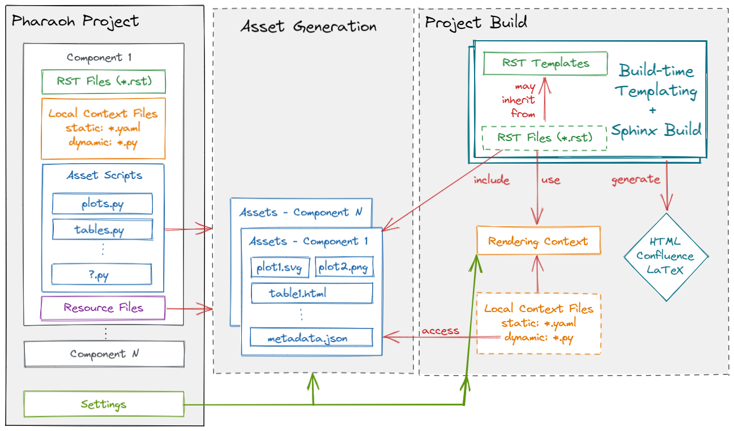
Workflow (after project generation)

Slide 6

Template & Asset Script Example
index.rst
custom123_context.yaml
{{ h1("Demo Component") }} {{ h2("Accessing local context") }} The following context value is defined in ``custom123_context.yaml``: ``{{ ctx.local.custom123.some_key }}`` {{ h2("Accessing project settings") }} This is the report title defined in the project settings: ``{{ get_setting("report.title") }}`` {{ h2("Including assets") }} {{ h3("Via directive filter (i==1)") }} .. pharaoh-asset:: label == "iris" and i == 1 {{ h3("Via search & Jinja loop") }} {% for asset in search_assets('label == "iris" and i > 1') %} **IRIS Example {{ asset.context.i }}** .. pharaoh-asset:: {{ asset.id }} {% endfor %}
some_key: "some_value"
default_assets.py
import plotly.express as px from pharaoh.api import get_project from pharaoh.assetlib.api import metadata_context proj = get_project(__file__) for i in range(1, 4): fig = px.scatter( data_frame=px.data.iris(), x="sepal_width", y="sepal_length", color="species", symbol="species", title=f"IRIS Example {i}", ) with metadata_context(label="iris", i=i): fig.write_html(file="iris_scatter.html")

Slide 7
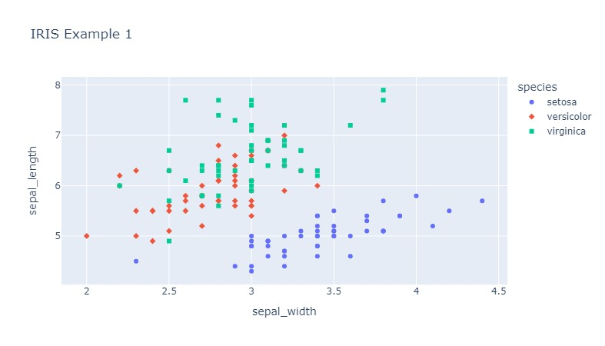
Asset Metadata
{ "asset": { "script_name": "default_assets.py", "script_path": "C:\\...\\components\\dummy\\asset_scripts\\default_assets.py", "index": 1, "component_name": "dummy", "user_filepath": "iris_scatter.html", "file": "C:\\...\\.asset_build\\dummy\\iris_scatter_5bb940ef.html", "name": "iris_scatter_5bb940ef.html", "stem": "iris_scatter_5bb940ef", "suffix": ".html", "template": "raw_html" }, "label": "iris", "i": 1 }
Assets generated by asset script are stored together with their metadata.
Asset metadata is used to lookup/embed assets during templating and provide additional templating context.

Slide 8
Templating – Asset Grouping
Assets may be grouped using their metadata to enable nested layouts.
In the example below, assets are grouped first by Vdd, then by Idd to dynamically create nested headings
{% set idd_plots = search_assets("signal_name == 'idd'") %}
{% for vdd, assets_grby_vdd in agroupby(idd_plots, key="vdd").items() %}
{{ h2("Plots for Vdd:%.1fV" % vout) }}
{% for iout, assets_grby_iout in agroupby(assets_grby_vdd, key="iout").items() %}
{{ h3("Plots for Iout:%.1fA" % iout) }}
{% for asset in assets_grby_iout %}
.. pharaoh-asset:: {{ asset.id }}
{% endfor %}
{% endfor %}
{% endfor %}

Slide 9
Sphinx Builders Comparison
Sphinx supports various output formats. The most important ones are compared below.
Feature | HTML | Confluence | LaTeX/PDF
Sphinx Base Directives | + | + | +
Static Tables & Plots | + | + | +
Interactive Tables & Plots | + | - | -
Table Scaling | + | + | -
Theming Support ¹ | + | - | -
¹ Sphinx Themes & CSS

Slide 10
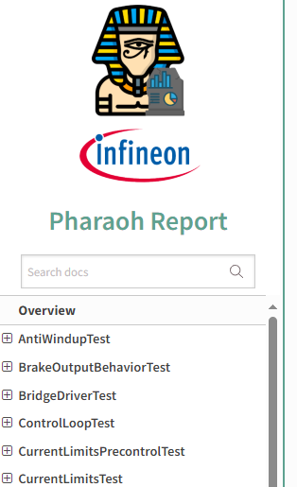
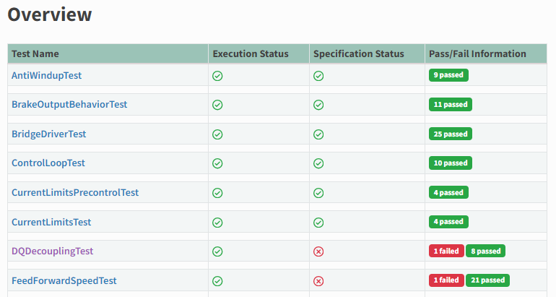
HTML Report Impressions
Sidebar with TOC
Overview page to list all test info

Slide 11
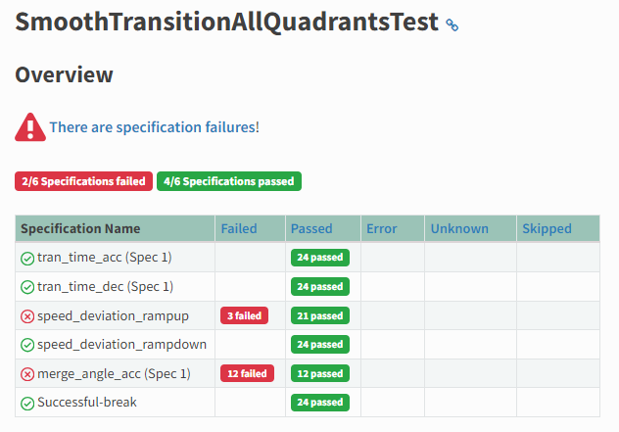
HTML Report Impressions
Quick Specification Status Overview

Slide 12
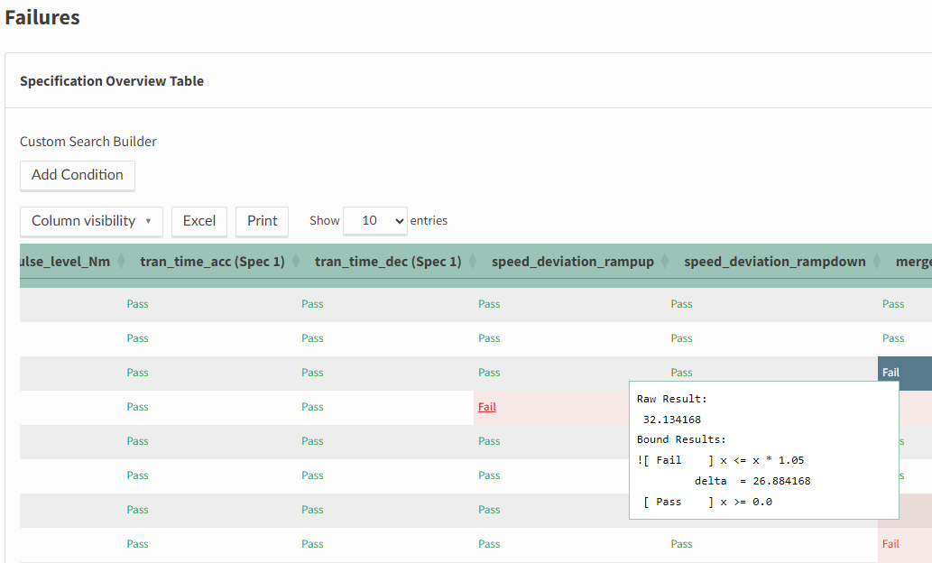
HTML Report Impressions
Interactive pass/fail table, listing operating conditions & spec results

Slide 13
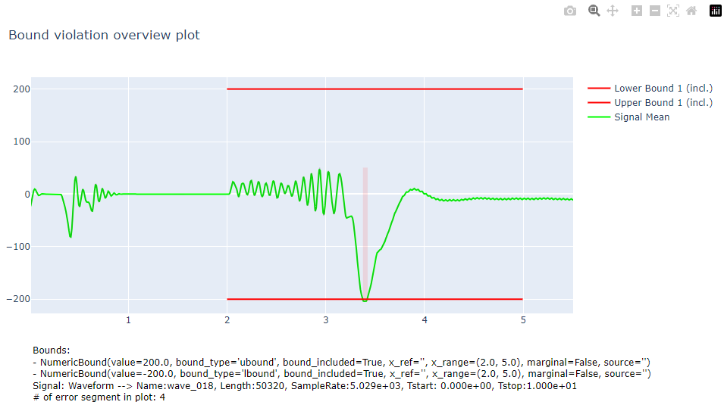
HTML Report Impressions
Interactive spec violation plots

Slide 14
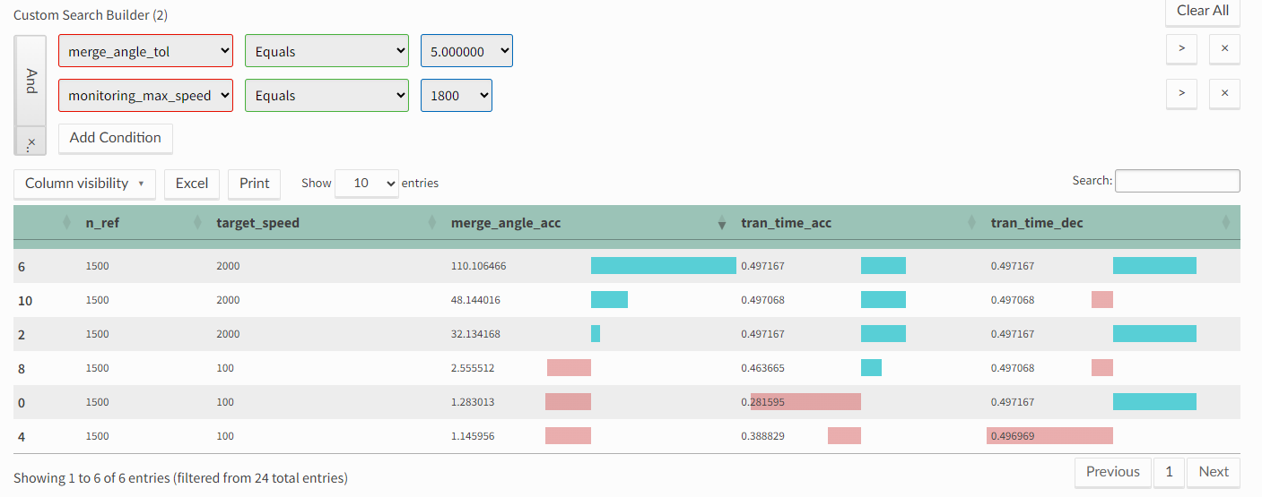
HTML Report Impressions
Interactive result table

Slide 15
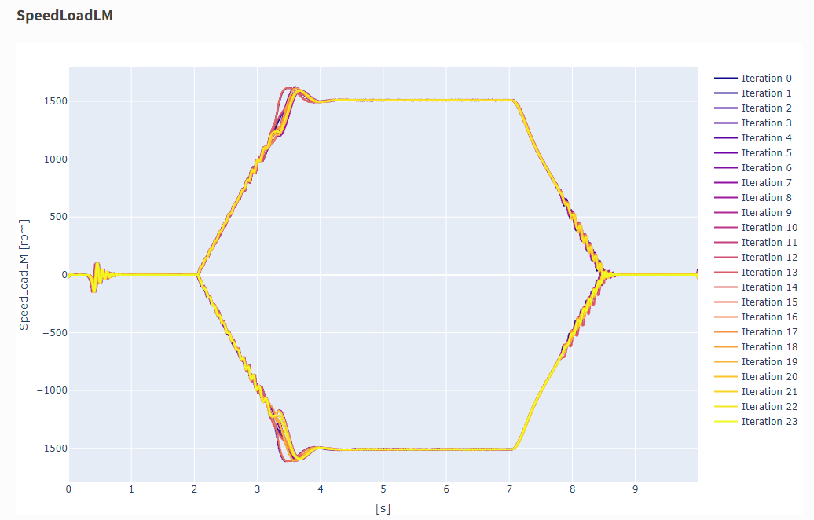
HTML Report Impressions

Slide 16
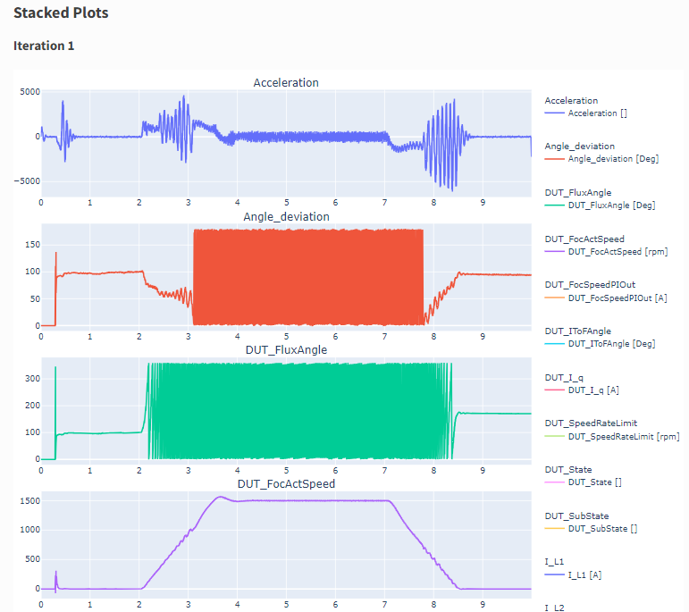
HTML Report Impressions

