Slide 1

Outsource to Ukraine
Unlock value and boost your
competitiveness

Slide 2
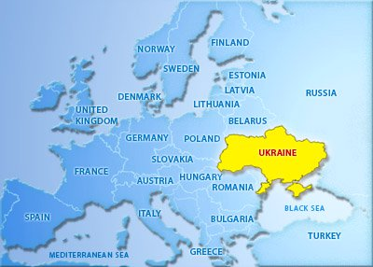
Why Ukraine?
Geographically the largest country in Europe with a well-educated and mostly urban population of 45 million. Over 70% of Ukrainians have a secondary or higher education.
Infrastructure for sustaining an export-oriented economy – close to 170,000 km of roadways, some 22,000 km of railways, 13 sea ports (includes deep-water) along mainland Ukraine and over 20 passenger airports.
Pro-western, pro-business government focused on implementing reforms and strengthening national security and institutions.
Free trade agreement with EU and Canada.

Slide 3
Why Ukraine?
The significant devaluation of the Hryvnia changed Ukraine into one of the most competitive low-cost production platforms globally. Labor, raw materials and other production costs have declined significantly in U.S. dollar terms.
The average nominal salary, at $289 per month (2018 figures), is significantly below regional peers and China. Labor intensive industries such as food and agribusiness, light manufacturing and small machinery-building are benefiting the most.

Slide 4
Why Ukraine?
Proximity to the large EU market makes Ukraine a competitive alternative to Southeast Asia, especially for industries demanding short supply chains and fast production cycles, such as textiles, apparel or footwear. Delivering goods in two days to European hubs versus a ship container traveling from Asia over 40 days is an unbeatable advantage.
World's largest sunflower oil producer; 3rd in corn export/6th in wheat; 10th in weapons; 11th largest steel exporter; 8% share of global mineral fertilizer market.
Best agricultural soils in the world, with 25% of the world`s most fertile black soil and 30% of arable land of the European Union.
Soft ecological requirements for new production allocation, comparable to highly civilized markets.
Constantly improving position in “Doing Business” ratings.
The prices to purchase (or lease) production real-estate are extremely low.
Large quantities of readily available raw materials.

Slide 5
Why Ukraine?
Low-cost
Skilled-labor
Infrastructure
Current macro conditions create real opportunities for production site relocation to Ukraine.

Slide 6
What we offer
Turnkey solution for relocation of your production to Ukraine:
FREE estimate of increase in value through comparison with the current cost structure.
Creation of safe and effective ownership structure, involving reputable international and local law firms.
Production site selection and optimal human resource solution for each phase.
Regulatory approval and appropriate certification at required government agencies.
Link-up of Ukrainian facilities to your current logistics, supply chain and final product delivery systems.
Establish commission-based sales office in Ukraine.
Procure local raw materials and finished products if needed.

Slide 7
Your trusted partners:
Serhiy Mozgovyi | 12+ years International Business experience involving commodities trading, relocation (Europe, Asia, Latin America) for business development/market research/risk analysis, cross-border supply chain analysis. Speaks 10 languages. Based in Canada.
Artem Mateshko | 10+ years of experience in various Finance roles in Canada and Ukraine encompassing: trading, sales and investment research. Based in Canada.
Yuriy Lisunkin | 10+ years in Project and Production Site Management from set-up through execution. Day-to-day operations supervision, costs and treasury control. Built from scratch one of the largest payment terminal networks in Ukraine. Based in Ukraine.
Dmitriy Sagalovskiy | 12Y experience in TOP Ukrainian banks in project finance and international business. Success story of launching largescale production of duck meat in Ukraine involving EU investors. Based in Ukraine.

Slide 8
Contacts
Please get in touch with us to discuss your interest:
Mr. Serhiy Mozgovyi
smozgovyi@gmail.com
+ 1 514 927 7892
Mr. Artem Mateshko
mateshkoartem@gmail.com
+ 1 514 431 1743
We are looking forward to your inquiries!

